Slide 1
What is the intrinsic predictability of supercell storms?
Paul Markowski
Department of Meteorology & Atmospheric Science
Pennsylvania State University
University Park, Pennsylvania, USA
Acknowledgments: Steve Greybush, Zach Lebo, Dave Stensrud, Yunji Zhang
Notes:
The short answer is “it depends.”

Slide 2
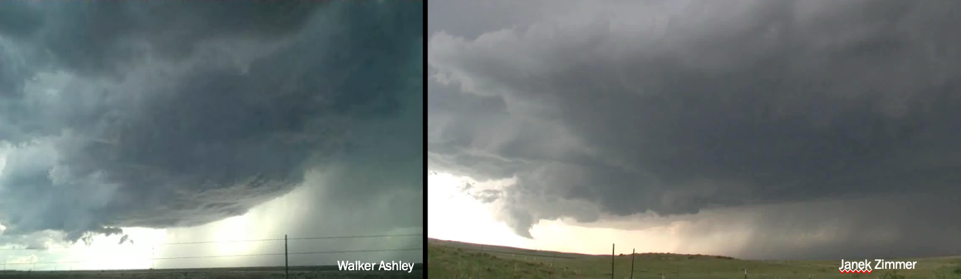
20
excluding warnings issued after tornado formation
The predictability of convective storms has received considerable attention in recent years, especially from those involved with the U.S. “Warn-on-Forecast” efforts.
The topic of practical predictability probably has been studied more to this date, that is, the ability to predict storm behavior using the best-available techniques.
The intrinsic predictability, of storms, that is, the ability to predict their behavior if perfect procedures are used, has received less attention.
18
16
14
12
10
lead time in minutes
8
lead time = 0 if warning issued after tornado formation
6
4
2
0
Stensrud et al. (2013)
1986
1998
1990
1992
1994
1996
1998
2000
2002
2004
Which storm will produce a tornado?

Slide 3
Methodology (short version)
An ensemble of 25 supercell simulations is produced, in which the only differences are (1) the locations of convection initiation and (2) the random number seeds used to introduce small temperature perturbations at t = 0
  The random temperature perturbations trigger (resolved) boundary-layer dry convection
  Storms are initiated via warm bubbles once a nearly steady boundary layer has been achieved

Slide 4
Methodology (longer version)
CM1, release 18
Δx = Δy = 75 m, Δz = 15–285 m
Domain: 127.4 km x 127.4 km x 17.9 km (1700 x 1700 x 121 grid points); periodic lateral boundaries; semislip lower boundary (z₀ = 12 cm); free-slip upper boundary
No heat or moisture fluxes, no radiation
Coriolis force acts on perturbation wind (initial wind profile is assumed to be geostrophic)
Initial conditions: sounding with ~3700 J kg^{–1} CAPE, veering (geostrophic) wind profile with westerly shear, random temperature perturbations (up to ±0.25°C) in lowest 1 km

Slide 5
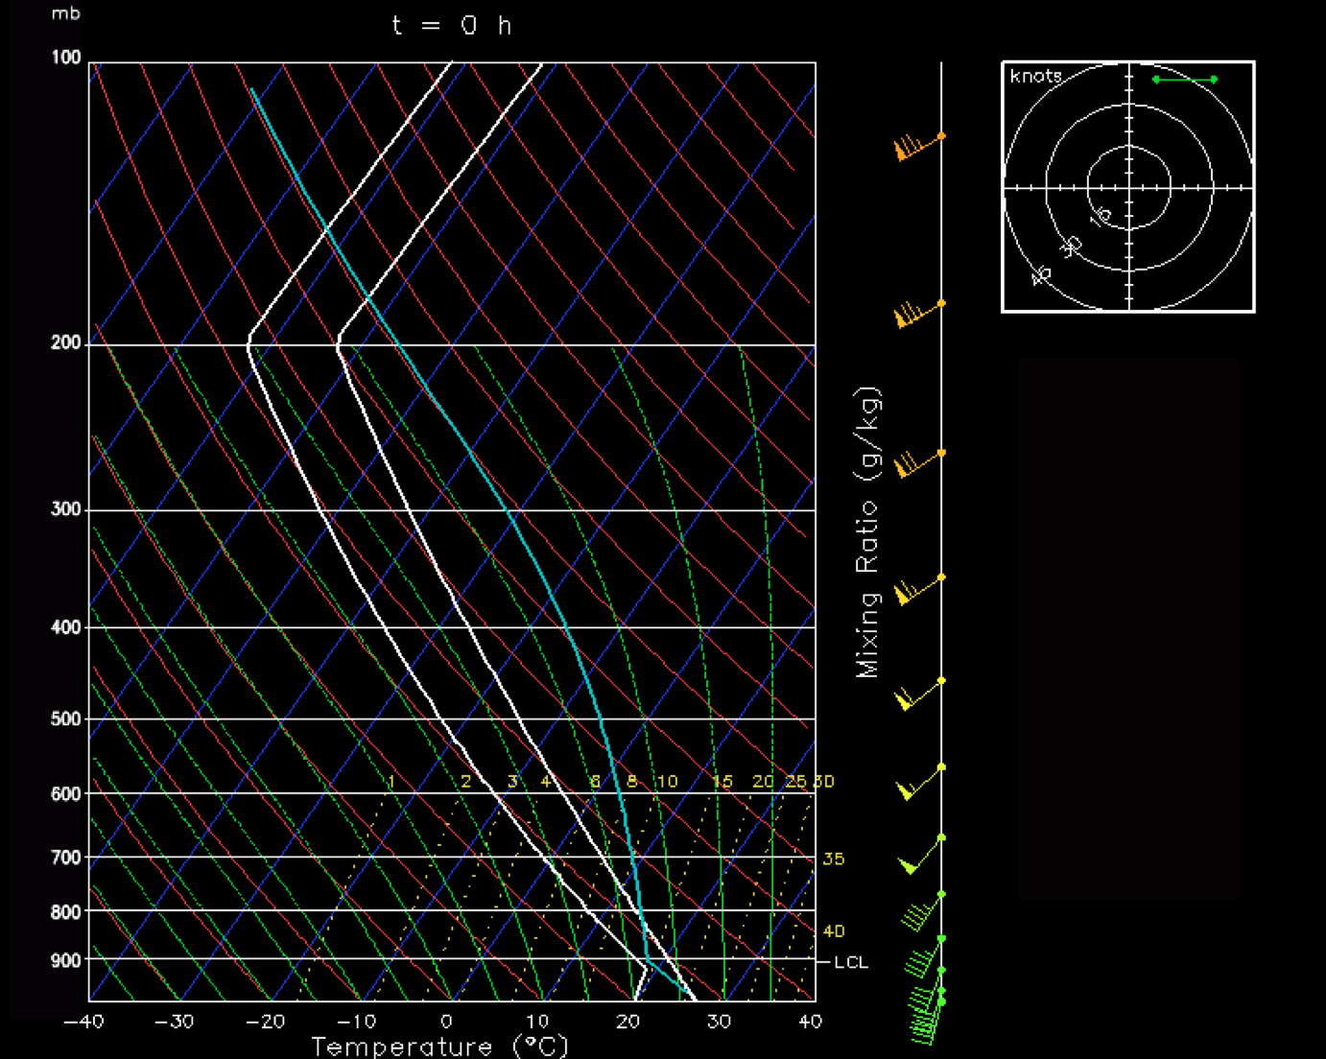
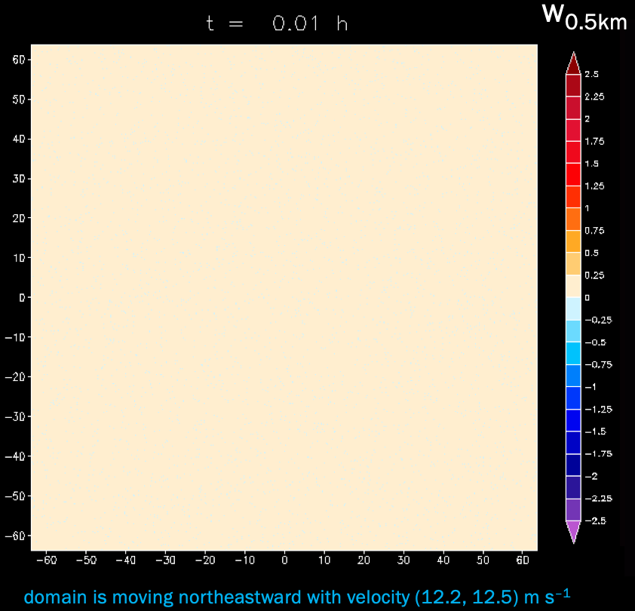
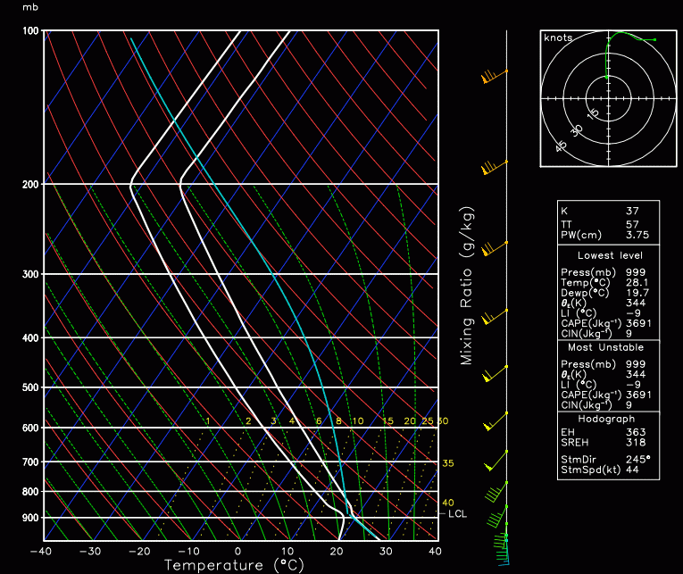
The random temperature perturbations trigger boundary layer dry convection
Five different random number seeds are used to create five different turbulent boundary layers
The simulations are run for 12 hours, by which time a nearly steady state is achieved
mean environment after 12 h
initial conditions
1 km
surface
2 km
2 km
surface
CAPE = 3681 J kg^{–1}
0–1 km SRH = 136 J kg^{–1}
0–3 km SRH = 217 J kg^{–1}
STP = 3.6

Slide 6
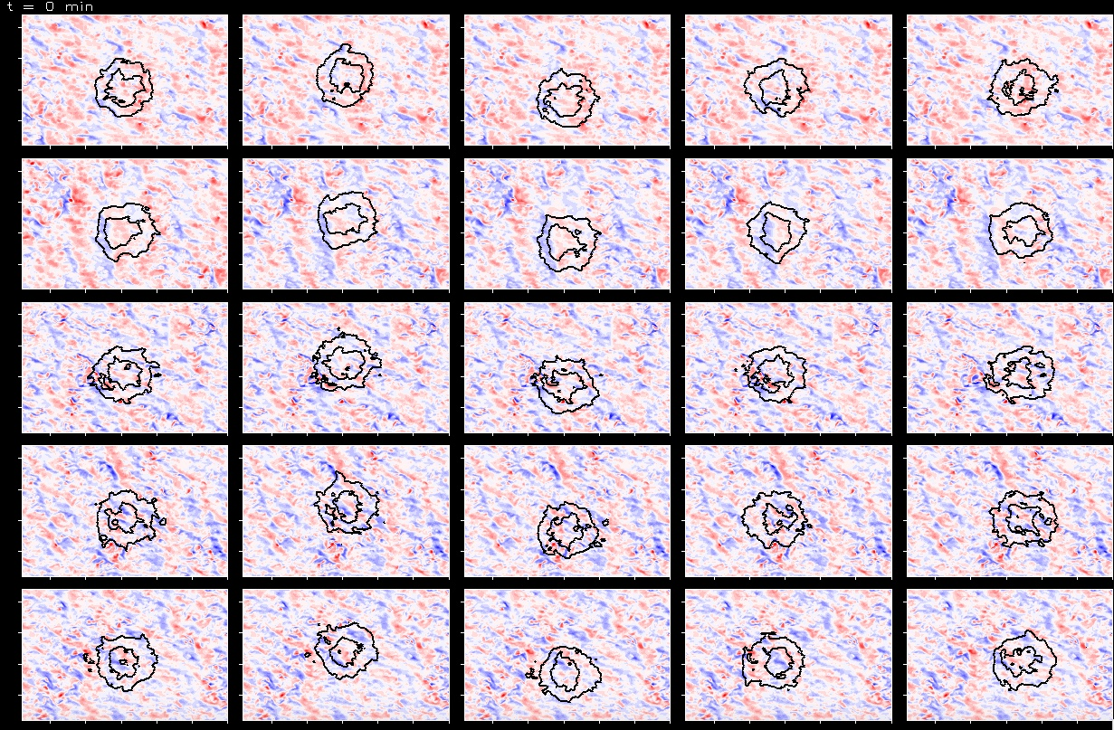
0.5km
Θ’ = +1°C
y
5 different turbulent boundary layers, but with identical mean sounding/hodograph
(5 different random number seeds)
5 different warm bubble locations
(CI is idealized and therefore not responsible for divergence of solutions as in nature)
given that there is no surface heat flux (neutral turbulent BL), perhaps the simulations should be viewed as taking place during the early evening transition
BL1
Θ’ = +2°C
x
5 km
BL2
BL3
BL4
BL5

Slide 7
Results

Slide 8
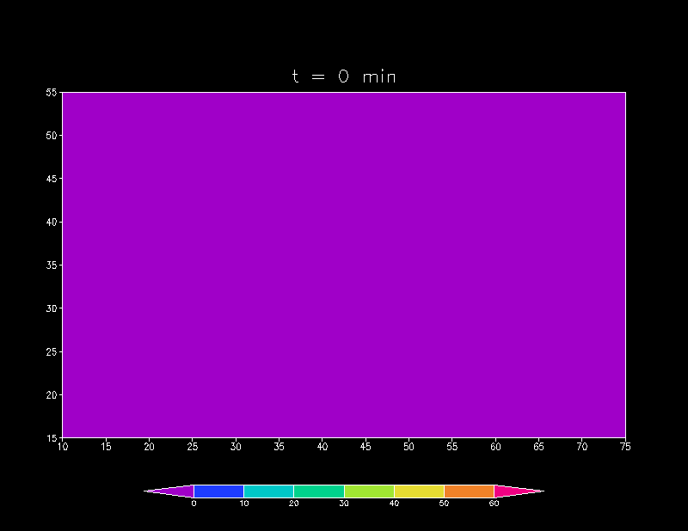
Ensemble mean
w_{5km} = 10, 20, 30 m s^{–1}
θ’ = –0.25 K
ζ = 0.01 s^{–1}

Slide 9
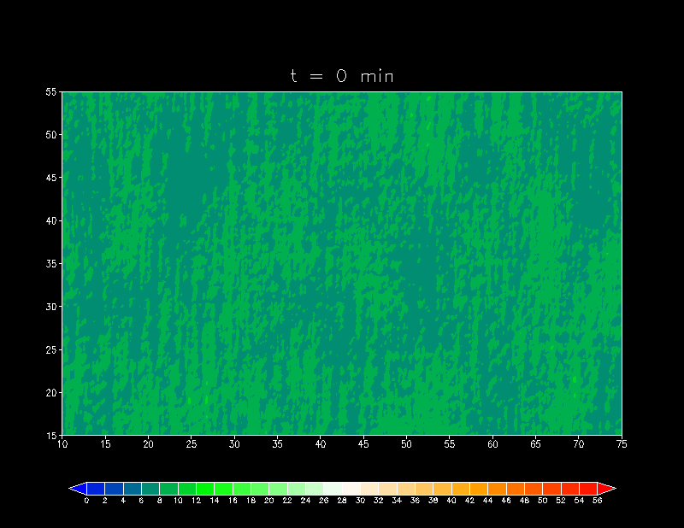
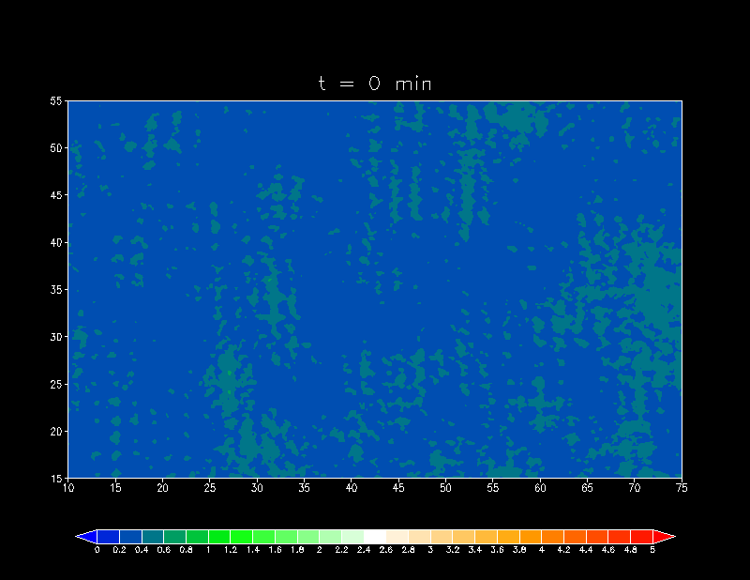
Ensemble variance (lowest 1 km)
mean
σ_{|v|} (m s^{–1})
σ_{θ} (K)

Slide 10
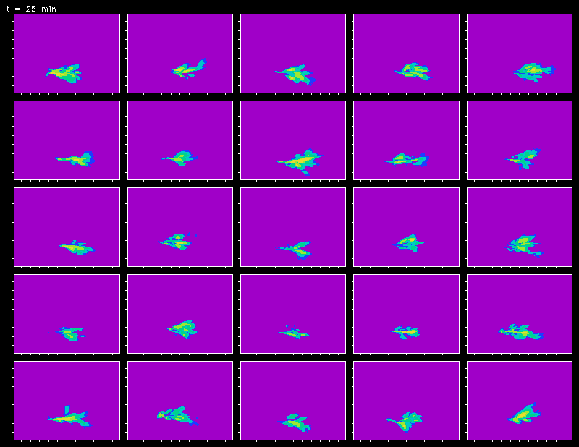

Slide 11
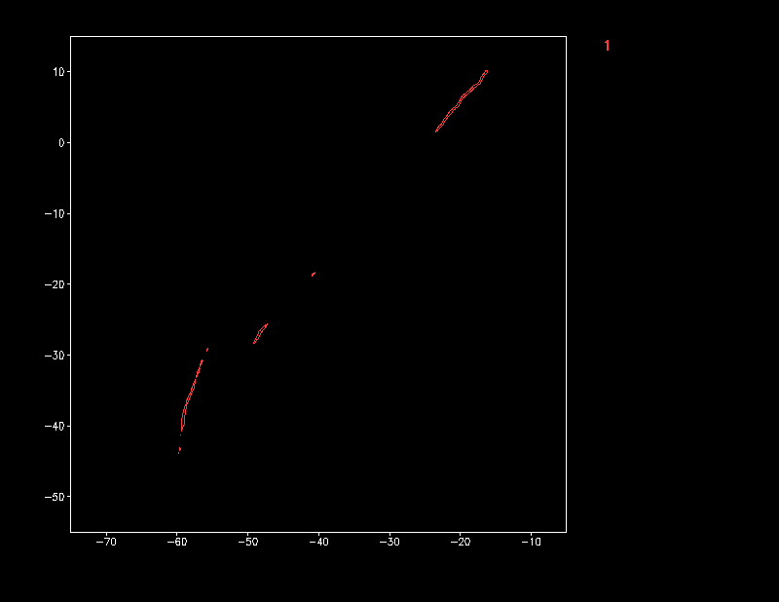
ζ = 0.25 s^{–1} swaths
swaths have been shifted to account for variety of warm bubble locations

Slide 12
ζ = 0.25 s^{–1} swaths
swaths have been shifted to account for variety of warm bubble locations

Slide 13
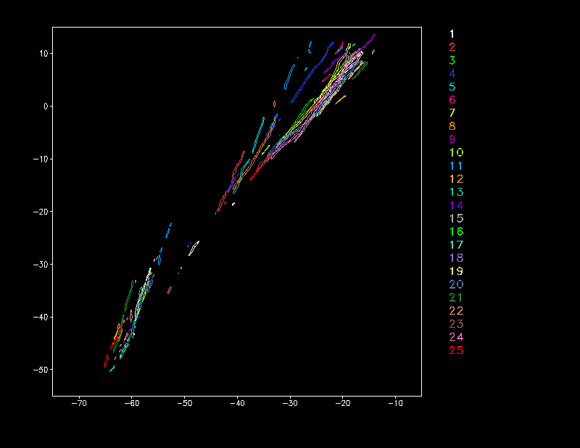
ζ = 0.25 s^{–1} swaths
width of swaths is 15 km
swaths have been shifted to account for variety of warm bubble locations

Slide 14
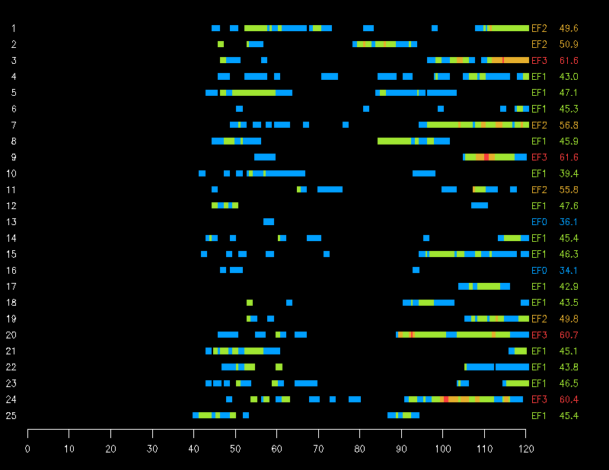
peak wind (m s^{–1})
Ensemble member
EF0
EF1
EF2
EF3
time (minutes)

Slide 15
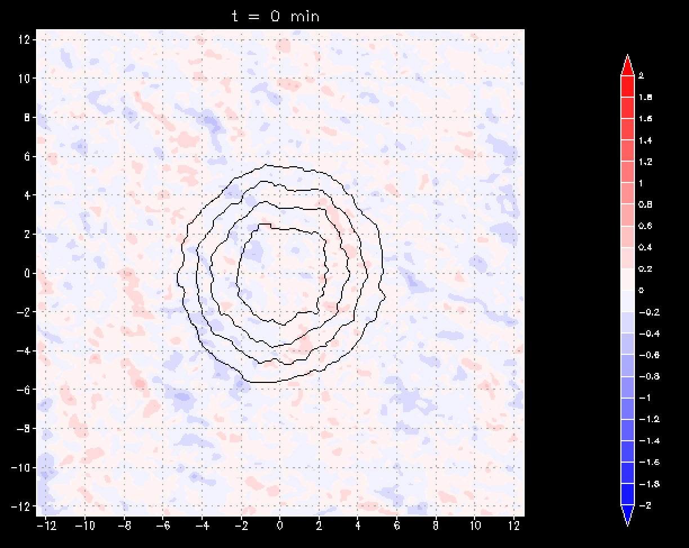
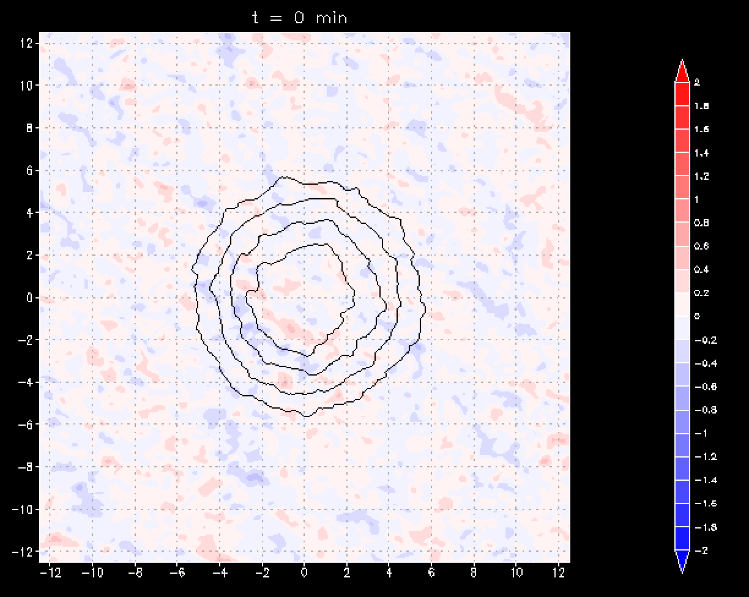
Mean vertical velocity at z = 1 km at time of warm bubble insertion
No obvious major differences between this and tornadic—really seems like butterflies flapping their wings.
6 strongest vortex cases
6 weakest vortex cases
Notes:
9 strongest cases: 1, 2, 3, 7, 9, 11, 19, 20, 24

Slide 16
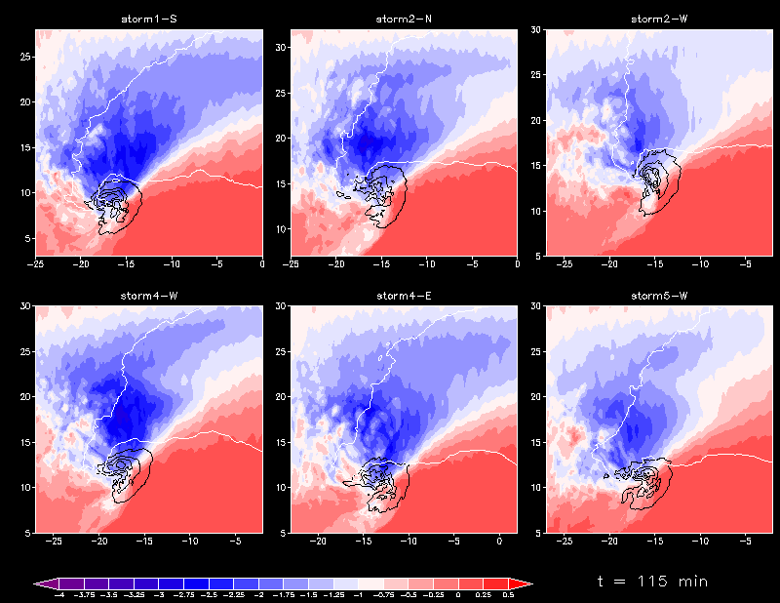
30-min avg surface θ’ in 6 strongest vortex cases
90–120 min

Slide 17
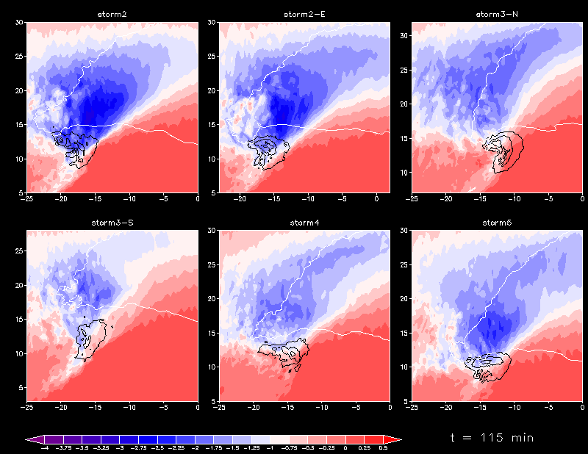
30-min avg surface θ’ in 6 weakest vortex cases
90–120 min

Slide 18
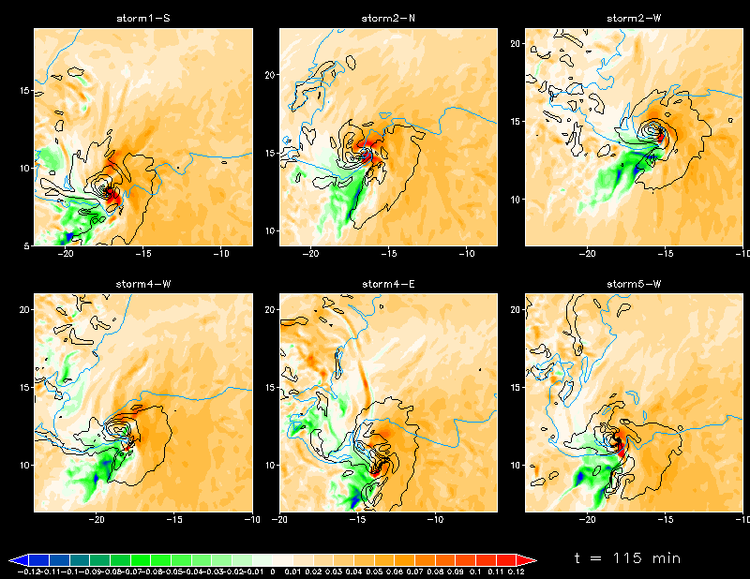
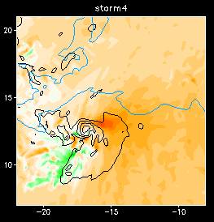
0–500 m streamwise vorticity
strongest vortex case
weakest vortex case
There are differences, but which, if any, are relevant?

Slide 19
Is there anything noteworthy about the mean fields within 5 min of the development of significant tornadoes?

Slide 20
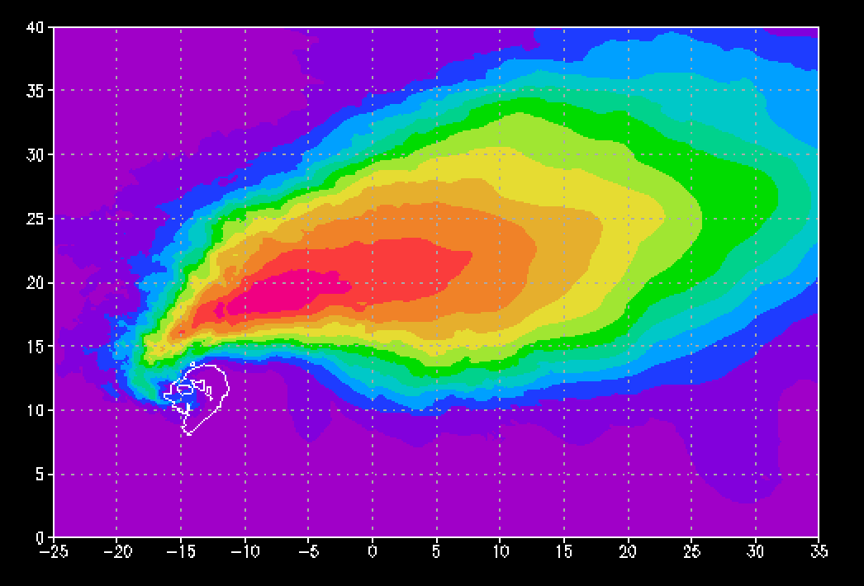
Mean reflectivity and w (5 m/s intervals) at 1 km
within 5 min of strong tornadogenesis (9 EF2, EF3 cases)
Nothing remarkable relative to the other cases. It’s also not clear which fields and which times we should be comparing anyway. Task for deep learning?

Slide 21
intrinsic predictability limit?
1.2
1.1
0.8
(x 10¹⁰ m² s^{–2})
ensemble variance
0.6
0.4
0.2
0.0
0
5
10
15
20
25
30
35
40
45
time
(min)

Slide 22
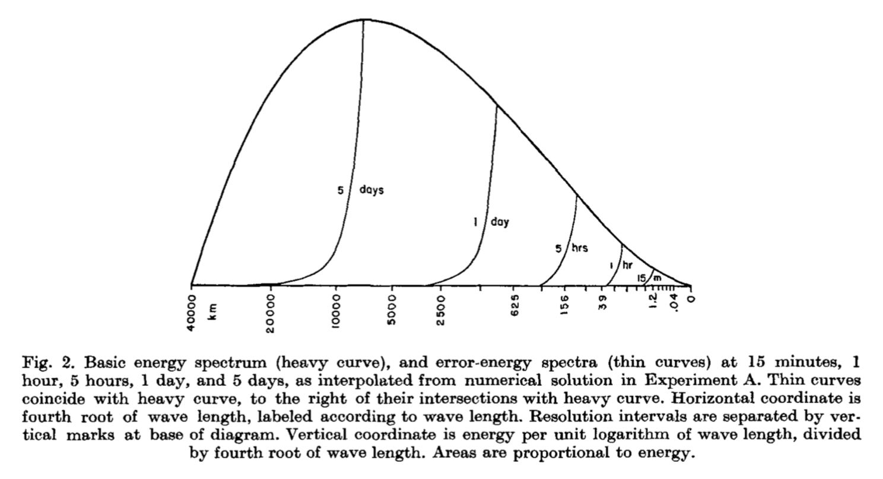
Lorenz (1969) actually predicted that the predictability limit of motions having scales of ~100 m would be ~10 min.

Slide 23
Concluding remarks
All of the storms are long-lived supercells with intense updrafts
All of the storms are at least weakly tornadic, and the envelope of tornado swaths spans ~15 km in width out to 2 h
  implication: one could issue a well-justified tornado warning out to at least 2 hours for an area smaller than a typical U.S. county
Tornado intensity has extremely limited predictably
Reducing the initial temperature perturbations by 80% (max perturbation only ±0.05°C) does not extend the predictability (as Lorenz predicted for flows containing many scales of motion)
The results probably represent a “best-case scenario” because (1) the environment was so favorable for supercells and tornadoes and (2) the CI was idealized
  For environments more “borderline” between supercells and nonsupercells, it’s likely that the differences between storm outcomes would be larger; also, more realistic CI involving interactions between BL thermals and mesoscale boundaries would be an additional source of variability among the outcomes

Slide 24
“This coming to terms with our limitations is actually much more satisfactory than it may seem because it amounts to making our objectives sensible. It is obvious that the deeper we probe into something the more complex it seems to be, and in the case of indescribably complicated motion, the only road to simplification is to decide that there shall be limits to the complexity we are prepared to study. Life is too short to spend it sorting out the infinite details of the flow on a single occasion, and anyone who did analyze them could have no assurance that the next occasion would be the same, nor that anyone else would be interested anyway.”
R.S. Scorer, 1978, Environmental Aerodynamics
(Chapter 7: Turbulence)

