Slide 1
Insights into Tornadogenesis from integrals of the vorticity equation and from angular-momentum advection 10th ECSS (Nov 4-8 2019 Krakow)
Robert Davies-Jones
Emeritus, National Severe Storms Laboratory
bobdj1066@yahoo.com
Start with angular-momentum advection as illustrated by axisymmetric model. Applies to later stages of tornadogenesis. Model uses precipitation drag to upset a balanced* initial state that resembles a mid-level mesocyclone.
*Flow pattern is constant, but amplitude decays slowly.

Slide 2
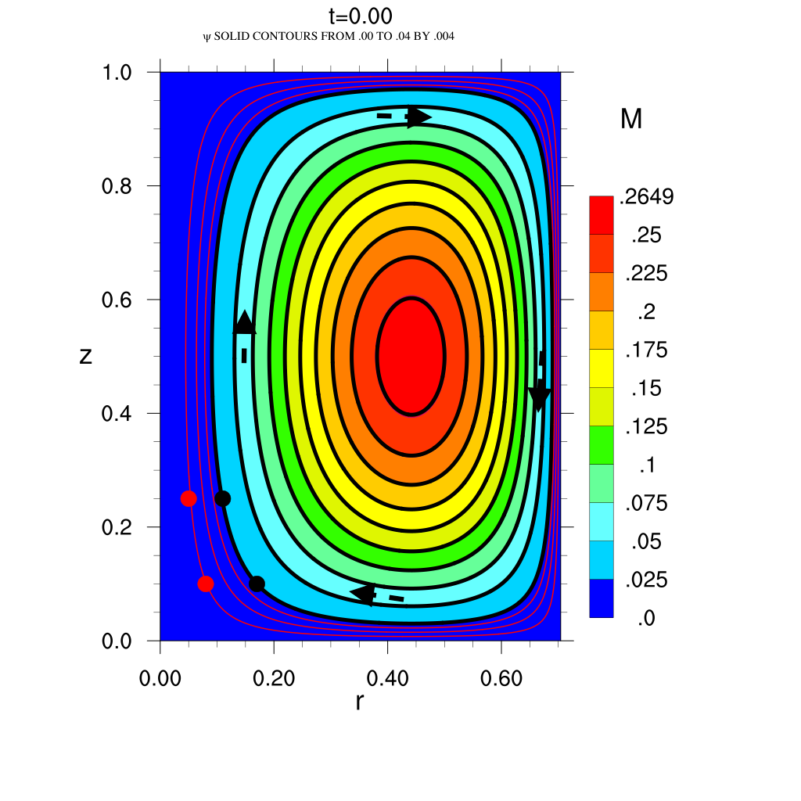
DJ08 closed domain
Solid contours Stokes streamfunction Ψ
12 km
Rain dropped 0< t<4
Angular momentum
(~ conserved)
Filled contours
Rain dashed
contours
1.5, 3.5 g/kg
Fall at 8 m/s
through initial
mid-level
mesocyclone
decreases
M is also stream-
function for
vorticity
w34
P-4
w
-14
v23
Initially M & Ψ
contours coincide
u -11
4.1
5.3
8.4 km
Ψ>0, M>0
Ψ=M=0 on boundaries
u,v,w in m/s, p in mb
red contours are extra ψ contours (.001, .002, .003)
static dots mark initial .001 & .004 ψ contours
No slip v, no stress u, w

Slide 3
What to look for in animation
Streamer drag upsets balanced (Beltrami) midlevel mesocyclone, enhances downdraft (ED). Tornado forms at t = 5.4 (~30 min).
M is quasi-conserved so nearly follows trajectories
ED drags M across ψ lines toward lower ψ. Branch of ED outflow flows in toward axis, dragging M with it (M advection is +ve )
Low-level air with larger M is then drawn into updraft
Due to upward M advection, updraft rotates faster, pressure falls,
& vortex aloft becomes more cyclostrophic
Owing to extra radial mass influx, ψ changes in corner region. But there is little change at 3 km (opposite to dynamic pipe). Corner streamlines lines turn vertical from \
No slip boundary condition on v turns flow further inward to very near axis
Causes tornado near ground with breakdown into vortex aloft
All rising air near ground is in tornado's high-speed updraft

Slide 5
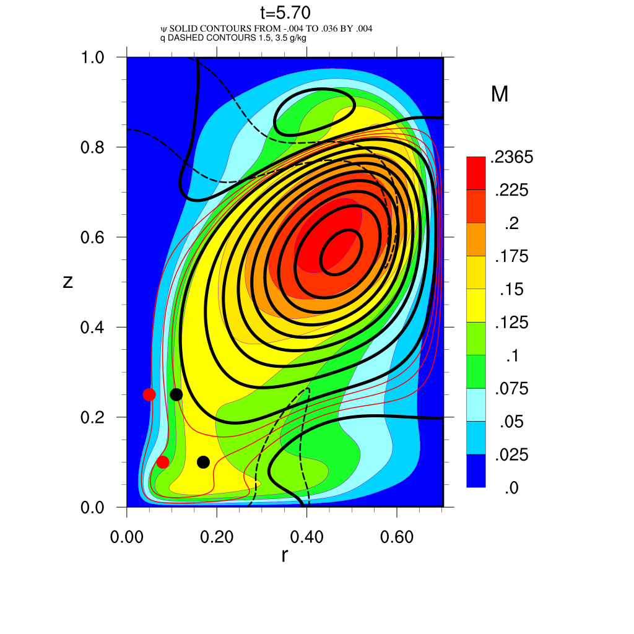
(30 min)
Axial downdraft
imminent
Axial updraft
Wider core
~ cyclostrophic
breakdown
Clear slot
ζ>0
ζ<0
Axial jet
Tornado →
Hook
Outflow
ξ<0
Tornado is result of downward & inward M transport in presence of ground

Slide 6
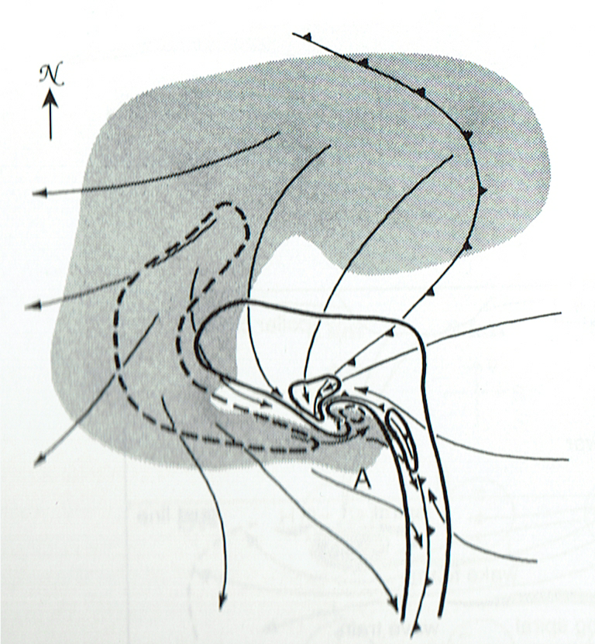
What's missing vorticity-wise in model
(1) Tilting of environmental vorticity (implicit in initial state)
(2) River bend effect (no reorientation of azimuthal vorticity)
(3) Baroclinic generation of vorticity that can be tilted
Part 2 discusses theory & roles of above in tornadogenesis.
(3)
(3 SVC)
(2)
(1)
svc = streamwise vorticity current
Klemp87

Slide 7
But first single Doppler circulation (DJ & Wood)
Circulation is 2π angular momentum for axisymmetry.
In constant-elevation surfaces, computed Dopper circulation around & mean convergence in fixed circles C (1 to 2.8 km radii) centered on vortices for tornado warning tool.
Because of unobserved wind, actual values 2x Doppler ones.
Circle averaging removes spurious quadrupole patterns.
Did this for Union City tornado (first TVS)

Slide 8
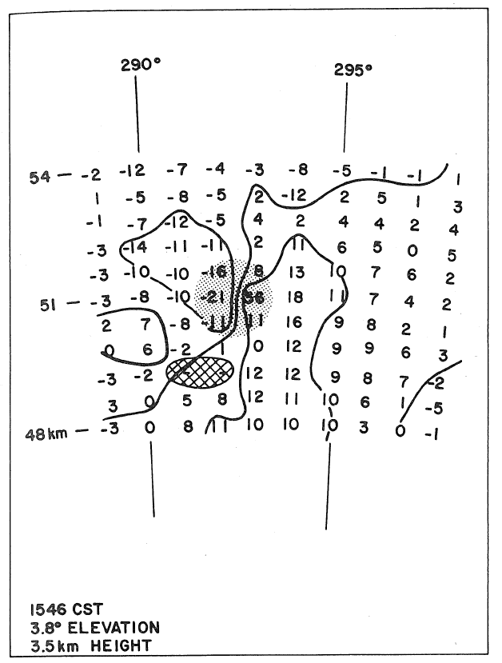
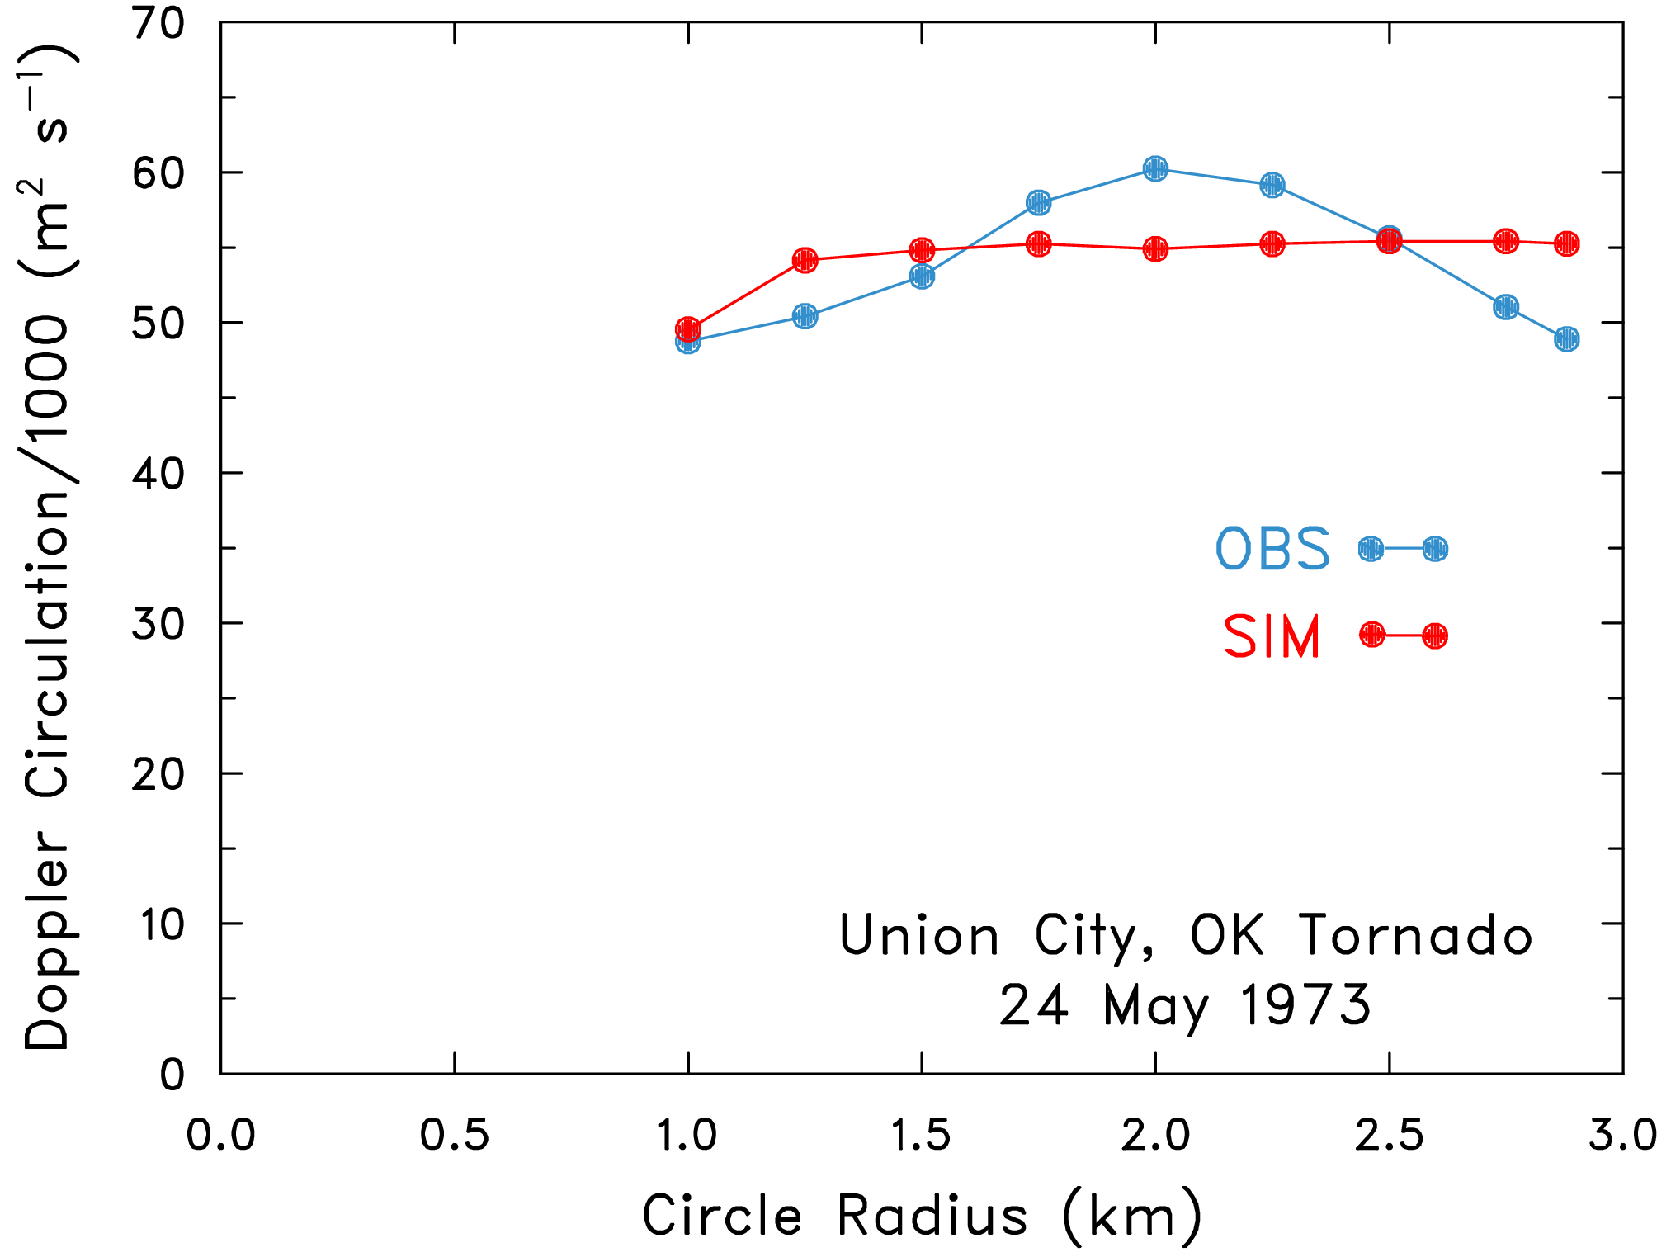
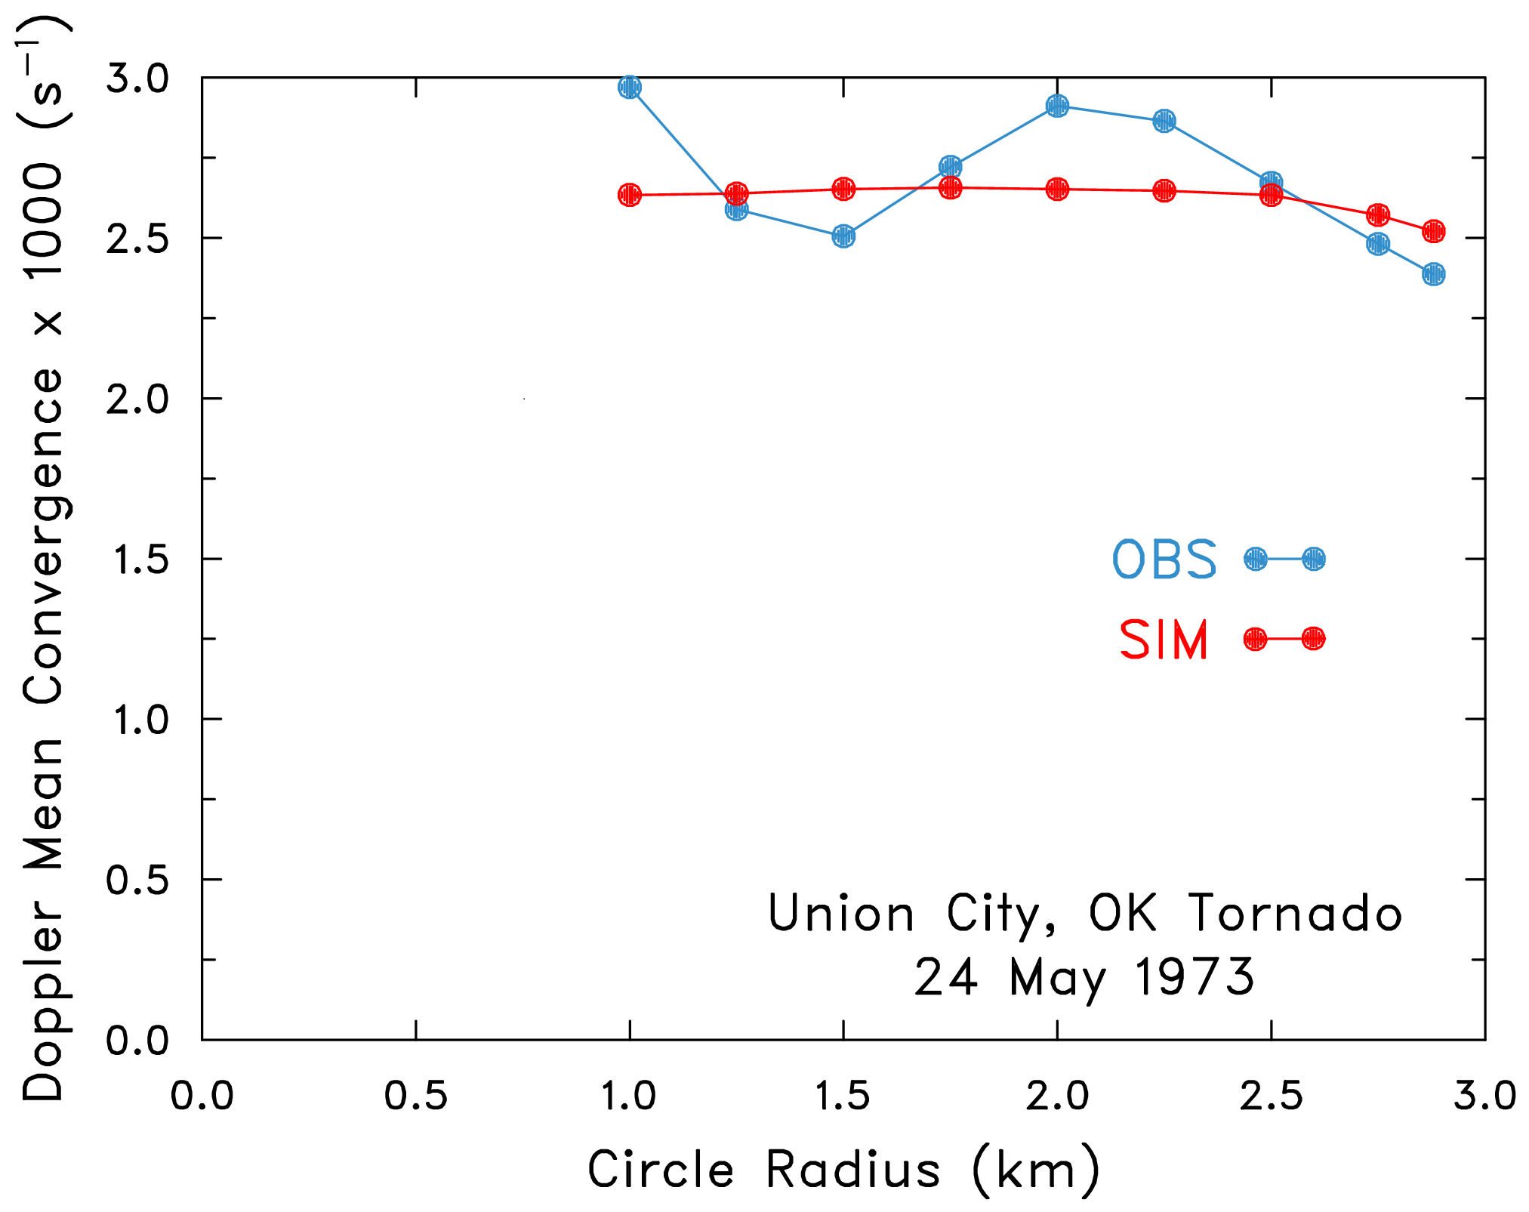
CIRCULATION vs. RADIUS
Simulated flow is potential vortex
+ constant convergence
TVS Range 51 km
Height 3.5 km
The circulation & mean convergence are
independent of circle radius.
Initial mesocyclone had totally contracted
into the mature tornado within a broad
region of constant convergence.
MEAN CONVERGENCE vs RADIUS

Slide 9
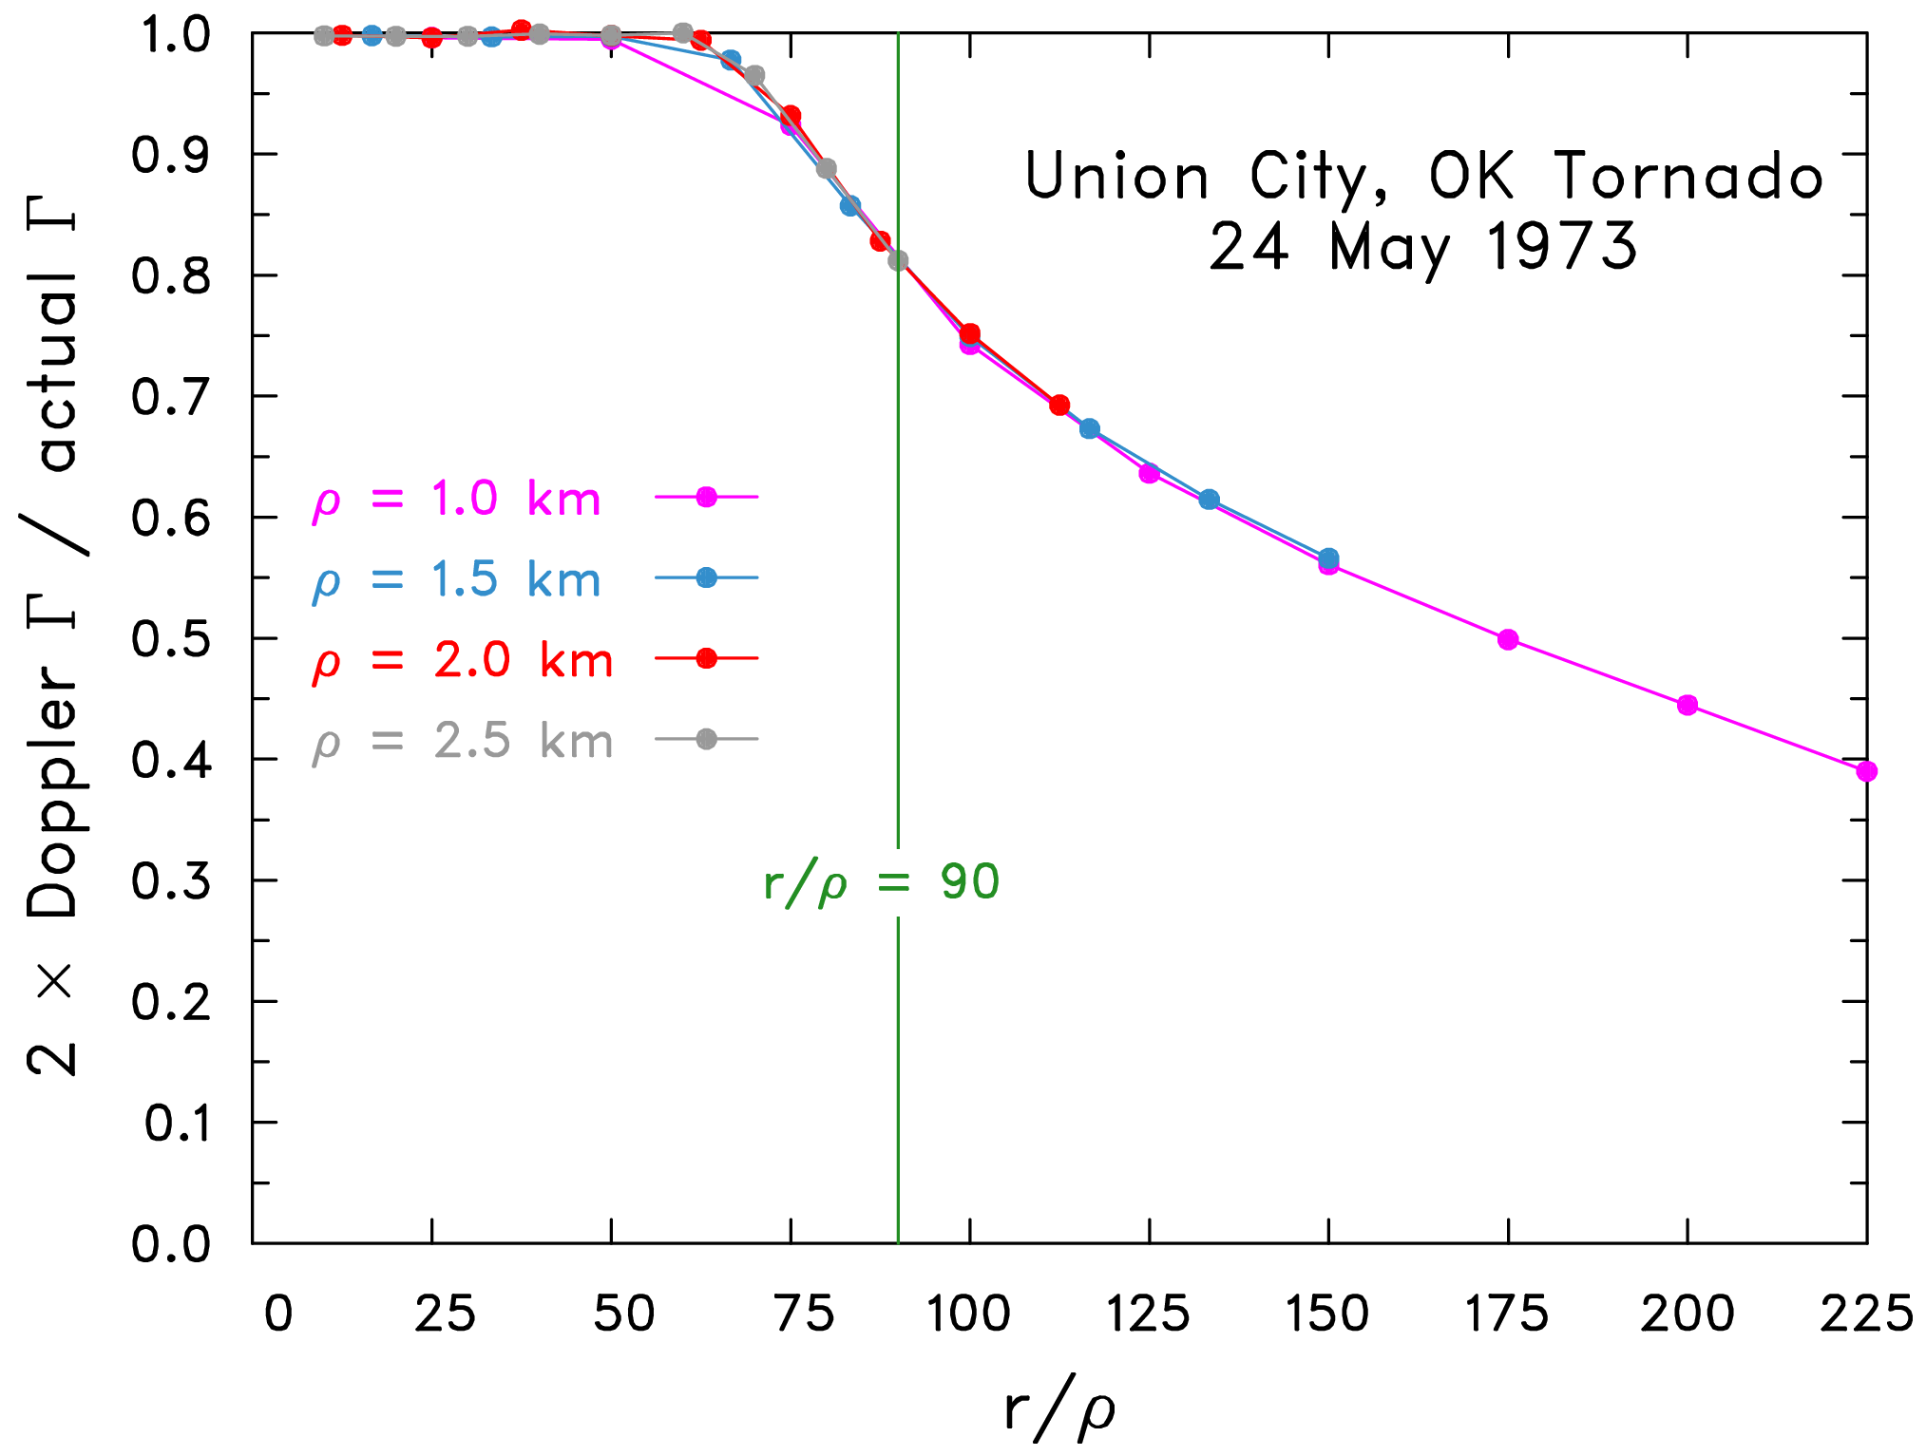
Circulation 10⁵ m²/s agreed with photogrammetrically observed circulation at 200 m AGL.
Used radar simulator to change range of the convergent potential vortex.
SINGLE CURVE
≤ 20% error for
RANGE/RADIUS ≤ 90
(this is worst case:
TVS @ midpoint of
azimuthal sampling
interval)
CIRCULATION vs RANGE ÷ RADIUS
Circulation is useful because it is quite range insensitive (unlike rotational velocity & shear).

Slide 10
[2] Insights into Tornadogenesis from integrals of the vorticity equation
Lagrangian approach
Theory only as yet, model diagnostics later?
Follows Dahl et al. (2014) but for baroclinic & frictional vorticity as well as barotropic
Uniform parcel stencil in environment
Arms (τ is time) are material “elastic strings” that stretch and turn.
The strings (covariant basis vectors) are frozen in the fluid.

Slide 11
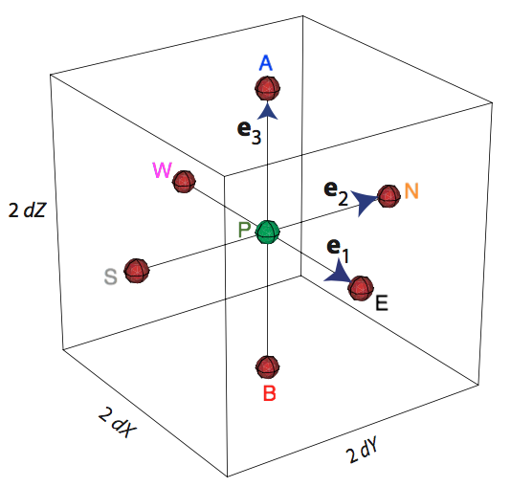
Initial strings
are unit eastward, northward, upward vectors,
τ₀ ισ ινιτιαλ τιμε
Initial grid volume
is tiny cube.
It is static
in XYZ-space
Parcel P green
dX=dY=dZ
Stencil parcels red

Slide 12
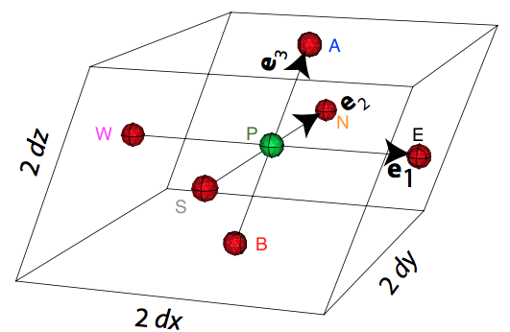
At later time τ, material volume is parallelepiped of same mass
Lagrangian continuity (mass conservation) equation:
= specific volume/ initial value

Slide 13
Vector rules:

Slide 14
For any force F

Slide 15
Lagrangian w-equation (w = αω):
Note that
e_{i} & linear combinations thereof are solutions of the barotropic
w-equation
Rotate X & Y axes so that in each material Z-surface, e'₁ & e'₂
are parallel to & 90° left of storm-relative environmental wind.
Subscript 0 denotes initial/environment, ' denotes rotated system.
Solution that satifies BCs is

Slide 16
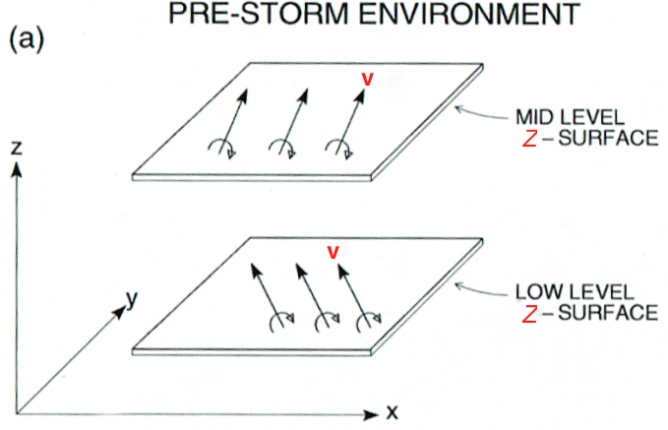
q₀ & β₀ are storm-relative
environmental wind speed,
direction.
Weights of w_{BT} are static (Dahl et al. 2014).
They are the imported storm-relative streamwise vorticity & crosswise vorticity. Barotropic vertical vorticity
Like DJ84, Rotunno & Klemp (1985) (semi-)linear formulas,
but fully nonlinear (X', Y' replaces x', y').

Slide 17
Baroclinic vorticity integral
w-equation becomes
Integrating with zero initial condition gives
Weights accumulate over time. Can compute w_{BC} from time integral of b, z material solenoids at stencil points, & current strings. Timing of generation immaterial.

Slide 18
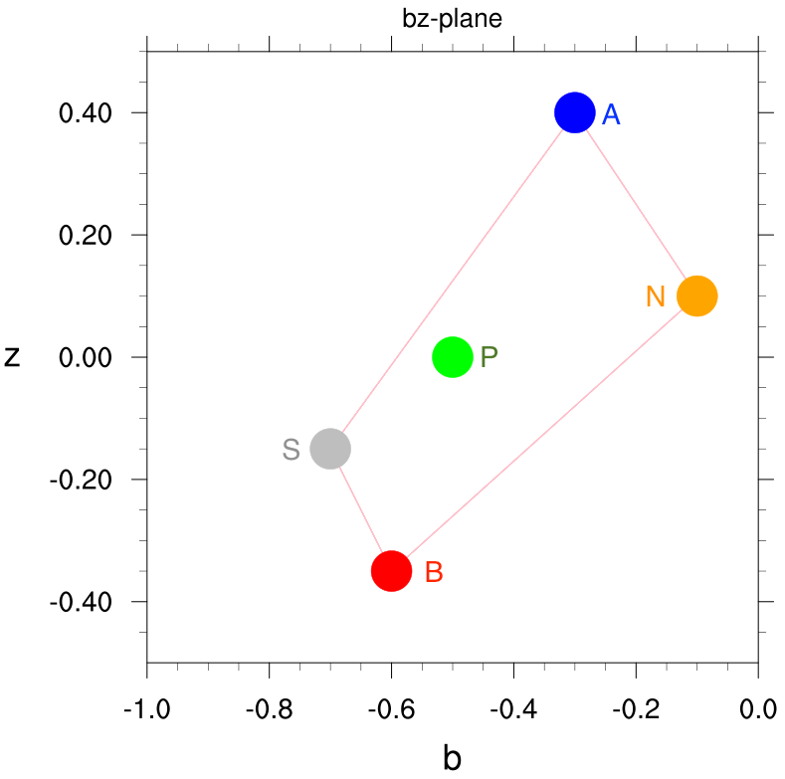
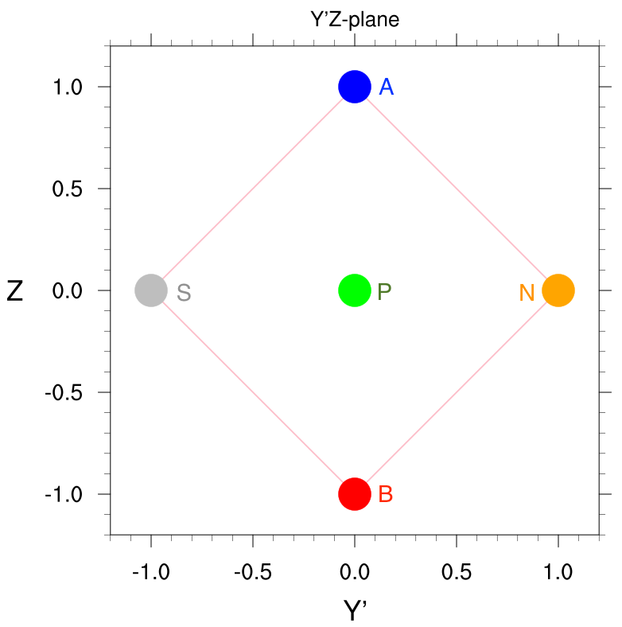
Need reversible trajectory scheme (symmetric in time)
Map buoyancy & height of parcels onto bz-plane.
Each Jacobian is ratio of algebraic (signed) areas (DJ01).
= area in (b, z) plane ÷ area of face of initial stencil
Area of square (face of cube) is static, = 2 (dX)² in each case
⬇
Values arbitrary!

Slide 19
Storm reaches steady state
Parcels now follow streamlines.
Can now solve for wind (by truism!):
in order to satisfy the initial condition v(τ₀) = q₀e'₁(τ₀).
The weight (contravariant component) of the wind is now q₀.
Define new orthonormal basis vectors t, n, b in streamwise,
transverse, and binormal (normal to Z-surface) directions.
v = qt, q wind speed.

Slide 20
Transverse & streamwise vorticity in steady isentropic flow
where R = ratio of environmental to current streamline spacing,
S(Z) is entropy, dS/dZ (< 0) is the environmental stratification,
dZ/db = ratio of environmental to current spacing of Z-surfaces,
ϕ is angle between e₂ and e₁ (or t).
Term A is stretched environmental streamwise vorticity
Term B is time integral of streamwise baroclinic vorticity generation
Term C is river-bend effect

Slide 21
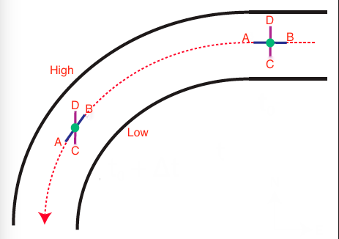
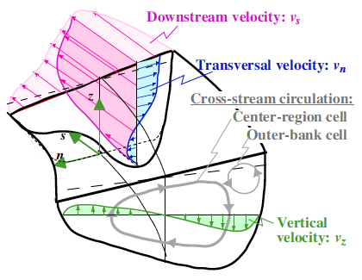
RIVER BEND EFFECT
DJ+01
Graf & Blanckaert 2002
Low
BA = e'₁is along streamline, DC= e'₂ is left normal initially. Flow speed increases with height. Vorticity upstream is transverse. The binormal vorticity is zero so ABCD does not rotate as a solid body. Instead anticyclonic (ac) shear curvature cancels cyclonic curvature vorticity & e'₂ rotates towards e'₁. The faster (slower) fluid at top (bottom) moves outward (inward) due to excess centrifugal force (pressure-gradient force).

Slide 22
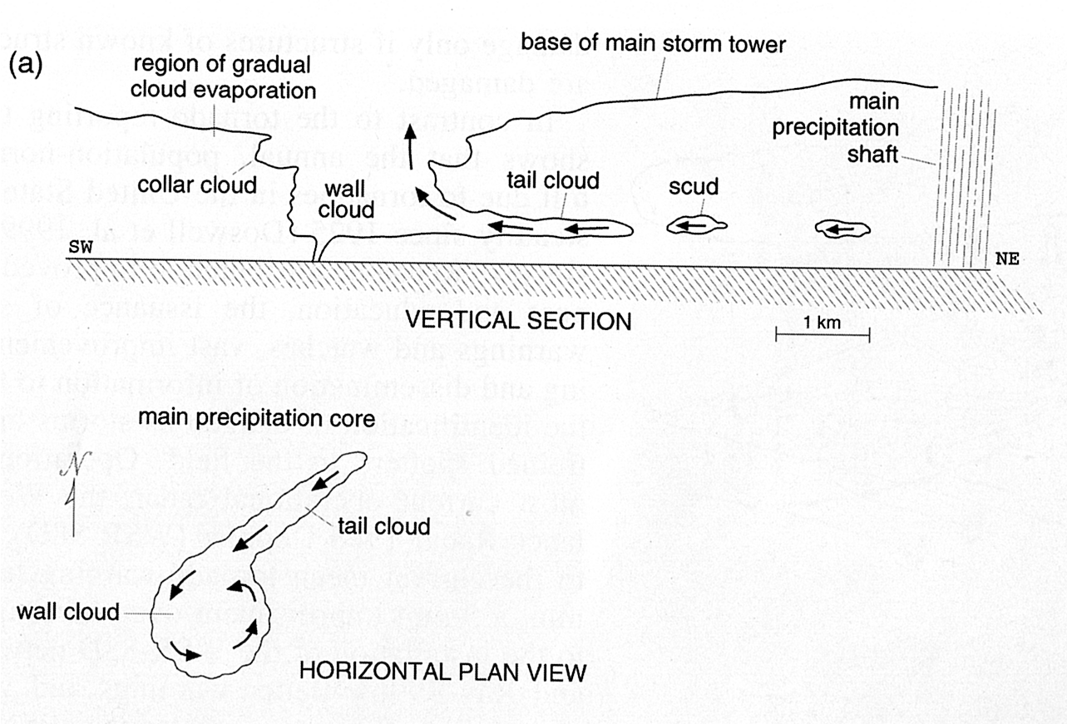
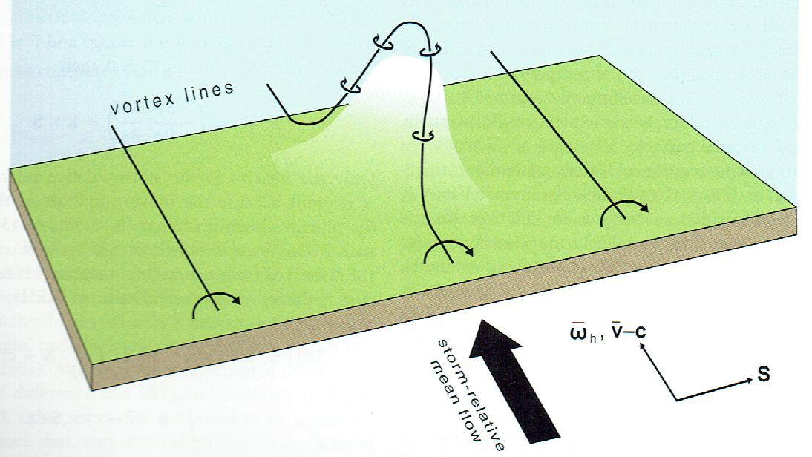
VORTICITY FOR UPDRAFT ROTATION
DJ84
Fujita59
Inflow parcels have lots of low-level 3D barotropic storm-relative streamwise vorticity. Amplified by streamwise stretching, they flow into the base of the storm updraft. Result is updraft rotation & low pressure at quite low levels.
Parcels in "streamwise vorticity current" along forward flank downdraft boundary get baroclinic streamwise vorticity owing to being in a transverse buoyancy gradient. Rotation locally enhanced where these parcels enter updraft.

Slide 23
VORTICITY CLOSE TO GROUND
Parcel enters downdraft. Its front side is heavier than its rear. Gets +ve transverse baroclinic vorticity.
Mesocyclone's radial pressure-gradient turns parcel to left.
In left-turning flow (outside mesocyclone core), parcel gets 3D streamwise vorticity from +ve transverse vorticity through river-bend effect.
As parcel exits left side of RFD & flows towards updraft, its 3D streamwise vorticity grows due to streamwise stretching (& by continuity isentrope packing & streamline confluence).
Vortex suction lifts cool parcel into updraft. Upward tilting & vertical stretching of its 3D streamwise vorticity maintains tornado.

Slide 24
SUMMARY OF VORTICITY DIAGNOSTICS:
The strings (covariant basis vectors) e'₁, e'₂, and e₃ are material line elements attached to each parcel.
Initially they are orthonormal. In a horizontally homogeneous environment e'₁&e'₂ are parallel & left normal to the storm-relative environmental wind, e₃ is upward.
The initially level Z-surfaces are material surfaces, within which initially streamwise and crosswise unit material lines e'₁& e'₂ are reoriented and stretched or diminished.
Barotropic-vorticity weights are static (initial streamwise & crosswise vorticity). Baroclinic-vorticity weights grow.
The strings propagate a parcel’s vorticity through time by factoring in the “frozen field” effect.
‘River-bend’ effect is due to e'₂ rotating towards e'₁ in left-turning flow & producing 3D streamwise vorticity from both barotropic & baroclinic transverse vorticity.

