Slide 1

Environments conducive for severe convective winds in Europe
10th European Conference on Severe Storms – ECSS 2019
Kraków, Poland
4th - 8th November 2019
George Pacey | Prof David M. Schultz | Dr Luis Garcia-Carreras
Master’s Student
University of Manchester, United Kingdom
Centre for Atmospheric Science
george.pacey@postgrad.manchester.ac.uk

Slide 2
Motivation and Background
Severe convective winds originating from thunderstorm downdrafts cause damage to businesses and personal property, and can cause fatalities.
Difficult to forecast as they are known to occur in different environments and convective organisational modes.
Remain relatively unexplored on a pan-European scale compared to other severe thunderstorm phenomena.
Further can information can help forecasters issue well-informed warnings to the general public and businesses.

Slide 3

Datasets
European Severe Weather Database
University of Wyoming Radiosonde Data
OPERA Radar Data

Slide 4
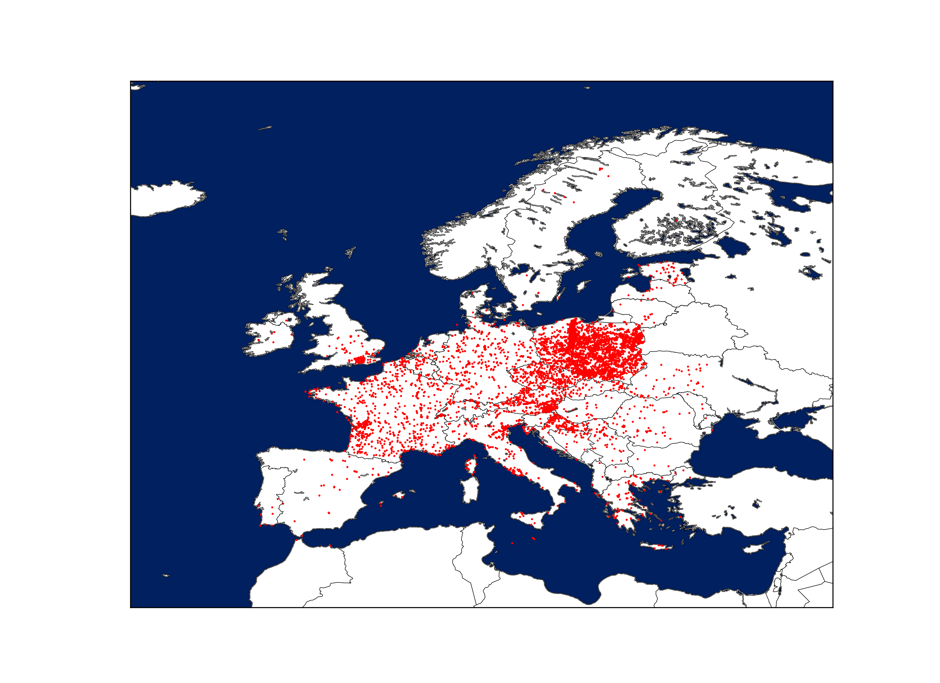
Criteria: Wind gust exceeding 25ms⁻¹ that is convective in nature.
Poland Derecho Event August 2017
8,400 severe convective wind reports between 2013-2018.
Highest density across Central Europe.
Multiple reports associated to each event.
Possible under reporting in certain countries.
Severe convective wind reports between 2013-2018 in the European Severe Weather Database.

Slide 5
Climatology 2013-2018
Event days per year
Number of event days per year
France
Austria
Greece
Italy
Croatia
Serbia
Spain
Ukraine
Romania
Holland
Estonia
Poland
Germany
Slovakia
Bosnia
Cz. Republic
Countries

Slide 6
During the summer season,
a severe convective wind event occurs every other day.
Total number of event days
Jan Feb Mar Apr May Jun Jul Aug Sep Oct Nov Dec
Months

Slide 7
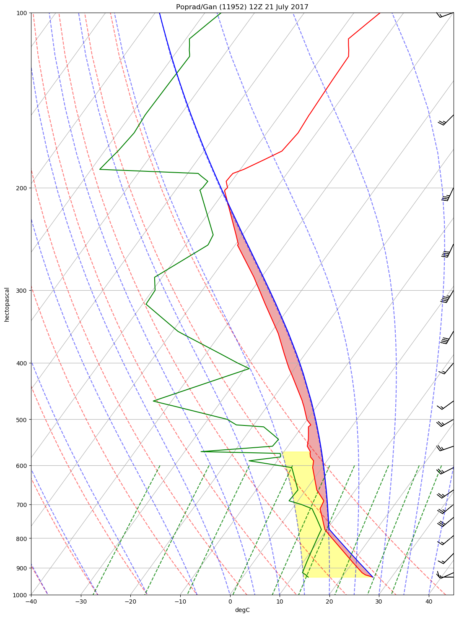
Pre-storm environment
    186 proximity soundings were analysed using proximity criteria of 0–100km within 0–3 hours after the radiosonde launch.
    For each proximity sounding traditional damaging wind parameters calculated such as CAPE, DCAPE, Lapse Rates, and Relative Humidity.
    Then all proximity soundings (based on their associated metrics) are clustered using the K-means clustering algorithm.

Slide 8
Pre-storm environment
Clustering analysis yields two clusters, i.e. severe convective winds generally occur under two environments.
Cluster 1 (LSHC) 64%
Low to moderate shear.
Moderate to high CAPE.
Moderate to high downdraft CAPE
High surface temperatures.
Low surface relative humidity.
Steep low level lapse rates.
Cluster 2 (HSLC) 36%
High shear.
Lower CAPE.
Lower downdraft CAPE
Lower surface temperatures.
Higher surface relative humidity.
Less steep low level lapse rates.

Slide 9
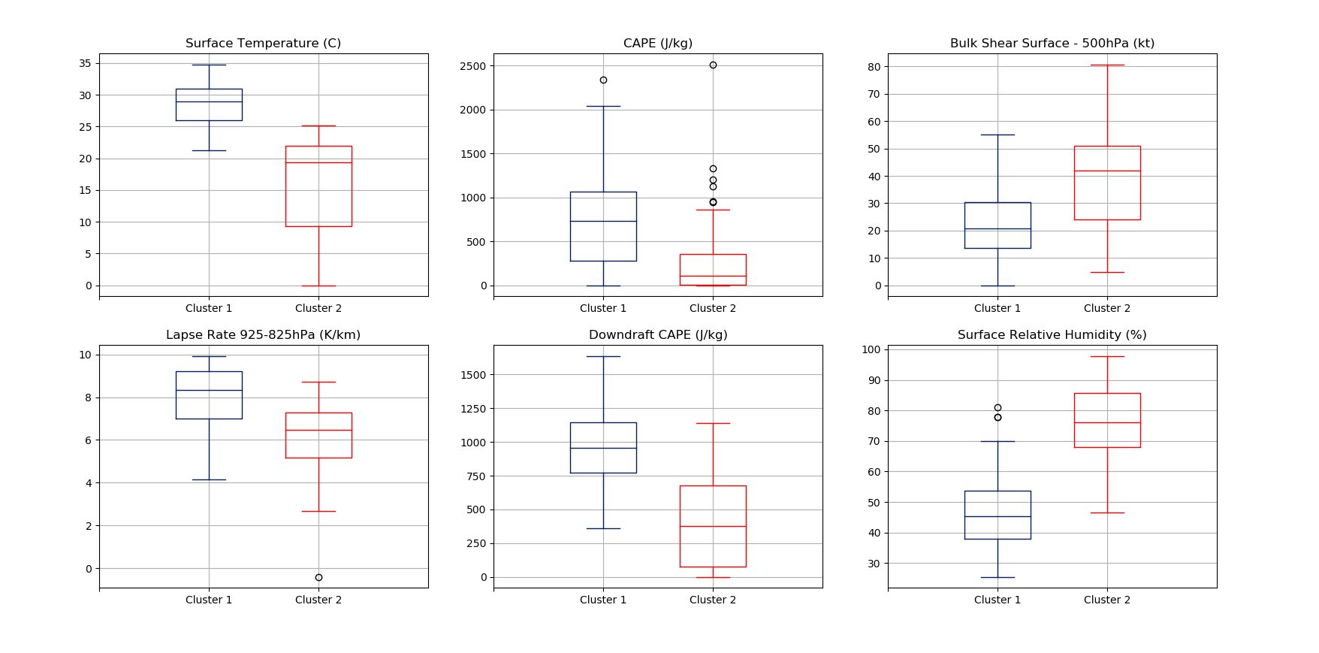

Slide 10
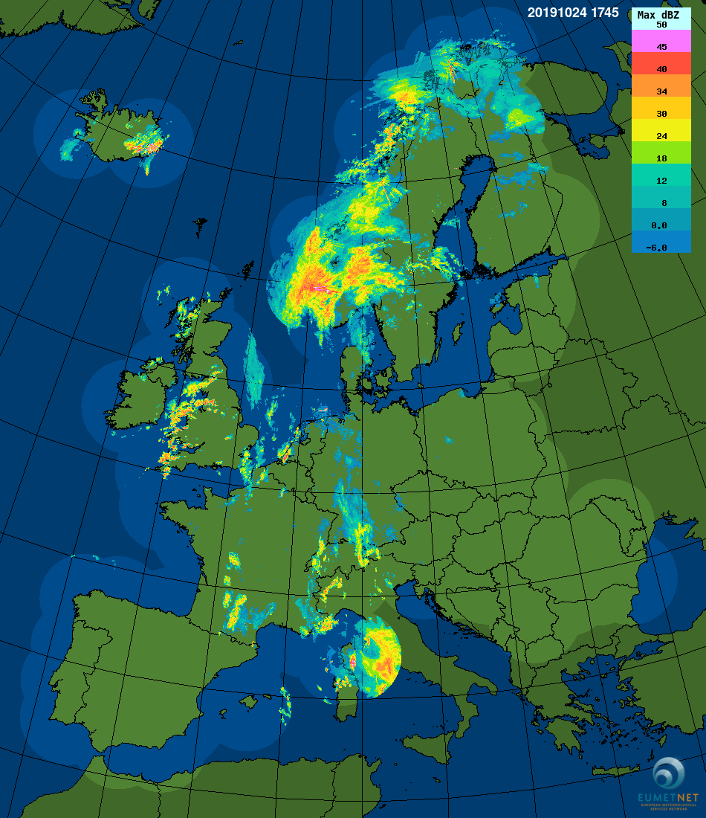
Radar storm morphology
OPERA Radar Network
Over 200 radars with coverage across 30 European countries.
Horizontal grid spacing of 2.0 km.
Radar scans at 15-minute temporal resolution.
3 composite products:
– Instantaneous Surface Rain Rate (mm hr⁻¹)
– Instantaneous Max Reflectivity (dBZ)
– 1 Hour Rainfall Accumulation (mm)

Slide 11
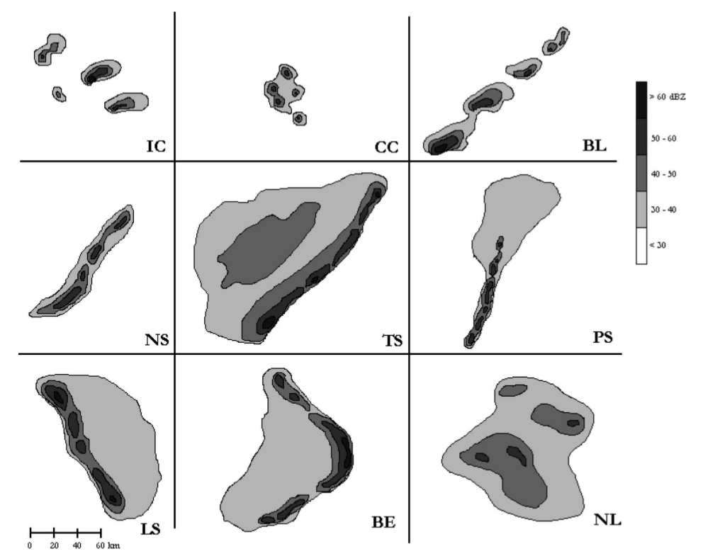
Radar storm morphology
Each event within radiosonde proximity was classified into one of the following categories.
An additional bin was created for unclassified events (UC) that did not meet conditions of given storm types.
NS, TS, PS and LS were subset into a linear category to simply the presentation of results.
192 events
Storm classification scheme from Gallus et al. 2008

Slide 12
Cluster 1 – 119 Events
Percentage of Total [%]
Isolated Cells
Cluster of Cells
Linear
Bow Echo
Non-linear
Unclassified
Morphologies

Slide 13
Cluster 1 – 119 Events
Cluster 2 – 67 Events
Percentage of Total [%]
Isolated Cells
Cluster of Cells
Linear
Bow Echo
Non-linear
Unclassified
Morphologies

Slide 14
Strongest Storms Morphology
A further 56 convective storms were classified with recorded station wind gusts exceeding 35m/s (125km hr⁻¹) or higher.
Separate from cluster and radiosonde analysis.
Investigation into whether there is a shift in convective mode during such events.
Highest convective gust wind recorded 58ms⁻¹ (209km hr⁻¹)
Wind Speed (m/s) | Country | Date
58.0 | Germany | 18/08/2017
52.8 | Greece | 29/05/2014
50.0 | France | 25/05/2018
47.2 | France | 19/07/2018
46.0 | France | 26/07/2013

Slide 15
Percentage of Total [%]
Linear
Non-Linear
Bow Echo
Isolated Cells
Cluster of Cells
Unclassified
Morphologies

Slide 16
Conclusions
Severe convective winds pose a threat to society in Europe and occur every other day during the warm season.
Occur generally in two environments: High CAPE and low–moderate shear (Cluster 1), or, low CAPE and high shear. (Cluster 2).
Cells make up around 2/3 of cluster 1 events, whereas linear systems become more dominant in cluster 2.
During the strongest recorded events Bow Echo and Non-Linear events increase, cells decrease.
These results present the first storm classifications of severe convective winds on a pan-Europe scale.
Providing further evidence of the challenge of forecasting severe convective winds in Europe.

