Slide 1
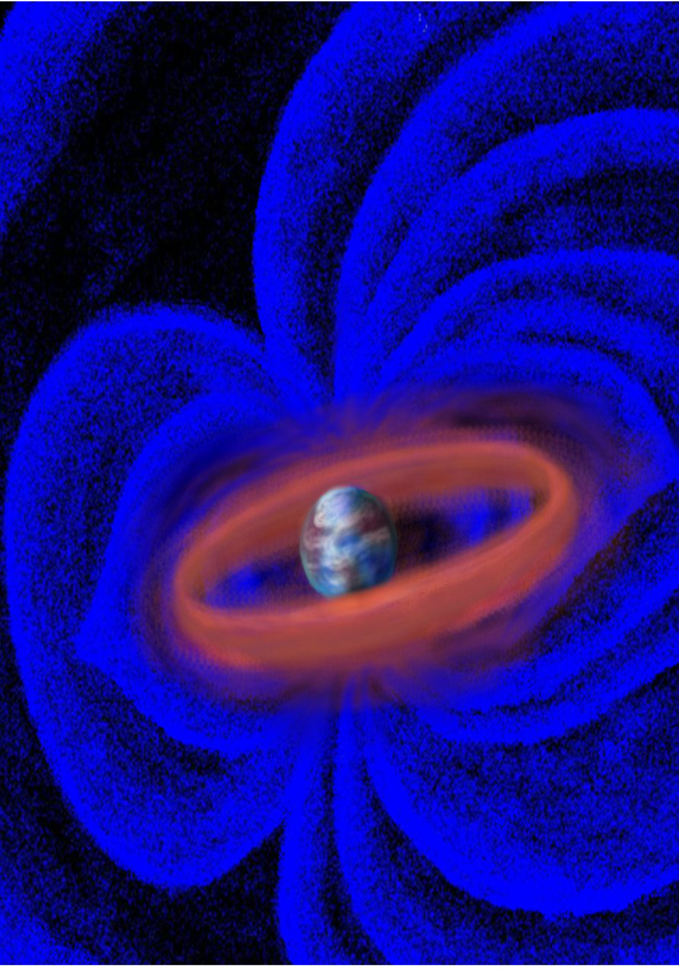
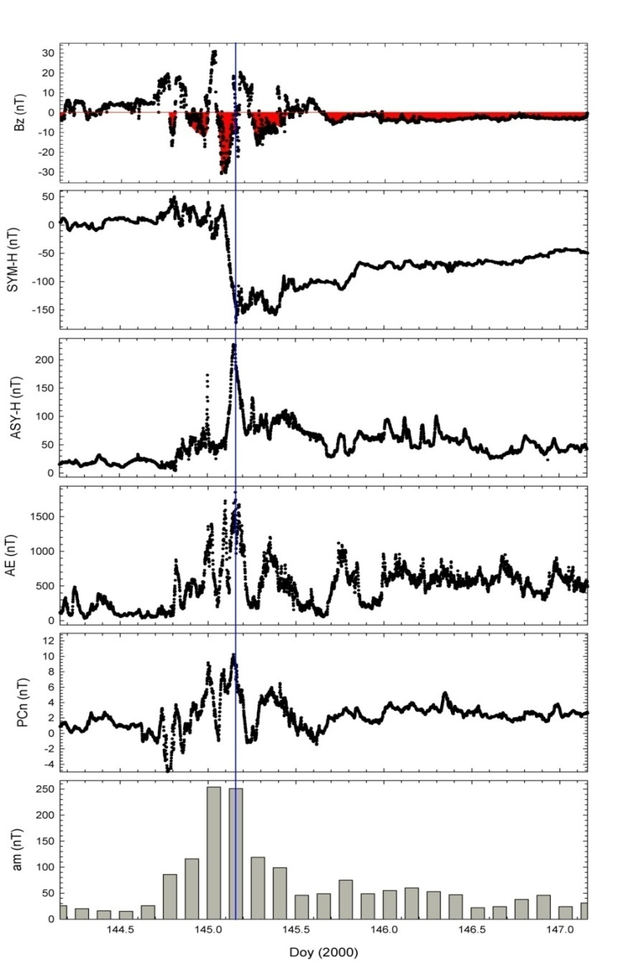
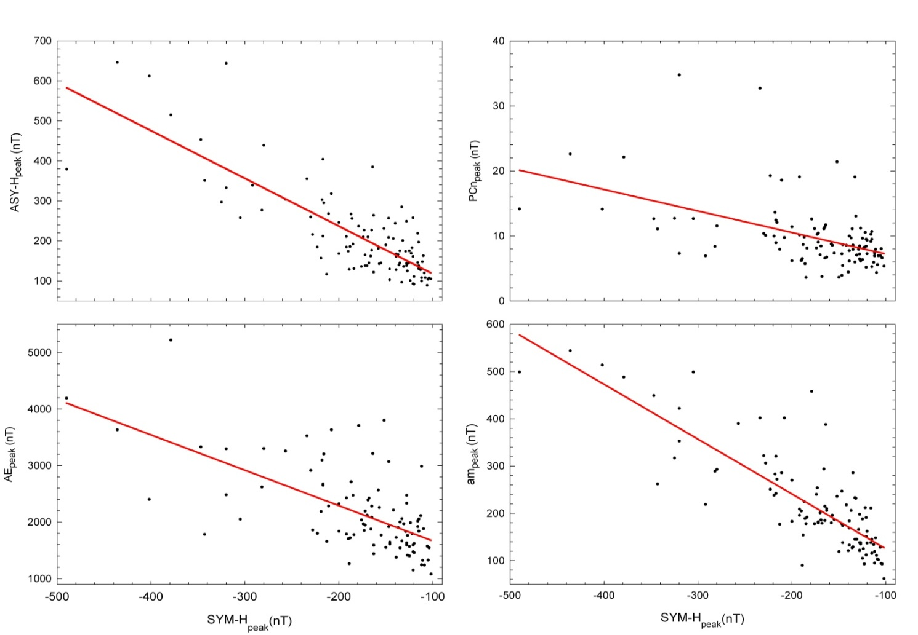
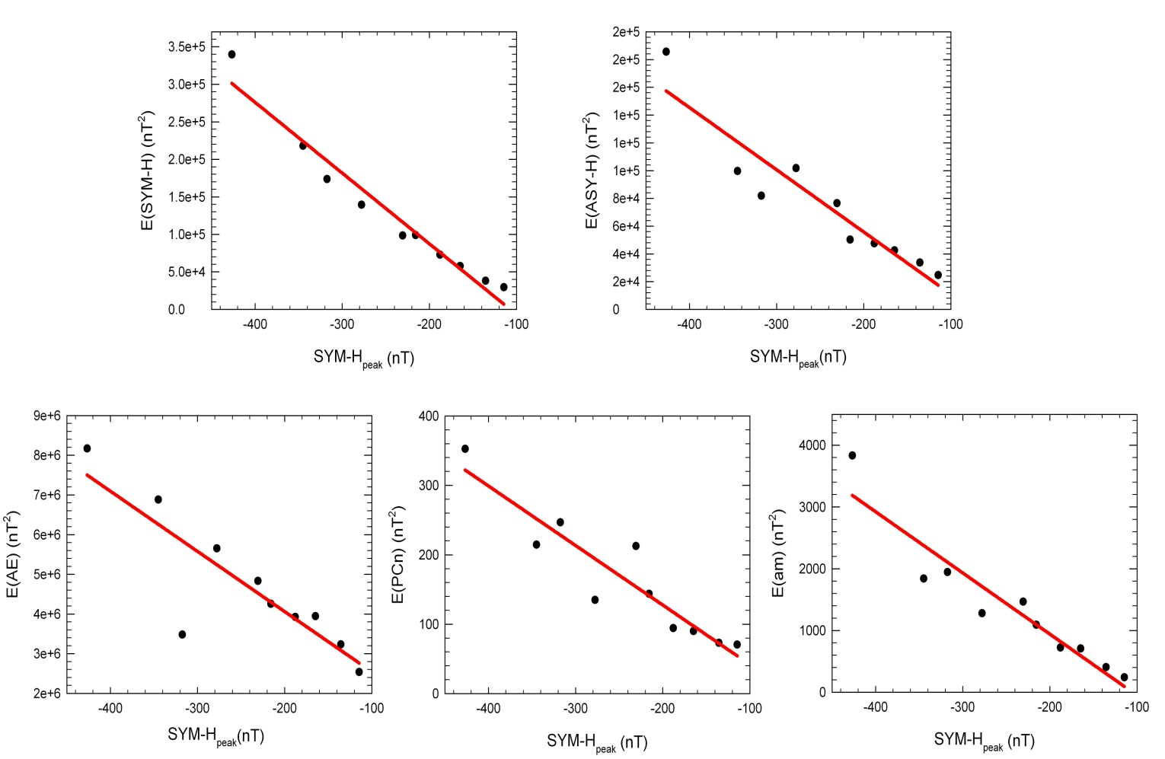
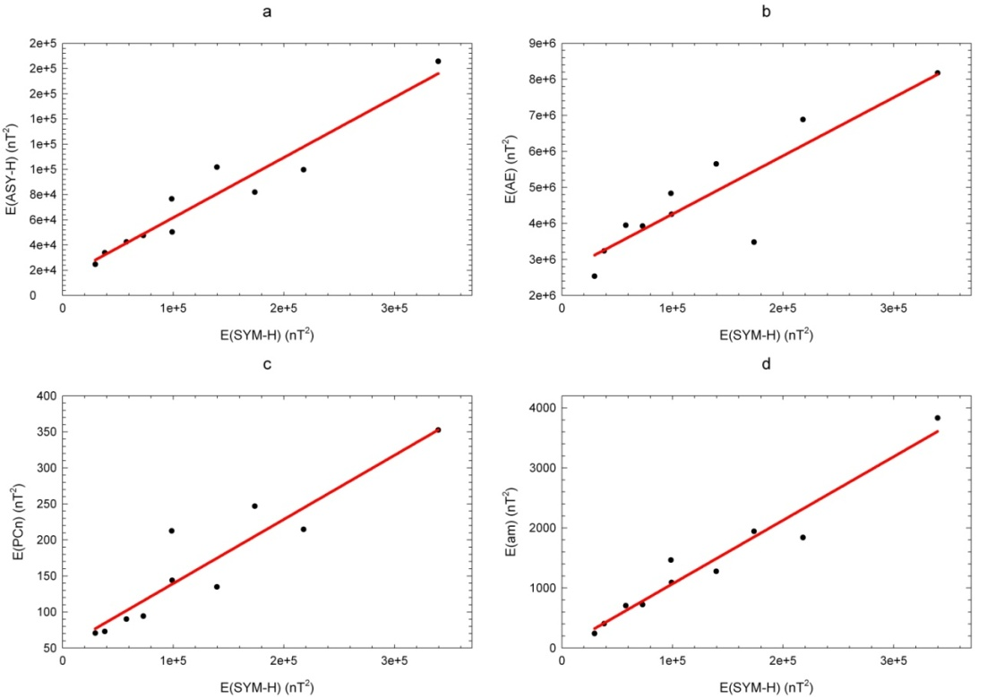
THE RELATIONSHIP BETWEEN THE BEHAVIORS OF THE DIFFERENT MAGNETOSPHERIC REGIONS
J. Aguado ⁽¹⁾, M. Menvielle ⁽²⁾, E. Saiz ⁽¹⁾, C. Cid ⁽¹⁾, Y. Cerrato ⁽¹⁾,,
⁽¹⁾ Space Research Group-Space Weather, Departamento de Física, Universidad de Alcalá, Spain (jesus.aguado@uah.es)
⁽²⁾ CETP/CNRS/IPSL, Centre d’étude des Environnements Terrestre et Planétaires, Saint Maur, France (michel.menvielle@cetp.ipsl.fr) and Département des Sciences de la Terre, Université Paris Sud XI, Orsay, France
ABSTRACT
Disturbances in the magnetosphere caused by the input of energy from the solar wind enhance the magnetospheric currents and it carries a variation of the geomagnetic field on different regions at the Earth's surface. Those magnetic field variations are measured by several indices. In this work, the AE and PCn indices at the auroral regions, the SYM-H and ASY-H indices at low latitudes and the am index to measure the global state of the disturbed magnetosphere, are used in order to obtain a relation between behaviors of the different magnetospheric regions. A comparative study of those indices is carried out for a selected set of storms from 1981 to 2006 using the superposed epoch method
1. INTRODUCTION
Several studies suggest that the asymmetric ring current closes the magnetosphere currents circuit through field aligned currents and auroral electrojets. Thus, it suggests a relationship between the indices used as proxies of the symmetric and asymmetric ring current (SYM-H and ASY-H) and auroral region (AE and PCn).
AE
PCn
SYM-H
Different regions and their magnetospheric currents are linked
am
Natural paths of the particles coming from solar wind
ASY-H
The global state of the disturbed magnetosphere is measured by the am index.
2. COMPARATIVE STUDY OF VARIOUS INDICES
2.b. AVERAGE MAGNETIC ENERGY DENSITY IN EACH REGION FROM EVERY MAGNETOSPHERIC INDEX
The study focuses on the intense geomagnetic storms (SYM-H < -100 nT) occurred in the period 1981-2006 whose recovery phases do not include substantial injection of energy (107 storms)
a) The peak values of different indices have been compared
b) A superposed epoch analysis categorizing the storms into five subsets by intensity, has been performed. For every subset and every geomagnetic index the mean storm has been obtained, starting at the time of index peak value, as zero epoch time
Magnetospheric current variation
ΔB
α INDEX
MAGNETIC ENERGY DENSITY VARIATIONS α B²
α INDEX²
2.a PEAK VALUES COMPARISON
Mean storm for the subset j
Power input in the magnetosphere
Different geomagnetic regions respond to the same disturbance at close time intervals
Peak values of the indices reached almost simultaneously
r² = 0.88
Epoch time interval
t = 0 h → index_{peak}
t_{i} = -24 h; t_{f} = 6 h
r² = 0.96
r² = 0.88
The higher the maximum kinetic energy of the ring current particles the higher the average magnetic energy density associated to each magnetospheric current
ASY-H_{peak}
am_{peak}
r² = 0.93
r² = 0.79
RELATED
r² = 0.64
r² = 0.68
r² = 0.75
r² = 0.86
r² = 0.90
SYM-H_{peak}
NON
RELATED
r² = 0.86
r² = 0.95
r² = 0.40
r² = 0.24
AE_{peak}
PCn_{peak}
The relationship between the average magnetic energy densities for the magnetospheric regions is confirmed
There is a clear relationship between SYM-H_{peak} and ASY-H_{peak} suggesting that the kinetic energy of the particles for both symmetric and asymmetric ring current are enhanced as a consequence of sharing location, when a significant power input into the magnetosphere takes place
A linear dependence exists between the maximum kinetic energy of the ring current particles (represented by the SYM-H_{peak} value) and the average magnetic energy density associated to each magnetospheric current (represented by the integral of the corresponding square index). Therefore, the ring current emerges, not only as the main current system in the magnetosphere during a storm event, but also as the representative of the whole magnetospheric current system
There is a high linear correlation between the average magnetic energy density of the different magnetospheric regions and the average magnetic energy density of the symmetric ring current
3. CONCLUSIONS
Acknowledgements:This work has been supported by grants: PPII10‐0183‐7802 from the Junta de Comunidades de Castilla‐La Mancha and AYA2009‐08662 from the Ministerio de Ciencia e Innovación of Spain.

