Slide 1
To observe the earth … and visualize the future
John D. Moore
2009 -2011 Albert Einstein
Distinguished Educator Fellow
New Jersey, United States
mr.moore.john@gmail.com

Slide 2
SPACE-EARTH EARTH-SPACE
Integrated “SEES” Model
Students now have the ability to
examine a geo-referenced location from the
top-down and bottom-up

Slide 3
“SEES” Model
Examines a geo-referenced location from the top-down and bottom-up
Fosters Geospatial Thinking
Identifies geo-referenced data points/sources
Incorporates Real-time Data

Slide 4
Geographic Information Systems (GIS)
Visual representation of Data Sets
Layers (Themes)
Geo-referencing (GPS)
Analyze (Query) Geospatial Data
Geospatial Thinking

Slide 5
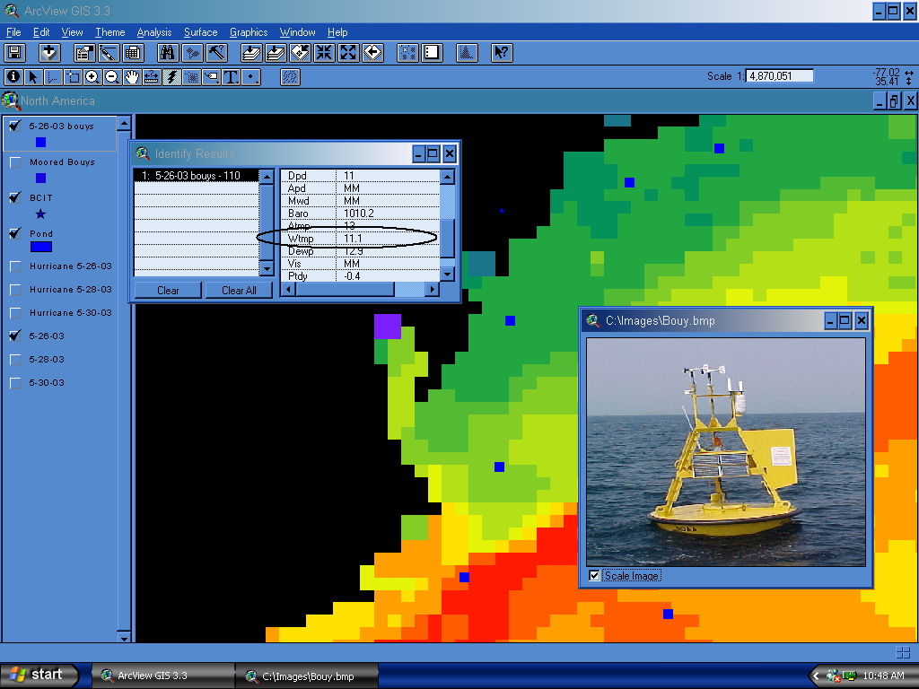

Slide 6
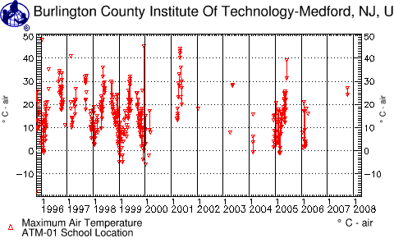
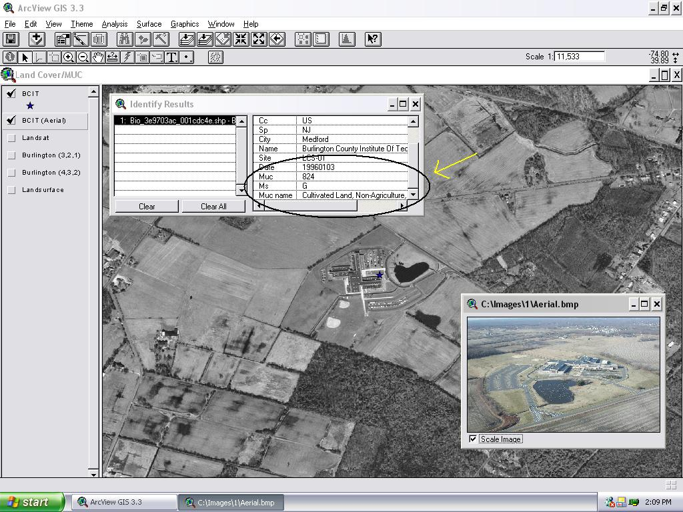
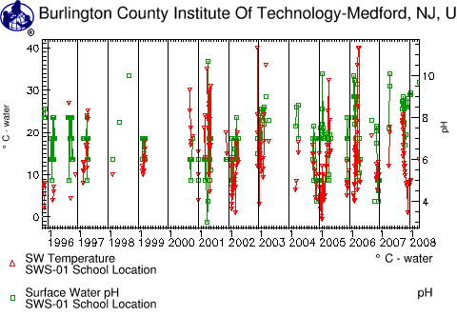
MONITORING LOCAL ENVIRONMENTAL CHANGE …
GLOBE DATA from the Burlington County Institute of Technology, Medford New Jersey USA
Monitoring Air Temperature
Changing Temps impact Green-up/down
Using Satellite Imagery and Aerial Photography to document Land-Use change.
How much change can occur before the MUC changes?
Surface H20 Temperature vs. pH
Changing Land-Use may alter runoff. The Pinelands are pH sensitive

Slide 7
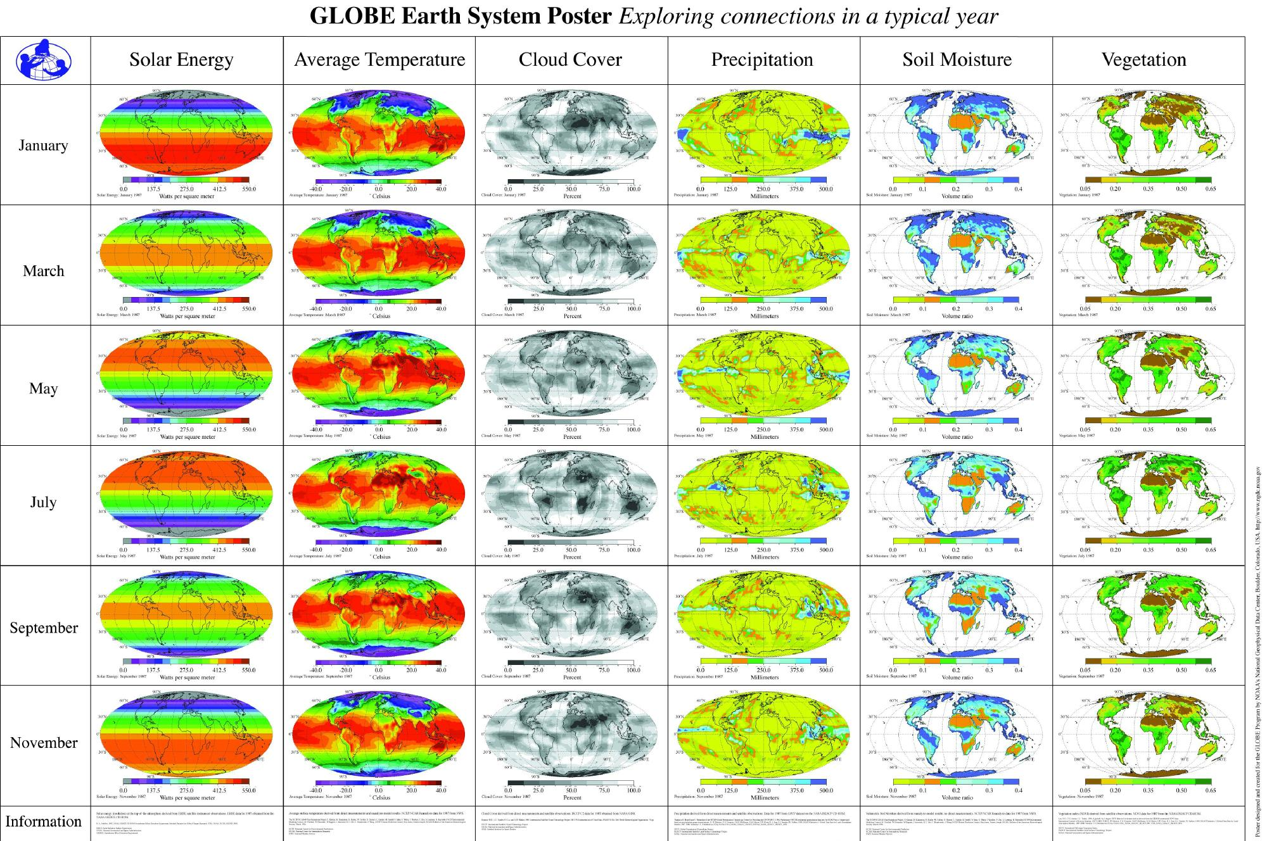

Slide 8
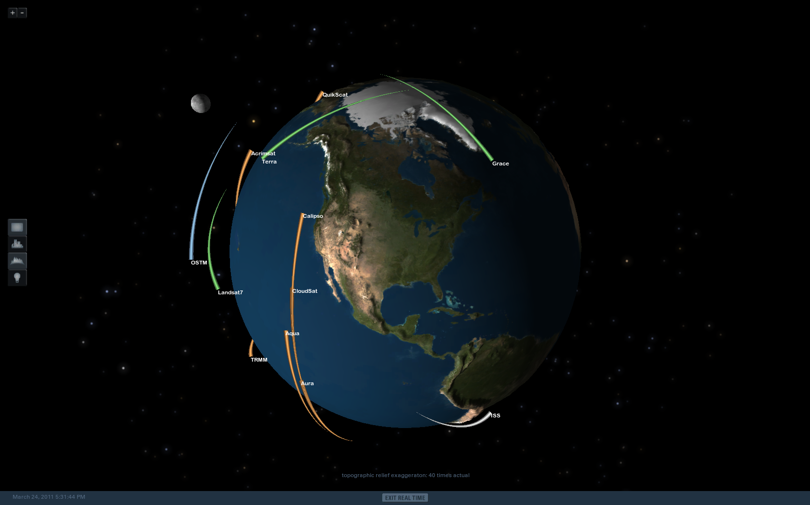

Slide 9
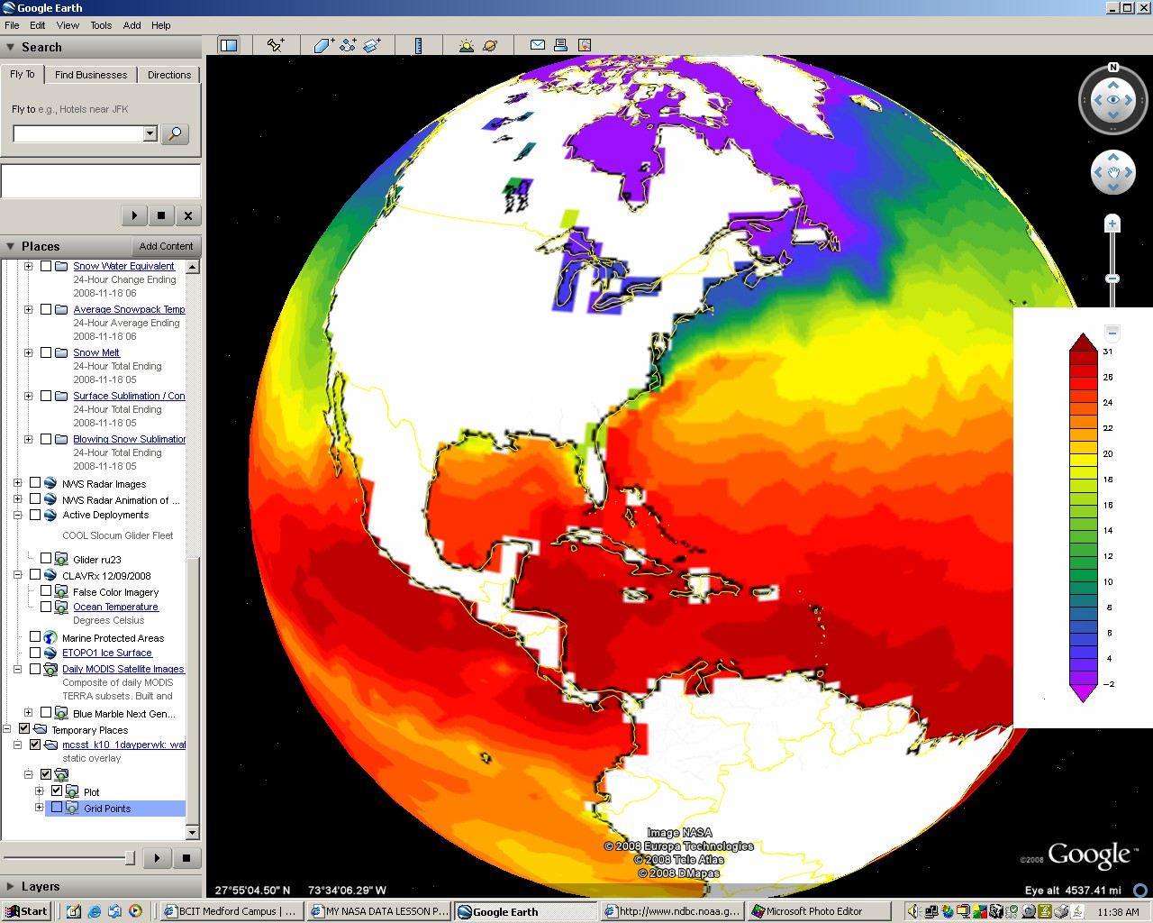

Slide 10
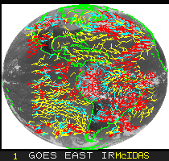

Slide 11
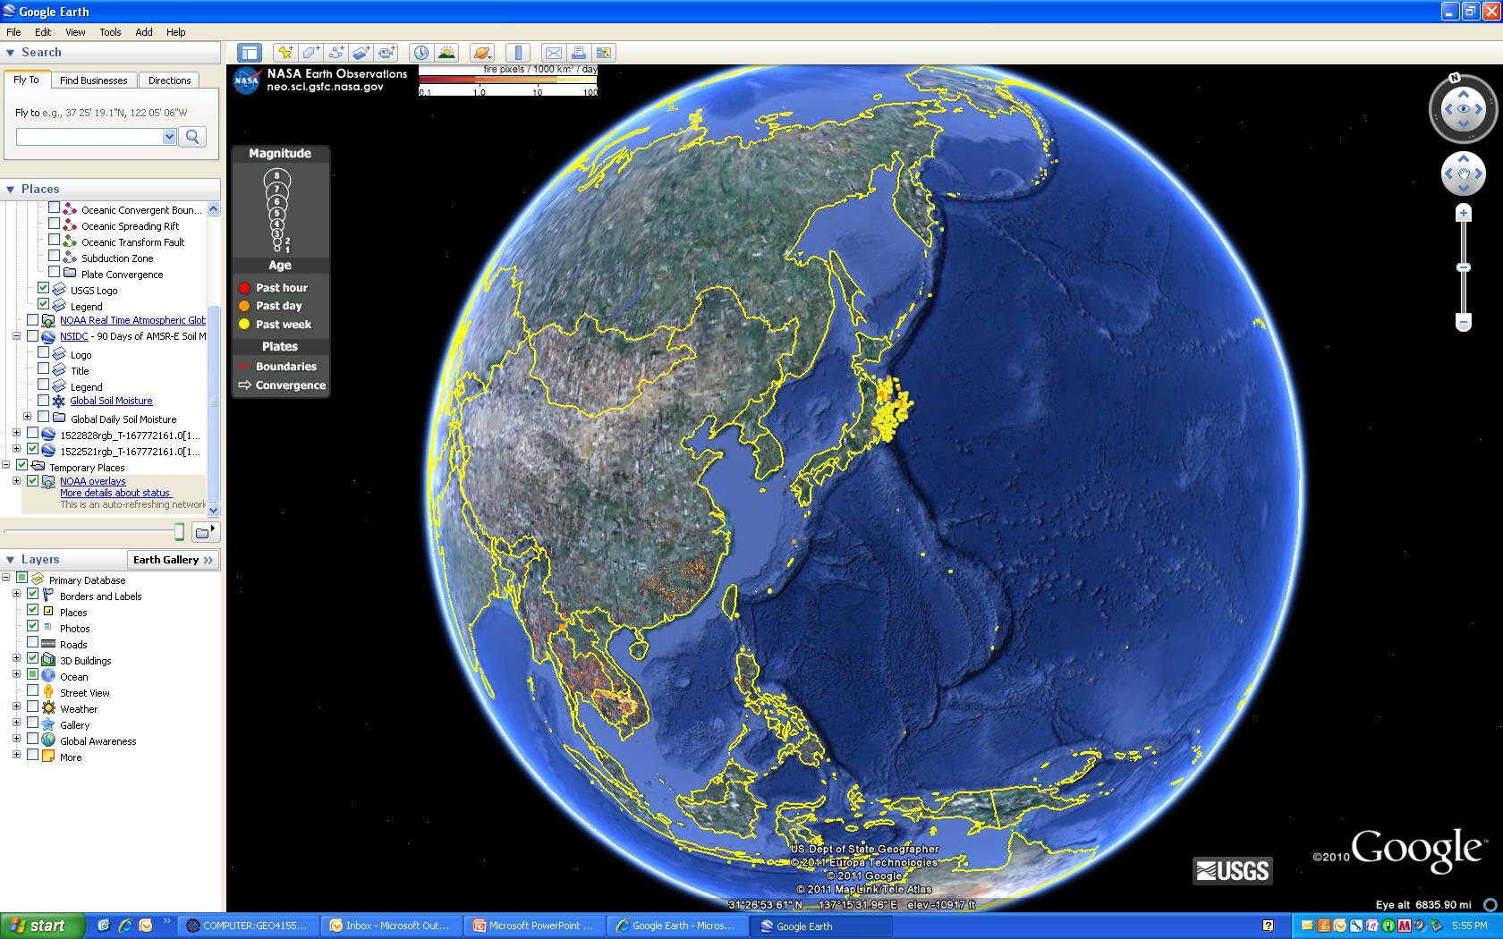

Slide 12
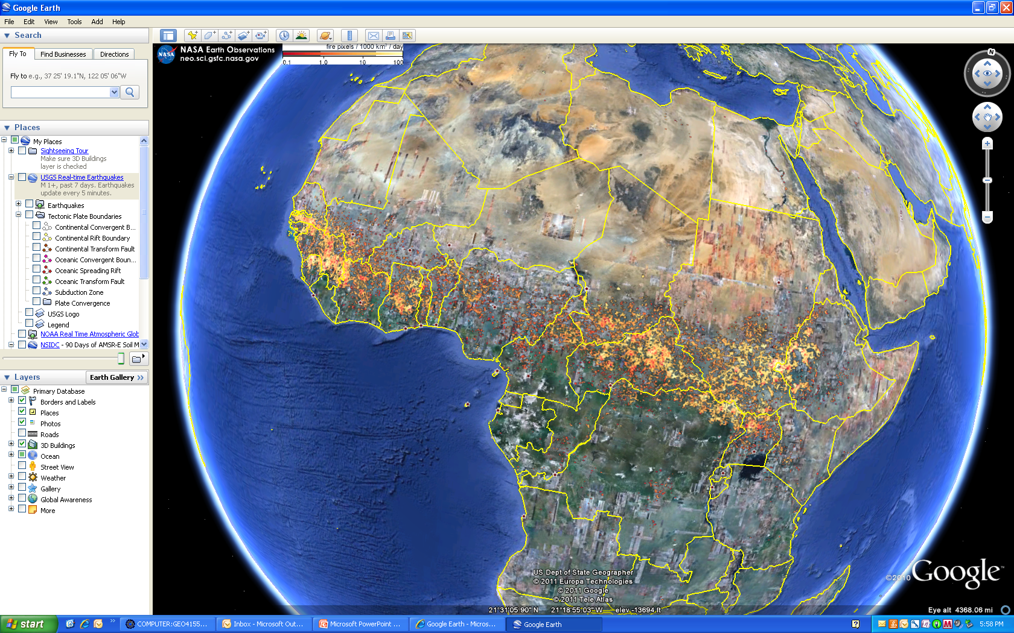

Slide 13
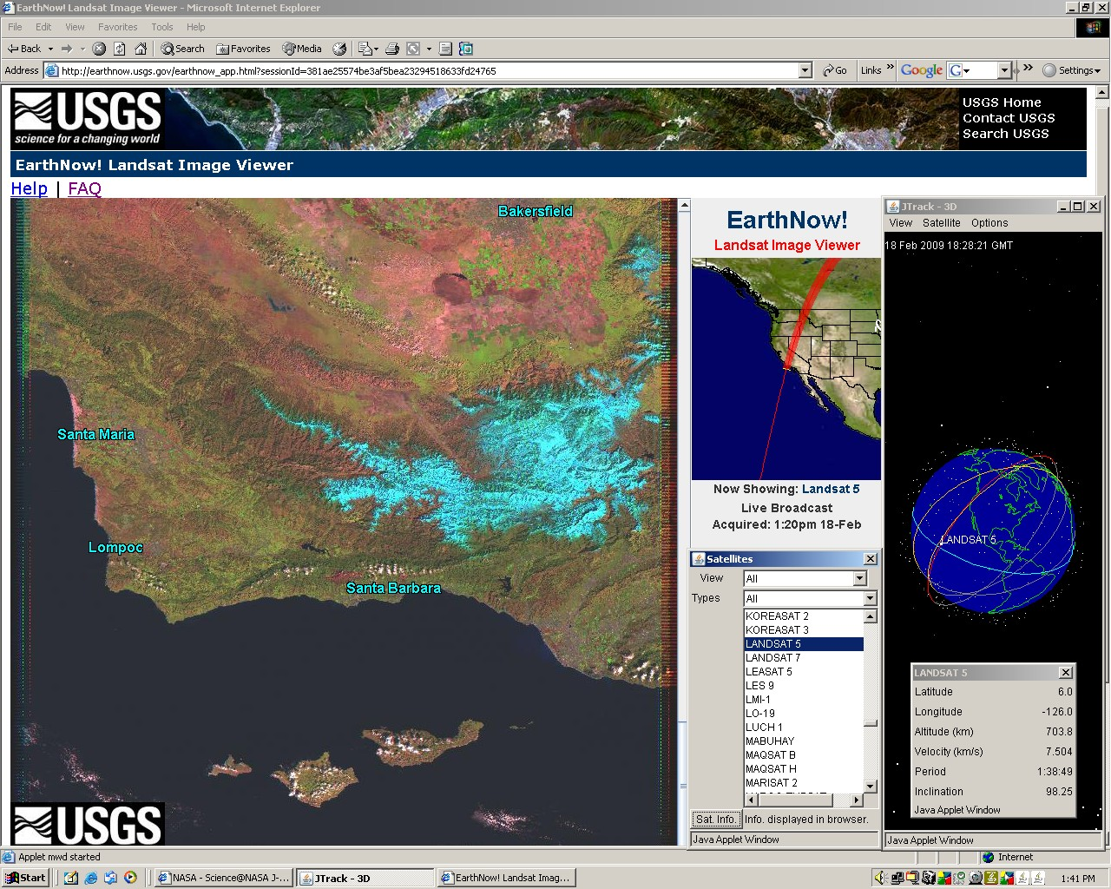

Slide 14
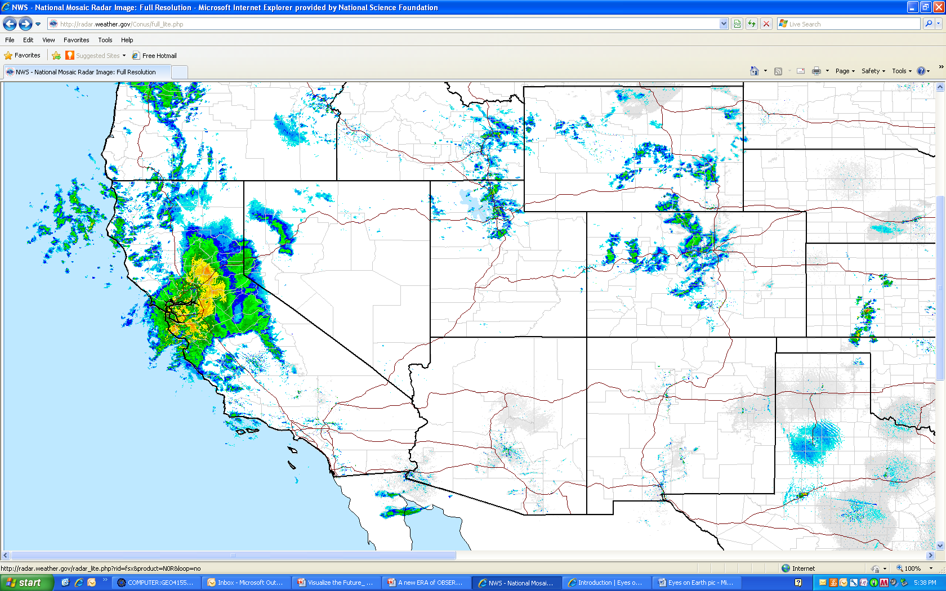

Slide 15
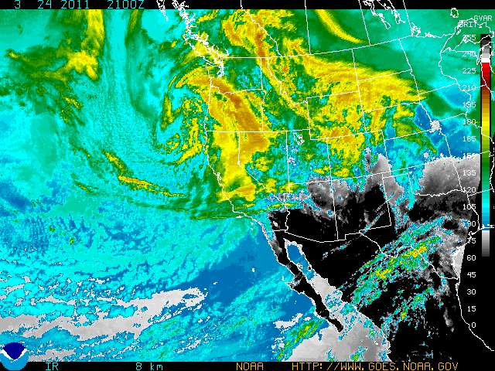

Slide 16
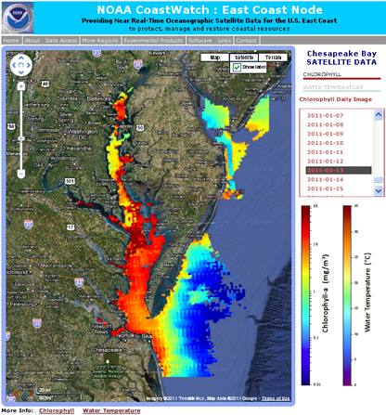

Slide 17
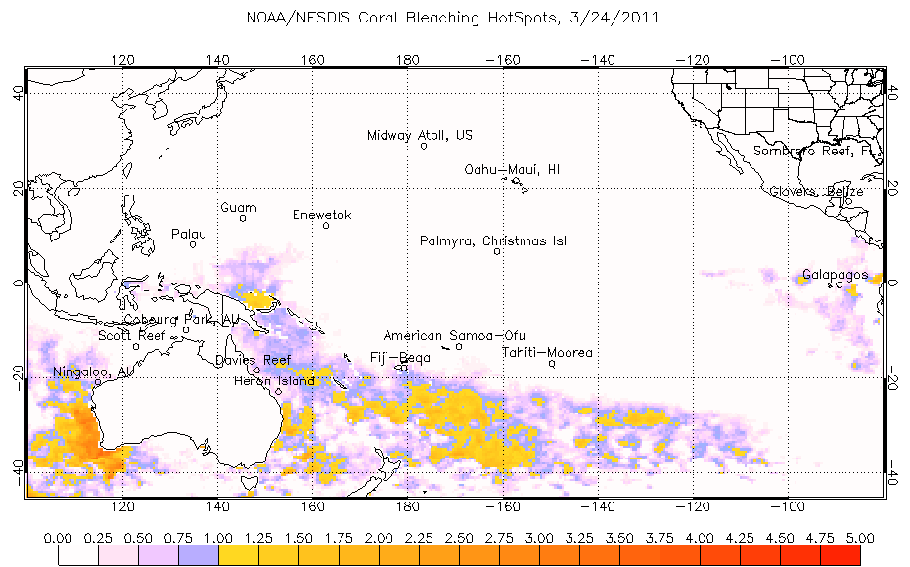

Slide 20
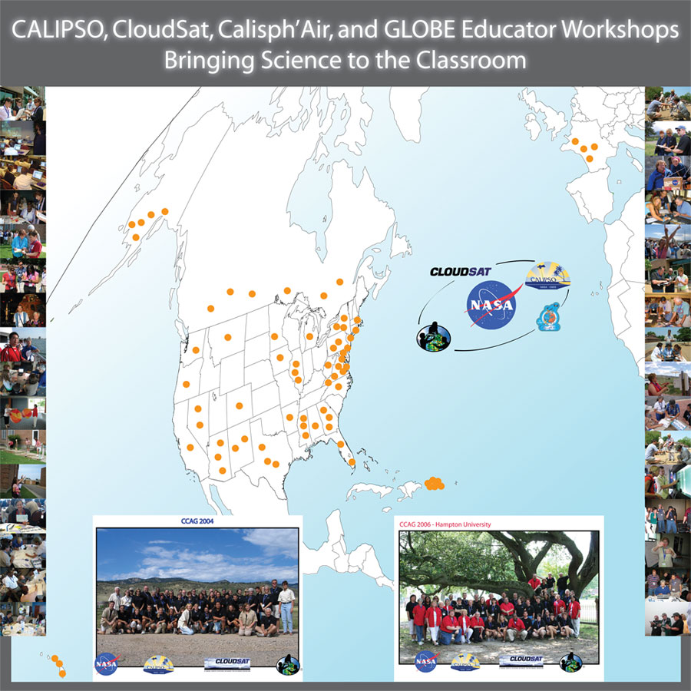

Slide 21
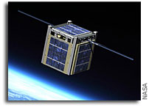
A new ERA of OBSERVATIONS
… to Observe the Earth and Visualize the Future
CUBESAT

Slide 22
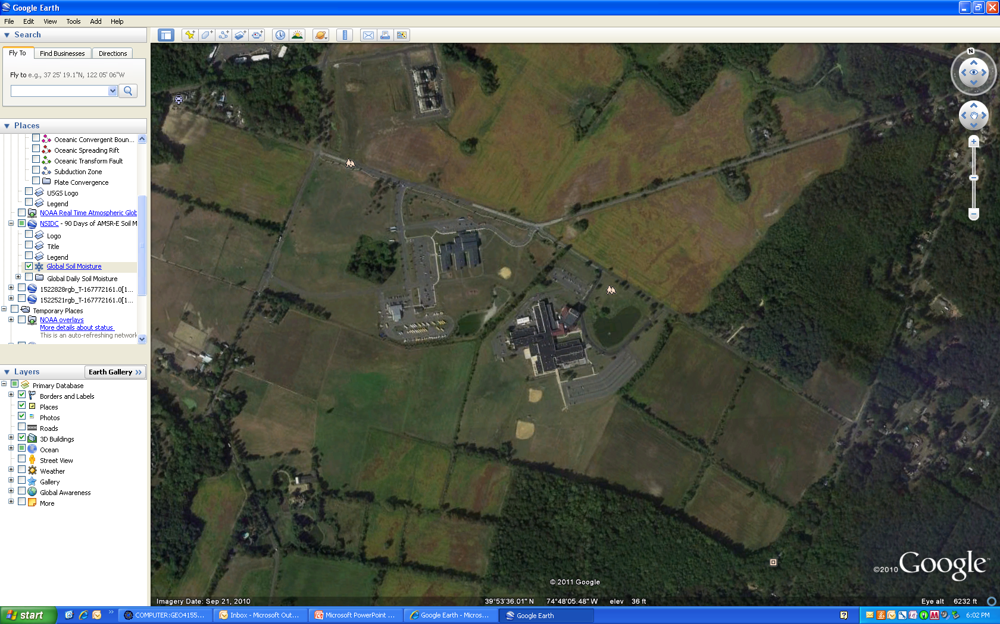

Slide 23
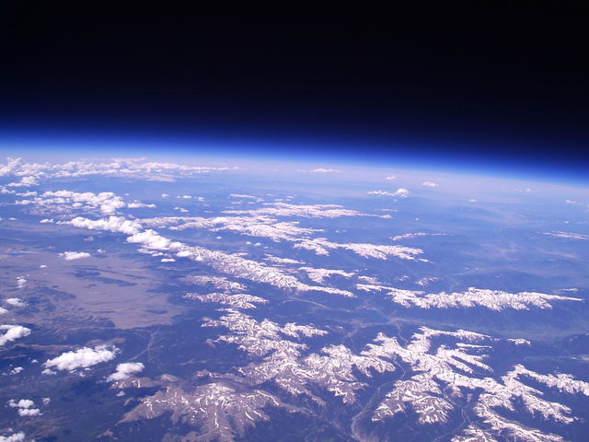

Slide 24
The BLUECUBE Enterprise
Ultimate aim: create new paradigm: BLUE CUBE
Build Launch Utilize Educate with CubeSats
To better promote STEM and Career and Technical Education
to middle and high school students by…
Building, testing, and validating the flight readiness of student built CubeSats
Launching CubeSats to LEO by commercial carriers
Tasking these ‘picosats’ by teachers to conduct data collection (upper atmospheric sensing and ground observations)
Downloading the acquired data to ground stations and amateur radio operators
Uploading acquired data to a web-based interface
Utilizing that data requested by the teacher in the classroom

Slide 25
EXPANDING THE RESEARCH ENVIRONMENT ENVELOPE
Bench work (1G)
Zero G Flights
(sec. μgrav)
Balloon Flights
Suborbital Flights (minutes μgrav)
Orbital Flights (μgrav)

Slide 26
Who’s Saying What?
“How do you get these [CubeSat] ideas into the classroom?” Dr. Eric Lander, Co‐Chair of the President’s Council of Advisors for Science and Technology, January 7, 2011
“This is the new era of observations....There is a leaky STEM pipeline...” Dr. Suresh, Director of the National Science Foundation, February 2011
“Its technology development... we have something now called... small satellites ... Even secondary students are getting involved... they can be involved in space exploration.” Charles Bolden, NASA Administrator before Congress, March 2, 2011

Slide 27
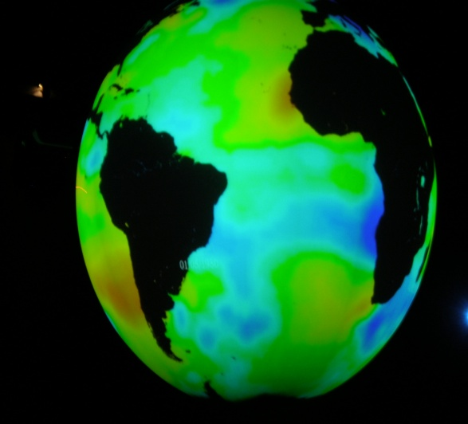
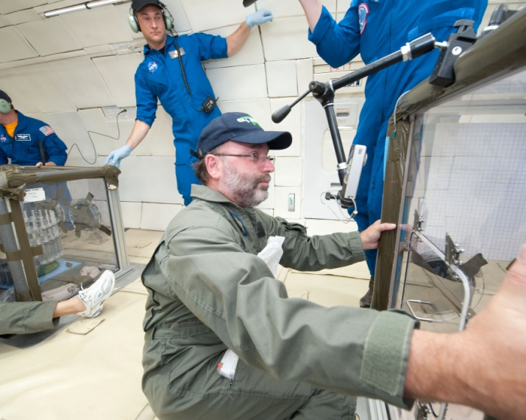
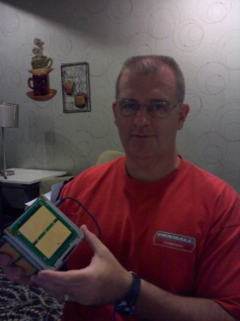
Towards the Future
Promoting the study of the Earth as a System
Applications of Real Time Data in the Classroom
Project Based Learning model … Science as Inquiry
Focuses on Career and Workforce Development
STEM oriented experiences
Engagement of the K-12 Community
21st Century Workforce Skills

