Slide 1


Metadata Standards for Sample-Based Observations
Kerstin Lehnert

Slide 2
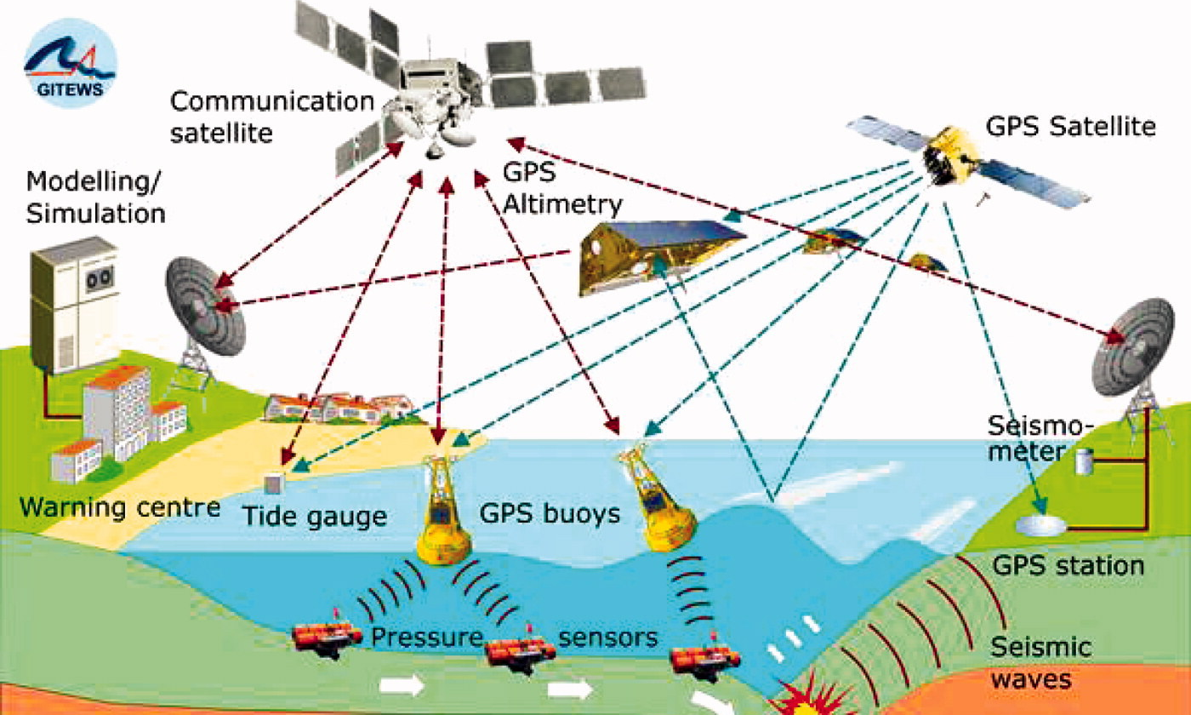
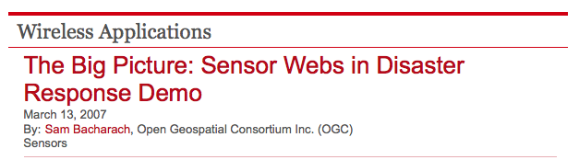

Slide 3
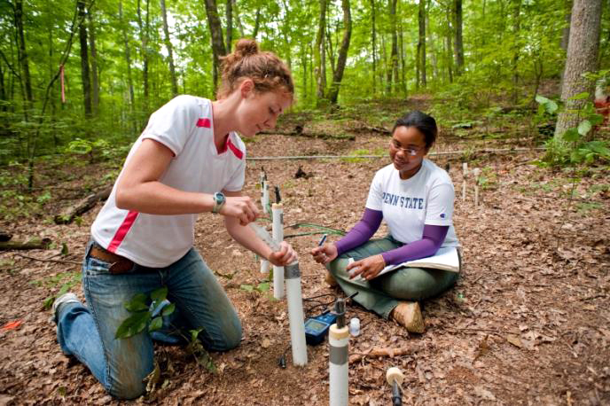
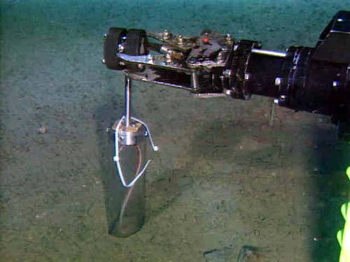
Samples: Part of Earth Observations
Soil sampling at the Shale Hill Critical Zone Observatory, Pennsylvania
Remotely Operated Platform for Ocean Science (ROPOS) collecting sediment push-core

Slide 4
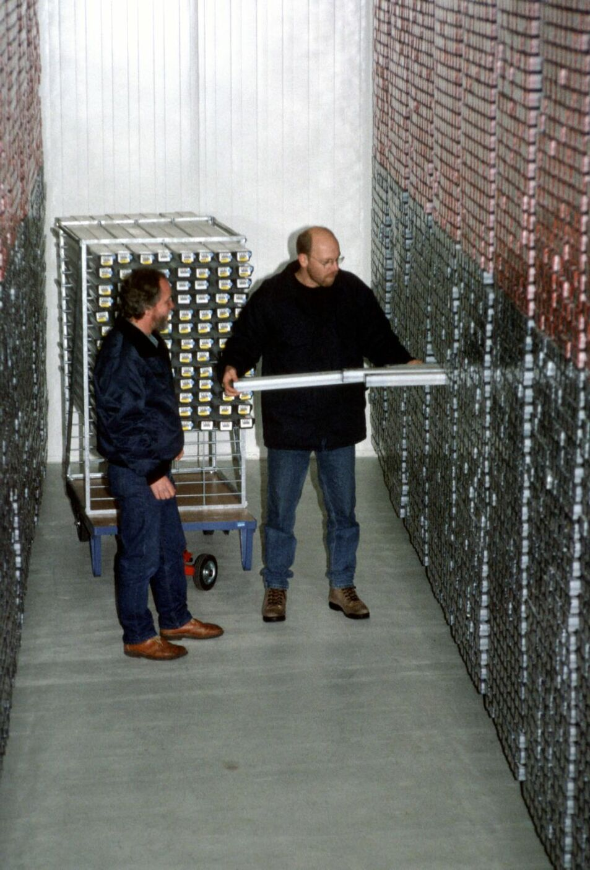
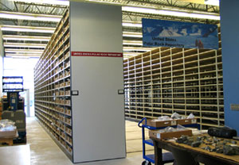
Sampling Legacy
US Polar Rock Repository (Ohio State University)
Bremen Core Repository (MARUM)

Slide 5
Why Metadata Standards?
Policies & Best Practices for sample documentation (sample repositories, data systems, publications)
  Discovery & access of samples
  Context for observations made on samples
  Long-term preservation
Sharing of samples across disciplines and globally
Interoperability
  between sample-based observation data systems
  between sample-based and sensor-based observation data systems

Slide 6
Observations
Feature of Interest
Observation
Result
Observation
(OGC O&M 2.0.0 / ISO19156; editor: Simon Cox)

Slide 7
Observations
Feature of Interest
Observation Result
Sampling Feature
Sampling
Observation
e.g. Station,
Transect, Section
“Observations commonly involve sampling of an ultimate feature of interest. This International Standard defines a common set of sampling feature types classified primarily by topological dimension, as well as samples for ex-situ observations.”
(OGC O&M 2.0.0 / ISO19156; editor: Simon Cox)

Slide 8
Sample-Based Observations
Feature of Interest
Observation
Specimen
Sampling
Observation
“A Specimen is a physical sample, obtained for observation(s) carried out ex situ, sometimes in a laboratory.
The class SF_Specimen is a specialized SF_SamplingFeature.”
(OGC O&M 2.0.0 / ISO19156; editor: Simon Cox)

Slide 9
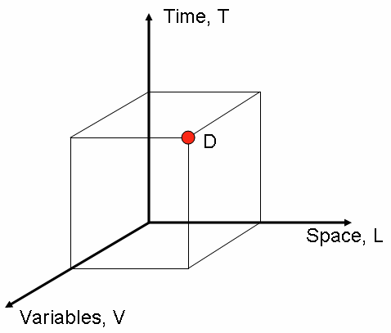
The Data Cube for Observations
Tarboton et al. 2007
“CUAHSI Community Observations Data Model (ODM) , Version 1.0”

Slide 10
Sample-Based Observations
Observation 1:
V₁ at T₁ & L₁
Observation 2:
V₂ at T₂ & L₂
Time, T
Observation 3:
V₃ at T₃ & L₃
Sample
Space, L

Slide 11
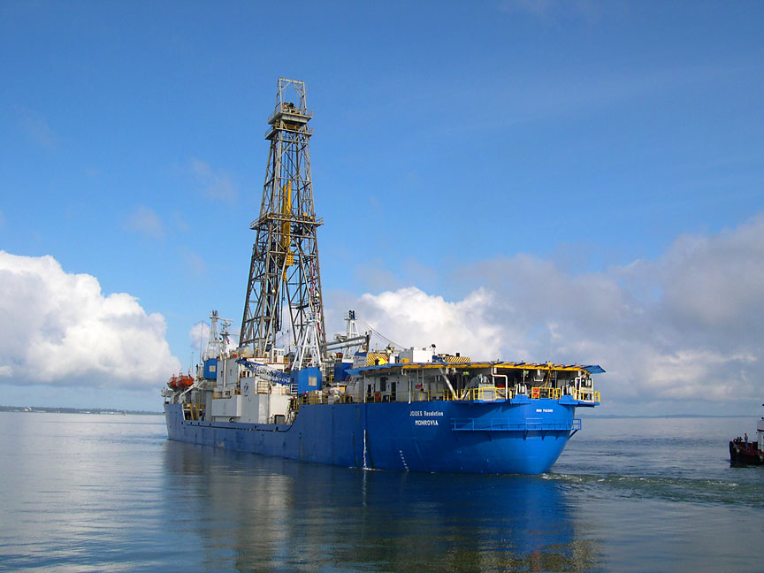
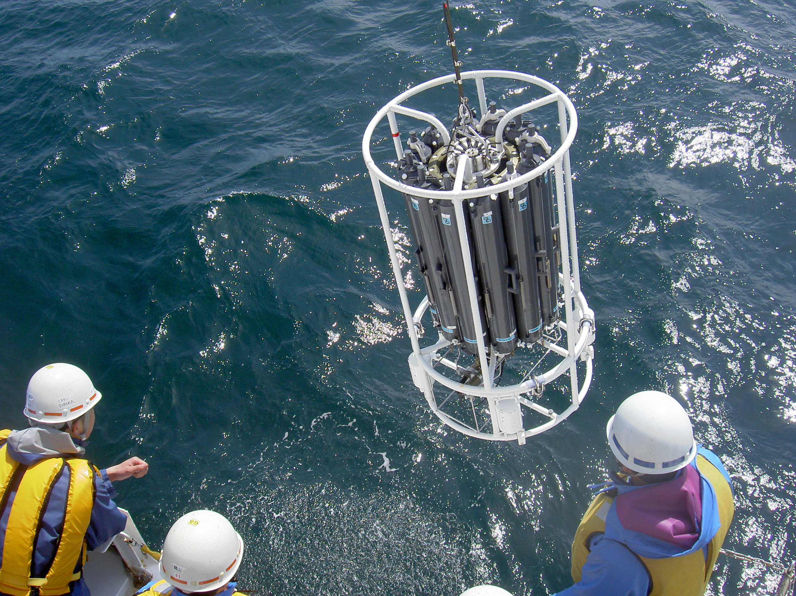
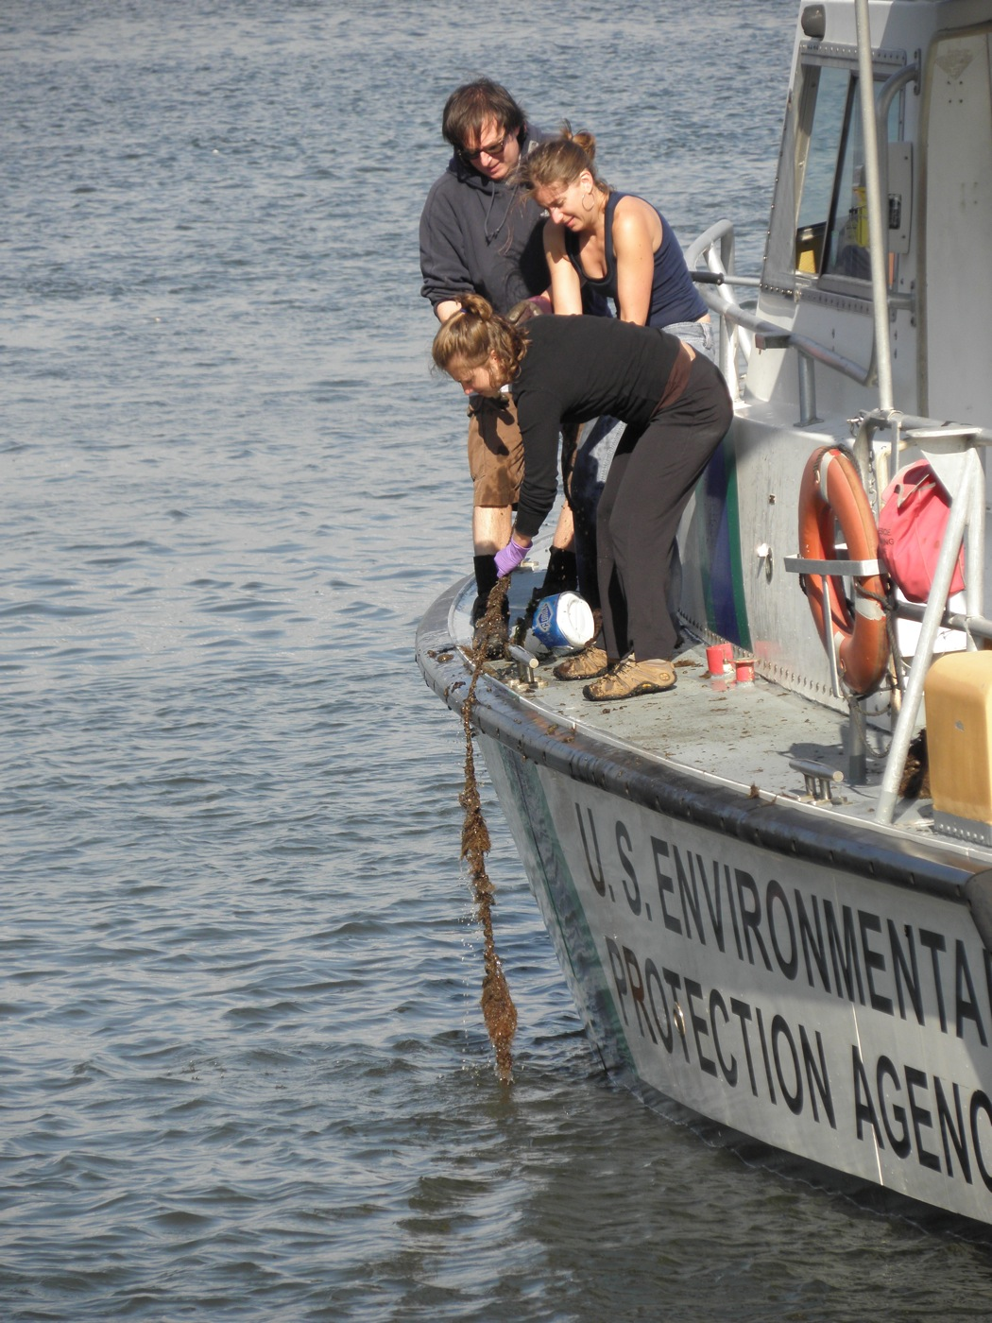
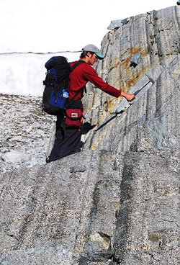
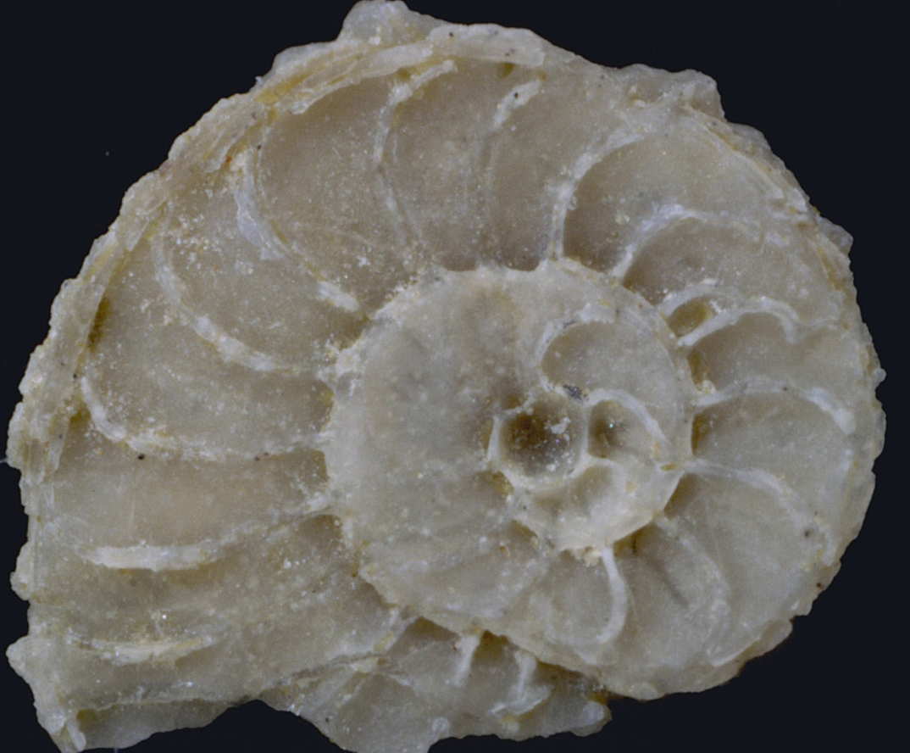
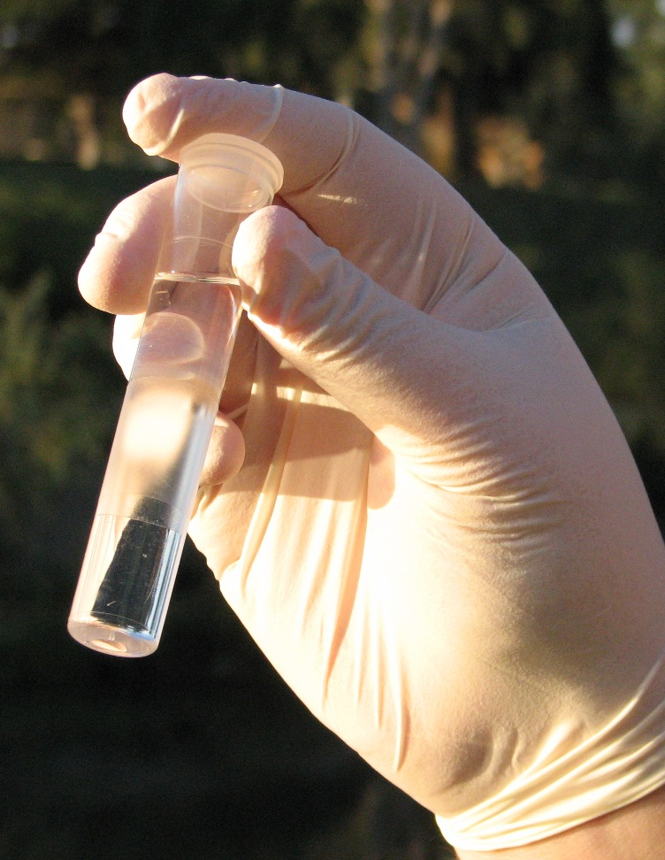
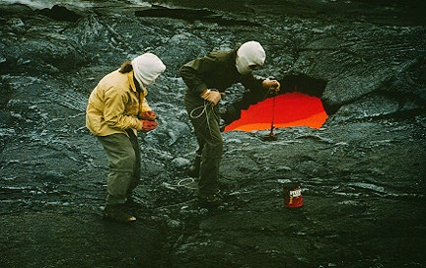
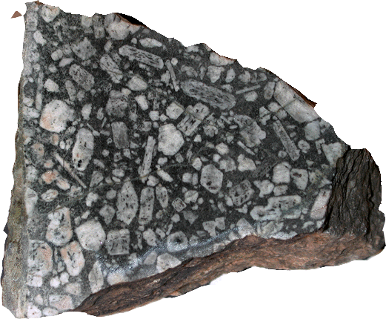
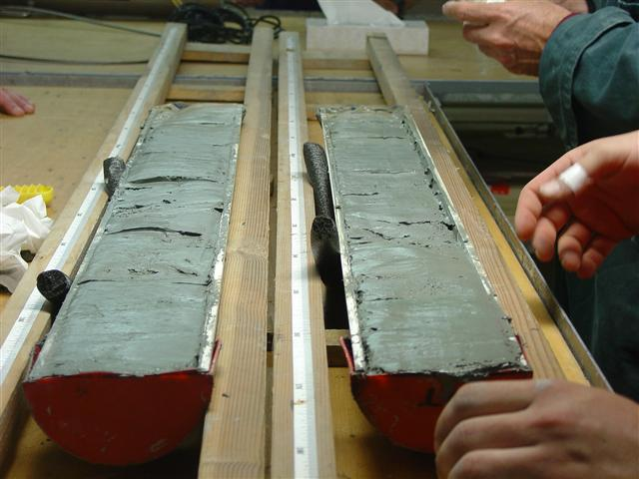
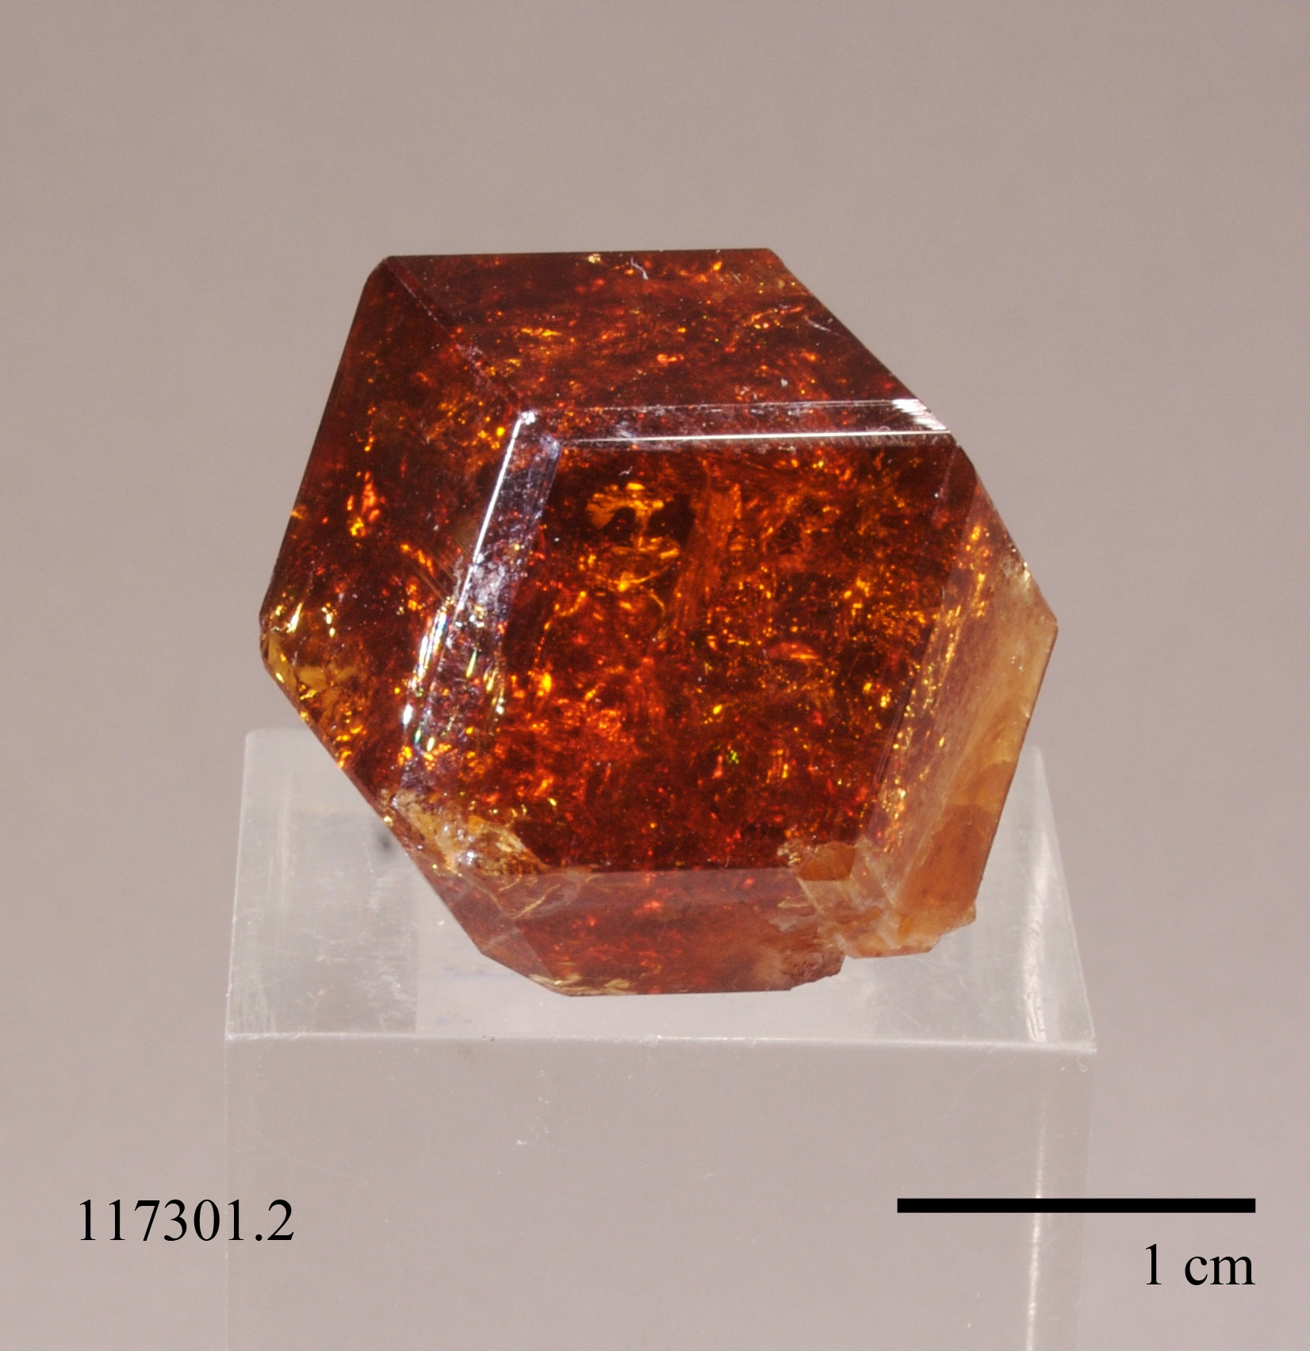
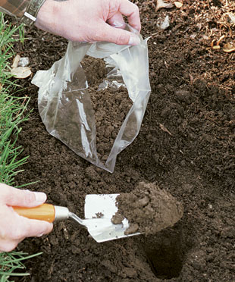
Geoscience Samples: Diversity

Slide 12
Sample Attributes
Application or sample
specific attributes
For example:
+ degree of alteration
+ cruise name
+ depth in core
Basic attributes
<<Feature Type>>
SF_Specimen
Location
+ materialClass: GenericName
+ samplingTime: TM_Object
+ samplingLocation: GM_Object [0..1]
+ samplingMethod: SF_Process [0..1]
+ currentLocation: Location [0..1]
+ specimenType: GenericName [0..1]
+ size: Measure [0..1]
OGC 2.0.0

Slide 13
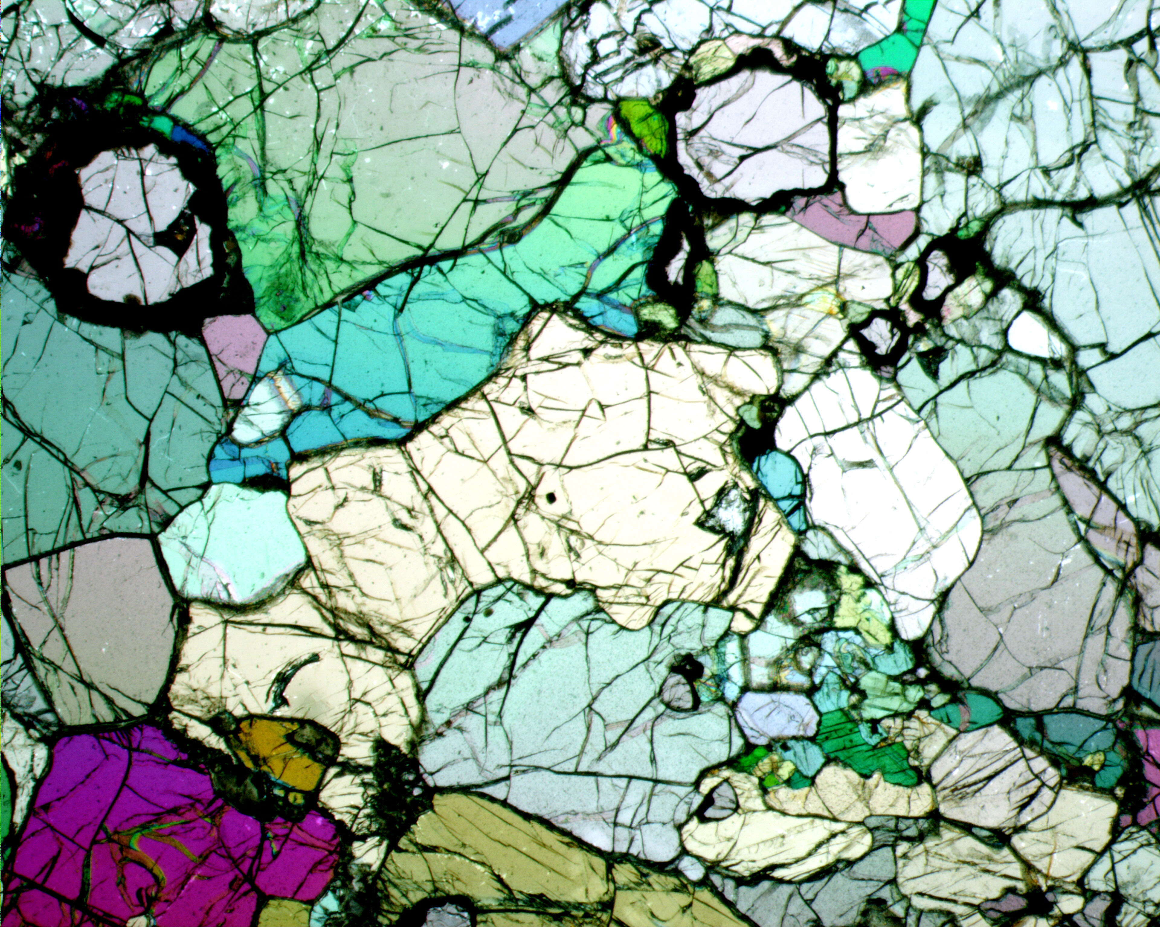
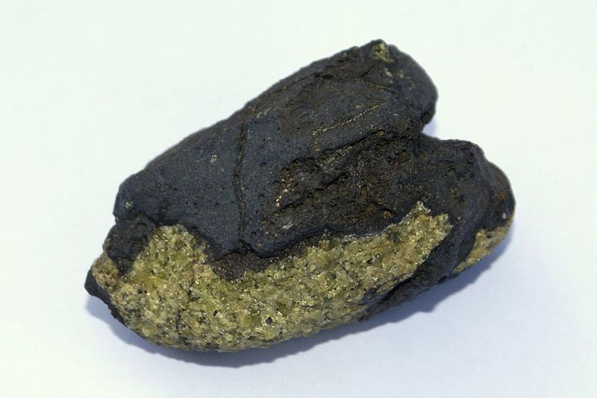
Requirements for Sample Metadata
Discovery Metadata
  Where was the sample collected?
  What type of sample is it?
  Where is it now?
Sample specific Metadata
  Rock texture
  Age
  Spatial relation to parent sample (‘depth in core’)
Unique Identification
  Unambiguously link data and sample
  Integrate disparate data
Metadata that allow to track relations to sub-samples and observations made on them

Slide 14

Sample-Based Data Systems
Example: Geochemical Observations

Slide 15
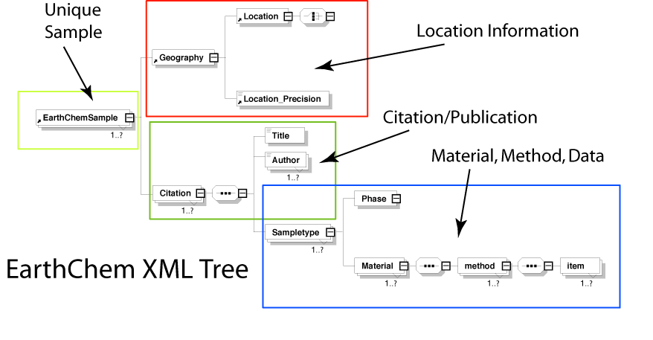
EarthChemML

Slide 16
Integrating Sample-Based Data in ODM2.0
Development by
J. Horsburgh
D. Tarboton
K. Lehnert
A. Aufdenkampe
C. Chan
M. Williams
I. Zaslasvsky

Slide 17
Sample Identification
Examples from the PetDB Database
Sample names are duplicated.
Sample names are modified or changed.

Slide 18

International GeoSample Number
A Global Unique Identifier for Earth Samples
IGSN:ODP010FMZ
⬆
Name space
Current syntax: 9 digits, alphanumeric
  First three characters: name space = unique user code (registered with SESAR)
  Last 6 characters: random alphanumeric string
  Allows 2,176,782,336 sample identifiers per registrant
Does not replace personal or institutional names.
Applied to samples & sub-samples
  system tracks relations
www.geosamples.org

Slide 19
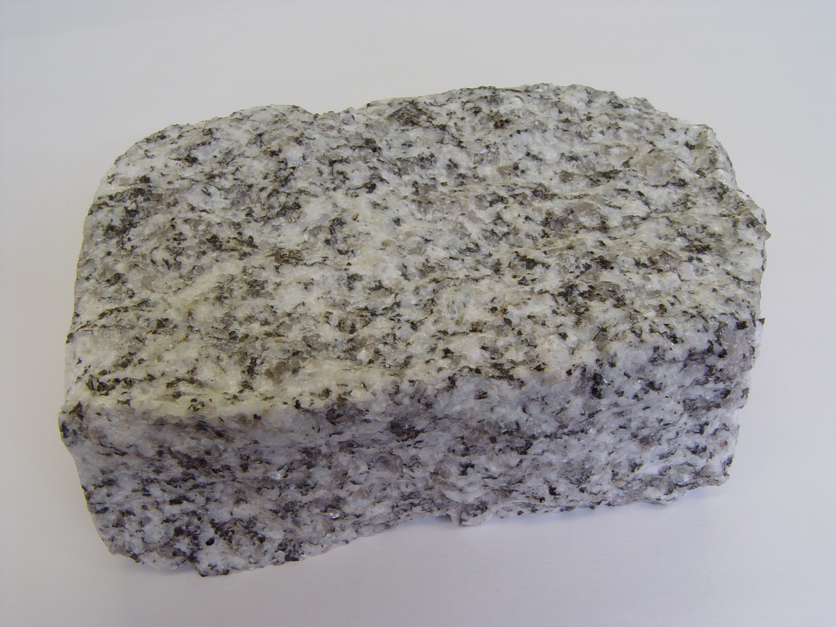
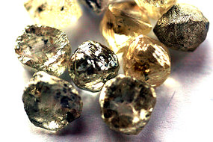
Linking Samples & Data with the IGSN
IGSN:KAL07H9Y8
IGSN:KAL07H9Y8
Sample Repository
IGSN:KAL07H9Y8
IGSN:KAL07H9Y8
Publication
Sub-sample (child)
IGSN:KAL99JK49
IGSN:KAL07H9Y8
Data System
IGSN:KAL99JK49
Publication sub-sample

Slide 20
IGSN Metadata Profiles
Identification metadata
  Sample name(s), registrant
Descriptive metadata
  Material, classification, age, size, comments
Geospatial metadata
  Geographical names, coordinates
Collection metadata
  Expedition/cruise, platform, date, collector, technique
Archival metadata
  Physical location of sample (repository), contact

Slide 21
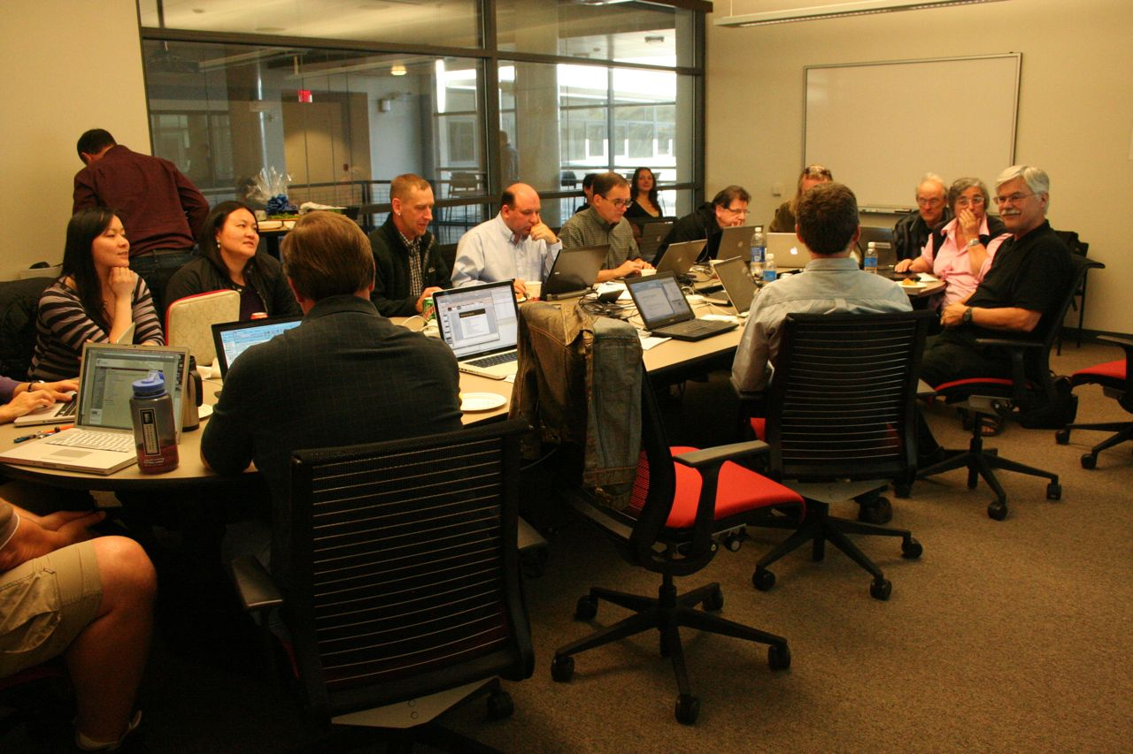
IGSN Workshop
San Diego Supercomputing Center
Feb 22-24, 2011
Agencies
  USGS (S. Bristol, B. Buczkowski)
  NOAA (T. Habermann, A. Milan)
  AASG (S. Richards)
  Geoscience Australia (L. Wyborn)
Standards
  OGC (S. Cox, I. Zaslavsky)
  ISO (S. Cox, T. Habermann, A. Milan)
  GeoSciML (S. Richards)
  WaterML (D. Valentine)
  INSPIRE (S. Cox)
  DataCite (J. Klump)
Organizations, Programs & Projects
  ICDP/IODP (J. Klump, R. Conze)
  US Ext. Cont. Shelf Program (B. Buczkowski)
  CZO (T. Whitenack, I. Zaslasvky)
  CUAHSI (D. Valentine, I. Zaslavsky)
  NGDC (T. Habermann)
  ANDS/AuScope (L. Wyborn)
  National Digital Catalog (S. Bristol)
  R2R (R. Arko, S. Miller)
  IEDA (MGDS, SESAR, EarthChem)
“Advancing the International Geo Sample Number IGSN as an International Standard for Sample Identification”

Slide 22
IGSN Workshop Results:
Participants agreed on the value of an internationally unified approach for registration and discovery of physical specimens in the Geoscience community.
Designed new modular and scalable IGSN architecture.

Slide 23
Management Layers in the IGSN System
Define IGSN scope
Register top-level registrars
Define IGSN syntax
Maintain IGSN handle system
Validate identifier registration
eGeosamples
IGSN Implementation Board
Register name spaces, aggregate metadata for namespaces
Validate metadata content for specimen registration
Maintain clearinghouse portal for accessing specimen metadata in their registered name spaces
SESAR
ExoPlanet
(invented example)
Near Space Observatory
(invented example)
Registrar
Establish detailed specimen description schema
Validate metadata content for specimens
Handle interaction with specimen collectors and curators to register specimens
IEDA
USGS
Geoscience Australia
CZO
ICDP
…
Registration Agent
Make decisions about what specimens merit registration
Maintain physical collections
Initiate registration of specimens
Registers samples through one of the higher level namespaces
Investigator
Analytical Lab
Repository
…
Registrant

Slide 24
IGSN Workshop Results:
Participants agreed on the value of an internationally unified approach for registration and discovery of physical specimens in the Geoscience community.
Designed new modular and scalable IGSN architecture.
Generated draft of IGSN Registration Metadata and SESAR Discovery Metadata compliant with international standards from ISO and OGC.

Slide 25
Metadata
IGSN Registration
IGSN
ResourceURI
Registrant ID
timeStamp
status
SESAR Discovery
IGSN
Registrant
MetadataTimeStamp
Title
Description
SamplingLocation
SamplingTime
Distributor
Originator
SpecimenType
MaterialClass
SamplingMethod
ISO & OGC O&M compliant
Agent Catalog
IGSN
SampleEvent
SamplePhysicalSize
RelatedResource
SamplingMethodDetails
ProcessingHistory
CurationHistory
More local detail…

Slide 26
IGSN Workshop Results:
Participants agreed on the value of an internationally unified approach for registration and discovery of physical specimens in the Geoscience community.
Designed new modular and scalable IGSN architecture
Generated draft of IGSN Registration Metadata and SESAR Discovery Metadata compliant with international standards from ISO and OGC.
Committed to establishing a formal governance structure.
  International IGSN Implementation Board to govern the IGSN, an incorporated not-for-profit organization.
  A Science Advisory Board to support & guide policies, technology, and procedures of the SESAR Metadata Clearinghouse and the local agents.

Slide 27
Challenge: Implementation
Consistent vocabularies & classification schemes
Metadata capture & reporting
Unique identifier (IGSN)
  In sample acquisition & curation
  In data management
  In publications
  Across disciplines
  Globally

Slide 28
Metadata!
Percentage of publications that lists geospatial coordinates for sample locations
Example: Journal of Petrology

