Slide 1
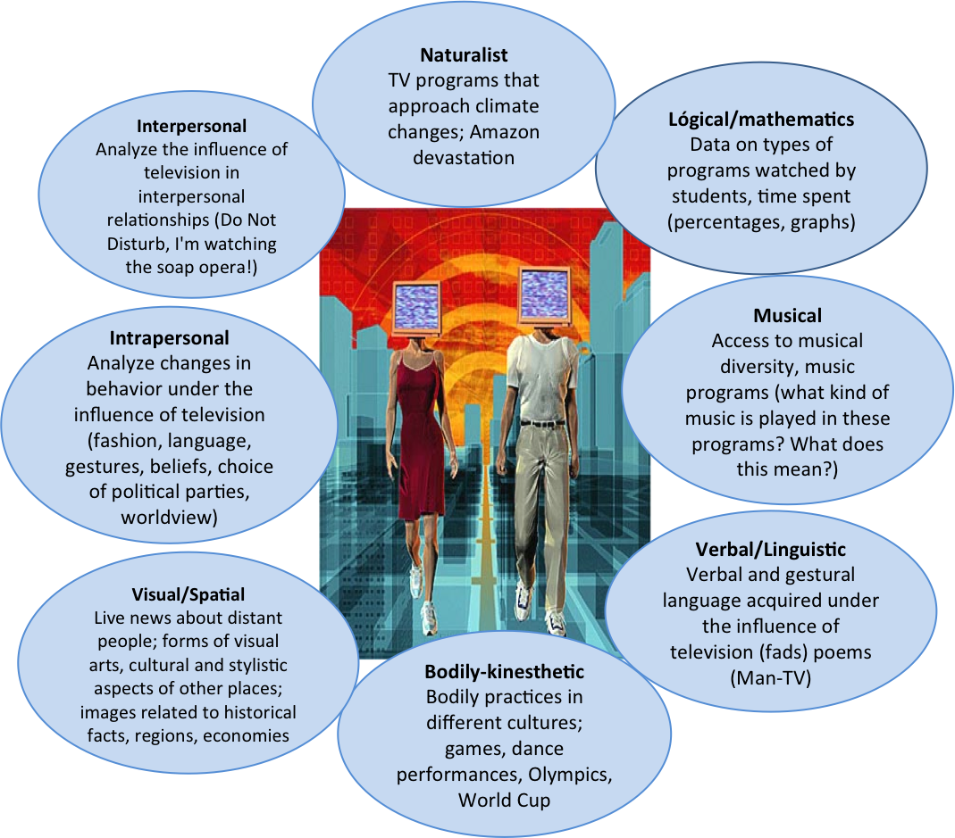
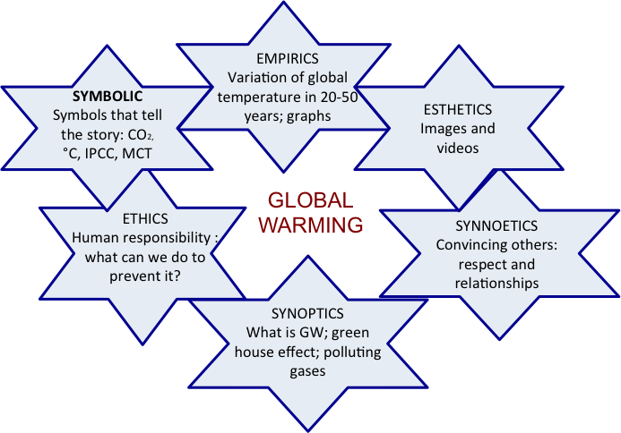
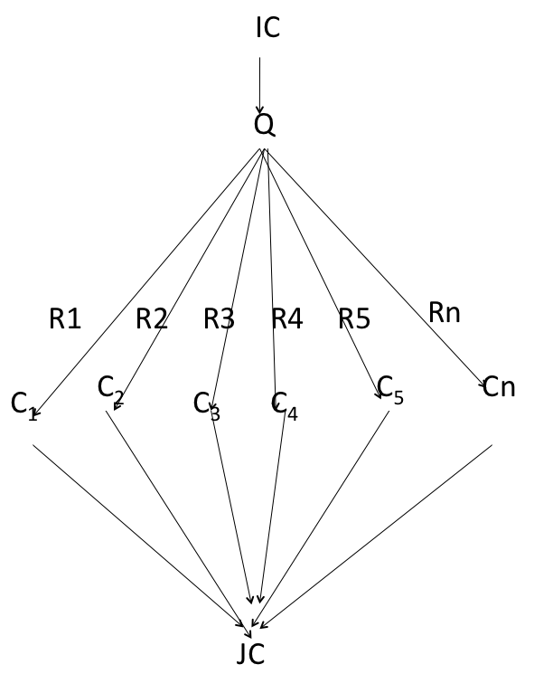
Building Interdisciplinary Thinking Through Thematic Projects
Silvia Elisabeth Moraes
Universidade Federal do Ceará Fortaleza, Brazil, Phones: 55-85-32424867; silviamoraes@ufc.br
Introduction
Interdisciplinarity is included in all Brazilian university curricular guidelines; however it is still seen as a theory without practice. Fragmentation, linearity and alienation are characteristics that reign in our curriculum. They should be replaced by a vision of totality which includes the psychological, social, philosophical, economical, artistic as well as scientific elements.
In the Programme for International Student Assessment (PISA 2009), Brazilian students showed a low level of scientific literacy: the capacity to use scientific knowledge, to identify questions and to draw evidence-based conclusions in order to understand and help make decisions about the natural world and the changes made to it through human activity.
That is why we have engaged in a research project, Interdisciplinarity in the curriculum of graduate courses in UFC (Federal University of Ceará), which proposes to find out what obstacles and possibilities exist in the implementation of interdisciplinarity in the university curriculum.
Results and Conclusions
The findings – our joint construction (JC) - indicate that one basic obstacle lies on the organization of academic work and the emphasis on memorization instead of knowledge production. Also, university teacher’s traditional formation limits their holistic-integrated thinking. Given necessary conditions, respondents developed creative and good quality projects demonstrating adherence and rapid assimilation of interdisciplinarity. However, for interdisciplinarity to be implemented it is necessary to reorganize schedules, planning hours for teachers of different areas.
TELEVISION AND MULTIPLE INTELLIGENCES
The Mother Earth project was planned by Pedagogy students who developed it with their 5th graders. School pupils were really enthusiastic about it and dedicated a lot of their extra time – at home, during breaks – to look for material to enrich it.
Methodology
Initial Construction (IC): Interdisciplinarity requires intense negotiation and it has found many obstacles in its implementation.
Respondents (R): 102 Science and Humanities students were asked to develop topics under the perspective of Gardner’s and Phenix’s theories. Themes varied: Evolution, Energy, Biodiesel, The Universe, Ethanol, Television, Industrial waste and the environment, Amazonia, Hunger around the world, etc…
Questionnaire (Q) via TELEDUC. Their answers were their constructions (C).
Joint Construction (JC): see Results and Conclusions.
Phenix’s theory of meanings
A curriculum developing these basic competences is designed to satisfy the essential human need for meaning.
In the Global Warming project students used the opportunity to observe themselves in terms of how they changed their perspective towards working with different areas. For my research, it was one of the most useful since they registered their impressions in detail: how they thought before and after the project.
Another conclusion is that the formation of interdisciplinary thinking cannot focus only on matters to which society demands solutions, since such matters are highly influenced and dictated by the economic and mediatic agenda. It is necessary that the students develop a critical-social perspective of knowledge with themes that originate from Science, thus making them think about the directions and uses of Science itself.
Our research continues: we are now going to ask university professors to be our respondents.
Gardner’s theory of multiple intelligences
Gardner proposes eight different intelligences to account for a broader range of human potential in children and adults. Our schools and culture, he says, focus most of their attention on linguistic and logical-mathematical intelligences. Many kids end up being labeled "learning disabled," "ADD (attention deficit disorder),“ underachievers, if their strong capacities are not within the scope of linguistic or logical-mathematical intelligences.
Bibliography
GARDNER, H. Frames of mind: the theory of multiple intelligences. New York: Basic Books, 1983.
GUBA E & LINCOLN Y. Fourth generation evaluation. New York: Sage, 1989
MORAES, SE. Interdisciplinaridade e transversalidade mediante projetos temáticos, Revista Brasileira de Estudos Pedagógicos, Vol 86, maio-dez 2005, 213-214
PHENIX P. Realms of Meaning: a philosophy of the curriculum for general education. New York: McGraw Hill Book Company, 1964.
Acknowledgments
Thanks to my students of Didactics I, 2008-2009 and to my dear son Eduardo Moraes Arraut, PhD, who contributed with a revision and lay- out of this poster
Adapted from Guba & Lincoln, [7] , P. 152.

