Slide 1



Electric transport in different granitic rocks
H.G. Silva^{1,*}, M.P.F. Graça², J. H. Monteiro², M. Bezzeghoud¹, R.N. Rosa¹, S. K. Mendiratta², M. Tlemçani¹, P. Moita¹
¹Geophysics Center of Évora and Physics Department, University of Évora, Portugal ²Physics Department, University of Aveiro, I3N, University of Aveiro, 3810-193 Aveiro, Portugal
*hgsilva@uevora.pt

Slide 2
Outline
Project
Samples
Samples preparation
Measurements:
4.1. Impedance spectroscopy (ε-f)
4.2. I-V characteristics
Conclusions and future work

Slide 3
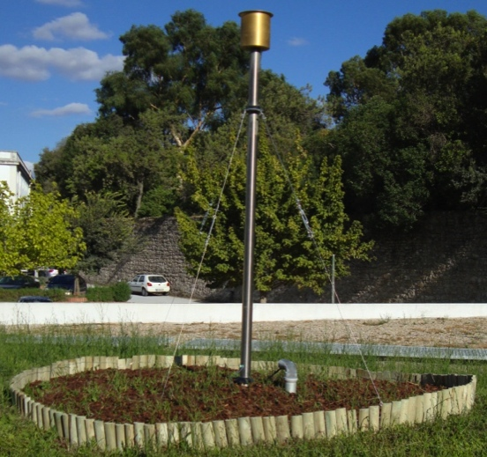
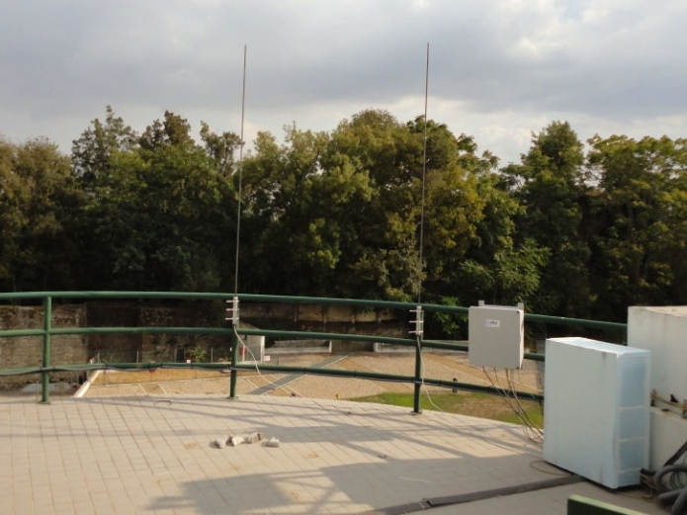
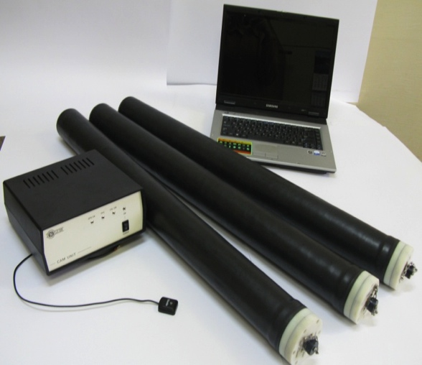
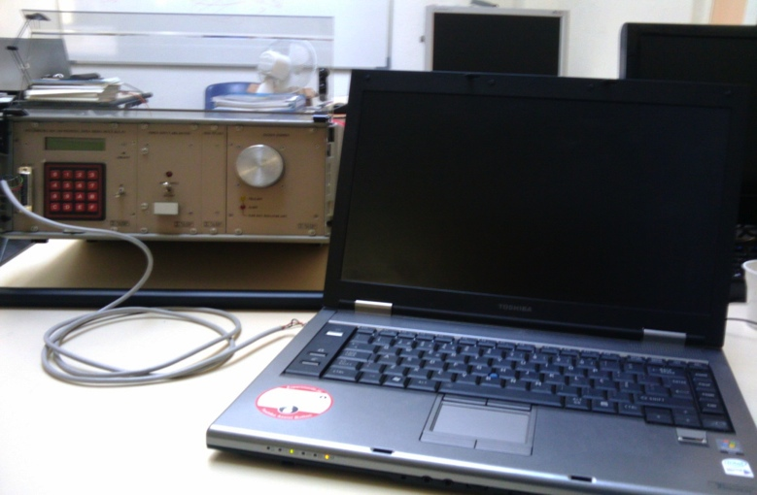
Our project
Atmospheric electric field sensor.
Radio receiver for very low and low frequencies.
Magnetometers for ultra-low frequencies (planned).
Meter of atmospheric Radon levels
(in installation).

Slide 4
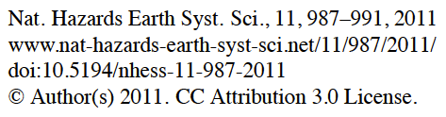
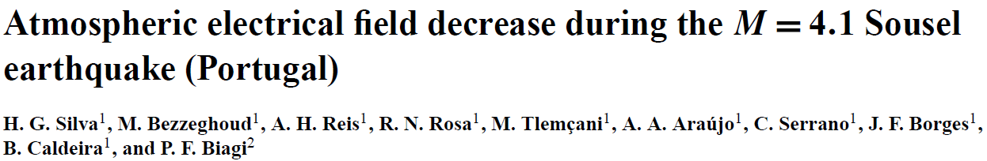

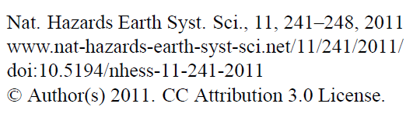
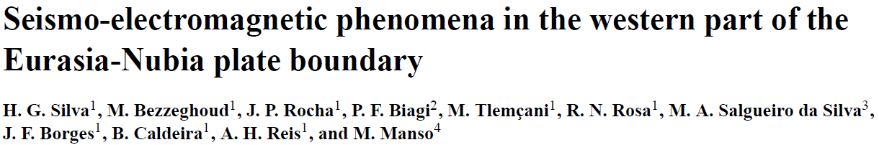
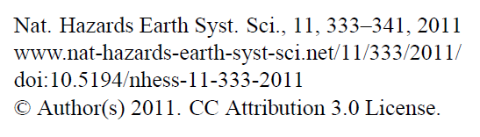
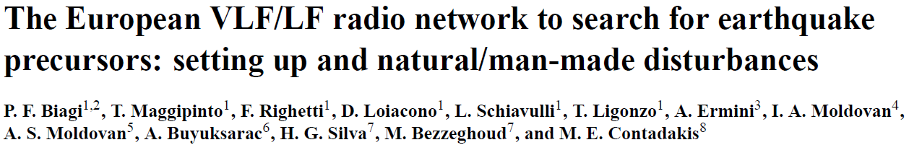
Our project

Slide 5
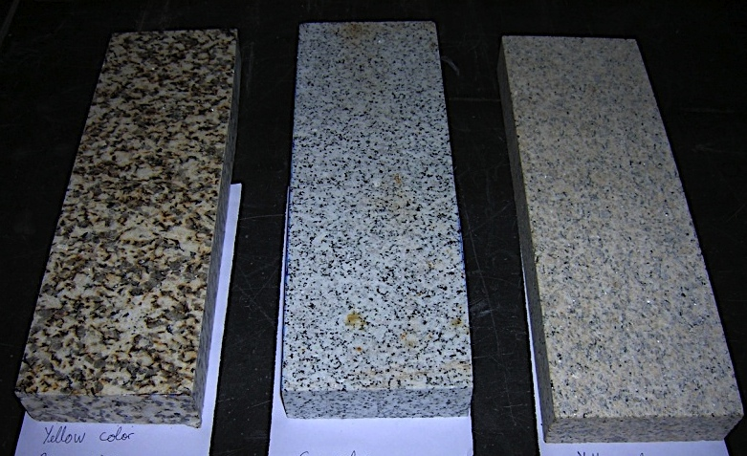
Samples
YC is a porphiritic coarse grained biotitic-muscovitic granite, yellow coloured and characterized by an abundance of large feldspar usually showing poorly defined shapes.
YC
GM
RM
RM is a granite with a homogeneous medium grained matrix (occasionally coarser grained quartz) and light rosy coloured determined by the tonality of the feldspar crystals that stand out from a greyish matrix.
GM is a granodiorite grey coloured and medium grained rock with homogeneous appearance. Dark minerals is mainly biotite.

Slide 6
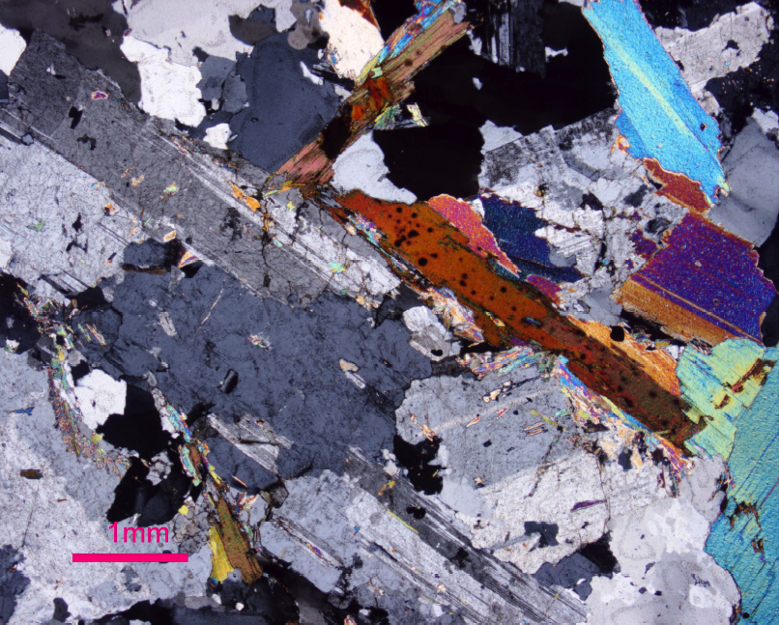
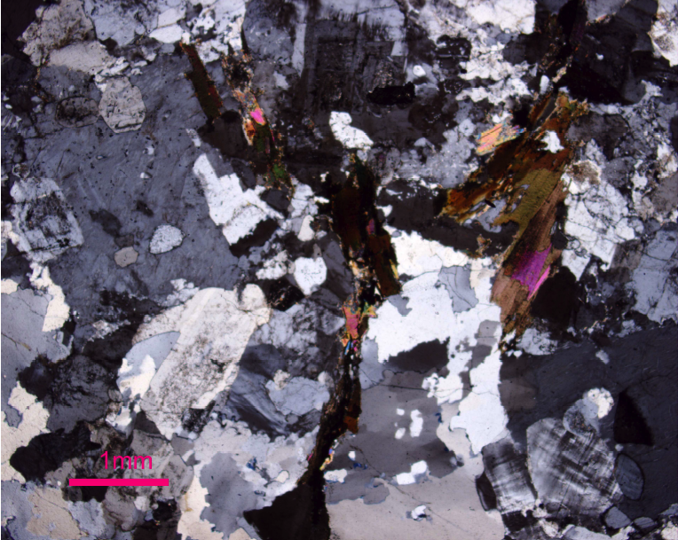
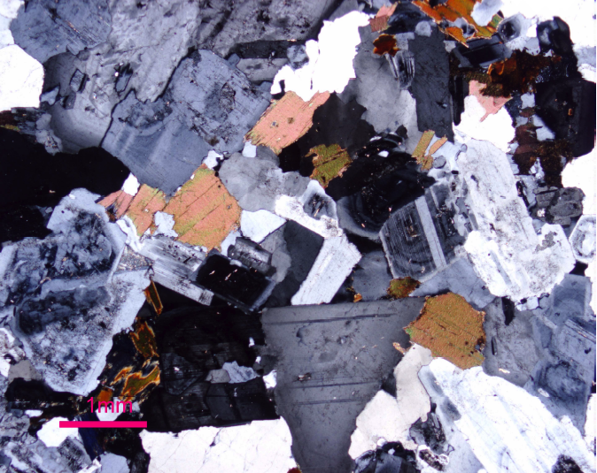
Samples
Samples
microphotographs
quartz
muscovite
Alkaline feldspar
plagioclase
biotite
biotite
plagioclase
quartz
YC
RM
Alkaline feldspar
Alkaline feldspar
quartz
biotite
plagioclase
GM

Slide 7
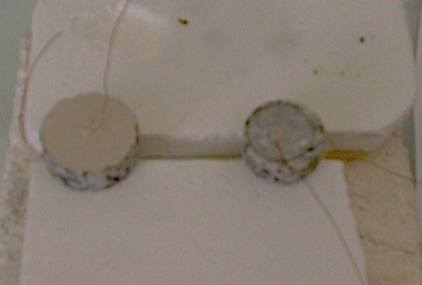
Samples preparation
Circular samples with approximately 24 mm diameter and 2-4 mm in thicknesses were prepared. Once cut and carefully polished (with a 15µm polishing disc) the samples here heated from room-temperature (RT) up to ~400 K and after cooled down again.
Circular electrodes with a diameter of 20 mm were then established using silver conductive paint (in the future, new contacts will be tested). The samples were submitted again to a heat treatment at ~400 K to evaporate the silver paint solvent.

Slide 8
Measurements
vacuum
He
Current-Voltage characteristics (I-V): were done at stabilized temperatures ranging from 100 K to 300 K using a Keitheley 6487 Picoammeter/Voltage Source.
N₂
sample
Impedance spectroscopy (ε-f): were done with V_{AC} = 1 V test signal in the frequency range of 40 Hz to 1 MHz at stabilized temperatures ranging from 100 K to 360 K. It was used an Agilent 4294A Precision Impedance Analyzer.
C
R

Slide 9
Impedance spectroscopy
Impedance spectra at different temperatures: a) Real part of the dielectric constant; b) Imaginary part of the dielectric constant.
Real and Imaginary part of ε as a function of temperature: a) f = 100 Hz; b) f = 1027 Hz; c) f = 10 520 Hz; d) comparison.
YC

Slide 10
Impedance spectroscopy
Impedance spectra at different temperatures: a) Real part of the dielectric constant; b) Imaginary part of the dielectric constant.
Real and Imaginary part of ε as a function of temperature: a) f = 100 Hz; b) f = 1027 Hz; c) f = 10 520 Hz; d) comparison.
GM

Slide 11
Impedance spectroscopy
Impedance spectra at different temperatures: a) Real part of the dielectric constant; b) Imaginary part of the dielectric constant.
Real and Imaginary part of ε as a function of temperature: a) f = 100 Hz; b) f = 1027 Hz; c) f = 10 520 Hz; d) comparison.
RM

Slide 12
I-V characteristics
GM
Current as a function of the temperature for different voltage levels: a) V = 5 V; b) V = 10 V; c) V = 50 V; d) Arrhenius plot with a linear fit (shown by cyan line).
I-V characteristics for GM at different temperatures. The inset shows a detail of the I-V curves in the temperature range from 180 K up to 280 K.
E_{a} ~ 26 meV

Slide 13
Conclusions and future work
An anomaly in the dielectric behavior near T~220 K is found.
This temperature is typical of the super-cooled phase transition of strongly confined water affecting electronic devises.
Samples YC and RM show a relaxation process taking place at f~10³ Hz readily evidenced in the K’’ curves here a significant peak appears at this frequency that does not change with temperature.
The I-V curves of GM sample are strongly thermal activated with typical energy of E_{a}~26 meV.
Our final objective is to Investigate possible mechanisms of charge creation in different crust materials and conditions (pressure and temperature).

Slide 14







Acknowledgments
Support
Team
Collaborations

Slide 15
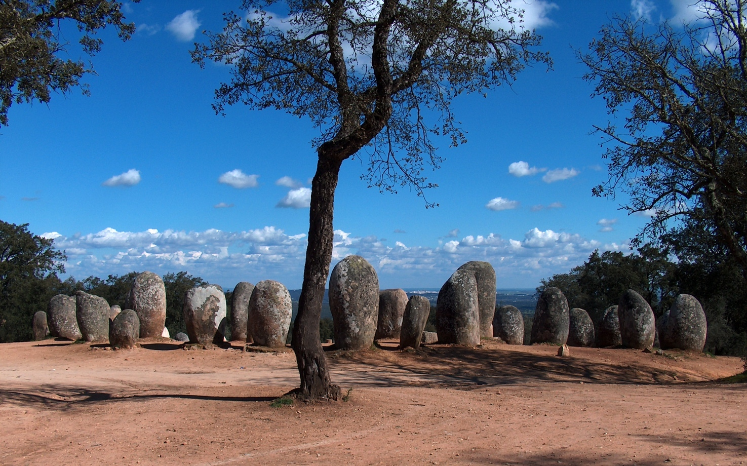
Thank you for attention
Almendres Cromlech at Évora
http://en.wikipedia.org/wiki/Almendres_Cromlech

