Slide 1


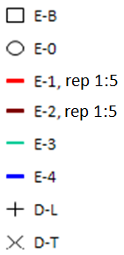
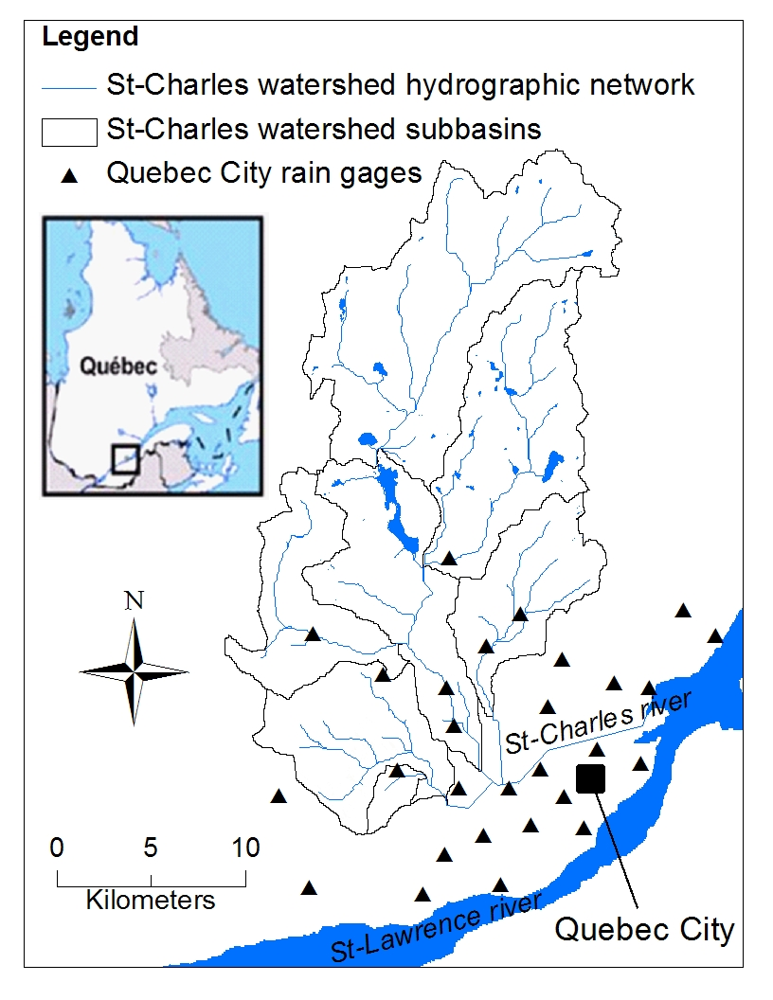
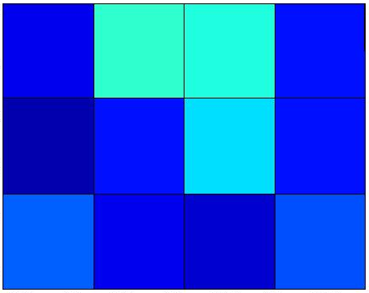

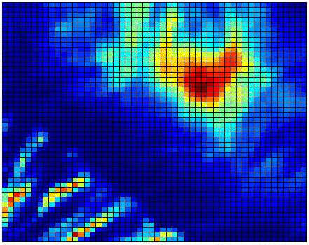
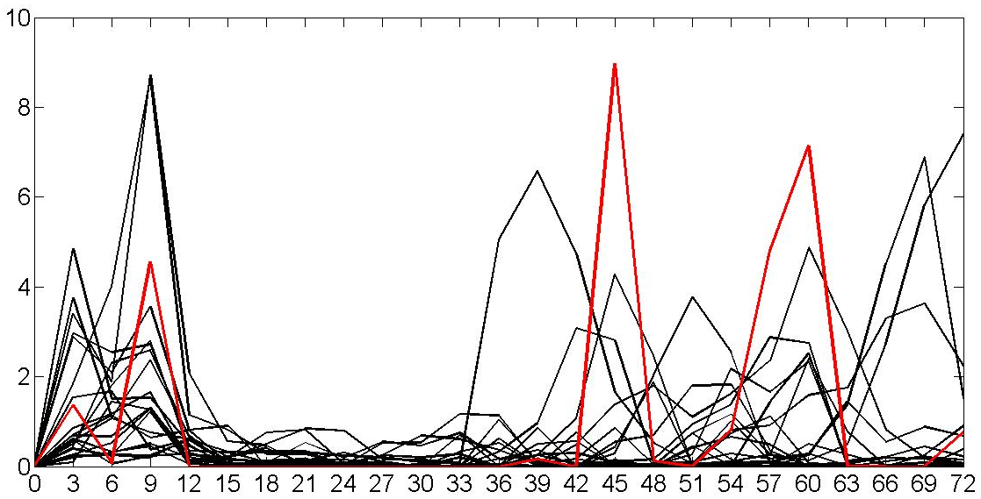
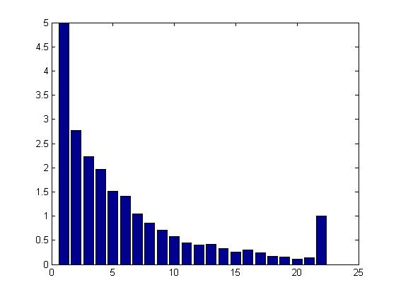
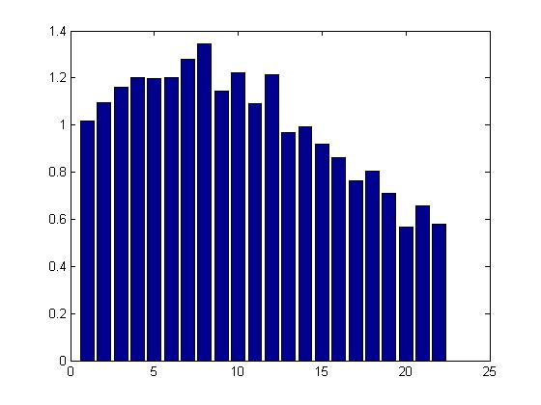
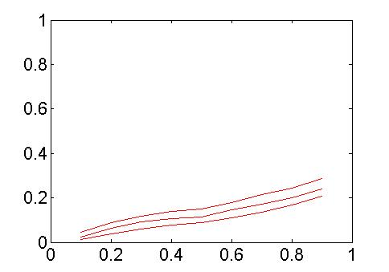
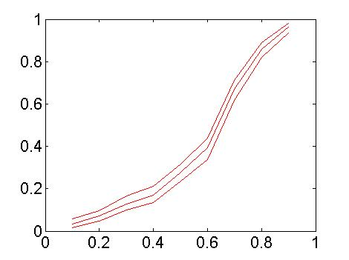
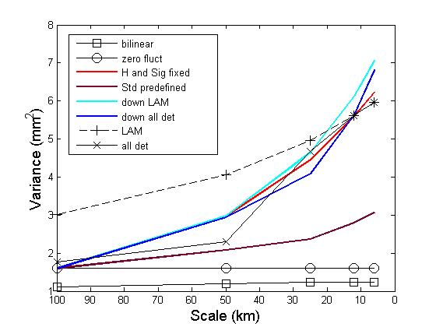
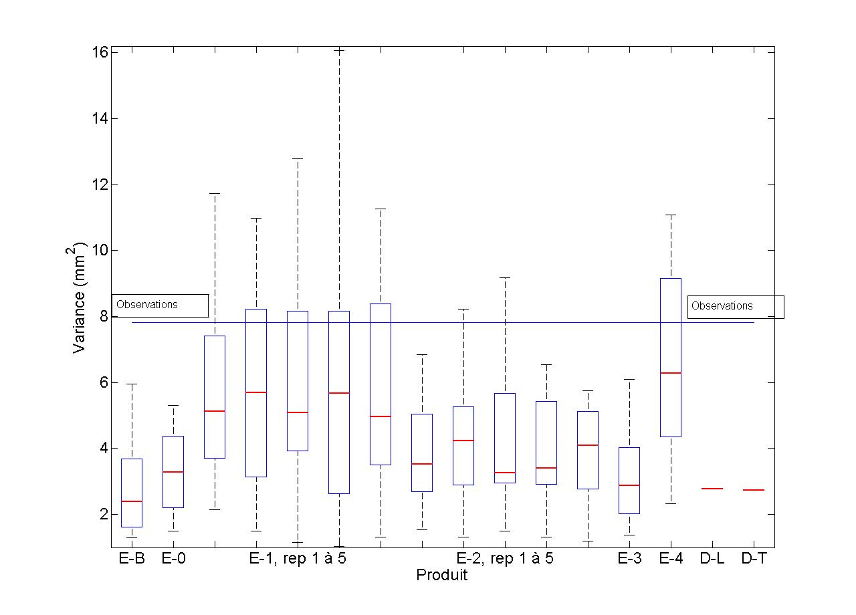






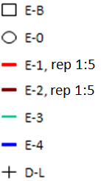

On the reliability of spatially disaggregated global ensemble rainfall forecasts
E. Gaborit¹, F. Anctil¹, G. Pelletier¹, and V. Fortin²
[1] Civil and Water Engineering Department, Laval University, Quebec, Canada. Contact: etienne.gaborit.1@ulaval.ca
[2] Numerical Weather Prediction Research, Environment Canada, Dorval, Canada
1. Problem statement
F. Method algorithm: each iteration increases the resolution by 2
G. Different disaggregation approaches
K. MAE vs CRPS at resolution 50km and complete data
L. CRPS as a function of the resolution
A- Studied watershed (500 km²)
B1- Ensemble Prediction System (EPS) member’s forecasted rainfall field example
There is a gap between the resolution at which ensemble rainfall forecasts are currently available and the small scale of watersheds sometimes used in hydrologic studies: an average precipitation amount forecasted for a 7000 km² sector (EPS resolution, see figure B1) often hides a strong rainfall variability inside that sector, such that local rainfall observations will actually exhibit areas experiencing no rainfall and others with amounts much higher than the average value forecasted for the global sector (difference between B1 and B2).
For each pixel of a given EPS member’s rainfall forecast field at a relative scale m (start from m corresponding to the initial EPS resolution):
Different ways to calculateξ_{m} for a pixel have led to different approaches :
MAE
CRPS
See J.
Accumulated precipitation over 3 hours* amount (mm)
generate ξ_{m,i} for each direction i given H, σ₁ and m (Eq. 2)
calculate X’_{m,i} for each direction i (Eq. 1) given ξ_{m,i} and X_{m} , which corresponds for the first step of this iterative disaggregating process to a EPS forecasted rainfall amount.
calculate the four disaggregated R_{k=1:4} rainfall amounts given the three X’_{m,i} fluctuations and the initial X_{m} amount (see figure D: a simple four unknown variables and four equations system).
Use the mean H and σ₁ values found by the authors presenting the method (APPROACH E1).
σ_{m,i} is a function of scale m, direction i and pixel’s rainfall amount (APPROACH E2).
ξ _{m,i} is calculated based on the “LAM” deterministic product forecasted rainfall fields (APPROACH E3) or based on all available deterministic products (approach E4).
m=m-1
100 km
Target Value =0
Target Value =0
70 km
Note: approaches E1 and E2 involving values’ selection from a probability density function, 5 repetitions of each of these approaches have been implemented to study the potential subsequent differences in the final disaggregated rainfall fields.
Deterministic product / mean of the ensembles
Ensemble products
B2- Possible actual rainfall field at a 6 km resolution
M. ROC Score at resolution 50km and rainfall threshold value 0.05mm
ensemble and deterministic products only
N. ROC Score for (mean) rainfall threshold value 0.05 mm, as a function of the resolution
3.2 Evaluation: direct confrontation with observed rainfall amounts
Target Value =1
See J.
Target Value =1
Period: 9 consecutive days of summer 2009 with strong convective events
* 3 hours is the time resolution of the used EPS
H. Example ensemble forecasts and observations on a 50-km resolution pixel, for one day and one emission hour
Resolution of the “LAM” deterministic model: 2.5 x 2.5 km
Rainfall amount over 3 hours (mm)
Observations
Ensemble forecasts
Ensemble forecasts are of potentially high interest for decision-making in hydrologic studies
Their resolution currently limits their use for studies conducted on small watersheds.
Forecasts/ Observations pairs used in a score calculation
Deterministic product / mean of the ensembles
Ensemble products
ensemble and deterministic products only
2. Objective
Taking the ensemble products leads to better results than taking their deterministic counterparts
The overall quality of the forecasts is preserved through scales (products E-B, E-0, E-1 and E-2)
The variance-enhanced products are of similar quality than the bi-linearily interpolated one
Bridge the spatial gap between ensemble rainfall forecasts’ original scale and small watersheds by increasing the rainfall variance inside each initial pixel of an EPS product member rainfall field.
Time since emission hour (hours)
O. Talagrand diagrams at resolution 6km without cases with no rainfall for all the ensemble’s members
P. Reliability diagrams at resolution 6km, for mean rainfall threshold 1 mm
Δt=3h
5
Y axis: mean number of cases with observation in rank n
Y axis: mean effective probability
Median and 95% confidence interval shown
Emission hour (2 per day)
Maximum considered horizon in the evaluation (72 h)
Target: flat shape
1
Target line
3. Methodology
Observed data: each pixel’s forecasted amount is compared with the mean observed amount of Quebec City rain gages (see figure A) located inside it. The number of pixels with observed data depends on the considered resolution.
Target line
There are at least three options for downscaling low-resolution ensemble forecasts: statistical downscaling, dynamical downscaling, and stochastic downscaling. Different disaggregation approaches based on a method proposed by Périca and Foufoula-Georgiou (1996) have been implemented to disaggregate the original Environment Canada’s EPS down to a 6 km resolution. This method consists in a recursive stochastic disaggregation process based on scaling relationships. It belongs to stochastic downscaling. In order not to modify the given original ensemble forecast, the choice has been made to:
Observation’s rank n (n=1:22)
Observation’s rank n (n=1:22)
X axis: nominal probability
Scores: all scores are calculated for one product considering all days, emission hours, horizons and pixels simultaneously.
Product E-B
Product E-1, repetition 1
Product E-B
Product E-1, repetition 1
Q. Variance of rainfall amounts over the entire disaggregated grid as a function of scale
R. Rainfall amounts’ variance box-plot for pixels with observed values at resolution 6km
Deterministic evaluation (using the ensembles’ mean or deterministic products):
See J.
Observations
95% boundary
75% boundary
Mean absolute error (MAE): directly comparable to the CRPS.
Relative operating characteristics score (ROC score): see Peterson et al., 1954.
Scores based on contingency tables with different rainfall thresholds values : see Rezacova et al. 2007.
median
25% boundary
Independently spatially disaggregate each 21 members (i.e. scenarios) of the ensemble product
Preserve the original mean rainfall amount inside each initial pixel
5% boundary
3.1 The method’s theory:
Probabilistic evaluation (using the ensembles):
D. Definition of standardized rainfall fluctuations
E. Scaling relationship
Continuous Ranked Probability score (CRPS, see Matheson and Winkler, 1976): comparable to the MAE.
ROC score (see above).
Talagrand diagrams (see Olsson and Lindström, 2008).
Reliability diagrams (see Olsson and Lindström, 2008).
Product
initial pixel average rainfall amount = X_{m}
Rainfall directional fluctuations:
(Eq. 2)
4. Results
Better variance and dispersion for the disaggregated products using the method proposed by Périca and Foufoula-Gergiou (1996) than for the one using bilinear interpolation
Standardized rainfall fluctuations
J. Symbols of the different evaluated products
K. MAE at a 06-km resolution using the mean of the ensembles and deterministic products
5. Conclusion
Standard deviation at relative scale m
bilinear interpolation of the original EPS (E-B)
MAE (mm)
Legend (see J.)
R₁
R₂
Parameters of the method
sub-pixels inside an original EPS one have the same rainfall amount as the latter (E-0)
This work shows that (the simple approach E-1 of) the method proposed by Périca and Foufoula-Georgiou (1996) represents an advantage over simpler methods to spatially disaggregate Ensemble Forecasts, since it allows increasing (thus improving) the rainfall variability inside an initial EPS member’s pixel while leading to similar performances from other scores’ point of views. However, the method currently lacks a consistent disaggregated rainfall values’ positioning and leads to significant spatial discontinuities between original EPS rainfall field’s pixels. Research is under way to increase this method’s usefulness.
R₃
R₄
relative scale m | 0 | 1 | 2 | 3 | 4
corresponding resolution (km) | 6 | 12 | 25 | 50 | 100
E-1
E-2
E-3
E-4
disaggregated products using the method proposed by the authors and using four different approaches (see point G. on the left).
Downscaled pixel rainfall amount = R_{k=1:4}
Over an area of for example 300 000 km², standardized rainfall fluctuations of any direction follow the same normal distribution law (Eq. 2) with zero mean and whose standard deviation shows a simple behavior over relative scales m.
rep 1:5 repetitions 1 to 5 (approaches E-1 and E-2)
2
3
Standardized fluctuations:
“LAM” deterministic product aggregated to the considered resolution (D-L)
Target value
References
1
(Eq. 1)
The deterministic product (D-T) used is the one whose resolution is just under the considered one (for resolutions 12 and 6km it is the “LAM” itself)
Complete data
Forecasts>0
Forecasts=0
Olsson, J., et Lindström, G. 2008. Evaluation and calibration of operational hydrological ensemble forecasts in Sweden. Journal of Hydrology, 350: 14– 24.
Perica, S., and Foufoula-Georgiou, E. 1996. Model for multiscale disaggregation of spatial rainfall based on coupling meteorological and scaling descriptions. Journal Of Geophysical Research, 101(D21): 26347-26361.
Peterson, W.W, Birdsall, T.G., and Fox, W.C., 1954. The theory of signal detectability. Trans. IRE prof. Group. Inf. Theory, PGIT, 2-4: 171-212.
Rezacova, D., Sokol, Z., Pesice, P. 2007. A radar-based verification of precipitation forecast for local convective storms. Atmospheric Research, 83: 211–224.
Target for score (value for perfect forecasts)
Better overall performance of the “LAM” product compared to the mean of the disaggregated ensembles

