Slide 1
An investigation of ice crystal sizes and shapes in deep convective clouds using radiance and polarization measurements in conjunction with model simulations
Bastiaan van Diedenhoven
(Columbia University, NASA GISS)
Ann Fridlind, Andrew Ackerman & Brian Cairns (NASA GISS)

Slide 2
Mourning Glory ☹

Slide 3
CRYSTAL-FACE campaign, Florida 2002
What are sizes and shapes of ice crystals produced by deep convection?
How do ice crystal vary with location and time?
How are ice crystals affected by aerosols?
MODIS airborne simulator (MAS),
CRS/EPOD Radars,
Research Scanning Polarimeter (RSP),
NAST-I (brightness temperature)

Slide 4
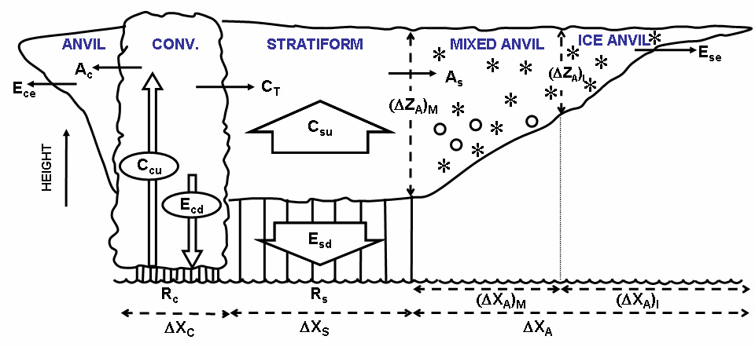
Aircraft flight tracks: 29 July 2002
Adapted from Houze et al. (1980)
Notes:
Among other mechanisms, tropical cirrus are generated at the tops of cumulonimbus clouds. The net effect of tropical cirrus on surface temperatures depends on several factors including cloud height, cloud thickness, and ice crystal sizes.

Slide 5
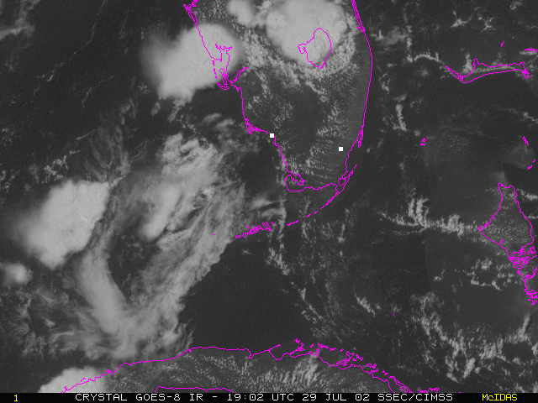
Radar ice water content & MAS retrievals
OT>4
MAS 11μm Brightness temp
Adapted from Houze et al. (1980)
MAS Effective radius
MAS optical thickness
See also Yuan et al., JCLIM, 2010

Slide 6
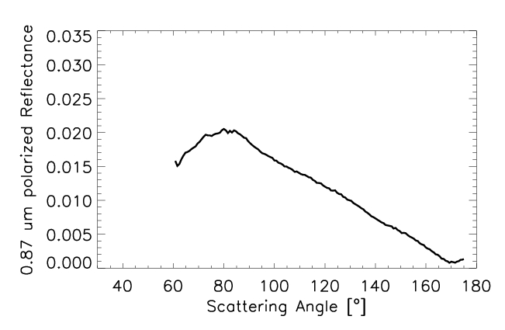
Particle shapes: Research scanning polarimeter (RSP)
Measures Stokes I, Q & U
Polarized reflectance:
152 viewing angles ±60°
Wavelengths used:
865 nm: little absorption
1880 nm: H₂O absorption; sees only very top of cloud
RSP measurement

Slide 7
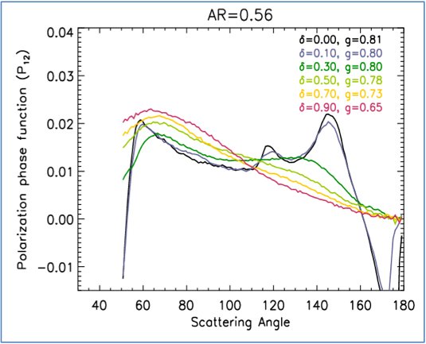
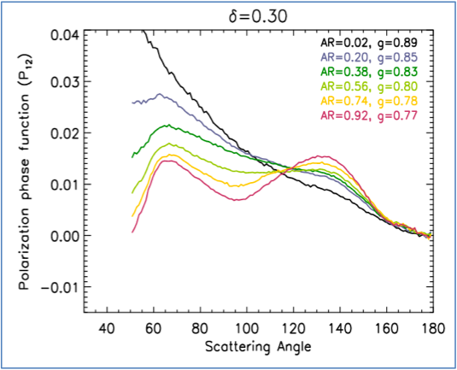
Particle shapes: Research scanning polarimeter (RSP)
Polarized reflectance mainly determined by polarized phase function (P₁₂) of ice crystals
P₁₂ depends strongly on ice shape
particle roughness
Aspect ratio
Thin plate
Rough plate
Thick plate
Pristine plate

Slide 8
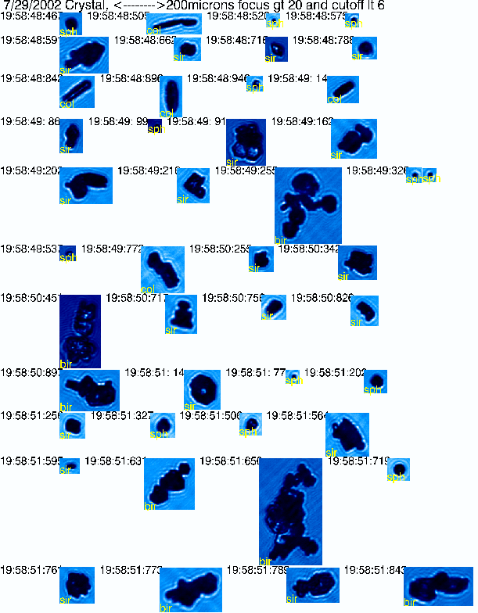
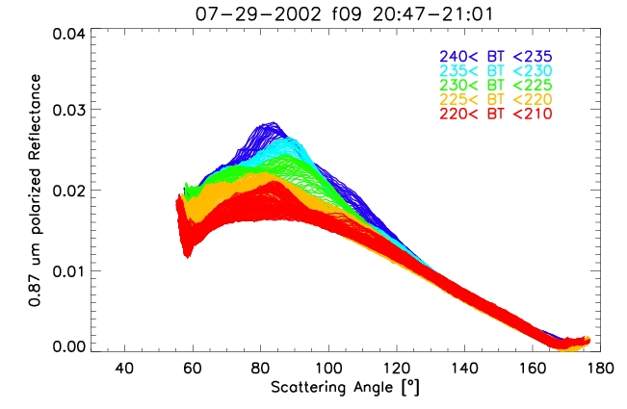
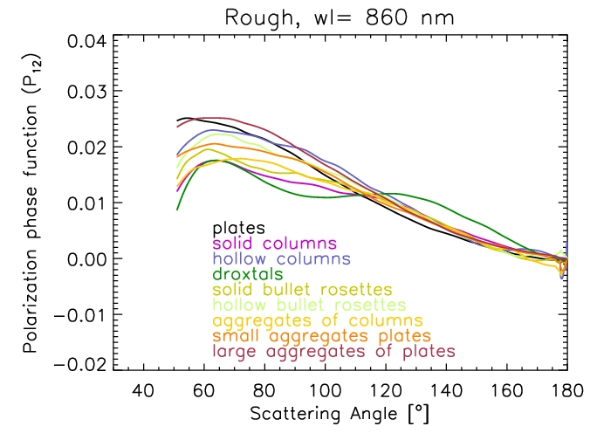
RSP Polarized reflectance
Aspect ratio ~0.1
Thanks to Ping Yang
?
Severely roughened ice
Aspect ratio ~0.8

Slide 9
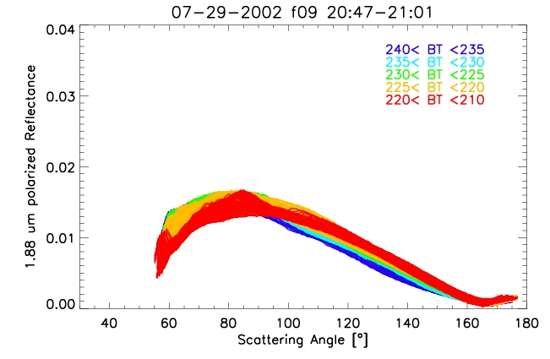
1.88 μm H₂O band: very top of cloud
1.88 μm:
Very top of cloud
0.87 μm: deeper layers
More extreme
Aspect ratio
deeper in
Aspect ratios ~1 at tops
of outflow

Slide 10
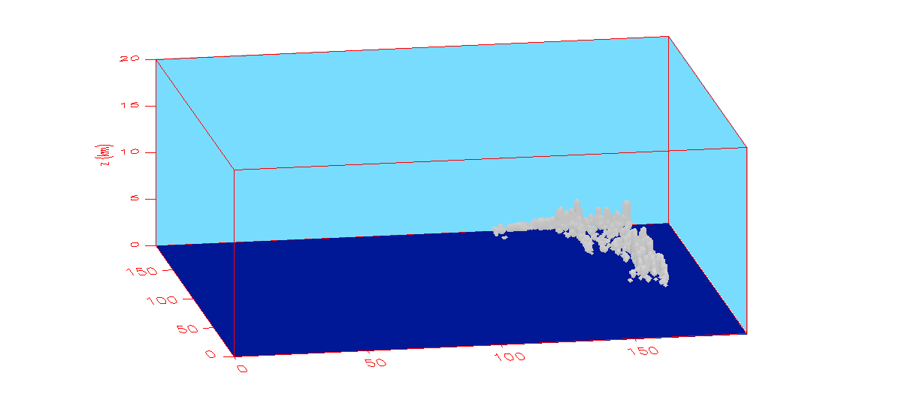
DHARMA model simulations

Slide 11
DHARMA model simulations (Ackerman et al., Nature 2004; Fridlind et al, science 2004; JGR 2007)
192 x 192 grid points, ~1km² resolution, 50-250 m vertical
Liquid, cloud ice and graupel hydrometeor classes
36 mass-doubling size bins per class
Ice fall speeds modeled assuming mass, area and aspect ratio relationships (Böhm 1989)
Measured ice nuclei (IN) profiles
29 July: very high IN from African dust, 3 cm⁻³ (deMott et al., GRL, 2003)

Slide 12
DHARMA model results

Slide 13
DHARMA model results

Slide 14
Sensitivity to IN availability
Homogeneous
freezing
Heterogeneous
freezing
IN availability

Slide 15
Conclusions 1
R_{eff} ~18 μm
Rough particles
Aspect ratio ~1
R_{eff} ~22 μm
Rough particles
Aspect ratio ~0.1
Rough particles
Aspect ratio ~1.

Slide 16
Conclusions 2
Polarized reflectance <80º scattering angle not fit well by optical models
Cloud Resolving Model:
Ice crystal sizes sensitive to IN availability
Observed sizes matched only with high IN availability
For more on ice shapes from polarized reflectance come see my poster today: XY74

