Slide 1

An Experimental Study on the Influence of Fluid Saturation on the Attenuation Coefficient of the First Dilatational Wave in Standard Sand Saturated by an Oil-Water Mixture
Chi-Chin Yang, Po-Chia Chen, and Wei-Cheng Lo
Department of Hydraulic and Ocean Engineering, National Cheng Kung University, Tainan 701, Taiwan
National Cheng Kung University

Slide 2
Outline
Introduction
Literature Review
Experimental Setup and Procedures
Theoretical Model
Results and Discussions
Conclusions
National Cheng Kung University

Slide 3
Introduction (1/2)
Acoustic wave phenomena in fluid-containing porous media have received considerable attention in recent years, not only because of their practical importance in reservoir engineering, but also because of an increasing scientific awareness of poroelastic behavior in groundwater aquifers.
National Cheng Kung University

Slide 4
Introduction (2/2)
Propagation and attenuation characteristics of elastics waves have been applied to measure the subsurface hydrological and geological parameters (Schrefler and Zhan, 1991; Cosenza et al., 2002).
Energy of elastic waves has been applied to enhance the recovery of petroleum (Beresnev and Johnson, 1994) and aquifer remediation (Lo et al., 2005)
National Cheng Kung University

Slide 5
Literature Review (1/2)
The classical work of Biot (1956) showed that two different kinds of dilatational waves can be found to propagate in an elastic porous medium bearing a viscous, compressible fluid.
Brutsaert (1964) first extended upon Biot’s theory into a more complex system wherein there are immiscible fluids permeating in soils.
National Cheng Kung University

Slide 6
Literature Review (2/2)
Lo et al. (2005) used continuum theory to establish the theoretical model for elastic wave propagation through unsaturated porous media;
Three different motional modes of dilatational waves were showed to exist, which are denoted as the first, second, and third dilatational waves in the descending order of wave speed.
National Cheng Kung University

Slide 7
Objective
The objective of this study is to investigate the effect of the viscosity of pore immiscible fluid mixtures on the attenuation coefficient of the first dilatational wave in standard sand.
The computed values from our experimental study will be compared with the theoretical values predicted by Lo et al. (2005).
National Cheng Kung University

Slide 8
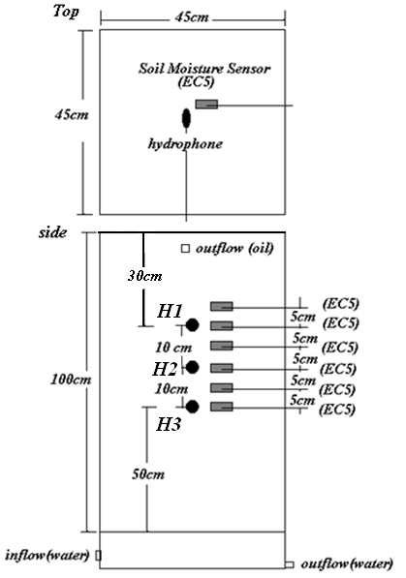
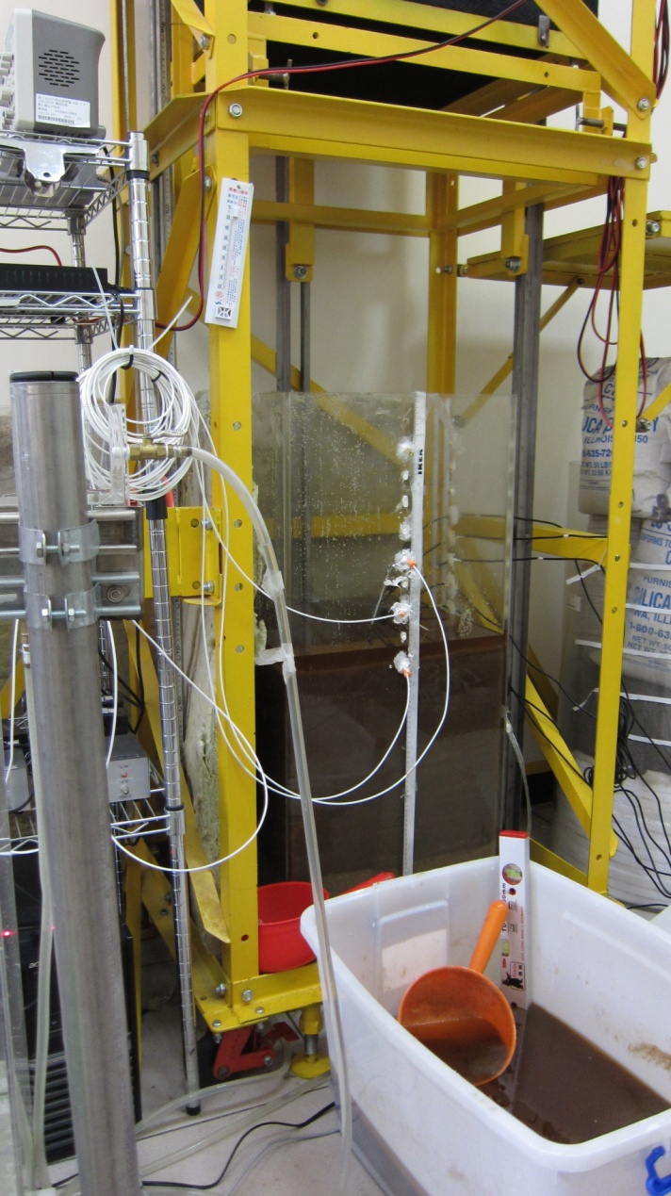
Experimental Setup and Procedures (1/3)
National Cheng Kung University

Slide 9
Experimental Setup and Procedures(2/3)
Acoustic Detections
Data Collection
The Brands We Use:
Signal generator: Protek 9305 Digital Synthesis Arbitrary Function Generator/Counter
Amplifier: ALTEC LENSING
Speaker: ALTEC LENSING
Hydrophone: Brüel & Kjær
Signal generator
Hydrophone
Soil moisture sensors
Moisture sensors: DECAGON DEVICES (EC-5)
Amplifier
Signal spectrum analyzer
Data logger
Loudspeaker
Computer
National Cheng Kung University

Slide 10

Experimental Setup and Procedures (3/3)
The pore immiscible fluid mixtures are diesel-water and soybean oil-water.
Starting from an oil-saturated scenario and then gradually increasing water saturation in a five-centimeter increment until the test sand sample fully saturated by water nearly.
Five excitation frequencies were examined with output signal wave being three cycles (Frequencies: 1500Hz, 2000Hz, 2500Hz, 3000Hz, and 3500Hz)
20 measurements were recorded with every change in water depth and frequencies.
National Cheng Kung University

Slide 11
Theoretical Model
Lo et al.(2005) model:
Solid:
elastic coefficients
coefficients related to inertial drag
coefficients related to viscous drag
Fluid 1:
Fluid 2:
National Cheng Kung University

Slide 12
Theoretical Values
Elastic and hydrological parameters of oil, water, and solid
Fitting parameter data by RETC
Dispersion relation obtained by Lo et al.(2005)
Attenuation coefficient
National Cheng Kung University

Slide 13
Results and Discussions (1/7)
The value of the attenuation coefficient of the first dilatational wave is the average one between two hydrophones, such as H1 and H3 .
The value of fluid saturation is the average one between two water moisture sensors.
National Cheng Kung University

Slide 14
Results and Discussions (2/7)
National Cheng Kung University

Slide 15
Results and Discussions (3/7)
The trend of the curve of experimental values is similar to that of theoretical values, especially at high frequencies.
The qualitative variations in the experimental and theoretical values may be partially due to the cause that the water saturation is calculated as the average one in the experiment.
National Cheng Kung University

Slide 16
Results and Discussions (4/7)
National Cheng Kung University

Slide 17
Results and Discussions (5/7)
The experimental values are larger than the theoretical values.
National Cheng Kung University

Slide 18
Results and Discussions (6/7)
National Cheng Kung University

Slide 19
Results and Discussions (7/7)
National Cheng Kung University

Slide 20
Conclusions
The effect of pore fluid viscosity on the attenuation coefficient of the first dilatational wave in standard sand saturated by two immiscible fluids was investigated experimentally.
It was shown that the experimental data qualitatively agrees with the theoretical values by Lo et al.(2005).
The quantitative variations in experimental and theoretical values may be due to the consolidated state of porous media and non-uniform fluid saturation.
National Cheng Kung University

Slide 21
Thank you
National Cheng Kung University

