Slide 1


Slide 2
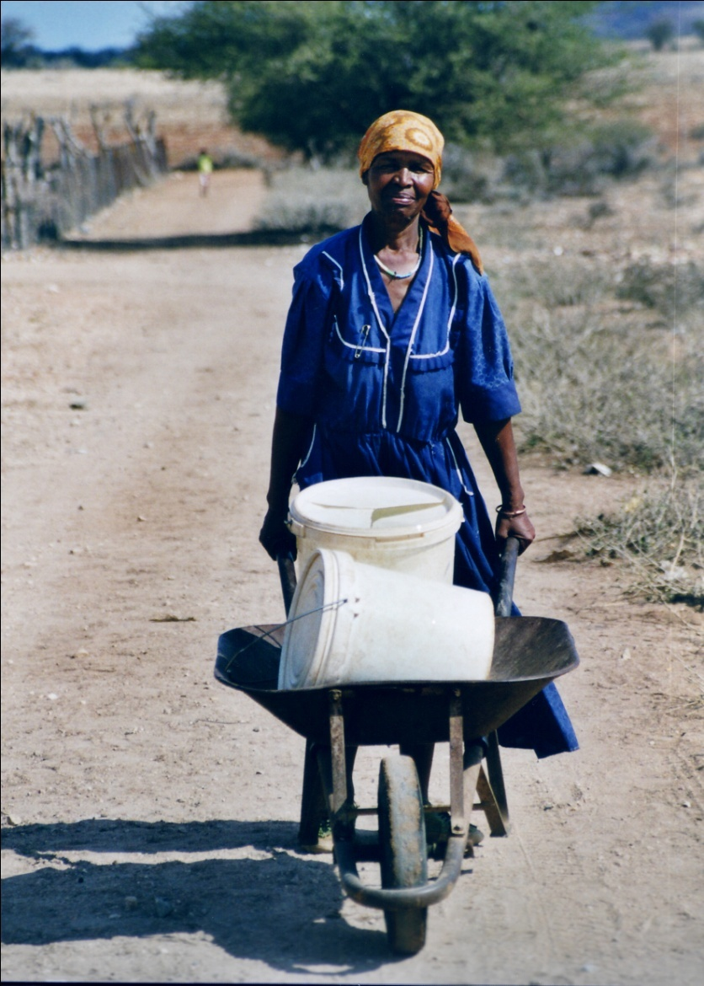
Presentation Structure
Thematic and objective
Database building
  Data collection
  Data framework
  Data formatting
African Dataset coherence
  PCA analysis
  Linear regression analysis
Extension of the dataset
South Africa
EuropeAid, F.Lefèbvre

Slide 3
Thematic and questions
The efficiency of the WSS management in a specific developing country = a combination of a wide range of variables¹
= > a complex and a cross cutting issue
OBJECTIVE :Better understand the keys elements involved in an improved WSS management.
Main QUESTIONS
1. Are the different variables and data coherent enough to establish spatial-temporal behaviors?
2. Can be established measurable protocols/models and can patterns be extrapolated in time?
¹ Integrated water resources management Principles laid down at the International Conference on Water and the Environment held in Dublin in January 1992

Slide 4
Data collection
Data collection
  International data providers : UNEP – FAO – JRC – WB …
  Scale : National country level over the world
  Time series : consistency issue requires a strict examination of data coherence and methodologies. 2004 year of reference
Variables selection criteria
  Relevance : potential role regarding water supply and sanitation
  Data availability : enough observations
  Reliability : produced by trustfully providers and with described methods
132 indicators analysed
shortlist of 53 indicators

Slide 5
Data framework
Environmental Cluster
Water resources availability
(Water poverty index, Water stress, water bodies ...)
Land cover indicators (dryland coverage, biodiversity index..)
Human pressure Cluster
Activities pressure ( water demand, irrigation level, industrial pollution, production indexes...)
Demographic pressure ( growth, repartition Urban-rural
Accessibility to WSS Cluster
Population access to Sanitation
Population access to Water Supply
Governance cluster
Stability and level of violence, government effectiveness, rule of law, regulatory quality , control of corruption
Country Well being Cluster
Health indicators (water-born disease, mortality, life expectancy..)
Poverty indicators ( HDI, National poverty index, education level...)
Education indicators
Official Development aid flow : global and WSS ODA

Slide 6
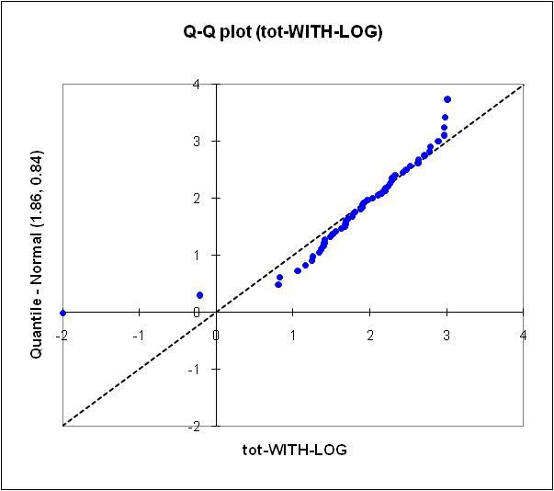
Data formatting
Process
  Normalization
  Missing data treatment: Imputation
Step 1 Variables Normalization
Standard normalization (SQRT- LOG - OLS) not possible on the worldwide dataset because of strong heterogeneous behaviour among countries
as preliminary phase => Restriction to Africa = 52 countries
Test of what?
  Missing data methods
  Methods used for data coherency
  Foreseen modelling methods
  Normalization Issue
  Processing the extremities distribution

Slide 7
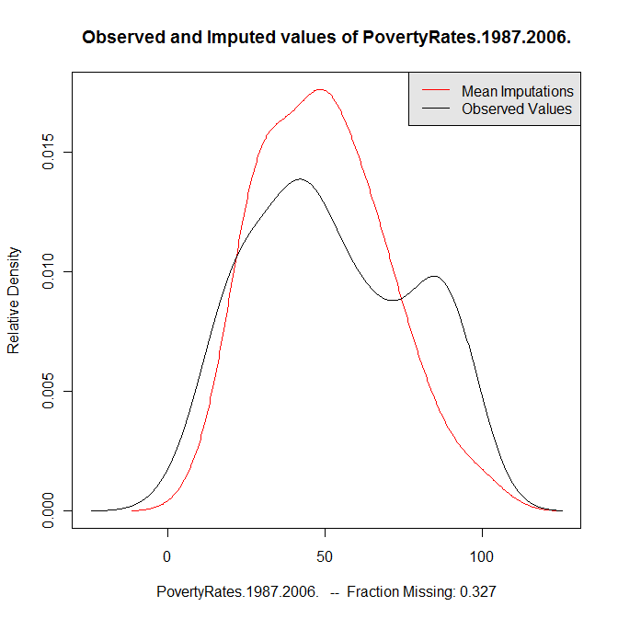
Data formatting
Step 2 Missing Data treatment
Objective : Qualitative approach
=> find order of magnitude rather than exact value
Method
Expectation – Maximization algorithm combined with bootstraps (EMB)¹
Assumptions:
- the complete data (that is, both observed and unobserved) are multivariate normal.
- the data are missing at random (MAR).
STEP by STEP imputation process starting from the ones with less missing data to the more incomplete ones.
¹Amelia II software is provided by Honaker James, King Gary, Blackwell Matthew, http://gking.harvard.edu/amelia/

Slide 8
Dataset coherency verification
1. Checking Variable Relationships Coherence
Principal component Analysis (PCA)
Adjusted R² = 50.386
(3 components)
On F1 axis group 1-2 representing the society development – poverty
On F2 group 3-4 represents the balance between water demand and resources
Coherency of the dataset on Africa
Group 4
Group 1
Group 2
Group 3
figure: the first two PCA factors of variables, (accumulated variability equal to 43,02%)

Slide 9
Dataset coherency verification
  2. Linear regression
  Objectives:
  Look for incoherent behaviours
  Test if linear models could be used in a later stage
  Water supply coverage and sanitation coverage are analysed separately
  The coherency of the final model relies on:
  the significance of the variables
  the confidence intervals

Slide 10
Preliminary phase on Africa
Anova with stepwise method
Dependent variable: Water supply access level (AIWS)
Adjusted R² = 0.629
Standards parameters of the final model
Model |  | Unstandardized Coefficients |  | Standardized Coefficients | t | Sig. | 95% Confidence Interval for B
 |  | B | Std. Error | Beta |  |  | Lower Bound | Upper Bound
1 | (Constant) | 52.427 | 8.783 |  | 5.969 | .000 | 34.768 | 70.086
 | Children Mortality under 5 years | -.593 | .093 | -.572 | -6.391 | .000 | -.779 | -.406
 | Environmental governance level | .406 | .115 | .326 | 3.526 | .001 | .175 | .638
 | Withdrawal industrial | .195 | .078 | .221 | 2.505 | .016 | .039 | .352
a Dependent Variable: TOT.AIS.2004

Slide 11
Preliminary phase on Africa
  Anova with stepwise method
  Dependent variable: Sanitation access level (AIS)
  Adjusted R² = 0.555
  Standards parameters of the final model
Model |  | Unstandardized Coefficients |  | Standardized Coefficients | t | Sig. | 95% Confidence Interval for B
 |  | B | Std. Error | Beta |  |  | Lower Bound | Upper Bound
5 | (Constant) | -22.101 | 9.794 |  | -2.257 | .029 | -41.815 | -2.386
 | Health expenditure | .354 | .132 | .376 | 2.685 | .010 | .089 | .620
 | Water Use intensity in agriculture | .441 | .114 | .376 | 3.881 | .000 | .212 | .669
 | Urban pop level | .311 | .109 | .296 | 2.848 | .007 | .091 | .530
 | Environmental gov | .478 | .155 | .369 | 3.085 | .003 | .166 | .790
 | Corruption perception index | -.427 | .179 | -.309 | -2.382 | .021 | -.788 | -.066
a Dependent Variable: TOT.AIS.2004

Slide 12
Conclusions of the preliminary phase
On AFRICA
Good points:
The dataset is coherent – IF data considered qualitative/estimates
Linear models explain most of the variability
Limits
Too few observations (52 countries) versus variables number (45 variables)
Variability (38%) in both cases remains not completely explained => Complex relationships between variables

Slide 13
Extension of the dataset
SOLVING POINT 1: too few observations
Available Options :
Increasing the number of observations
Grouping variables
We start with option 1 :
-> clustering worldwide countries list
-> using different Agglomerative Hierarchical Clustering (AHC) methods with several distances
-> looking at the stability of results
Increasing the dataset by adding countries with similar behaviours to African’s

Slide 14

Thanks you for your attention
Questions?

