Slide 1
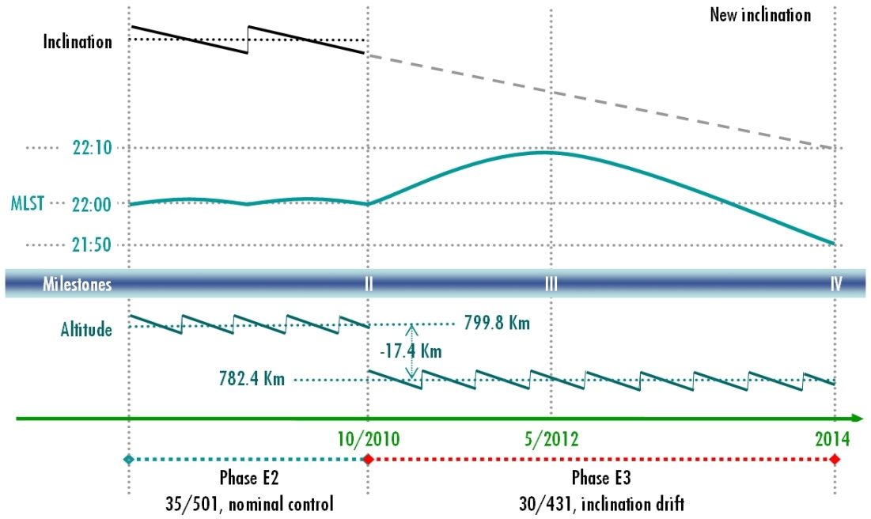
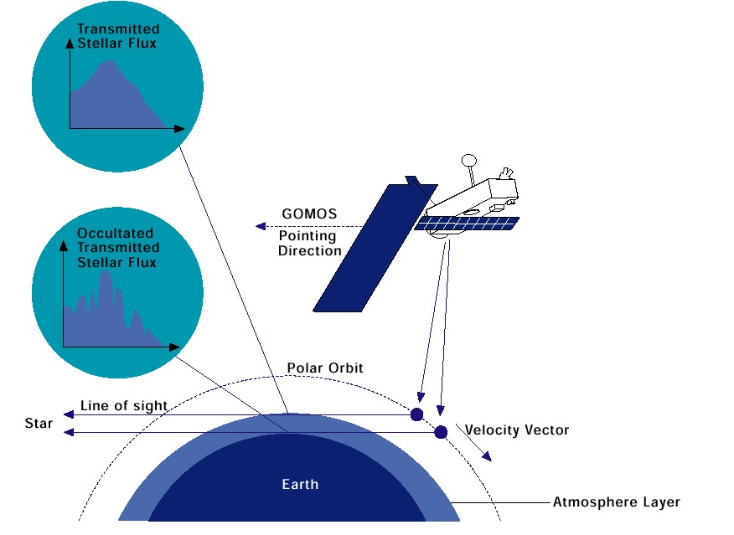
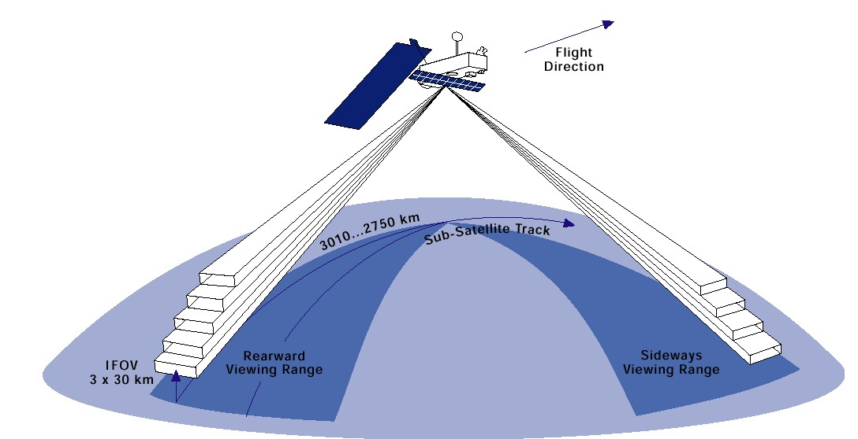
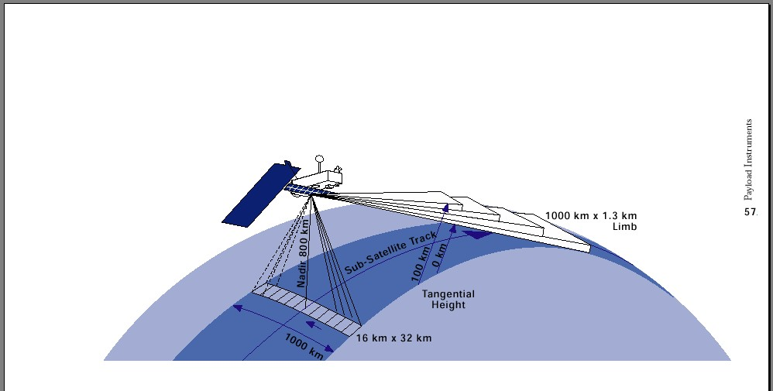
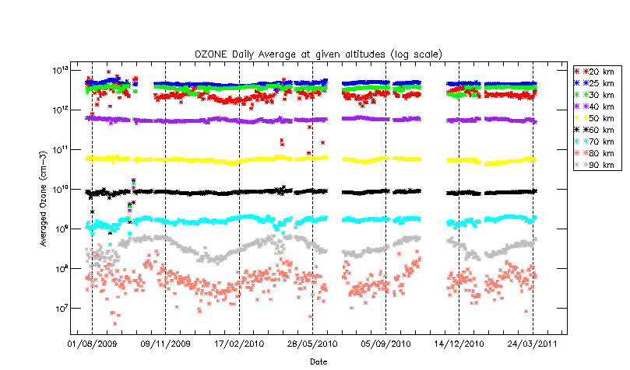
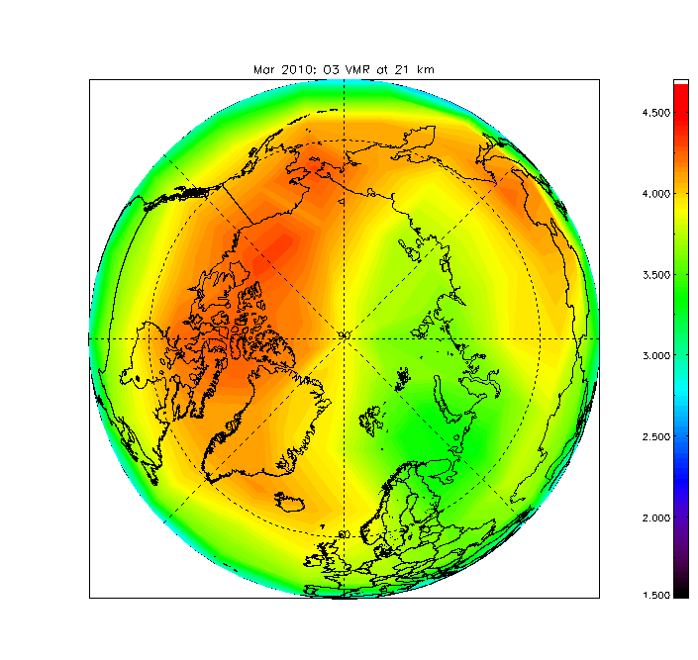
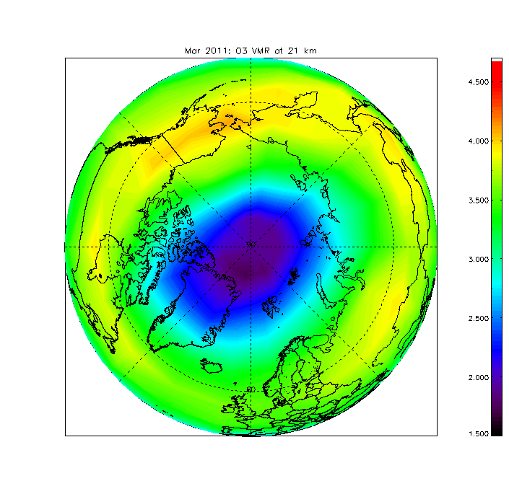
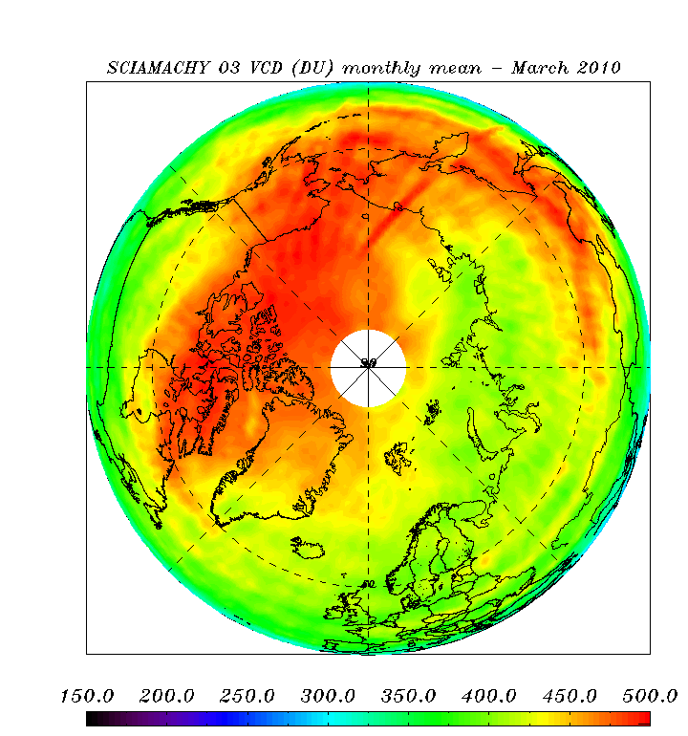
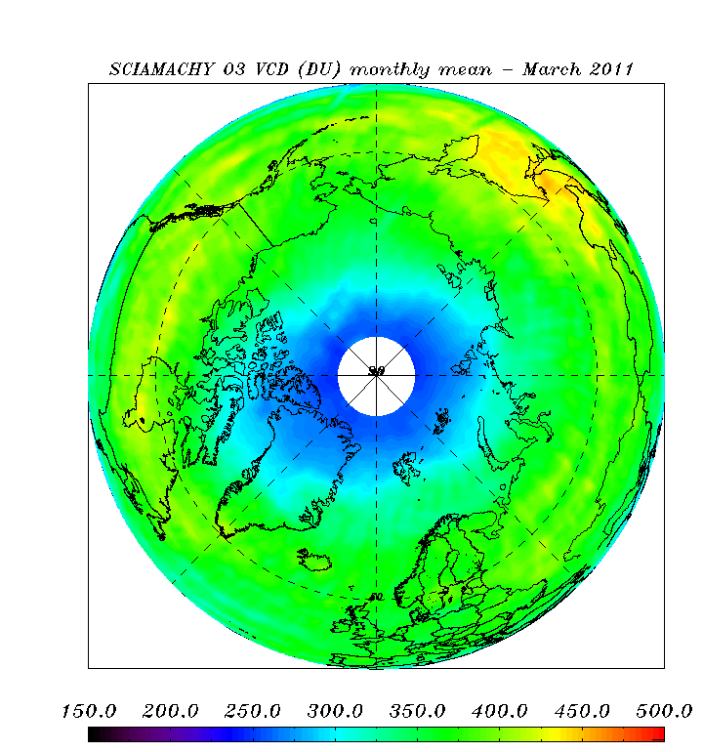
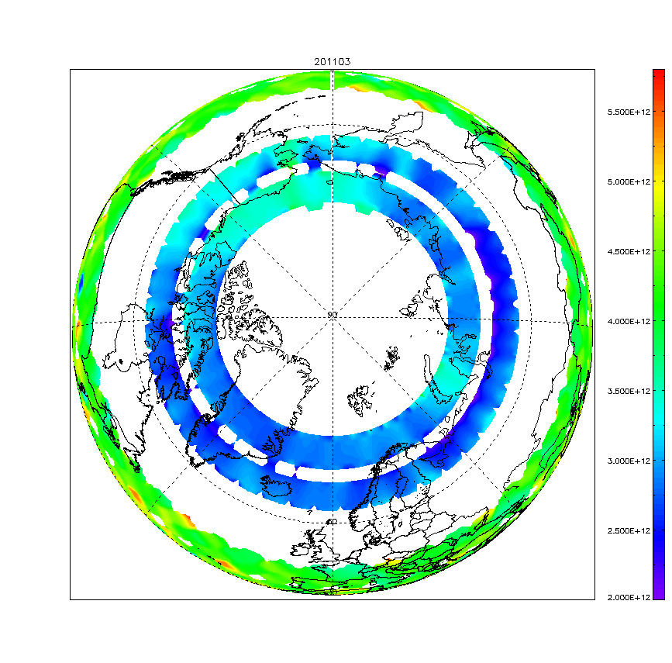
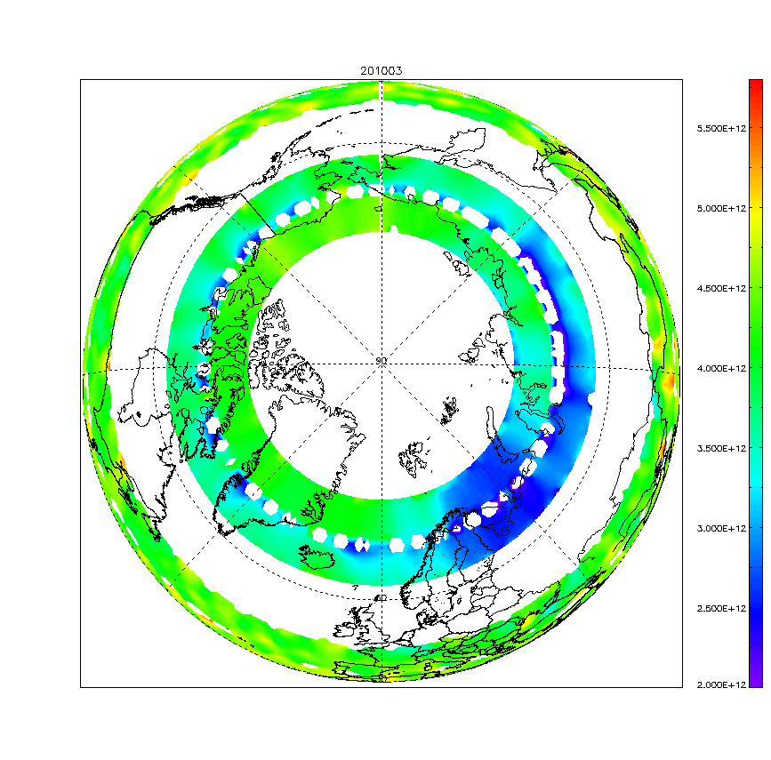
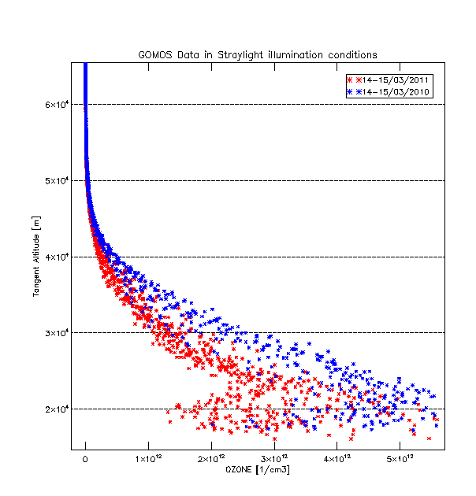
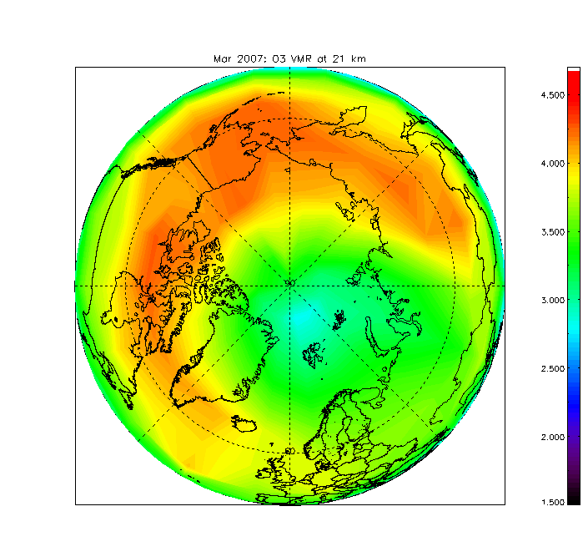
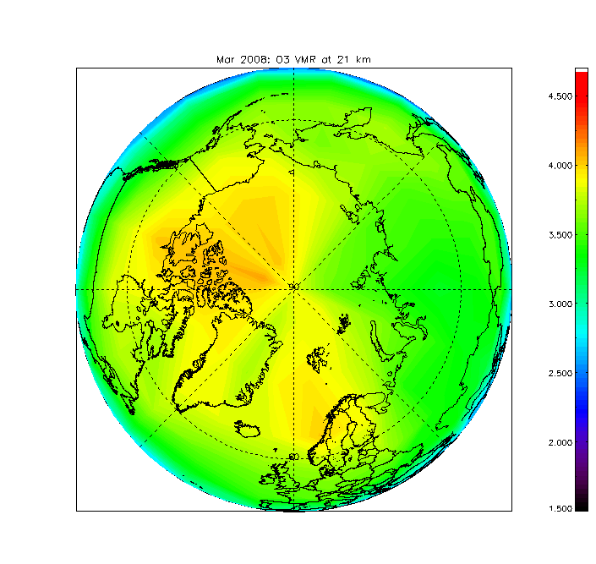
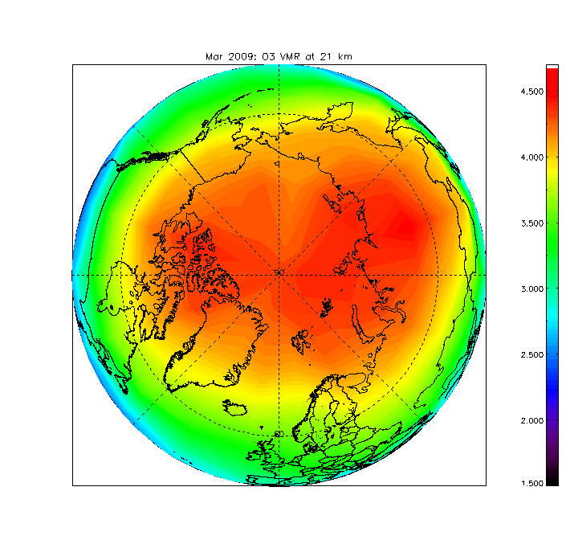
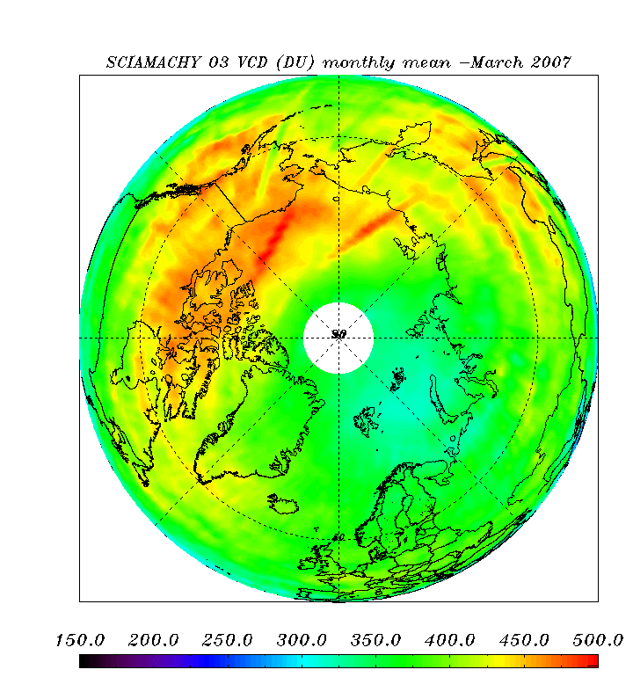
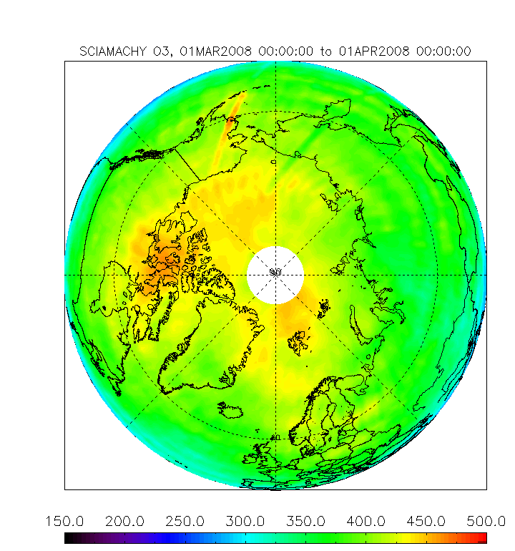
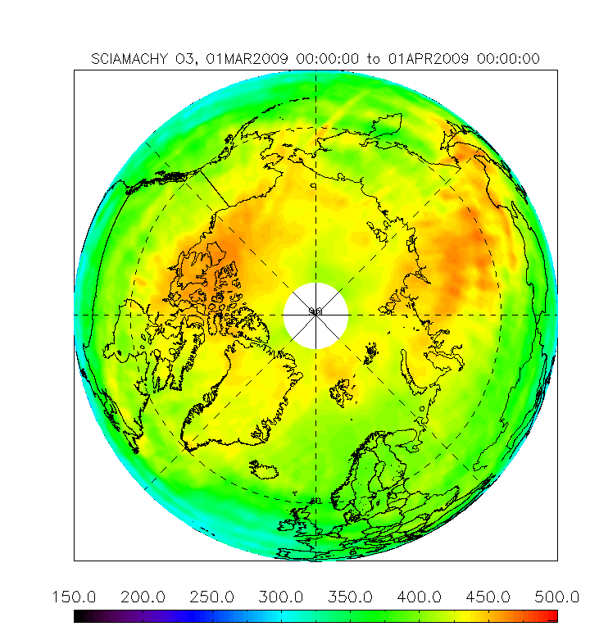
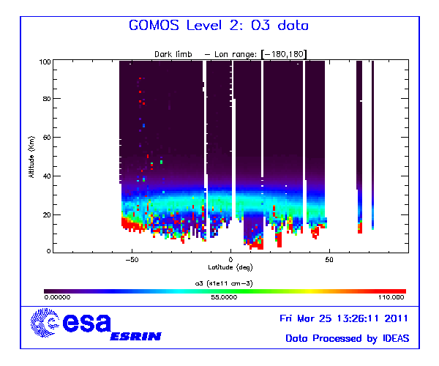
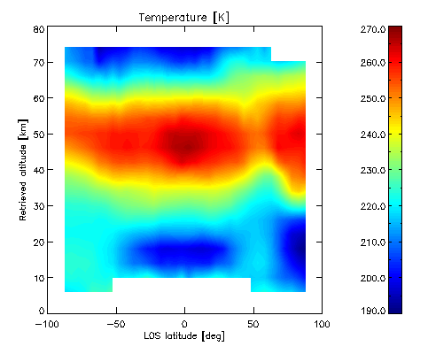
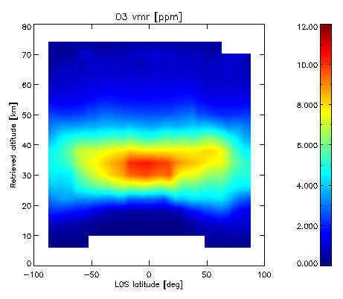
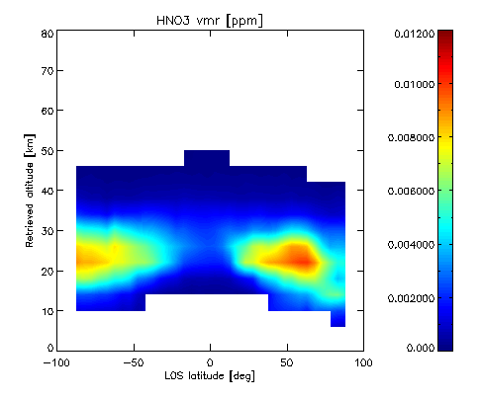
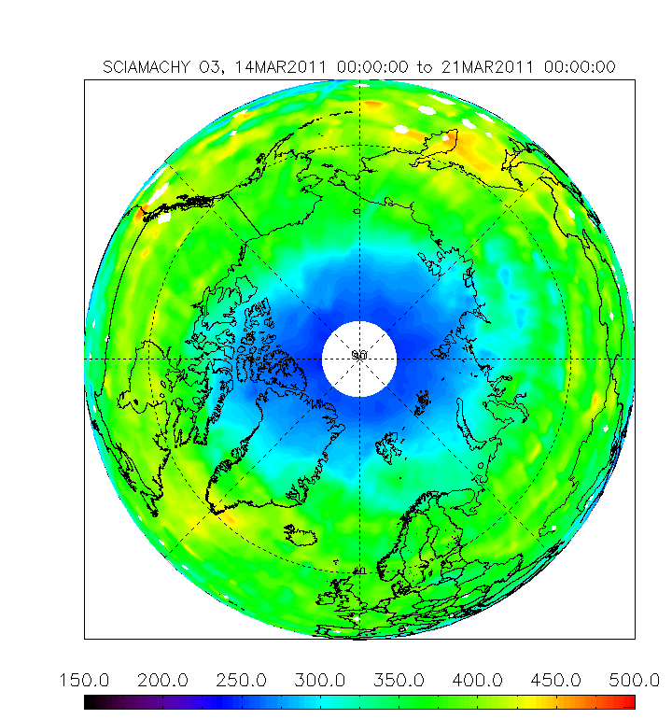
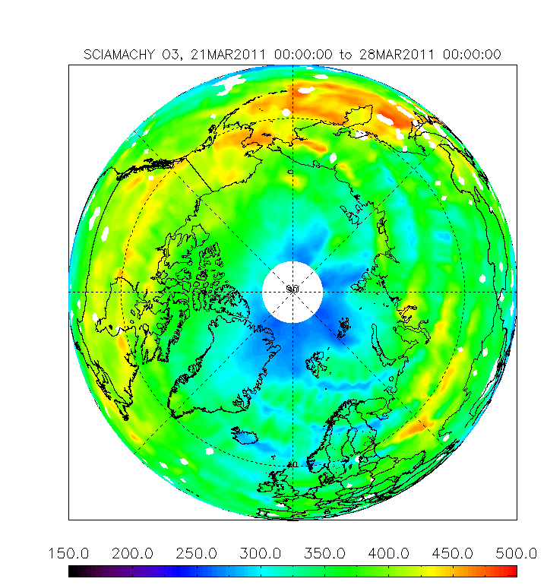
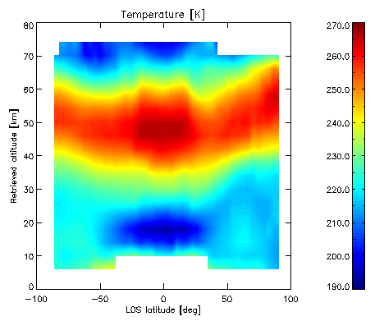
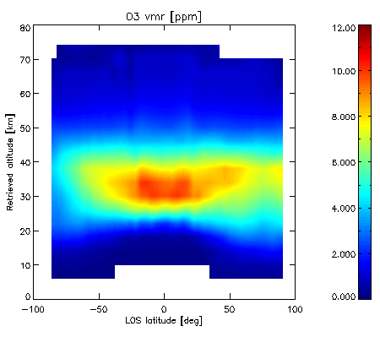
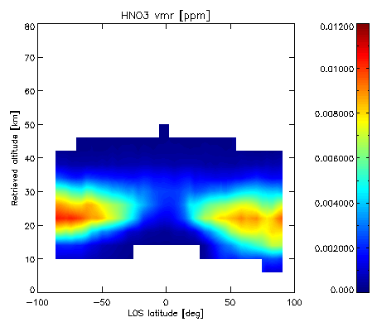
The ENVISAT-ESA Atmospheric-Chemistry dataset: operational data availability and re-processing status
F. Niro ⁽¹⁾, G. Brizzi⁽¹⁾, A. Dehn⁽¹⁾, L. Saavedra de Miguel⁽¹⁾, G. Scarpino⁽¹⁾, T. Fehr⁽²⁾, R. von Kuhlmann⁽²⁾, P. Vogel⁽³⁾, G. Barrot⁽⁴⁾, H. Bovensmann⁽⁵⁾, G. Lichtenberg⁽⁶⁾, G. Perron⁽⁷⁾, P. Raspollini⁽⁸⁾ and GOMOS/MIPAS/SCIAMACHY QWGs
(1) Serco S.p.A., Via Sciadonna, 24, 00044 Frascati, Italy; (2) , European Space Agency (ESA) - ESRIN, Via Galileo Galilei, 00044 Frascati, Italy; (3) European Space Agency (ESA) - ESTEC, Kepplerlaan 1, Noordwijk, The Netherlands; (4) ACRI-ST - 260, Route du Pin Montard - B.P. 234, 06904 Sophia Antipolis Cedex FRANCE; (5) University of Bremen, Institute of Environmental Physics, P.O. Box 330440, D-28334 Bremen, Germany; (6) Deutsches Zentrum für Luft- und Raumfahrt e.V. (DLR) Institut für Methodik der Fernerkundung (MF-AP) 82234 Weßling;
(7) ABB Bomem Inc., 585 Blvd. Charest East, Quebec, G1K 9H4, Canada; (8) Istituto di Fisica Applicata “N. Carrara” (IFAC) del Consiglio Nazionale delle Ricerche (CNR), Firenze, Italy
Satellite characteristics | Launched in Mar 2002 in a sun-synchronous polar orbit with controlled altitude and MLST in the range 22:00 +/- 5min
Performances | All platform modules and payload performances are excellent.
Mission extension | The satellite altitude was successfully lowered by 17.4 km during 22- 26 Oct 2010. The orbit inclination will not be maintained, resulting in a drifting MLST (+/- 10min), allowing to extend the lifetime to mid 2014.
ENVISAT Atmo- Chem data | Limb products (with validated altitude range) |  |  |  |  |  |  |  |  |  |  |  |  | Nadir products
 | Press | Temp | H₂O | O₃ | HNO₃ | CH₄ | N₂O | NO₂ | NO₃ | BrO | O₂ | Clouds | Aerosol | O₃ | NO₂ | BrO | SO₂ | H₂O | CO | OClO | Clouds properties
GOMOS |  | 18 – 30 km | < 50 km | 18– 45 km |  |  |  | 20 – 50 km | 20 – 45 km |  | 15 – 70 km |  | 10 – 35 km
MIPAS | 18 – 65 km | 18 – 65 km | 18 – 52 km | 18 – 52 km | 17 – 34 km | 12 – 40 km | 12 – 40 km | 23 – 50 km |  |  |  | Flag
SCIAMACHY |  |  |  | 20 – 40 km |  |  |  | 20 – 40 km |  | 15– 27 km |  | Cloud Top |  | VCD | VCD | VCD | VCD | VCD | VCD | Slant column | CTH, COT, AAI
ENVISAT Atmo-Chem missions
GOMOS
MIPAS
SCIAMACHY
Instrument type | GOMOS is a spectrometer measuring the UV, visible and near infrared atmospheric spectrum using a stellar occultation technique.
Instrument performances | Corrective actions were undertaken to cure a problem with the stellar tracking unit, today the instrument performances are excellent.
Mission extension | No showstopper were identified for the continuation of GOMOS mission until mid 2014, ENVISAT end of life.
Instrument type | Michelson Interferometer measuring the thermal IR emission of the atmosphere with Limb viewing geometries.
Instrument performances | The instrument performances are excellent in the OR mission scenario. The anomaly in the Interferometer is under control.
Mission extension | No showstopper were identified for the continuation of MIPAS mission until mid 2014, ENVISAT end of life.
Instrument type | SCIAMACHY is a spectrometer observing backscattered, reflected, transmitted or emitted radiation from the atmosphere in three viewing geometries: nadir, limb, and sun/moon occultation.
Instrument performances | Instrument performances are excellent.
Mission extension | No specific showstoppers are expected for the continuation of the mission until ENVISAT end of life
Version 6.01 of the processor is under validation, it will be used for operations and for the 3rd re-processing campaign.
IPF6.01 implements significant upgrades in the algorithm, mainly: i) the new intra-pixel PRNU allows improvement in the H2O retrieval, ii) improved HRTP profiles will be available , iii) the Full VCM will be used for the error determination.
Level 1 and Level 2 operational processing is operational NRT and off-line with processor version 5.05.
The MIPAS full mission was re-processed to Level 1 and Level 2 with IPF 5.05, data are available in the D-PAC ftp server.
Full mission re-processing with processor V6 (4 additional species: CFC-11, CFC-12, N2O5, ClONO2) will start 2nd Quarter of 2011.
The full-mission Level 1 reprocessing with IPF 7.03/7.04 is completed and accessible on the D-PAC FTP server.
The Level 2 reprocessing with processor version 5.01 has been stopped.
Reprocessing will restart with the upcoming processor version 5.02 implementing improvements for SO2, CO and OClO.
Processing
status
Current processor | Processing | Availability | IPF | Dissemination method
Level 1 | NRT/ Off-line | NRT : 3h Off-line: 10 days | 5.01 | ftp (E-K)
 | Re-processed | Full mission: 2002 – 2011 | 5.01 | ftp (D-PAC)
Level 2 | NRT/ Off-line | NRT : 3h Off-line: 10 days | 5.01 | ftp (E-K)
 | Re-processed | Full mission: 2002 – 2011 | 5.01 | ftp (D-PAC)
Current processor | Processing | Availability | IPF | Dissemination method
Level 1 | NRT/ Off-line | NRT : 3h Off-line: 10 days | 5.05 | DDS ftp (E-K)
 | Re-processed | Full mission: 2002 – 2011 | 5.05 | ftp (D-PAC)
Level 2 | NRT/ Off-line | NRT : 3h Off-line: 10 days | 5.05 | ftp (E-K)
 | Re-processed | Full mission: 2002 – 2011 | 5.05 | ftp (D-PAC)
Current processor | Processing | Availability | IPF | Dissemination method
Level 1 | NRT/ Off-line | NRT : 3h Off-line: 10 days | 7.04 | DDS ftp (E-K)
 | Re-processed | Full mission: 2002 – 2011 | 7.03/04 | ftp (D-PAC)
Level 2 | Fast delivery/ Off-line | FD : 24h Off-line: 10 days | 5.01 | ftp (D-PAC)
 | Re-processed | Full mission: 2002 – 2009 | 3.01 | ftp (D-PAC)
Highlights on GOMOS –ESA long term archive
Long term monitoring of Ozone Mesospheric peak
Highlights on MIPAS –ESA long term archive
Ozone VMR at 21 km in the Arctic during March from 2007 to 2011
Highlights on SCIAMACHY–ESA long term archive
Arctic Ozone Total column during March from 2007 to 2011
Ozone daily mean in the tropics at different altitude since 2008
GOMOS products are limited in terms of global coverage, due to the stellar occultation technique, on the other hand the stability of the measurement principle (self-calibrating) is a guarantee of the consistency of the data quality along the mission.
The GOMOS data offer a unique opportunity to study long term trend of target species, especially Ozone from the Stratosphere up to the Mesosphere. The plot on the left shows the Ozone daily means in the Tropics since 2008. This plots highlights the unique capability of GOMOS to closely monitor the Ozone mesospheric peak.
The plots below shows the GOMOS observation of the Ozone depleted area in the Arctic region during March 2011.
O3 VMR (ppm) at 21 km: March 2010
O3 VMR (ppm) at 21 km: March 2011
The MIPAS Level 2 NRT and off-line processing restarted with IPF 5.05 in 2010.
The full MIPAS mission was re-processed to Level 2 with processor V5.05.
The data quality looks nominal and in line with the scientific requirements.
The plots on the left show the MIPAS O3 VMR at an altitude of 21km over the Arctic region for March from 2007 to 2011. The exceptional ozone depletion observed during March 2011 is clearly visible in these plots.
O3 Vertical Column (DU): March 2010
O3 Vertical Column (DU):: March 2011
SCIAMACHY ESA operational Level 2 V5.01 data provide Total Column of O3, BrO, NO2, SO2 volcanic/anthropogenic, H2O, CO and OClO.
Level 2 data are available as Fast delivery products (24h) and off-line (after 10 days).
The exceptional Arctic Ozone hole detected during March 2011 is clearly observed in the SCIAMACHY ESA operational data.
The Ozone depletion in the Arctic during March 2011 (by about 50%) is highlighted in these plots and compared with previous years.
O3 number density: March 2011
O3 number density: March 2010
O3 number density profiles in the Arctic: March 2010 -2011
O3 VMR (ppm) at 21 km: March 2007
O3 VMR (ppm) at 21 km: March 2008
O3 VMR (ppm) at 21 km: March 2009
O3 Vertical Column (DU): March 2007
O3 Vertical Column (DU): March 2008
O3 Vertical Column (DU): March 2009
Highlights on ENVISAT-ESA Atmospheric-Chemistry dataset
O3 number density monthly mean: March 2011
GOMOS operational ESA data
Temperature, O3 and HNO3 retrieved from MIPAS measurements of 16 March 2011
MIPAS operational ESA data
Ozone VCD for the week: 14– 21 Mar 2011
Ozone VCD for the week: 21– 28 Mar 2011
SCIAMACHY operational ESA data
The GOMOS operational data allows to closely monitor the state of the Earth’s atmosphere, in particular the Ozone distribution on a wide vertical range, going from the lower Stratosphere up to about 100 km., allowing to detect the O3 Mesospheric peak.
The plot on the left shows the GOMOS Ozone monthly mean for March 2011.
The accuracy of GOMOS data is affected by the characteristics of the considered stars (e.g., star magnitude, star temperature). However, the usage of the same star along the mission allows to precisely determine long term trend, owing to the very stable instrument measurement principle (self calibrating).
The monitoring of the MIPAS operational data allows to follow closely the evolution of the Ozone hole in the Arctic during March 2011 and its relation with the atmospheric status (e.g., Temperature).
The zonal mean for Temperature, O3 and HNO3 (VMR) during 16 March 2011 and for the same day of 2010 are shown in the plots on the left.
The extremely cold temperature in the Arctic during March 2011 can be observed as the correlation of the ozone depletion area with HNO3 VMR.
The monitoring of the SCIAMCHY fast-delivery products (24h after sensing) allows to follow the evolution of the Ozone hole in the Arctic during the past two weeks.
The evolution of the Ozone depleted area around the Arctic will be monitored with care in the coming weeks.
Currently there are some concerns about the possible migration of Ozone depleted air masses towards high populated regions of the Northern Hemisphere.
Temperature, O3 and HNO3 retrieved from MIPAS measurements of 16 March 2010
Summary and conclusion | GOMOS | MIPAS | SCIAMACHY
 | With the extension of the ENVISAT mission until mid 2014 GOMOS dataset will cover a period of more than 12 years. Taking into account the stability of the GOMOS performances (self-calibrating) the GOMOS archive will represent a unique dataset for long term studies, especially for Ozone in the Stratosphere and Mesosphere. | After a long interruption in the availability of MIPAS geophysical products the Level 2 operational processing was resumed in 2010. The full MIPAS mission was re-processed to Level 2 using the IPF 5.05 and the dataset was released to the users. The first validation results confirm the quality of the Level 2 data generated with V5. | The SCIAMACHY operational ESA data is a valuable tool for global and continuous monitoring of Earth’s atmospheric status. With the upcoming activation of the processor version 5.02 the retrieval of SO2, CO and OClO Total Column will be significantly improved. The processor 5.02 will be used for the full mission re-processing.
Source of info | Products access and info | ESA EOHelp |  | Mail to: eohelp@eo.esa.int
 | Products calibration | SciaL1c |  | http://earth.esa.int/object/index.cfm?fobjectid=4073
 | Reading tool | Beat/VISAN |  | http://www.stcorp.nl/beat/
 | Monitoring web page | PCS web page |  | http://earth.eo.esa.int/pcs/envisat/

