Slide 1
Benthic foraminiferal response to trophic changes across the last glacial-Holocene transition in the abyssal eastern Mediterranean Sea
Katharina Müller-Navarra*, A. Lochte & G. Schmiedl
University of Hamburg
*katharina.mueller-navarra@uni-hamburg.de

Slide 2
Study Area
Study Area
SL71-2

Slide 3
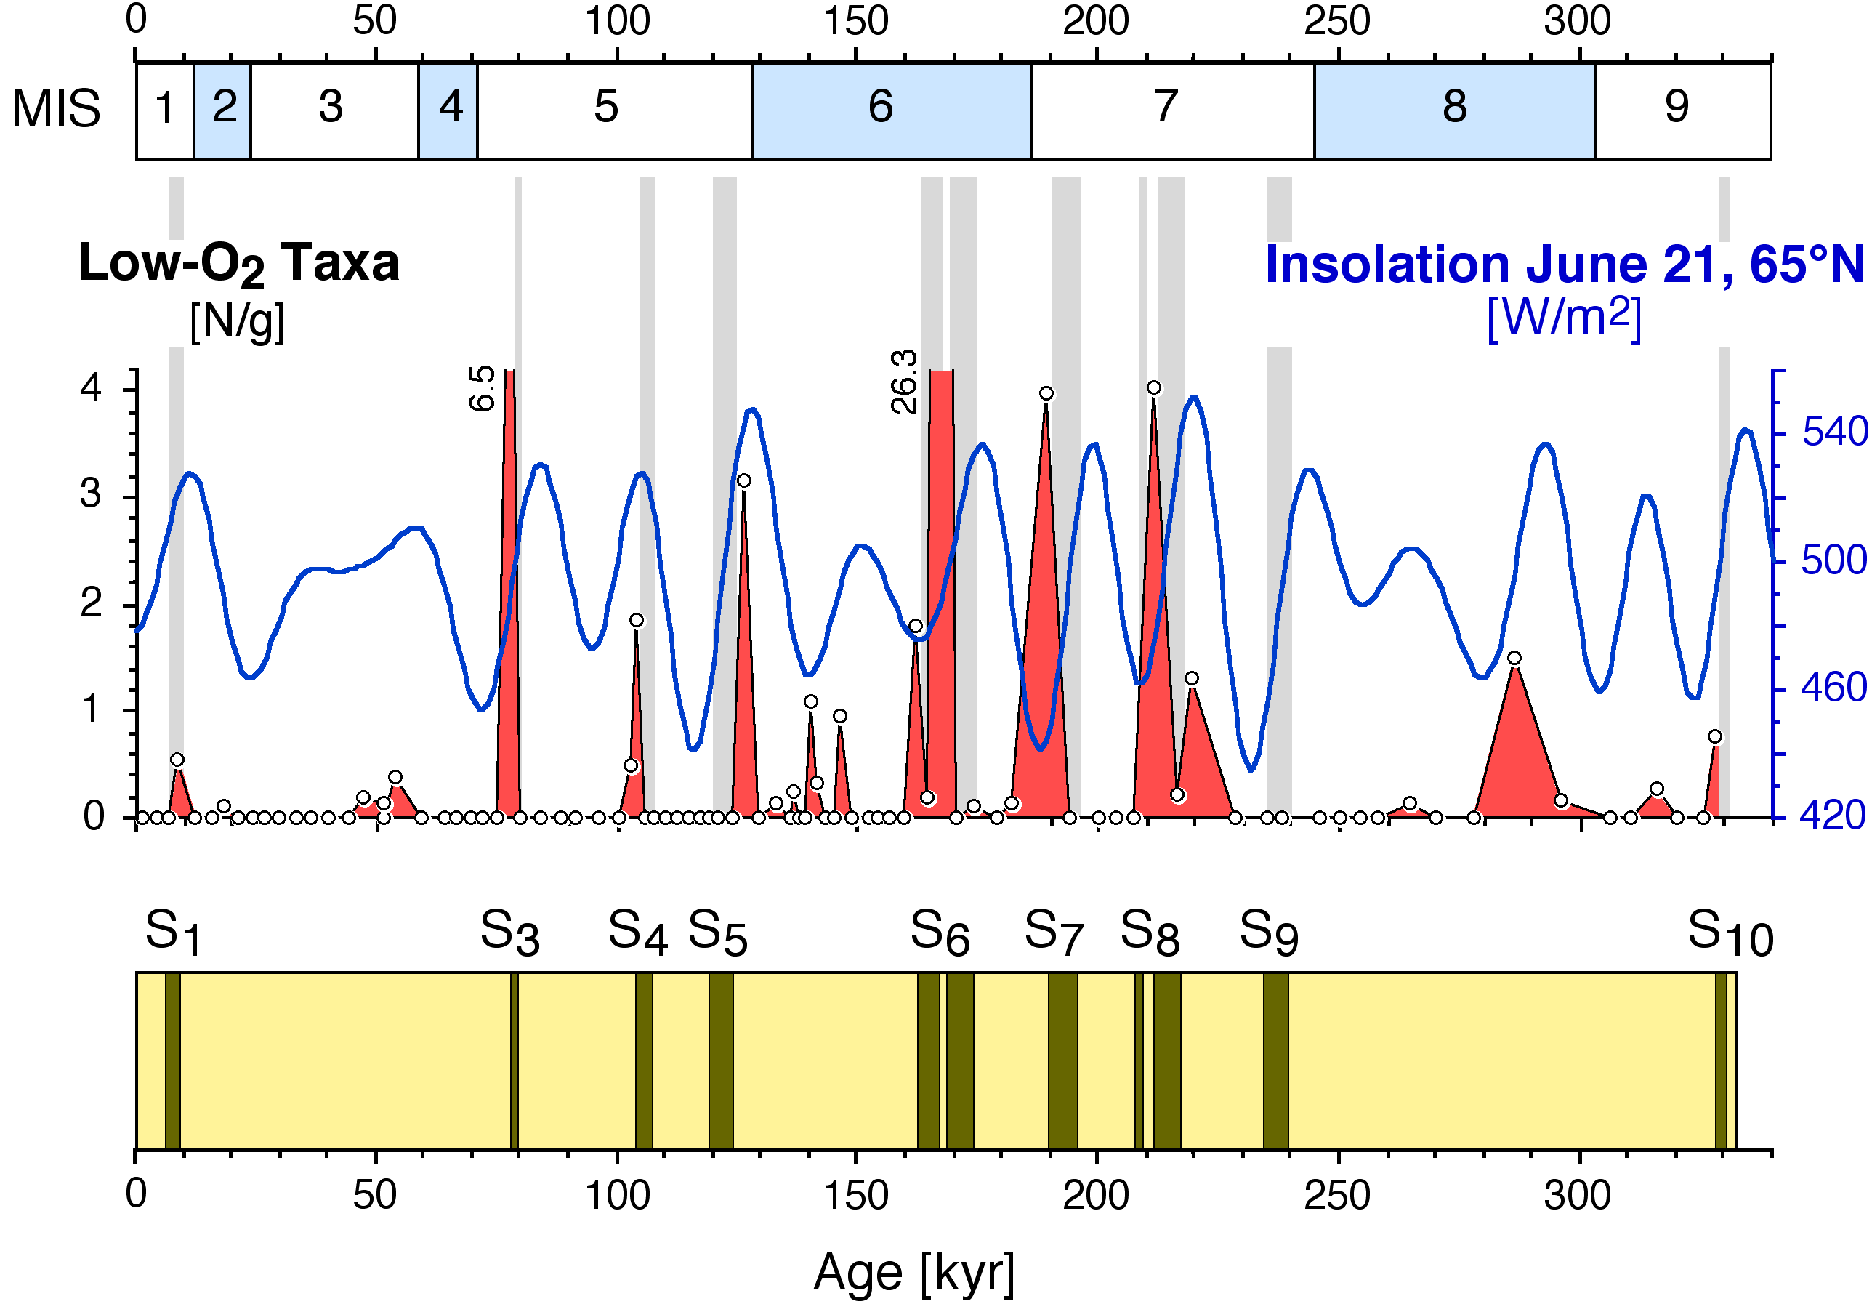
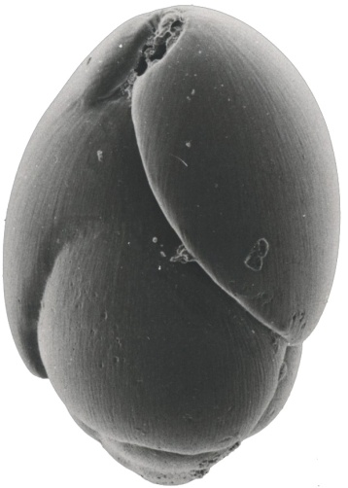
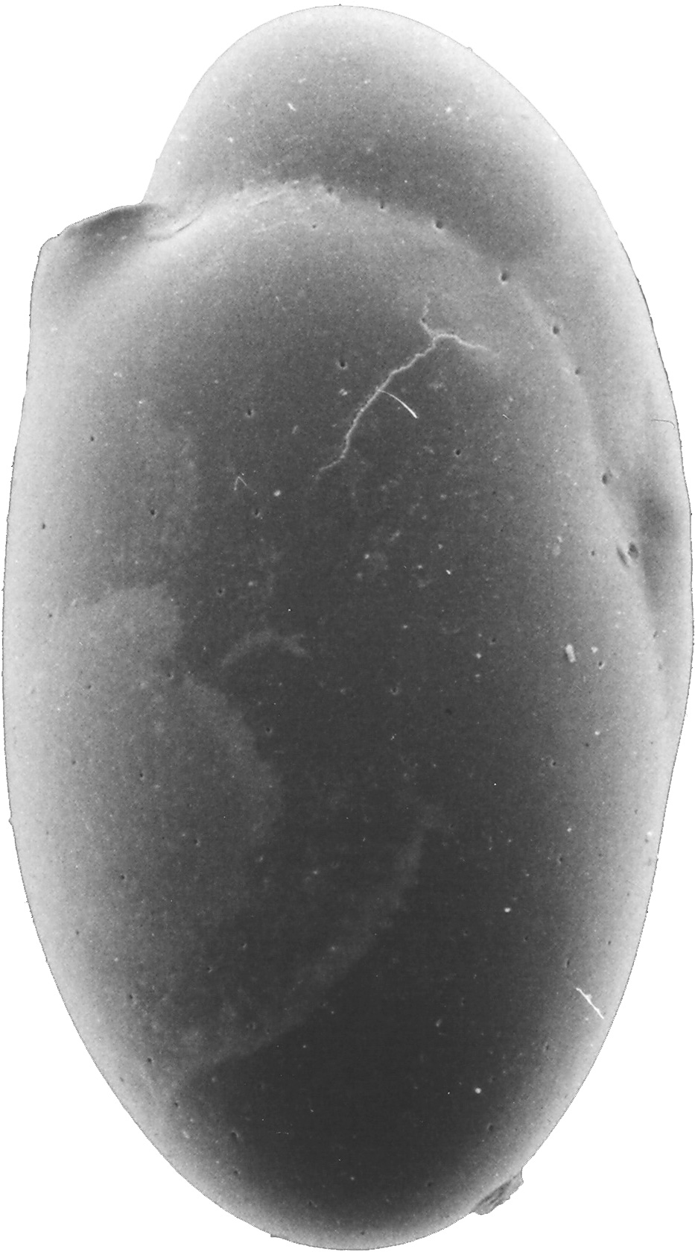
Sapropel formation
Approach
0.1 mm
Globobulimina
affinis
0.1 mm
Chilostomella
oolina
Katharina Müller-Navarra

Slide 4
Results & Discussion I
Baseline
Baseline
3xNutri
3xNutri
Nile+Nutri
Nile+Nutri
IniGlac
IniGlac
IniGlac+3xNutri
IniGlac+3xNutri
Levantine
>1800 m
[R. Grimm 2012, unpubl.]
Katharina Müller-Navarra

Slide 5
Results & Discussion II
Q-mode PCA
PC2
A.tubulosa
0.1 mm
PC3
Q. viennensis
PC1
M. subrotunda
Sapropel S1
PC4
C. laevigata
0.1 mm
Cal. years BP
food content
ultra-oligotroph
oligotroph
mesotroph
oligotroph
Katharina Müller-Navarra

Slide 6
Results & Discussion III
Sapropel S1
Bolivina spp
Individuals
>125µm
Ind./g
Cal. years BP
20 µm
Sapropel S1
Eponides
pusillus
Individuals
63–125µm
20 µm
Anomalinoides
minimus
Cal. years BP
Notes:
Keine Eutrophierung sondern Anreicherung von Nährstoffen aufgrund von Sauerstoff-
abreicherung
1 opportunistic taxa Anomalinoides minima & Eponides pusillus are related to seasonal phytoplankton blooms (ZITAT)

Slide 7
Conclusions
- Benthic foraminiferal faunas are lacking evidence for eutrophication in the Levantine Basin before sapropel S1 formation
- The model shows: there is the potential to develope an oxygen depletion within a time periode of 6000 years due to enhanced fresh water supply
(- We are currently measuring benthic isotope data)
Katharina Müller-Navarra

Slide 8
Thanks!
Katharina Müller-Navarra*, A. Lochte & G. Schmiedl
University of Hamburg
*katharina.mueller-navarra@uni-hamburg.de
Katharina Müller-Navarra

