Slide 1
The curse of abundance – An attempt to design a hydrological multimodel system for forecasting purposes over Europe
Fredrik Wetterhall
Emanuel Dutra, Chantal Donnelly, Lena Strömbäck, Peter Salamon, Lorenzo Alfieri, Konrad Bogner, Florian Pappenberger, Blazej Kreminski, Gianpaolo Balsamo

Slide 2
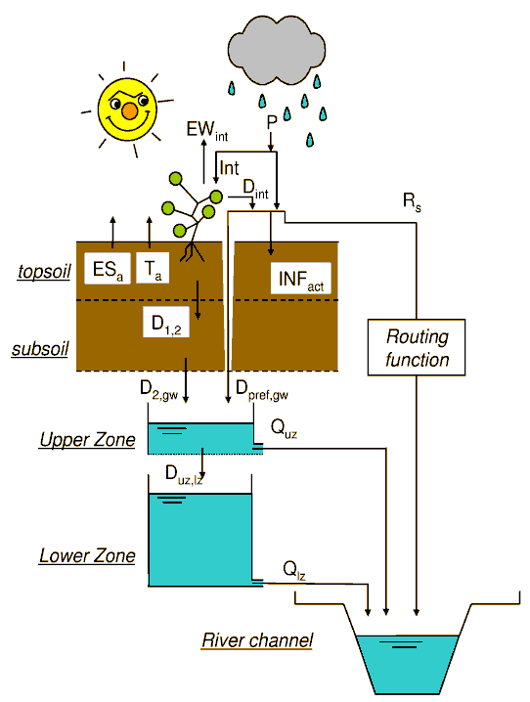
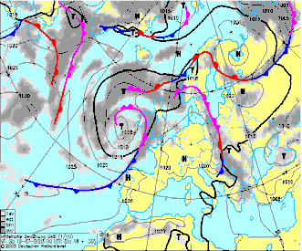
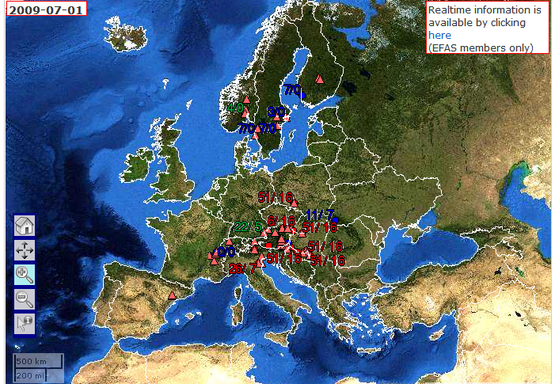
The European Flood Awareness System: what is it?
R194
Added value: Early warning system for river floods, complementary to MS systems
Providing National Flood Forecasting Agencies and Emergency Response Coordination Centre (ERCC) with probabilities of flooding 3-15 days in advance for all Europe (typically 4-6 days)
EFAS provides early warning information only; informing the public and civil protection is done by the national forecasting centers and ERCC (ERCC daily to National Civil Protection)
EFAS went fully operational October 2012
40 member organisations
Multiple weather forecasts (and other data)
Hydrological model
Flood forecast and warnings

Slide 3
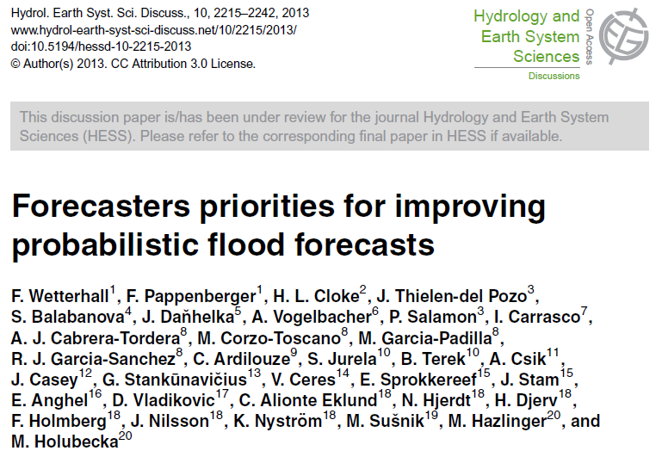
What do users want from EFAS?
R197
At the EFAS annual meeting 2012 we asked >30 operational forecasters about what they most wanted improved in EFAS (Wetterhall et al., 2013, HESS), and the top priorities were:
“Introduce multi-model approach for meteorology AND hydrology”
Advantage: Full assessment of model uncertainty and a more robust system (more trust)
Disadvantage: More uncertainty,
not straight-forward in decision making
Longer run times

Slide 4
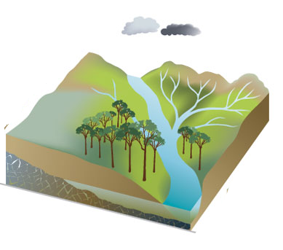
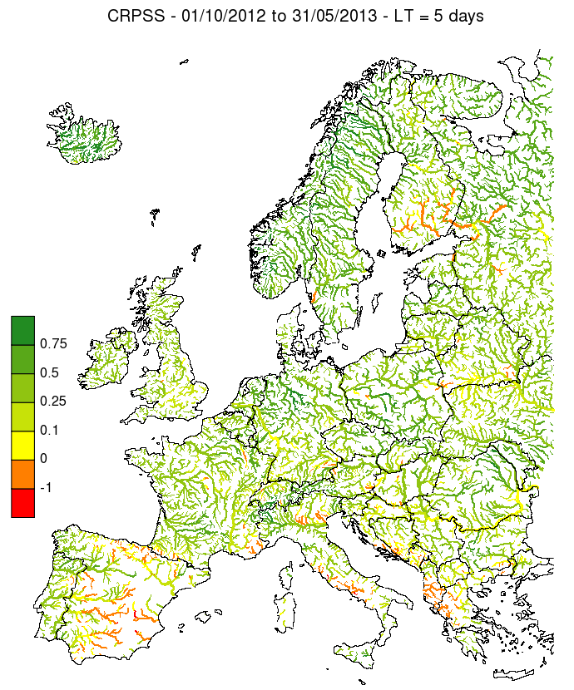
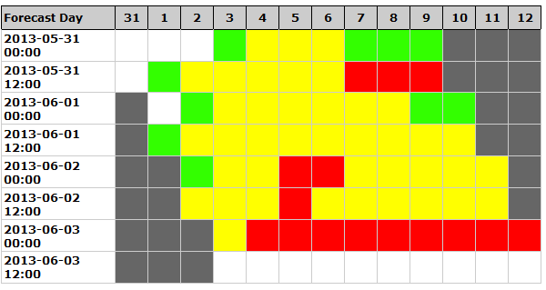
Forecasting chain in EFAS
Hydrology
EPS
Preprocessing/
calibration
Feedback to the model
Postprocessing
Warning
Verification

Slide 5
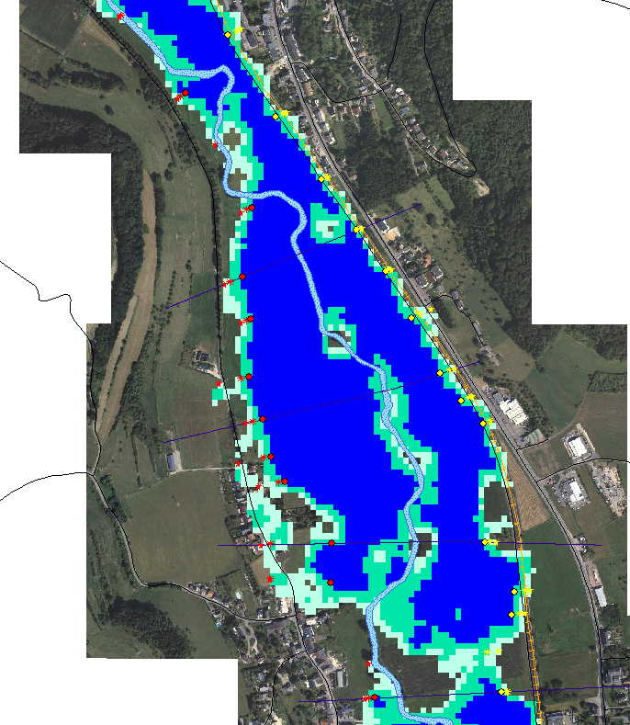
Forecasting chain in future EFAS
Multimodel
Hydraulics
Hydrology
EPS
Preprocessing/
calibration
Feedback to the model
Postprocessing
R212
Warning
Verification

Slide 6
Criteria for the hydrological models to be included
open source code
existing user community
flexibility to grid structure, sub-basin and basin scale requirements with a possibility to be coupled to different land-surface schemes (e.g. HTESSEL, CLM, SWAT, etc.)
possibility of calibration with suitable tools
flexibility in grid resolution between 1km and 10 km
facility of introducing discharge observation stations for comparison and calibration purposes.
pan European model set up already existing or, in case not existent, feasibility to set up European model
CLM | mHM
E-HYPE | MPI-HM
G2G | NOAH-MP
GWAVA | ORCHIDEE
H08 | PCR-GLOBWB
HTESSEL | SWAT
JULES | SWIM
LaD | TOPLATS
LISFLOOD | VIC
LPJml | WASMOD-M
Mac-PDM | WaterGAP
MATSIRO | WBMplus

Slide 7
Initial test of three models
Hydrological models | LISFLOOD | HTESSEL/ CAMA | EHYPE
Characteristic | Hydrological model with channel routing | HTESSEL coupled with CamaFlood | Semi-distributed conceptual model
Resolution | 5 km gridded | 80 km land surface model 25 km routing | Catchment based (varying resolution)
Driving data | 5 km gridded observed data | ERA-Interim corrected with GPCP/ 5 km gridded observed data | ERA-Interim corrected with GPCC/ 5 km gridded observed data
Test period: 1990-2010
Observational discharge: 212 stations from GRDC

Slide 8
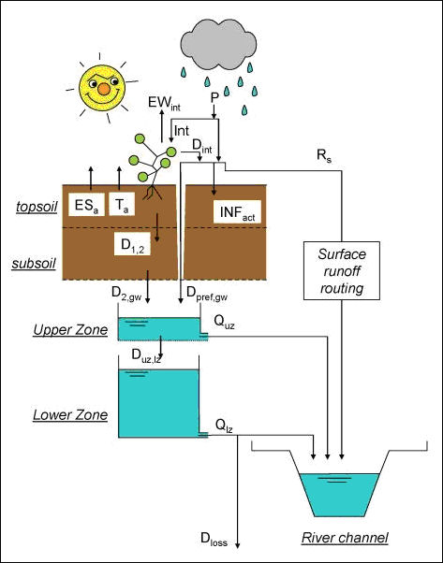
LISFLOOD
Notes:
Raster-based model developed at JRC
Input maps of precipitation, temperature and evapotranspiration
Output maps of surface runoff, rapid and slow groundwater
Channel routing through kinematic wave
Currently setup over Europe on a 5 x 5 grid for EFAS

Slide 9
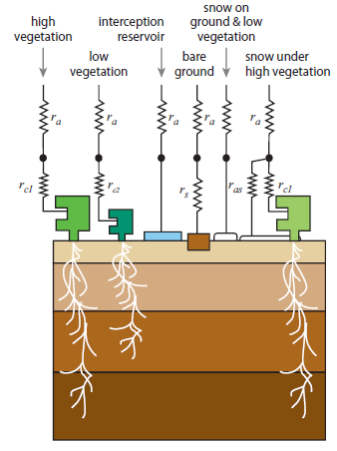
HTESSEL and CaMa-Flood
Notes:
HTESSEL:
ECMWF land surface scheme with new soil (Balsamo 2009 JH) and snow hydrology (Dutra 2010 JH)
Surface and soil runoff
4-layers in soil, no active groundwater component
Coupled with operational ECMWF models but also as a stand-alone offline model
CaMa-Flood: Catchment-based Macro-scale Floodplain model (Yamazaki, 2011 WRR).
Distributed river routing model
River and floodplain storage with sub-grid topographic parameters
Diffusive wave equation along river network map.
Input: Fine-resolution (1 km) datasets SRTM30 DEM & GDBD Flow Direction Map

Slide 10
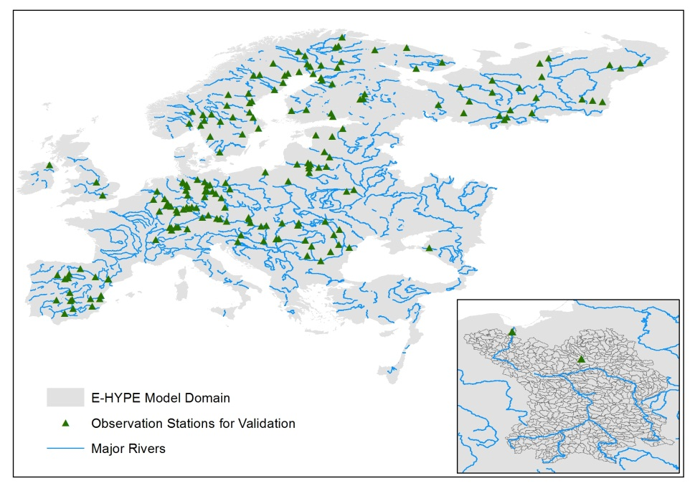
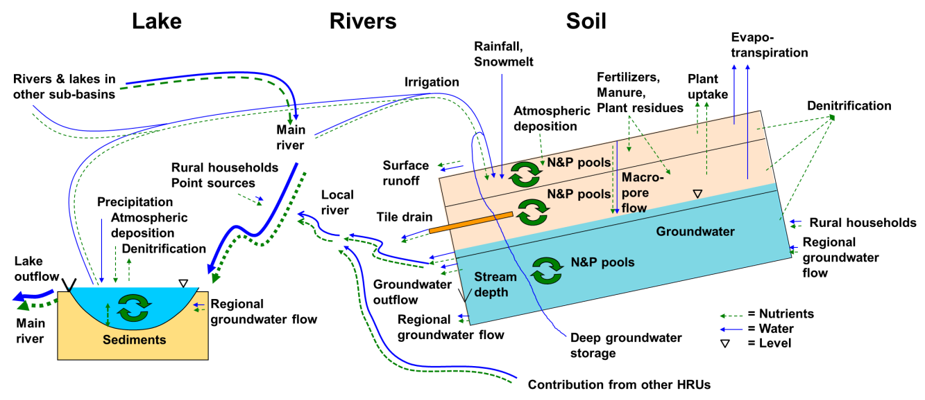
E-HYPE – pan European HYPE application
Notes:
Semi-distributed
35000 subbasins
Median size 215 km²
Set-up using continental (and global) databases
Input: Precipitation and temperature subbasin averages

Slide 11
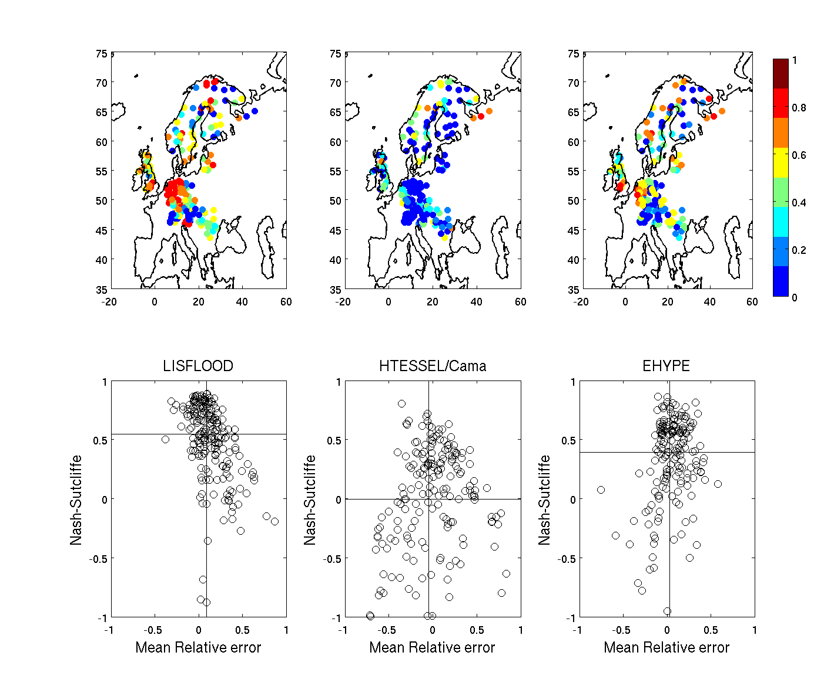
Results: Nash-Sutcliffe and mean relative error

Slide 12
Catchment area

Slide 13
Rhein 160800 km2
Observed NS MRE
LISFLOOD 0.89 9.4
HTESSEL 0.25 -9.6
EHYPE 0.65 -7.6

Slide 14
Danube 658400 km2
Observed NS MRE
LISFLOOD 0.55 6.2
HTESSEL 0.62 -12
EHYPE 0.32 -14

Slide 15
Severn 4000 km2
Observed NS MRE
LISFLOOD 0.64 21
HTESSEL 0.45 17
EHYPE 0.81 6.4

Slide 16
Multimodel – how useful is it for decision making?

Slide 17
Create one supermodel to rule them all?
Bayesian Model Averaging (BMA) accounts for the model uncertainty by averaging over the best models according to posterior model probability
The BMA methodology applied for this study performs analysis assuming a uniform distribution on model priors and using a simple BIC (Bayesian Information Criterion) approximation to construct the prior probabilities on the regressions coefﬁcients (Raftery, Hoeting, Volinsky, Painter & Yeung 2010).
If M = {$M_{1}$,…, $M_{k}$} denotes the set of models and if $∆$ is the quantity of interest (e.g. stream-flow), then the posterior distribution of $∆$ given the data D is:
This is an average of the posterior distributions under each model weighted by the corresponding posterior model probabilities.
$$pr\left(∆\right|D)=\sum_{k=1}^{K}{pr\left(∆ | M_{k},D\right)pr(M_{k}|D)}$$

Slide 18
Results: Bayesian model averaging
BMA improves NSE in 76% of the cases

Slide 19
Results: Bayesian model averaging
 | BMA | LISFLOOD | HTESSEL | E-HYPE
Best model before |  | 84 % | 3% | 13 %
Best model after | 76% | 24% | - | -
NS median | 0.76 | 0.66 | 0.087 | 0.36

Slide 20
Very preliminary conclusions
There are many models potentially suitable for inclusion in EFAS
The different models do perform differently depending on basin characteristics
BMA improves the performance of the models in most cases, and gives reasonable results even if the individual models are not doing well in a particular catchment
Without proper calibration it is difficult to draw conclusions on the quality of the driving data
Combining models will be a challenge – ensemble of models or weighted mean?
Is it necessary? Largest bias and uncertainty still in the NWP!
Future steps
Further calibration of LISFLOOD and CaMaFlood
Performance of the models probabilistic operational mode
Forecast display and dissemination
R201

Slide 21
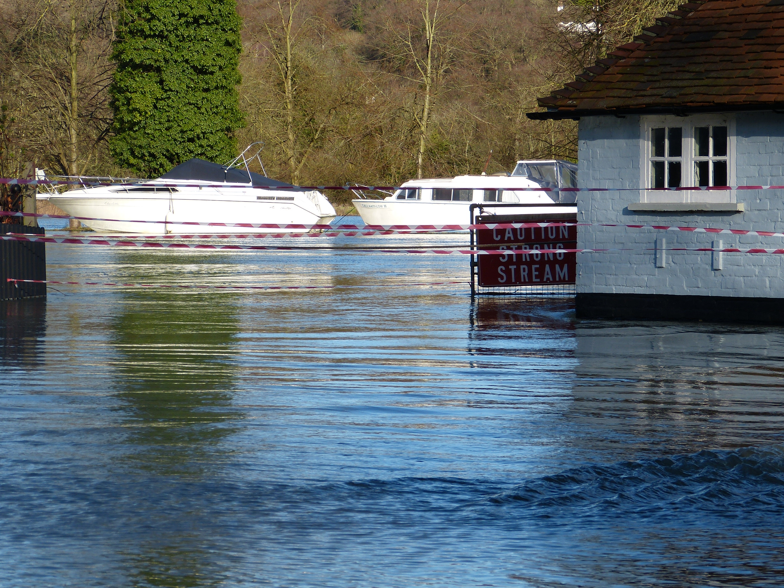
Thank you for your attention!

Slide 22
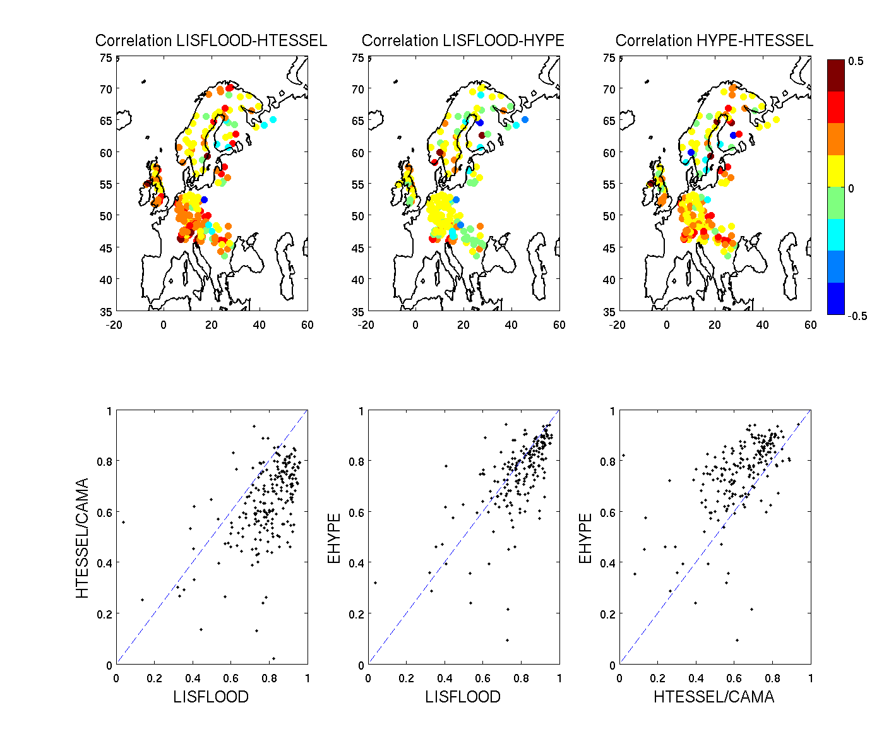
Results: Correlation LISFLOOD, HTESSEL/Cama and EHYPE

Slide 23
Influence of the observed precip data used on the results
Corrected ERAI and EFAS 5km gridded datasets perform on par.
The height correction is too wet
The EFAS 5km gridded has the best water balance
OBS! E-HYPE in this version is only rudimentary calibrated

Slide 24
Pite River (northern Sweden)
Observed NS MRE
LISFLOOD 0.55 6.2
HTESSEL 0.62 -12
EHYPE 0.32 -14

