Slide 1
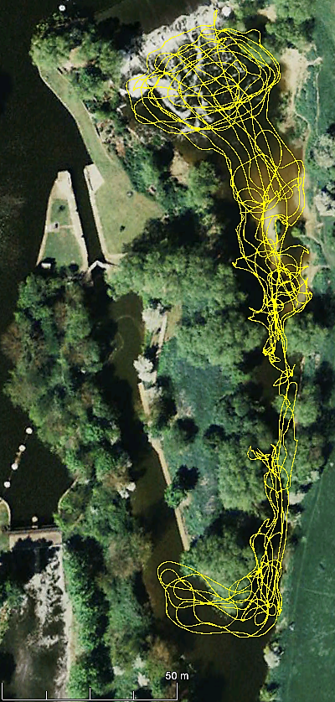
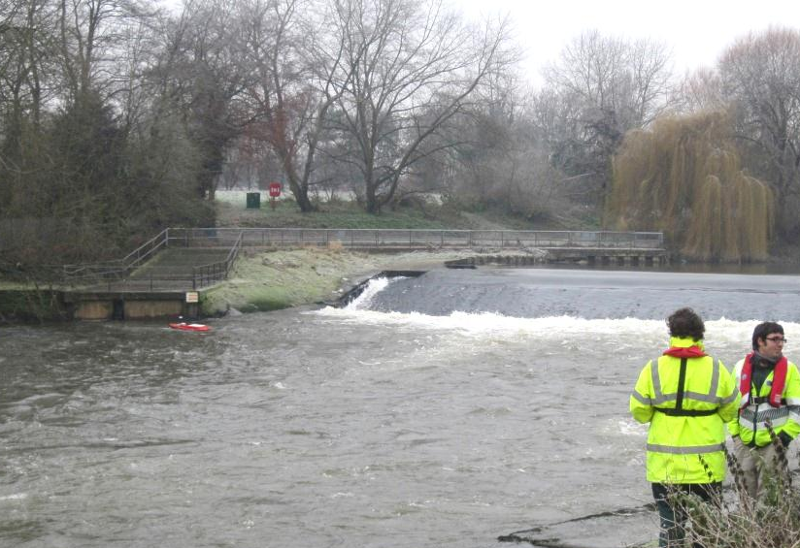
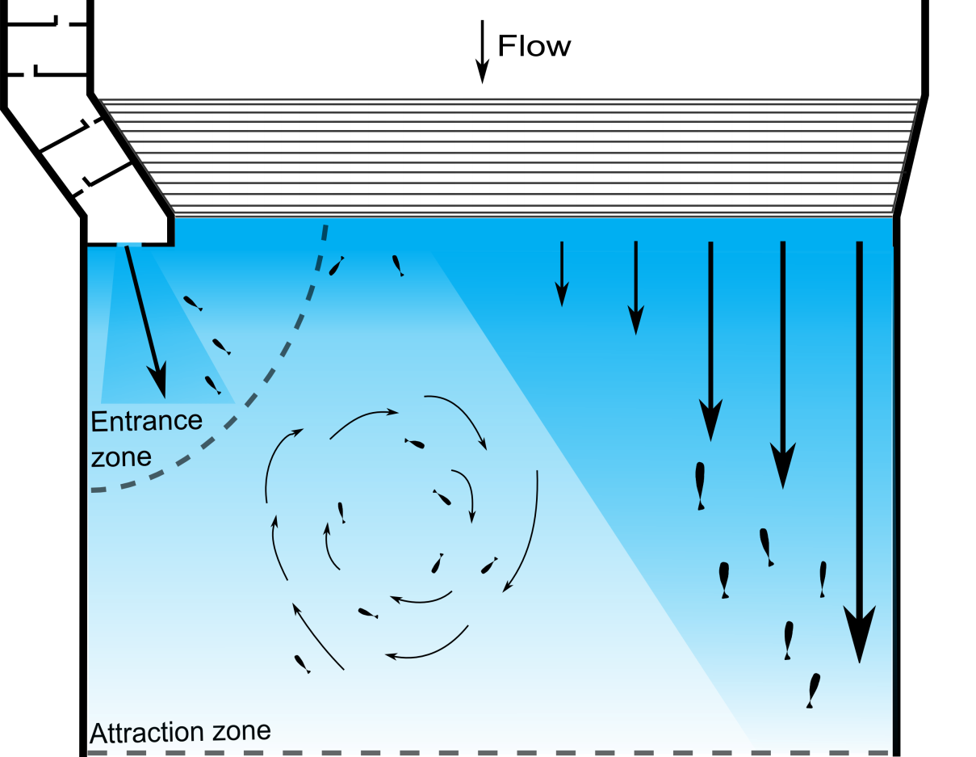
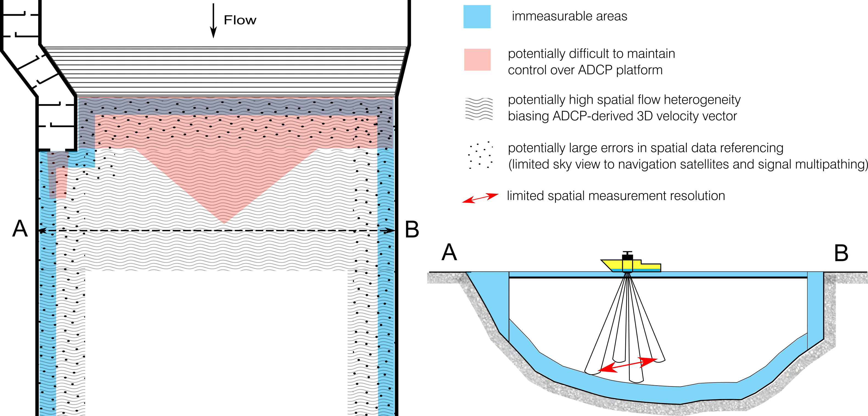
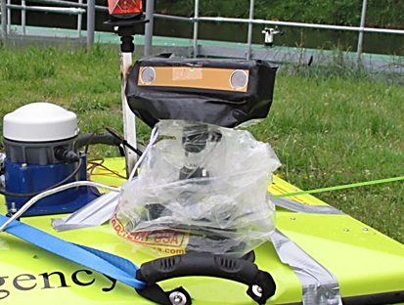
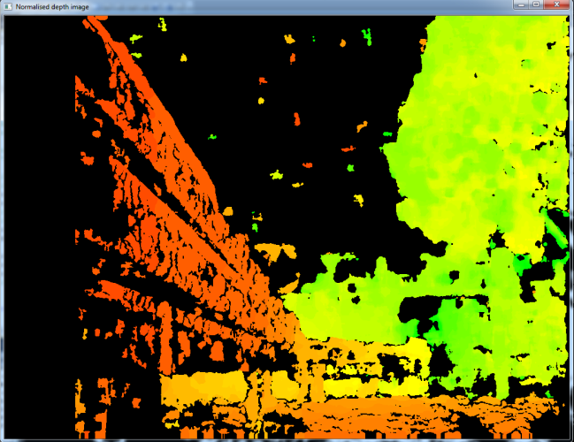
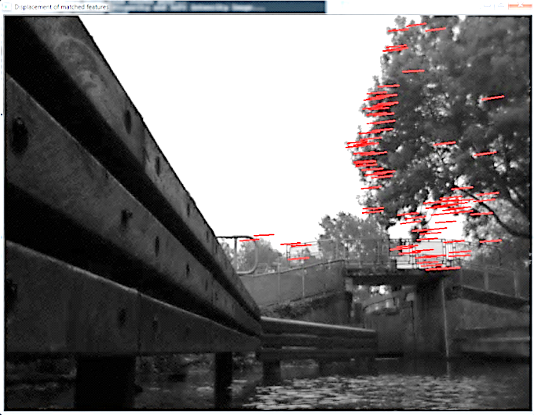
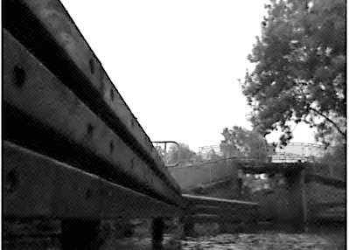
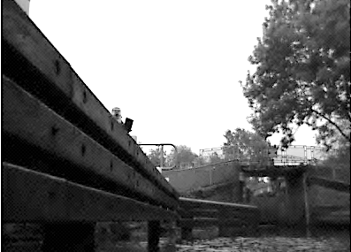
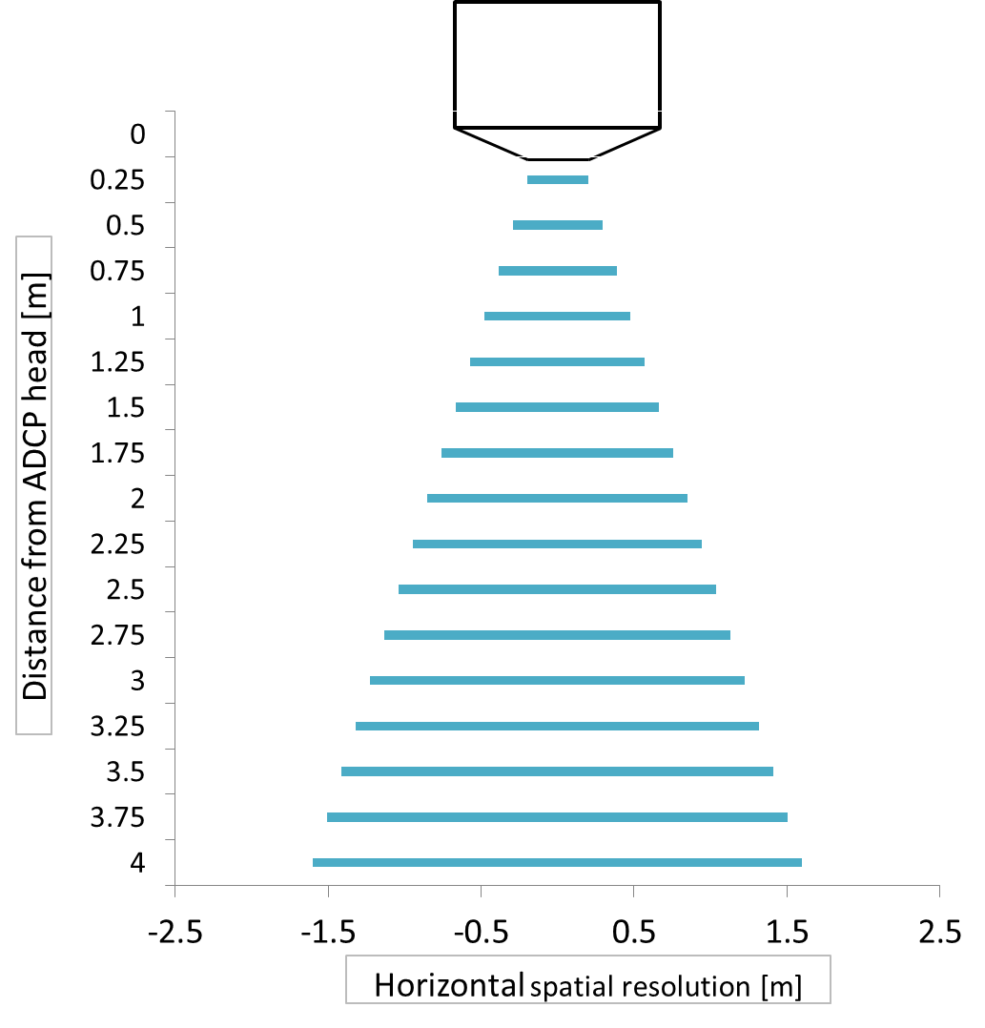
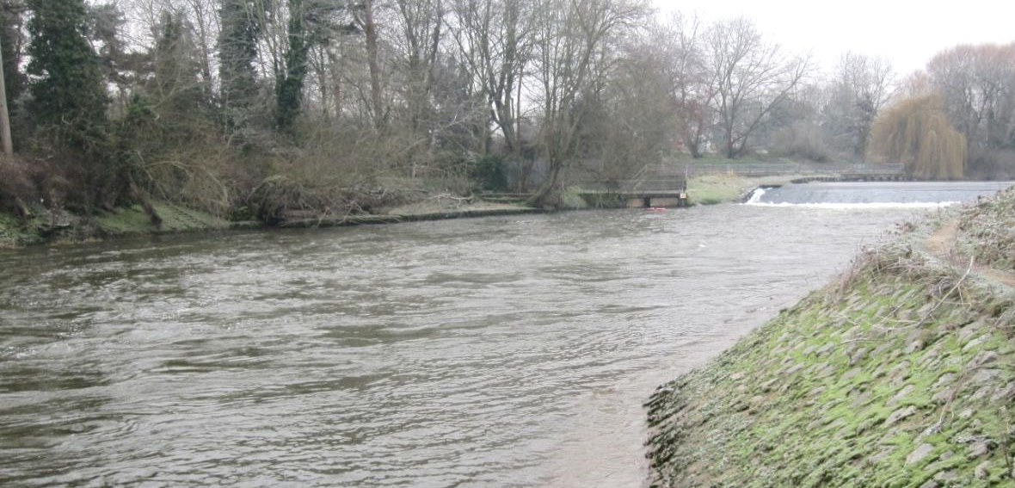
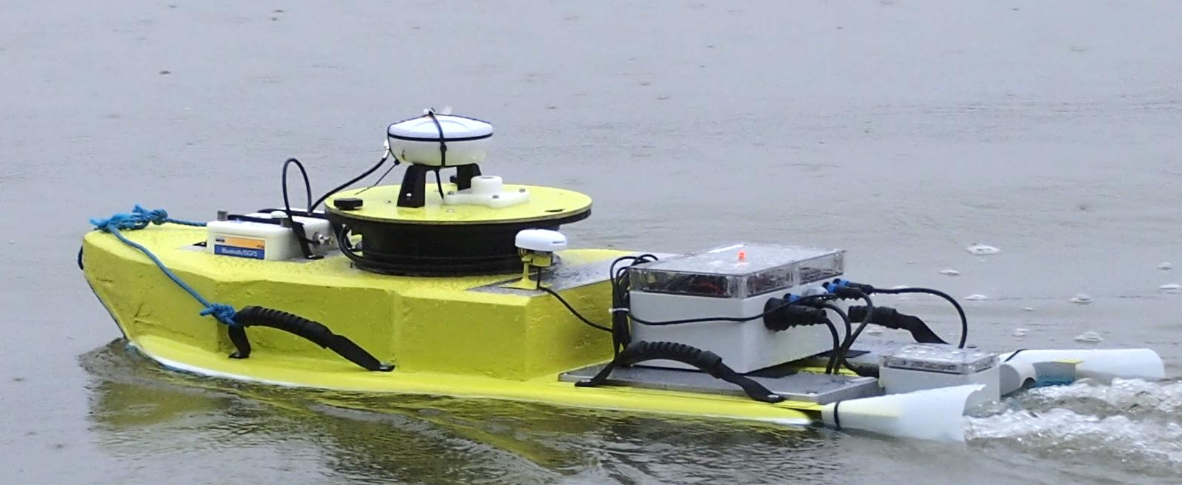
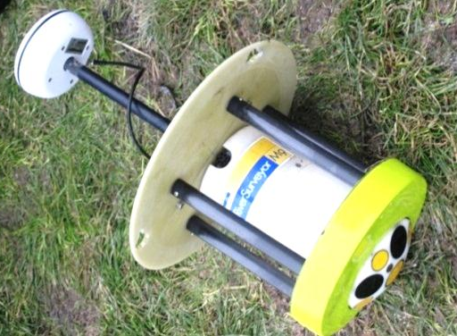
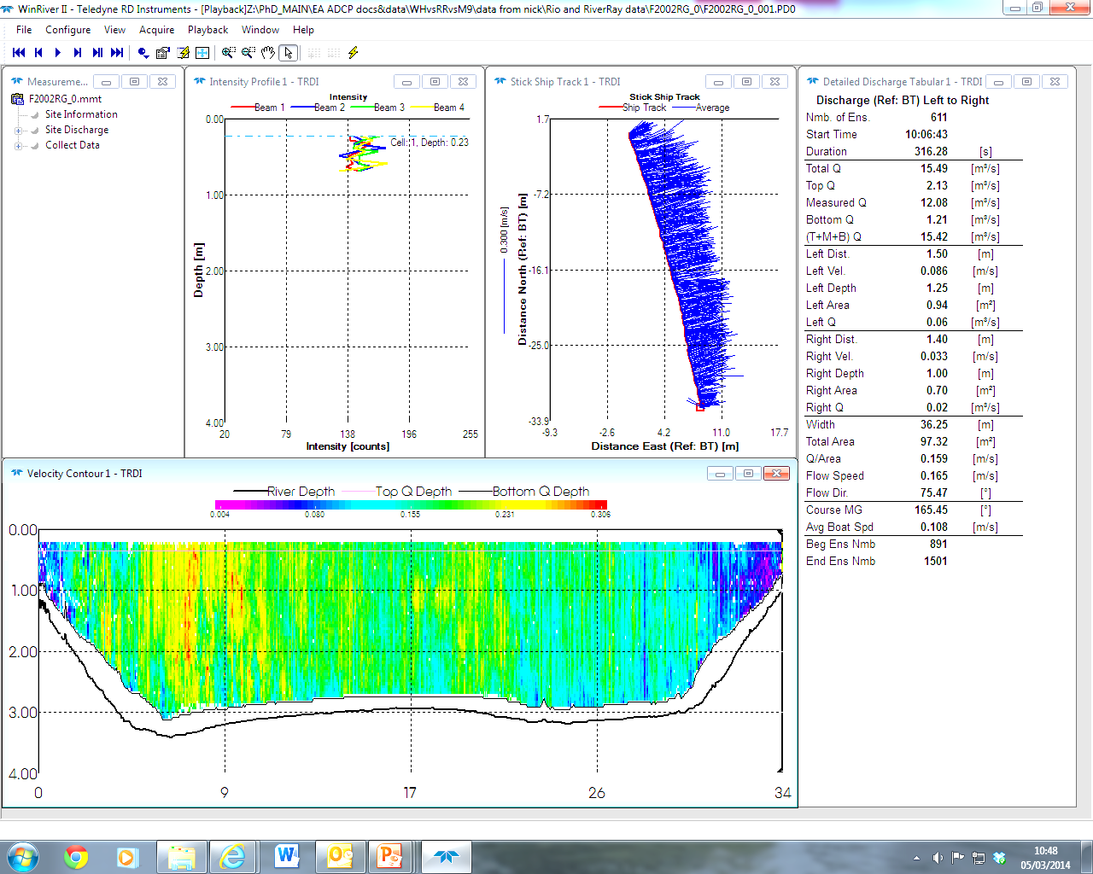


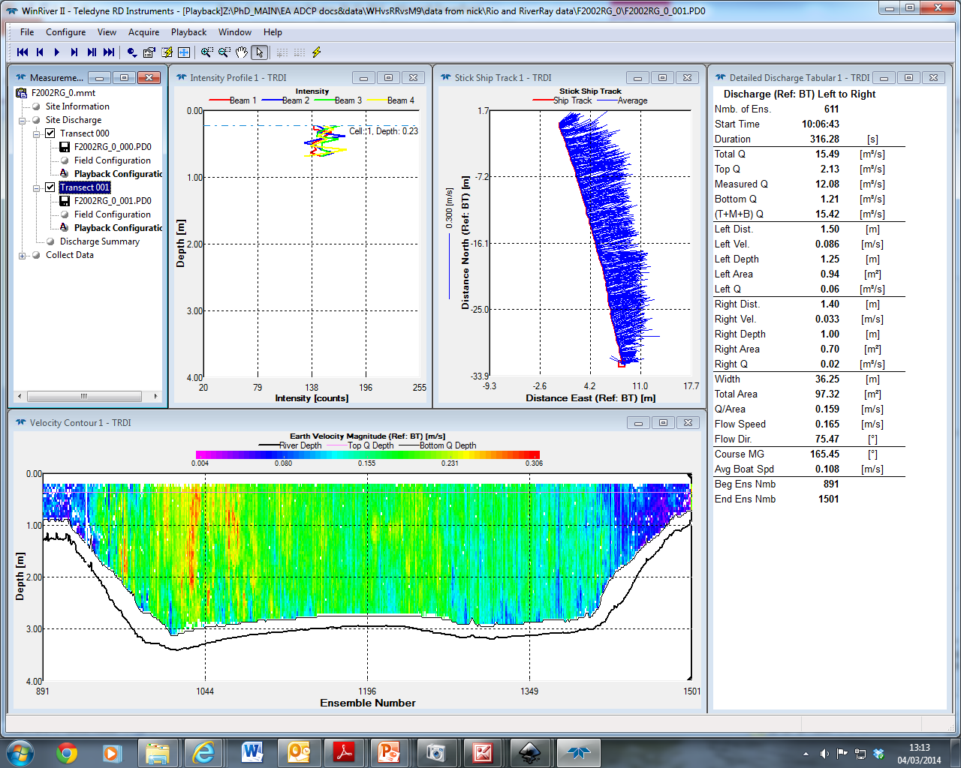

Fish pass assessment by remote control: Towards a
framework for quantifying the hydraulics at fish pass entrances
Thomas Kriechbaumer¹, Kim Blackburn¹, Andrew Gill¹, Toby Breckon², Nick Everard³, Ros Wright³, Monica Rivas Casado¹
1. Target – fish passage at barriers with minimal delay
2. Project aim
This project aims to develop a framework for the rapid quantification of near-pass hydraulics with Acoustic Doppler Current Profilers (ADCPs) deployed from radio-controlled boats. The initial steps focus on alleviating the major limitations of current ADCP technology.
3. Why ADCPs?
4. Initial results
Identifying ADCP limitations
On rivers, ADCPs are primarily deployed for discharge measurements. Their use beyond this purpose requires careful considerations of data quality.
Developing spatial ADCP data referencing approaches beyond GPS
Fish pass monitoring studies of the last decades indicate passage efficiencies below 50% at many fish passes globally, especially for non-salmonid species. Frequently, this is due to unfavourable near-pass hydraulic conditions, masking the fish pass entrance.
Near river banks, vegetation can limit sky view to navigation satellites. A low number of satellites “in view” and unfavourable satellite geometry (high horizontal dilution of precision – HDOP) lead to degraded GPS position accuracy.
20m
Fig.5. GPS performance assessment on the River Avon at Pershore, 12/12/2012
Platform track
To overcome GPS limitations, an ADCP positioning system based on stereo-vision (visual Simultaneous Localisation and Mapping – SLAM) is developed.
Fig.1. Strong competing flows and potentially weak attraction at a vertical slot pass on the River Severn, Shrewsbury, 13/12/2012
Fig.2. Possible hydraulic features downstream a weir with a fish pass; strong flows over the barrier and recirculation zones are masking the pass entrance..
Advancing radio-control ADCP deployment
A small-sized radio-control ADCP platform has been developed to facilitate data collection at fish passes in small rivers. It includes a data-logging system for multiple-sensor integration and the hardware for autonomous platform control to facilitate the implementation of sampling strategies.
Fig.6. Capturing stereo-images (left), estimating scenery depth based on stereo-disparity (middle) and tracking of salient features (right) are major steps in visual SLAM.
ADCPs enable the rapid collection of vast amounts of data on water velocity and depth, from which other hydraulic variables can be derived.
Increasing ADCP measurement resolution
ADCP-derived 3D velocities are based on measurements along all four ADCP beams. This leads to a decreasing spatial resolution with increasing measurement depth. Approaches to increase the resolution are currently tested.
Fig.3. ADCP-measured water velocities and depths
a)
Water depth [m)
Water velocity [ms⁻¹]
Fig.7. Spatial resolution of 3D velocities measured with a RioGrande 1200kHz ADCP
Distance made good (m)
Fig.4. New platform carrying a RiverSurveyor M9 ADCP on the River Thames at Eynsham, 06/02/2014
© Cranfield University 2014
www.cranfield.ac.uk/sas
¹Cranfield University, Department of Environmental Science and Technology, Cranfield, UK, t.kriechbaumer@cranfield.ac.uk,+44 07454 001948
²Durham University, School of Engineering and Computing Sciences, Durham, UK
³Environment Agency, Wallingford and Feering, UK

