Slide 1


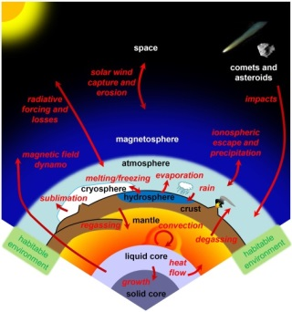
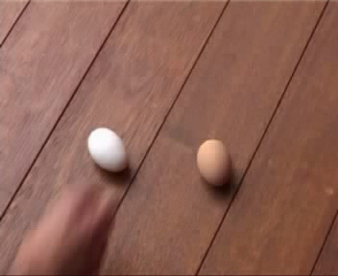
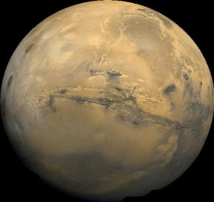
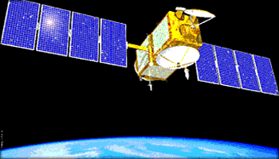

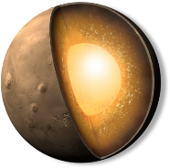
Planetary deep interiors, geodesy, and habitability
Véronique Dehant Royal Observatory of Belgium
Definition of Habitability
Considering geophysics
Importance of interior
© NASA
© NASA
composition,
structure,
thermal state
origin and sus-tainability of life on planets
evolution
Mars at present 7 mbar atmosphere; may not be the atmosphere in the early stage
Mars lost its early atmosphere during the (pre-)Noachian
Escape, Erosion, impacts, recycling?
habitability
Planetary reservoirs
Conclusions
Habitability conditions go beyond the simple hypothesis of existence of liquid water
Planetary reservoirs and their evolution and interactions play a major role
Space geodesy allows better understanding the interior (and rotation) of planets and constrains planetary evolution
internal core,
mantle,
lithosphere,
crust
Space geodesy
ocean
interactions
atmosphere
Future missions such as the InSIGHT (Interior exploration using
Seismic Investigations, Geodesy, and Heat Transport)
for determination of Mars interior and evolution, and thus in the
understanding of the habitability of Mars
References

Slide 2
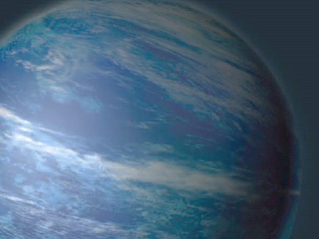


Life in exotic water worlds?
Planetary deep interiors, geodesy, and habitability
Véronique Dehant Royal Observatory of Belgium
Authors and Affiliations
Véronique Dehant
Royal Observatory of Belgium, Avenue Circulaire 3, 1180 Brussels, Belgium
v.dehant@oma.be

Slide 3
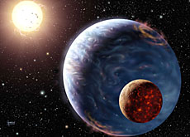
Life in exotic water worlds?
Planetary deep interiors, geodesy, and habitability
Véronique Dehant Royal Observatory of Belgium
Definition of habitability:
All necessary and sufficient conditions in order that an active life can exist, even if it does not exist.
= Measure of a planet's or a natural satellite's potential to sustain life. (Wikipédia)
An artist’s impression of an extra solar planet
Photo credit: David A Hardy, astroart.org
Copyright: STFC.

Slide 4
Life in exotic water worlds?
Planetary deep interiors, geodesy, and habitability
Véronique Dehant Royal Observatory of Belgium
Habitability conditions:
  Energy source (solar, volcanism, tidal energy, natural radioactivity…)
  Stable liquid water
  C, H, N, O, P, S, amino-acides … nutriments

Slide 5
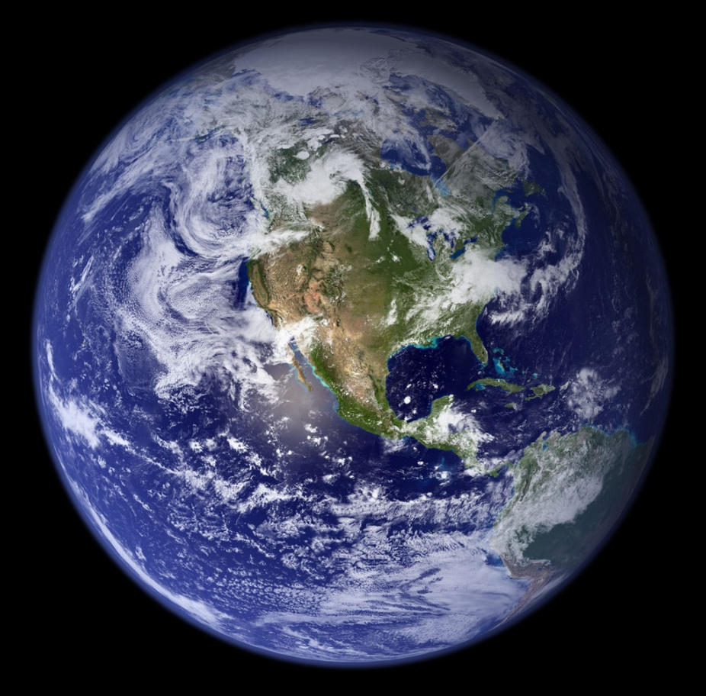
Life in exotic water worlds?
Planetary deep interiors, geodesy, and habitability
Véronique Dehant Royal Observatory of Belgium
Earth criterias for habitability:
Magnetic field
Plate tectonic
Volcanism
Atmosphere
Liquid water
Gravity
Carbon cycle
Satellite: the Moon
Impacts
© ESA

Slide 6
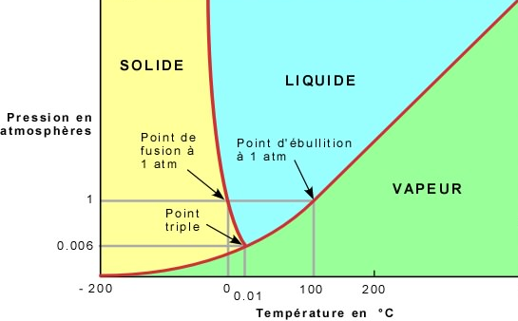
Life in exotic water worlds?
Planetary deep interiors, geodesy, and habitability
Véronique Dehant Royal Observatory of Belgium
Conditions, physical state of water H₂O in function of temperature and pressure
Atmospheric pressure on Venus
SOLID
LIQUID
Pressure in
Atmosphere
boiling point
fusion point
Atmospheric pressure on Earth
VAPOR
triple point
Atmospheric pressure on Mars
Atmospheric pressure on Mercury
Temperature in °C

Slide 7
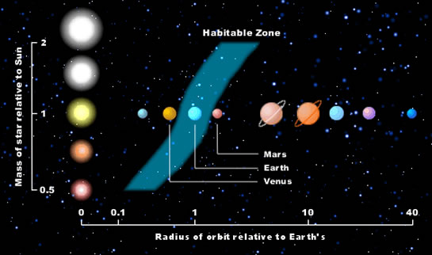
Life in exotic water worlds?
Planetary deep interiors, geodesy, and habitability
Véronique Dehant Royal Observatory of Belgium
Habitable Zone
Sources: http://www.astrobio.net/pressrelease/3157/tidal-habitable-zone

Slide 8
Life in exotic water worlds?
Planetary deep interiors, geodesy, and habitability
Véronique Dehant Royal Observatory of Belgium
? habitability conditions of a planet ?
astronomy
liquid water
habitable zone (HZ) around a star
energy
solar system: between Venus and Mars
nutrients
life
+ atmosphere, greenhouse effect
Building blocs of life
HZ includes early Mars
+ important geodynamic processes

Slide 9
Life in exotic water worlds?
Planetary deep interiors, geodesy, and habitability
Véronique Dehant Royal Observatory of Belgium
interdisciplinary approach
The evolution of planets is driven by the composition, structure, and thermal state of their internal core, mantle, lithosphere, crust, and by interactions with possible ocean and atmosphere.
composition,
structure,
thermal state
origin and sus-tainability of life on planets
evolution
habitability

Slide 10
Life in exotic water worlds?
Planetary deep interiors, geodesy, and habitability
Véronique Dehant Royal Observatory of Belgium
It is essential to understand the relationships and interactions between those different planetary reservoirs and their evolution through time, and in particular, the deep interior part of terrestrial planets and moons. The core of a planet, when composed of liquid iron alloy, may provide magnetic field and further interaction with the magnetosphere, ingredients believed to be important for the evolution of an atmosphere and of a planet in general. The deep interior is believed to be of high importance for its habitability.
internal core,
mantle,
lithosphere,
crust
planetary reservoirs
ocean
interactions
atmosphere

Slide 11
Life in exotic water worlds?
Planetary deep interiors, geodesy, and habitability
Véronique Dehant Royal Observatory of Belgium
Best candidates for hosting life
Earth-like planets,
natural satellites, and undifferentiated asteroids
satellites possessing an atmosphere (Earth, Mars, Venus and Titan)
satellites possessing a subsurface ocean (e.g., Europa, Ganymede)

Slide 12
Life in exotic water worlds?
Planetary deep interiors, geodesy, and habitability
Véronique Dehant Royal Observatory of Belgium
biological aspects
physical aspects
astrobiology
terrestrial life
integration
Extra-terrestrial life
geophysical aspects,
geochemical aspects,
geological aspects, biological aspects
ability of planets to host life
habitability
+ planetary science aspects
INTERDISCIPLINARY APPROACH

Slide 13
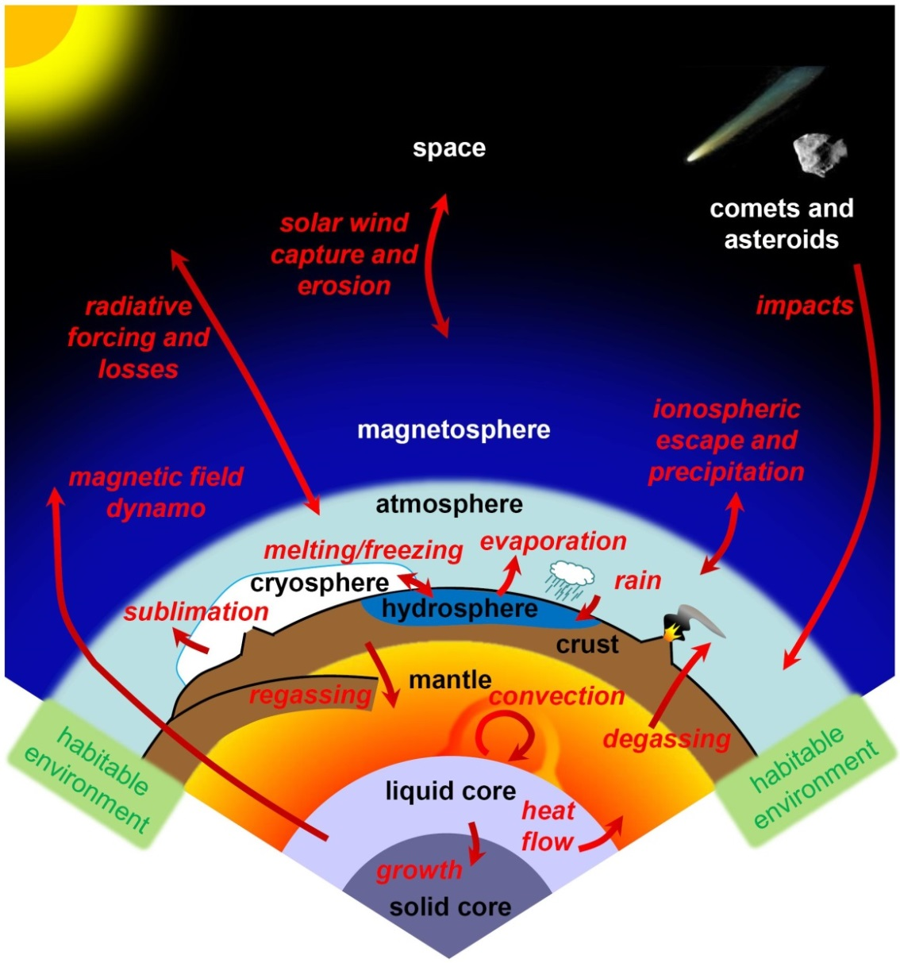



Life in exotic water worlds?
Planetary deep interiors, geodesy, and habitability
Véronique Dehant Royal Observatory of Belgium
Interuniversity
Attraction Pole

Slide 14
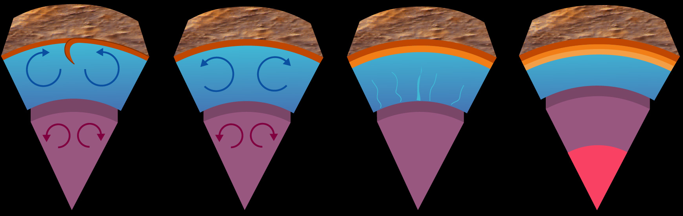
Life in exotic water worlds?
Planetary deep interiors, geodesy, and habitability
Véronique Dehant Royal Observatory of Belgium
Past
Present?
Present? or future
  Many questions about Mars’ core (size, state, inner core?)
  Important for the understanding of origin, evolution, and dynamics of Mars

Slide 15
Life in exotic water worlds?
Planetary deep interiors, geodesy, and habitability
Véronique Dehant Royal Observatory of Belgium
Interior properties obtained from rotation

Slide 16
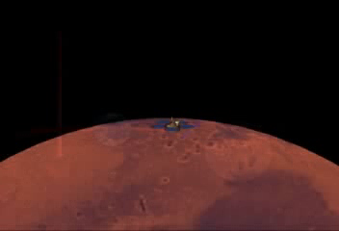
Life in exotic water worlds?
Planetary deep interiors, geodesy, and habitability
Véronique Dehant Royal Observatory of Belgium
Measurements = Doppler effects on radio signal

Slide 17
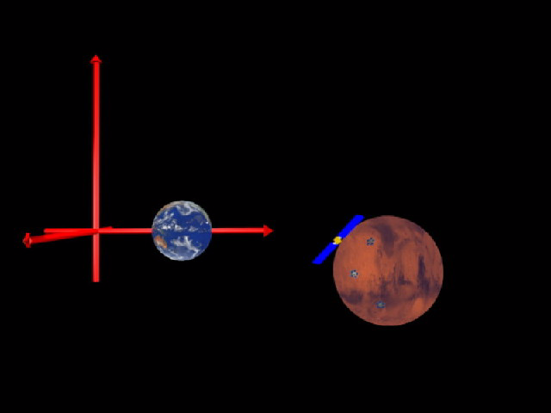
Life in exotic water worlds?
Planetary deep interiors, geodesy, and habitability
Véronique Dehant Royal Observatory of Belgium
Several radio links possible: Earth-orbiter,
orbiter-lander, lander-Earth

Slide 18
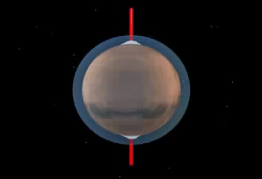
Life in exotic water worlds?
Planetary deep interiors, geodesy, and habitability
Véronique Dehant Royal Observatory of Belgium
Rotation changes = seasonal variations of moments of inertia;
Related to CO₂ sublimation-condensation process

Slide 19
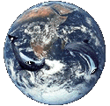

Life in exotic water worlds?
Planetary deep interiors, geodesy, and habitability
Véronique Dehant Royal Observatory of Belgium
Lander and orbiter, even rover at the surface of planets or moons of the solar system help in determining their interior properties. First of all orbiters feel the gravity of the planet and its variations. In particular, the tidal mass redistribution induces changes in the acceleration of the spacecraft orbiting around a planet.
© NASA
X-Band
UHF

Slide 20
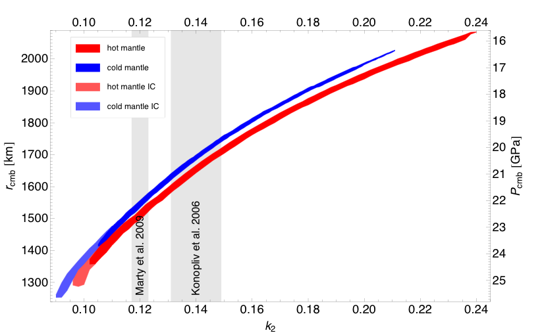
Life in exotic water worlds?
Planetary deep interiors, geodesy, and habitability
Véronique Dehant Royal Observatory of Belgium
k2 as a function of core size
The Love number k₂ has been determined for Venus, Mars, and the Earth, as well as for Titan and will be deduced for Mercury and for some of the Galilean satellites from new missions such as JUICE (Jupiter Icy satellite Explorer).
From Rivoldini et al. 2011; Konopliv et al., 2006, 2011

Slide 21
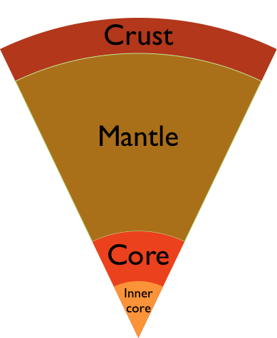
Life in exotic water worlds?
Planetary deep interiors, geodesy, and habitability
Véronique Dehant Royal Observatory of Belgium
Interior structure model of Mars as recently derived at ROB (Rivoldini et al. 2011)
The properties of the interior can also be determined from the observation of the rotation of the celestial body e.g. Radar observation from the Earth ground stations of Mercury (Margo et al. 2012, JGR) to determine the moments of inertia of Mercury with an unprecedented accuracy. Rovers such as the MERs (Mars Exploration Rovers) allow as well to obtain the precession
and nutation of Mars from
which the moments of
inertia of the planet and
its core can be deduced.
spherical symmetric, hydrostatic and elastic
homogeneous crust
depth dependent thermoelastic properties in mantle and core
convecting liquid Fe-S core
solid γ-Fe inner core (melting data dependent)

Slide 22
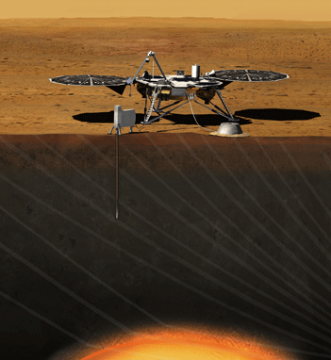
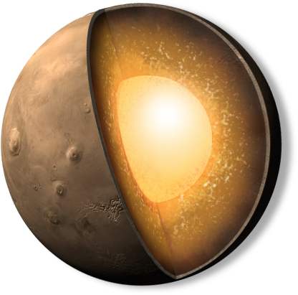
Life in exotic water worlds?
Planetary deep interiors, geodesy, and habitability
Véronique Dehant Royal Observatory of Belgium
Future missions such as the InSIGHT (Interior exploration using Seismic Investigations, Geodesy, and Heat Transport) NASA mission will further help in the determination of Mars interior and evolution, and thus in the understanding of the habitability of Mars.
See Le Maistre et al. 2012; Dehant et al. 2012.
InSIGHT
2016!
© NASA

Slide 23
Life in exotic water worlds?
Planetary deep interiors, geodesy, and habitability
Véronique Dehant Royal Observatory of Belgium
References
Rivoldini A., Van Hoolst T., Verhoeven O., Mocquet A., and Dehant V., 2011, “Geodesy constraints on the interior structure and composition of Mars.”, Icarus, 213, 451-472, DOI: 10.1016/j.icarus.2011.03.024.
Le Maistre S., Rosenblatt P., Rivoldini A., Dehant V., Marty J.C., and Karatekin Ö., 2012, “Lander Radio science experiment with a direct link between Mars and the Earth.”, Planet. Space Sci., 68(1), 105-122, DOI: 10.1016/j.pss.2011.12.020.
Dehant V., Banerdt B., Lognonné P., Grott M., Asmar S., Biele J., Breuer D., Forget F., Jaumann R., Johnson C., Knapmeyer M., Lefeuvre M., Mimoun D., Mocquet A., Read P., Rivoldini A., Romberg O., Schubert G., Smrekar S., Spohn T., Tortora P., Ulamec S., and Vennerstrøm S., 2012, Future Mars geophysical observatories for understanding its internal structure, rotation, and evolution, Planet. Space Sci., 68(1), 123-145, DOI: 10.1016/j.pss.2011.10.016.
Konopliv A.S., Asmar S.W., Folkner W.M., Karatekin Ö., Nunes D.C., Smrekar S.E., Yoder C.F., Zuber M.T., 2011, “Mars High Resolution Gravity Fields from MRO, Mars Seasonal Gravity, and Other Dynamical Parameters.”, Icarus, 211(1), pp. 401-428, DOI: 10.1016/j.icarus.2010.10.004.

