Slide 1
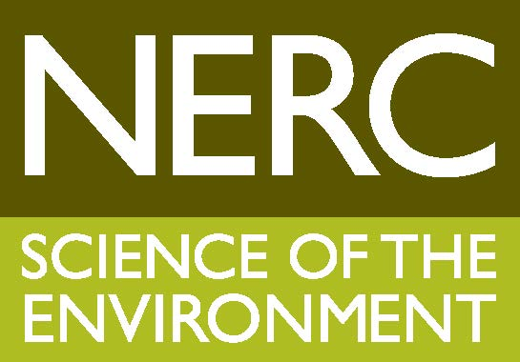
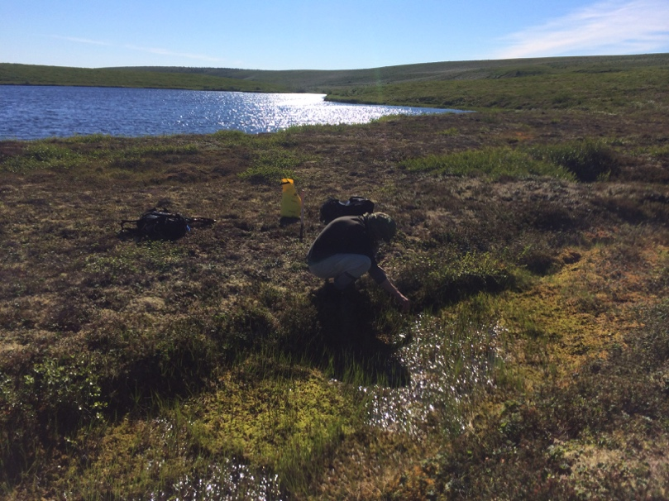
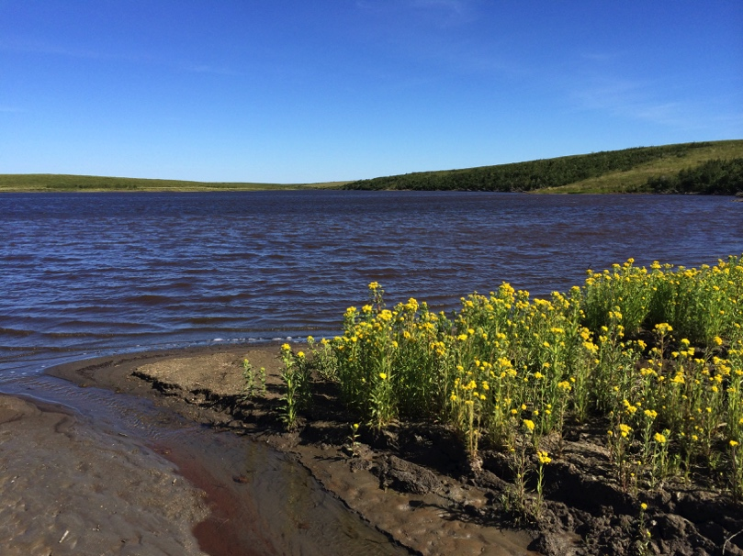
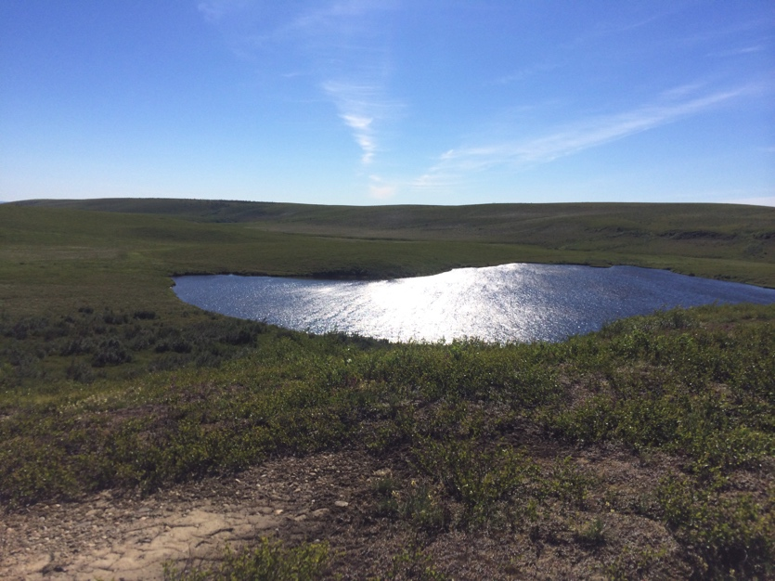
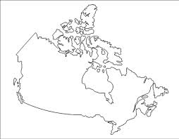
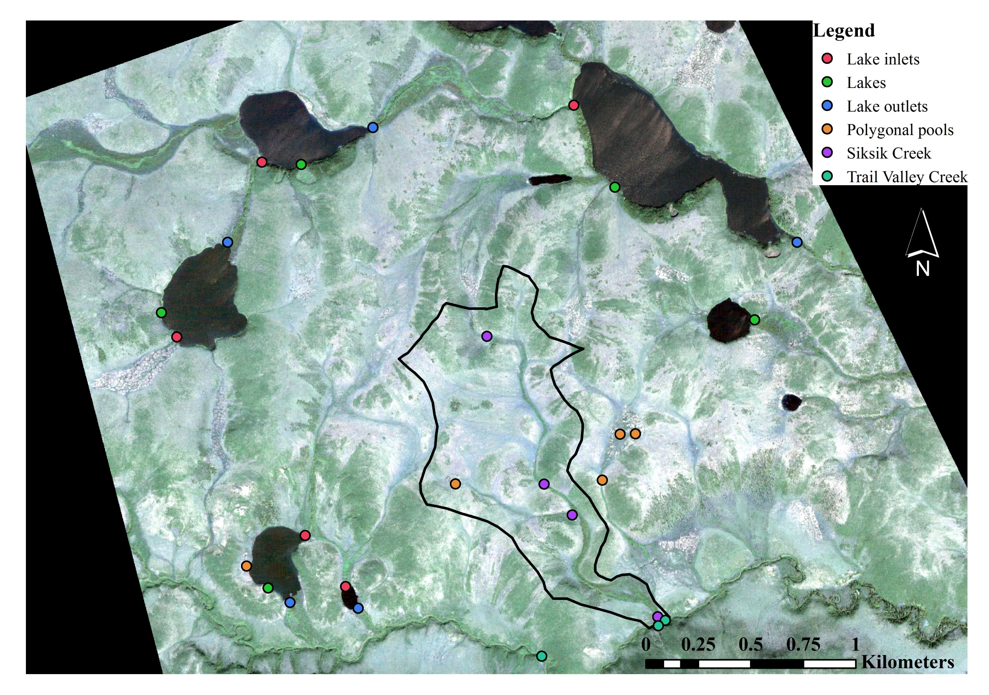
EGU2015-13454
Surface water types in the Western Canadian Arctic:
geochemical evolution and aquatic carbon transport
Joshua F. Dean¹ (joshua.dean@stir.ac.uk), Mike F. Billett¹, Kerry J. Dinsmore², Jason S. Lessels³, Lorna Street⁴, Ian Washbourne², Jens-Arne Subke¹, Doerthe Tetzlaff³, Robert Baxter⁴, and Philip A. Wookey⁴.
¹University of Stirling, ²Centre for Ecology and Hydrology, ³University of Aberdeen, ⁴Heriot Watt University, ⁵University of Durham
Background
Arctic surface waters are a substantial conduit for terrestrial C flow as well as a potential source of GHGs to the atmosphere. The HYDRA project (“Permafrost catchments in transition: Hydrological controls on carbon cycling and greenhouse gas budgets”), aims to quantify the assimilation and movement of C through the plant-soil-water-atmosphere continuum.
Here we consider the evolution of different surface water types in the Western Canadian Arctic, and their potential significance to catchment-scale aquatic C fluxes in a warming Arctic.
Water chemistry – Reducing Data Complexity
A principal component analysis (PCA) was applied to sampling dates with full records (n=181), and a canonical discriminant analysis (CDA) was applied to the principal components (Fig. 6).
The first 6 principal components describe 84% of biogeochemical variability, and include significant contributions from almost every variable (n=15), rather than a few specific variables.
Figure 2. Water types at the study site (from left to right): A polygonal pool next to a lake; A lake inlet; A view of a lake within the tundra landscape.
Distinguishing Water Types
Canonical 1 groups Sik and Poly, In and TVC and Lake and Out together, respectively (Fig. 6); Canonical 2 helps separate Sik from Poly, but only distinguishes TVC from the other groups.
This supports what we see in the C chemistry: The waters grouped by canonical 1 have similar flow path timescales, and geochemical inputs.
Canonical 1 and 2 suggest TVC receives inputs from the water types defined here and elsewhere upstream.
Key Research Questions
Are there biogeochemically distinct surface water types in the Arctic?
How are these water types linked in space and time?
What is the significance of water evolution pathways to C fluxes?
Study area
Figure 1. Above – location of the study area in the Western Canadian Arctic. Right – location of the sampling points for each water type. Siksik Creek catchment is outlined, and drains into Trail Valley Creek.
Figure 3. Boxplots of pH and primary ion concentrations in water samples collected during both the 2013 and 2014 field campaigns
Study Site
The area is located 55 km NNE of Inuvik, NWT, Canada (68° 44’ N, 133° 38’W). Sampling focused on the smaller (<1 km²) Siksik Creek, surrounding lakes and polygonal pools, and the larger river system these drain into (Trail Valley Creek; Fig. 1).
The land surface is dominated by mineral hummocks overlying glacial tills, with peat soils filling the inter-hummocks. The average permafrost active layer depth is 5 to 40 cm during the summer.
Figure 6. CDA results comparing water types classified by the PCA. The circles indicate the 95% confidence interval for each water type. Direction and length of each ray indicates the magnitude and sign of the correlation between the first 6 principal components and the first 2 canonicals. C1 describes 73%, and C2 14% of the variability in the PCs; C1 identifies 3 groups Sik/Poly from TVC/In, Lake/Out; C2 only distinguishes TVC from the rest of the groups.
Sample Collection
Samples were collected during the thaw season (June-September) of 2013 and 2014 from 6 water types (Fig. 1 and 2):
Lake inlets [“In”]
Lakes [“Lake”]
Lake outlets [“Out”]
Polygonal (ice-wedge) pools [“Poly”]
Siksik Creek (small headwater catchment) [“Sik”]
Trail Valley Creek (large stream system) [“TVC”]
Figure 4. Boxplots of dissolved C species concentrations
Figure 5. Relative proportion of C species and total C concentrations
Initial Conclusions
Surface water types are statistically significantly different (Wilks’ λ = 0.16, degrees of freedom = 30, P < 0.0001).
The PCA and canonical discriminant analysis suggest the water types align in 2 different ways: (a) where direct/indirect atmospheric interaction is short [Poly > Sik > TVC], or (b) long [In > Lake > Out].
Our initial interpretation suggests that the evolution of the aquatic system in the Arctic will have significant implication for aquatic C cycling and connectivity.
Carbon Species
Total C concentrations varied from 20 to 41 mg l⁻¹ C (Fig. 4 and 5);
Poly had highest C concentrations – these pools have low water volumes and allow water to interact with organic soils for longer;
Sik has high C concentrations – water has low direct/indirect atmospheric interaction when C mineralisation and degassing can occur;
Lowest C concentrations were In, Lake, Out and TVC where flow paths are longer, increasing direct/indirect atmospheric interaction.
Methods
Water samples were collected and filtered in the field, along with dissolved gas samples using the headspace method; samples were analysed in the UK.
For more information
please visit http://www.project-hydra.net
Acknowledgements
This work was supported by the UK Natural Environment Research Council (grant number NE/K000268/1). We would also like to thank the Aurora Research Institute in Inuvik and Prof. Philip Marsh of Wilfrid Laurier University for their support during the field campaigns.

