Slide 1
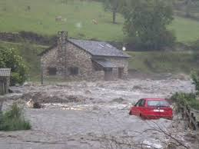


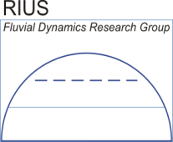

EFFECTS OF GLOBAL CHANGE ON HYDRO-GEOMORPHOLOGICAL HAZARDS IN MEDITERRANEAN RIVERS (FLOODHAZARDS)
DR. JOSÉ ANDRÉS LÓPEZ-TARAZÓN
jalopez@uni-potsdam.de
INTRODUCTION
OBJECTIVES
STUDY AREA
RESEARCH DESIGN

Slide 2
Floodhazards aims to predict and assess the hydro-geomorphological hazards associated with global change in Mediterranean regions
Key focal points are:
understanding the evolution of the river features (e.g. water, sediment, channel deformation) which determine the hydro-geomorphological flooding hazards
change of these hazards as a result of global change (i.e. rainfall, temperature and human-based changes).
OBJECTIVES
STUDY AREA
RESEARCH DESIGN

Slide 3
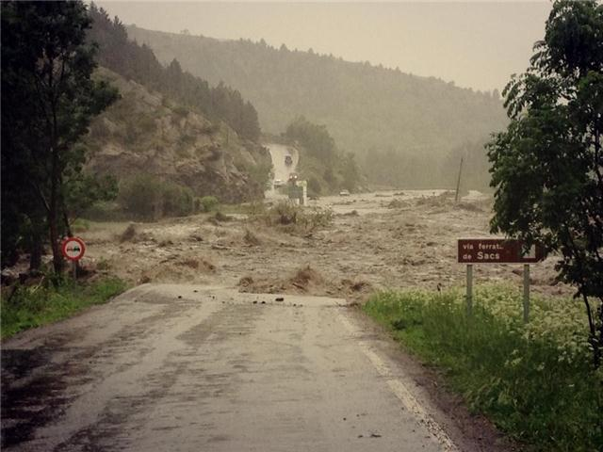
Objectives:
- Analyse the historical and contemporary conditions, modelling their hydro-morphological patterns and transfer of water and sediments at the catchment scale (by using WASA-SED), and modelling the effects at critical points at the reach-scale (by using IBER).
- Forecast the impacts of global change on flooding hydro-geomorphological hazards.
Questions we intend to answer:
Q1
Q2
Q3
INTRODUCTION
STUDY AREA
RESEARCH DESIGN

Slide 4
Objectives:
- Analyse the historical and contemporary conditions, modelling their hydro-morphological patterns and transfer of water and sediments at the catchment scale (by using WASA-SED), and modelling the effects at critical points at the reach-scale (by using IBER).
- Forecast the impacts of global change on flooding hydro-geomorphological hazards.
How does global change and basin size affect hydro-geomorphological hazards?
Questions we intend to answer:
Q1
Q2
Q3
INTRODUCTION
STUDY AREA
RESEARCH DESIGN

Slide 5
Objectives:
- Analyse the historical and contemporary conditions, modelling their hydro-morphological patterns and transfer of water and sediments at the catchment scale (by using WASA-SED), and modelling the effects at critical points at the reach-scale (by using IBER).
- Forecast the impacts of global change on flooding hydro-geomorphological hazards.
Which are the most important variables affecting hazards?
Questions we intend to answer:
Q1
Q2
Q3
INTRODUCTION
STUDY AREA
RESEARCH DESIGN

Slide 6
Objectives:
- Analyse the historical and contemporary conditions, modelling their hydro-morphological patterns and transfer of water and sediments at the catchment scale (by using WASA-SED), and modelling the effects at critical points at the reach-scale (by using IBER).
- Forecast the impacts of global change on flooding hydro-geomorphological hazards.
Will hydrogeomorphological hazards change if global change predictions are borne out?
Questions we intend to answer:
Q1
Q2
Q3
INTRODUCTION
STUDY AREA
RESEARCH DESIGN

Slide 7
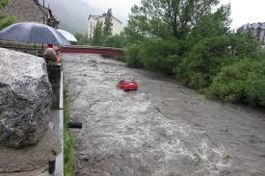
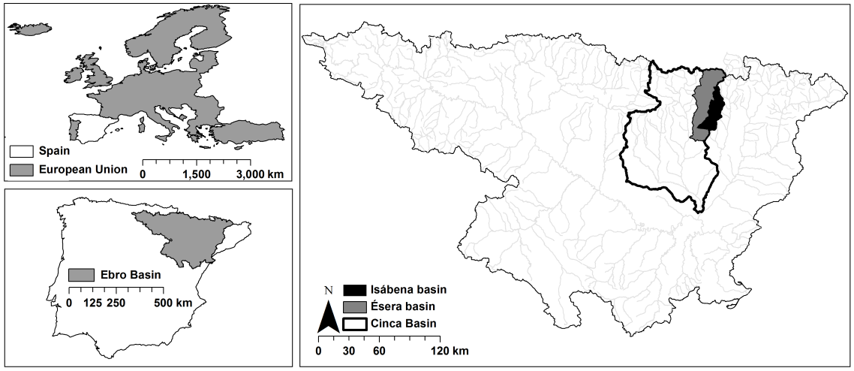
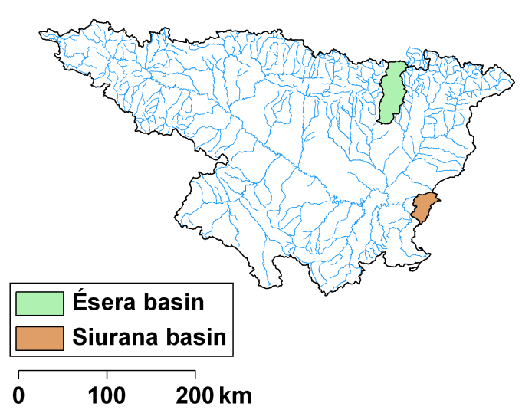
Four basins in the Iberian Peninsula with very different geological and climatological characteristics and affected by different anthropogenic impacts
Two Pyrenean nested catchments (the most important tributaries of the Cinca river, in turn the second largest tributary of the Ebro basin)
The very last tributary of the Ebro basin
THE ISÁBENA
THE SIURANA
THE ÉSERA
INTRODUCTION
OBJECTIVES
RESEARCH DESIGN

Slide 8
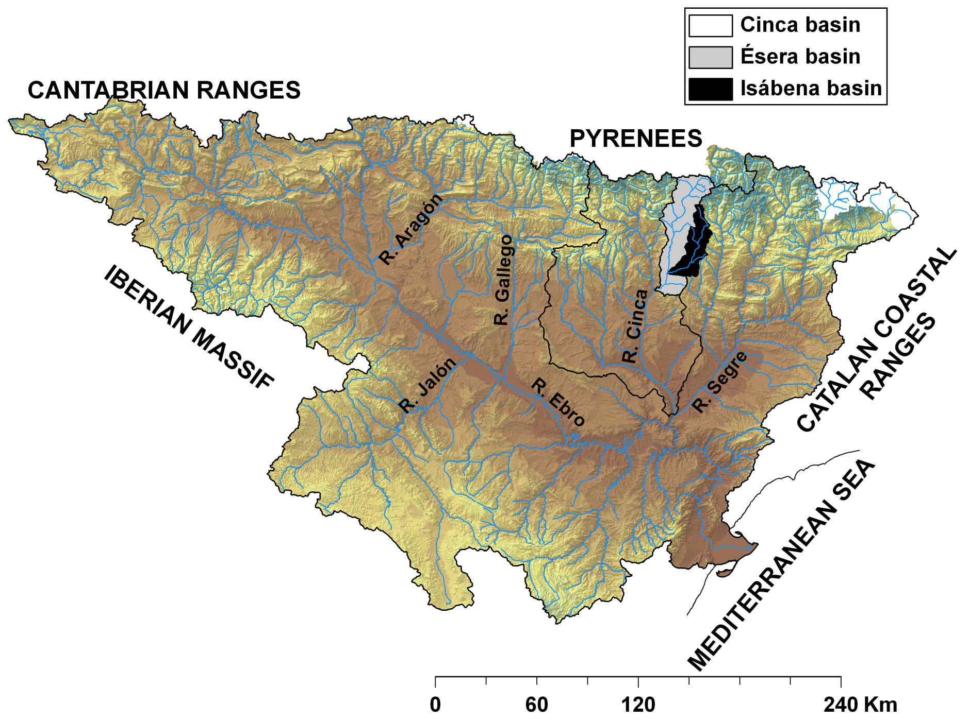
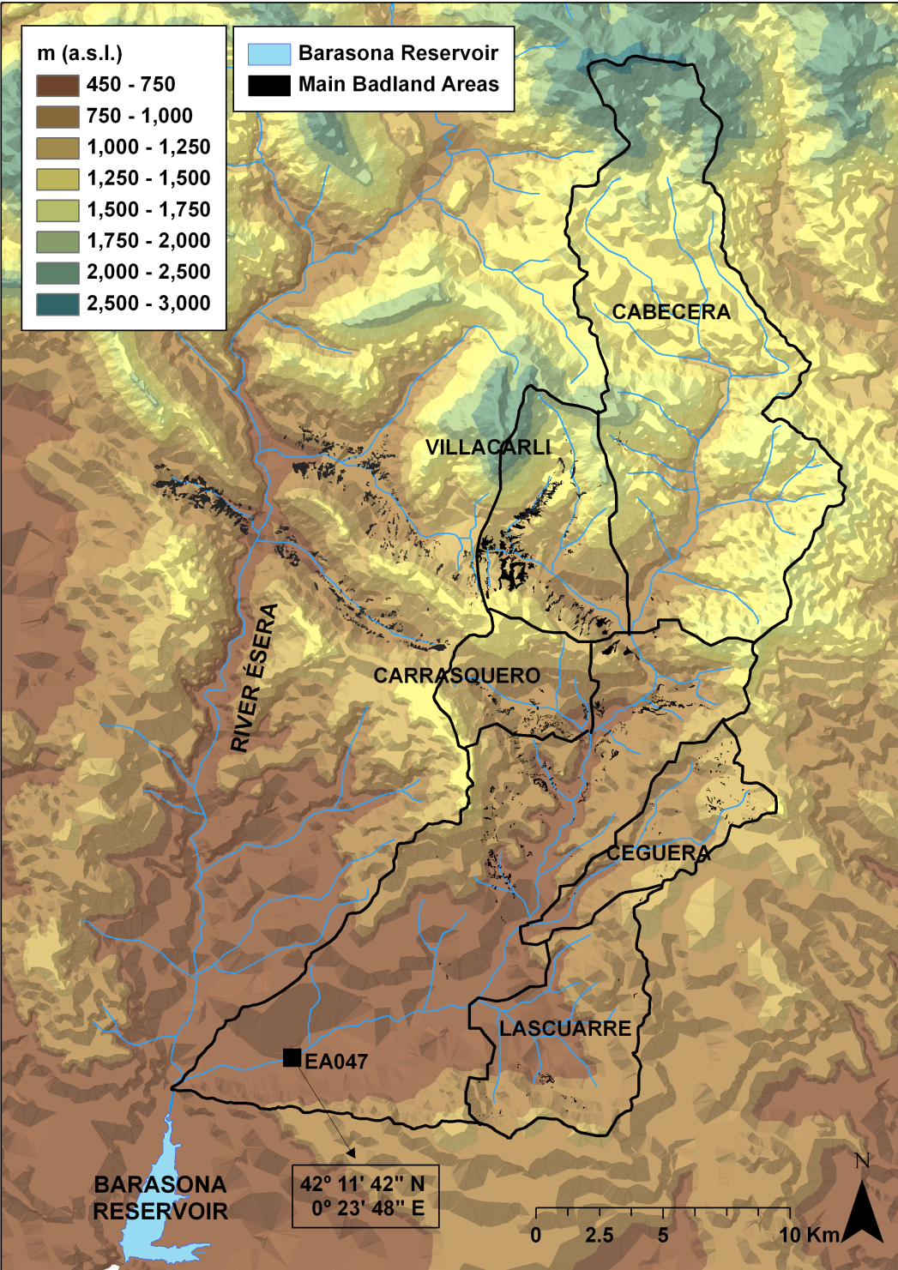
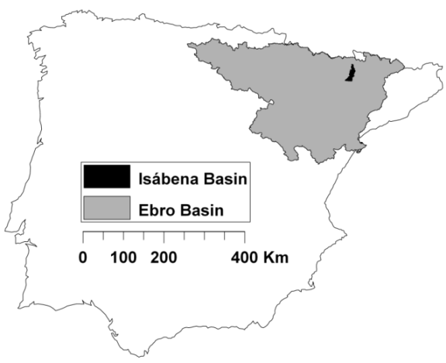
The Isábena (i.e. 445 km²), running through a badland stripe, usually generating hyperconcentrated flows, and delivering huge suspended sediment yields into the Barasona reservoir. (López-Tarazón et al., 2009, 2010, 2011, 2012, 2014) .
INTRODUCTION
OBJECTIVES
RESEARCH DESIGN

Slide 9
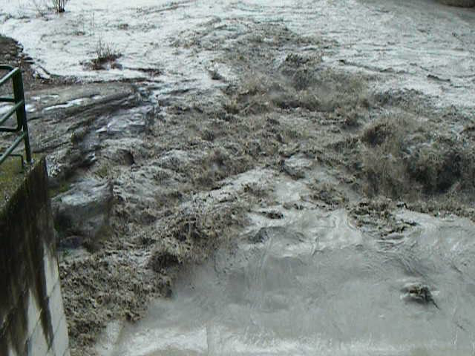

Slide 10
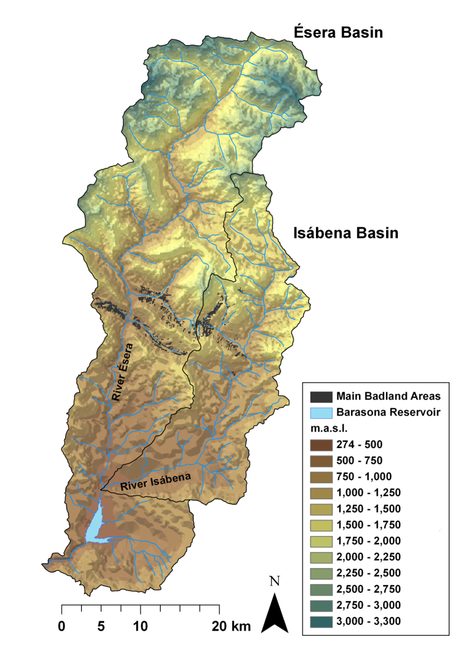
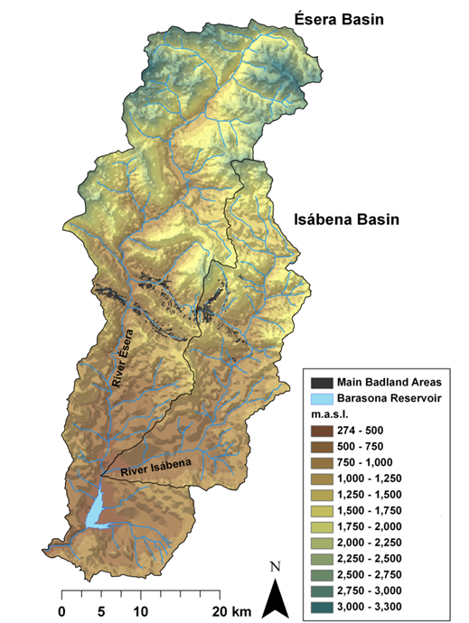

The Ésera (i.e. 1,535 km²), sharing the same badland stripe of the Isábena, usually delivering huge suspended sediment yields generating the siltation of the Barasona reservoir. (López-Tarazón et al., 2015) .
INTRODUCTION
OBJECTIVES
RESEARCH DESIGN

Slide 11
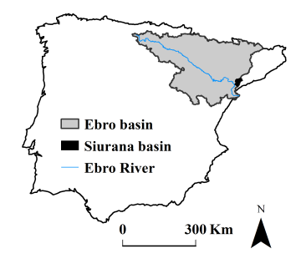
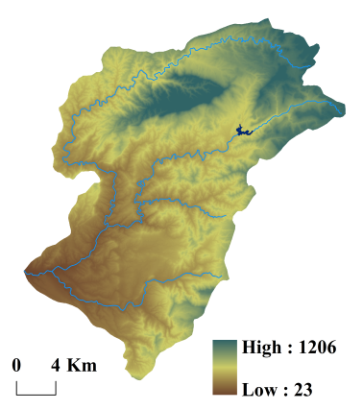
Siurana basin
The Siurana (i.e. 610 km²) is a very Mediterranean river (even drying up in summer) highly affected by impoundment (Lobera et al., 2015a, 2015b) but suffering catastrophic flood events often .
INTRODUCTION
OBJECTIVES
RESEARCH DESIGN

Slide 12
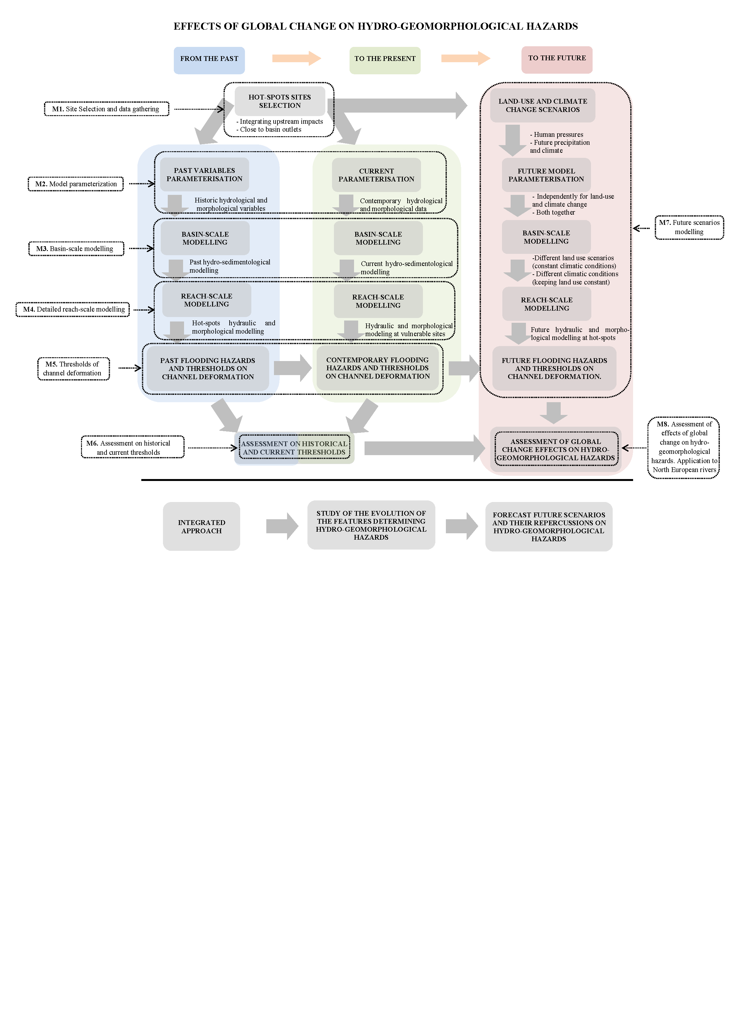
INTRODUCTION
OBJECTIVES
STUDY AREA

Slide 16
INTRODUCTION
OBJECTIVES
STUDY AREA

