Slide 1



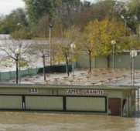
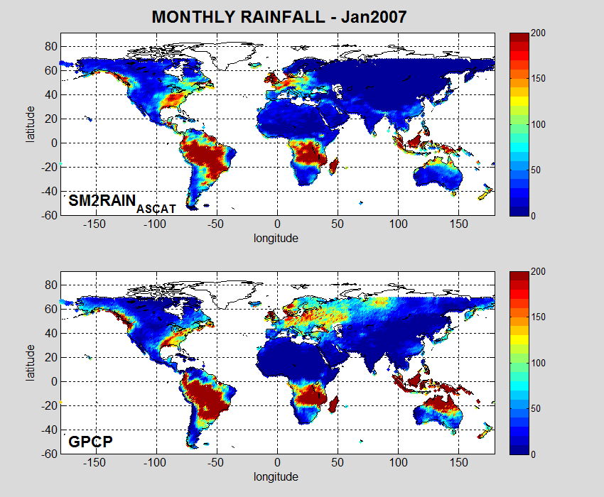
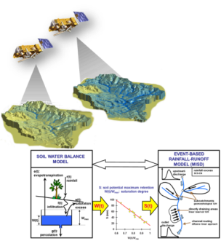
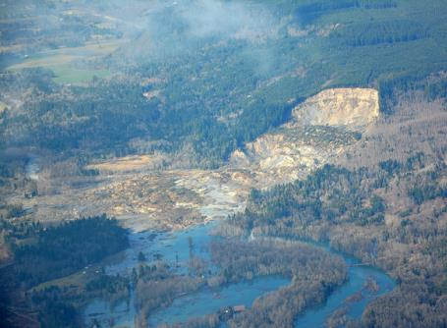
European Geosciences Union
General Assembly 2015
Vienna
15th April 2015
Rainfall estimation from soil moisture data:
crash test for SM2RAIN algorithm
Luca Brocca(1), Clement Albergel(2), Christian Massari(1), Luca Ciabatta(1), Tommaso Moramarco (1), Patricia de Rosnay(2)
(1) Research Institute for Geo-Hydrological Protection (IRPI-CNR), Perugia, Italy
(2) European Centre for Medium-Range Weather Forecasts (ECMWF), Reading, UK
http://hydrology.irpi.cnr.it
Notes:
1

Slide 2

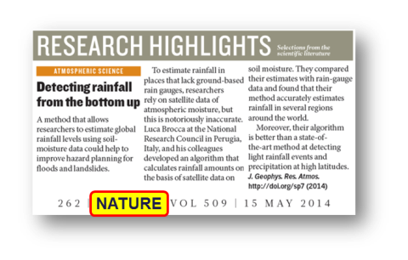
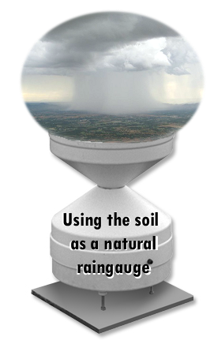
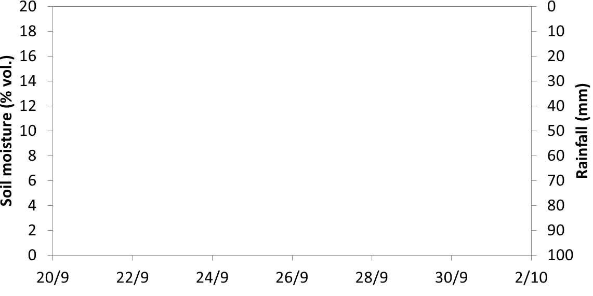
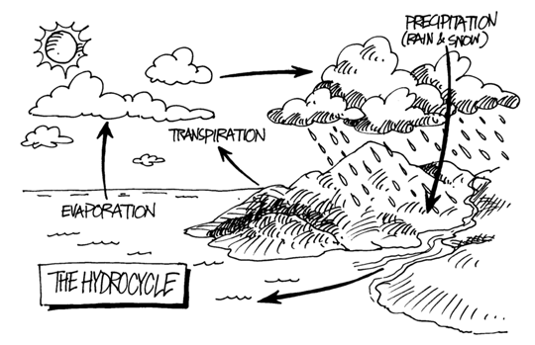

What is SM2RAIN?
RAINFALL
SOIL MOISTURE
The soil moisture variations are strongly related to the amount of rainfall falling into the soil. Therefore, we can use soil moisture observations for estimating rainfall by considering the “soil as a natural raingauge”.
SM2RAIN

Slide 3

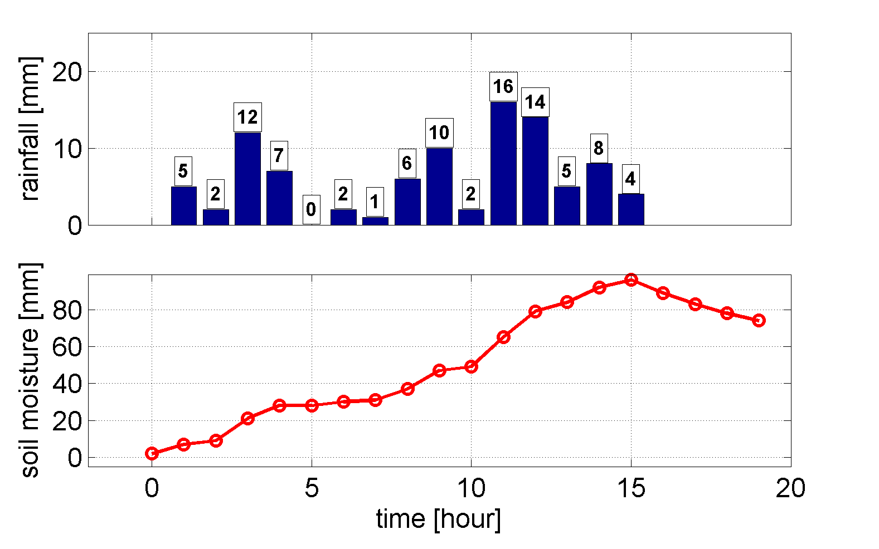

“Top down” vs “Bottom up” perspective
TOP DOWN PERSPECTIVE
Ptop-down=(5+0+2+8)*4= 60 mm
5
0
2
8
The underestimation is due to the satellite overpasses in period with low rainfall
Ptrue=94 mm
92
With only two overpasses the bottom up approach provides a better estimate of the accumulated rainfall
2
Pbottom-up=(92-2)= 90 mm
BOTTOM UP PERSPECTIVE
Notes:
3

Slide 4
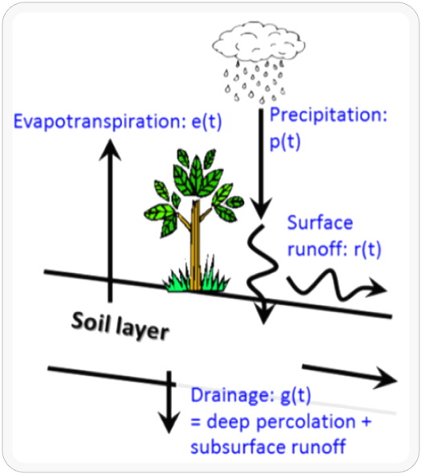

SM2RAIN algorithm
relative saturation
surface runoff
precipitation
drainage
Soil water balance equation
THESE ASSUMPTIONS WERE FREQUENTLY CRITICIZED BY REVIEWERS … AND COLLEAGUES
soil water capacity
= soil depth X porosity
evapotranspiration
Inverting for p(t):
Assuming:
+
+
during rainfall
Notes:
4

Slide 5
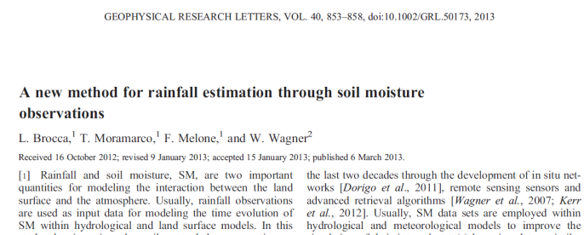
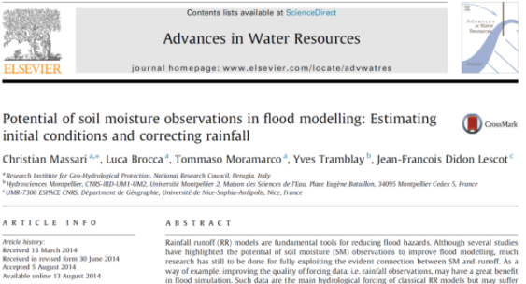
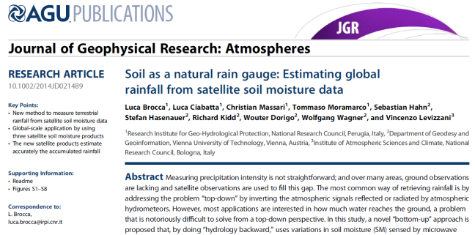
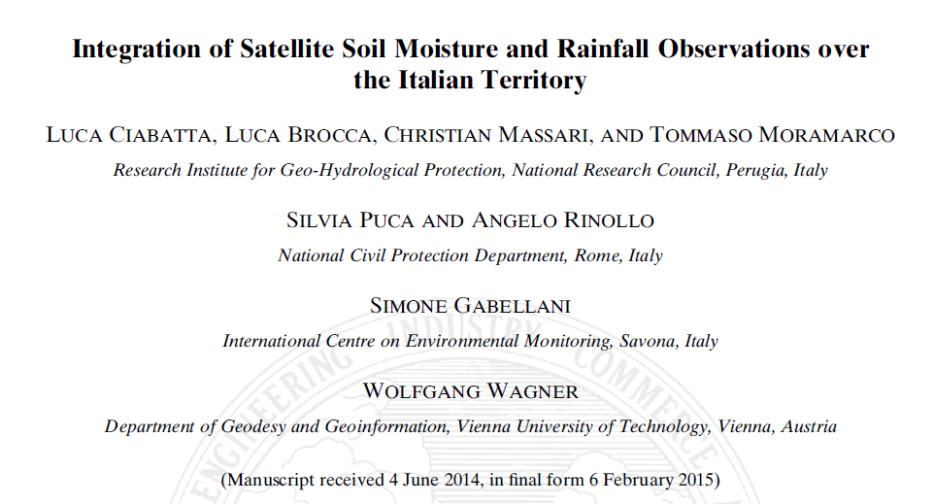
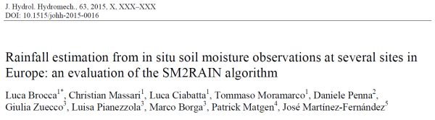
SM2RAIN papers…so far!
2013
2014
2015
SM2RAIN dataset from ASCAT, 0.25°, 2007-2013, freely available
Notes:
5

Slide 6
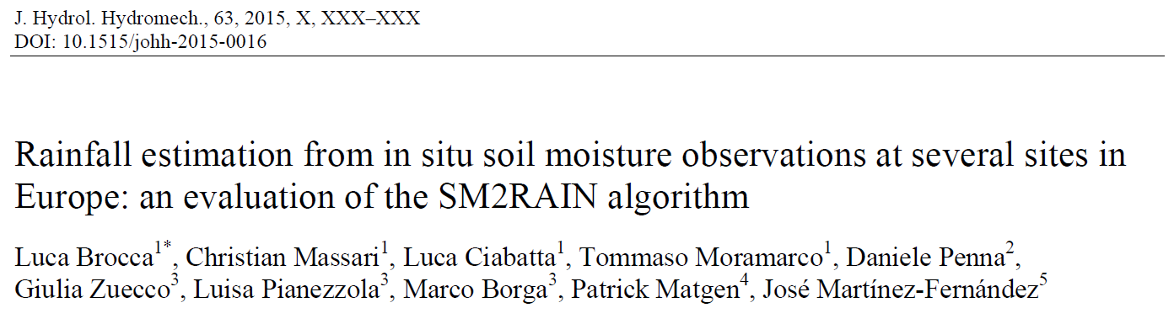
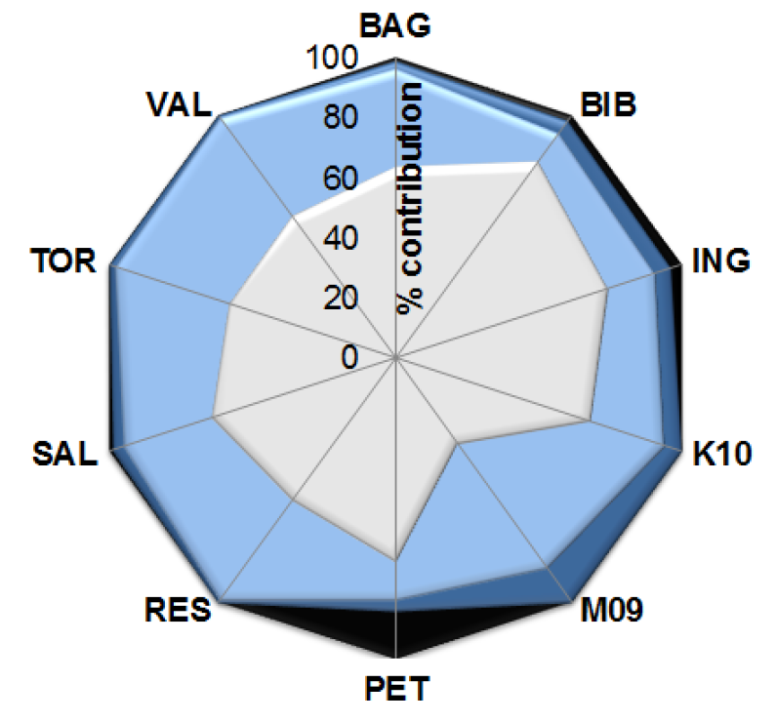
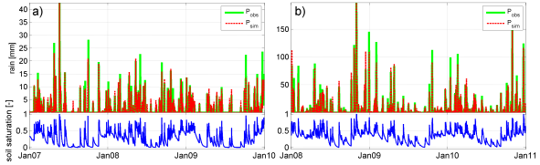
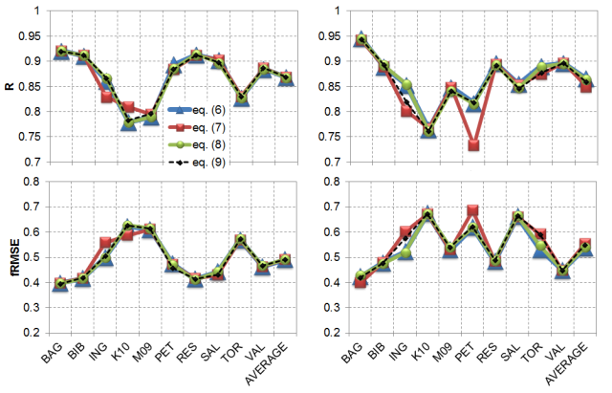
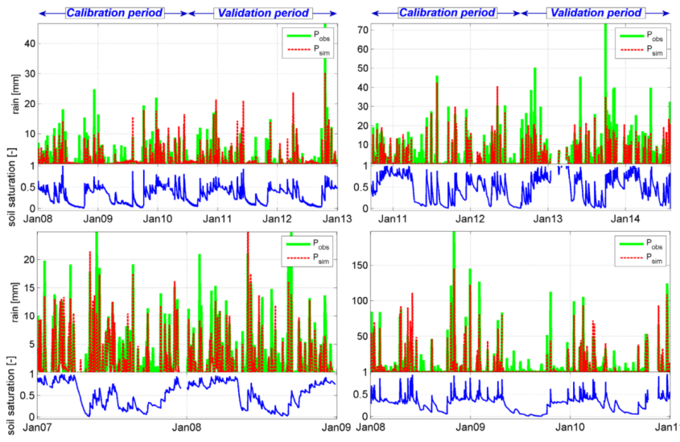
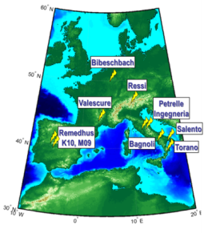
SM2RAIN: in situ observations
Synthetic data
Evapotranspiration
4%
Real data
Average daily correlation=0.94!
calibration
validation
Drainage
30%
In situ soil moisture observations
Runoff
2%
Soil moisture variations
64%
Percentage contribution to the total simulated rainfall of the different components of the water balance
0.75<R<0.95
Notes:
6

Slide 7
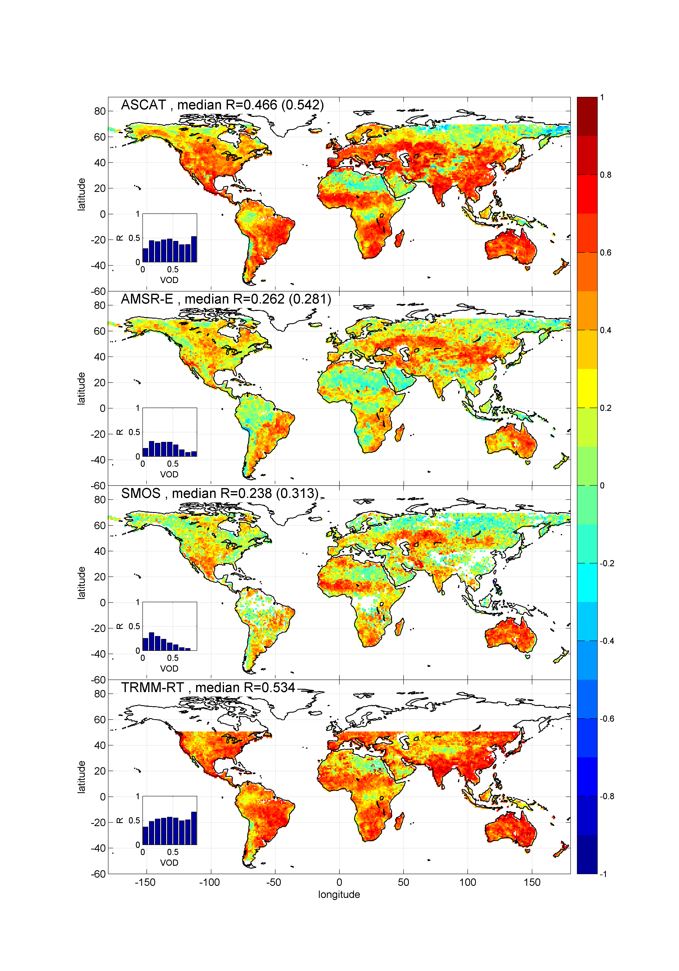
SM2RAIN: satellite observations
Correlation map between 5-day rainfall from GPCC and the rainfall product obtained from the application of SM2RAIN algorithm to ASCAT, AMSR-E and SMOS data plus TMPA 3B42RT
(VALIDATION period 2010-2011)
Notes:
7

Slide 8
Global monthly rainfall from ASCAT
Notes:
8

Slide 9

SM2RAIN CRASH TEST
1) Global land surface simulation with the latest ECMWF land surface model (period 2010-2013) driven by ERA-Interim atmospheric reanalysis
2) Extraction of modelled soil moisture data for the first three soil layers (0-7, 0-28, 0-100 cm)
3) Application of SM2RAIN to modelled soil moisture data for each soil layer (0-7, 0-28, 0-100 cm)
4) Comparison of SM2RAIN-derived rainfall with true rainfall data (from ERA-Interim) used to drive the land surface simulations

Slide 10
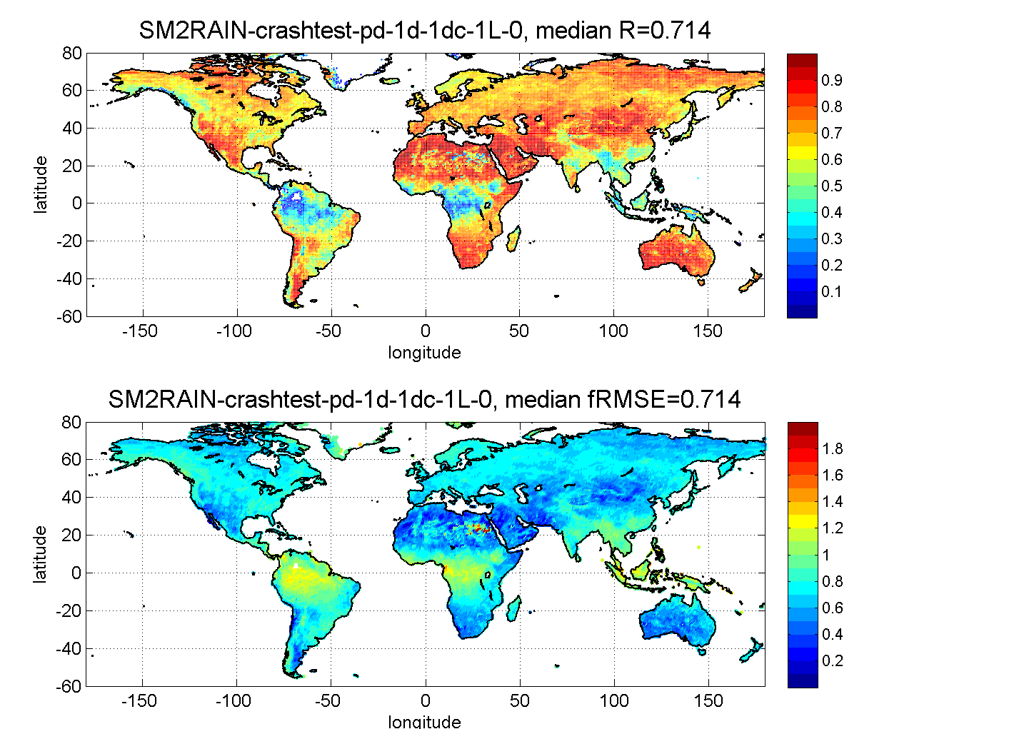
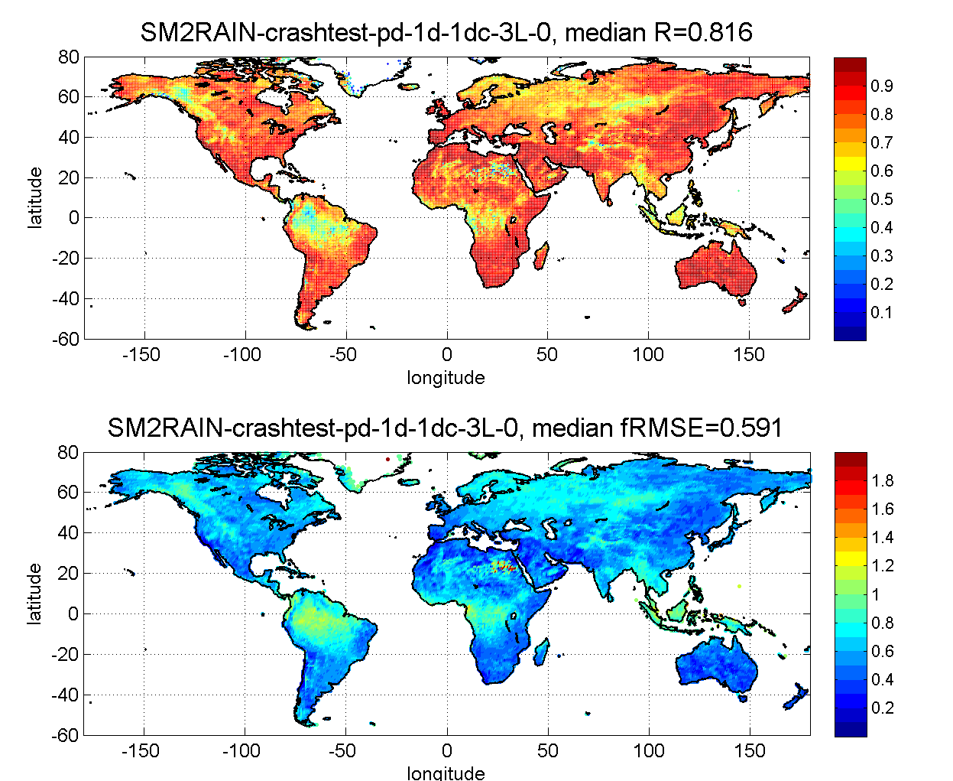
CRASH TEST: 1 layer vs 3 layers
First soil layer (0-7 cm)
Root-zone (0-100 cm)
Proxy of the investigation depth of satellite sensors
Added-value of root-zone information, with 2 soil layers (0-28 cm) results are similar (median R=0.790.

Slide 11
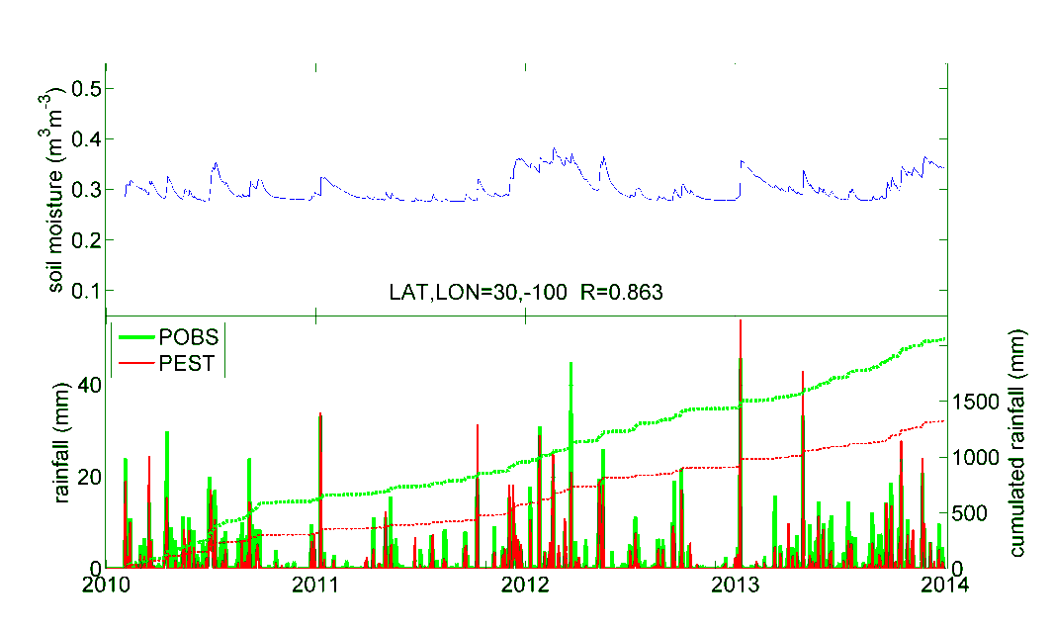
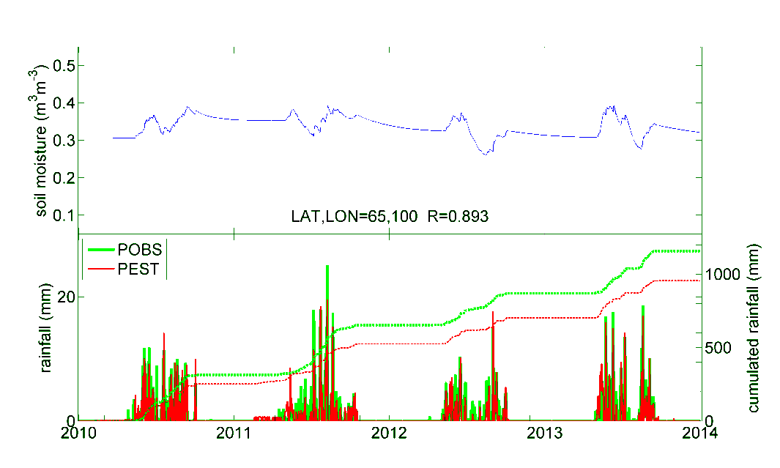
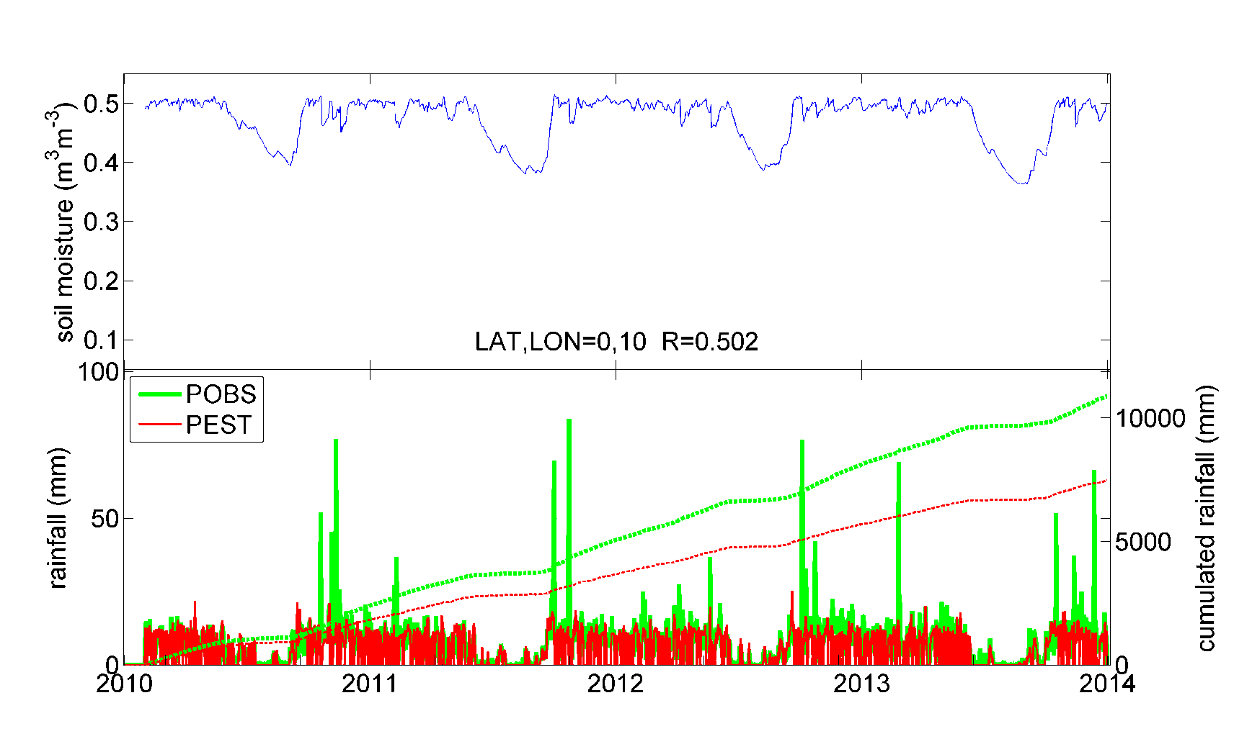
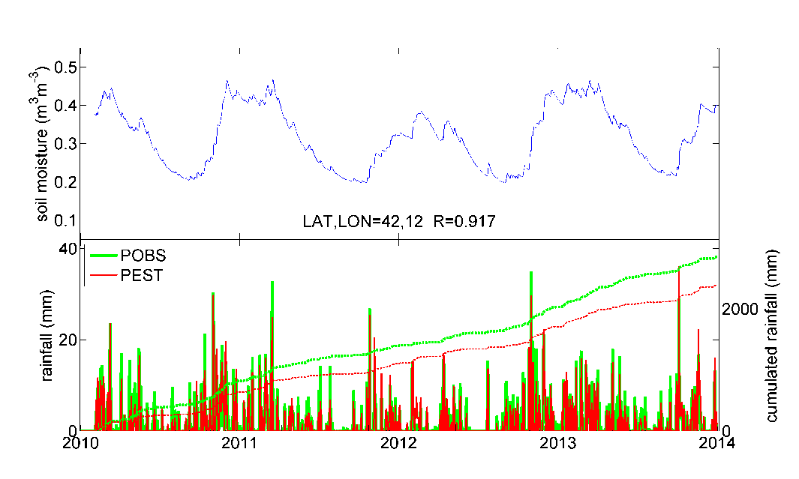
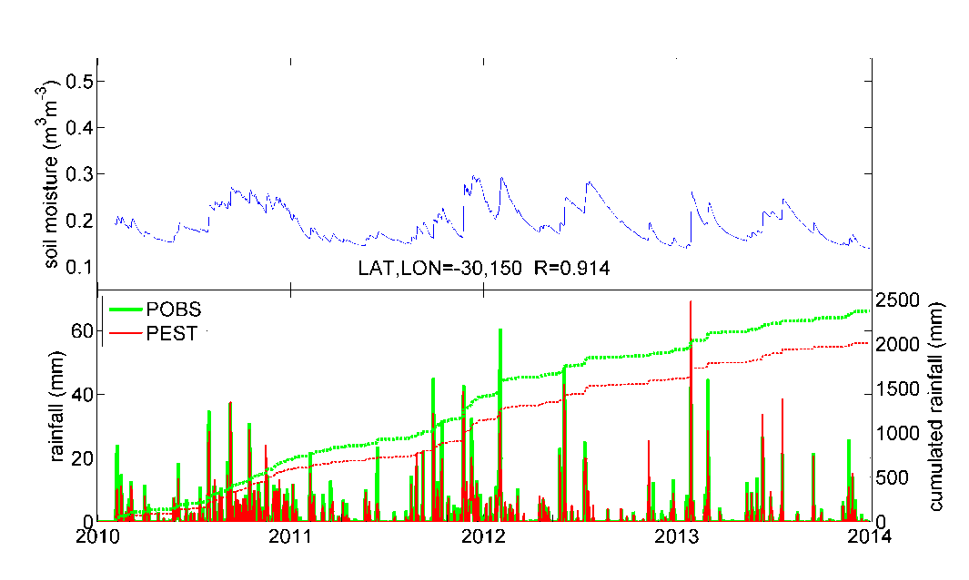
CRASH TEST: timeseries
South USA
Siberia
Congo
Central Italy
Central Australia

Slide 12
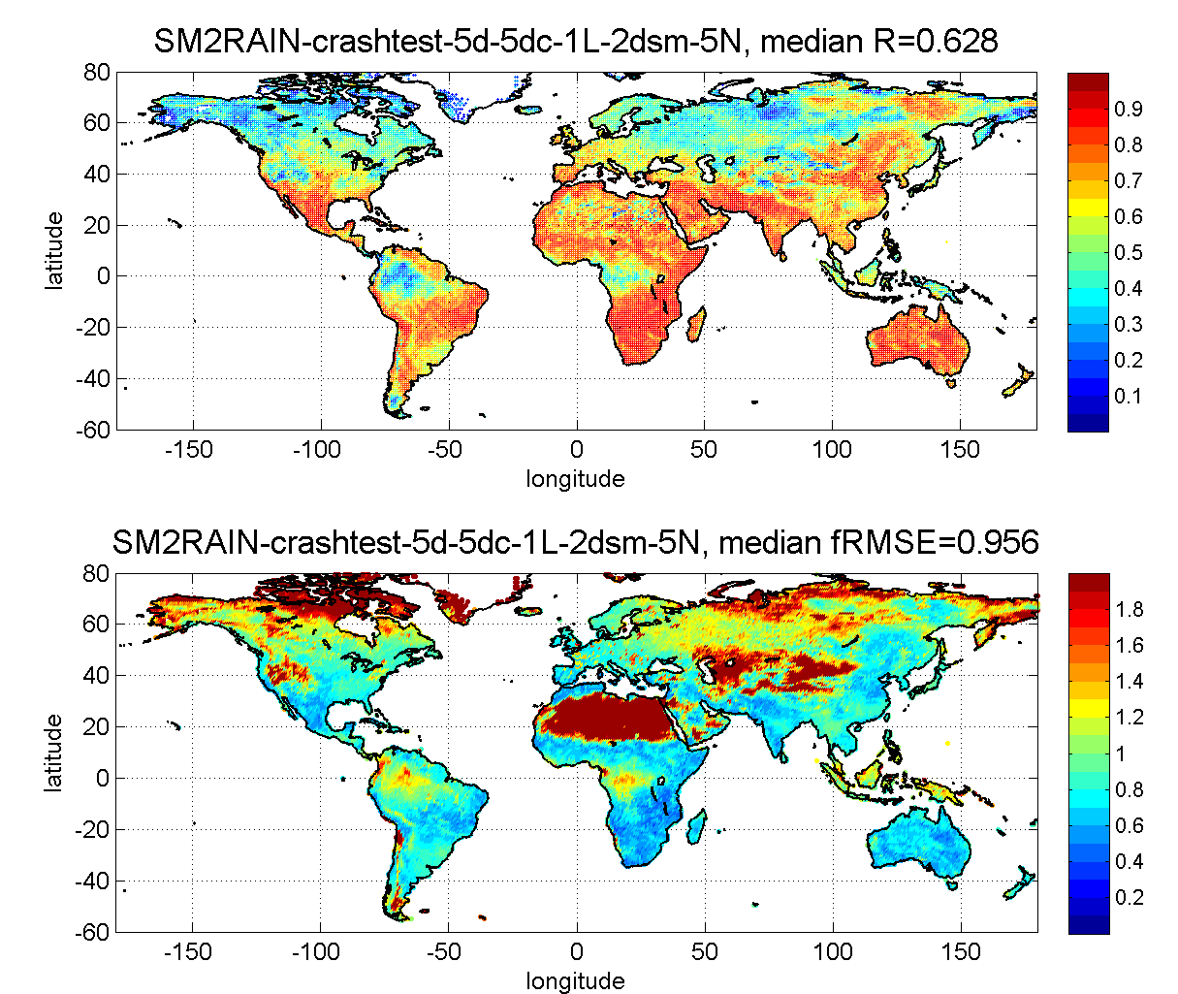
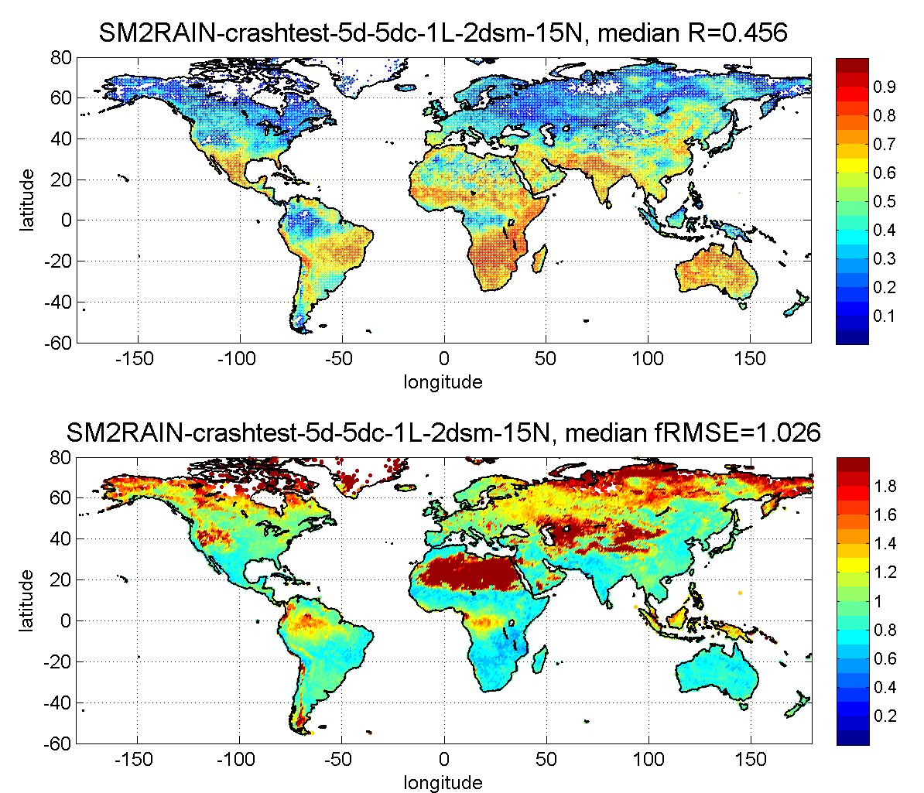
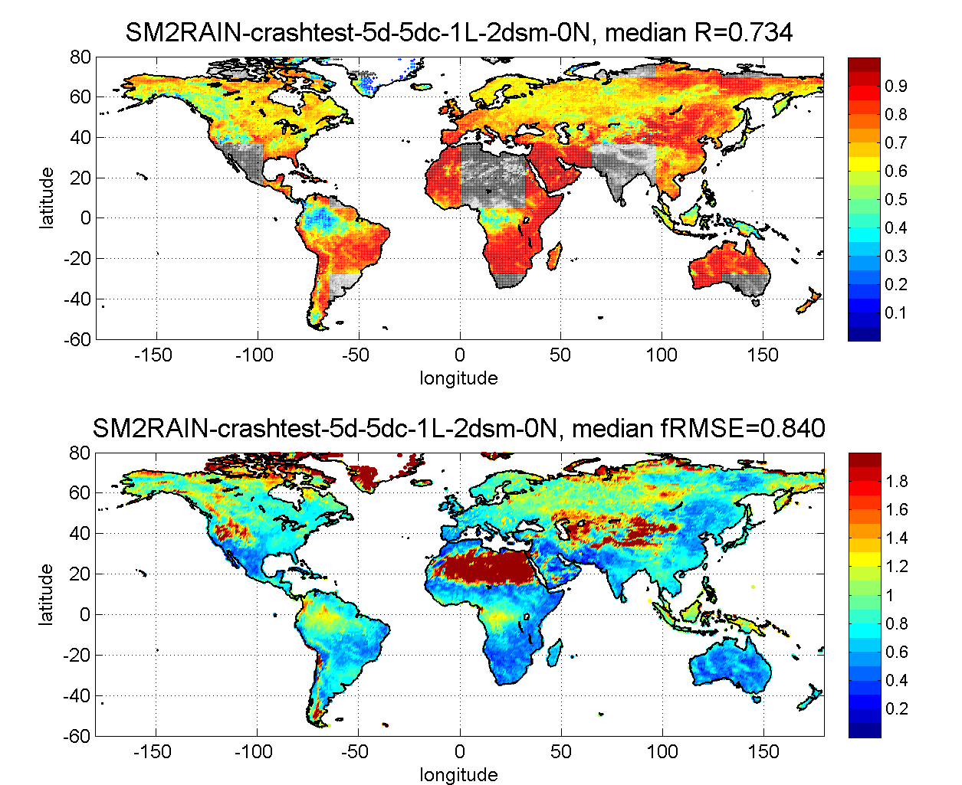
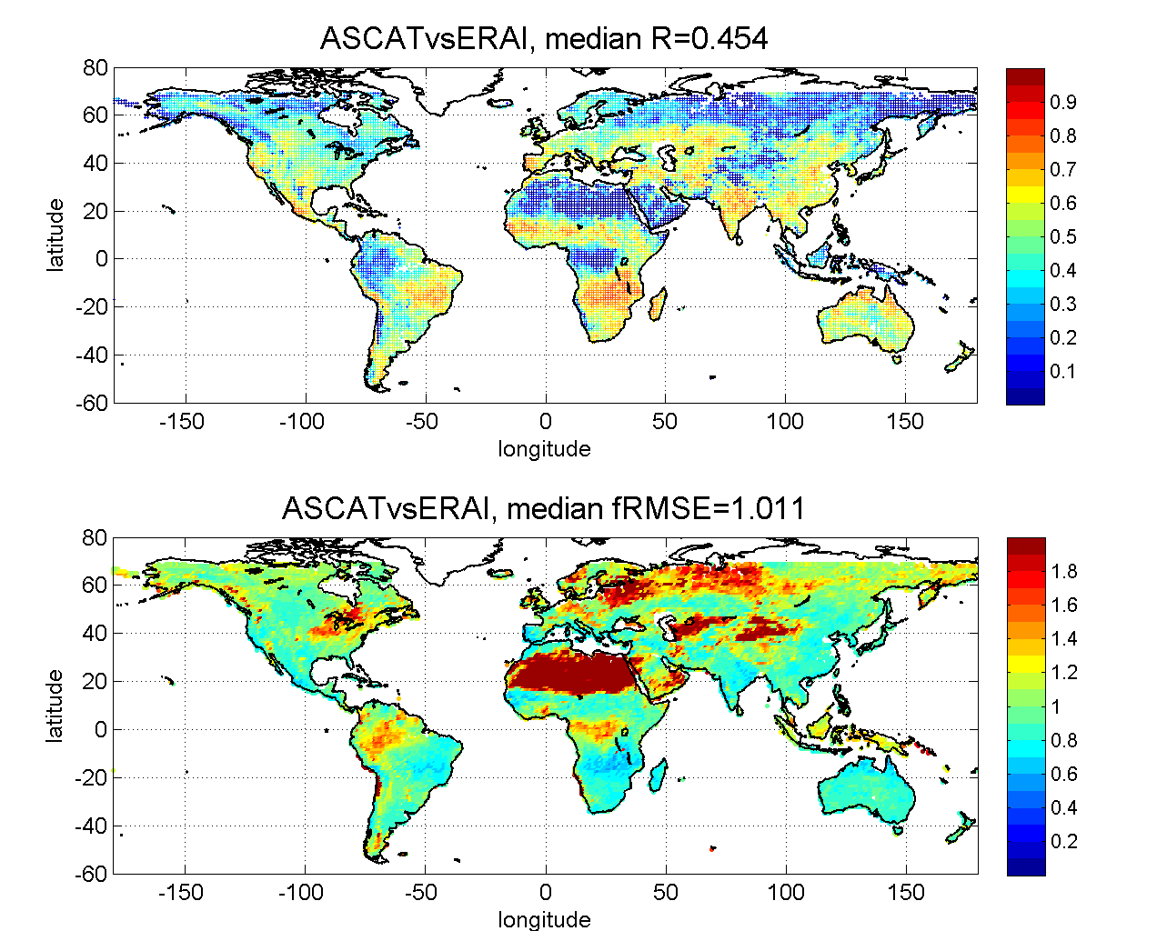
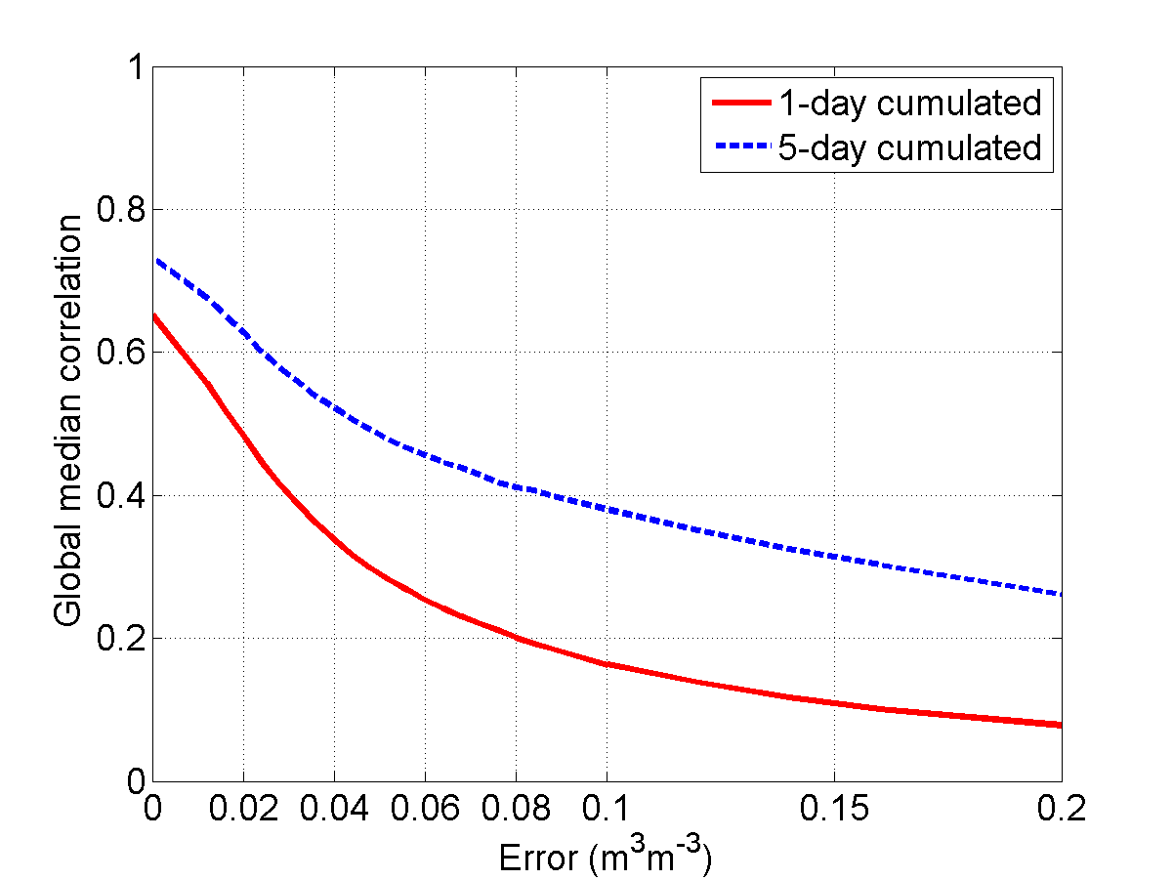
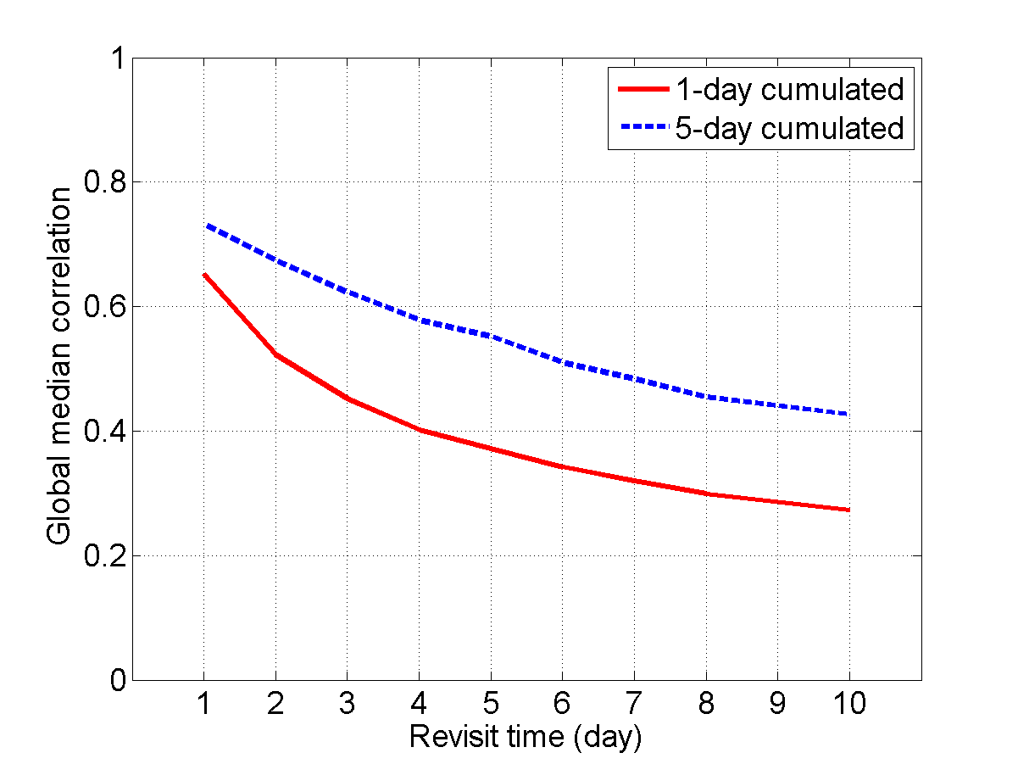
Error estimation of SM products
5) Adding random perturbation to modelled soil moisture data the error in the satellite products can be estimated
SMOS /SMAP target
ASCAT/AMSR2
SMOS/SMAP
Sentinel-1

Slide 13
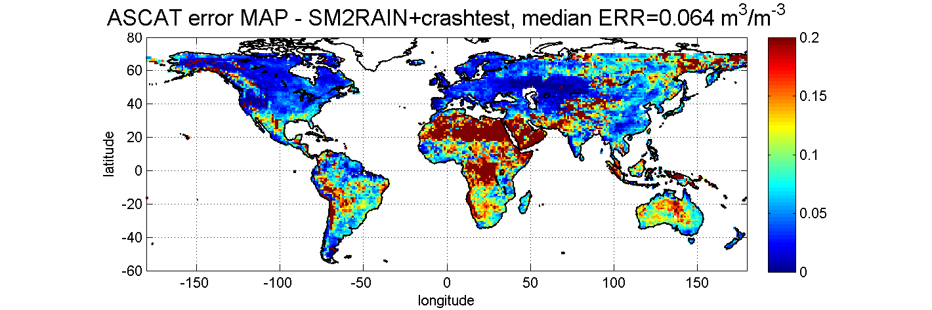
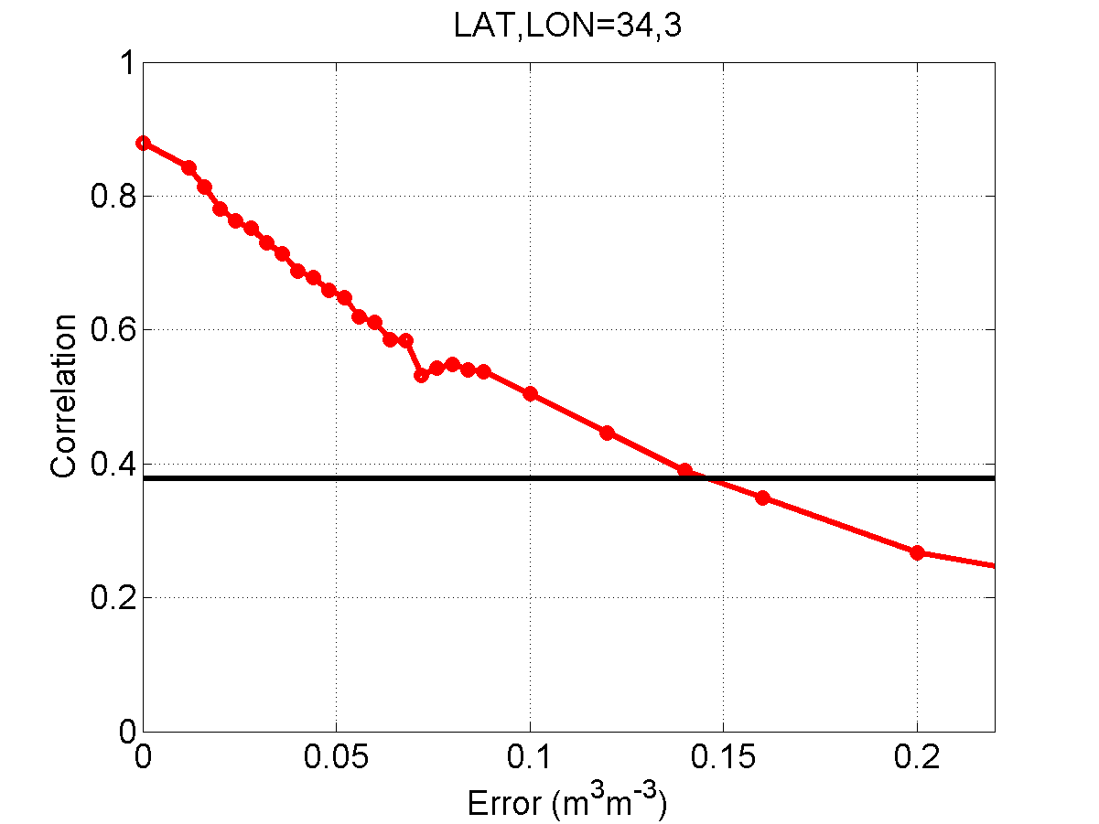
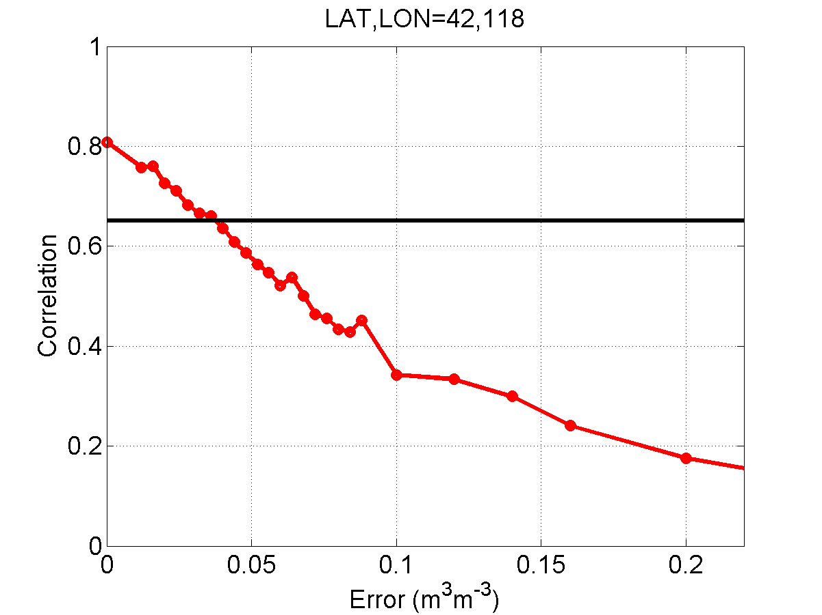
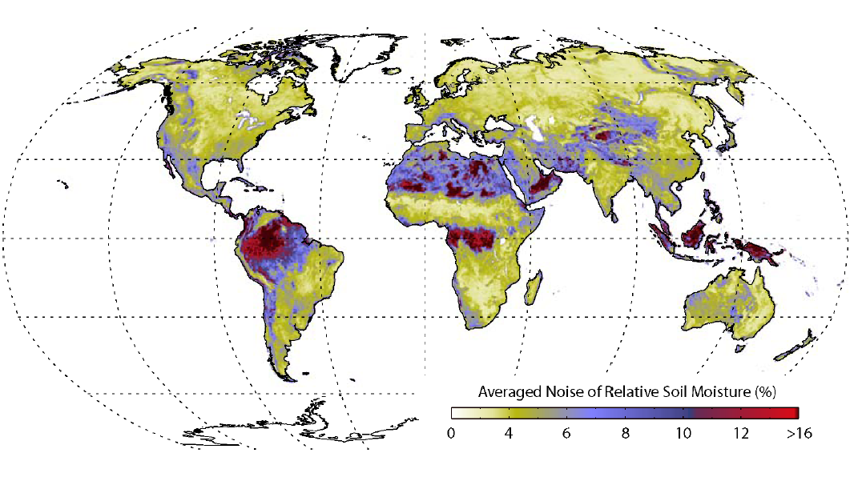
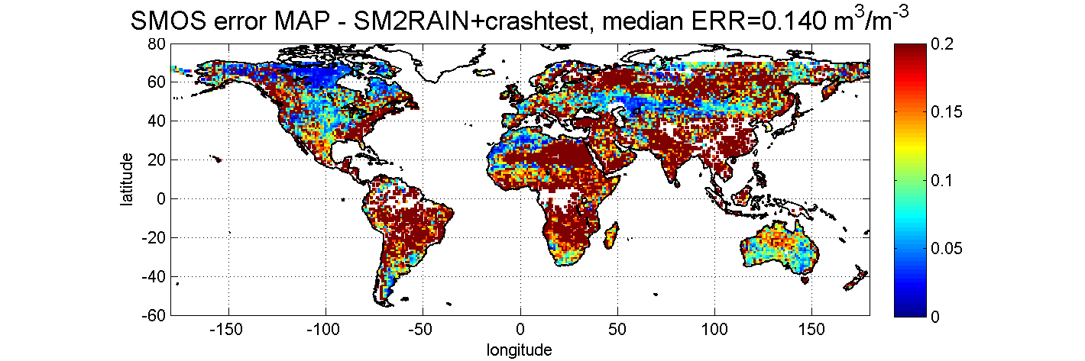
Error estimation ASCAT & SMOS
For each land pixel…
Estimated
ERROR=0.14 m³m⁻³
ASCAT/SMOS correlation
ASCAT/SMOS correlation
Estimated ERROR=0.04 m³m⁻³
Lower temporal resolution

Slide 14
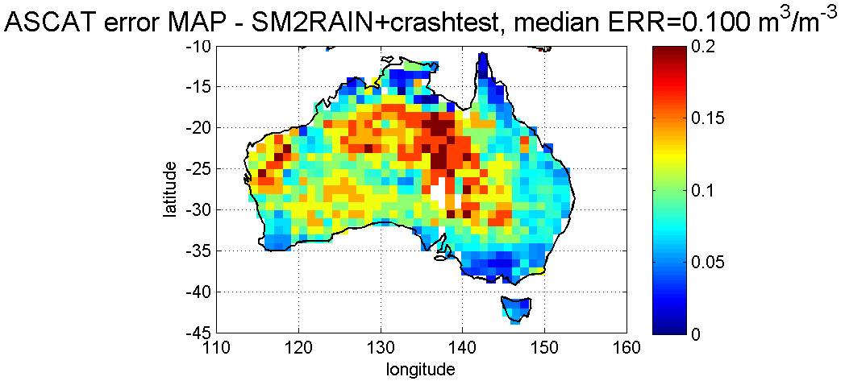
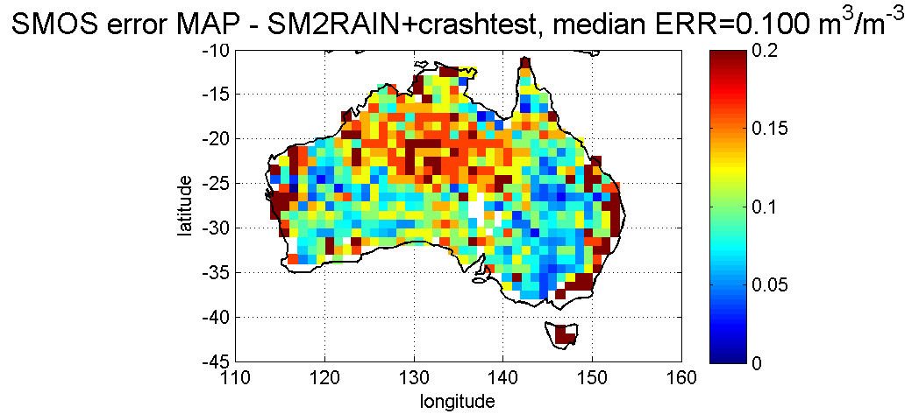
Error estimation ASCAT & SMOS
Good performance of both sensors except in the central region
Higher error of SMOS along the coast (spatial resolution issue)

Slide 15
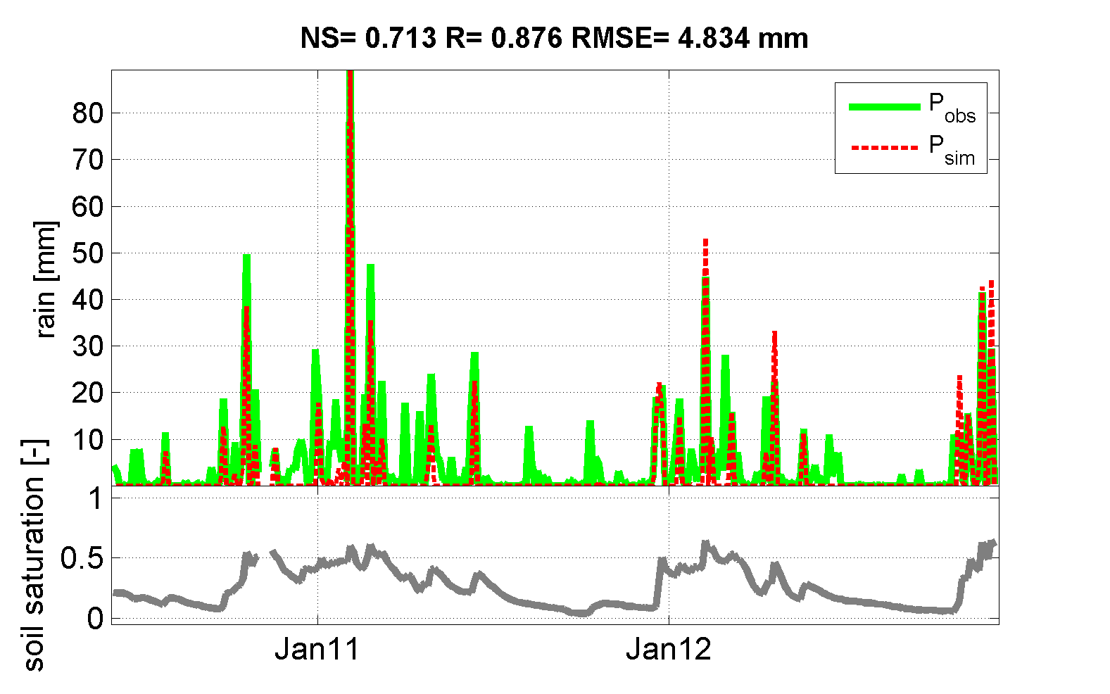

FLOOD MODELLING APPLICATION
Sensor at 25 cm depth: missing summer rainfall
Massari et al. (2014, HESS)
Use of different soil moisture dataset for flood forecasting
Early Warning System for Flood and Fire forecasting

Slide 16


Conclusions
○ SM2RAIN algorithm shows consistent results on a global scale
○ Runoff and evapotranspiration seems not to play a significant role, while temporal resolution and saturation have a greater impact
○ The application of the crash test together with SM2RAIN algorithm can be exploited for estimating the error in satellite soil moisture products
FOR FURTHER INFORMATION
URL: http://hydrology.irpi.cnr.it/people/l.brocca
URL IRPI: http://hydrology.irpi.cnr.it
This presentation is available for download at:
http://hydrology.irpi.cnr.it/repository/public/presentations/2015/egu-2015-l.-brocca
Notes:
With this term we refer to the relative wetness or dryness of a watershed. In Mediterranean regions they are high variable and can have significant effect on the flow response in these systems during wet weather

