Slide 1
Interpreting lateral 2-D bank hyporheic flux based on GA-VS2DH
European Geosciences Union
General Assembly 2015
Longcang Shu, Xiaoru Su, Zhonghui Wen
Department of College of Hydrology and Water Resources, Hohai University

Slide 2
Outline
Background
GA-VS2DH Method
Experiments and Application
Conclusions
Acknowledgements

Slide 3
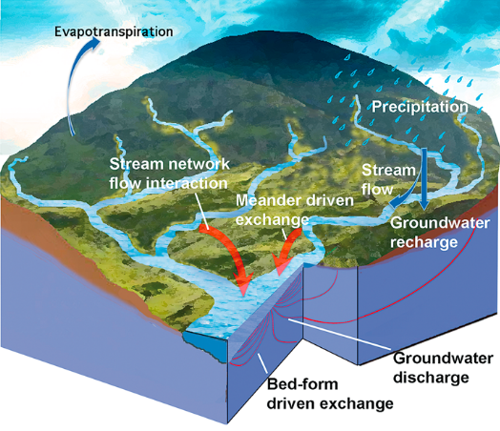
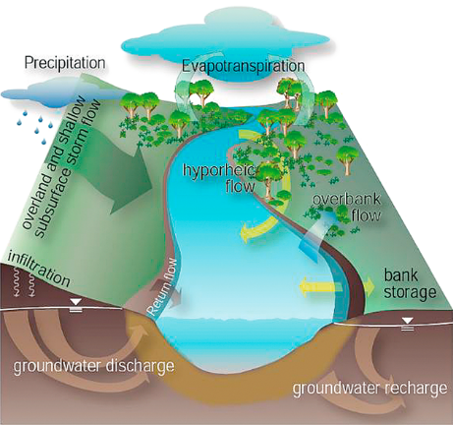
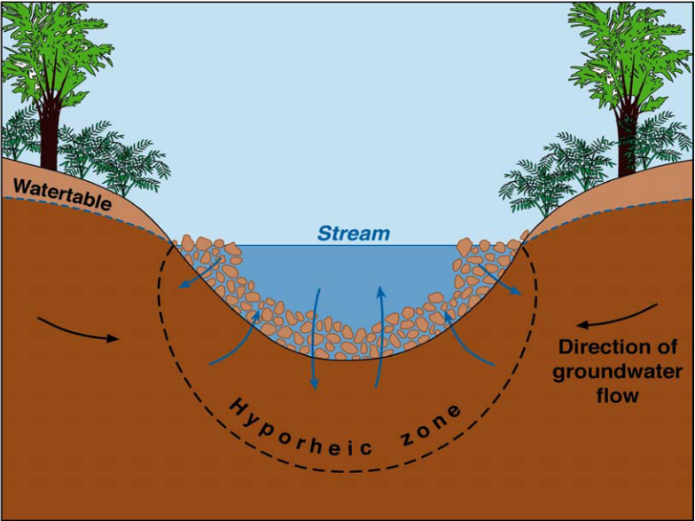
Background
a) Watershed or Basin scale
b) Stream reach scale
Groundwater and surface water could exchange with each other at various spatial scales.
Hyporheic flux is the transport of surface water through sediments in flow paths that return to surface water.

Slide 4
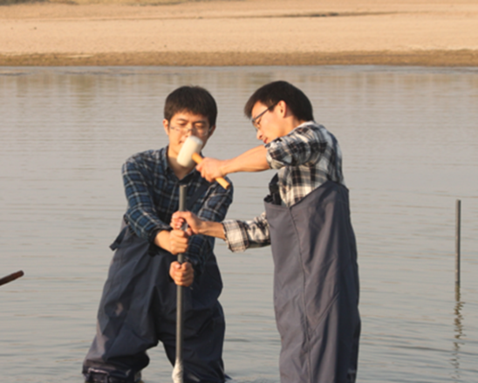
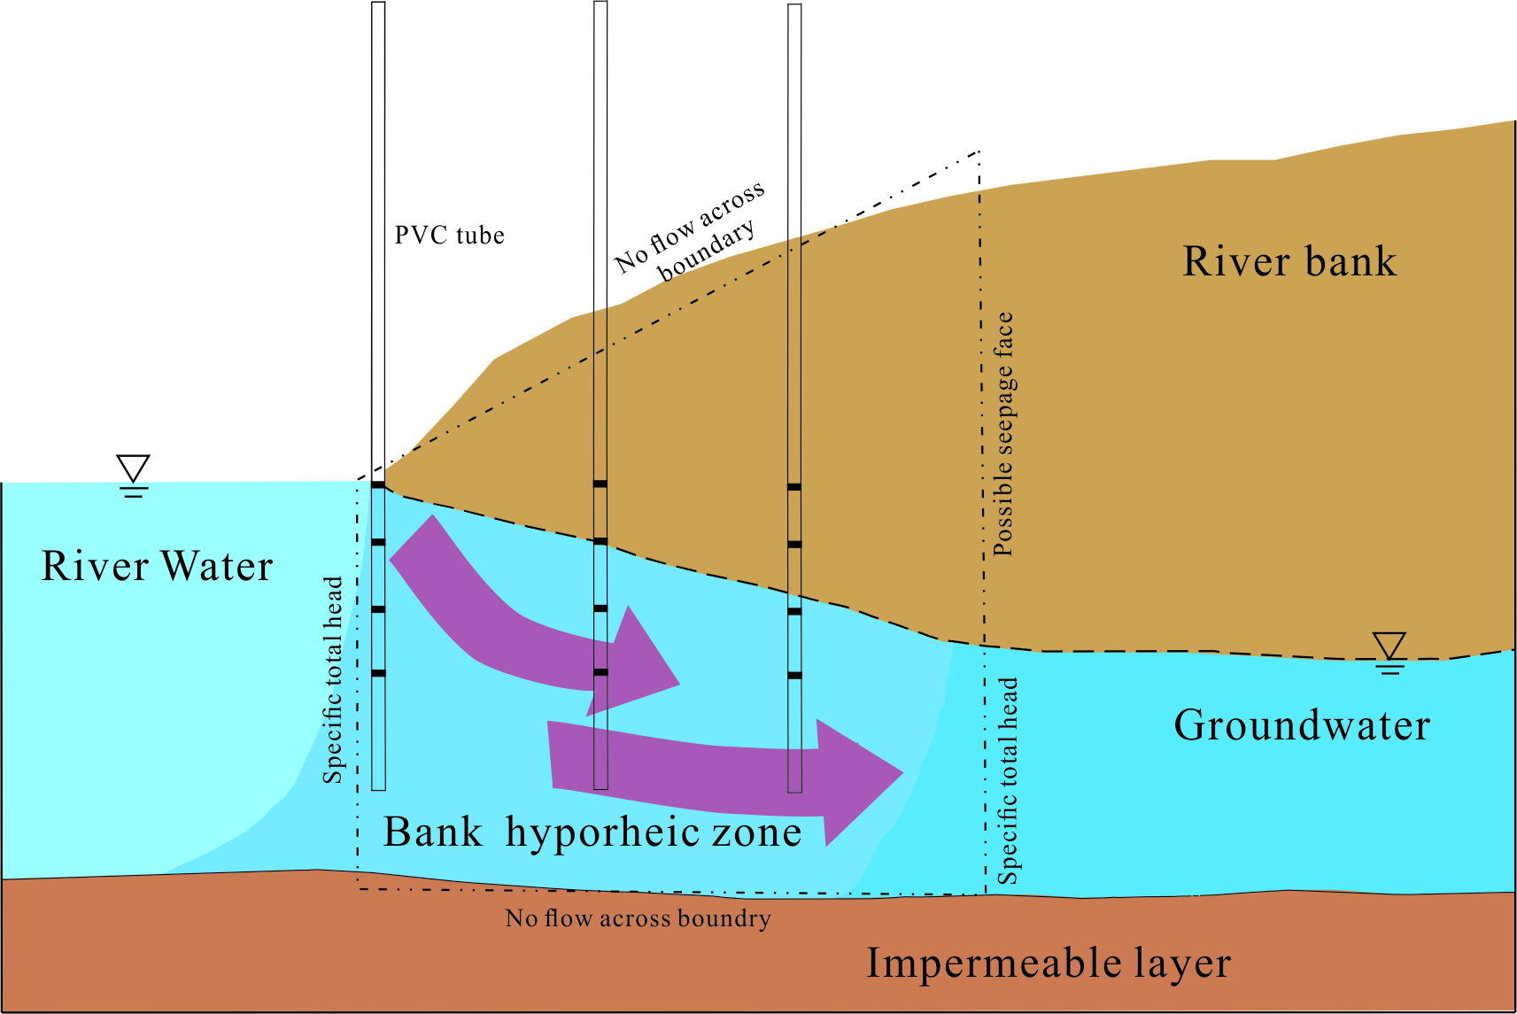
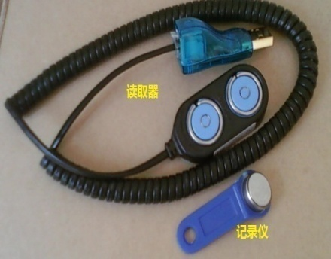
Background
Heat as a tracer method has been demonstrated to be a robust method in estimating hyporheic flux for the relatively low cost and ease of deployment.
In our study a new GA-VS2DH nested loop method was proposed based on Microsoft Visual Basic 6.0 to simulate hyporheic flux and parameters in bank hyporheic zone.

Slide 5
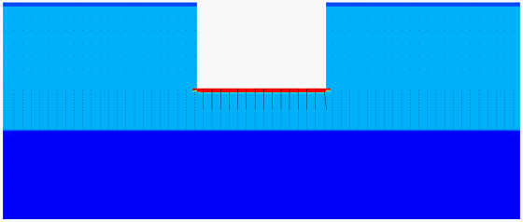
GA-VS2DH Method
VS2DH is a two-dimensional ﬁnite difference model that simulates heat transport and water ﬂow in variably saturated sediments.
$\frac{∂\left[θC_{W}+\left(1−∅\right)C_{S}\right]T}{∂t}=∇×K_{t}\left(θ\right)∇T+∇×θC_{W}D_{h}∇T−∇×θC_{W}Tv+QC_{W}T^{∗}$
$C\left(ψ\right)\frac{∂h}{∂t}=∇\left[K\left(ψ\right)×∇h\right]$
By model calibration, hydraulic parameters and thermal parameters could be obtained by fitting simulated temperatures to the observed temperatures in river bank area.
Groundwater recharged by surface water
Simulated by VS2DH

Slide 6
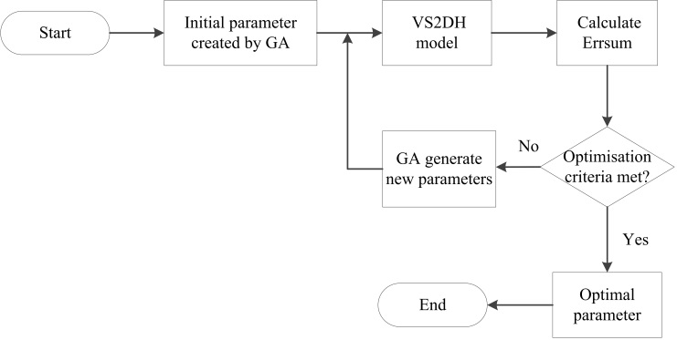
GA-VS2DH Method
GA (Genetic Algorithm) is a search technique used to obtain the approximate solutions for optimization and search problems.
The model calibration procedure is to minimize the difference between observed and simulated temperatures.
$$Errsum=\sum_{j=1}^{n}{{\sum_{i=1}^{m}{ }(T_{obs}−T_{cal})}^{2}}$$

Slide 7
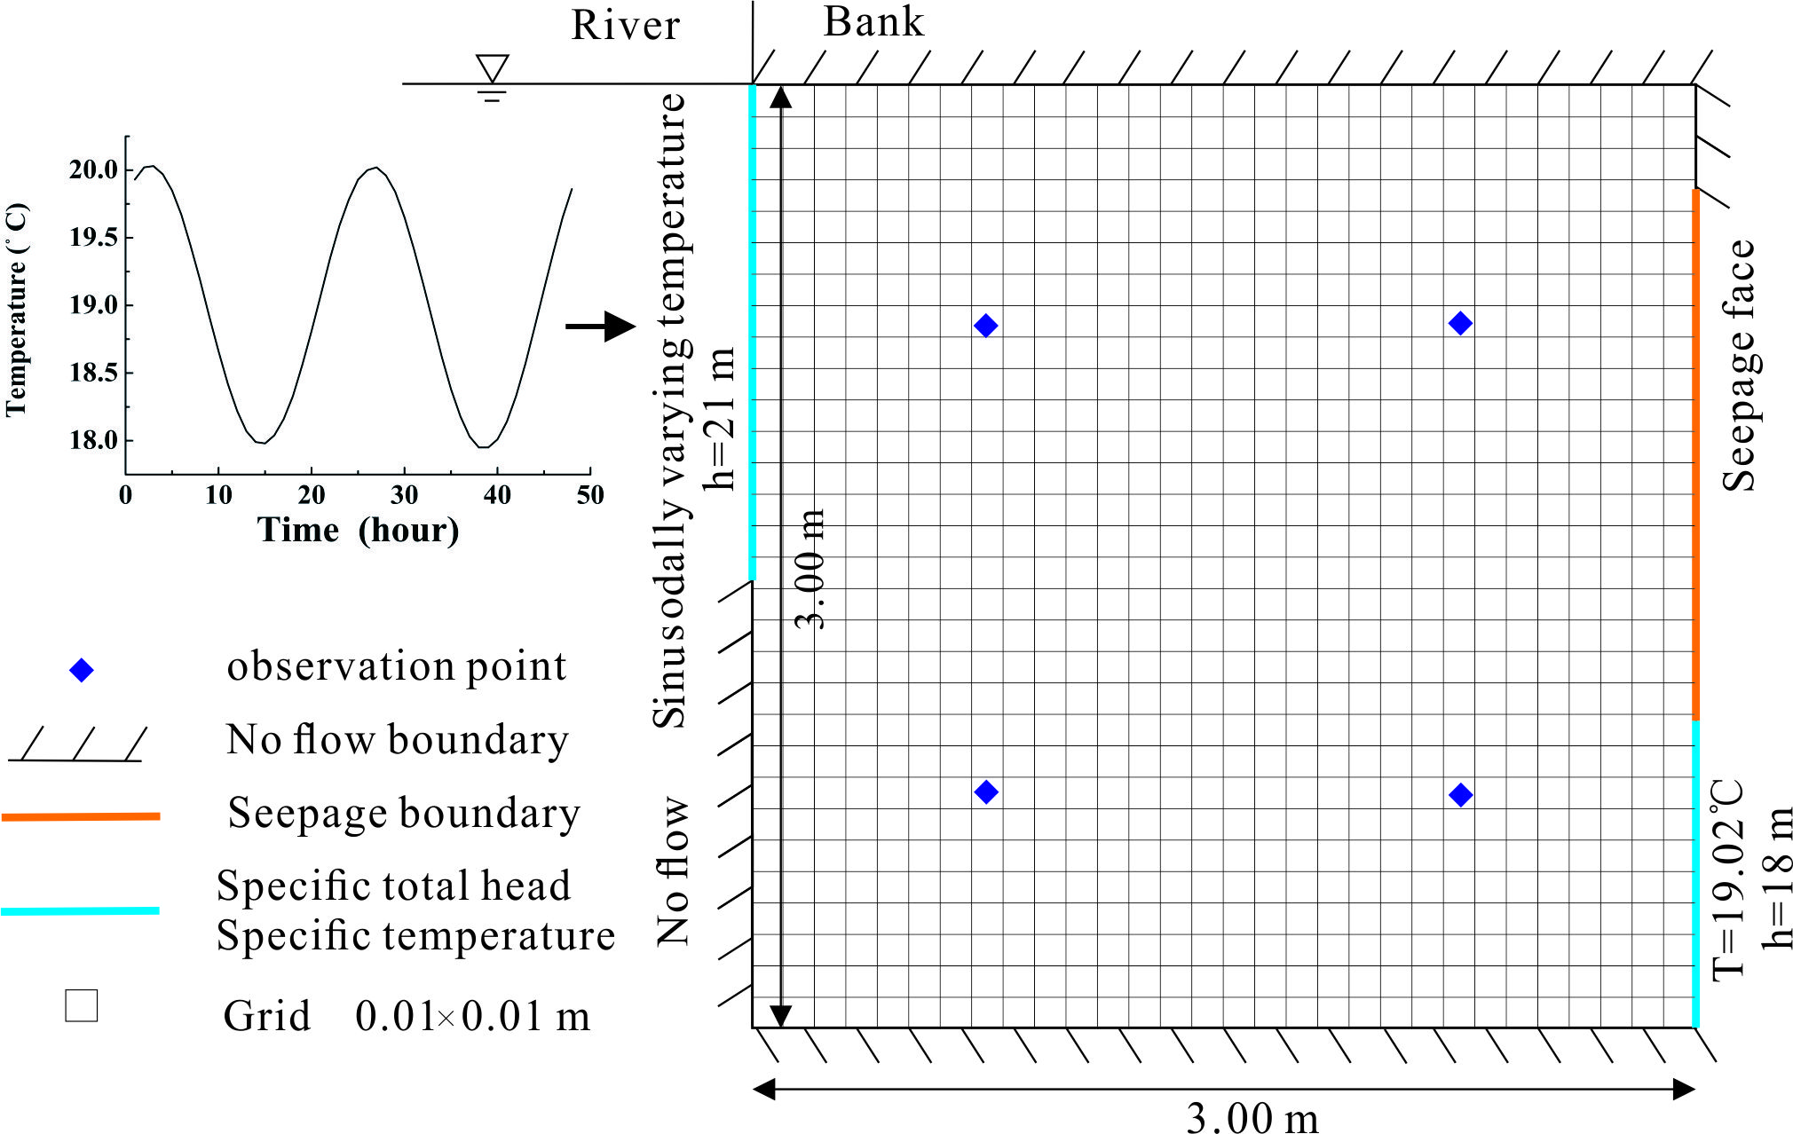
Experiments and Application
A 2-D hypothetical model was built to assess the reliability of GA-VS2DH.
Temperature ℃
Parameter | $$K$$ (m/d) | $$∅$$ | $$D$$ (m) | $C_{S}$ ($×$10⁵J/m³℃) | $$K_{t}$$ ($×$10⁵W/m℃) | $$C_{W}$$ ($×$10⁵J/m³℃)
Search bounds | 0.01~10 | 0.1~0.4 | 0.1~20 | 20~23.6 | 1.2~1.9 | 40~42.4
Initial value | 0.100 | 0.200 | 8.000 | 21.800 | 1.296 | 42.000
Simulated value | 0.087 | 0.178 | 8.578 | 20.309 | 1.801 | 42.107

Slide 8
Experiments and Application
Sensitivity analysis can be used to evaluate the reliability of the parameter estimation.
Parameters were changed ±10% and ±20% on the basis of initial values, respectively, to investigate their effects on temperature profiles
$$U_{δ}=\frac{∂S_{T}}{∂δ/δ}$$
$$∂S_{T}=α\sum{{(T_{1}−T_{2})}^{2}}$$
$U_{δ}($℃²) | $$K$$ | $$∅$$ | $$D$$ | $$C_{S}$$ | $$K_{t}$$ | $$C_{W}$$
-20$\%$ | 2.35 | -0.05 | 2.16 | -0.91 | 0.09E-02 | 1.12
-10$\%$ | 1.02 | -0.02 | 0.93 | -0.43 | 0.05E-02 | 0.47
10$\%$ | -0.77 | 0.02 | -0.72 | 0.39 | -0.05E-02 | -0.35
20$\%$ | -1.39 | 0.04 | -1.28 | 0.75 | -0.09E-02 | -0.61

Slide 9
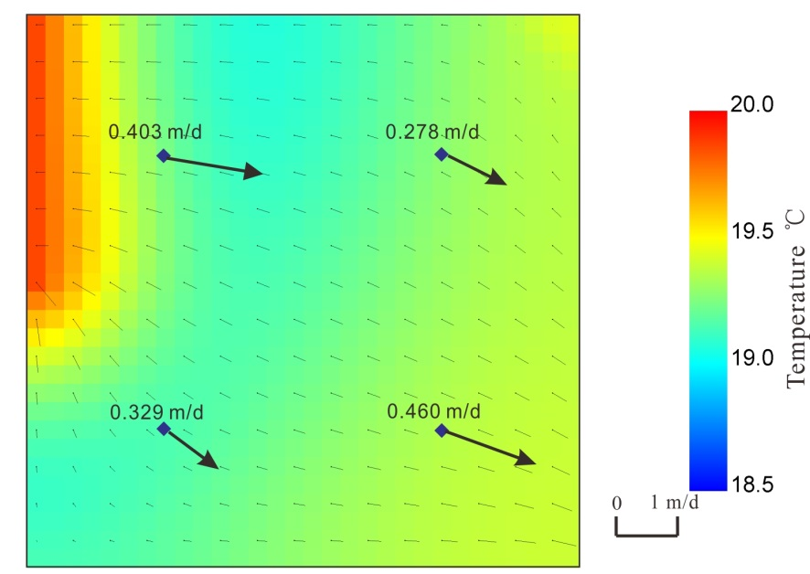
Experiments and Application
The hyporheic flux shows a spatial heterogeneity both in value and flow path.
The initial hyporheic flux and simulated ones agree well and it indicates the reliability of GA-VS2DH in simulating hyporheic flux.
Observation points | Initial hyporheic flux (m/d) |  |  | Simulated hyporheic flux (m/d)
 | q_{x} | q_{z} | q | q_{x} | q_{z} | q
1 | 0.394 | 0.084 | 0.403 | 0.394 | 0.09 | 0.403
2 | 0.221 | 0.169 | 0.278 | 0.221 | 0.169 | 0.278
3 | 0.260 | 0.204 | 0.330 | 0.259 | 0.203 | 0.329
4 | 0.442 | 0.131 | 0.461 | 0.442 | 0.130 | 0.460

Slide 10
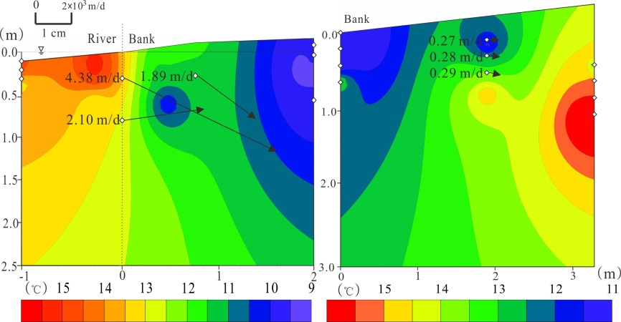
Experiments and Application
GA-VS2DH was applied in bank area of the Dawen River and the Qinhuai River. The bank sediments of the former consist mainly of sand and the bank sediments of the latter consist largely of clay.
The application of GA-VS2DH to the two different sediments could be used to evaluate the effects of the method.
(a) The Dawen River (b) The Qinhuai River

Slide 11
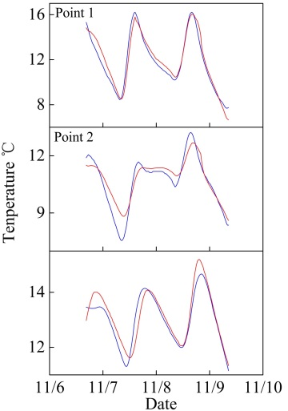
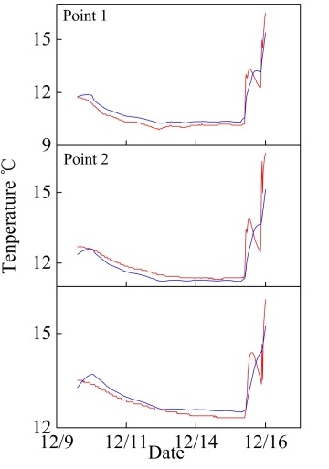
Experiments and Application
The observed temperatures (red line) and simulated temperatures (blue line) agree well with observed temperatures for the two sites.
The hydraulic conductivity was 1.293 and 0.019 m/d, respectively, which correspond to sand and clay in the two sites.
(a) The Dawen River (b) The Qinhuai River
Simulated Parameter | $$K$$ (m/d) | $$∅$$ | $$D$$ (m) | $C_{S}$ ($×$10⁶J/m³℃) | $$K_{t}$$ ($×$10⁵W/m℃) | $$C_{W}$$ ($×$10⁶J/m³℃)
The Dawen River | 1.293 | 0.109 | 1.615 | 22.235 | 1.900 | 40.146
The Qinhuai River | 0.019 | 0.107 | 19.750 | 20.283 | 1.812 | 41.012

Slide 12
Conclusions
In the hypothetical case, the identified parameter values and hyporheic flux agree well with the original values. The study suggested that the simulating results using GA-VS2DH were acceptable and reliable.
In this paper, hydraulic conductivity (K) and dispersivity (D) are sensitive parameters and have a high reliability.
The hydraulic conductivity in the Dawen River and the Qinhuai River banks corresponded to the sediments in the two sites, which indicates the simulated results in the field sites were reasonable.
The GA-VS2DH could be applied to simulate lateral 2-D (vertical and lateral) hyporheic flux.

Slide 13
Acknowledgements
This research was supported by
National Natural Science Foundation of China grants: 41172203 and 41201029
Specialized Research Fund for the Doctoral Program of Higher Education of China: 20120094120019
Fundamental Research Funds for the Central Universities of China: 2012B00314
China Postdoctoral Science Foundation: 2013M540410

Slide 14
Thank You For Your Attention!

