Slide 1

A stochastic prediction of in situ stress magnitudes from the distributions of rock strength and breakout width at IODP Hole C0002A in Nankai accretionary prism, SW Japan
April 14, 2015
Insun Song¹, Chandong Chang², and Hikweon Lee¹
(1) Korea Institute of Geoscience and Mineral Resources
(2) Chungnam National University, Korea

Slide 2

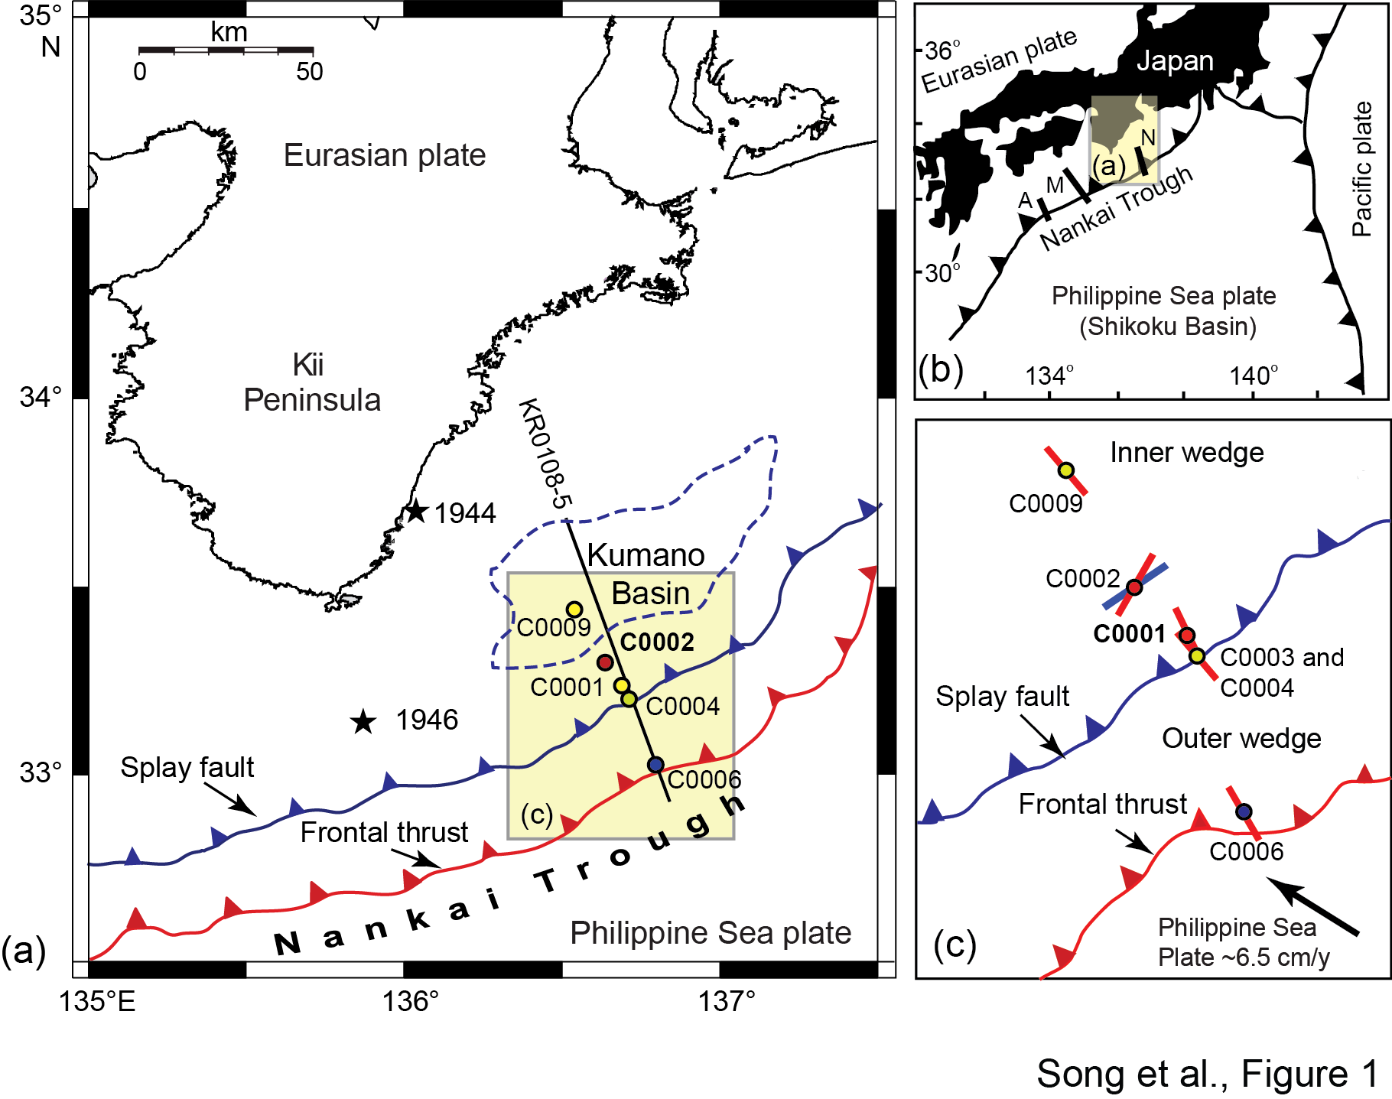
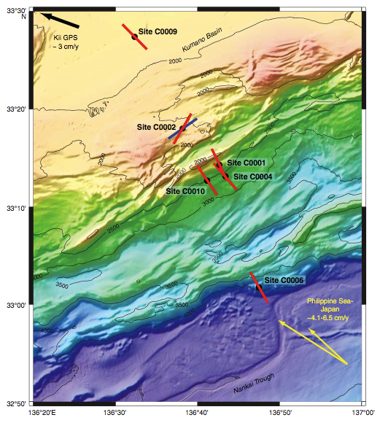
Location of study area and tectonic setting

Slide 3
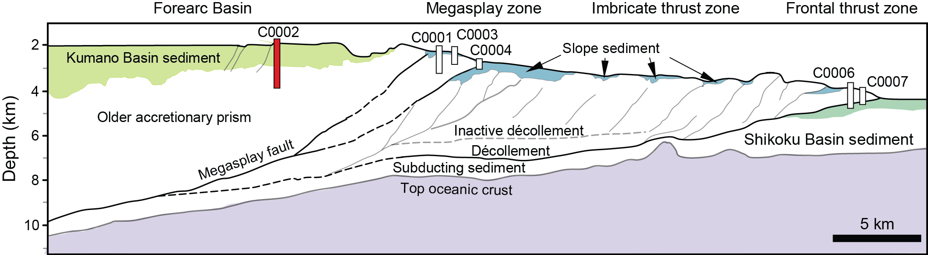
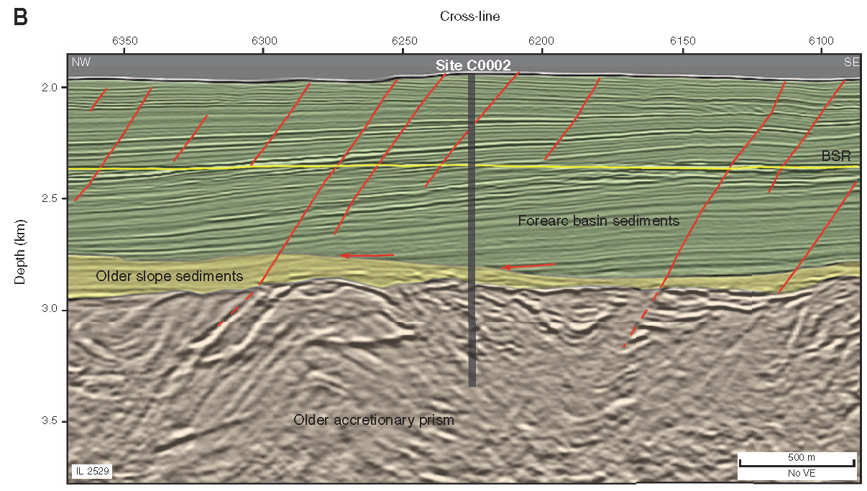
Geologic profile

Slide 4
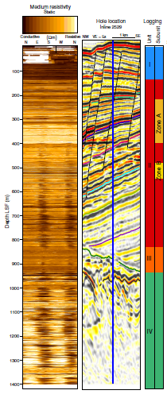

Breakouts and in situ stress
σ_{hmin}
σ_{hmax}
σ_{hmax}
σ_{hmin}
15
10
rock
strength
θ_{b}
θ_{b}
σ_{θθ} (MPa)
5
0
0
60
120
180
240
300
360
σ_{H}
θ (º)
IODP EXP 314 NanTroSEIZE report

Slide 5
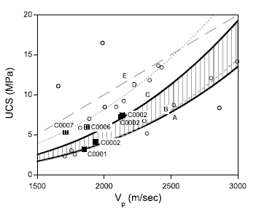
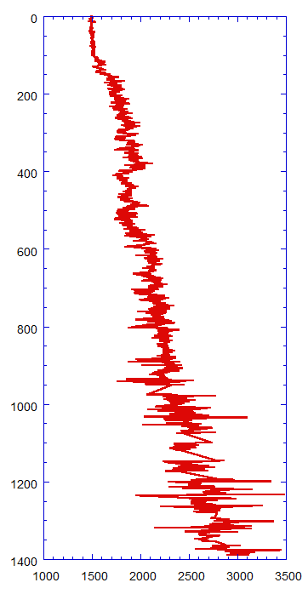
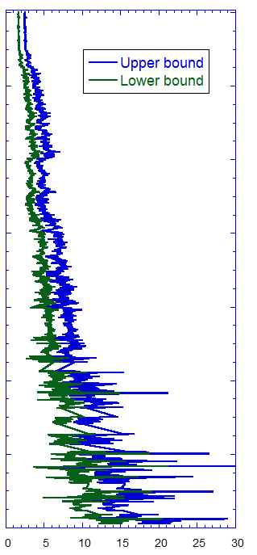
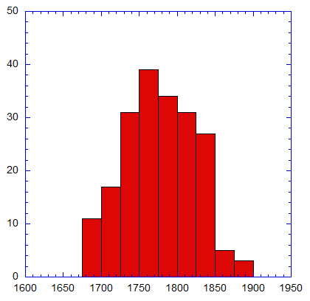
Strength vs. sonic velocity
(Chang et al., 2009)
Depth (mbsf)
C0002A 200-230 mbsf
Ave.=1784.4m/s
Counts
V_{P} (m/s)
UCS (MPa)
V_{P} (m/s)

Slide 6
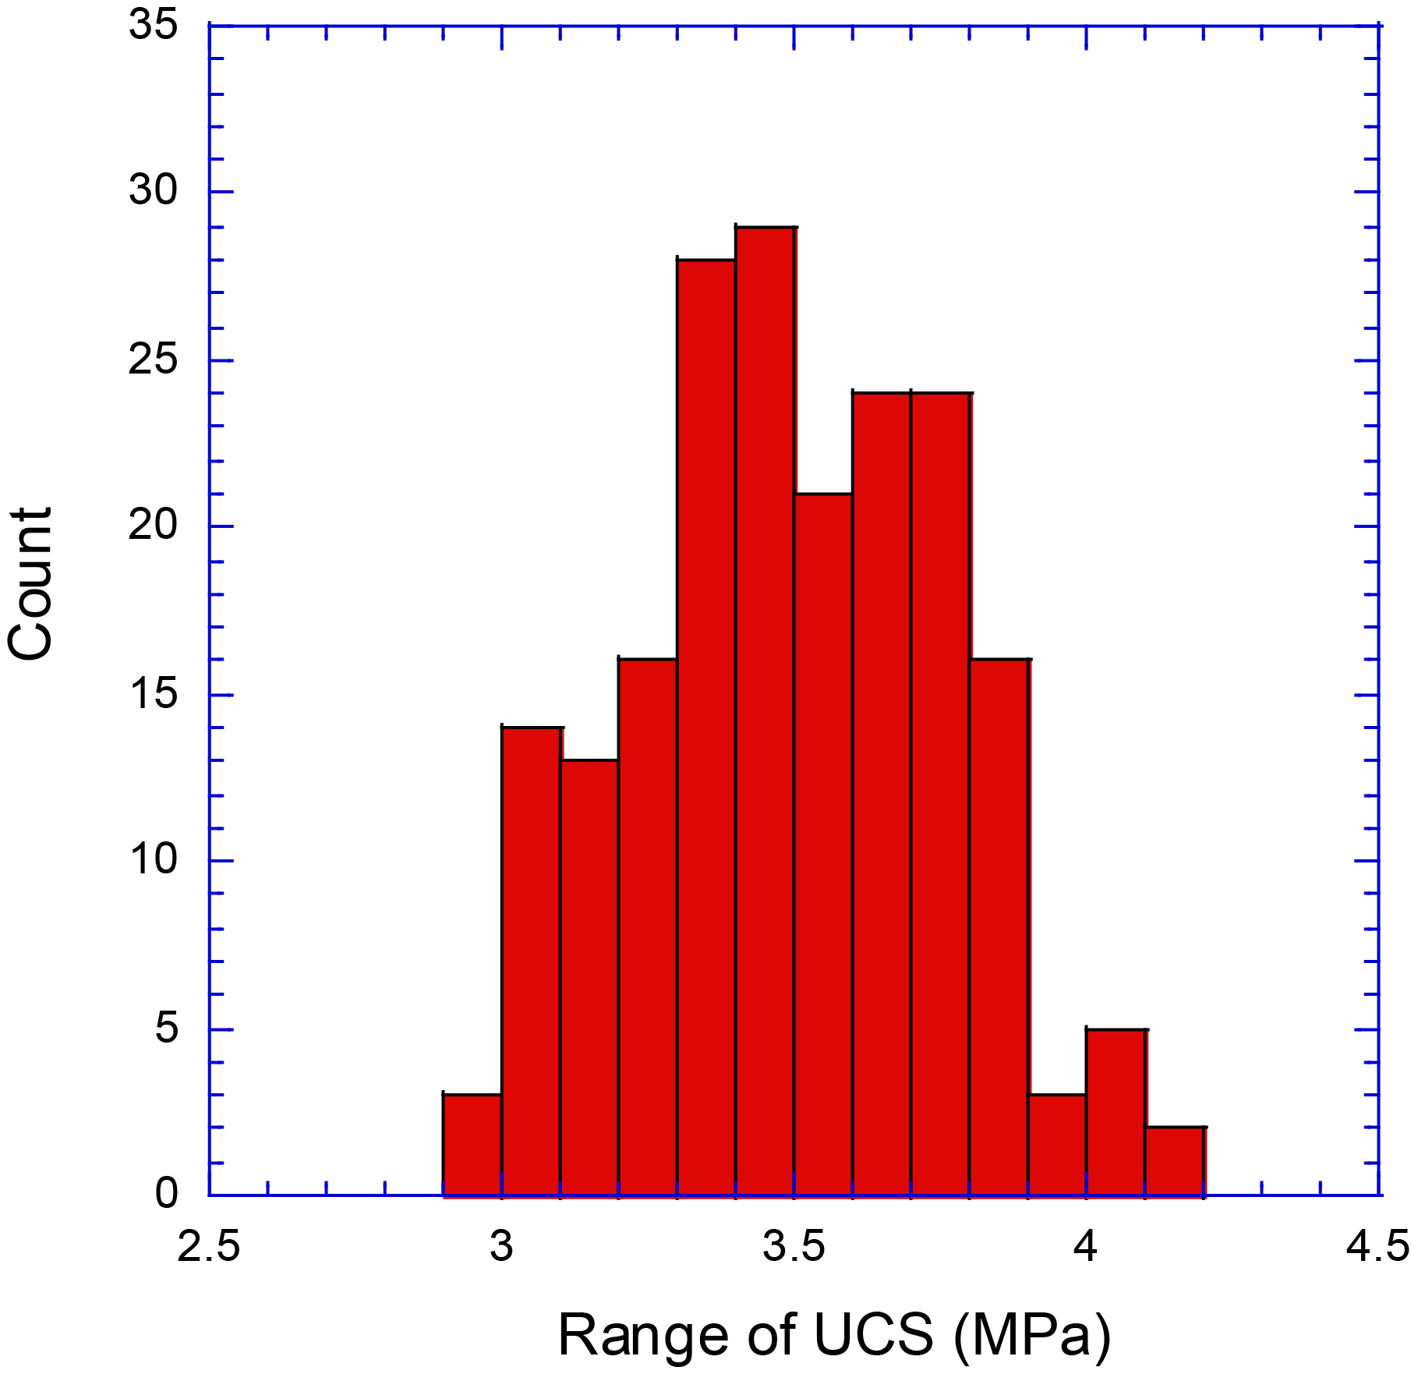
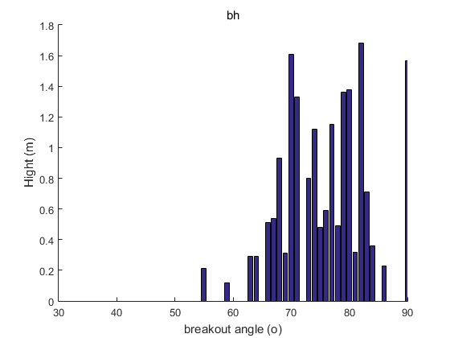
Determination of far-field stress magnitudes
C0002A 200-230 mbsf
θ_{B}
Counts
θ_{b}
σ_{hmax}
breakout
UCS (MPa)
4.0
C0002A (200-230mbsf)
3.5
θ_{B}
θ_{b}
σ_{θθ} (MPa)
Height (m)
2.0
1.5
0
60
120
180
240
300
360
σ_{H}
θ (º)
θ_{B}

Slide 7
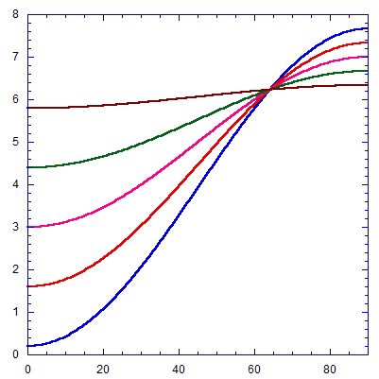
Average strength vs. average breakout width
Average strength
Average width
Stress (MPa)
θ (º)

Slide 8
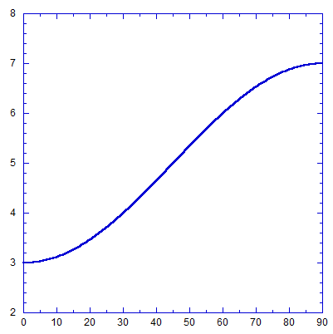
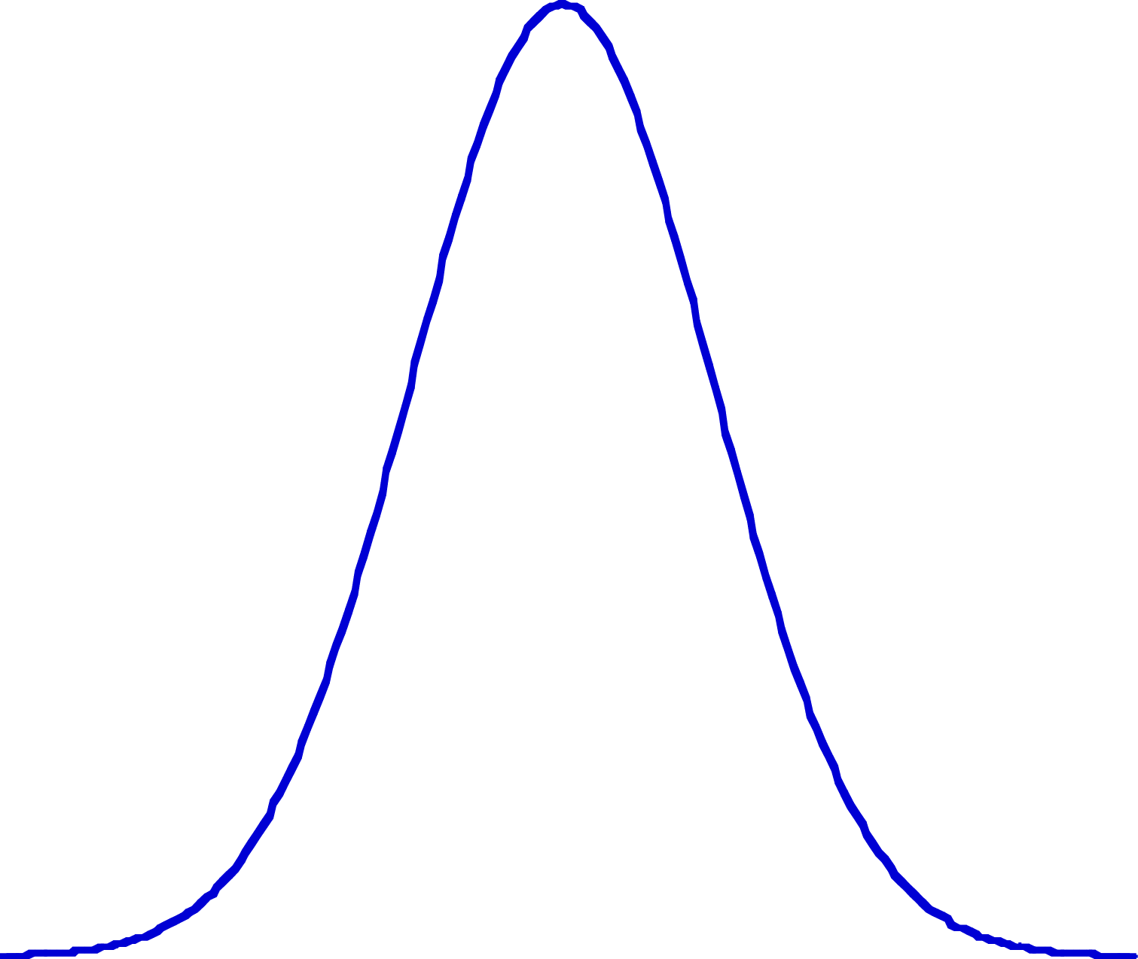
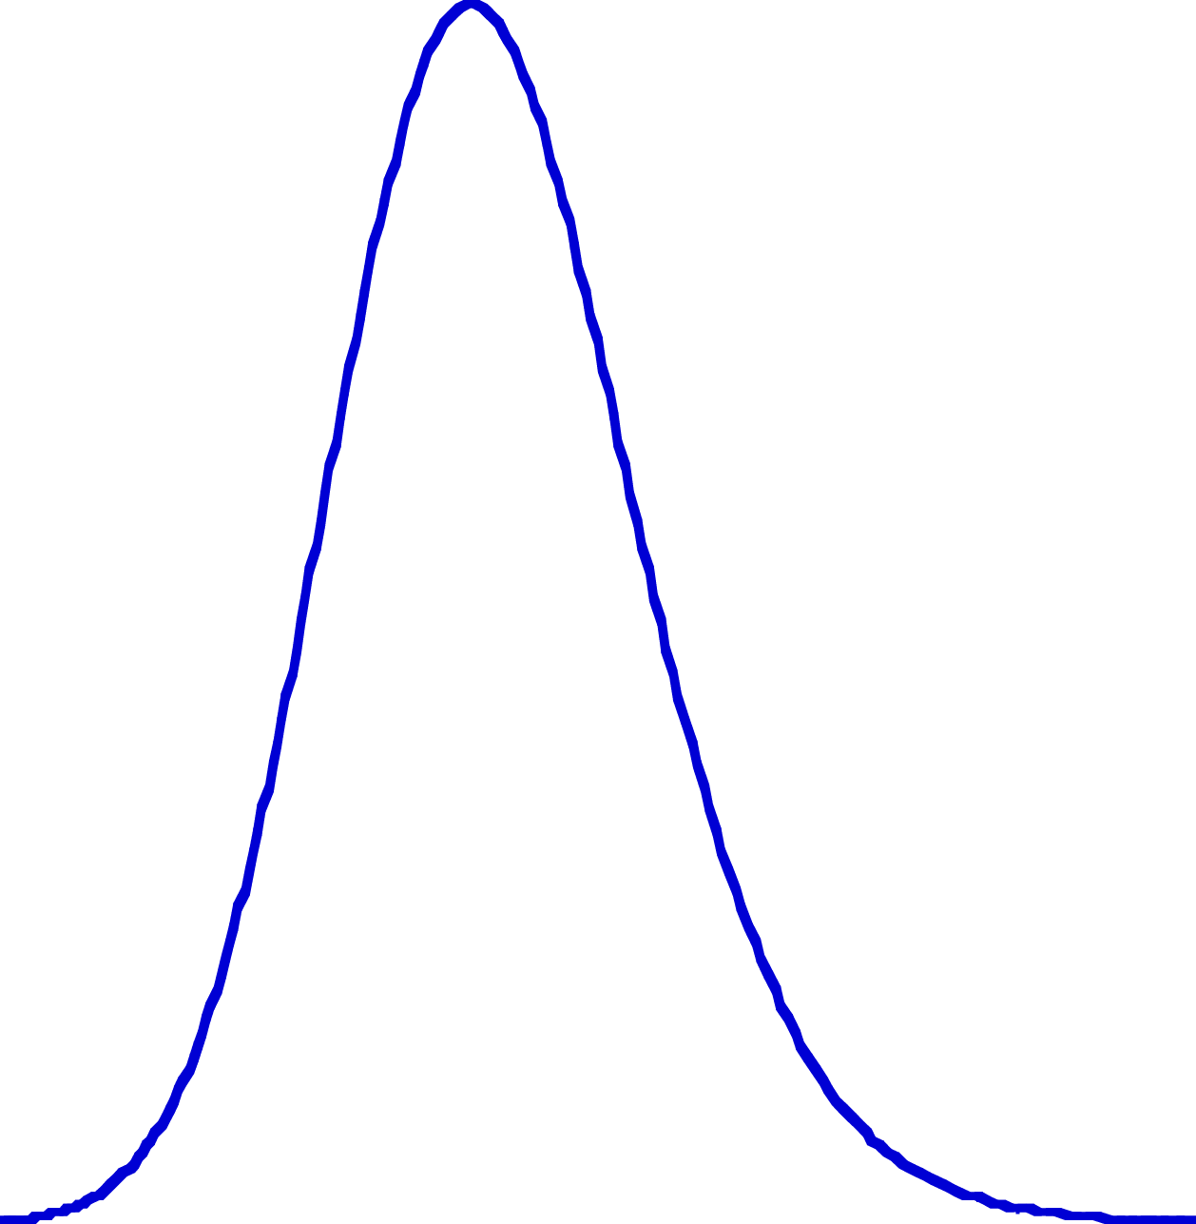
Strength distribution vs. breakout width distribution
Stress (MPa)
θ (º)

Slide 9
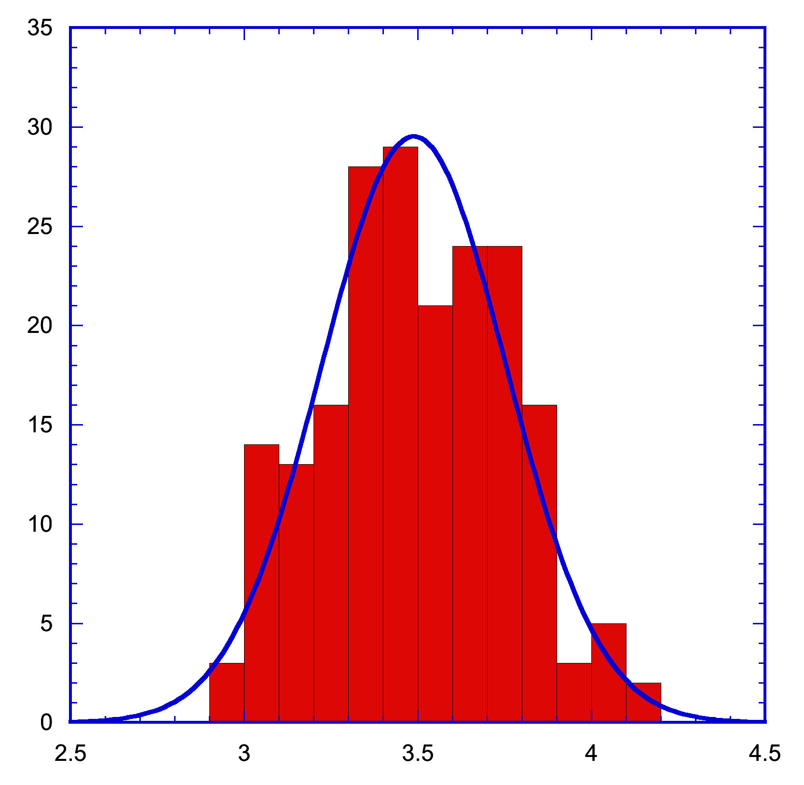
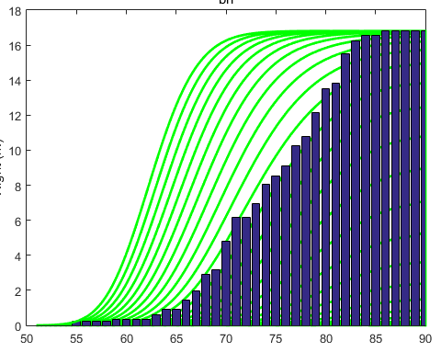
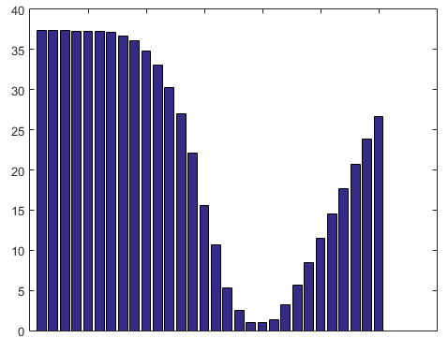
In situ stress determination algorithm
For S_{h} = 26 MPa
ΔS_{H} = 0.05 MPa
Counts
Cumulated density in height (m)
Cumulated probability
UCS (MPa)
θ_{B}
Assume Gaussian distribution of UCS(P) and μ_{i} = 0.6 (Song et al., 2010)
Using the M-C failure criterion with probability, calculate the probability function of breakout width for given far-field stresses (S_{hmax} and S_{hmin})
Compare the probability with breakout density in height
Select the far-field stress with the minimum misfit
For S_{h} = 26 MPa
ΔS_{H} = 0.05 MPa
Integration of all misfits
S_{H} = 28.5 MPa

Slide 10
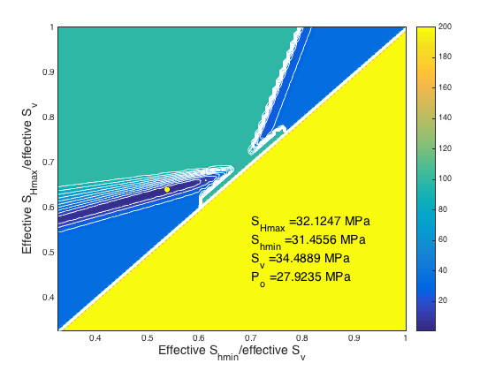
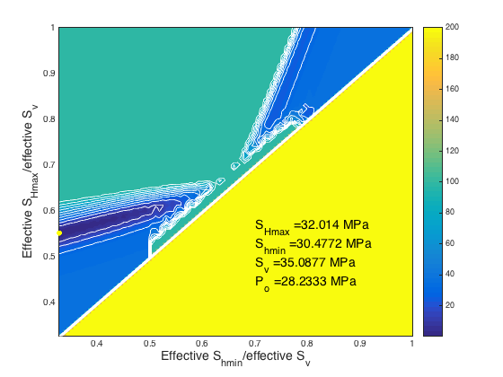
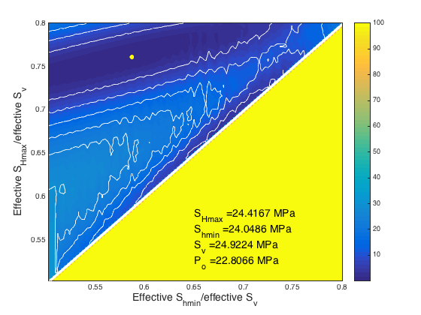
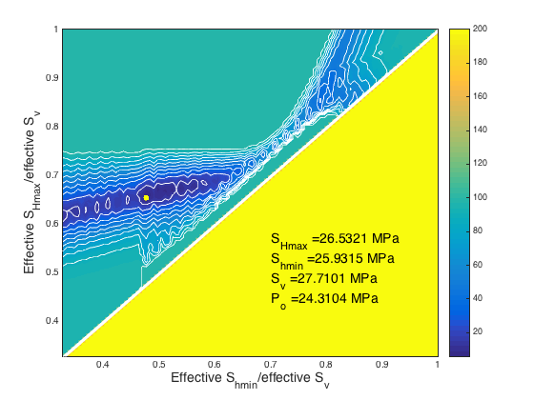
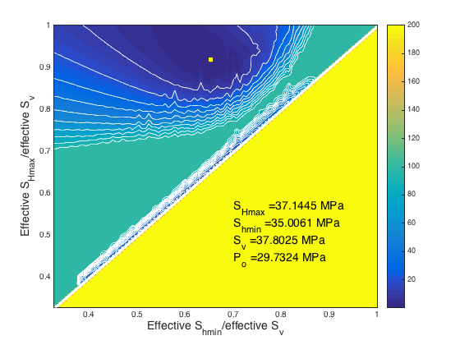
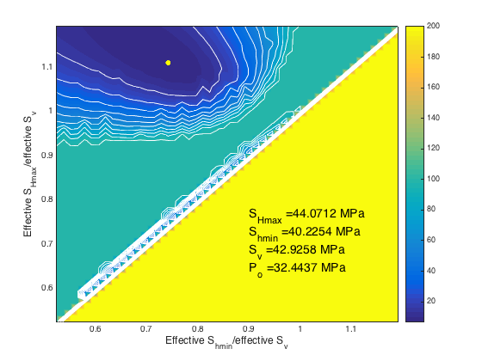
Examples of grid searching method
484 mbsf
335 mbsf
S_{hmin} from LOT
845 mbsf
875 mbsf
1172 mbsf
1295 mbsf

Slide 11
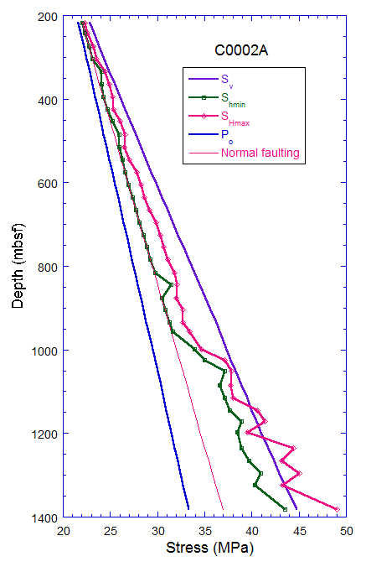
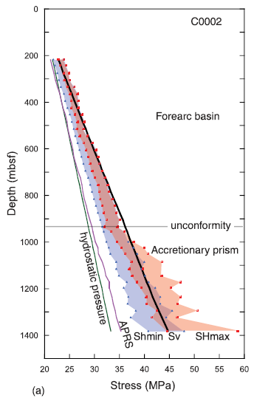
Stress profiles
(Chang et al., 2009)
hydrostatic
Lithostatic
LOP
unconformity
μ_{s}=0.6

Slide 12
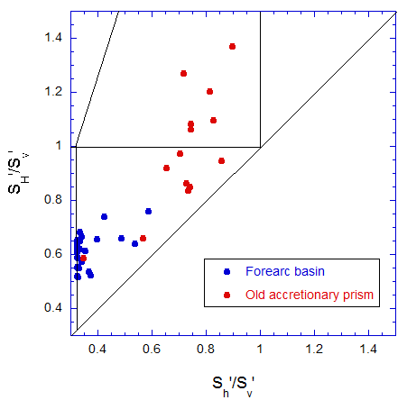
Stress polygon
LOP
C0002A

Slide 13
Conclusions
Using the distributions of rock strength and breakout width instead of their averages, we were able to determine both S_{hmin} and S_{Hmax} simultaneously.
In normal faulting stress regime, S_{hmin} is insensitive to error and becomes more sensitive as it goes to the strike-slip faulting stress regime.
In Kumano forearc basin in situ stress is very close to the limit equilibrium condition for normal faulting.
Underneath the unconformity the stress condition becomes stable and goes to the strike-slip fault stress regime with increasing depth.

Slide 14

THANK YOU

