Slide 1
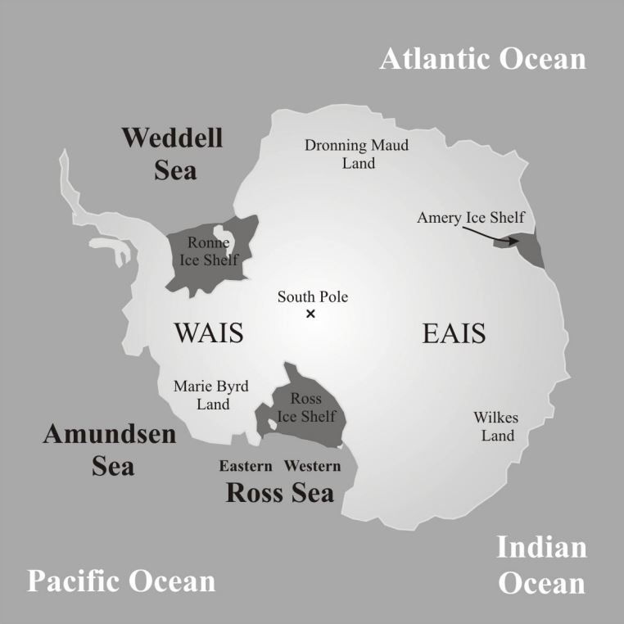
Centennial to millennial variations of atmospheric methane during the early Holocene
Ji-Woong Yang^{1*}, Jinho Ahn¹ and Edward Brook²
¹School of Earth and Environmental Sciences, Seoul National University (SNU), Seoul 151-747, South Korea ²Department of Geosciences, Oregon State University (OSU), Corvallis, Oregon 97331-5506, USA
*Correspondence to: Ji-Woong Yang (luckyno44@gmail.com)
Siple Dome ice core
Gas extraction system
Isotopic constraints
Millennial-scale variability
▶ Higher accumulation rate than other ice cores allows high-resolution study.
▶ Melt-Refreeze wet extraction line built in SNU
▶ Suitable for study natural methane budget.
▶ Replicate precision of 1.01 (1σ) ppb.
▶ Gradually depleted ¹³C/¹²C ratio implies that no abrupt emission from ¹³C-enriched sources, or pyrogenic and geologic methane.
Core site | Mean Acc. Rate cm year⁻¹ i.e.
Siple Dome | 11.2ª
WAIS Divide | 22.0^{b}
Talos Dome | 8.7^{c}
EPICA DML | 7.0^{d}
EPICA Dome C | 2.7e
Vostok | 1.1^{g}
Ice samples
Vacuum
P
Standard tank
Siple Dome
Bellows valve
Rasmussen et al., (2006)
warming
P
Gradually depleted in ¹³C
Greenland
GC – FID
(Agilent® 7890A)
northward
cooling
Ethanol bath
ITCZ
Deplazes et al., (2012)
ªJones et al., (2014); ^{b}Banta et al., (2008); ^{c}Frezzoti et al., (2007); ^{d}Oerter et al., (2004); ^{e}EPICA members, (2004); ^{g}Siegert, (2003)
Modified after Bertler et al., 2006
southward
Severinghaus et al., (2009)
stronger
Respiration
System performance
Comparison with OSU data
stronger
Wang et al., (2005)
weaker
▶ Replicate measurements were carried out with time interval of 8 ~ 80 days to test our system performance.
▶ 1 pooled standard deviation between replicates yields an excellent precision of 1.01 ppb (less than 0.5%).
▶ SNU and OSU dataset agree well each other, showing a mean difference (OSU-SNU) of 3.23 ppb.
▶ We present a high-resolution early Holocene CH4 composite. Mean time resolution of 26 year.
Inter-polar difference
Monsoon
weaker
stronger
▶ Small variation during the early Holocene.
▶ Mean IPD = 50.5 ± 4.0 ppb (8.7 ~ 11.3 ka)
▶ Consistent with previous estimates.
Finkel and Nishiizumi (1997)
Solar activity
Depth (m) | 1st measurement |  |  | 2nd measurement |  |  | Difference
 | CH₄ (ppb) | St. Dev. (ppb) | Date (dd/mm/yy) | CH₄ (ppb) | St. Dev. (ppb) | Date (dd/mm/yy) | CH₄ (ppb) | Date (days)
523.15 | 630.12 | 0.11 | 27-01-14 | 630.98 | 2.23 | 24-02-14 | -0.86 | 29
530.95 | 663.00 | 4.39 | 03-02-14 | 664.69 | 0.92 | 24-02-14 | -1.69 | 22
558.30 | 674.85 | 3.02 | 14-03-14 | 674.84 | 6.40 | 02-04-14 | 0.01 | 20
559.85 | 680.01 | 8.24 | 03-02-14 | 682.67 | 2.68 | 26-03-14 | -2.66 | 52
561.15 | 682.95 | 1.00 | 14-03-14 | 681.62 | 4.44 | 02-04-14 | 1.33 | 20
562.41 | 682.30 | 1.37 | 26-03-14 | 682.33 | 2.12 | 02-04-14 | -0.03 | 8
578.15 | 674.20 | 6.02 | 04-02-14 | 672.88 | 3.29 | 24-04-14 | 1.32 | 80
weaker
▶ Comparison with 1/1800 year⁻¹ high-pass filtered proxy data after smoothed by 150 year running average.
▶ Methane decreases at 8.2, 9.3, 10.3 and 10.9 ka occur in concert with changes in Greenland climate, Cariaco basin precipitation, terrestrial respiration, Asian monsoon intensity and solar activity.
▶ Hypothetical mechanism:
Abrupt changes in solar activity → ice-rafted debris discharge → cooling in North Atlantic region → southward displace of ITCZ → precipitation decrease in tropical wetlands → methane emission decrease
30 year resampled after annual interpolation
References
Ahn, J., Brook, E., and Buizert, C.: Response of atmospheric CO2 to the abrupt cooling event 8200 years ago, Geophys. Res. Lett., 41, 604-609, doi:10.1002/2013GL058177, 2014.
Brook, E. J., Harder, S., Severinghaus, J., Steig, E. J., and Sucher, C. M.: On the origin and timing of rapid changes in atmospheric methane during the last glacial period, Global Biogeochem. Cy., 14, 2, 559-572, 2000.
Chappellaz, J., Blunier, T., Kints, S., Stauffer, B., and Raynaud, D.: Variations of the Greenland/Antarctic concentration difference in atmospheric methane during the last 11,000 years, J. Geophys. Res., 102, 15, 15987-15997, 1997.
Chappellaz, J., Stowasser, C., Blunier, T., Baslev-Clausen, D., Brook, E. J., Dallmayr, R., Fain, X., Lee, J. E., Mitchell, L. E., Pascual, O., Romanini, D., Rosen, J., and Schupbach, S.: High-resolution glacial and deglacial record of atmospheric methane by continuous-flow and laser spectrometer analysis along the NEEM ice core, Clim. Past, 9, 2579-2593, doi:10.5194/cp-9-2579-2013, 2013.
Moller, L., Sowers, T., Bock, M., Spahni, R., Behrens, M., Schmitt, J., Miller H., and Fischer, H.: Independent variations of CH4 emissions and isotopic composition over the past 160,000 years, Nat. Geosci., 6, 885-890, doi:10.1038/NGEO1922, 2013.
Sowers, T.: Atmospheric methane isotope records covering the Holocene period, Quat. Sci. Rev., 29, 213-221, 2010.
Mean IPD = 51.7 ± 2.7 ppb
(8.7 ~ 10.0 ka)
Acknowledgements
We are grateful to Michael Kalk and Brian Bencivengo for providing and handling Siple Dome ice cores, to Logan Mitchell for helpful discussions and advices, and to Jérôme Chappellaz for sharing NEEM methane dataset. Also thanks go to Youngjun Ryu for his assistance on methane measurements and to Yoo-Hyeon Jin for contribution to development of gas extraction system.

