Slide 1
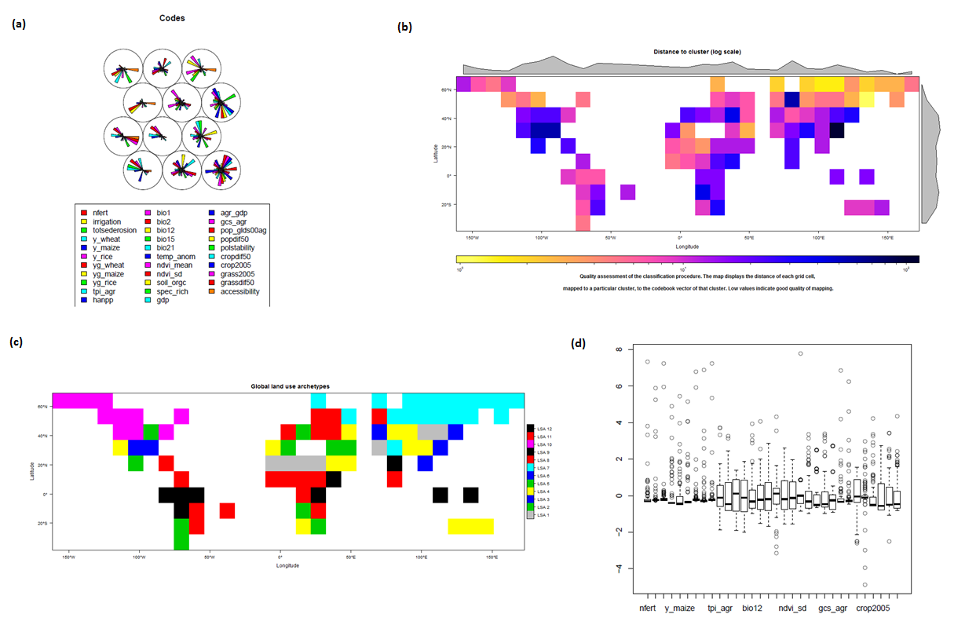
Open and reproducible global land use classification
Daniel Nüst*, Tomáš Václavík°, Benjamin Pross* * 52North Initiative for Geospatial Open Source Software GmbH, Münster, Germany ° UFZ – Helmholtz Centre for Environmental Research, Leipzig, Germany
Notes:
Hi! My name is Daniel and I‘d like to interest you in a new software framework to publish your R scripts online.
Reproducibility lies at the core of science. This has been acknowledged by many initiatives, big and small, that make it easier for scientists to employ the necessary vigor in their daily work, that is required to ensure reproduciblity. In the research project GLUES, we have tried to publish a scientific analysis as an interoperable web process after the fact. If you come to my PICO stand I will show you how we succeeded in doing that.
The anaysis that is published online (see QR code on the slides) uses a complex machine learning algorithm and is implemented in R. Tomas Vaclavik et al. use around thirty global land use datasets to create a data-driven global land use classification. To the user, the web algorihtm exposes several input parameters which can be changed in a simple web form (see left hand side of the slide). The user then „executes“ the algorithm and get access to a variety of processed data and visualisations. On the right hand side of the slide you see a global map showing the quality of the classification algorithm. It is very blocky because the user set the number of sampling points to merely 1000, compared to the original algorithsm 1.000.000. Other output figures concern the actual classification, e.g. a map or plots of the codebook vectors, showing how each input dataset influences each created class.
The workflow and architeccture behind this public classification process is as follows: A script developer annotates the R script with basic metadata: What are the process inputs and outputs, what is ist name, and who wrote it. This annotated script is uploaded to the 52°North WPS4R framework. A user connects to the WPS and starts and algorithm, e.g. via a web infterface, or via GIS. WPS4R executes the algorithm with the user‘s slection of parameters by creating an R workspace and sending the commands to Rserve. After the R script is fininshed, WPS4R picks up the results of the algorithm and returns them using the WPS service interface.
Not all input datasets can be published openly. This drawback in reproduciblity can in part be compensated by future steps in our research, because users are still able to _use_ the datasets in their analysis, even if they cannot download them. Also lacking right now is the cumbersome pre-processing. On the other hand, the online process allows to at least experiment with the non-public datasets to a certain extend.
Please come over if I got you interested in tthe topic, and feel free to try out the process some time this year when the server is not crashed due to many visitors during EGU ☺.

Slide 2
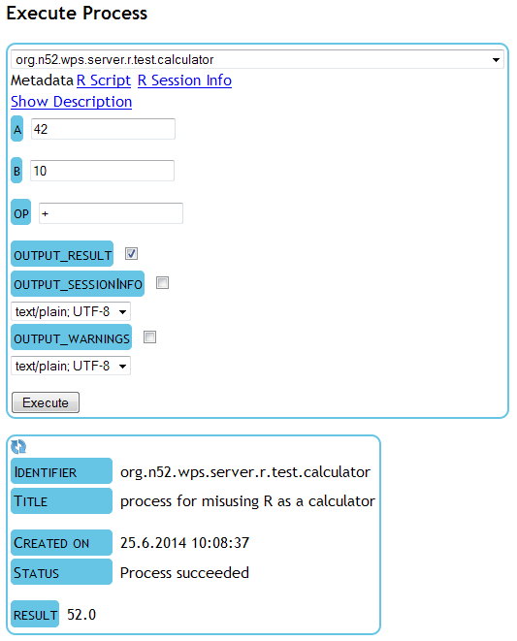
Open and reproducible global land use classification
Daniel Nüst*, Tomáš Václavík°, Benjamin Pross* * 52North Initiative for Geospatial Open Source Software GmbH, Münster, Germany ° UFZ – Helmholtz Centre for Environmental Research, Leipzig, Germany
Desktop apps
Web apps
Services
SOA
Big Data
…
Script developer: annotated script
OGC WPS
Download script and resources
User icons made by Freepik from www.flaticon.com are licensed by CC BY 3.0
R via Rserve
WPS4R
IT admin/software developer

Slide 3
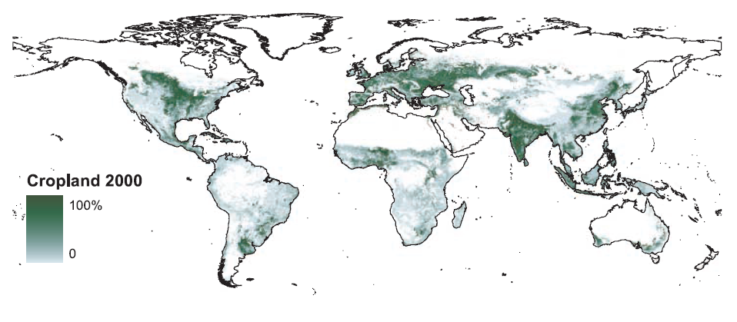
GLOBAL LAND USE
Meeting future demands for food and other commodities will require land-based production to expand or intensify
Problem:
Agricultural expansion is well mapped but patterns of land-use intensity are poorly understood at the global scale
Solution:
Integrated system approach
Moving beyond mapping agricultural classes towards mapping land-use systems
Foley et al. (2005)
http://geoportal-glues.ufz.de/stories/landsystemarchetypes.html

Slide 4
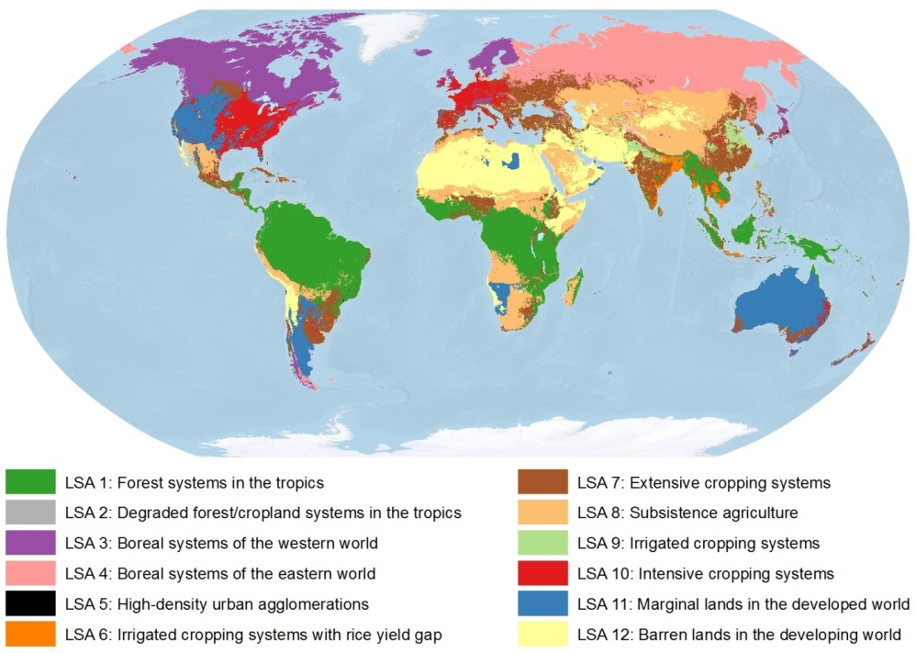
GLOBAL LAND USE
Aim: Mapping archetypes of land-use system
A new approach for representing global land-use intensity
Using unbiased, bottom-up approach driven by data
Accounting for multidimensional aspects of land use
Land system archetypes: unique patterns of:
land-use intensity
environmental conditions
socioeconomic factors
that appear repeatedly across the terrestrial surface of the earth
http://geoportal-glues.ufz.de/stories/landsystemarchetypes.html

Slide 5
INDICATORS
32 global variables at 5 arc-minute resolution (~9.3×9.3 km at the equator)
1) Land-use inputs/outputs
Nitrogen fertilizer
Factor | Unit
Cropland area | km² per grid cell
Cropland area trend | km² per grid cell
Pasture area | km² per grid cell
Pasture area trend | km² per grid cell
N fertilizer | kg ha⁻¹
Irrigation | Ha per grid cell
Soil erosion | Mg ha⁻¹ year⁻¹
Yields (wheat, maize, rice) | t ha⁻¹
Yield gaps (wheat, maize, rice) | 1000 t
Total production index | index
HANPP | % of NPP₀
HANPP

Slide 6
INDICATORS
32 global variables at 5 arc-minute resolution (~9.3×9.3 km at the equator)
2) Environmental conditions
3) Socioeconomic conditions
Factor | Unit
Temperature | °C × 10
Diurnal temperature range | °C × 10
Precipitation | mm
Precipitation seasonality | coeff. of variation
Solar radiation | W m⁻²
Climate anomalies | °C × 10
NDVI – mean, seasonality | index
Soil organic carbon | g C kg⁻¹ of soil
Species richness | # of species
Factor | Unit
Gross Domestic Product | $ per capita
GDP in agriculture | % of GDP
Capital Stock in agriculture | $
Population density | persons km⁻²
Population density trend | persons km⁻²
Political stability | index
Accessibility | travel time
Mean annual temperature
Accessibility to cities and market places

Slide 7
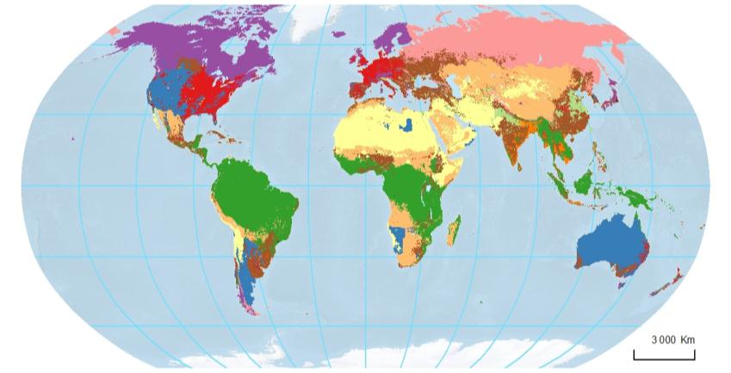
DATA-DRIVEN ANALYSIS: SELF-ORGANIZING MAP
Self-organizing maps (SOM) – unsupervised classification algorithm
R-package: kohonen http://cran.r-project.org/web/packages/kohonen/
2D topology of SOM
Complex datasets visualized by reducing their dimensionality to 2D
Cluster analysis performed by grouping observations based on their similarity

Slide 8
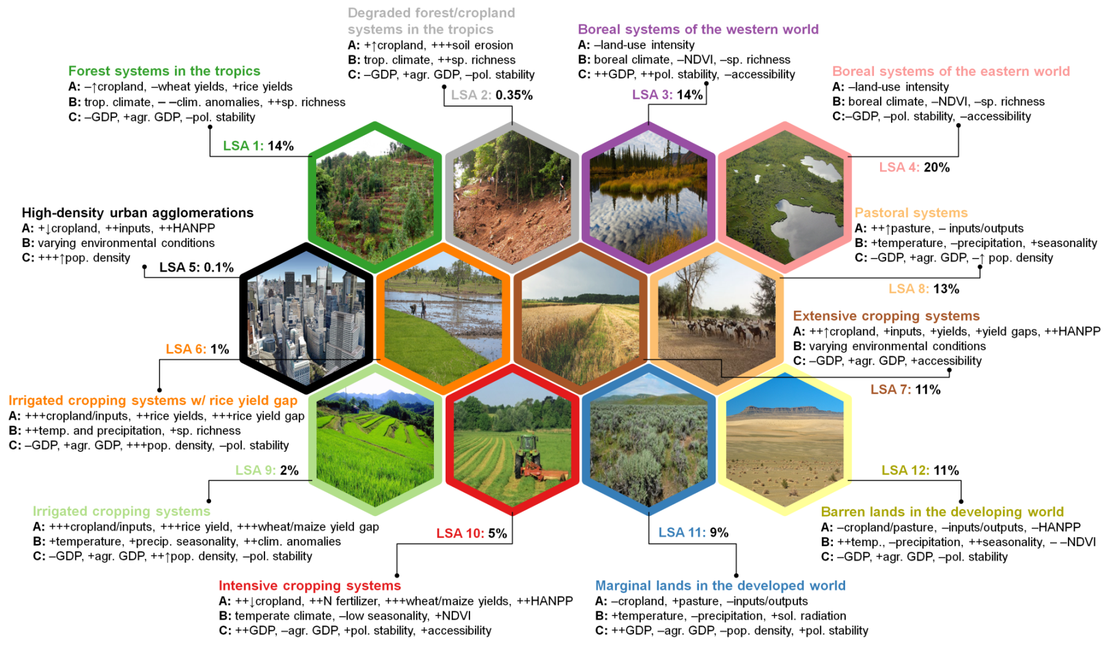
ORIGINAL TWELVE LAND SYSTEM ARCHETYPES
Screenshot from the original paper of the discovered land system archetypes. Each archetype is represented by a picture and some of the most influential factors (input data). The number of classes was a decision made by the original authors of the analysis. The web process allows interested users to make their own choice about this number and other input parameters, but using exactly the same datasets.

Slide 9
WPS4R ARCHITECTURE
Desktop apps
Web apps
Services
SOA
Big Data
…
User icons made by Freepik from www.flaticon.com are licensed by CC BY 3.0
Script developer: annotated script
OGC WPS
Download script and resources
R via Rserve
WPS4R
IT admin/software developer

Slide 10
OGC WPS
OGC Web Processing Service
Describes inputs & output of geospatial web processing services
http://en.wikipedia.org/wiki/Web_Processing_Service | http://www.opengeospatial.org/standards/wps
GetCapabilities: service-level metadata
DescribeProcess: process description (metadata, inputs, outputs)
Execute: start and retrieve results of a process instance
Synchronous
Asynchronous
Open source implementations

Slide 11
R
THE place for the latest and greates in (geo)statistical analysis
extension packages (5000+ and rising)
open source (foundation, active communities)
http://www.r-project.org/

Slide 12
PROCESS INPUTS
The following input parameters of the process are available to the user:
Sample size (numbers of points spread over the globe)
Sampling type (strategy such as regular, random, …)
Standardization method (how to move inputs to a common scale)
SOM-specific parameter
Grid topology (rectangular or hexagonal)
Grid dimensions (influences # of output classes)
Future versions might allow to select the used datasets or integrate own datasets, select input layers, …

Slide 13
PROCESS OUTPUTS
Screenshot of some of output plots based on mere 100 sampling points for illustration purposes: (a) classification information (output of the self-organizing map) showing how the input variables (colour-coded) influence each of the output classes (circles at the top); (b) global plot of "property-distance" which is a measure of classification quality; (c) the global land use archetypes map in a very coarse version; (d) statistical background information of the self-organizing map.

Slide 14
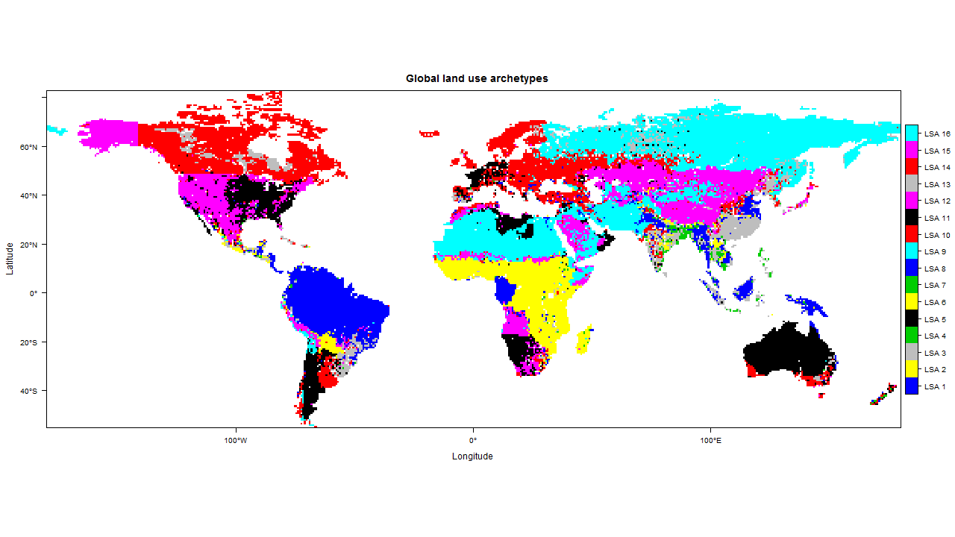
USER CHOICE: 16 CLASSES
Map of global land use archetypes calculated for 16 classes using a WPS4R-based geoprocess. The original paper’s classes were manually labelled and appropriately named. This is not possible for the automatic classification, which will not give the same name to the same detected pattern in subsequent runs of the algorithm.

Slide 15
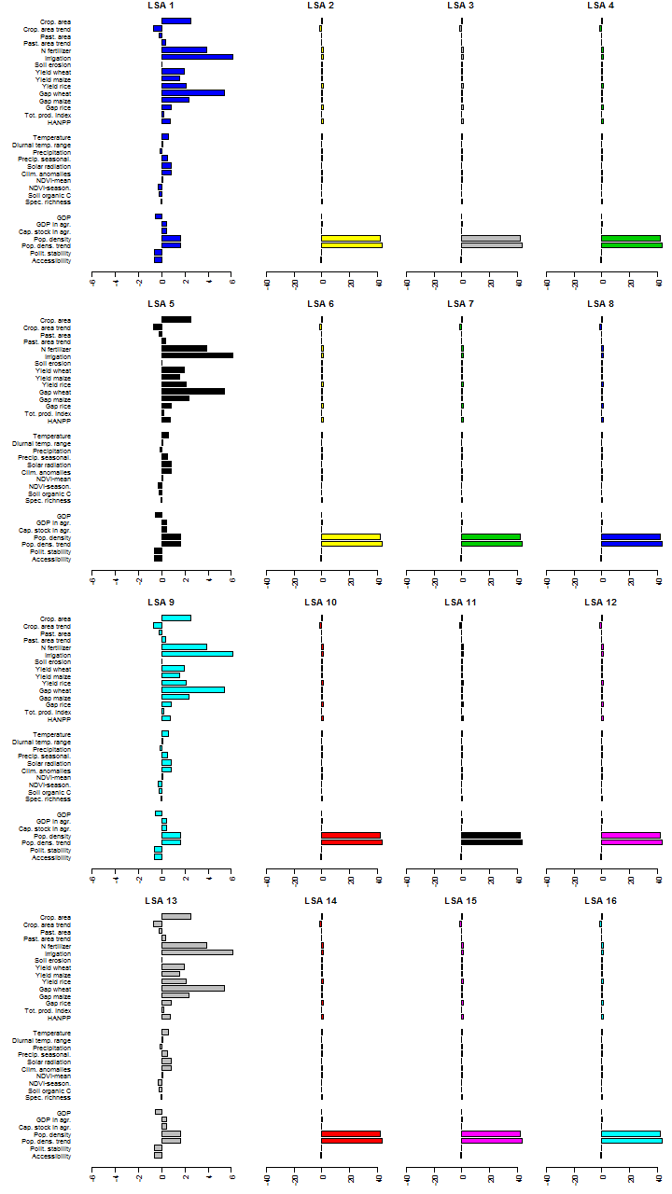
PROCESS OUTPUT: 16 CODEBOOK VECTORS
The codebook vector plots show how each input variable is used to represent one of the output variables. In the original paper, these plots were sceled differently to show effects that are hidden by the two very strong variables at the bottom of each plot. In the automatic plot creation, these adjustments are not possible.

Slide 16
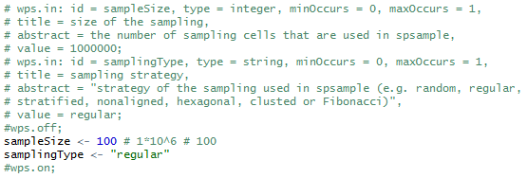
ANALYSIS SCRIPT & WPS DESCRIPTION
Full scripts at https://github.com/52North/glues-wps/ >>

Slide 17
GLUES PROJECT
http://modul-a.nachhaltiges-landmanagement.de/en/
development and implementation of practical solutions for global and regional challenges of land management
12 worldwide regional projects are analyzing complex correlations between land use, globalization, climate change, loss of biodiversity, population growth and urbanization.
research activities of the regional projects are supported by the scientific coordination project GLUES (Global Assessment of Land Use Dynamics, Greenhouse Gas Emissions and Ecosystem Services)
Communication & support (outreach, networking, science-policy-interface, stakeholder integration)
Scientific approaches (synthesis, models & scenarios, geodata infrastructure)

Slide 18
LESSONS LEARNED
Script required work to be published as web processes
Some preprocessing and visualisation steps were done outside of R and had to be re-done
Script was not intended to be used by others > code craftsmanship from start
Web publication is possible but complex analysis naturally create complex interfaces and geoprocesses

Slide 19
NEXT STEPS
Improve usability of WPS4R
Extend algorithms and go beyond mere reproduction
allow user to provide own regions, which are analysed in light of the raw data – How well is my study area represented by the archetype?
allow user to provide own datasets via web services

Slide 20
RESSOURCES & REFERENCES
Vaclavik, T., Lautenbach, S., Kuemmerle, T., Seppelt, R. (2013): Mapping global land system archetypes. Global Environmental Change 23(6): 1637-1647. DOI: 10.1016/j.gloenvcha.2013.09.004.
Hinz, M., Nüst, D., Pross, B., Pebesma, E. (2013): Spatial Statistics on the Geospatial Web. In: The 16th AGILE International Conference on Geographic Information Science, Short Papers.
52°North WPS instance running the process available at http://wps1.glues.geo.tu-dresden.de/wps/, the used process is org.n52.wps.server.r.glues.systemarchetypes.
Source code is available on GitHub: WPS4R is part of the 52°North WPS repository (https://github.com/52North/WPS), the analysis script is in the glues-wps repository (https://github.com/52North/glues-wps).
Contact Daniel Nüst (d.nuest@52north.org) from 52°North for technical questions on WPS4R and R, and Tomas Vaclavik (tomas.vaclavik@ufz.de) from UFZ for questions on the analysis and archetypes.

