Slide 1
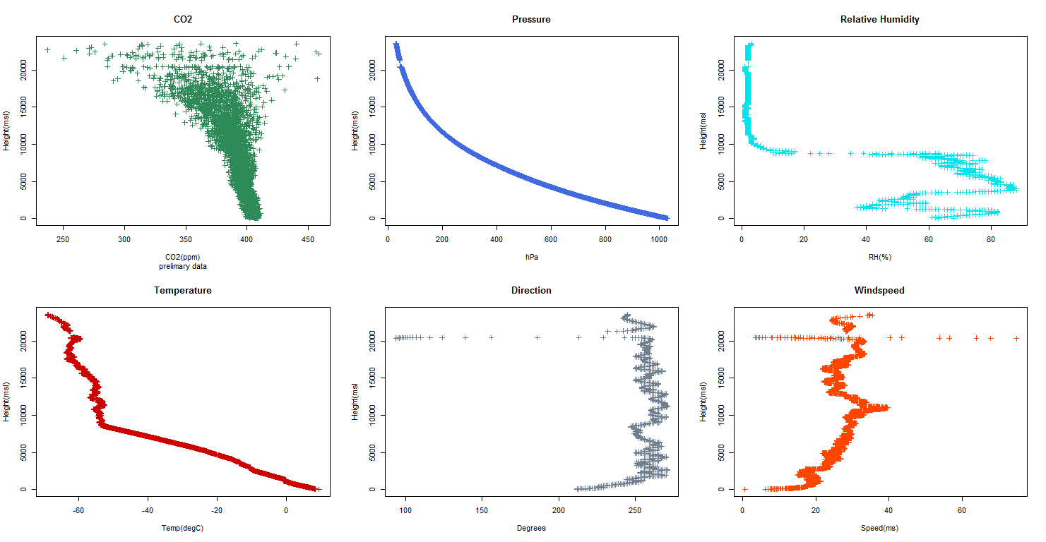
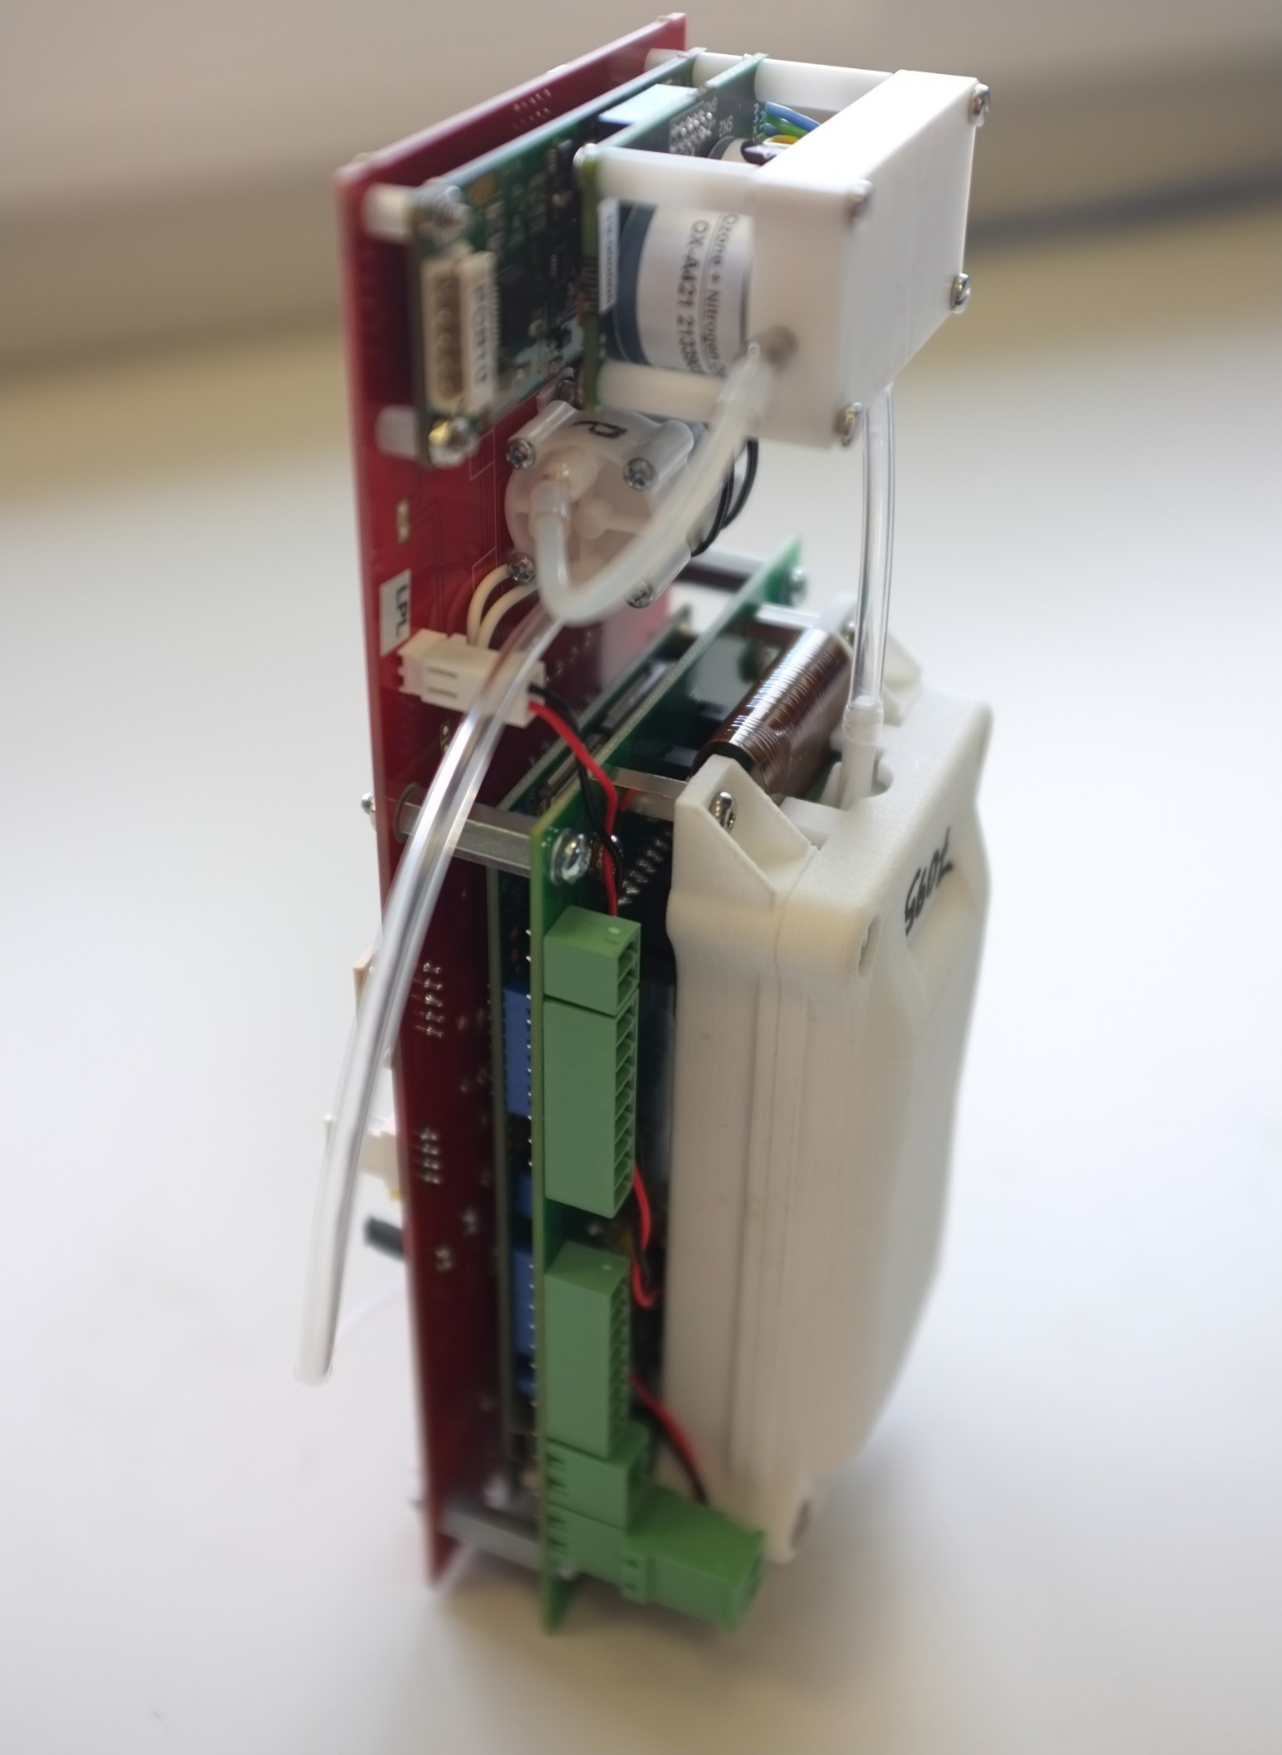
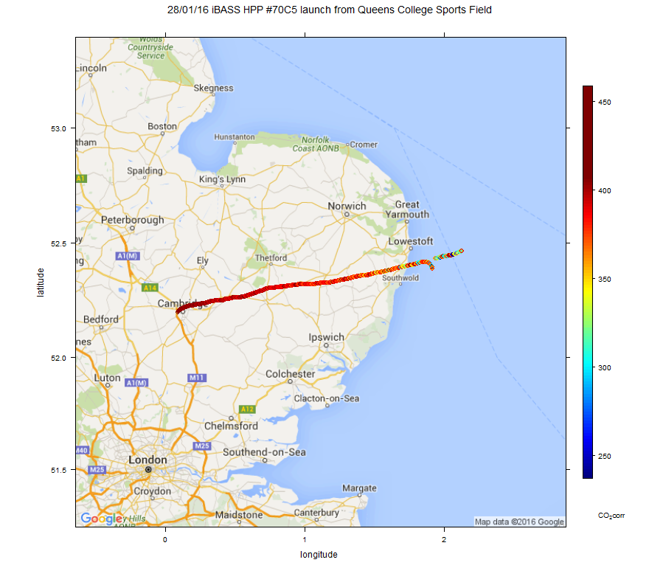
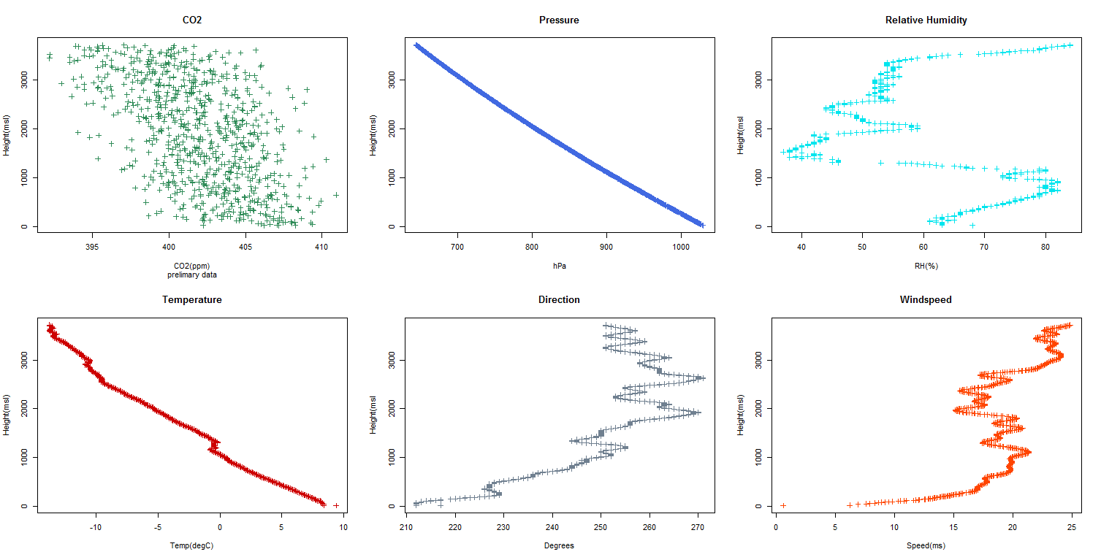
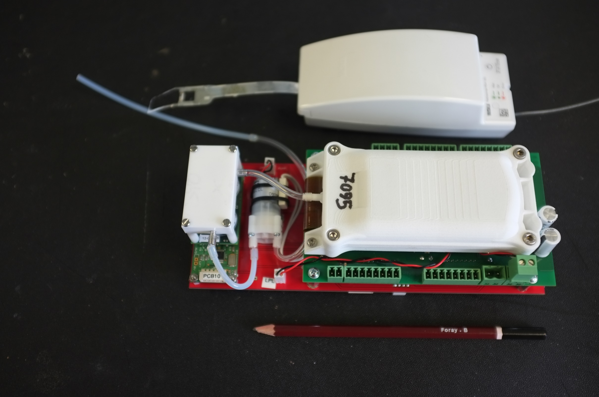
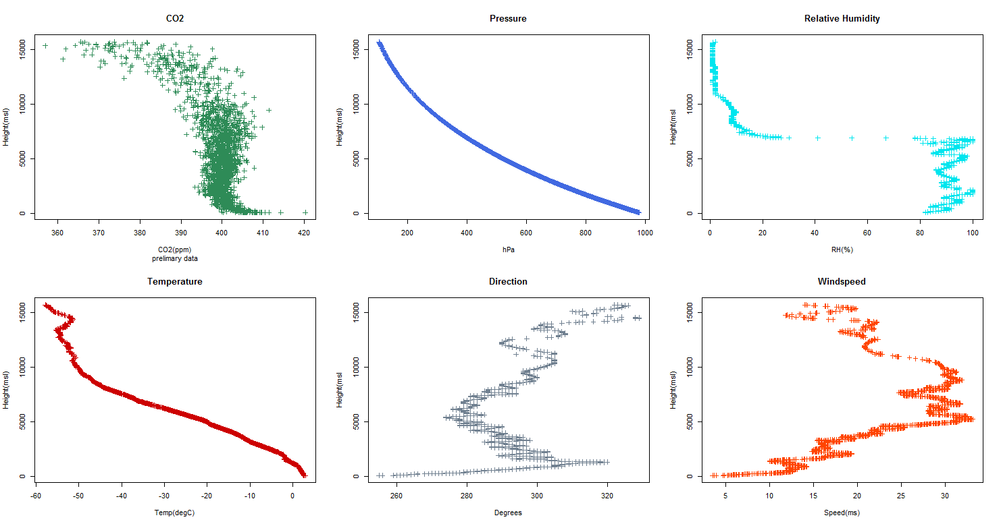
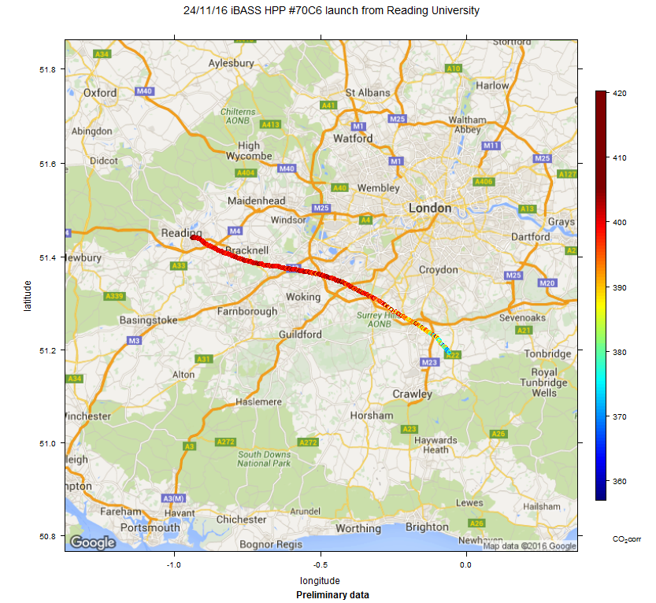
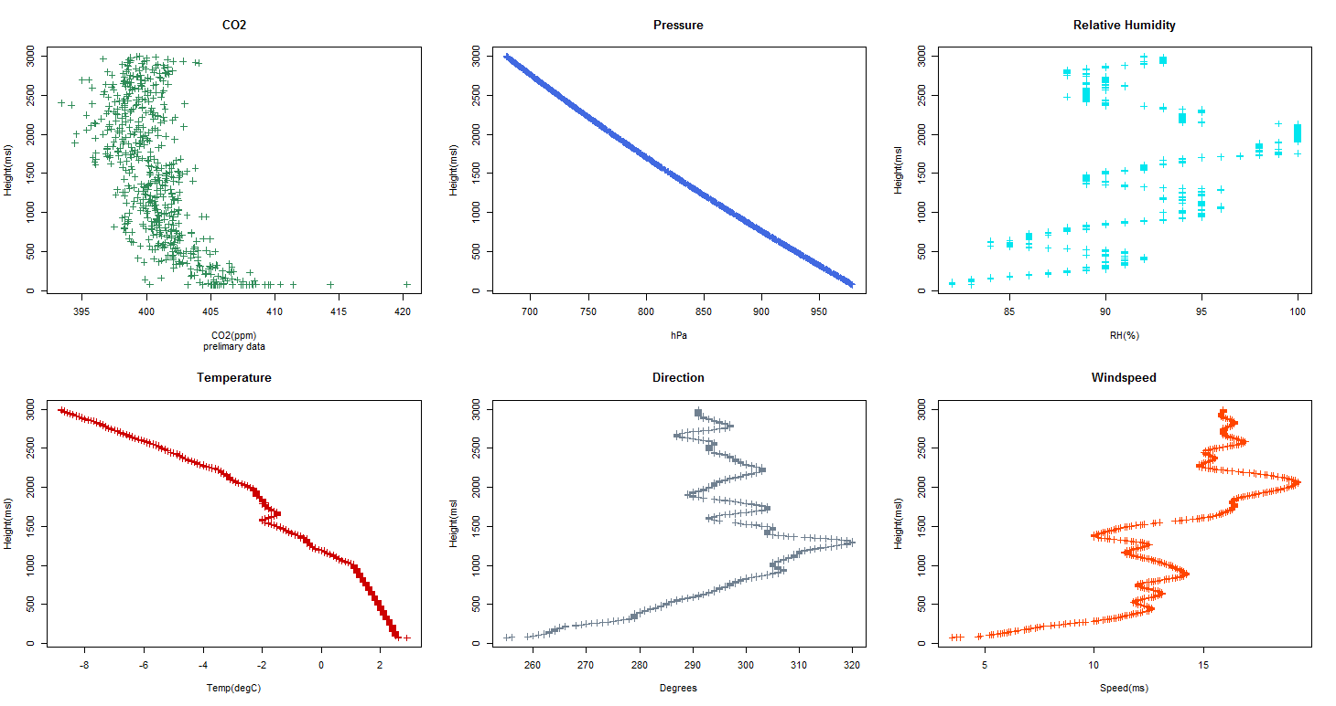
ChemSonde: CO₂ profiles using radiosondes
Paul Smith, Ray Freshwater, Bin Ouyang, Rod Jones, Neil Harris | University of Cambridge, Department of Chemistry, UK | ps683@cam.ac.uk
1. Problem
5. ChemSonde platform (cont.)
8. Results – Cambridge 28/01/16
Composition studies of the upper atmosphere limited to satellites, aircraft or large balloons.
Expensive & intermittent – any alternatives?
Flight duration ~ 2 - 3 hrs
Ascent rate ~ 5 - 6 ms⁻¹
RS41 response < 1 sec
CO₂ response < 1 sec
Sample flow ~ 1.2 l min⁻¹
Vertical resolution ~ 5 m
CO₂ range 0 – 3200 ppm
CO₂ LOD ~ 2.5 ppm
CO₂ sensitivity ~ 0.3 ppm
Actively heated optical bench
96 cm path-length, highly sensitive
Figure 4 (right) complete profile with [CO₂] (preliminary)
Figure 5 (Bottom right) first 3 km
Figure 6 (Below) flight path
of ChemSonde.
2. Potential solution
Radiosondes – launched globally for meteorology.
Cheap, with good temporal & vertical resolution.
Vaisala RS41 sonde accommodates custom sensors.
3. Project overview
6. Launch procedure
9. How do we work out [CO₂ ]?
Integrate new sensors from SenseAir and Alphasense into a module that can interface with the RS41 sonde.
Test the module in an environment chamber by mimicking pressure & temperature profiles.
Improve the design, test, modify, improve again.
Field test & analyse data, validate against existing technologies (FAAM) and compare with models.
Step 1
Step 2
Inflate balloon & prepare parachute, comms check
Step 3
Span & Zero check of ChemSonde, then fit into enclosure
Step 4
Attach balloon contact local Air Traffic Control LAUNCH!
Calibrate RS41 radiosonde & prepare ChemSonde
Pressure & Temperature
& [CO₂]_{estimate}
Lamp & filter profiles & detector response curve
Hitran database for CO₂
(4 to 4.7 µm)
Calculate Voigt line shape & strength
Calculate theoretical transmission T_{theor}
Change [CO₂] by
(T_{theor} – T_{obs}) / k
Compare with observed transmission
T_{obs}
Calculate gradient
k = dT/d[CO₂]
NO
Converged?
YES
Report [CO₂]
4. ChemSonde platform
7. Results – Reading 24/11/16
10. Conclusions
Figure 1 (right) complete profile with [CO2] (preliminary)
Figure 2 (bottom right) first
3 km altitude
Figure 3 (below) flight path
of ChemSonde
We have demonstrated a novel system for atmospheric profiling of CO₂ – ChemSonde.
The platform will sample other species in future.
ChemSonde can add to aircraft & satellite data.
ChemSonde provides a platform for detection, attribution & verification of Paris pledge & renew.
Teflon sample inlet
Vaisala RS41
Alphasense CO/OX ECC’s
(future project)
SenseAir CO₂ HPP
Dimensions:
215 x 85 x 75 mm
768 g (inc. box)
Pump
Motherboard
Acknowledgements
Battery (2CR5)
3 hours (90 g)
Alphasense – John Saffell
CAA – David Millar
Chemsitry / Engineering Department, UCAM
Queens College Cambridge – Mark Reeder
SenseAir AB, Sweden – All the Engineers
Research funded by NERC – NE/K005855/1
Reading University – Keri Nicoll
Vaisala UK – David Bullock

