Slide 1
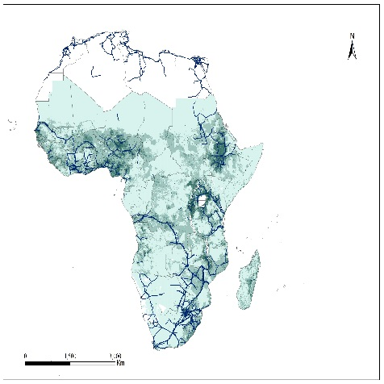
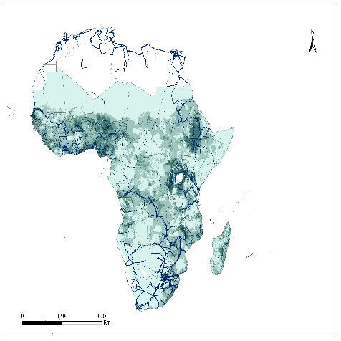
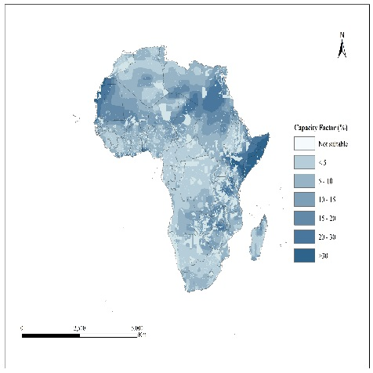
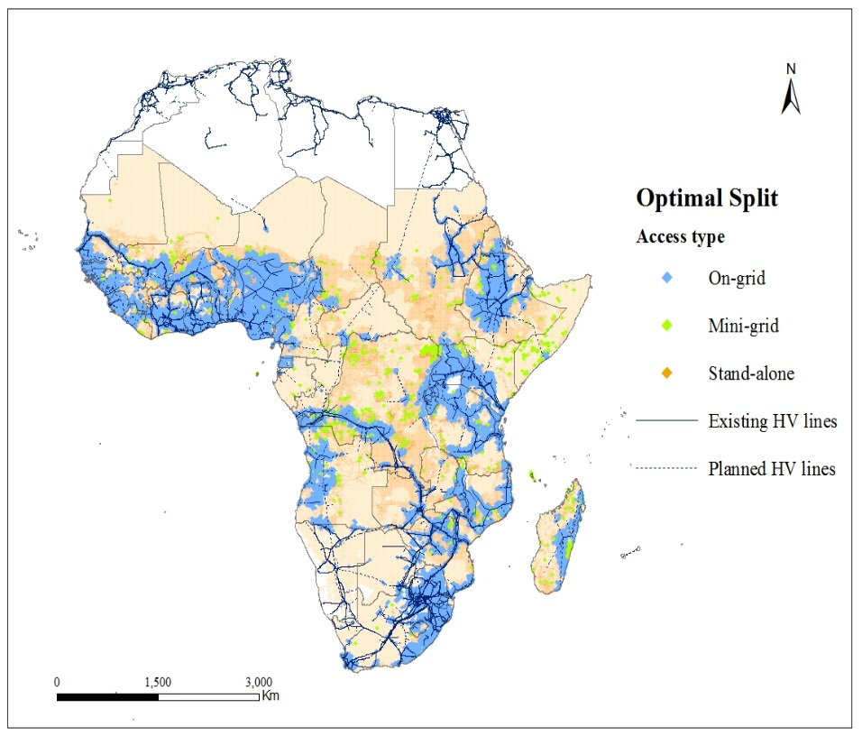
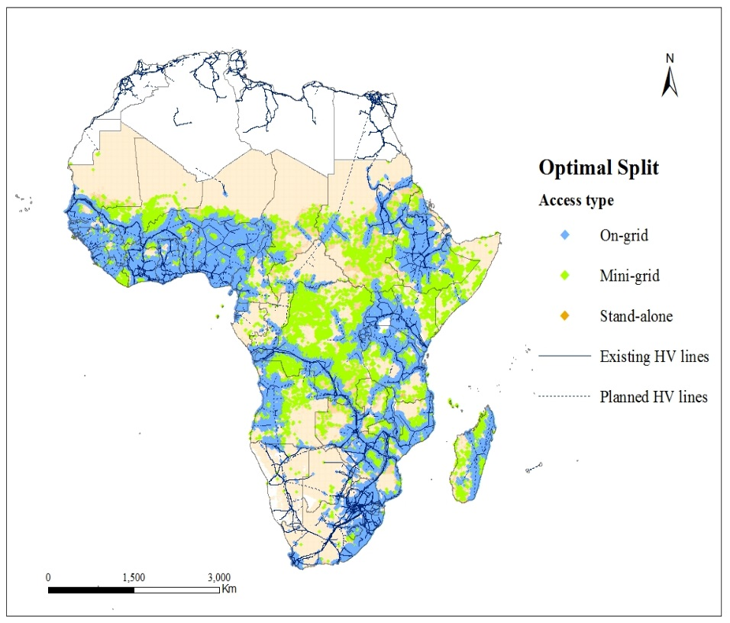
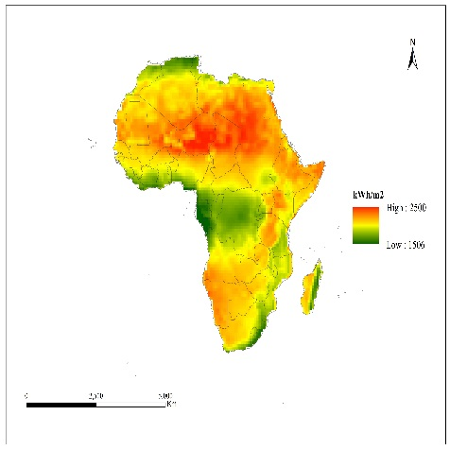
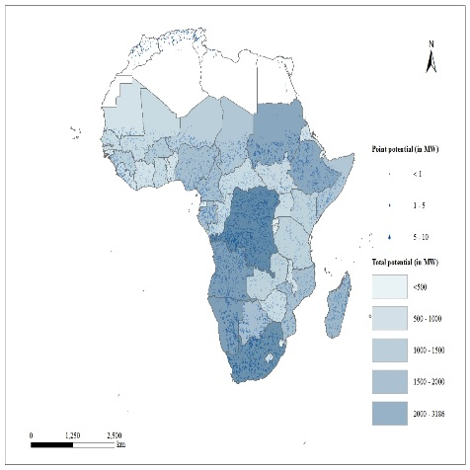
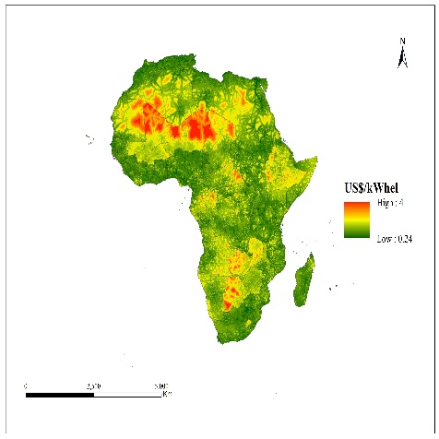
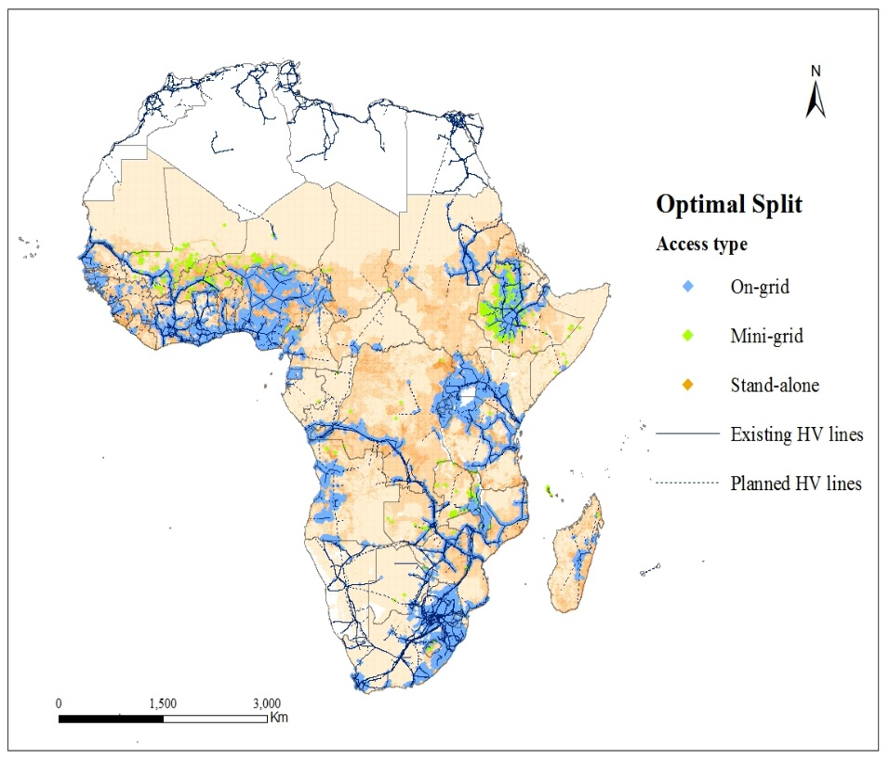
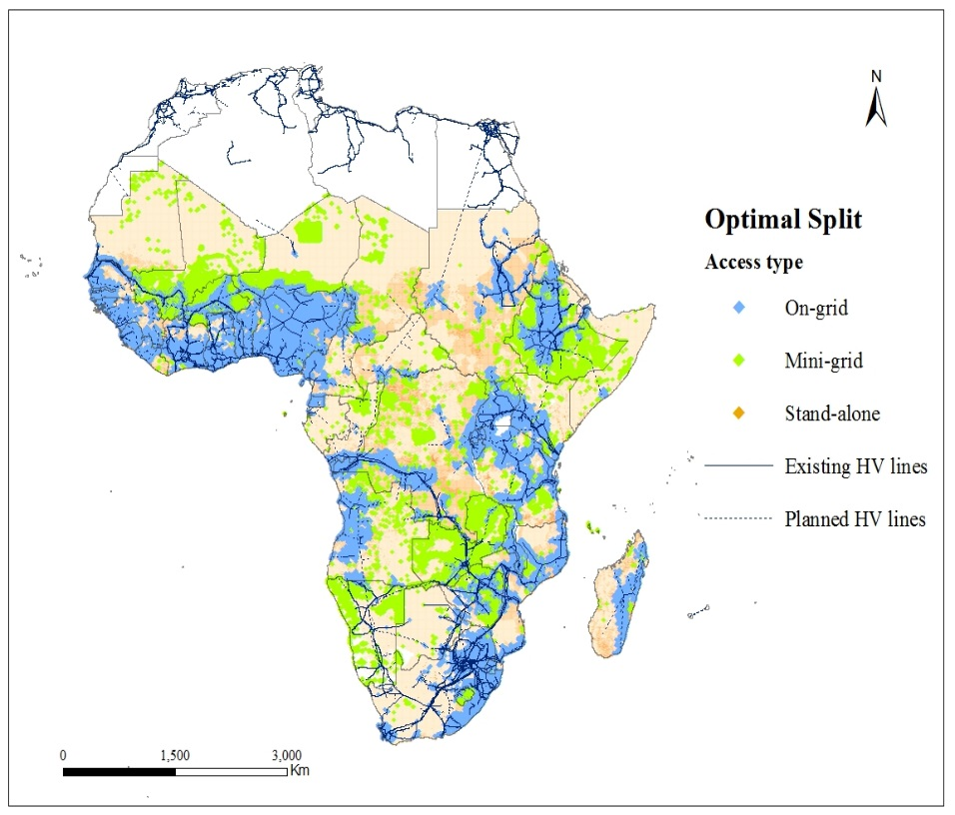
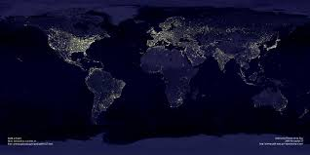
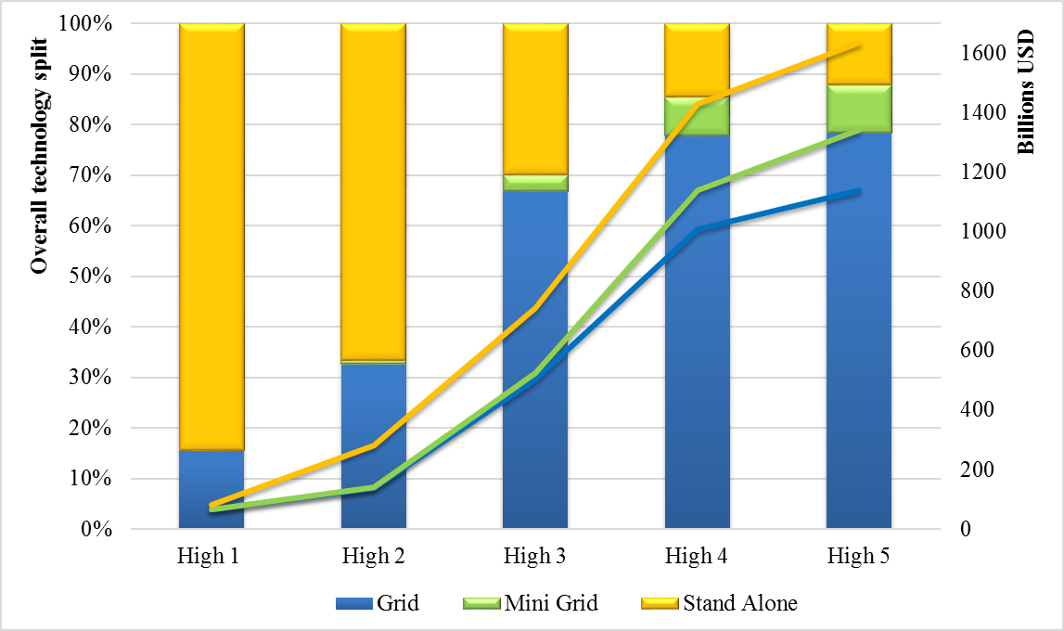
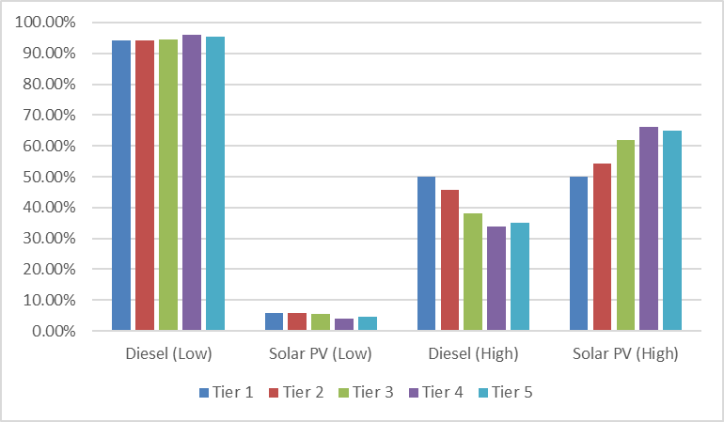
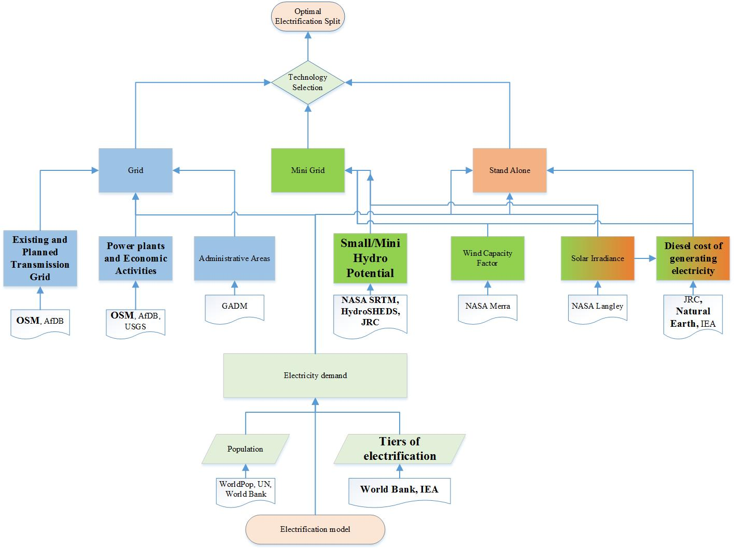
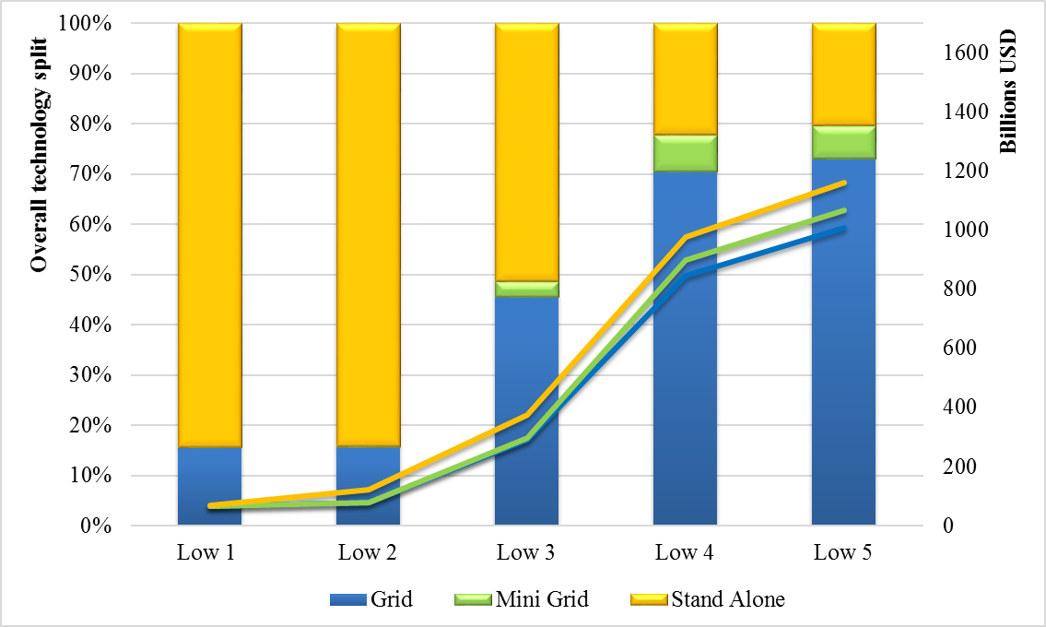
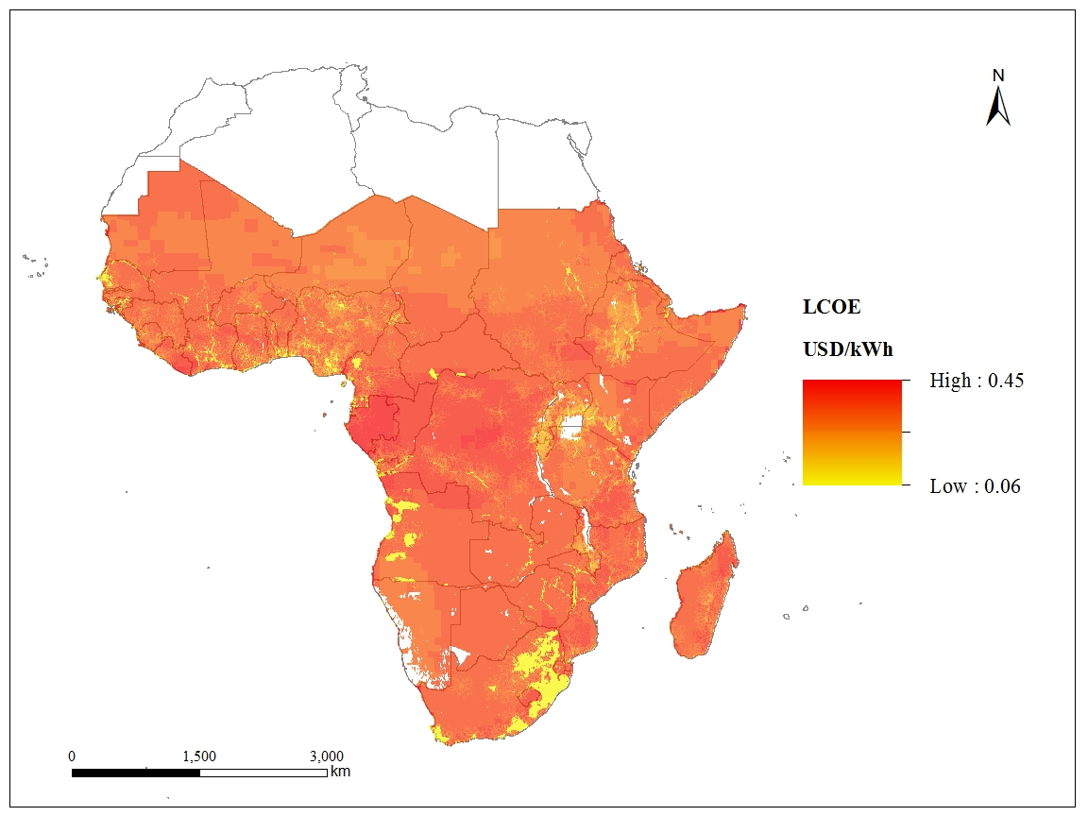
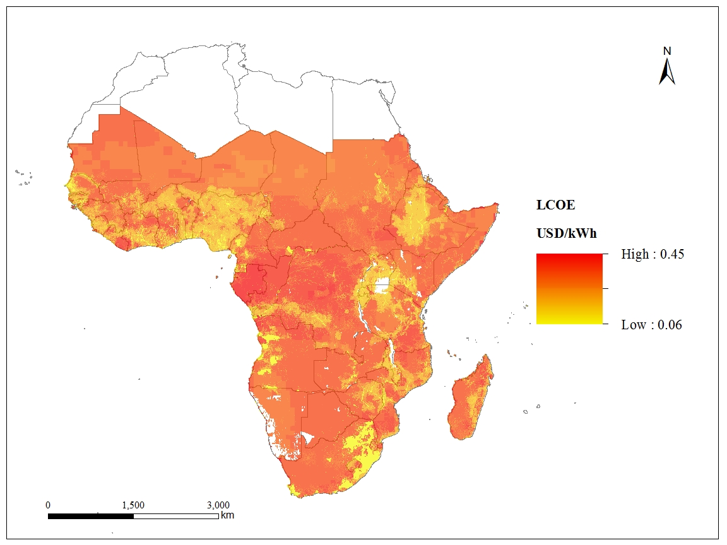
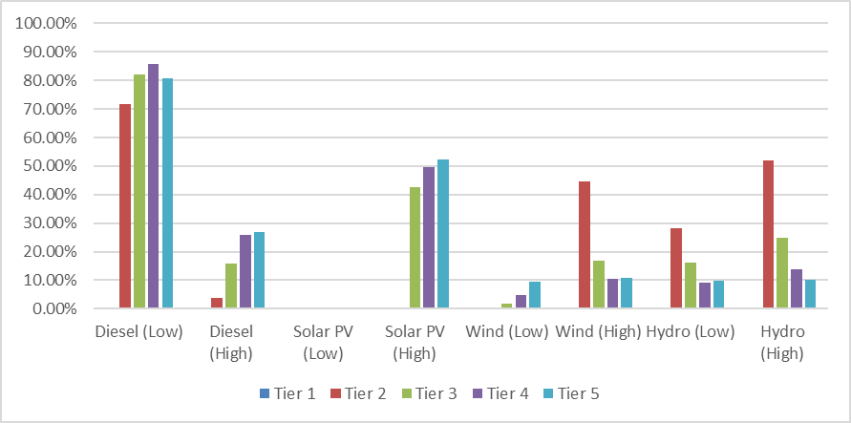
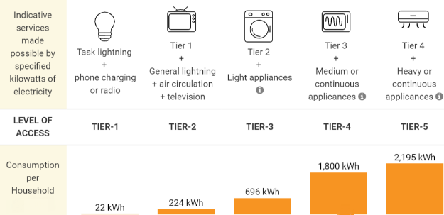
Lighting up the World The first global application of the Open Source, Spatial Electrification Toolkit (OnSSET), with a focus on Africa
Dimitrios Mentis, Mark Howells, Holger Rogner, Eduardo Zepeda, Alexandros Korkovelos, Shahid Siyal, Oliver Broad, Morgan Bazilian, Ad de Roo
Geospatial Analysis
Least cost mix of electrification technologies
Background
According to the latest Global Tracking Framework (2015), 18% of the global population live without access to electricity services. The provision of reliable, secure, and affordable energy services is necessary to ensure economic and social development. Universal access to electricity by 2030 is one of the key goals of the UN Sustainable Energy for All (SE4All) initiative. Accelerating access to electricity requires, inter alia, strategies and programmes that effectively address and account for the geographical, infrastructural and socioeconomic characteristics of a country or region.
Least cost mix of electrification technologies
Current Population and Existing Transmission Grid
Projected Population 2030 and Planned Transmission Grid
Wind Power Capacity Factor
Tier 3
Tier 5
High Diesel Price
2.7 billion people rely on the traditional use of biomass for cooking, which causes harmful indoor air pollution.
Solar Irradiance
Small and Mini Hydropower potential
Geospatial cost of generating electricity using Diesel Gensets
Low Diesel Price
1.3 billion people are without access to electricity.
Methodology
Africa is split in ca 240,000 settlements. Based on technology costs, the projected population of each settlement, the local grid connection characteristics, the availability of local resources (wind, solar, hydro, diesel), we run a cost based geospatial electrification model, that provides the optimal split in terms of On vs. Off grid solutions. The analysis is carried out for 5 levels of electricity access (World Bank Tiers) in order to compare how the optimal electrification mix alters with varying energy demand.
Results
In this continental analysis, there are 30 scenarios considered to capture the specificities of different countries. These scenarios include 2 diesel prices, 5 tiers of electrification, 3 grid electricity prices. OnSSET estimates critical figures for all considered 240,000 settlements such as:
Levelized Cost of Generating Electricity
Least cost mix of electrification technologies
Investment needs to reach universal access to electricity
Optimal overall system configuration
Investment Needs
Overall System Configuration
Stand Alone – Technology Split
Publications:
IEA World Energy Outlook 2014
IEA World Energy Outlook 2015
Global Tracking Framework 2015
Elsevier Energy for Sustainable Development: “A GIS based approach for electrification planning – A case study on Nigeria”
Elsevier Energy: “A cost comparison of technology approaches for improving access to electricity services”
Methodology Flow Chart
Big data analysis > 1TB of geospatial information
Utilization of Open Source Databases
Least Levelized Cost of Generating Electricity
Tier 3 – 696 kWh/household/annum
Tier 5 – 2195 kWh/household/annum
Mini Grid – Technology Split
IN COOPERATION WITH:
Take away insights
The study develops cost-optimal spatially explicit estimates of electricity technology mixes to meet different Tiers of continental electricity access.
For low demand regimes, decentralized generating options (solar, wind, hydro and diesel) contribute considerably to the achievement of universal access.
With increasing demand supply shifts to grid connections, i.e., centralized generation. As diesel prices increase there is a shift to greater deployment of renewable mini-grids.
Dimitrios Mentis mentis@kth.se
Division of Energy Systems Analysis
Brinellvägen 68,
10044, Stockholm, Sweden
Tel: +46-70 6069 2060

