Slide 1
The ALTIUS mission
D. Fussen¹, E. Dekemper¹, Q. Errera¹, G. Franssens¹, N. Mateshvili¹, E. Neefs¹, D. Pieroux¹, J. Vanhamel¹, F. Vanhellemont¹, L. De Vos², L. Aballea²
¹Royal Institute for Space Aeronomy (BIRA-IASB), Brussels, Belgium
²OIP Sensor Systems, Oudenaerde, Belgium

Slide 2
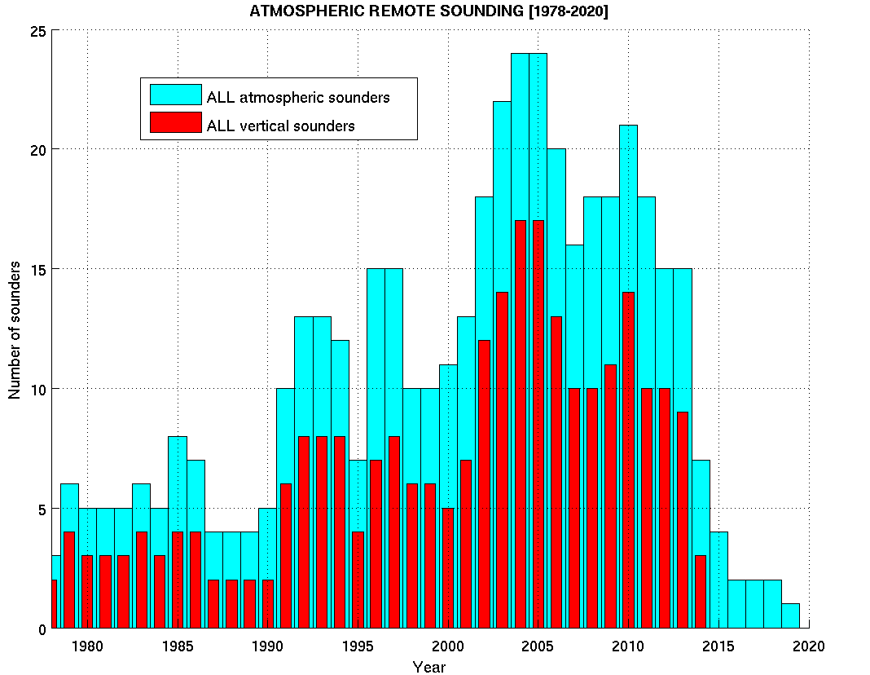
The limb gap
Projection of limb sounders population
as of 2005 (source: NDACC)

Slide 3
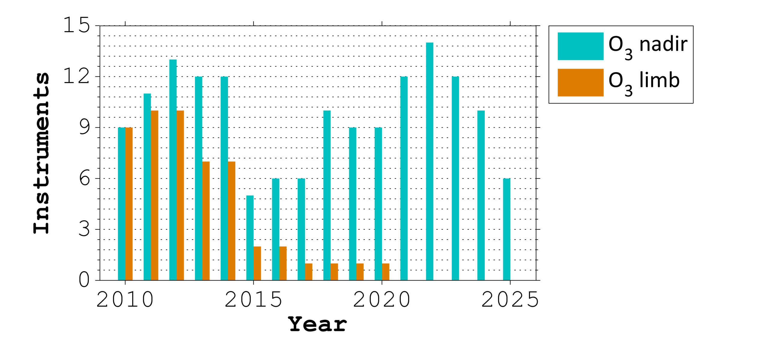
The limb gap
Projection of limb sounders population
as of 2014 (source: WMO/OSCAR)
as of 2005 (source: NDACC)
remaining instruments:
OSIRIS, ACE, MLS, OMPS
forthcoming instruments:
SAGEIII-ISS, OMPS

Slide 4
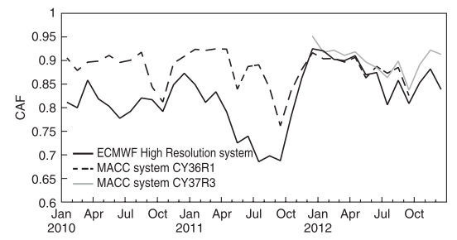
Importance of limb measurements
The OPEROZ study (2015) has listed the needs for high vertical resolution data for two user communities:
U1: operational services (CAMS, NWP, ...)
Impact of limb data assimilation at Neumayer station.
(Dragani et al., QJRMS, 2014)
MACC: SBUV, SCIA, OMI, MLS
ECMWF: SBUV, SCIA, OMI
post-ENVISAT era
MACC: SBUV, SCIA, OMI, MLS
ECMWF: SBUV, SCIA, OMI, MIPAS, IR radiances

Slide 5
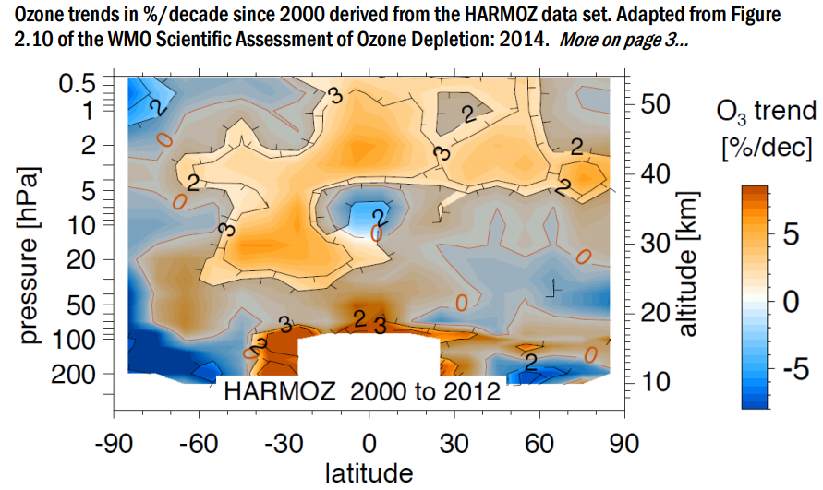
Importance of limb measurements
The OPEROZ study (2015) has listed the needs for high vertical resolution data for two user communities:
U1: operational services (CAMS, NWP, ...)
U2: long-term monitoring (WMO, O3CCI, SI2N, ...)
Vertically-resolved O3 trends from the HARMOZ dataset.
(O3CCI newsletter, July 2015)

Slide 6
Importance of limb measurements
The OPEROZ study (2015) has listed the needs for high vertical resolution data for two user communities:
U1: operational services (CAMS, NWP, ...)
U2: long-term monitoring (WMO, O3CCI, SI2N, ...)
Mission requirements according to the OPEROZ study
Vertical coverage (km) | Along-track Sampling B/T (km) |  | Horizontal coverage | Vertical resolution B/T (km) |  | Update Frequency B/T (h) |  | Uncertainty B/T (%)
LS | 100 | 200 | Global, incl. polar night | 1 | 2 | 12 | 24 | 8 | 16
MS | 100 | 200 | Global, incl. polar night | 1 | 2 | 12 | 24 | 4 | 8
US | 200 | 400 | Global, incl. polar night | 2 | 4 | Daily | Weekly | 4 | 8
Timeliness | < 3 hours
Stability B/T | 1 / 3 %/decade

Slide 7
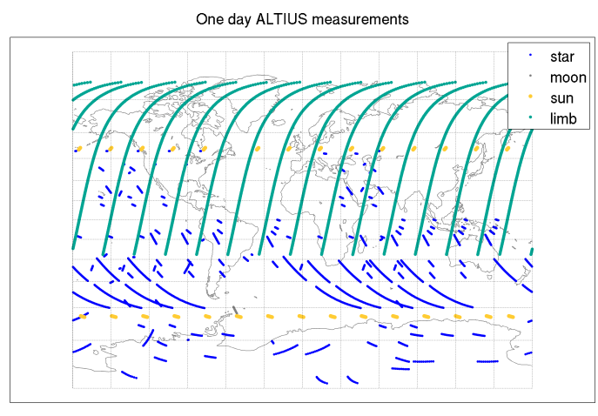
The ALTIUS mission
ALTIUS was initiated long before OPEROZ, in 2005, with a bottom-up approach:
SOLSE/LORE, OSIRIS, SCIAMACHY and SAGE-III had proven the limb-scattering method
main experimental error driver: tangent height registration
breakthrough in AOTF technology enabling UV-VIS-NIR spectral imagers
successful agile micro-satellite bus: PROBA (Belgium)

Slide 8
The ALTIUS mission
Scientific objectives
(all measurement modes: limb scattering, solar/stellar/planetary occultations)
Priority | Observable | Vertical range | Vertical res. [km] | Horizontal res. along parallels [km] | Horizontal res. along meridians [km] | Total error [%] | Coverage | Photo-chemistry [day/night]
A | O₃ | UT-LS | 1 | 10 | 500 | 5 | global | d/n
A | O₃ | US | 1 | 10 | 500 | 5 | global | d/n
A | O₃ | MS | 1 | 50 | 500 | 20 | polar | n
B | NO₂ | LS-US | 2 | 50 | 500 | 30 | global | d/n
B | H₂O | UT-LS | 2 | 50 | 500 | 20 | global | d/n
B | CH₄ | UT-LS | 2 | 50 | 500 | 20 | global | d/n
B | aerosol | UT-LS | 1 | 20 | 500 | 25 | global | d/n
B | PSC | UT-LS | 1 | 20 | 500 | 25 | polar | d/n
C | PMC | MS | 1 | 20 | 500 | 50 | polar | d/n
C | OClO | LS-US | 1 | 50 | 500 | 25 | global | n
C | BrO | UT-LS | 1 | 50 | 500 | 20 | global | d
C | NO₃ | LS-US | 1 | 50 | 500 | 25 | global | n
C | T° | LS-MS | 2 |  |  | 2
C | gradients | LS-US | 1 | 10 | 10 | 30 | global | d/n

Slide 9
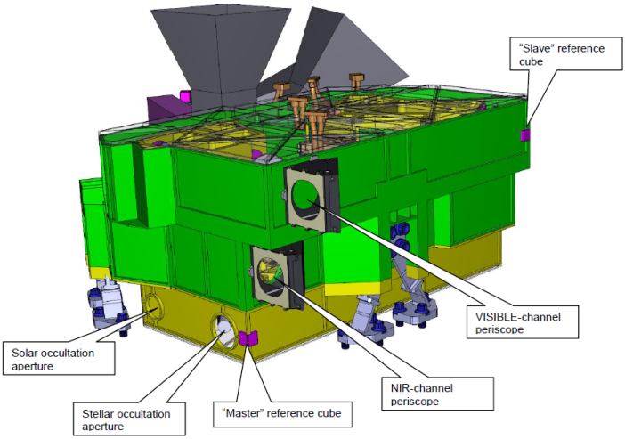
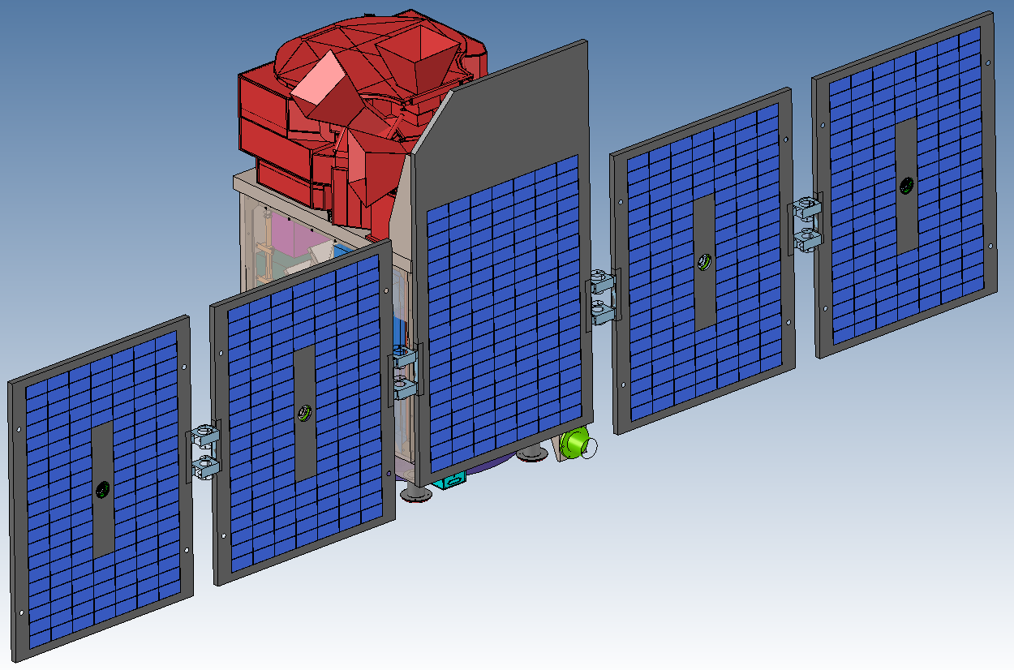
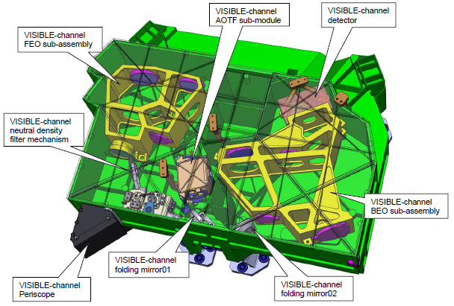
The ALTIUS mission
Numbers
mass | P/L: 57kg, S/C: 174kg
power | P/L + S/C on duty: 122W (avg)
orbit | 650km LEO, 10:30 LTDN, 3±0.2 days revisit time
pointing | jitter: < 25µrad (2σ, over 5sec)

Slide 10
The ALTIUS mission
Numbers
 | UV | VIS | NIR
spectral range | 250-400 | 440-800 | 900-1800
filter type | Fabry-Perot | AOTF (TeO2) | AOTF (TeO2)
detector type | CMOS | CMOS | HgCdTe
spectral res. | 2-2.5 nm | 2-9 nm | 2-9 nm
field of view | 2°x2° | 2°x2° | 2°x2°
image sampling | 171x171 | 512x512 | 256x256
spatial sampling | 600 m | 200 m | 400 m

Slide 11
The ALTIUS mission
O3 L-2 product performance assessment (limb scattering)
Ratio | Wavelengths |  | Alt. Range | Norm. Alt. | Heritage
Doublet 1 | λ_{s} : | 300 nm | 35-60 km | 65 km | OSIRIS
 | λ_{w} : | 351 nm
Doublet 2 | λ_{s} : | 315 nm | 30-50 km | 55 km | OSIRIS
 | λ_{w} : | 351 nm
Triplet | λ_{w1} : | 525 nm | 10-40 km | 45 km | SOLSE/LORE
 | λ_{s} : | 600 nm
 | λ_{w2} : | 675 nm

Slide 12
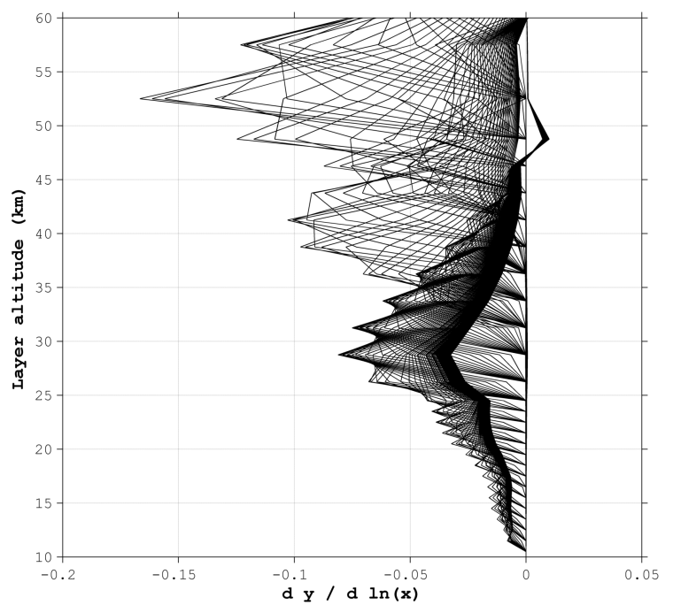
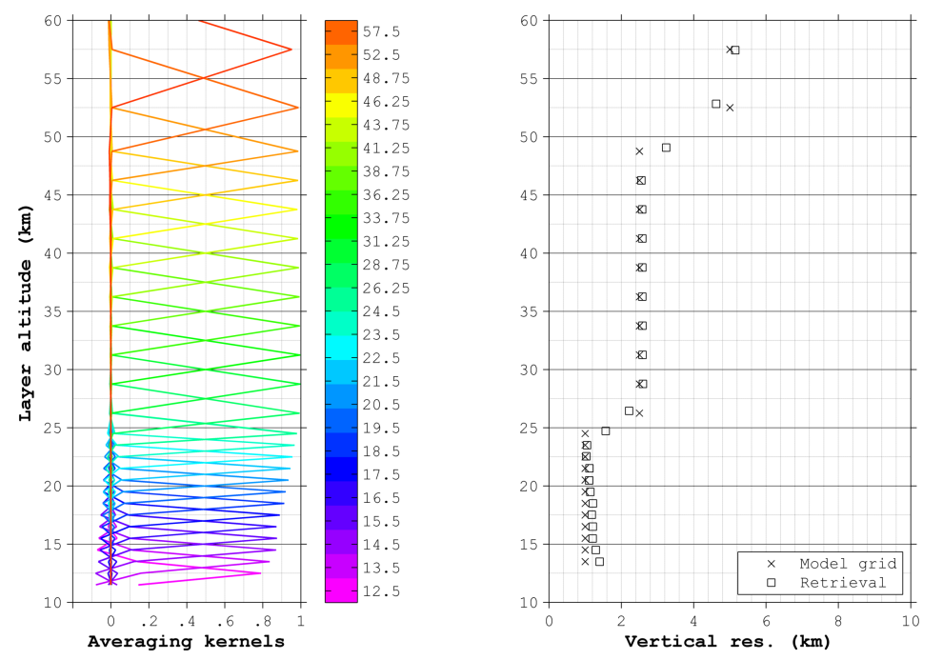
The ALTIUS mission
O3 L-2 product performance assessment (limb scattering)
Error source | Error Type | 15km | 20km | 25km | 30km | 35km | 40km | 45km | 50km | 55km
SNR | random | 7%(2) | 6%(1) | 2.5%(1) | 2%(1) | 2%(1) | 3%(2) | 4%(3) | 4%(3) | 6%(4)
Pointing | bias | 5% | 5% | 1% | 2% | 2% | 3% | 4% | 3% | 4%
Spectral | bias | 0% | 0% | 0% | 0% | 0% | 0.5% | 1% | 1% | 1%
Total |  | 8.6% (5.4) | 7.8% (5.1) | 2.7% (1.4) | 2.8% (2.2) | 2.8% (2.2) | 4.3% (3.7) | 5.7% (5.1) | 5.1% (4.4) | 7.3% (5.7)

Slide 13
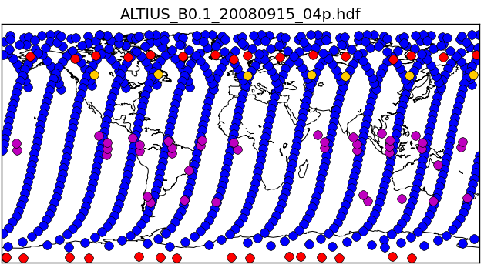
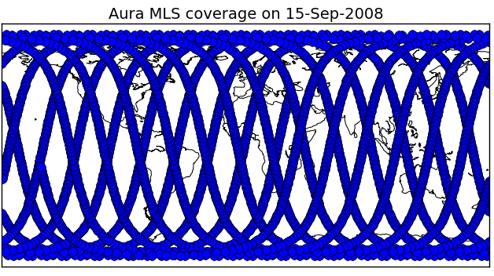
The ALTIUS mission
Does ALTIUS meet the OPEROZ requirements?
Vertical coverage (km) | Along-track Sampling B/T (km) |  | Horizontal coverage | Vertical resolution B/T (km) |  | Update Frequency B/T (h) |  | Uncertainty B/T (%)
LS | 100 | 200 | Global, incl. polar night | 1 | 2 | 12 | 24 | 8 | 16
MS | 100 | 200 | Global, incl. polar night | 1 | 2 | 12 | 24 | 4 | 8
US | 200 | 400 | Global, incl. polar night | 2 | 4 | Daily | Weekly | 4 | 8
Timeliness | < 3 hours
Stability B/T | 1 / 3 %/decade

Slide 14
The ALTIUS mission
Next steps
After two successful reviews by ESA (OPEROZ), and a panel of experts (for other scientific objectives), ALTIUS is fully supported by BELSPO.
ALTIUS will be proposed as an Earth-Watch mission at the next PB-EO in May. Interested countries will be requested to declare themselves.
As a new Earth-Watch mission, ALTIUS will be formally presented at the next ministerial council (end 2016).
After approval, the ALTIUS developments will restart with the phase B2 ending with the PDR (6 months).
Launch expected in 2020, hoping to bridge with the next OMPS mission.

