Slide 2
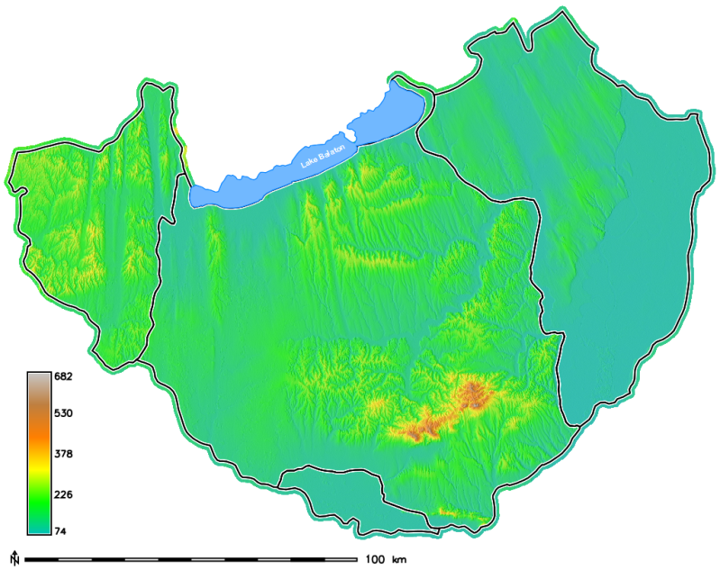
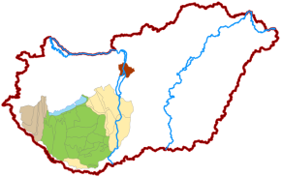
How to produce objective geomorphometric maps for geomorphologic purposes?
DEM-based delineation of relevant landforms
How to map landscape on the right scale?
Do not use one scale, instead choose multi-scale mapping technique giving an optimal search window size representative of the study area
A possible way to get from elevation data to landscape map is…
define optimal search distance using Topographic Grain principle
delineate landforms with the geomorphons multi-scale mapping approach
use pattern recognition techniques to observe characteristics of the topography
The study area covers ~20.500 km² and it is representative of the main types of topography and relative relief in the country.

Slide 3
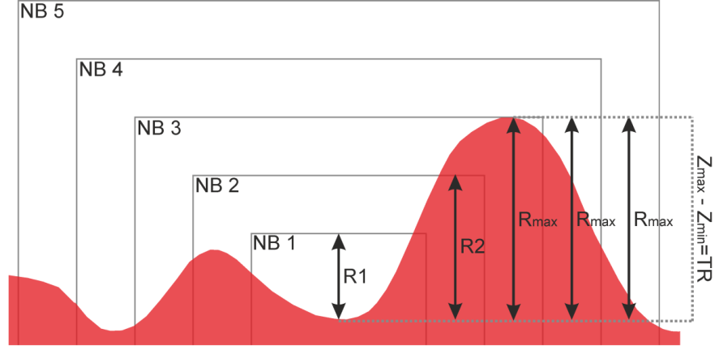
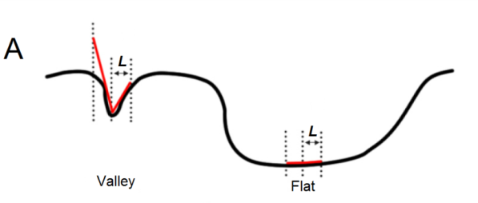
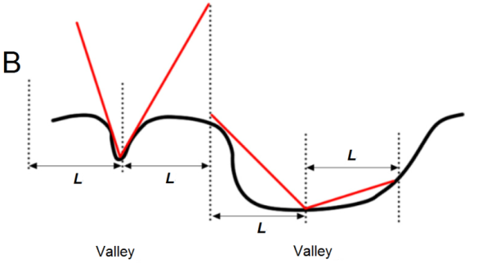
The Topographic Grain principle (Wood, W. F. – Snell, J. B. 1960, Pike, R. J. et al. 1989) is a possible solution to detect the optimal search window for generation of land surface parameters or search parameter for delineating characteristic landform elements with r.geomorphon tool.
possibility to analyse land surface parameters and delineate landforms on relevant scale
best use of scale flexibility in r.geomorphon tool
The methodology is entirely based on Open-source software (bash shell scripts for GRASS GIS and R scripts).
The line-of-sight principle
Detecting landforms at different scales: (A) Smaller value of L results in detection of locally-determined landforms (B) Larger value of L results in simultaneous detection of landforms on several sizes (after Stepinski, T.  Jasiewicz, J. 2011)
Concept of TG calculation
By increasing the neighbourhood matrix the local relief is reaching a point where it approximates the representative relief of an area.

Slide 4
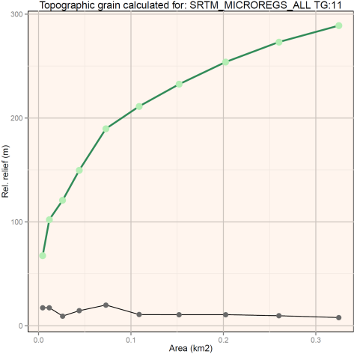
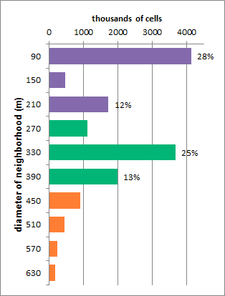
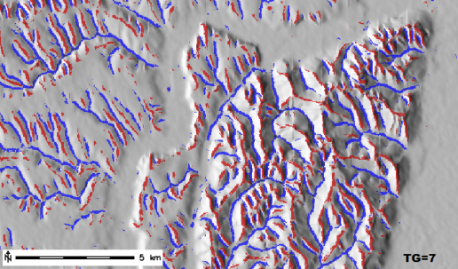
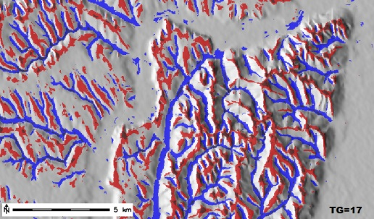
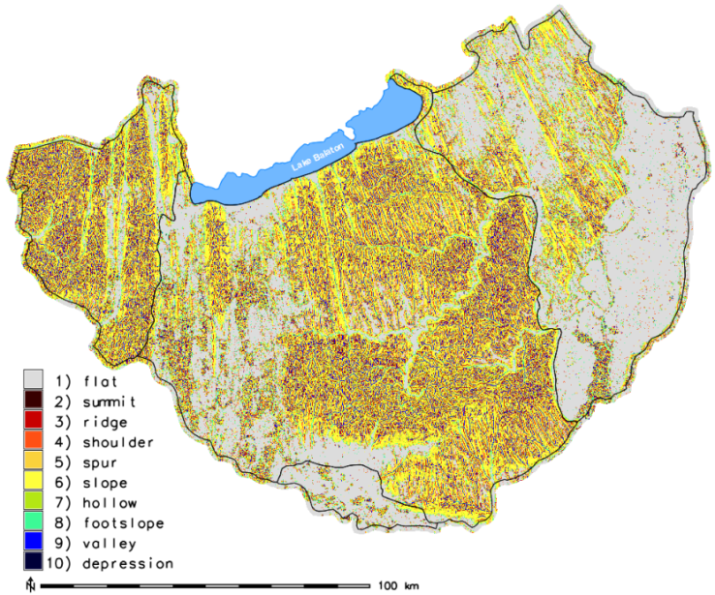
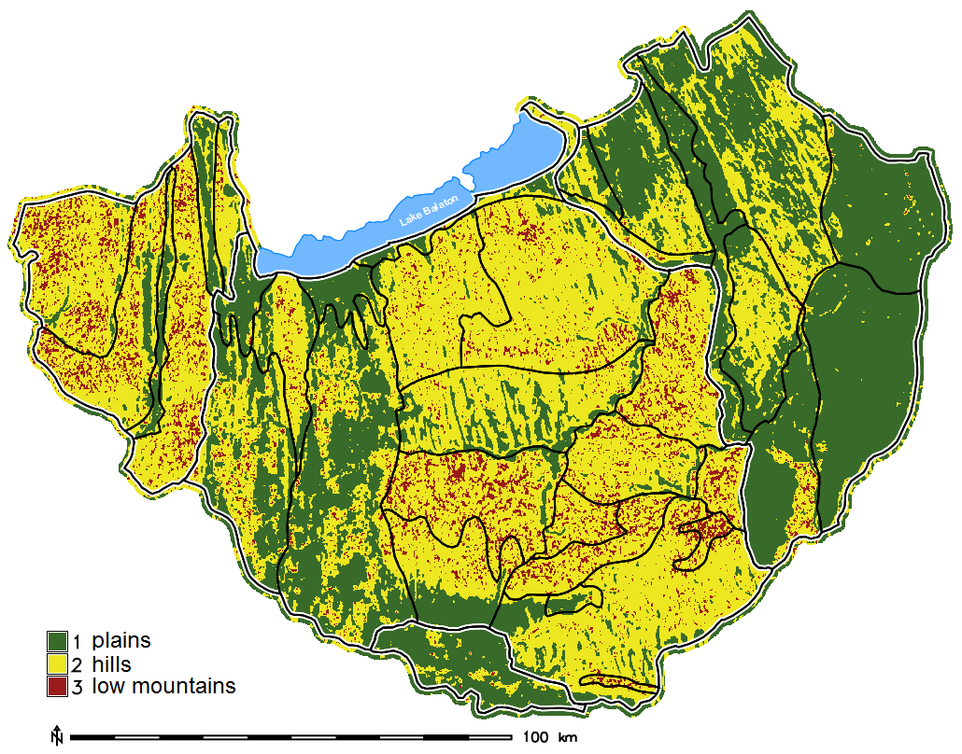
The TG value for the study area was determined in 11 cells. The search window size proved representative in this complex area. Small TG results in fragmented valley and ridgeline network while using large value produces generalized map.
The physiographic units are in accordance with the relative relief and landform maps. Considering the geomorphological forms and the general topography the method did right by characterising most of the study site as hills.

Slide 5
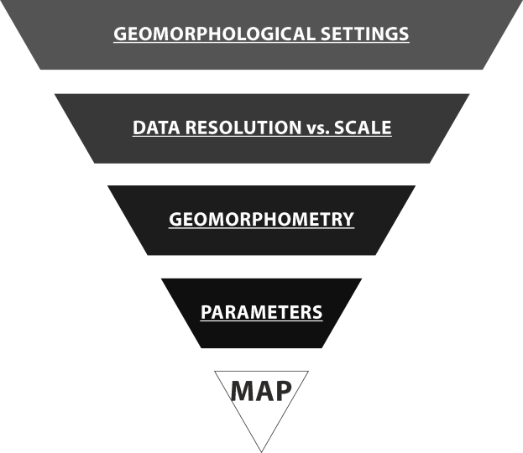
A common drawback of geomorphological analyses based on digital elevation datasets is the definition of search window size for the derivation of morphometric variables.
Considering geomorphological perspective it is hardly eligible to map an entire landscape on a fixed scale.
The methods of DEM-based geomorphometric mapping are constantly developing into the direction of multi-scale landform delineation, but the optimal threshold for search window size is still a limiting factor.
This study focuses on the calculation of the suitable search window size for the geomorphons mapping approach by using the Topographic Grain principle.
The methodology is entirely based on Open-source software (bash shell scripts for GRASS GIS and R scripts).
The analyses were carried out on the SRTM1 model as freely available elevation data with suitable resolution.
Based on delineated landforms the physiographic characteristics of the landscape are also analysed.
To get the best possible output representing the landscape it is necessary to consider the limiting factors.

Slide 6
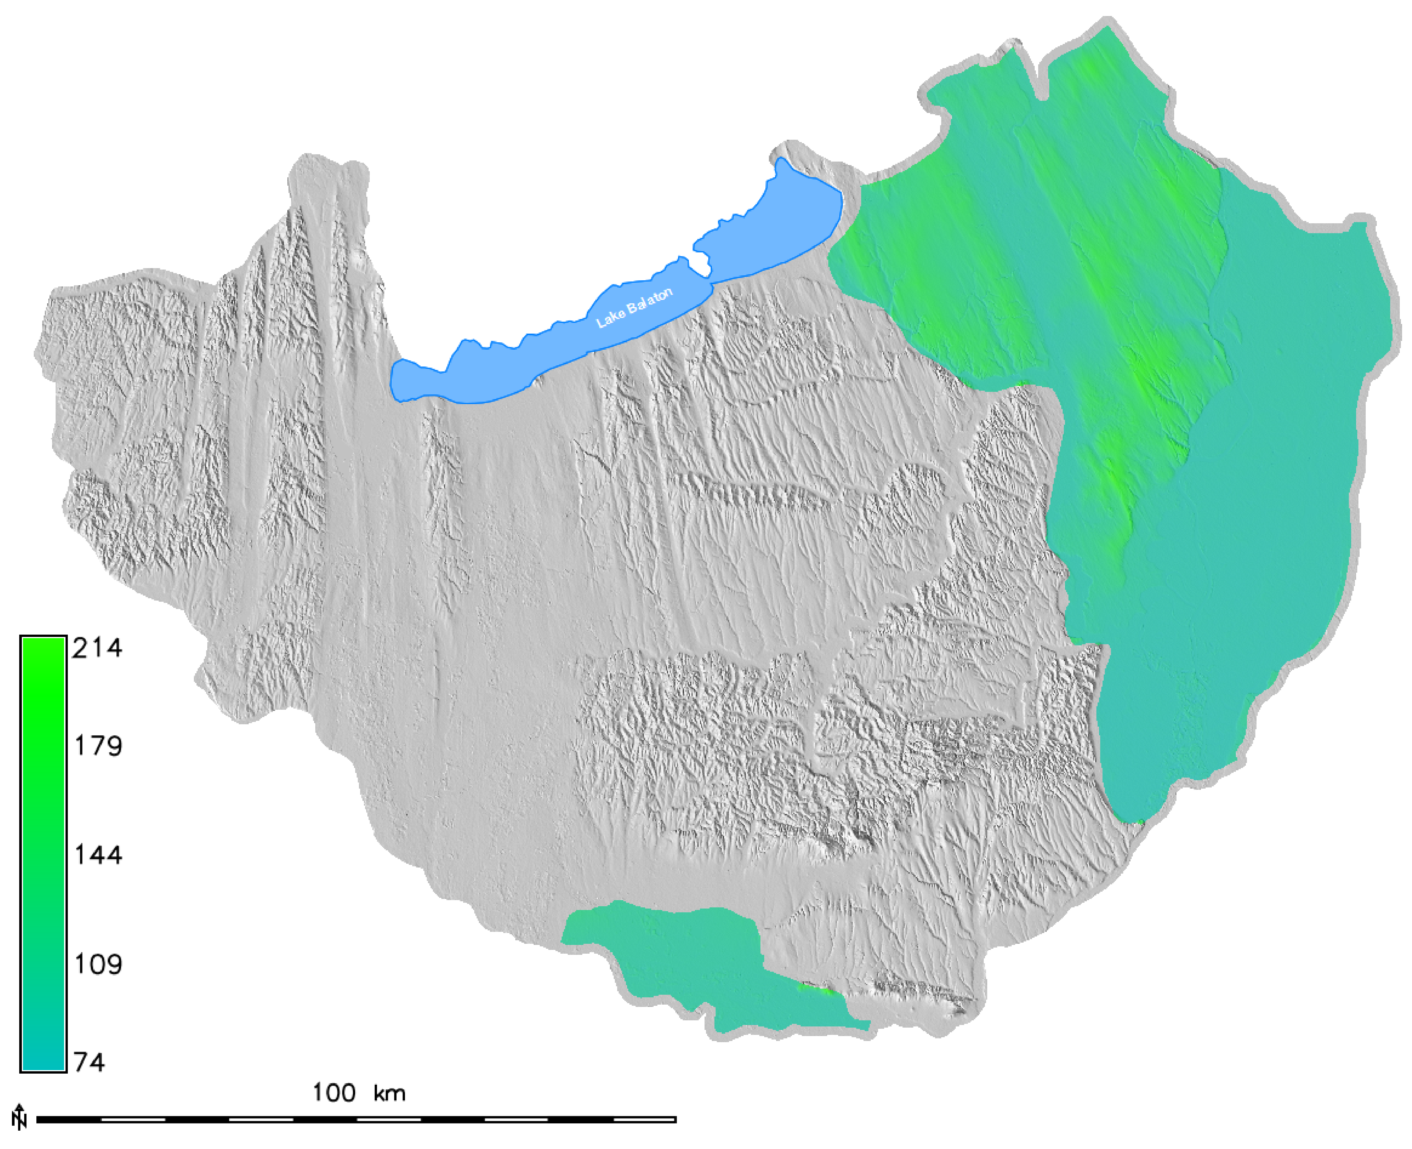
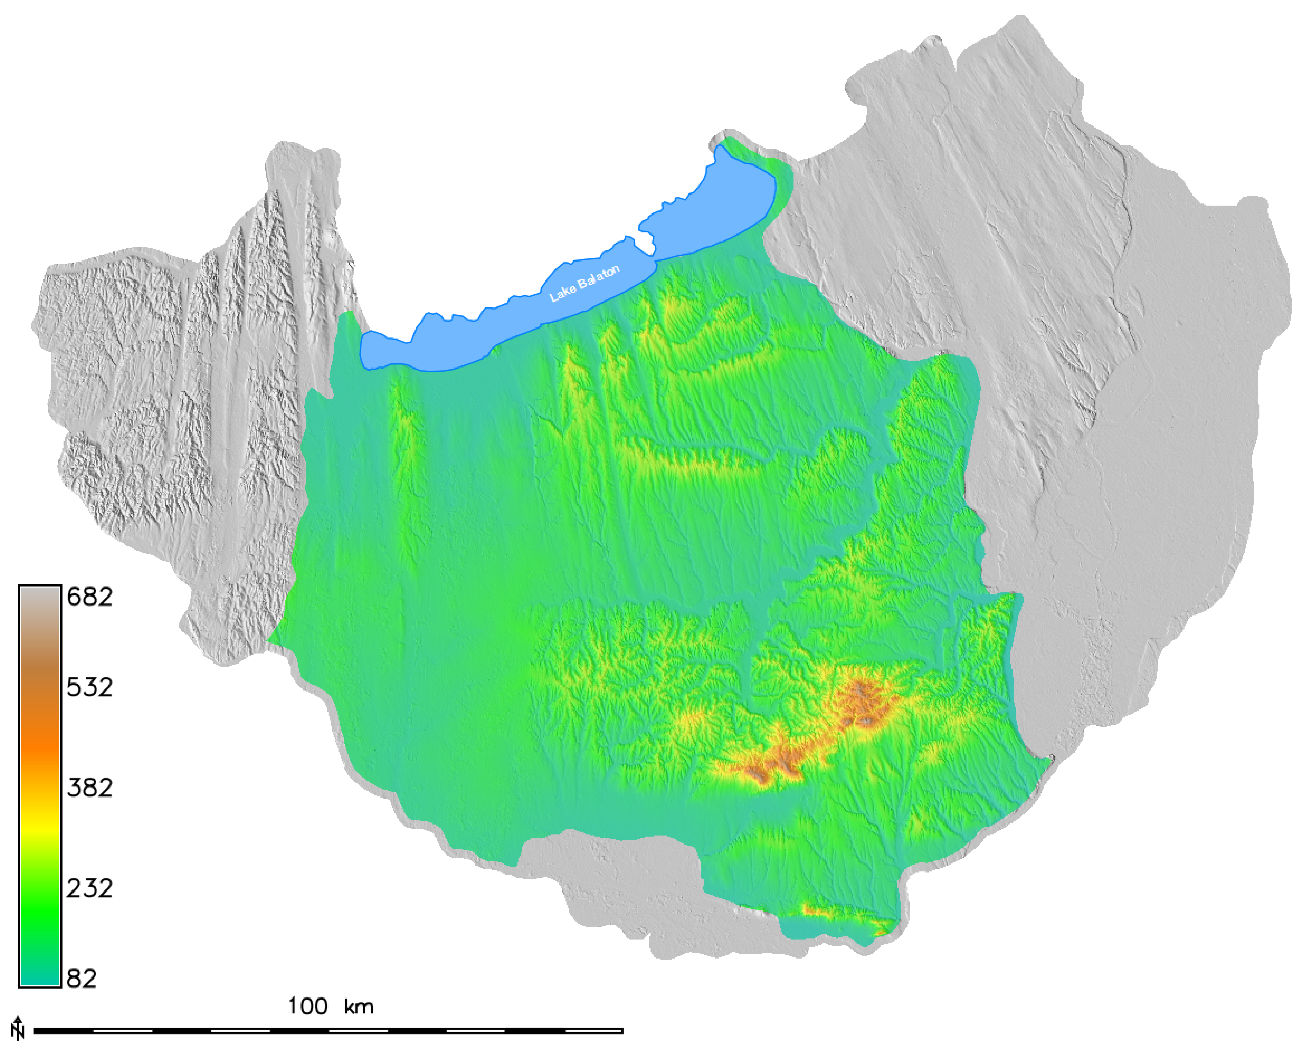
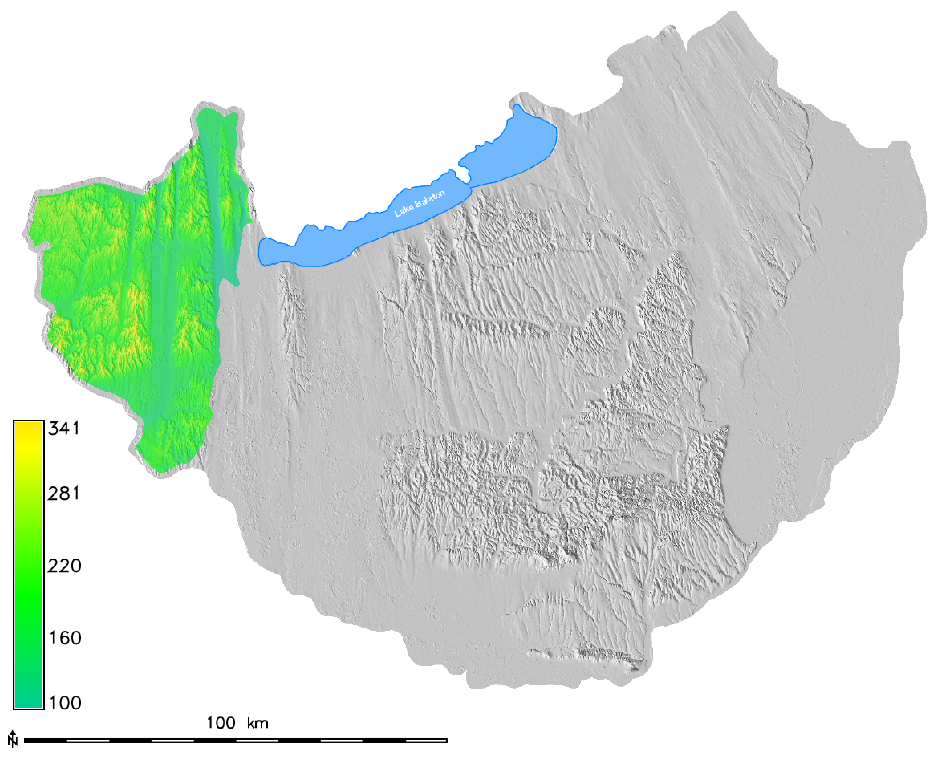
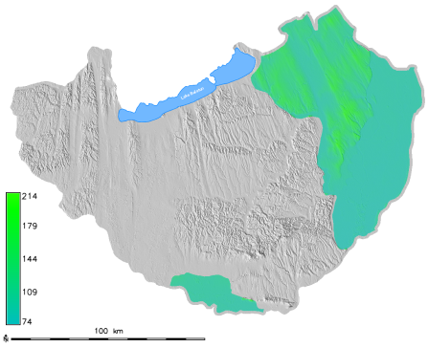
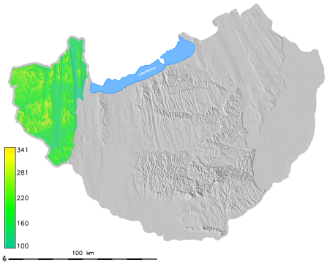
Great Hungarian Plain
Rate: 31%
Min elev.: 74 m
Max elev.: 214 m
Mean elev.: 108 m
STD of elev.: 23 m
Transdanubian Hills
Rate: 56%
Min elev.: 82 m
Max elev.: 682 m
Mean elev.: 165 m
STD of elev.: 51 m
The study area covers ~20.500 km² and it is representative of the main types of topography and relative relief in the country.
For the analysis the area was first split on the basis of the macroregions.
The most complex region is the well dissected Transdanubian Hills with the widest range of elevation values and high order stream network.
Alpine foreland
Rate: 13%
Min elev.: 100 m
Max elev.: 341 m
Mean elev.: 191 m
STD of elev.: 41 m

Slide 7
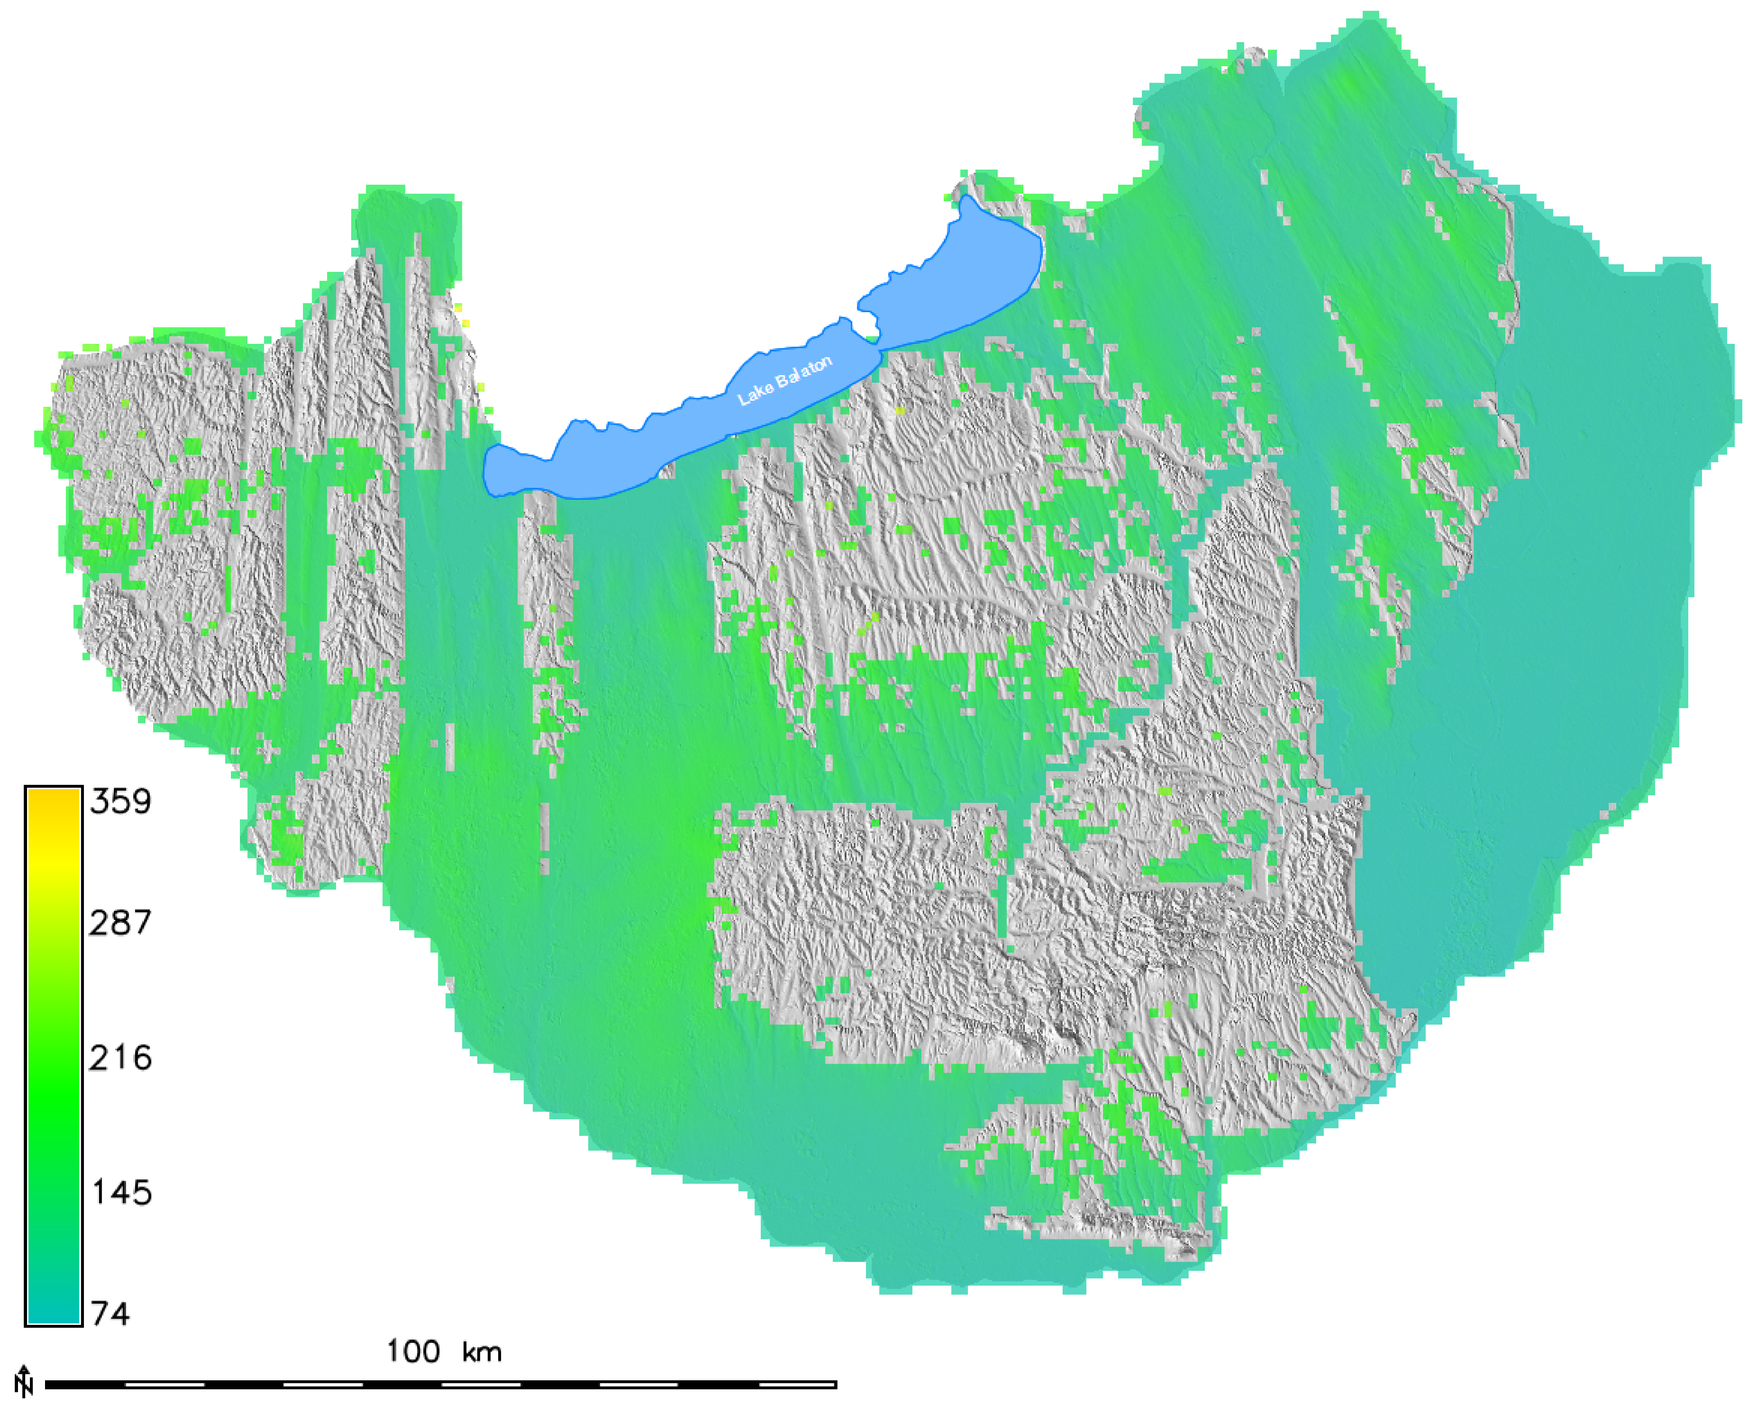
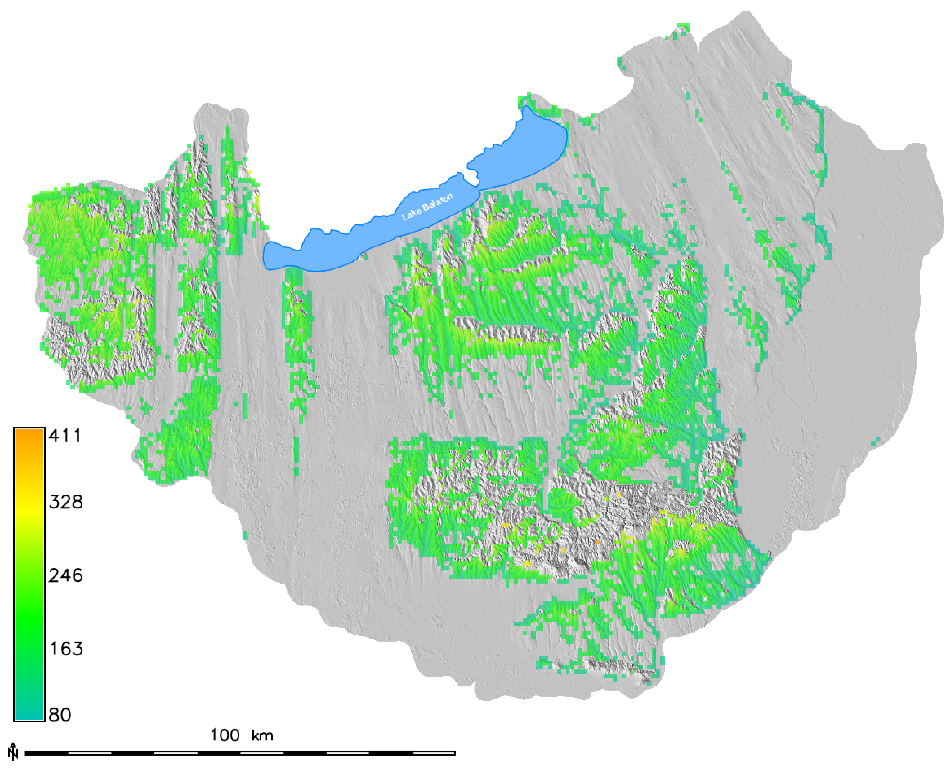
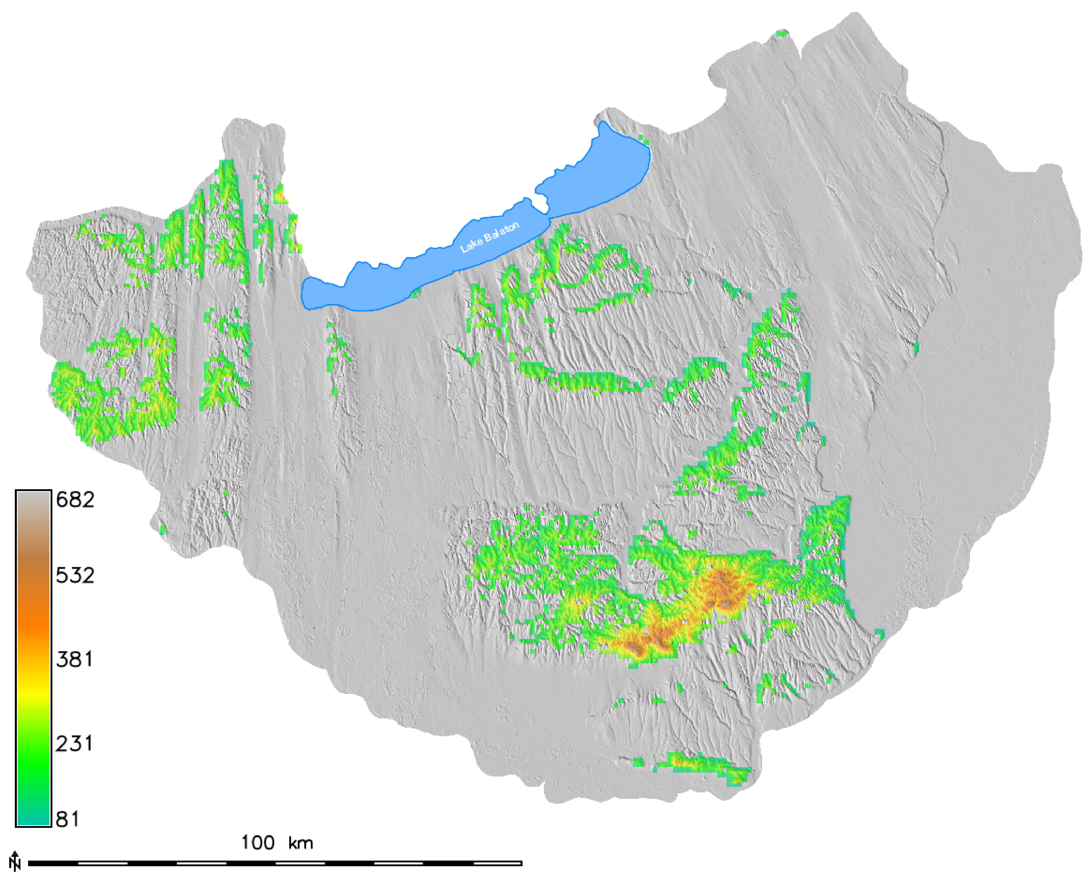
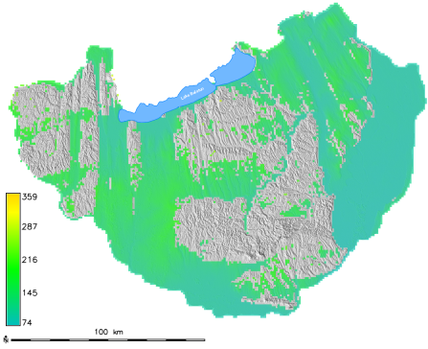
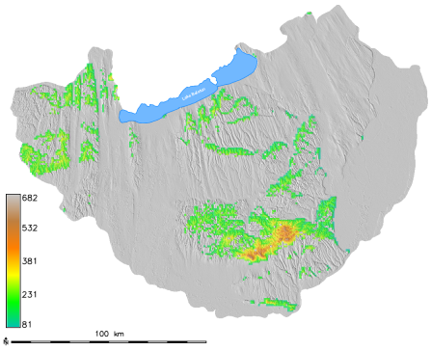
1st relief cluster
Rate: 62%
Min elev.: 74 m
Max elev.: 359 m
Mean elev.: 124 m
STD of elev.: 29 m
 | MEAN | STD
1st relief cluster | 13 m/km² | 9
2nd relief cluster | 53 m/km² | 15
3rd relief cluster | 102 m/km² | 29
2nd relief cluster
Rate: 27%
Min elev.: 80 m
Max elev.: 411 m
Mean elev.: 176 m
STD of elev.: 40 m
The relative relief values (calculated for 1 km²) were also used to divide the region into landscape types.
The clusters were defined by the k-means clustering method in R. The regions are representing more homogenous area in terms of horizontal and vertical dissection.
As the area belongs to 3 macroregions, only 3 clusters were defined. Further research proved that based on relative relief the study site could have been divided to 5 regions.
3rd relief cluster
Rate: 11%
Min elev.: 81 m
Max elev.: 682 m
Mean elev.: 219 m
STD of elev.: 69 m

Slide 8
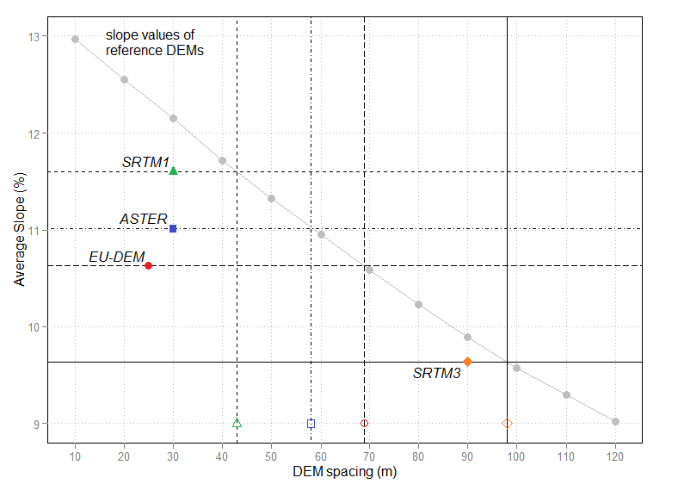
Finding digital elevation data with resolution suitable for geomorphic mapping purposes was necessary. Resolution determines how well the dataset reflects the complexity of the terrain. The accuracy of land-surface parameters not only depends on the cell size, but also on the effective spatial resolution.
The calculated effective resolutions (based on Guth, P. L. 2010) show that the horizontal spacing of the global elevation datasets is over-estimated, with the SRTM1 model proven to be the best possible model (Józsa, E. 2015).

Slide 9
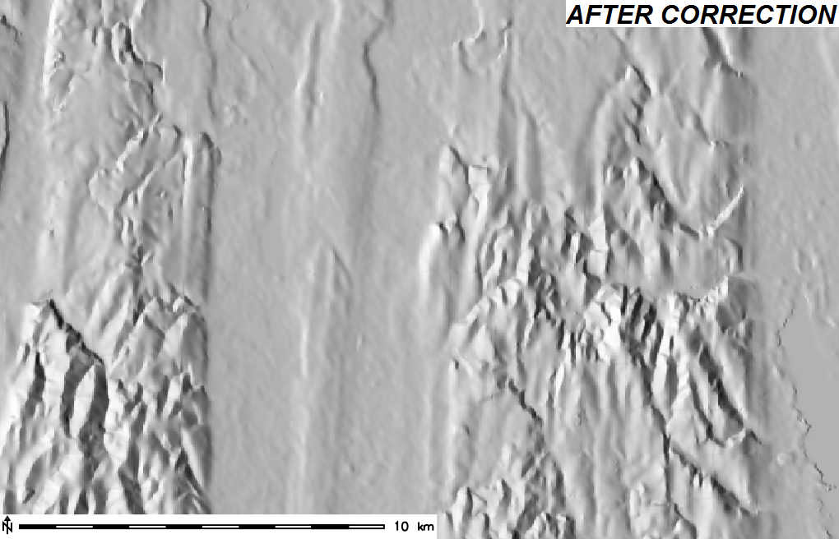
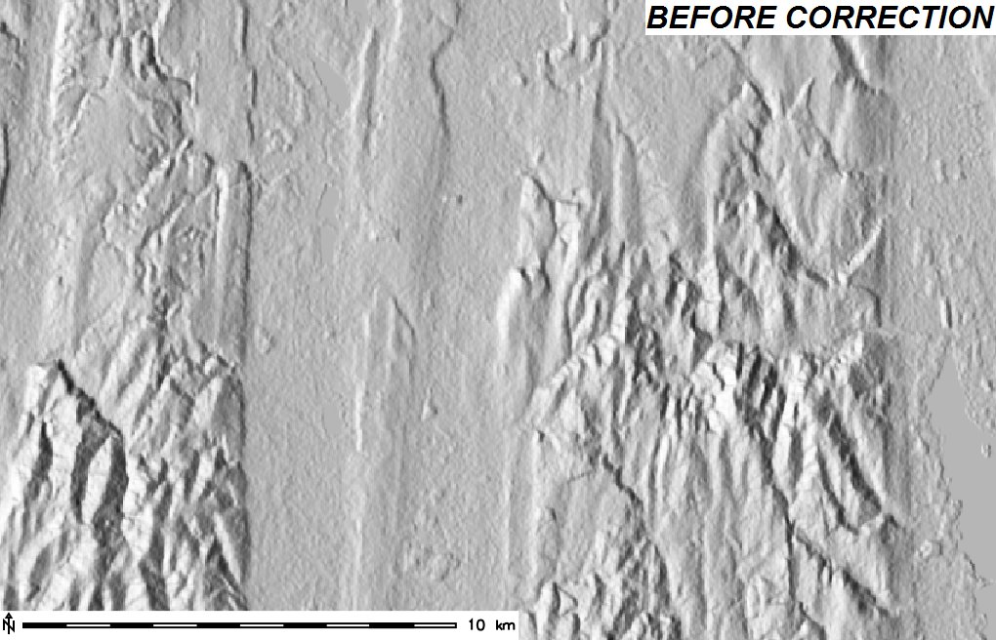
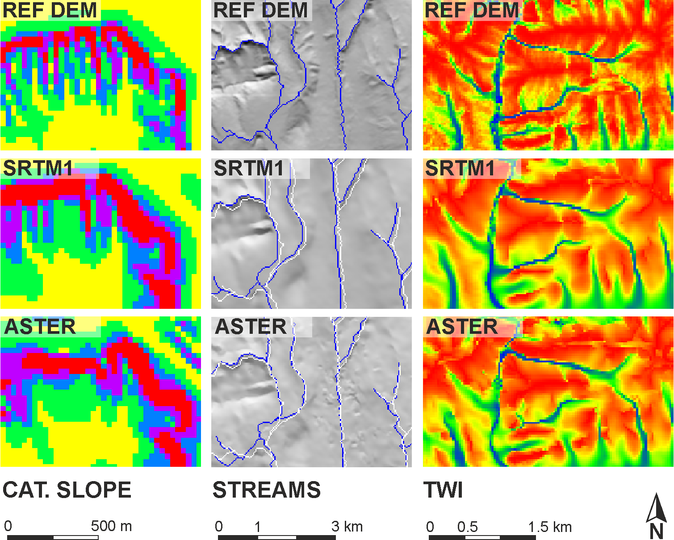
The range of applications of elevation models is narrowed by the errors affecting the land-surface derivatives (Temme, A. J. A. M. et al. 2009). The DSM error propagation to the LSPs was checked by comparing slope, stream network and Topographic Wetness Index using reference DEMs.
During pre-processing steps (e.g. correction of horizontal misfit and outliers, denoising, reducing tree offset) the artefacts were removed and the representation of topography was improved. Previous tests in the area (Józsa, E. 2015) suggest that the SRTM1 satellite-based DSM is a fairly good base dataset for geomorphometric analyses.

Slide 10
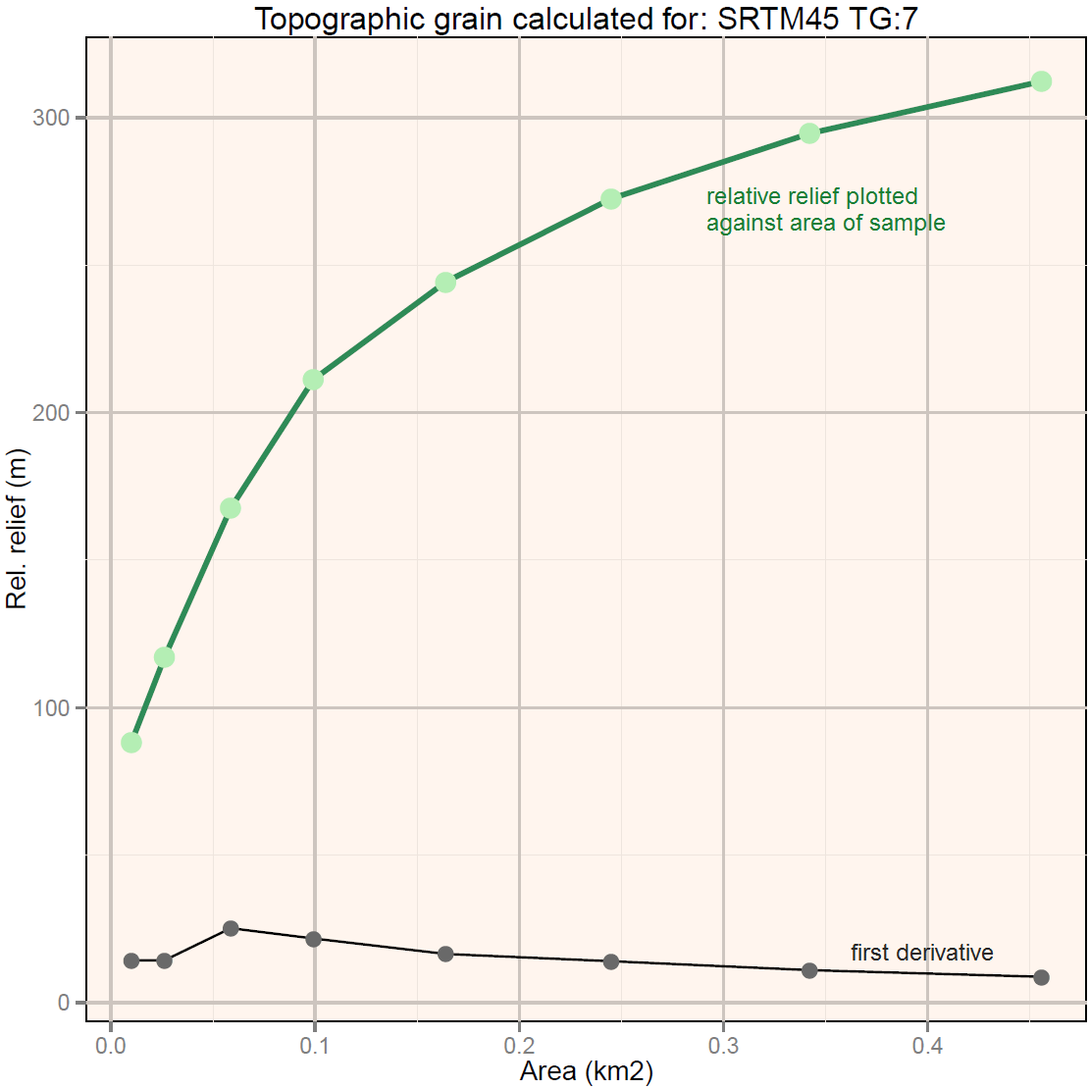
The Topographic Grain principle (Wood, W. F. – Snell, J. B. 1960, Pike, R. J. et al. 1989) is a possible solution to detect the optimal search window for generation of land surface parameters or search parameter for delineating characteristic landform elements with r.geomorphon tool.
TG value is detected by calculating the relative relief values with nested neighbourhood matrices. By plotting the values against the sample area it is possible to define a break-point where the increase rate of local relief encountered by the sample is significantly reducing.
By increasing the neighbourhood matrix the local relief is reaching a point where it approximates the representative relief of an area.

Slide 11
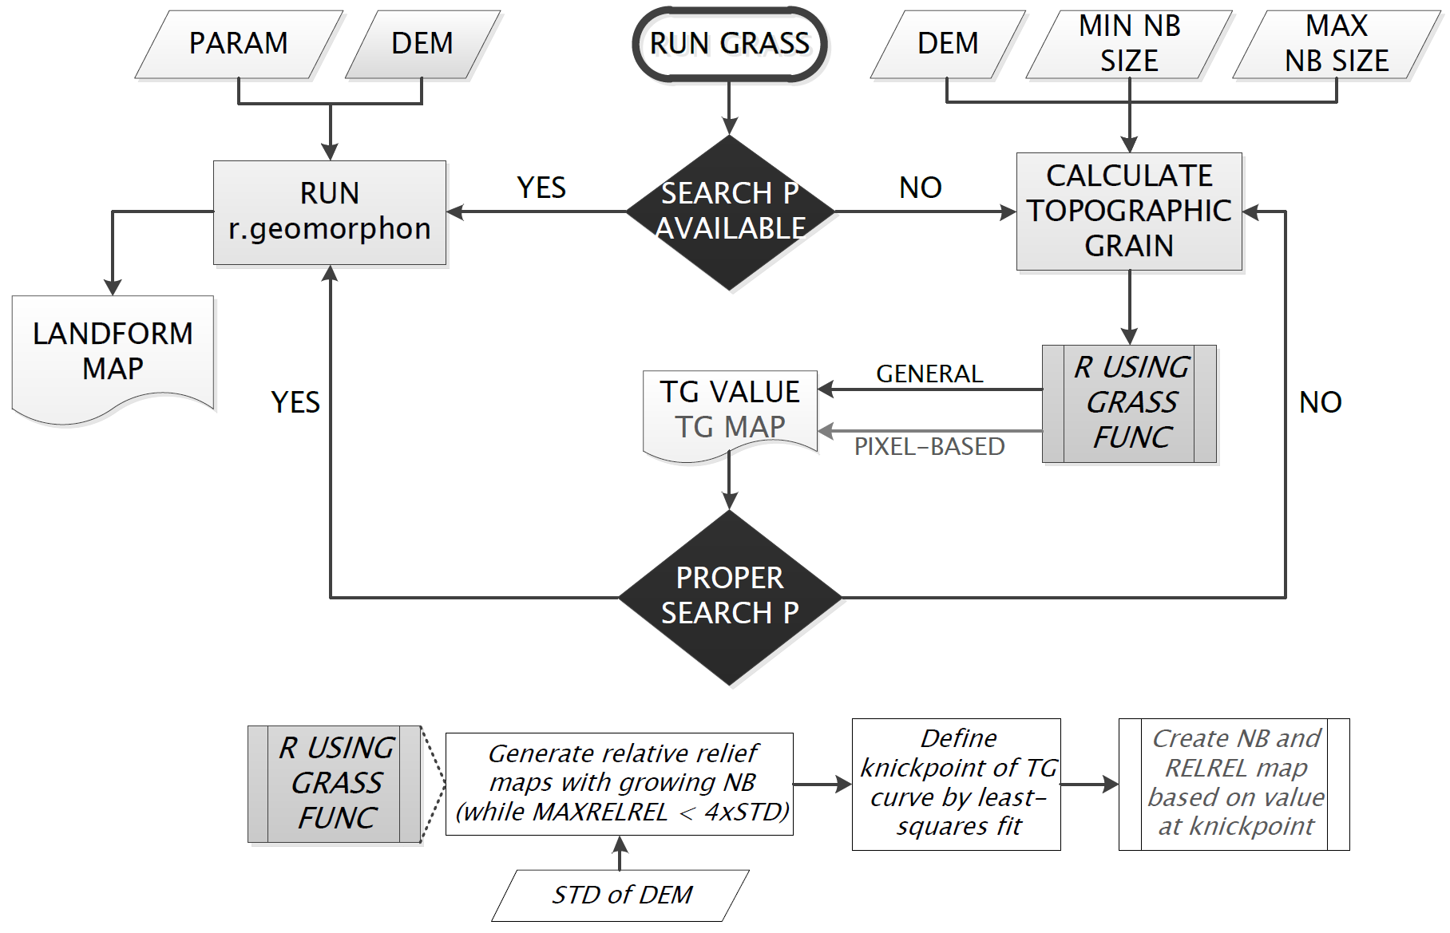
Workflow of TG calculation – the process is connected to the creation of the geomorphometric map.

Slide 12
Advantages | Challenges
efficient calculation of characteristic ridgeline-to-channel distance | change to acceptable coarser resolution not yet automated in tool
cell-based and general TG and local relief values | only odd numbers as neighbourhood sizes
objective and consistent output maps | possible consequences of edge effect during calculation not revealed
application of TG value for other DEM-based land surface parameters | further potentials in interpretation of multiple breaks or absence of knickpoint on TG curve
user-friendly interface & information windows | TG calculation tool only for UNIX OS (currently)
possibility to analyse land surface parameters and delineate landforms on relevant scale
best use of scale flexibility in r.geomorphon tool

Slide 13
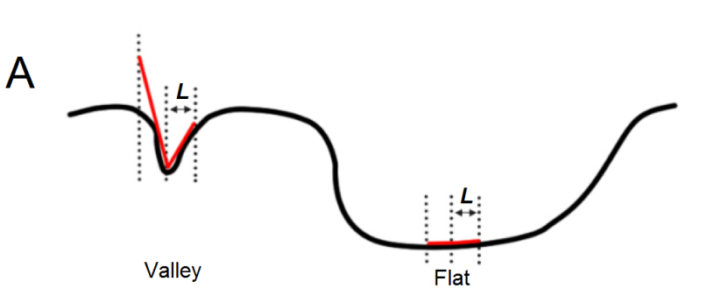
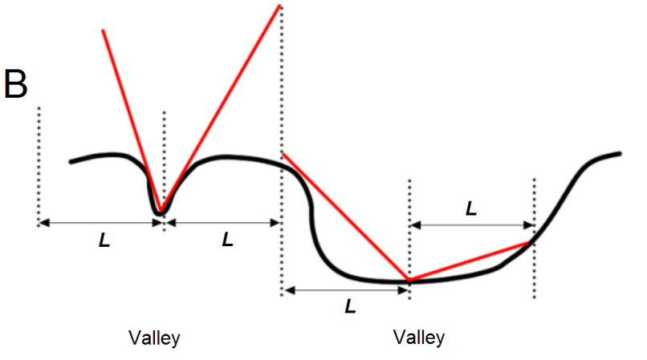
Geomorphons mapping technique
Local Ternary Patterns principle combined with line-of-sight principle
single scan of DEM >> geomorphons >> 10 most common landform element
‘…although L (lookup distance) is a free parameter, it can be set to an optimal value (…) which is large enough to map landforms at most relevant scales but small enough for rapid computations …’
(Jasiewicz, J.  Stepinski, T. 2013)
Detecting landforms at different scales: (A) Smaller value of L results in detection of locally-determined landforms (B) Larger value of L results in simultaneous detection of landforms on several sizes (after Stepinski, T.  Jasiewicz, J. 2011)
>> landforms larger than the L_{max} are broken down to smaller elements therefore the threshold needs to be set for a relatively large value

Slide 14
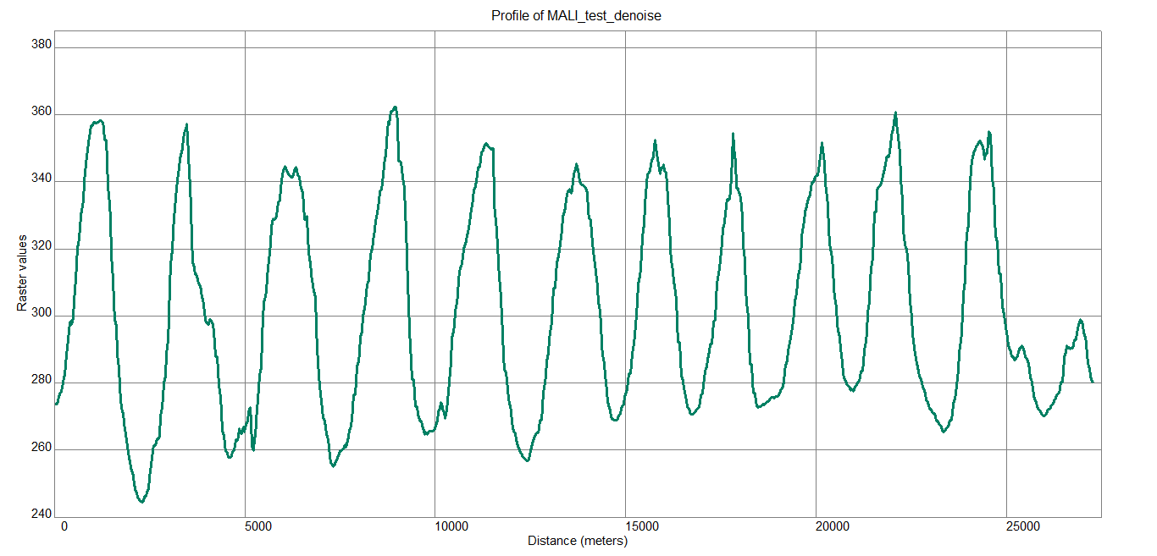
Example in Mali, Erg Chech Desert shows landform pattern represented as repetitive sand dunes.
Calculated TG (L): 19
>> 570 m TG
>> 1000–1500 m interdune-to-crest distance + effect of smaller forms

Slide 15
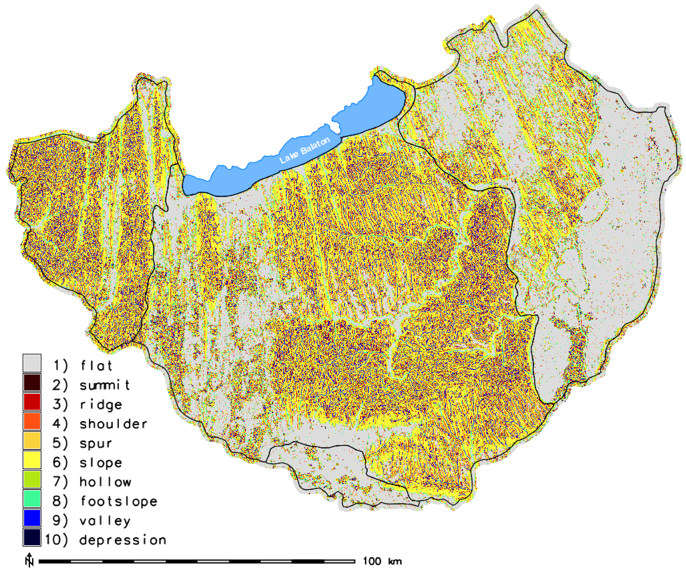
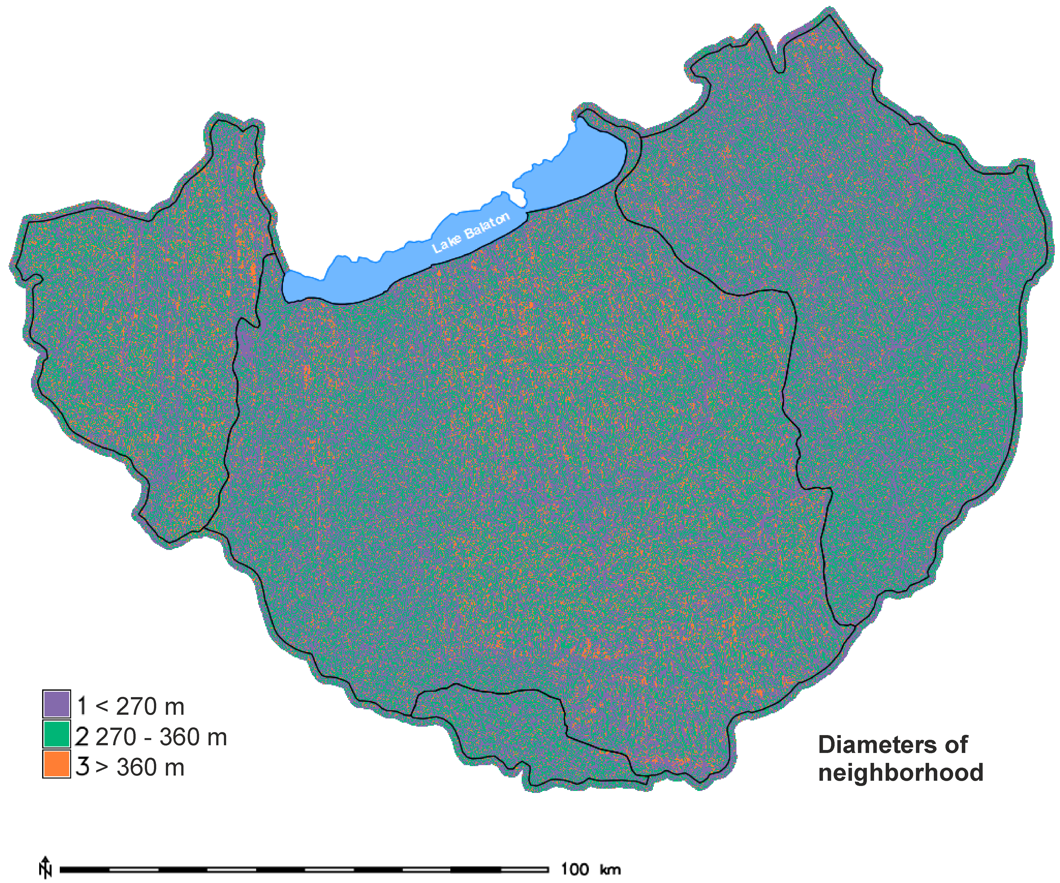
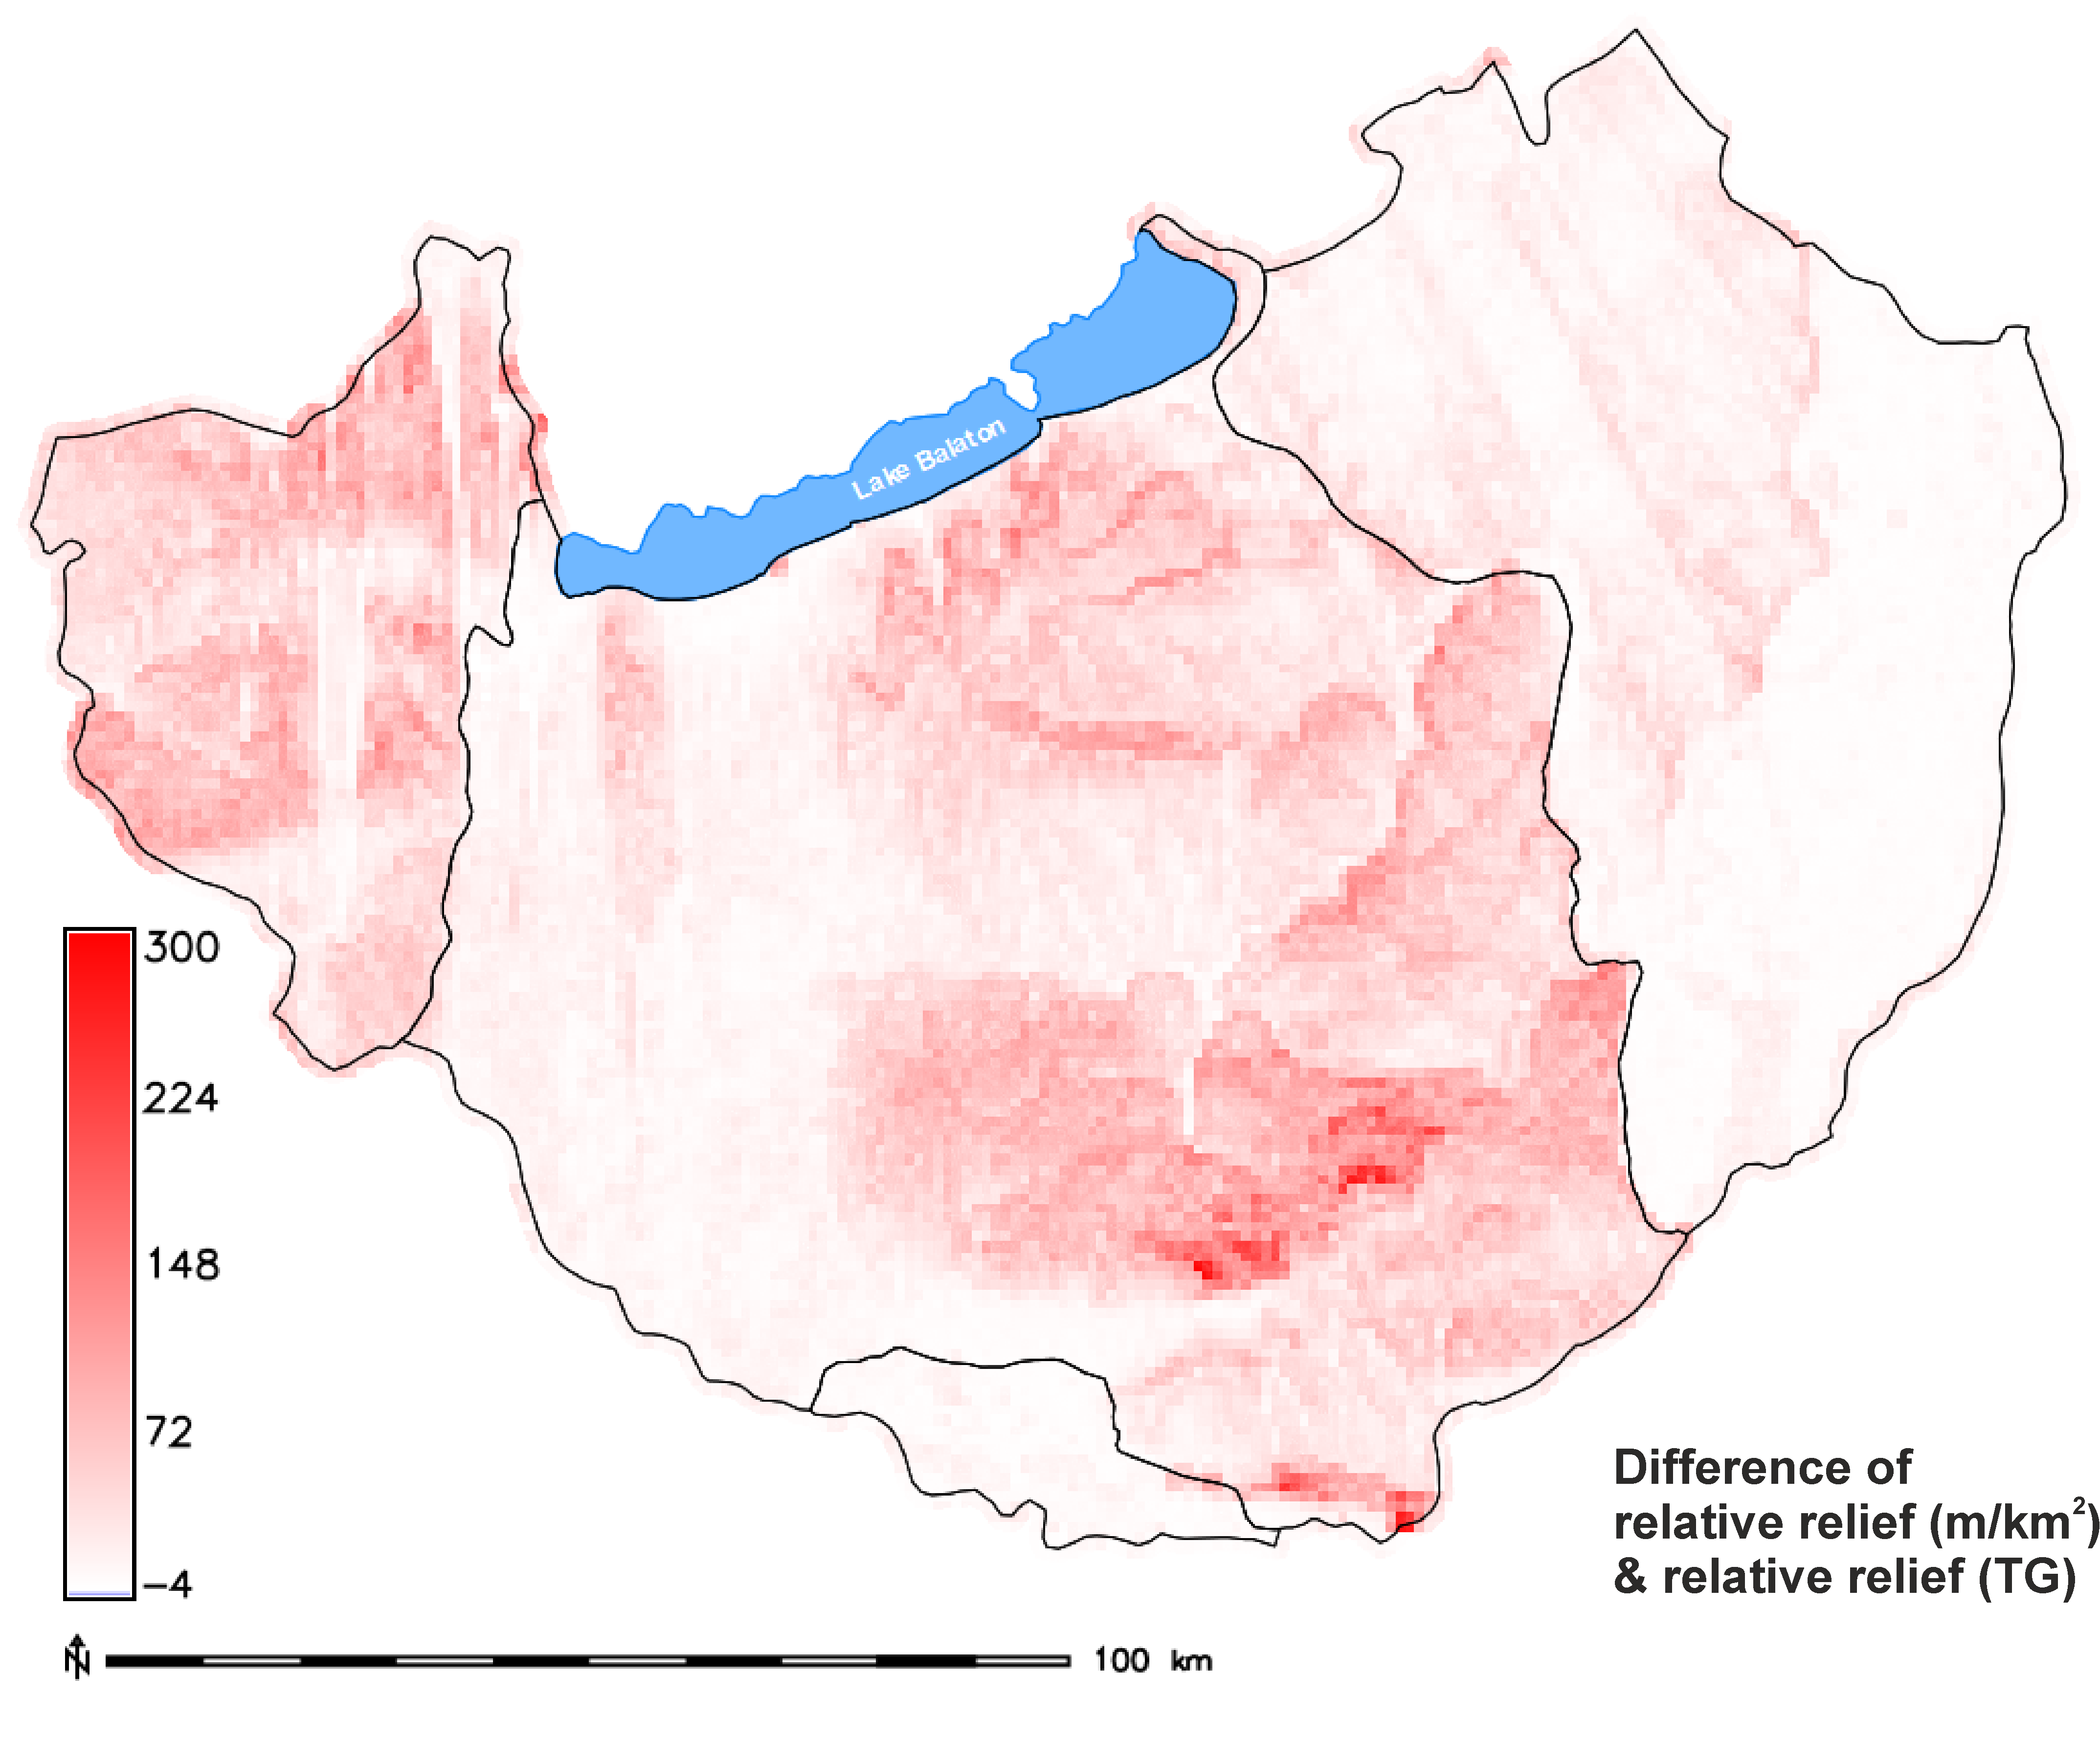
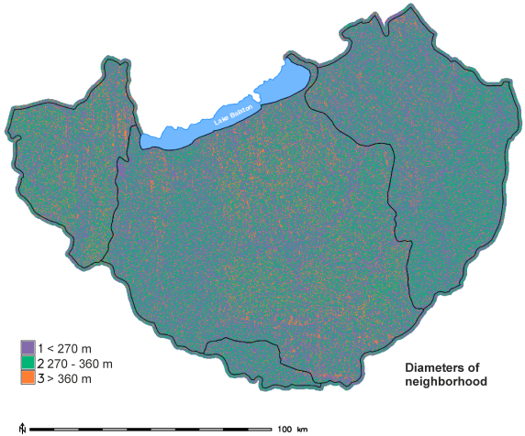
The TG value for the study area was determined in 11 cells.
The difference map of the relative relief calculated for km² and the values produced by the method shows that the former strongly overestimated the characteristic local relief.
The search window size map reveals that the 330 m diameter is scattered over the region, confirming that it is representative in this complex area. According to the results the most frequent diameter is 90 m, but these values occur mainly in flat regions.
The geomorphic map showing the relevant forms was created by using the TG value as L parameter in r.geomorphon.

Slide 16
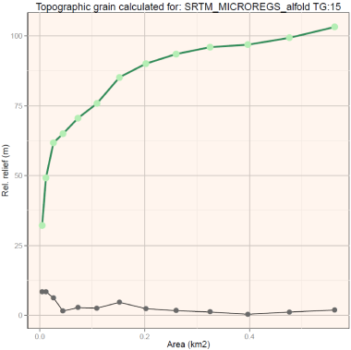
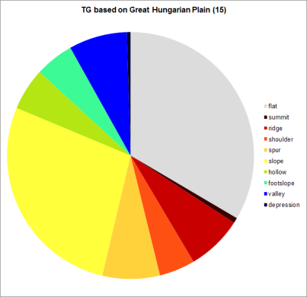
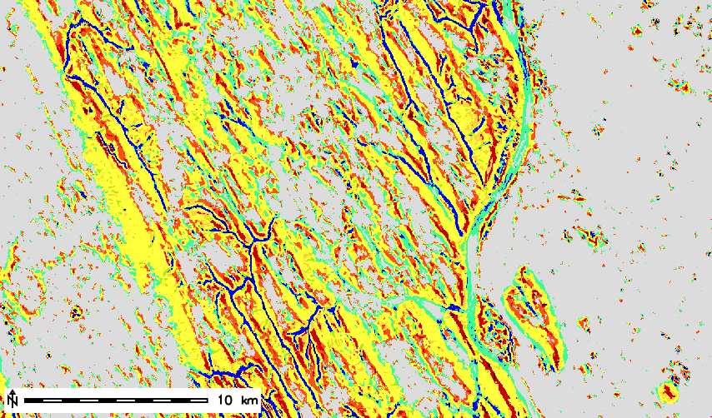
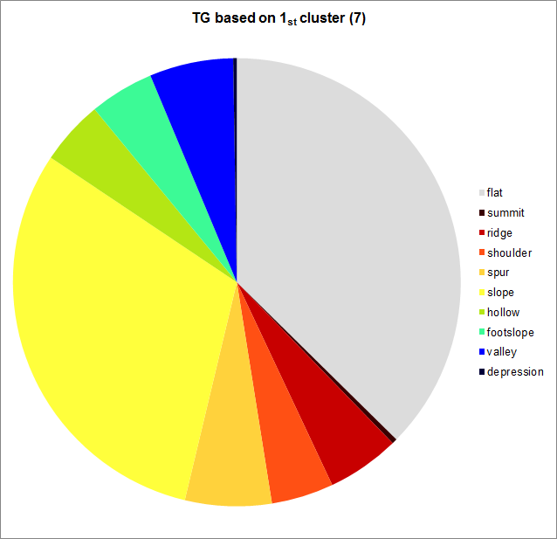
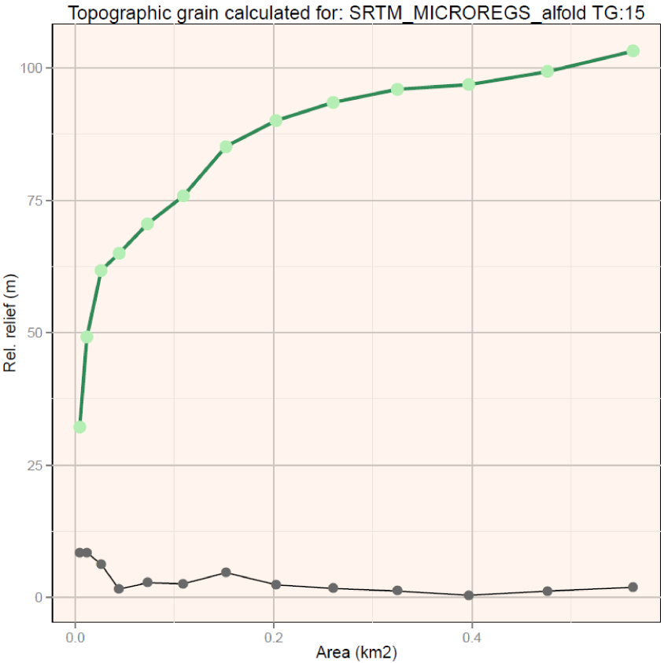
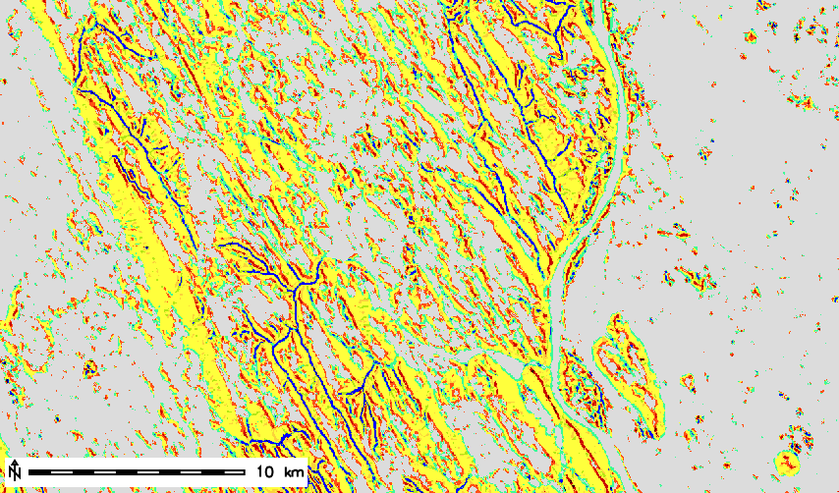
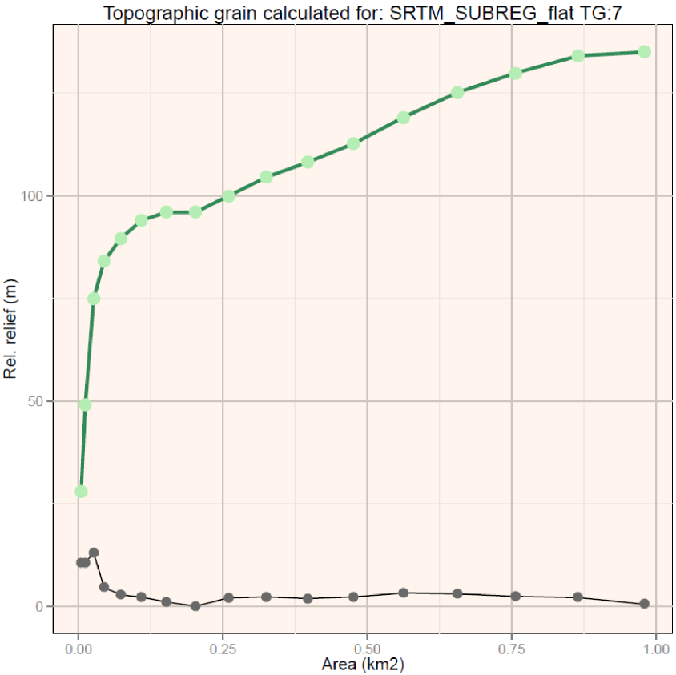
Matching landforms compared to the geomorphons map calculated with the general TG:
GHP |  | 1st cluster
95% | flat | 100%
97% | summit | 49%
93% | ridge | 63%
84% | shoulder | 76%
81% | spur | 63%
88% | slope | 92%
80% | hollow | 63%
87% | footslope | 75%
93% | valley | 70%
97% | depression | 49%
In the study area the Great Hungarian Plain can be divided into 2 characteristic sections. The Danube and Drava river are surrounded by extensive floodplains while the northern part is a loess plateau with tectonically indicated valley network. The dissection of this latter region caused the TG value to be 15. When the area was divided on the basis of k-means clustering only the really flat cells were grouped together. This caused the TG calculation to identify the meso-relief represented by the former oxbows, levees and other fluvial forms. The distribution of the mapped forms confirms the proper behaviour of changing the L parameter.

Slide 17
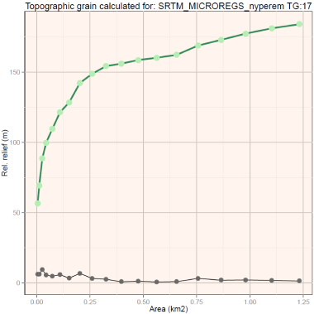
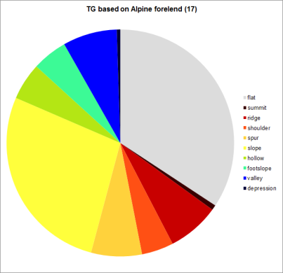
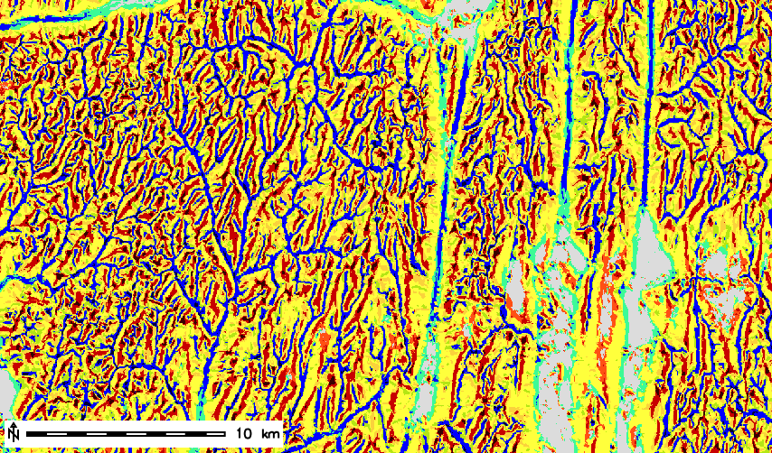
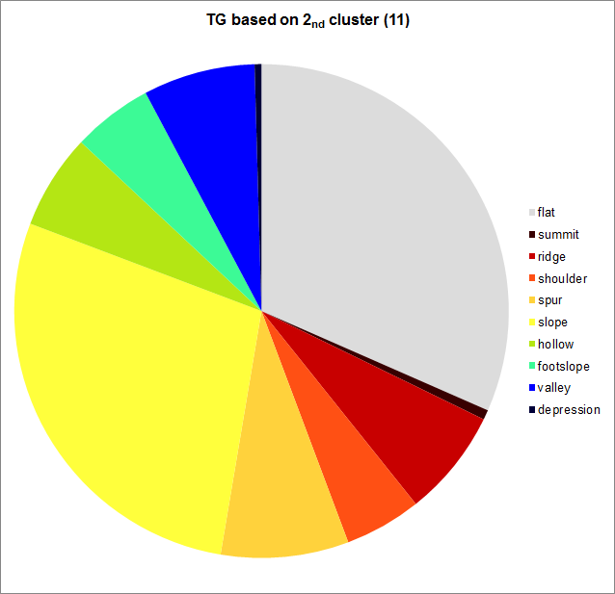
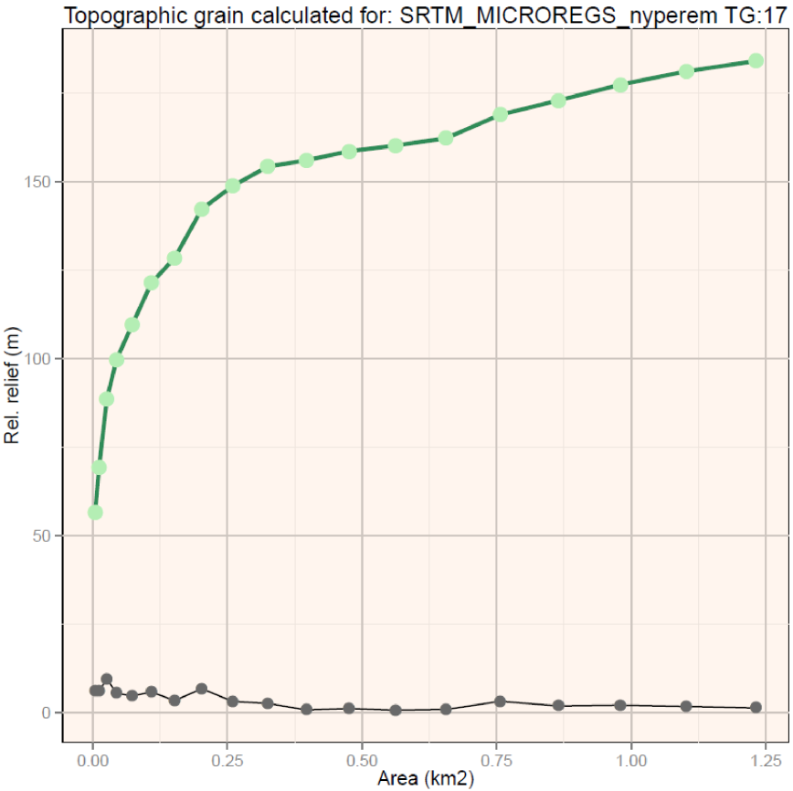
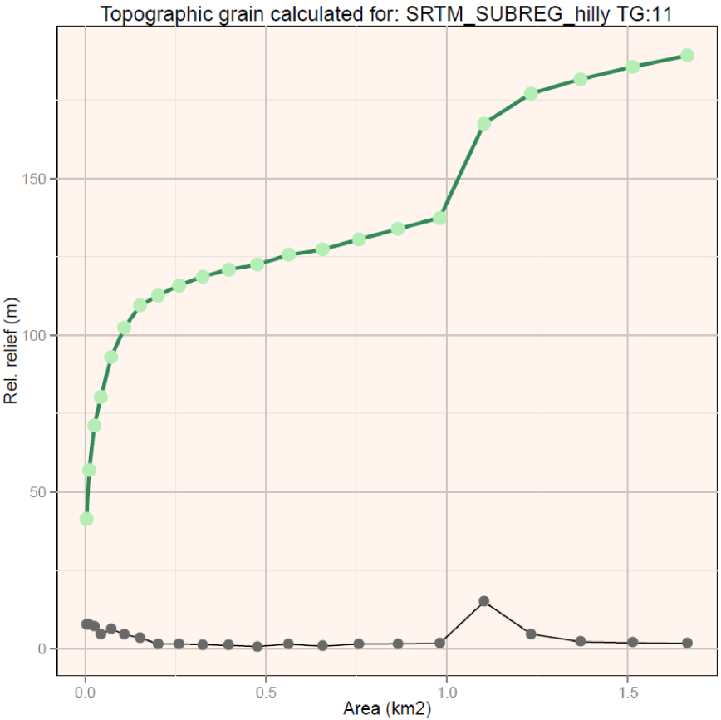
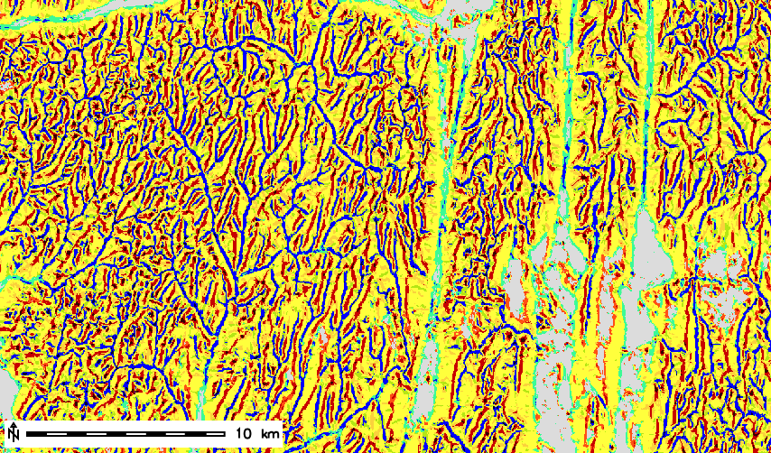
Matching landforms compared to the geomorphons map calculated with the general TG:
AF |  | 2nd cluster
93% | flat | 100%
96% | summit | 100%
90% | ridge | 100%
77% | shoulder | 100%
74% | spur | 100%
83% | slope | 100%
73% | hollow | 100%
82% | footslope | 100%
90% | valley | 100%
96% | depression | 100%
Based on the similarities in elevation and local relief values the Alpine foreland and the 2nd cluster was compared. Even though this macroregion is well dissected by a narrow valley network, the long and wide meridional valleys and interfluves are dominant in the landscape, resulting in a larger TG value. These were grouped to the 1st cluster due to the flatness of the valley bottoms. The second curve of the relative relief values shows a sudden increase and another break appears at 1110 m. This suggests that the elevation dataset could have been divided into more clusters.

Slide 18
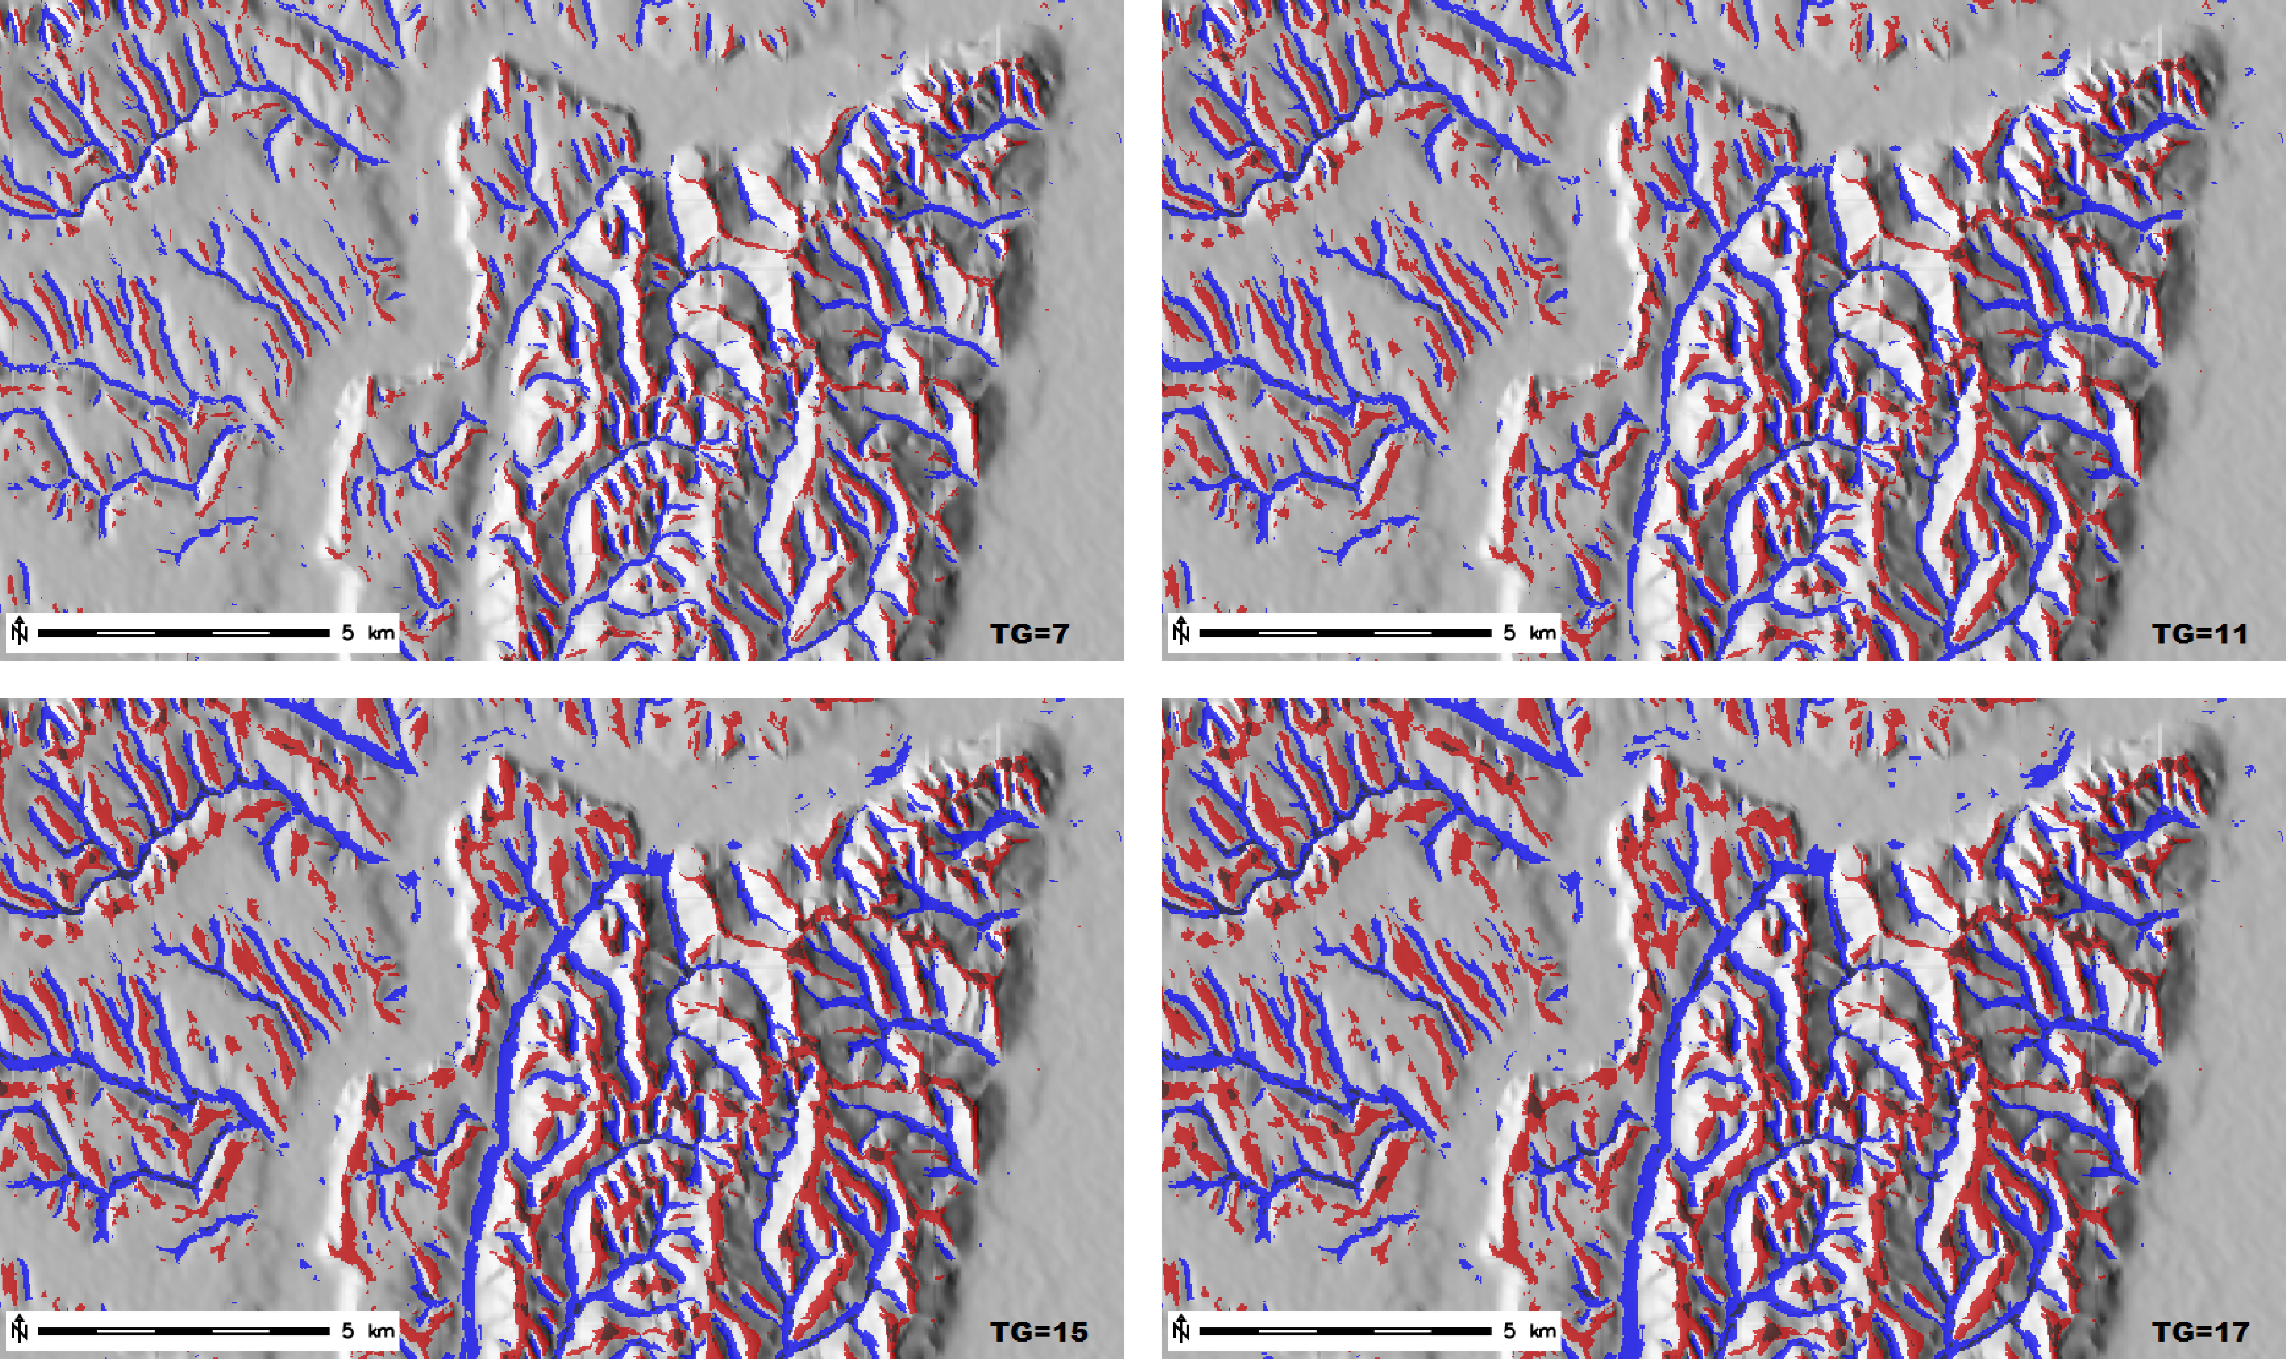
In the case of the 2nd, 3rd cluster and the Transdanubian Hills the method calculated the same TG value (11).
The distribution of the landforms suggest that the approach mapped similar extent of positive and negative forms.
The maps on the right confirm that the wider, shallower and deeper, narrower valleys were also well delineated. Unfortunately on the floodplain (upper figure) the Gemenc forest is not mapped as flat, due to the characteristics of the SRTM1 data. The lower figure shows the Western Mecsek Mountains and its gently sloping, dissected foreland as well.
The maps on the left represent the effect of different L parameters. The 7 L value causes the valley and ridgeline network to be fragmented. The 17 L value is increasing the valley bottoms and hilltops on the expense of the shoulder, spur and hollow categories, which could be indicative of the recent development of landforms.

Slide 19
1A - floodplain
1B - plain
2A - hills
2B – dissected plateaus
3A – medium mountains
3A – low mts
Based on the delineated landform elements it was possible to automatically map the physiographic units within the study area by a supervised segmentation process. For this reason the GeoPAT GRASS GIS toolset (Jasiewicz, J. et al. 2015) was used. The 7.5x7.5 km large sample sites (maps above) are representative for the plains, hills and mountainous (in Hungarian perspectives) regions of Southern Transdanubia.
This technique allows the recognition of spatial patterns, in our case landscape types, over a large dataset with efficient computation of the similarity to the sample tiles (Jasiewicz, J. et al. 2014). The landscape analysing methodology is strongly based on the geomorphons mapping approach, which was proven to be very sensitive to the settings of L parameter.

Slide 20
The map of the algorithm-delineated physiographic units show significant similarity to the derived clusters, but also many of the micro- and macroregion borders are recognizable.
The above mentioned errors of the elevation dataset also propagated to the results of the segmentation. This could be eliminated by including other land surface parameters, such as slope, relative relief, height, in the algorithm.
The output is in accordance with the relative relief and landform maps. It was able to recognize the plains (also the flat valley bottoms and plateaus) based on the sample tiles. Taking into consideration the geomorphological forms and the general topography the method did right by characterising most of the study site as hills. The regions showing low mountainous signatures (deeper valleys, narrower ridges, summits) were also delineated correctly, embedded in the hills.
Plains | Hills | Low mountains
Rate: 40% | Rate: 53% | Rate: 7%
Min elev.: 77 m | Min elev.: 74 m | Min elev.: 74 m
Max elev.: 262 m | Max elev.: 667 m | Max elev.: 682 m
Mean elev.: 114 m | Mean elev.: 168 m | Mean elev.: 210 m
STD of elev.: 25 m | STD of elev.: 49 m | STD of elev.: 60 m

Slide 21
Applicability:
the characteristic local ridgeline-to-channel spacing calculated by the TG principle can be used as an objective L parameter for the geomorphons mapping approach
the two techniques combined allows the multi-scale delineation of relevant landform elements in complex study areas
the landform elements can be used for further investigation of the physiography
the mapping technique can narrow the gap between GIS-based and manual geomorphological mapping while providing objective, coherent and repeatable results
Efficiency:
the TG calculation tool can be implemented in GRASS GIS as a script tool taking advantage of the interoperability with the R software
Further research:
improvement of data quality and TG calculation tool
further analysing potential of TG-based landform mapping on different scales and landscapes

