Slide 1
EGU 2016 Vienna April 22, 2016
Infrared laser spectroscopic
gas sensing
Markus W. Sigrist
ETH Zürich, Switzerland
www.lss.ethz.ch
sigristm@phys.ethz.ch
Laser Spectroscopy and Sensing
ETH Zurich

Slide 2
Outline
Introduction: spectroscopy, laser sources
Mid-IR VECSEL: simultaneous C₁-C₄ alkanes detection
QCL & QEPAS: short-lived species (HONO)
DFG & multipass cell: surgical smoke analysis
Conclusions and outlook
Laser Spectroscopy and Sensing
ETH Zurich

Slide 3
Molecular absorption in te mid-IR
From
Laser Spectroscopy and Sensing
ETH Zurich

Slide 4
(Broadly) tunable narrow-band mid-IR lasers
Semiconductor Lasers
Laser Spectroscopy and Sensing
ETH Zurich

Slide 5
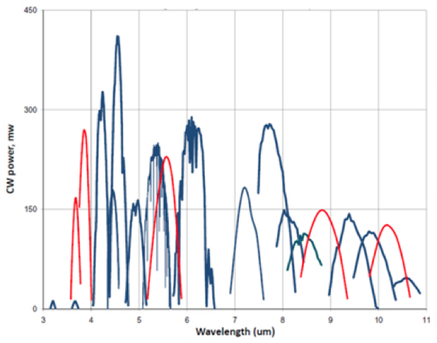
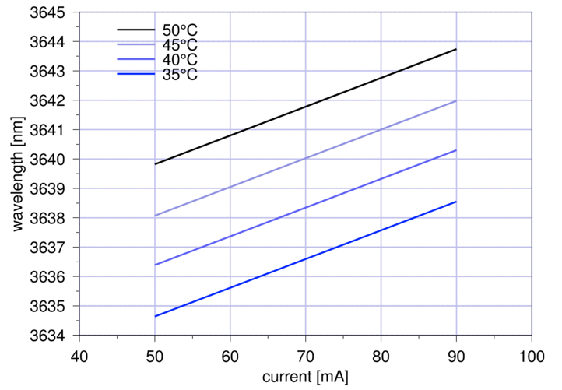
CW power, wavelength &
tuning ranges of EC-QCLs
Wavelength & Tuning range
of specific ICL, power 3 mW
Laser Spectroscopy and Sensing
ETH Zurich
Notes:
5

Slide 6
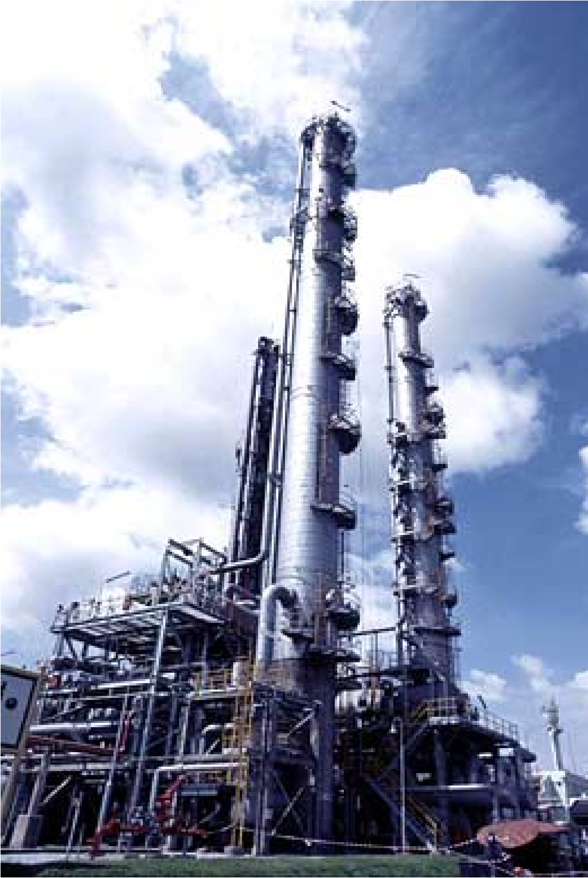
Sensing of alkanes (methane, ethane, propane, butane)
Natural gas / biogas composition analysis
Energy content measurement
Fuel blending and control
Optimization of power generation
(fuel cells, gas turbines)
Monitoring of hydrocarbon leaks
at pipelines and refineries
Laser Spectroscopy and Sensing
ETH Zurich

Slide 7
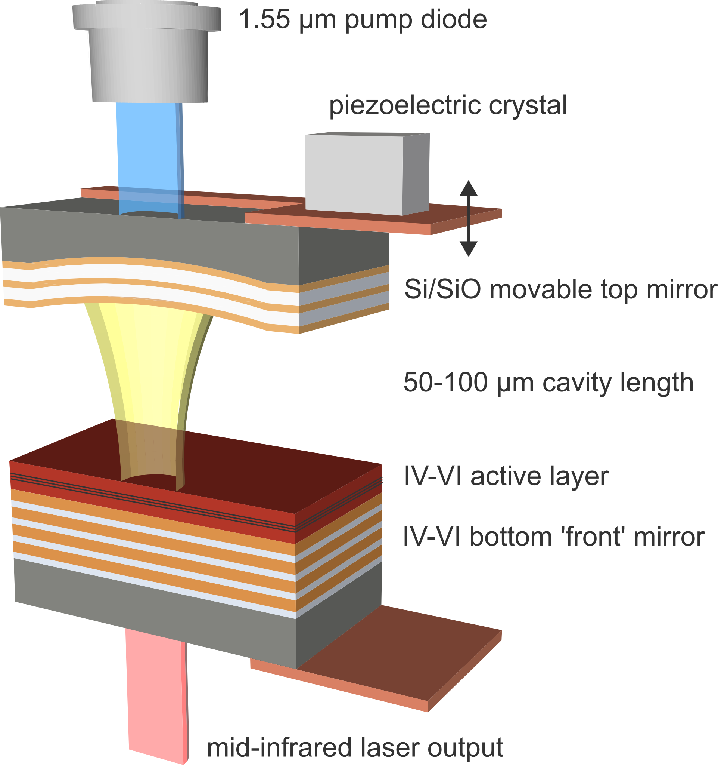
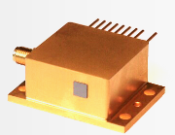
Diode-pumped lead salt VECSELs
(Vertical Extended Cavity Surface Emitting Lasers)
λ ≈ 3.4 μm
Tuning range: > 150 cm-1
Pulse power: 10 mW_{p}
Duty cycle: 0.5%
Laser Spectroscopy and Sensing
ETH Zurich

Slide 8
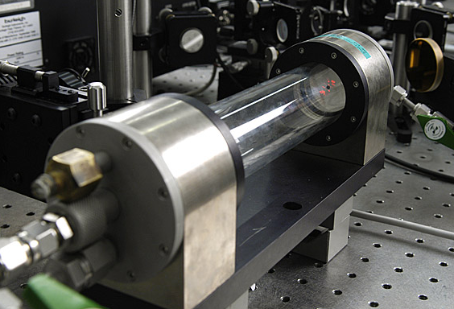
Experimental setup with VECSEL, sample and reference cell
Laser Spectroscopy and Sensing
ETH Zurich

Slide 9
Measured reference spectra of C₁ – C₄ alkanes
Individual gases buffered in N₂
at atm. pressure
averaged over
100 scans
Total acquisition
Time: 200 s
Butane
Propane
Ethane
Tuning by PZT voltage
Methane
Laser Spectroscopy and Sensing
ETH Zurich

Slide 10
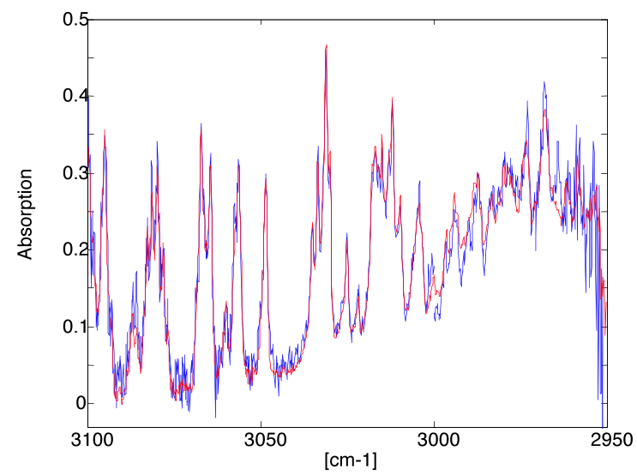
Spectrum of mixture of C₁-C₃ alkanes and H₂O vapor
Measurement
Fit (Hitran)
23 ppm methane
24 ppm ethane
20 ppm propane
1.7 %vv H₂O vapor
Buffer gas: N₂
atm. pressure
Absorption
Measurement time
10 x 2 sec
Detection limit:
0.6 ppm
J. Rey et al.: Appl. Phys. B 117, 935-030 (2014)
Laser Spectroscopy and Sensing
ETH Zurich

Slide 11
Nitrous acid (HONO)
Important source of OH radicals in earth atmosphere
Key role in atmospheric oxidation capacity which affects regional air quality and global climate change
HONO sources and sinks not well understood due to challenging measurement:
Atmospheric concentration only few ppb, >10 ppb indoor
- Atmospheric lifetime: 10 - 20 minutes
Sensitive and fast measurement technique is essential
Laser Spectroscopy and Sensing
ETH Zurich

Slide 12
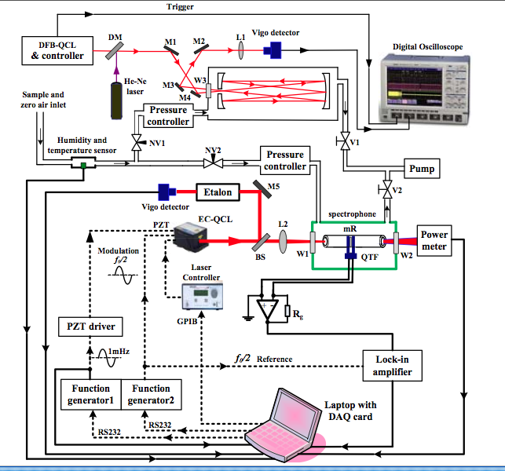
Short-lived species detection (HONO) with EC-QCL-QEPAS
EC-QCL (ca.1255 cm-1)
50 mW
QEPAS with mR
Compact 40 mm3 cell
Calibration with 110 m
cell and DFB QCL
Air sampling resid. time:
10 ms vs 7 min.
H. Yi, W. Chen et al.:
Appl. Phys. Lett. 106,
101109 (2015)
Laser Spectroscopy and Sensing
ETH Zurich

Slide 13
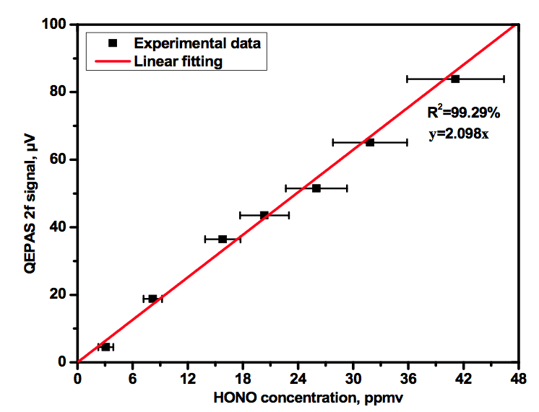
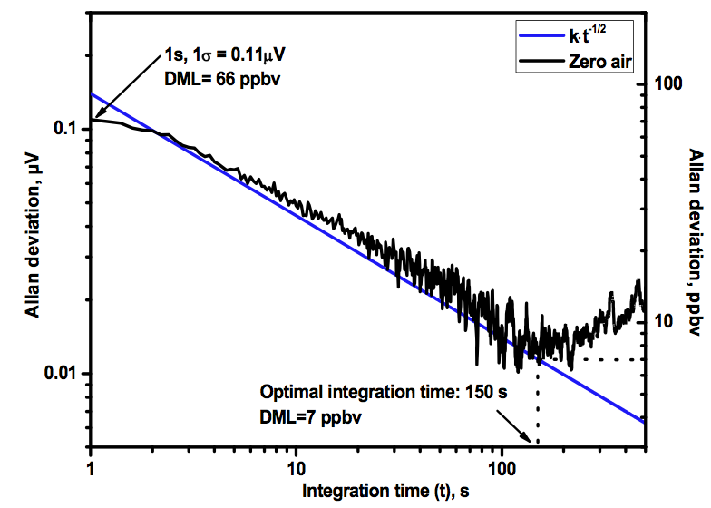
Good linearity of 2f QEPAS
signals with titrated HONO
concentrations
Poster X2.446
Allan variance plot
Detection Limit 66 ppb
(1 sec) , 7 ppb (150 sec)
With 1W QCL: Extrapol.det. limit
3.3 ppb (1s), 330 ppt (150 s)
Laser Spectroscopy and Sensing
ETH Zurich

Slide 14
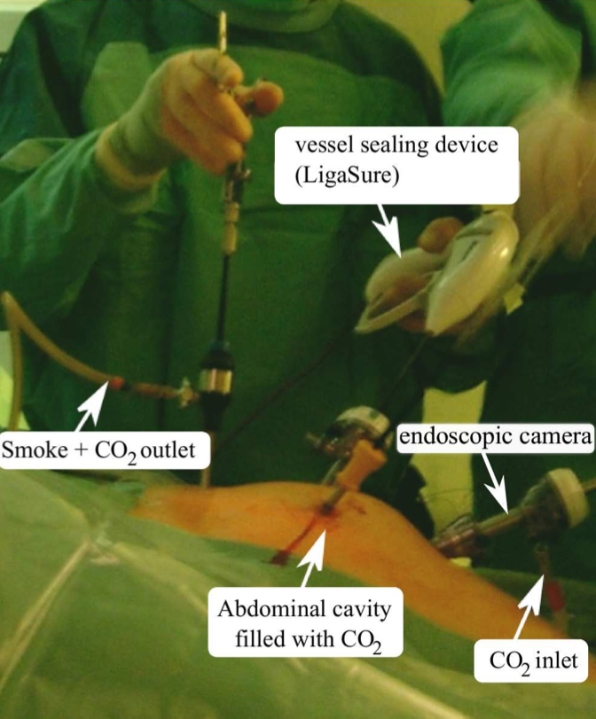
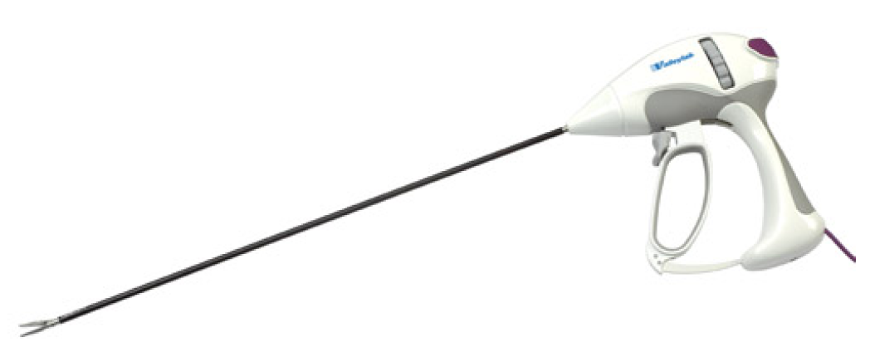
Analysis of surgical smoke: in vivo studies
Smoke produced during minimal-invasive surgery with electro-knives or lasers. Smoke samples are taken at the hospital, collected in Tedlar bags, followed by laser and FTIR spectroscopic analysis in our lab
Photo of electro-knife
Collaboration with
University Hospital Zürich
(Dr. Dieter Hahnloser)
M. Gianella et al.: Appl Phys. B 109, 485 (2012)
M. Gianella et al.: Innov. Surgery (2013)
Laser Spectroscopy and Sensing
ETH Zurich

Slide 15
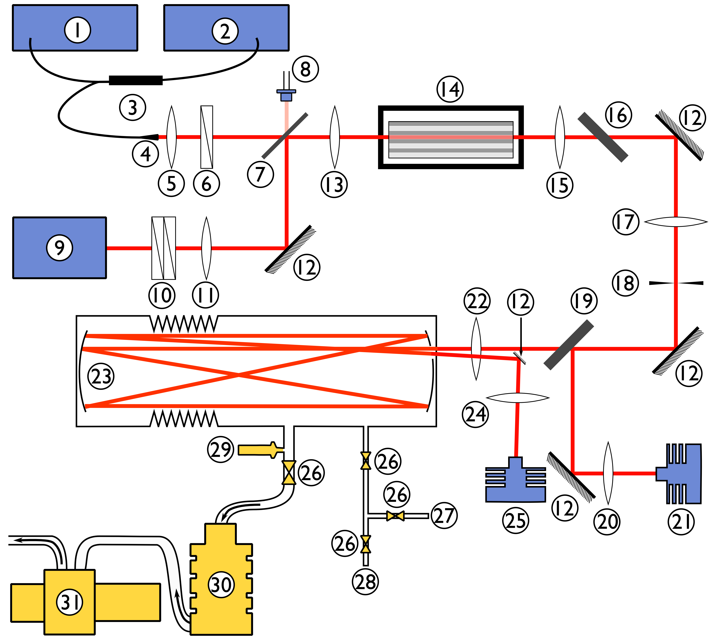
DFG spectrometer
Broadly tunable, Mode-hop free, Room temperature
1 ECDL, 1520-1600nm
5 mW CW
2 Wavemeter for ECDL
9 Nd:YAG, 1064.5 nm,
5 kHz, 6 ns, 300 mW av
14 PPLN, 5 cm, 8 periods
23 Heatable multipass cell
up to 35 m
21/25 Detectors (VIGO)
Idler: 150 μW av.
2817 - 2920 cm-1 (29.5 μm)
2900 - 3144 cm-1 (29.9 μm)
Step size 0.002 cm-1
Minimum detectable absorption coefficient: 5×10-7 cm-1 Hz-1/2
(few ppm for many compounds of interest)
Laser Spectroscopy and Sensing
ETH Zurich

Slide 16
Spectral analysis of surgical smoke
Principal Component Analysis (PCA)
with improved Mix-Match Algorithm
and PNNL database (with 300 gaseous compounds, but no sevoflurane)
M. Gianella et al.: Appl. Spectr. 63, 338 (2009)
Laser Spectroscopy and Sensing
ETH Zurich

Slide 17
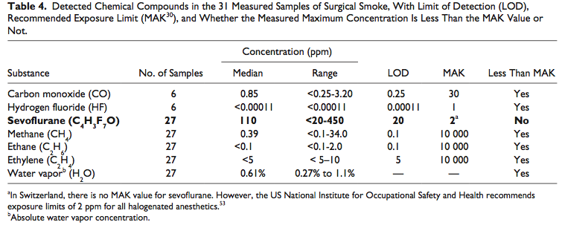
Chemical composition of in vivo samples
From: M. Gianella et al.: Surgical Innovation 2013 (online : June 26, 2013)
Laser Spectroscopy and Sensing
ETH Zurich
Notes:
17

Slide 18
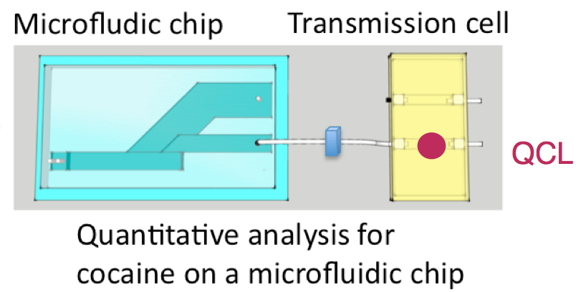
Conclusions and Outlook
QCL & QEPAS: HONO detection, small volume
LOD: 66 ppb (1 sec), 7 ppb (150 sec)
DFG for analysis of surgical smoke (partially unknown composition)
First quantitative in vivo analysis, identification of gases & anesthetic at ppm
Mid-IR VECSEL for C₁-C₄ alkanes analysis
Fast analysis at sub-ppm level
New laser developments:
ICLs, Diode-pumped Pb salt VECSELs, QCLs, frequency combs/supercontinuum
Detection schemes:
Cavity-enhanced techniques, ATR, QEPAS and cantilever PAS,integrated devices
New application areas
Field & POC measuremen, Lab-on-a-chip
Laser Spectroscopy and Sensing
ETH Zurich

Slide 19
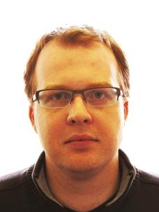
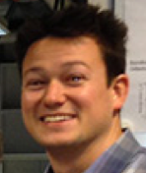
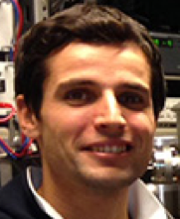
Acknowledgement
Michele
Gianella
Julien Rey
Ferdinand
Felder
Matthias Fill
Weidong Chen
Collaboration and Funding
Dr. Dieter Hahnloser
Laser Spectroscopy and Sensing
ETH Zurich

Slide 20
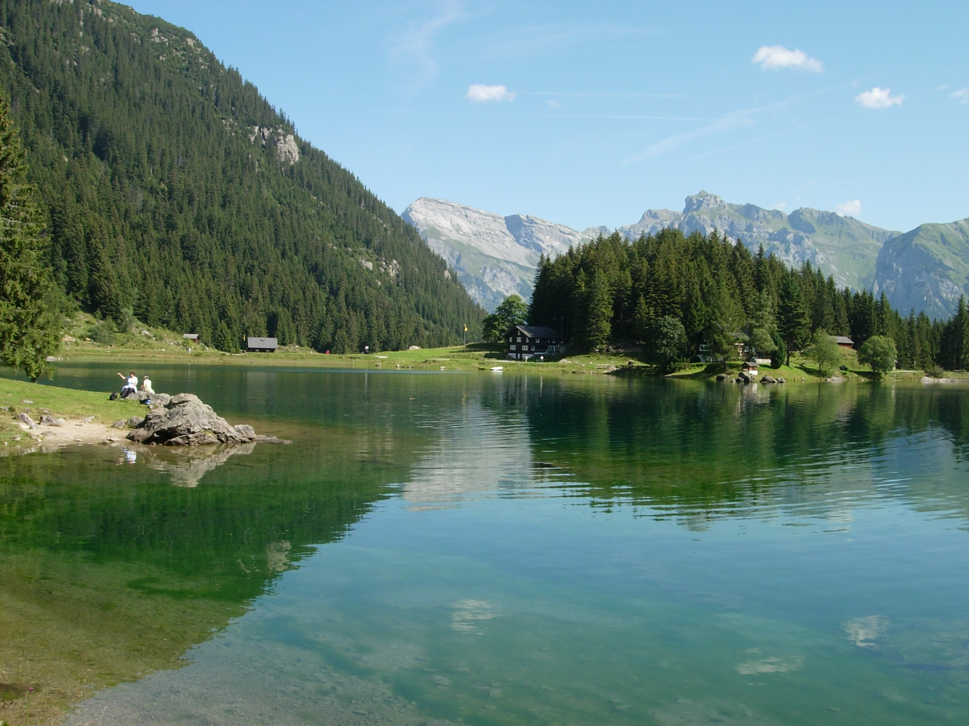
Thank you for your attention
Notes:
20

