Slide 1

ENSO-dynamics in CMIP simulations in the framework of the recharge oscillator model.
Asha Vijayeta & Dietmar Dommenget

Slide 2
Introduction
ENSO statistics and dynamics in CMIP simulations exhibit wide spread uncertainties.
Linear recharge oscillator concept is used to diagnose ENSO-dynamics.
Questions:
Do the models disagree with each other and have biases?
Effect of model biases and model spread on the ENSO dynamics?
Are the dynamical errors compensating and if so which ones?

Slide 3
Linear Recharge Oscillator (ReOsc) Model
T = NINO3 SST anomaly
Burgers et al.(2005)
Damping
Effect of h on SST
Stochastic forcing(random heating and wind stress)
Stochastic forcing(random wind stress)
Damping
Effect of SST on h
h = Mean equatorial Pacific thermocline depth anomaly
ESTIMATION OF PARAMETERS

Slide 4
Data Used
Dataset used:
CMIP5 “Historical” and CMIP3 “20c3m” (1900-1999).
Variables used:
Thermocline depth anomaly in equatorial Pacific (20 ⁰C isotherm, estimated from potential temperature)
SST anomaly & net heat-flux anomaly in NINO3 region.
Zonal windstress anomaly in NINO4 region.
1979–2014 HadISST1.1 Data for SST
1982-2002 BMRC 20degree isotherm depth
1979–2014 ERA Interim zonal surface wind stress
1984–2004 OAFlux surface fluxes.
To calculate
observed values

Slide 5
ReOsc model a good representation of ENSO in CMIP models?
 | Standard deviation of SST | Standard deviation of H | Central period | Mean correlation (4-8months lead)
Observation(1982-2002) | 1.0 | 6.8 | 3.0 | 0.54
Recharge oscillator toy model | 0.99 | 8.9 | 3.5 | 0.65

Slide 6
Proof of Concept
Proof 1: Standard deviation of SST anomaly
Proof 2: Standard deviation of H anomaly

Slide 7
SST Equation parameters
Model mean for both parameters within observed uncertainty range.
Large model spread in a₁₁ and a₁₂.

Slide 8
Thermocline equation parameters
Thermocline damping model mean outside of observed uncertainty range.
Large model spread in a₂₁ and a₂₂.
All CMIP5 models have stronger than observed thermocline damping.

Slide 9
Standard deviation of stochastic noises
Model mean outside of observed uncertainty range.
Large model spread in both noises.
Majority of the CMIP models have underestimated noises.

Slide 10
Components of SST coupling parameters
ReOsc toy model
Separate SST damping parameter(a11)
and effect of SST on thermocline(a21)
into atmospheric and oceanic part
Heat flux feedback
Y15 model
Bjerknes feedback

Slide 11
Atmospheric feedbacks:
Bjerknes Feedback vs net Heatflux feedback
Almost all CMIP models have underestimated windstress and net heatflux feedback

Slide 12
Ocean vs. atmospheric component of SST damping parameter(a₁₁)
Compensating atmospheric and
oceanic parameter errors

Slide 13
Ocean vs. atmospheric component of thermocline effect on SST parameter(a₂₁)
Compensating atmospheric and
oceanic parameter errors

Slide 14
Effect of model biases
on the ENSO dynamics.
Effect of the model spread
on the ENSO dynamics.
Individual parameter set to observation
Individual parameter set to model spread
SST damping parameter model spread has maximum effect on stdv(SST) and stdv(H).
Thermocline influence on SST (a12) parameter model spread has maximum effect on the central period and SST-H correlation.
Thermocline damping parameter(a22)
and the stochastic noises need to be corrected.

Slide 15
SUMMARY
ENSO-dynamics and their diversity in CMIP ensemble well represented by ReOsc model.
All CMIP models have biases, underestimated atmospheric feedbacks and stochastic noises, overestimated thermocline damping.
No substantial improvement from CMIP3 to CMIP5.
CMIP models get the right ENSO characteristics for wrong reasons. Compensating atmospheric and ocean parameter errors.
Model spread of SST damping has maximum effect on stdv(SST) and stdv(h).
Thermocline influence on SST (a12) model spread has maximum effect on the central period and correlation.

Slide 16
Thank you.

Slide 17
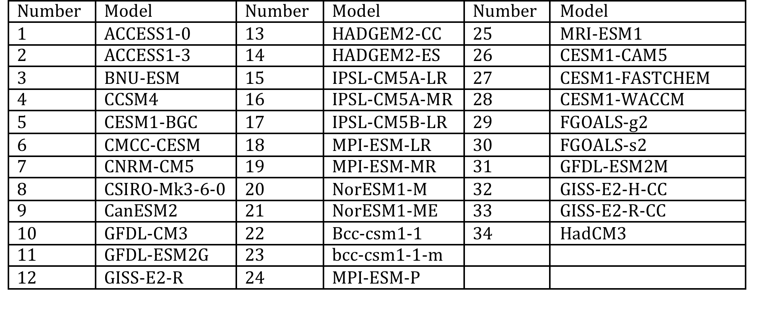
No. | Model
1 | ukmo_hadcm3
2 | ncar_ccsm3_0
3 | mri_cgcm2_3_2a
4 | mpi_echam5
5 | miroc3_2_hires
6 | ipsl_cm4
7 | iap_fgoals1_0_g
8 | giss_model_e_r
9 | giss_aom
10 | gfdl_cm2_0
11 | cnrm_cm3
12 | cccma_cgcm3_1_t63
13 | cccma_cgcm3_1

Slide 18
Frauen and Dommenget (2010)
Yu et. al(2015)
Y15 Model
T(t)= NINO3 SST anomaly
Ocean component of SST damping
Effect of h on SST
coupling parameter
heatflux forcing
heat capacity of mixed layer
windstress forcing
h Damping
Ocean component of Effect of SST on h
h(t) = Mean equatorial Pacific thermocline depth anomaly

Slide 19
ReOsc model fit Skill
Proof 4: cross-correlation SST vs. thermocline depth anomaly(mean of 4-8 lead months)
Proof 3: Central period of SST anomaly Power spectrum

Slide 20
SENSITIVITY TO PARAMETERS
Individual parameter=observation
Rest parameters=multi model mean

Slide 21
Influence of Model parameter spread on the statistical properties

