Slide 1
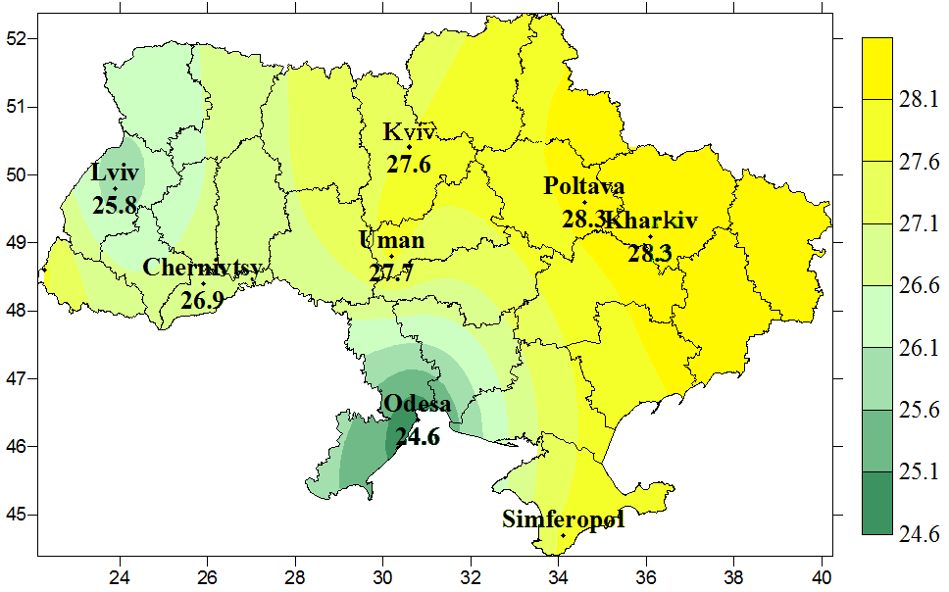
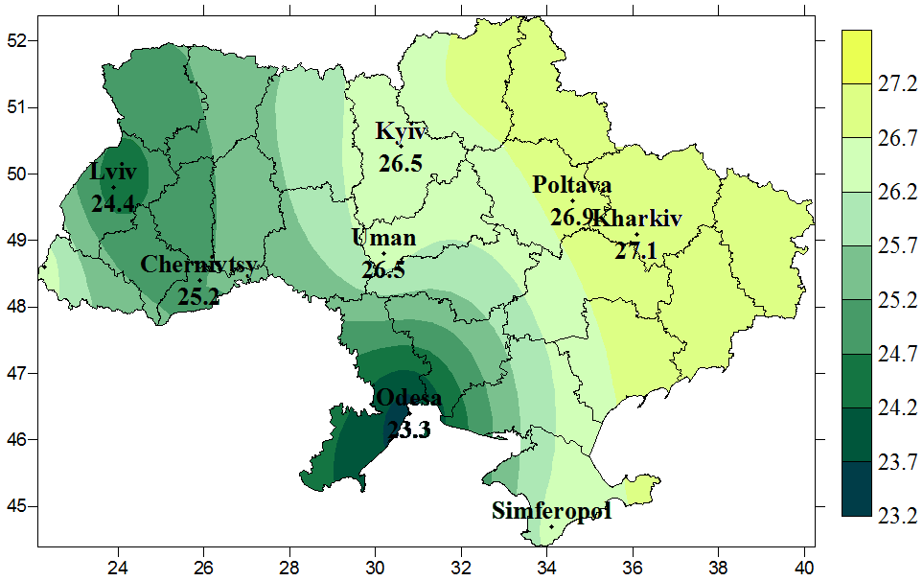
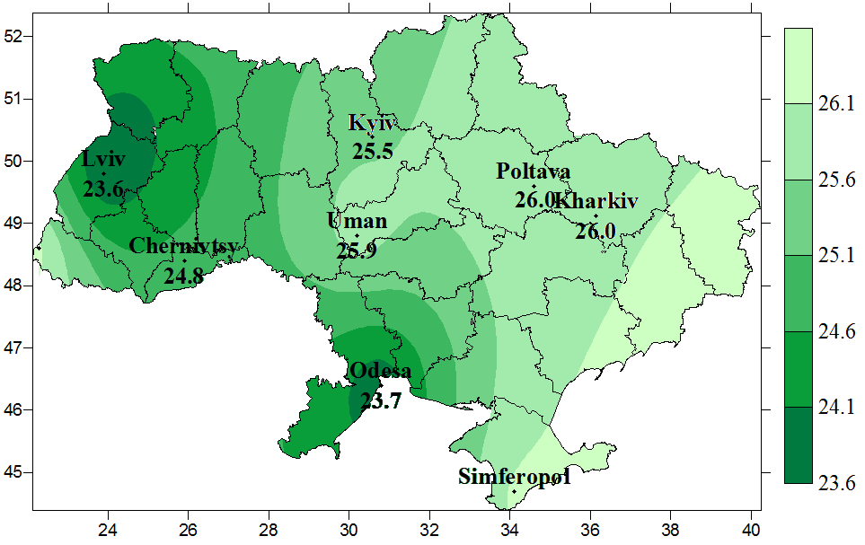
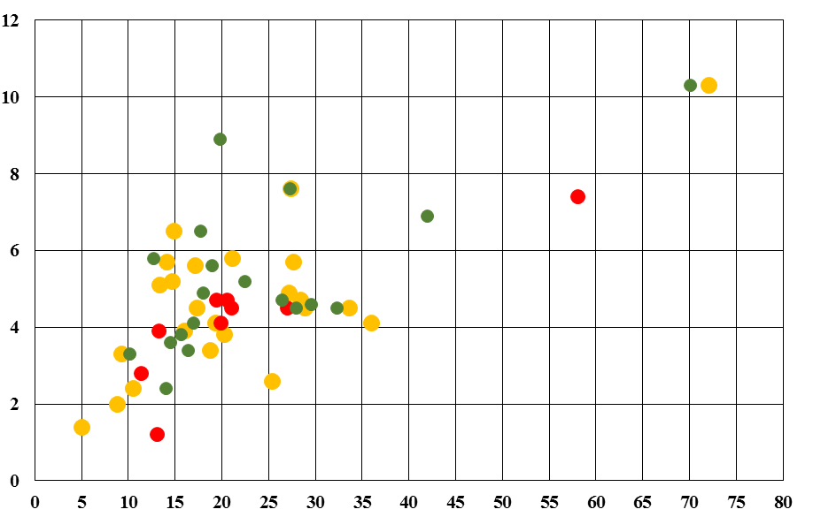
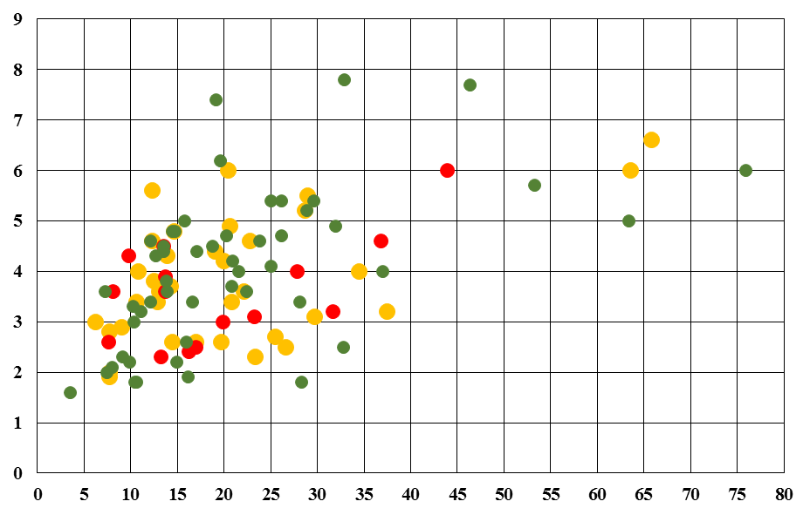
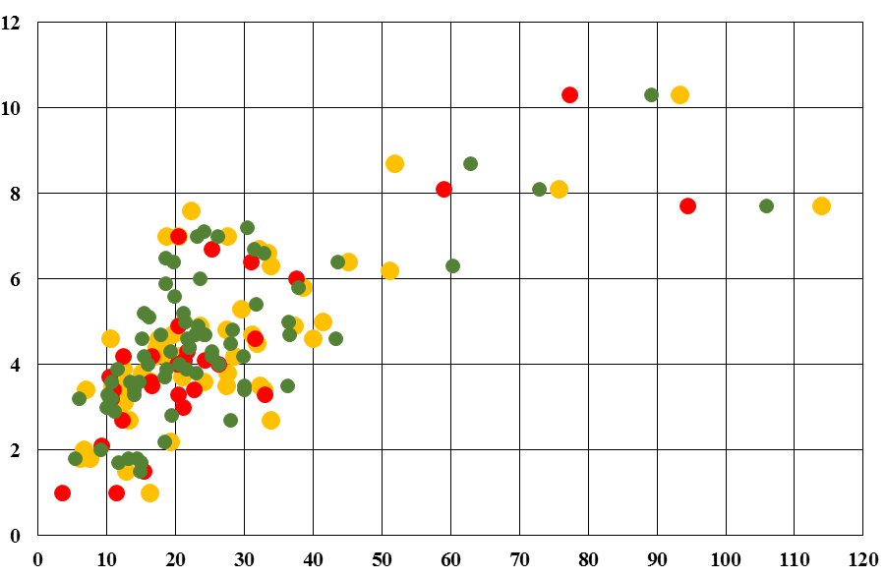
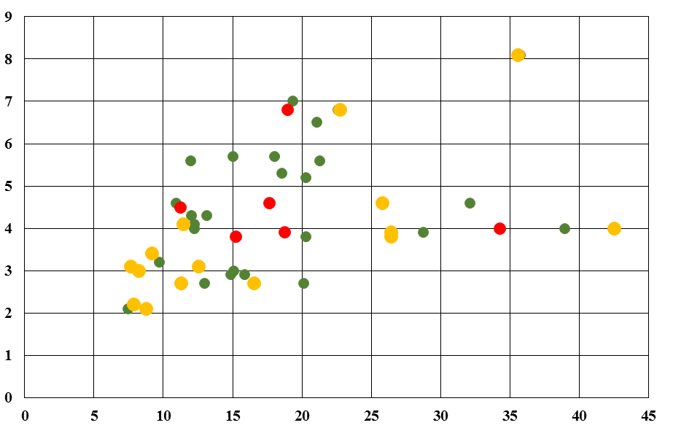
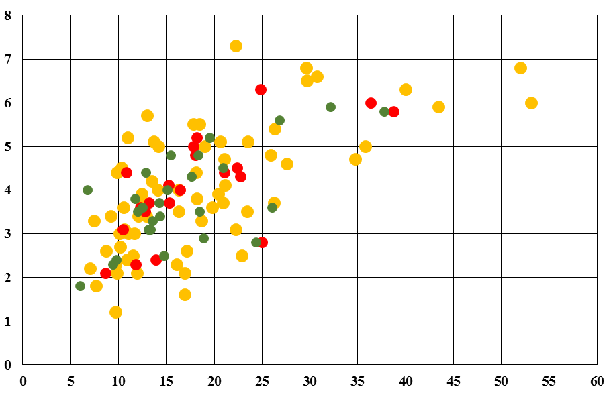
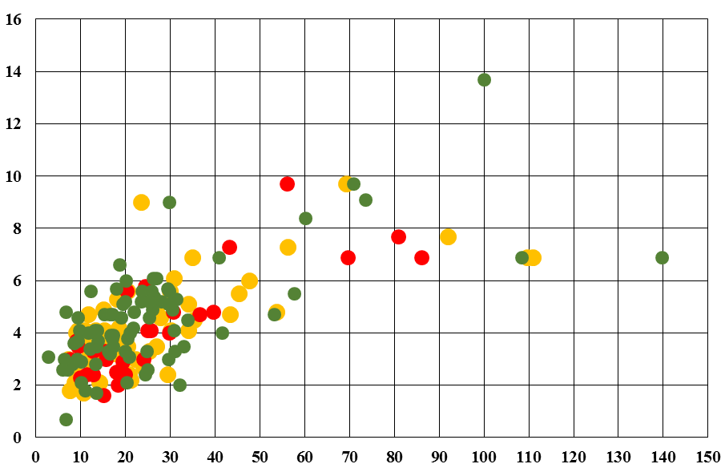
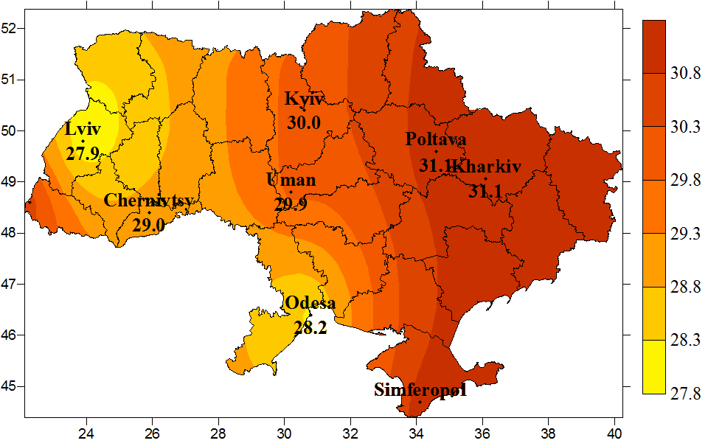
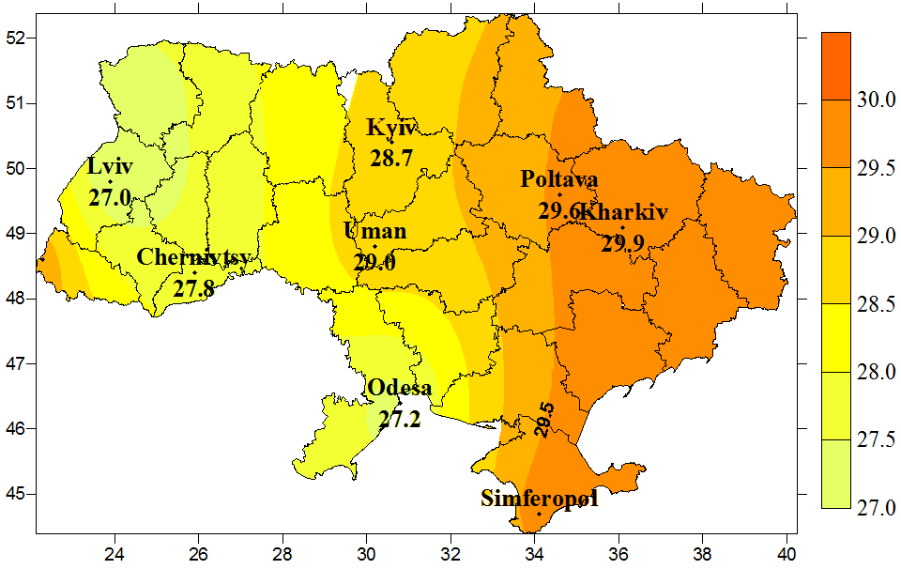
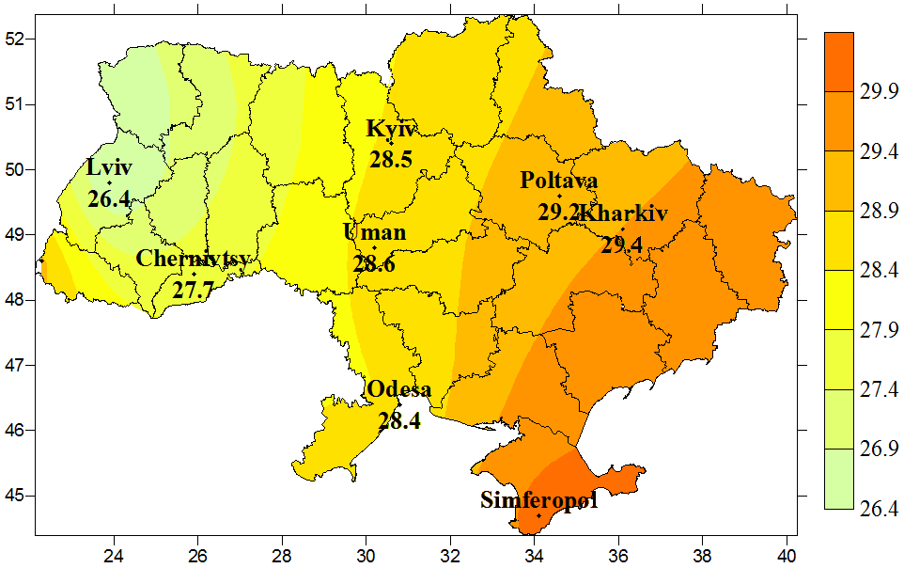
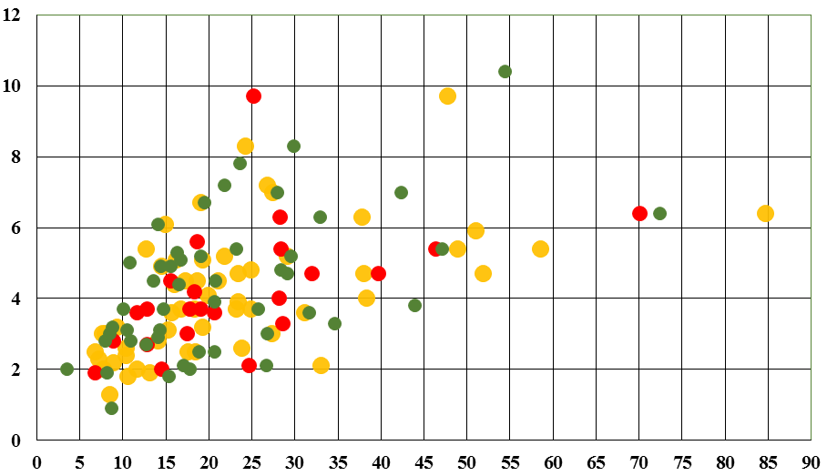
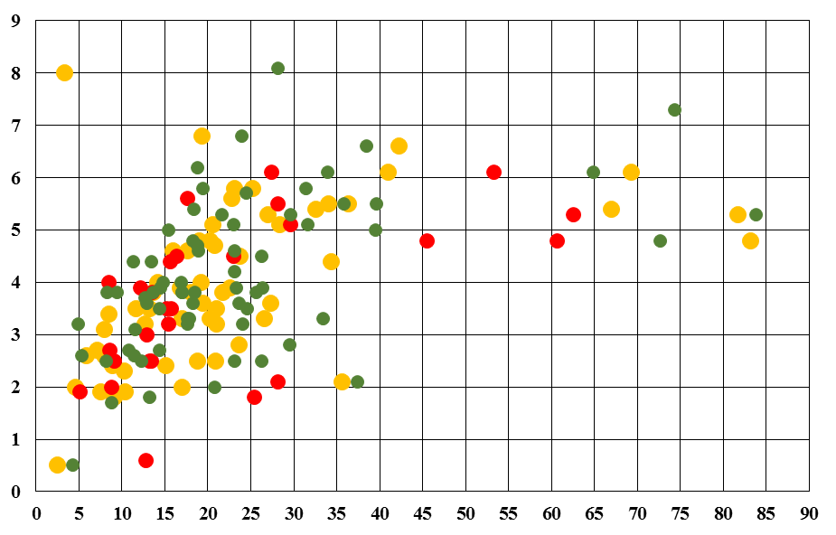
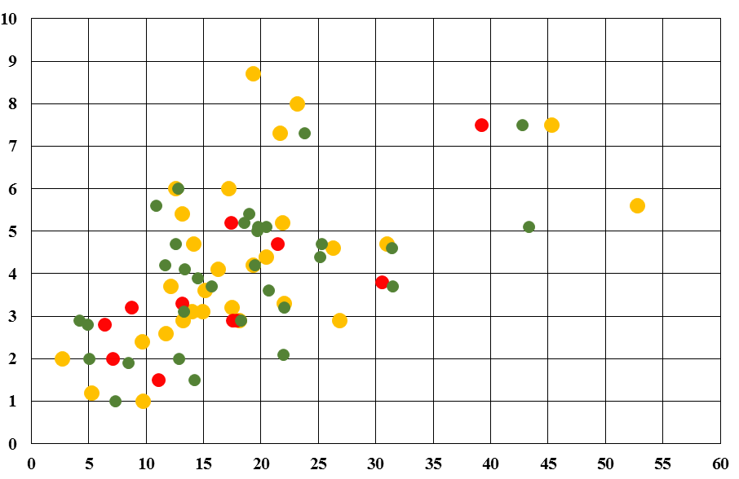
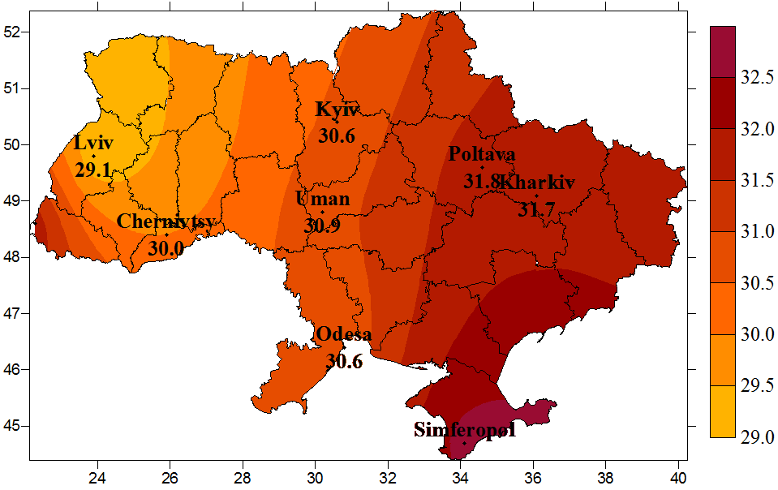
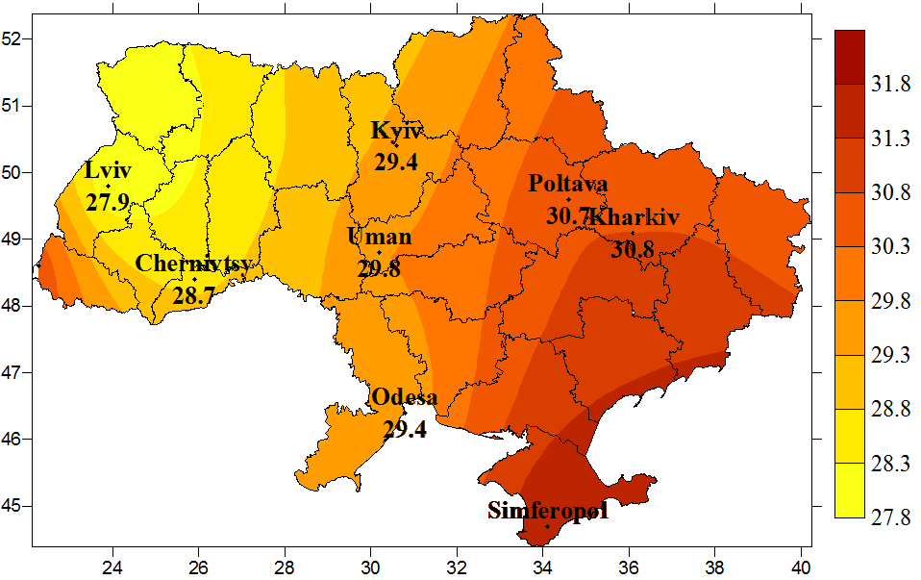
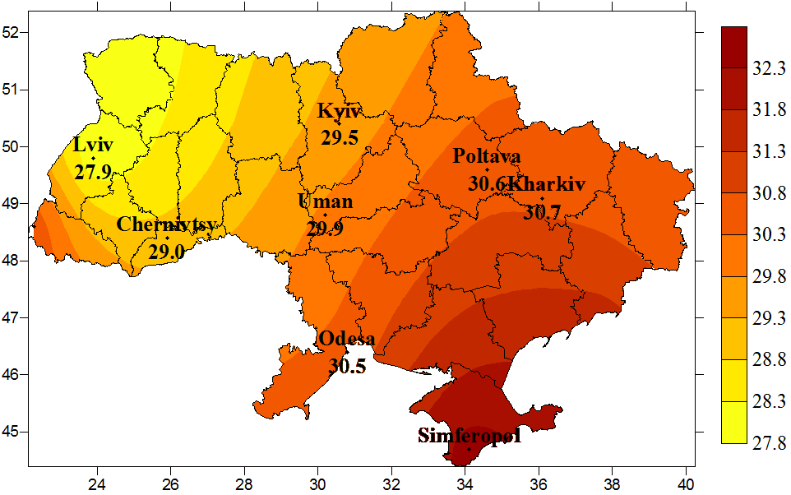
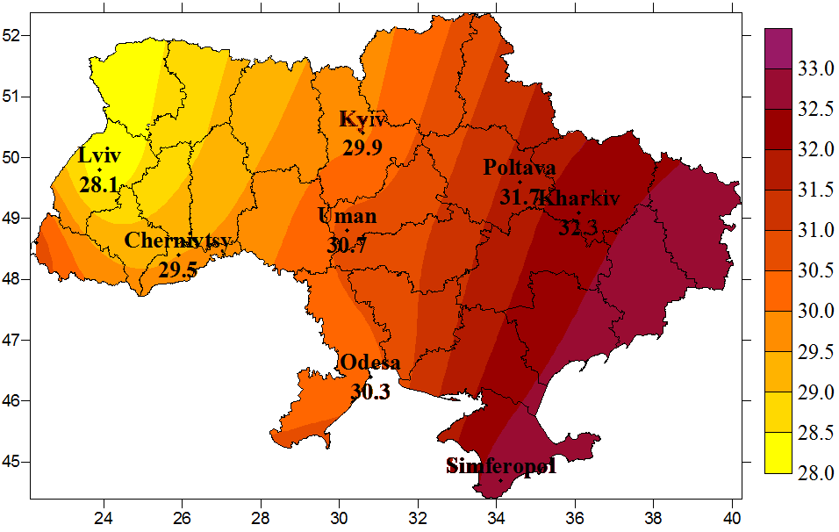
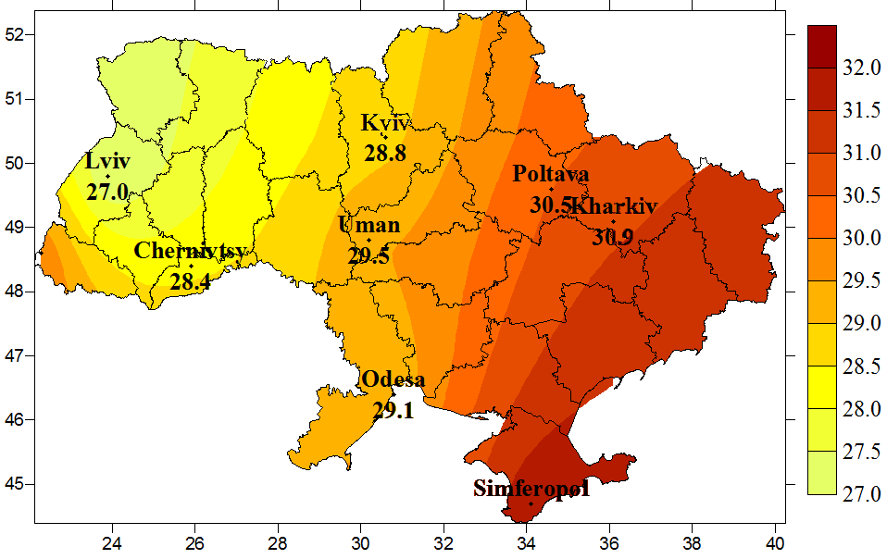
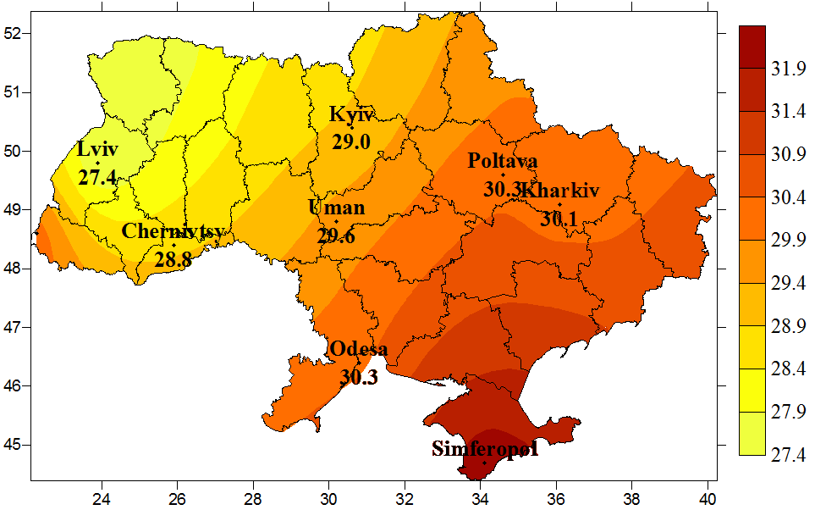
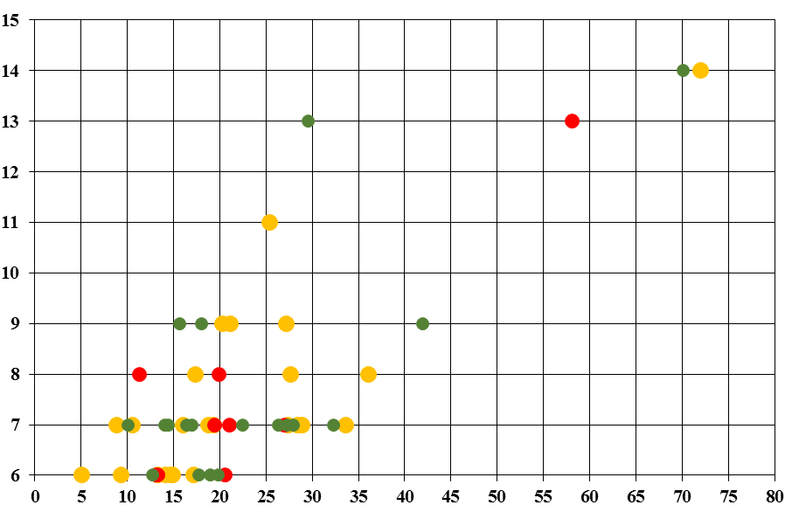
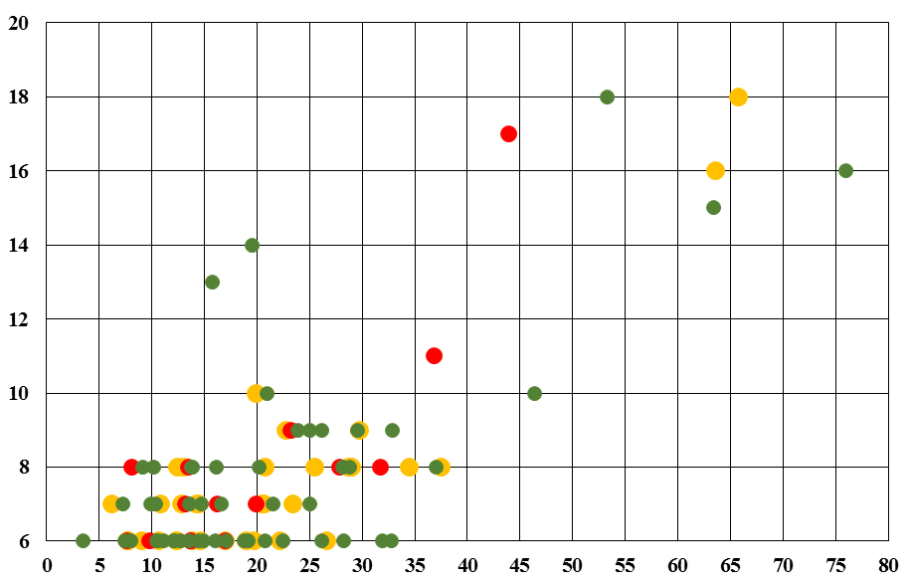
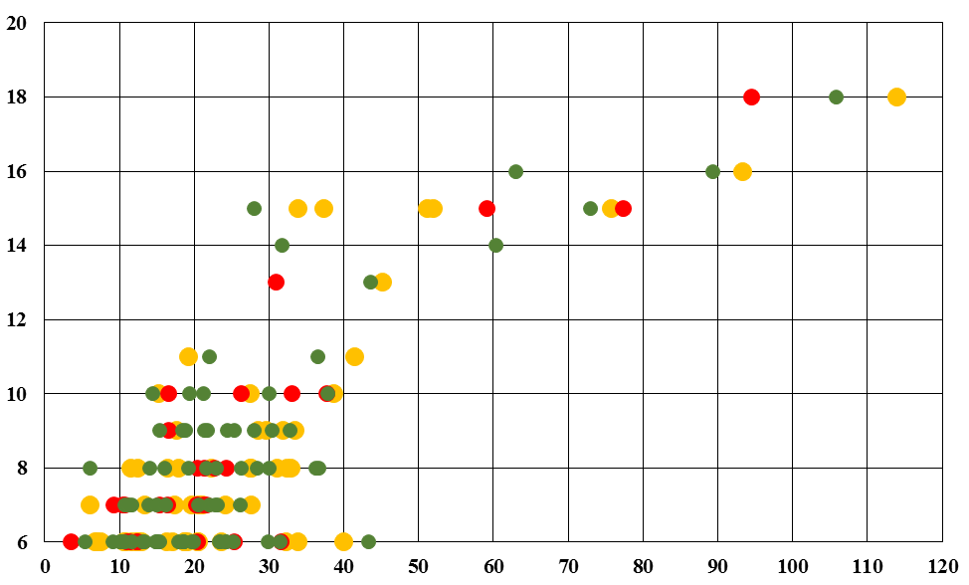
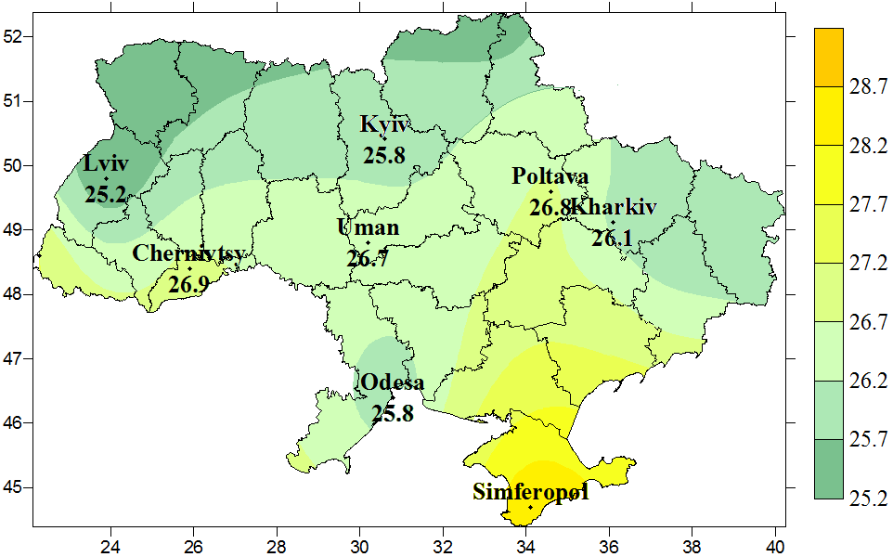
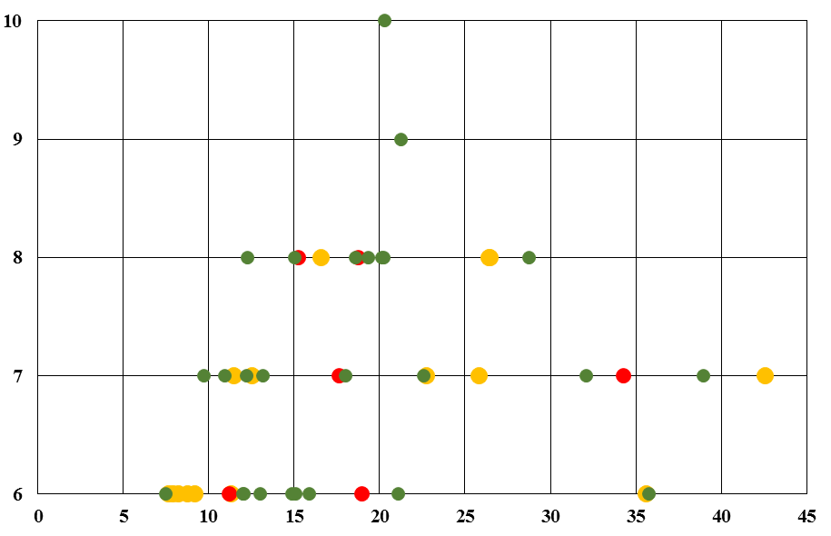
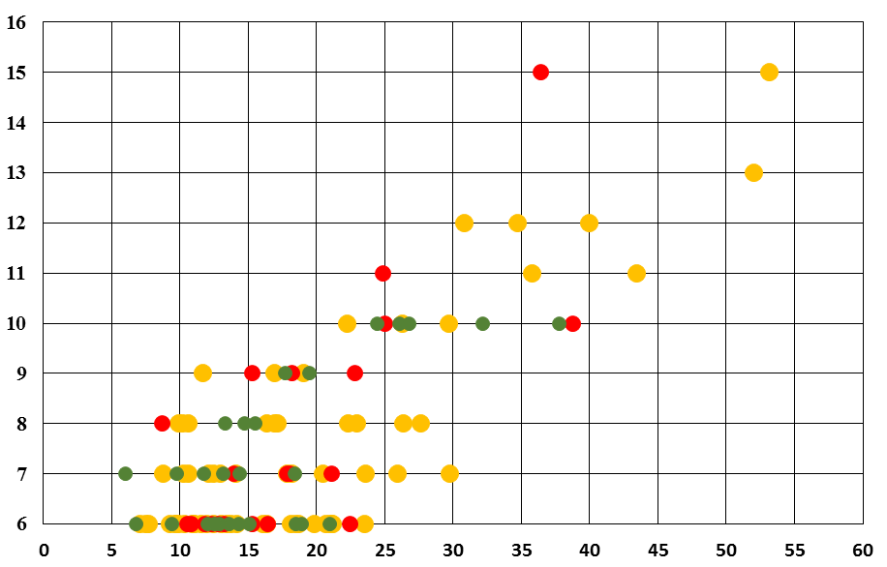
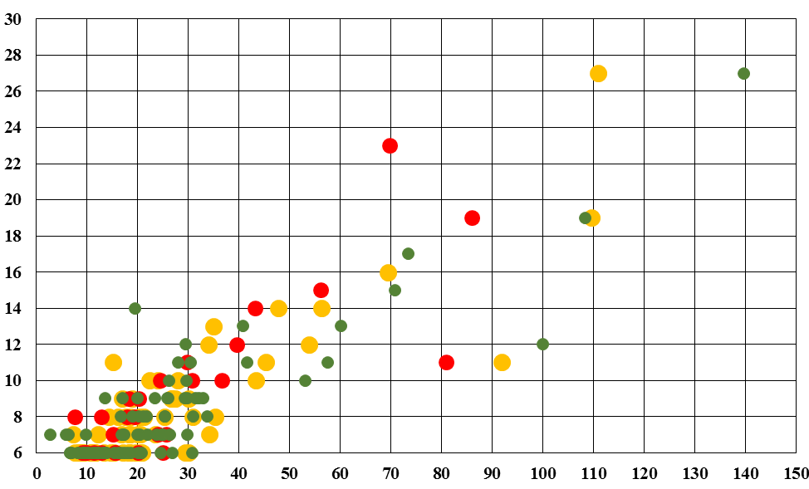
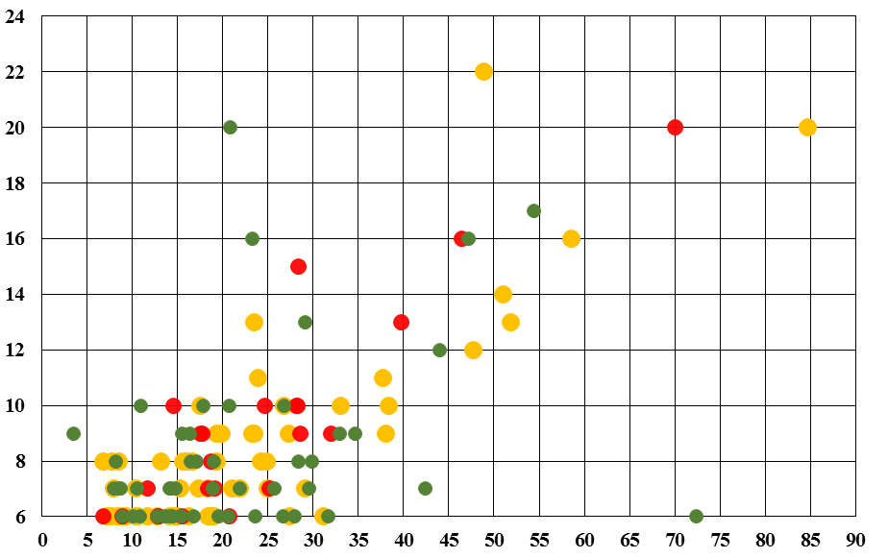
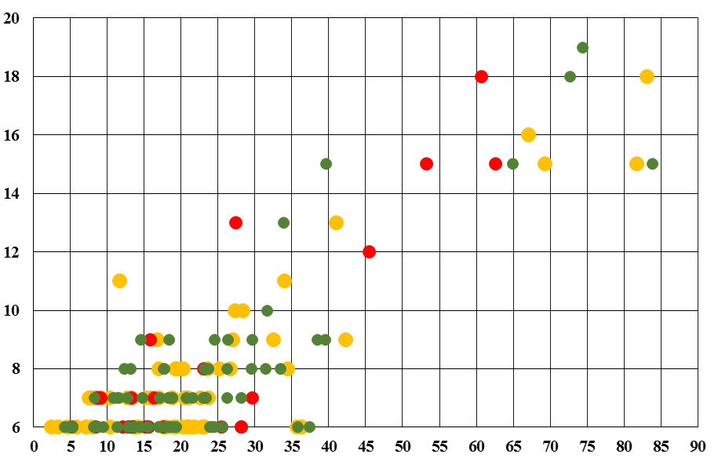
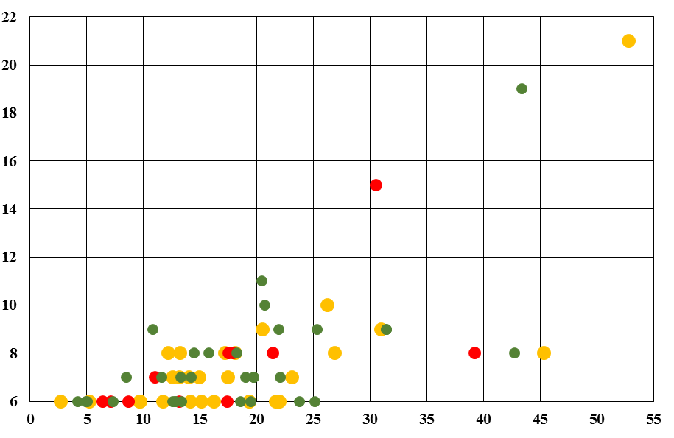
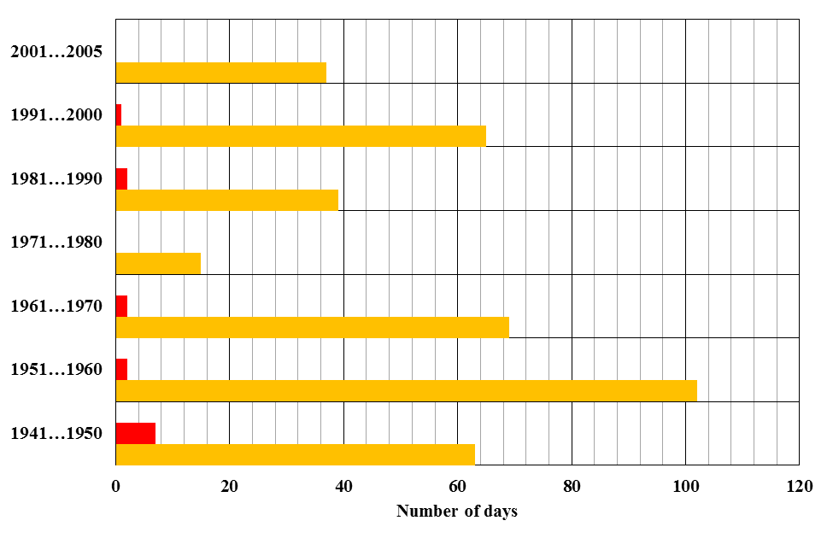
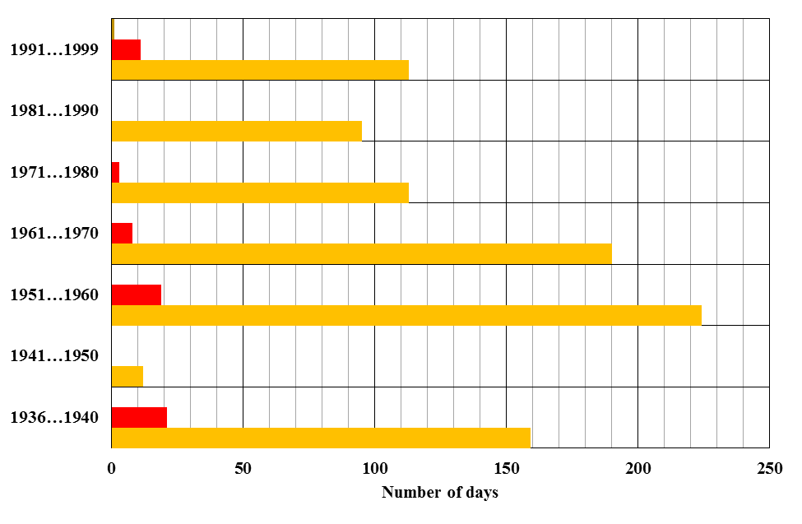
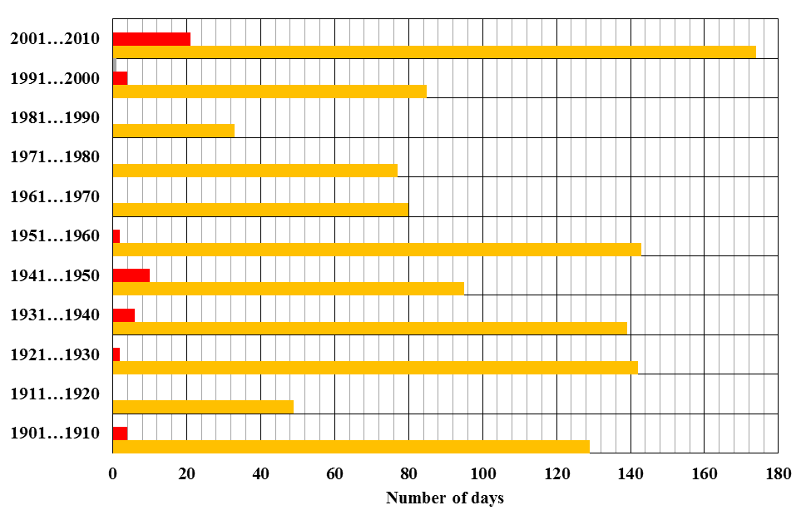
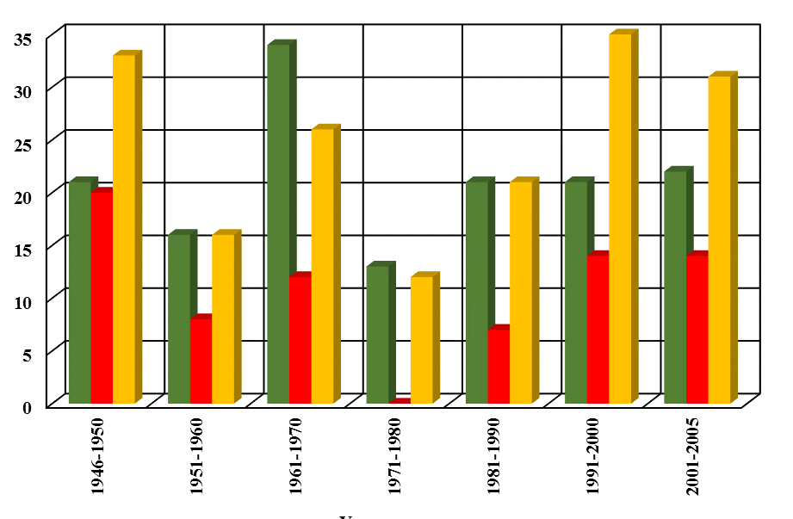
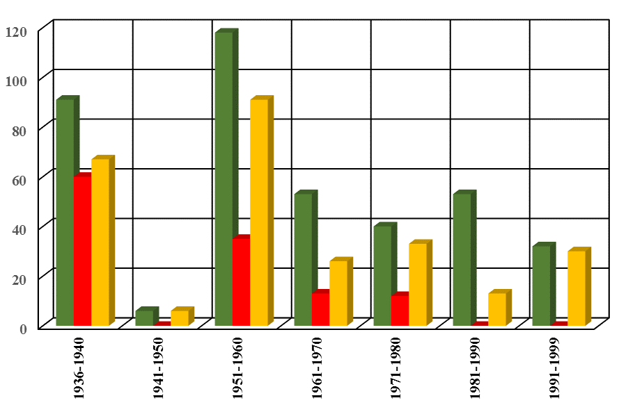
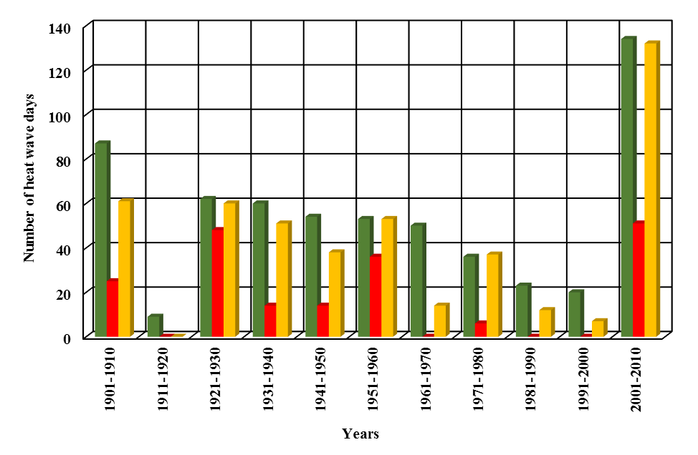
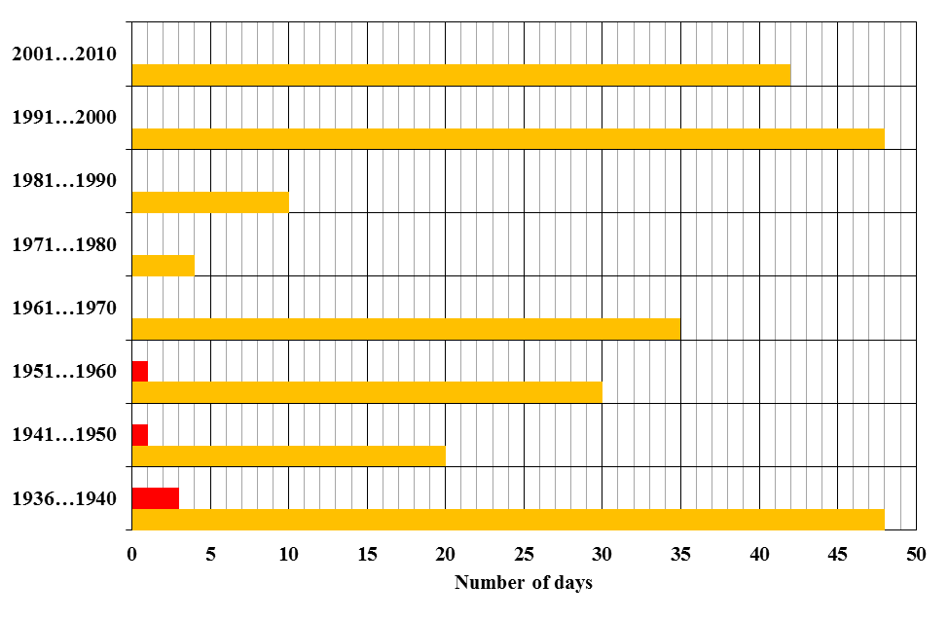
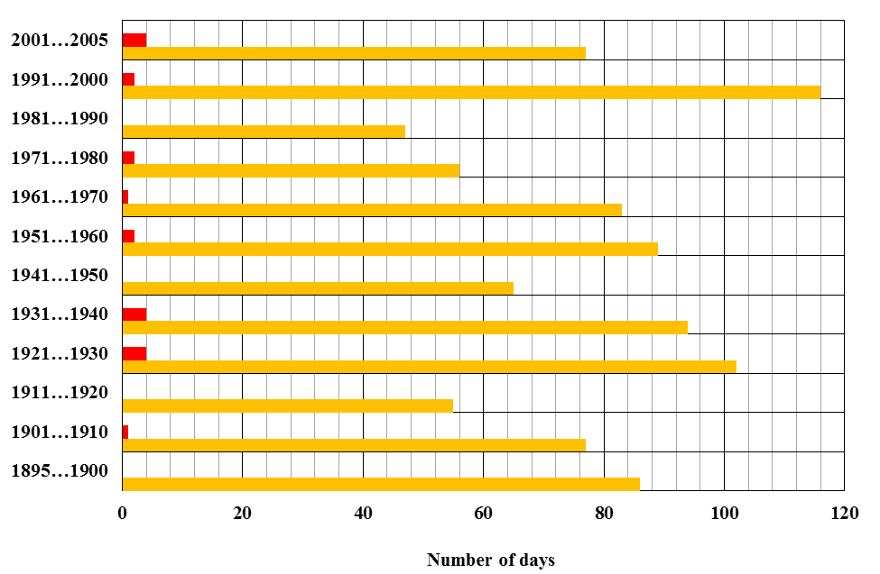
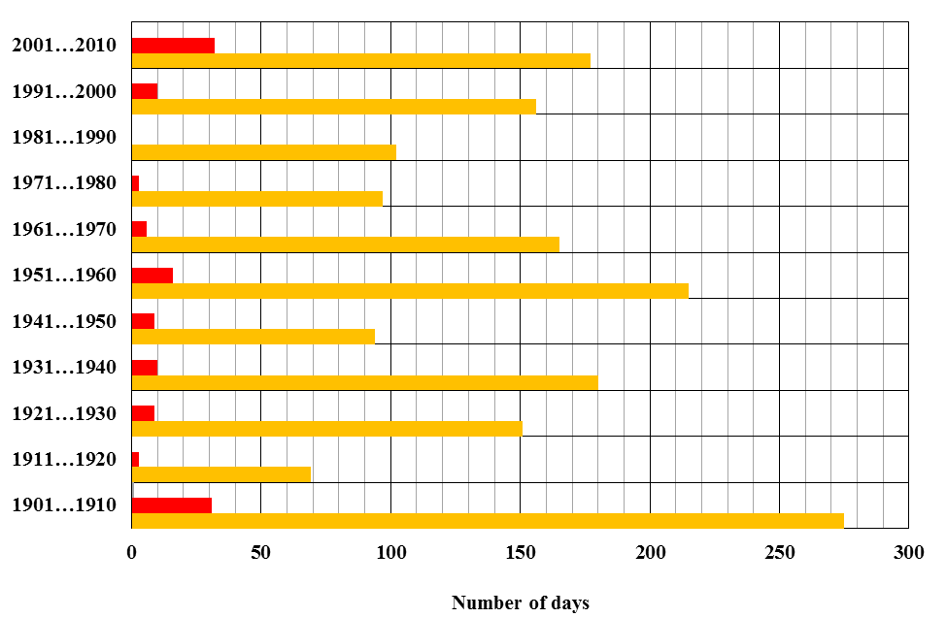
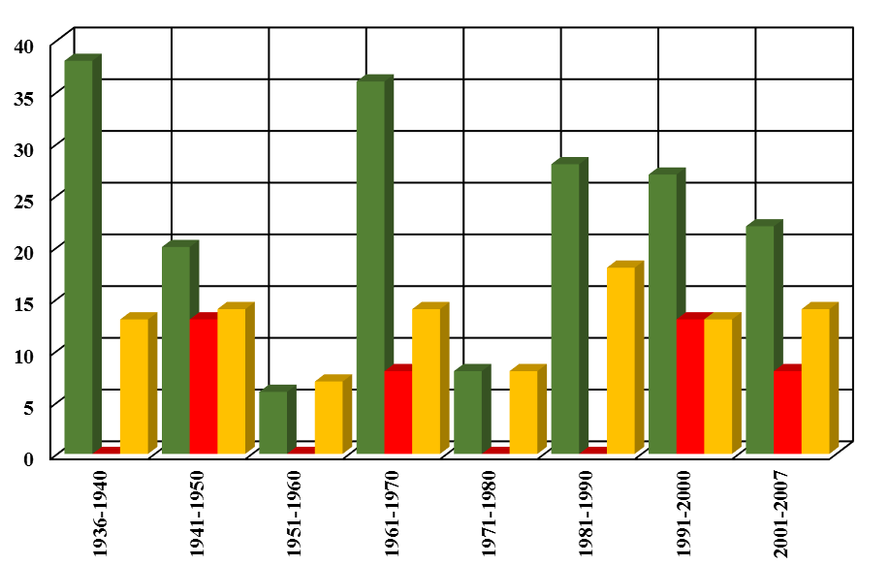
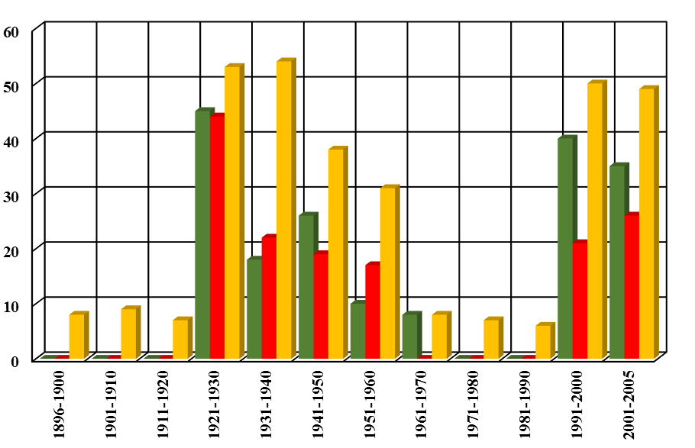
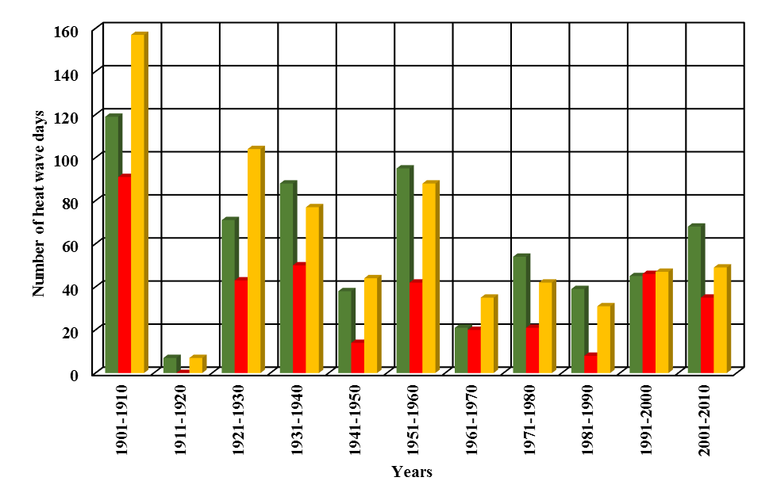
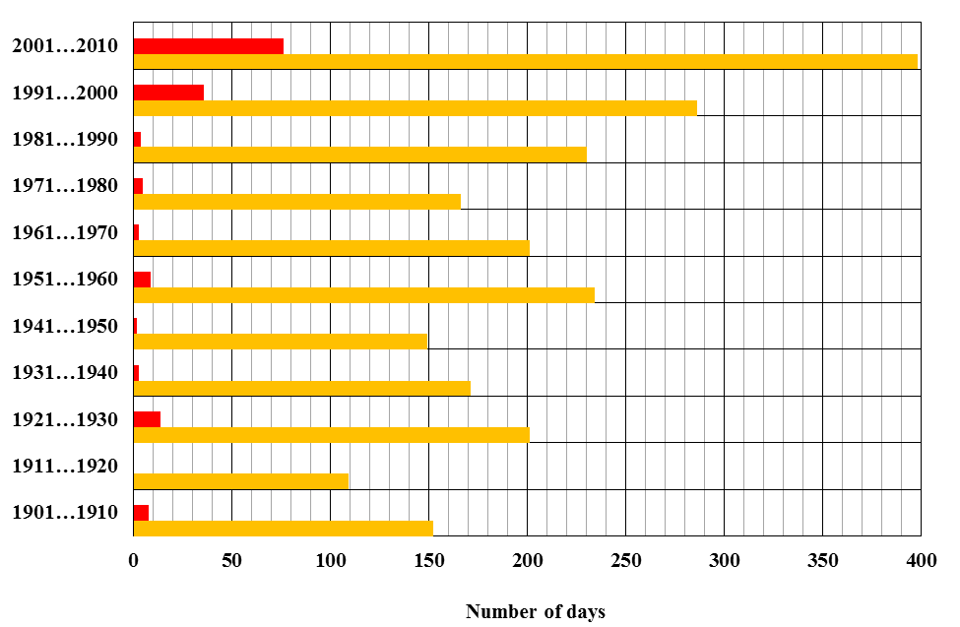
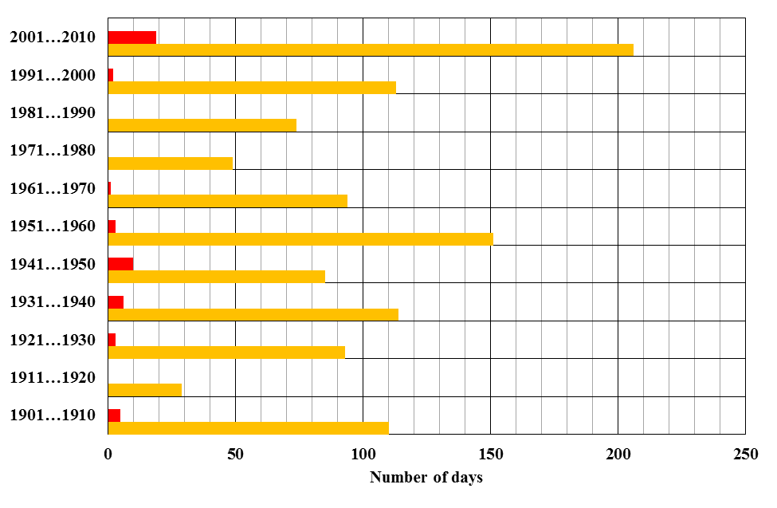
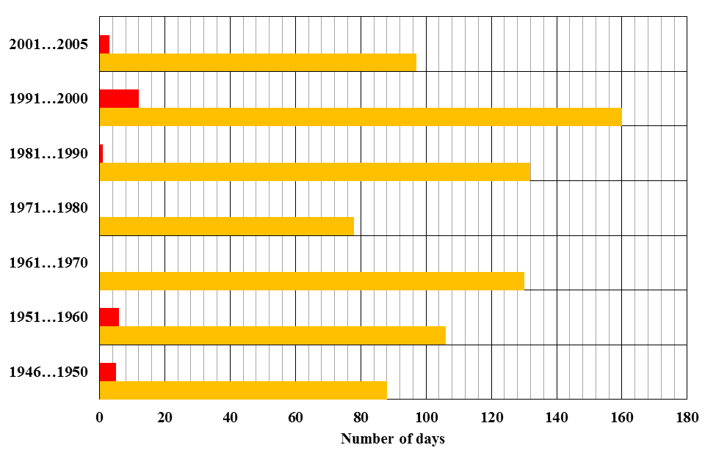
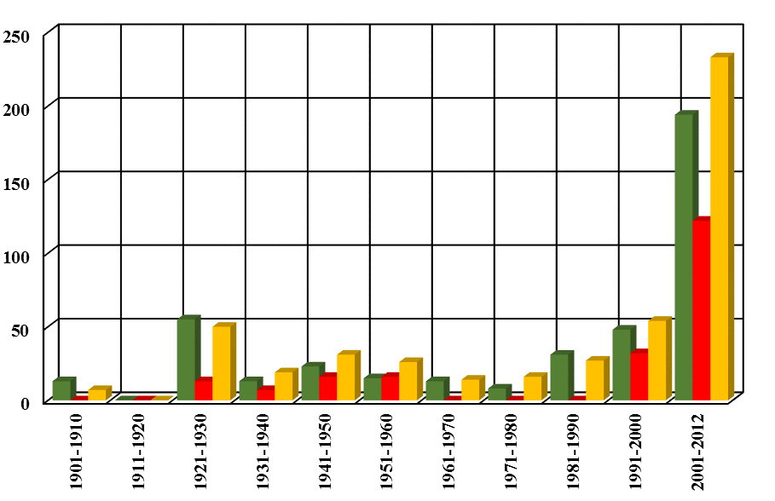
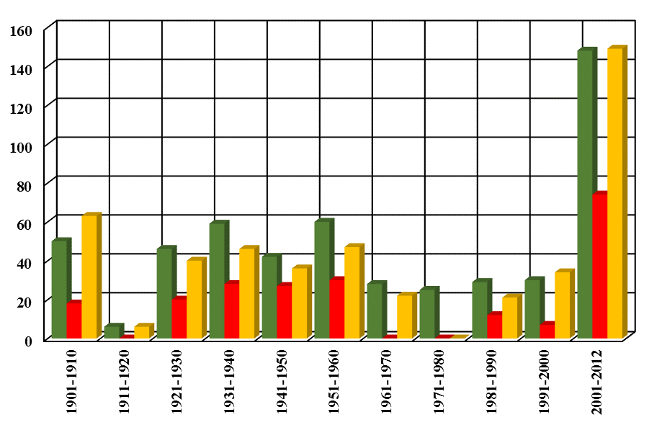
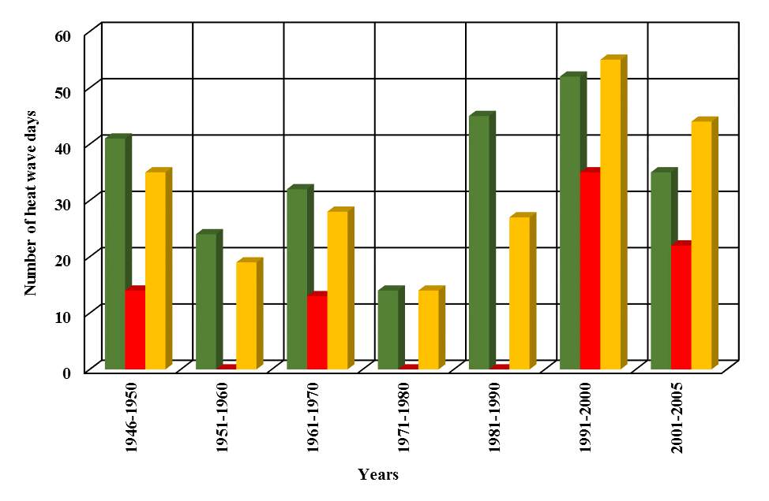
Heat wave event dynamics over the territory of Ukraine in the context of the global climate change
Inna Khomenko, Oleksandr Dereviaha
Odesa State Environmental University, Odesa, Ukraine (innchom@mail.ru, iderevyaga@gmail.com)
Introduction
The association between climate change and the frequency and intensity of extreme heat events is now well established. General circulation models of climate change predict that heatwaves will become more frequent and intense, especially in the higher latitudes, affecting large metropolitan areas that are not well adapted to them. The investigation devoted to determination of temporal and spatial characteristics of heat waves for the Ukraine territory.
May, TX95p
May, TX90p
May, TXA5
Chernivtsi
Kharkiv
Kyiv
Data and methodology
Lviv
Odesa
Poltava
Database contains the mean daily maximum temperature series from 9 meteorological stations of the Ukraine for the warm period, which is defined as a period of 153 days from May 1st to September 30st. For each station the observation period spans different years (see the table below). The data were obtained from http://www.ecad.eu/.
June, TX95p
June, TX90p
June, TXA5
Station | Observation period | Year, for which data are not available
Chernivtsi | 1935-2012 | -
Kharkiv | 1951-1999 | 1994
Kyiv | 1900-2012 | -
Lviv | 1945-2009 | -
Odesa | 1894-2005 | 1907, 1940, 1942, 1943
Poltava | 1900-2012 | 1942, 1943
Simferopol | 1900-2013 | 1942
Uman | 1935-2011 | -
Uzhhorod | 1946-2011 | -
Simferopol
July, TX95p
July, TX90p
July, TXA5
Uman
Uzhhorod
TX90p index
TXA5 index
TX95p index
Stations were selected in accordance with a map of division of the Ukraine territory in five regions for which uniformity of climatic, geographical and economic factors had been taken into account so that each region is represented (see the figure above).
The study was based on the Peaks over Threshold Approach, was applied to study the frequency of heat waves at nine stations of Ukraine using three heat indices. The first heat index is TX90p defined by CCI/CLIVAR. The second index (TX95p) is stated as the first one but 95th percentile was used instead 90th percentile. The last index (TXA5) proposed WMO is calculated as the calendar day average maximum temperature increased by 5°C. Heat waves were determined as period of more than five consecutive days in which daily maximum temperature exceeds one of the indices.
In the study frequency distribution of heat wave events in the planes of “accumulated temperature – heat wave length” and “accumulated temperature – heat wave amplitude” are obtained to determine their intensity.
Frequency of occurrence of heat wave event as a function of
accumulated temperature and amplitude of heat wave.
Vertical axis – amplitude of heat wave. Horizontal axis – accumulated temperature.
This frequency distribution shows that the most heat wave events are concentrated in area with accumulated temperature of 5 to 40°С and heat wave amplitude of 2 to 8°С. The most violent heat waves are observed in Kyiv and Poltava, where in some cases accumulated temperature can reach up to 140 С and amplitude of heat wave can come up 12-14°С. In Lviv and Odesa there are the least intensive heat waves with maximum accumulated temperatures of 43-53°С. The highest accumulated temperatures and amplitudes of heat waves occur for the TX90p and TXA5 indices.
August, TX95p
August, TX90p
August, TXA5
Chernivtsi
Kharkiv
Kyiv
It is known that increment of number of days with maximum temperatures ≥ 30, 35 and 40°C presents vulnerability indicator of metropolitan areas to climate change. For Simferopol, Uman and Kyiv noticeable growth in days with maximum temperatures equal or greater than 30 and 35°C, are obtained in the decade 2001-2010 (2 to 2,7 times for number of days with maximum temperatures ≥ 30°C and 19 to 57 times for number of days with maximum temperatures ≥ 35°C). In Poltava the greatest number of such days was observed in period of 1901-1910, although in comparison with the 1961-1990 climate normals number of days in which the average daily maximum temperature reached 30°C increased 1,5 times and number of days in which ones reached 35°C jumped by more than 10 times. For other stations the data only in the 2001-2005 period are available and the results obtained also show rapid expansion of days with maximum temperature ≥30°C 1,7 (Uzhhorod) to 5,1 (Lviv) times and ≥35°C 18 (Uzhhorod) and 8 (Odesa) times.
September, TX95p
September, TX90p
September, TXA5
Lviv
Odesa
Poltava
Maps of mean monthly indices for climate normal period of 1961 to 1990 for the Ukraine territory
Simferopol
Uman
Uzhhorod
Maps of mean monthly indices for climate normal period of 1961 to 1990 for the Ukraine territory
Chernivtsi
Kharkiv
Kyiv
Chernivtsi
Kharkiv
Kyiv
In comparison with the climate normal 1961-1990 period for all stations in question number of heat wave days is growing. However, the most increment of number days of heat wave days in the period of 2001-2010 are observed in Odesa located on the seashore and Simferopol situated on the Crimean Peninsula. Number of heat wave days increased 8,2 (Simferopol) to 36,2(Odesa) times according to the TXA5 index and 8,3 (Simferopol) to 14,0 (Odesa) times according to the TX90p index. In the climate normal period in these cities there was no heat wave according to the TX95p index, but in the beginning of the XXI century such heat waves occurred.
Other stations where very fast increment of number of heat wave days are observed are Kyiv (3,6 to 25,5 times) and Uman (4,1 to 13,8 times). For all cities the greatest growth in number of heat wave days took place according to the TX90p index. Odesa city excepted, least growth in number of heat wave days are observed for the TXA5 index.
TX90p index
TXA5 index
TX95p index
Frequency of occurrence of heat wave event as a function of
accumulated temperature and duration of heat wave.
Vertical axis – duration of heat wave. Horizontal axis – accumulated temperature.
Lviv
Odesa
Poltava
This frequency distribution shows that the most heat wave events are concentrated in area with accumulated temperature of 5 to 40°С and heat wave duration of 6 to 10 days. The longest heat waves take place in Poltava (up to 27 days for the TXA5 and TX90p indices) and Simferopol (up to 22 days for the TX90p indices) and the shortest ones occur in Lviv (9-10 days for the TXA5 index). The longest heat wave for the TX95p index (23 days) was observed in Poltava.
Lviv
Odesa
Poltava
Simferopol
Uman
Uzhhorod
The maps of mean monthly indices for the 1961-1990 period over the Ukraine show that there is decrease in indices from the east to the west in May and June and from southeast to northwest in July and August. In September all of indices are reduced from the southern to the northern parts of the Ukraine. The highest values correspond to the TX95p index and the lowest ones correspond to TXA5.
Simferopol
Uman
Uzhhorod
Conclusions and further development
The most vulnerable to the climate change the north, central and southern part of the Ukraine are. Mean monthly index fields show that all of indices decrease from the east to west from May to August and from the south to north in September. The results obtained can be used for heat wave hazard classification of the Ukraine territory
Days with mean daily maximum temperature ≥ 30°C
Days with mean daily maximum temperature ≥ 35°C
Days with mean daily maximum temperature ≥ 40°C
TX90p index
TXA5 index
TX95p index
Number of days with mean daily maximum temperature ≥ 30, 35 and 40°C. Vertical axis – years. Horizontal axis – number of days.
Number of days with heat waves defined by three indices vs year.
Vertical axis – number of days. Horizontal axis – years.

