Slide 1
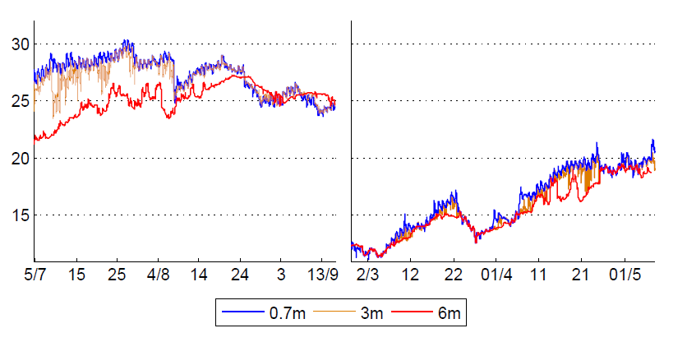
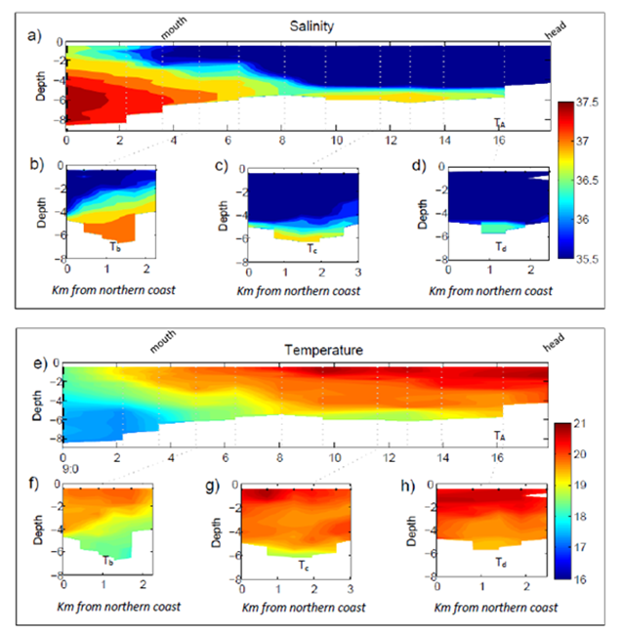
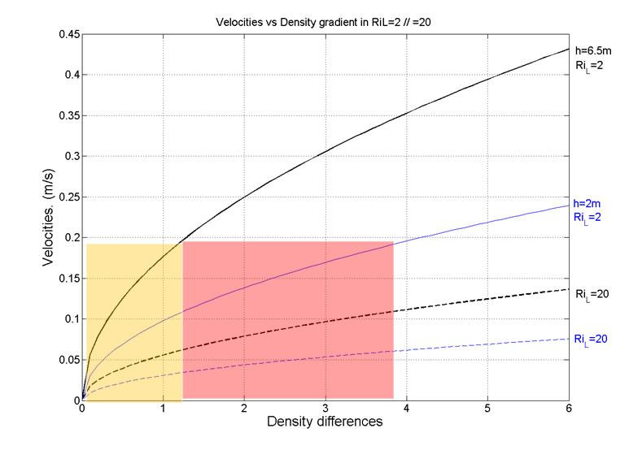
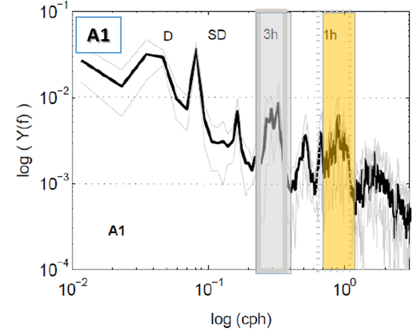
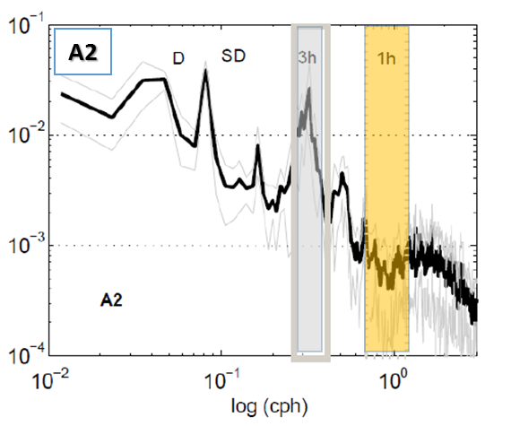
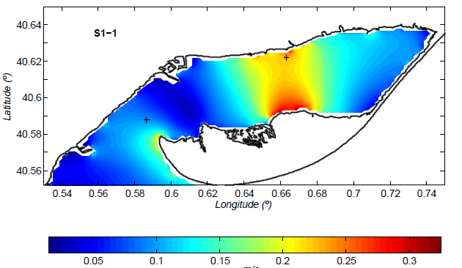
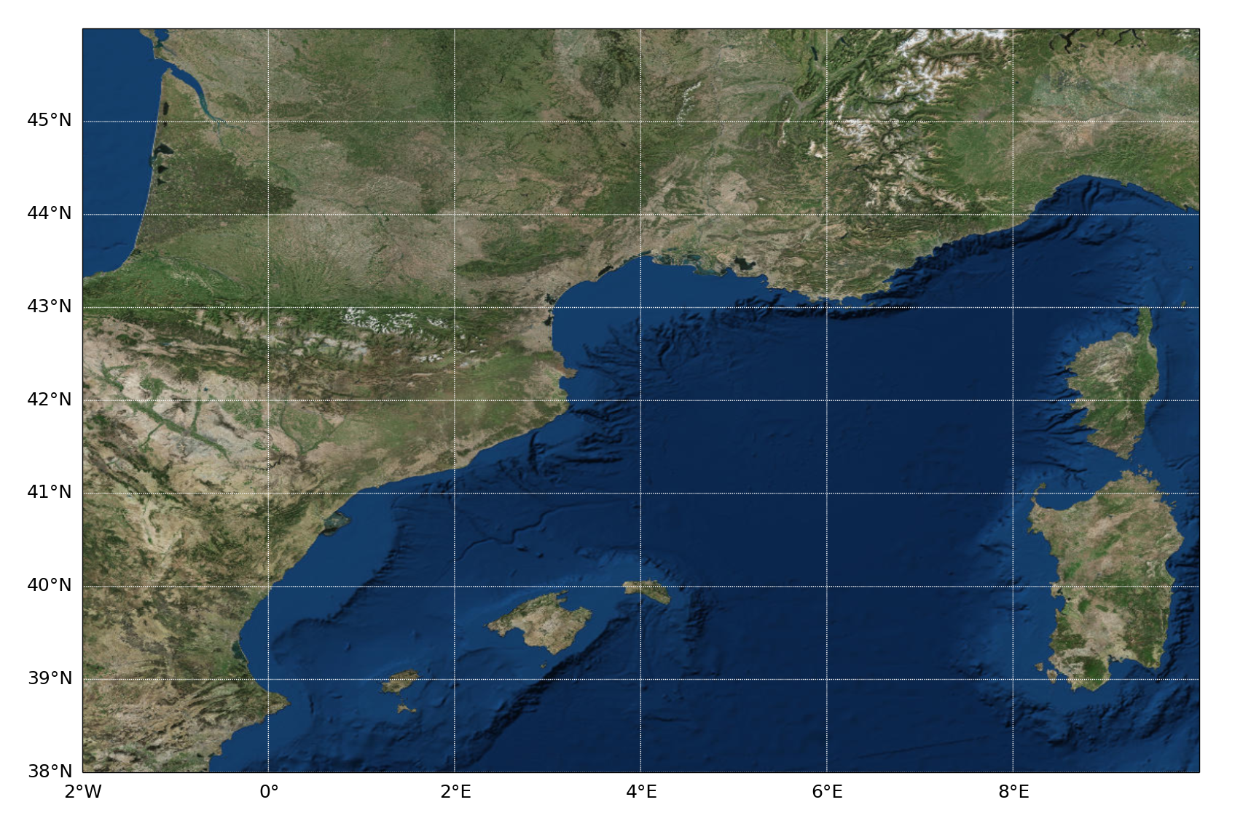
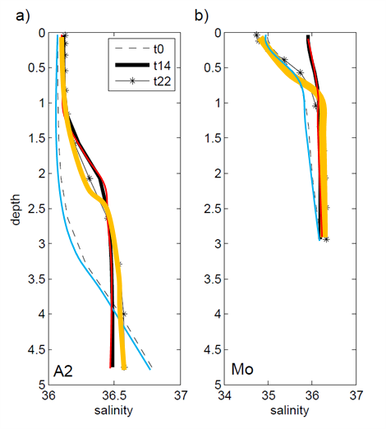
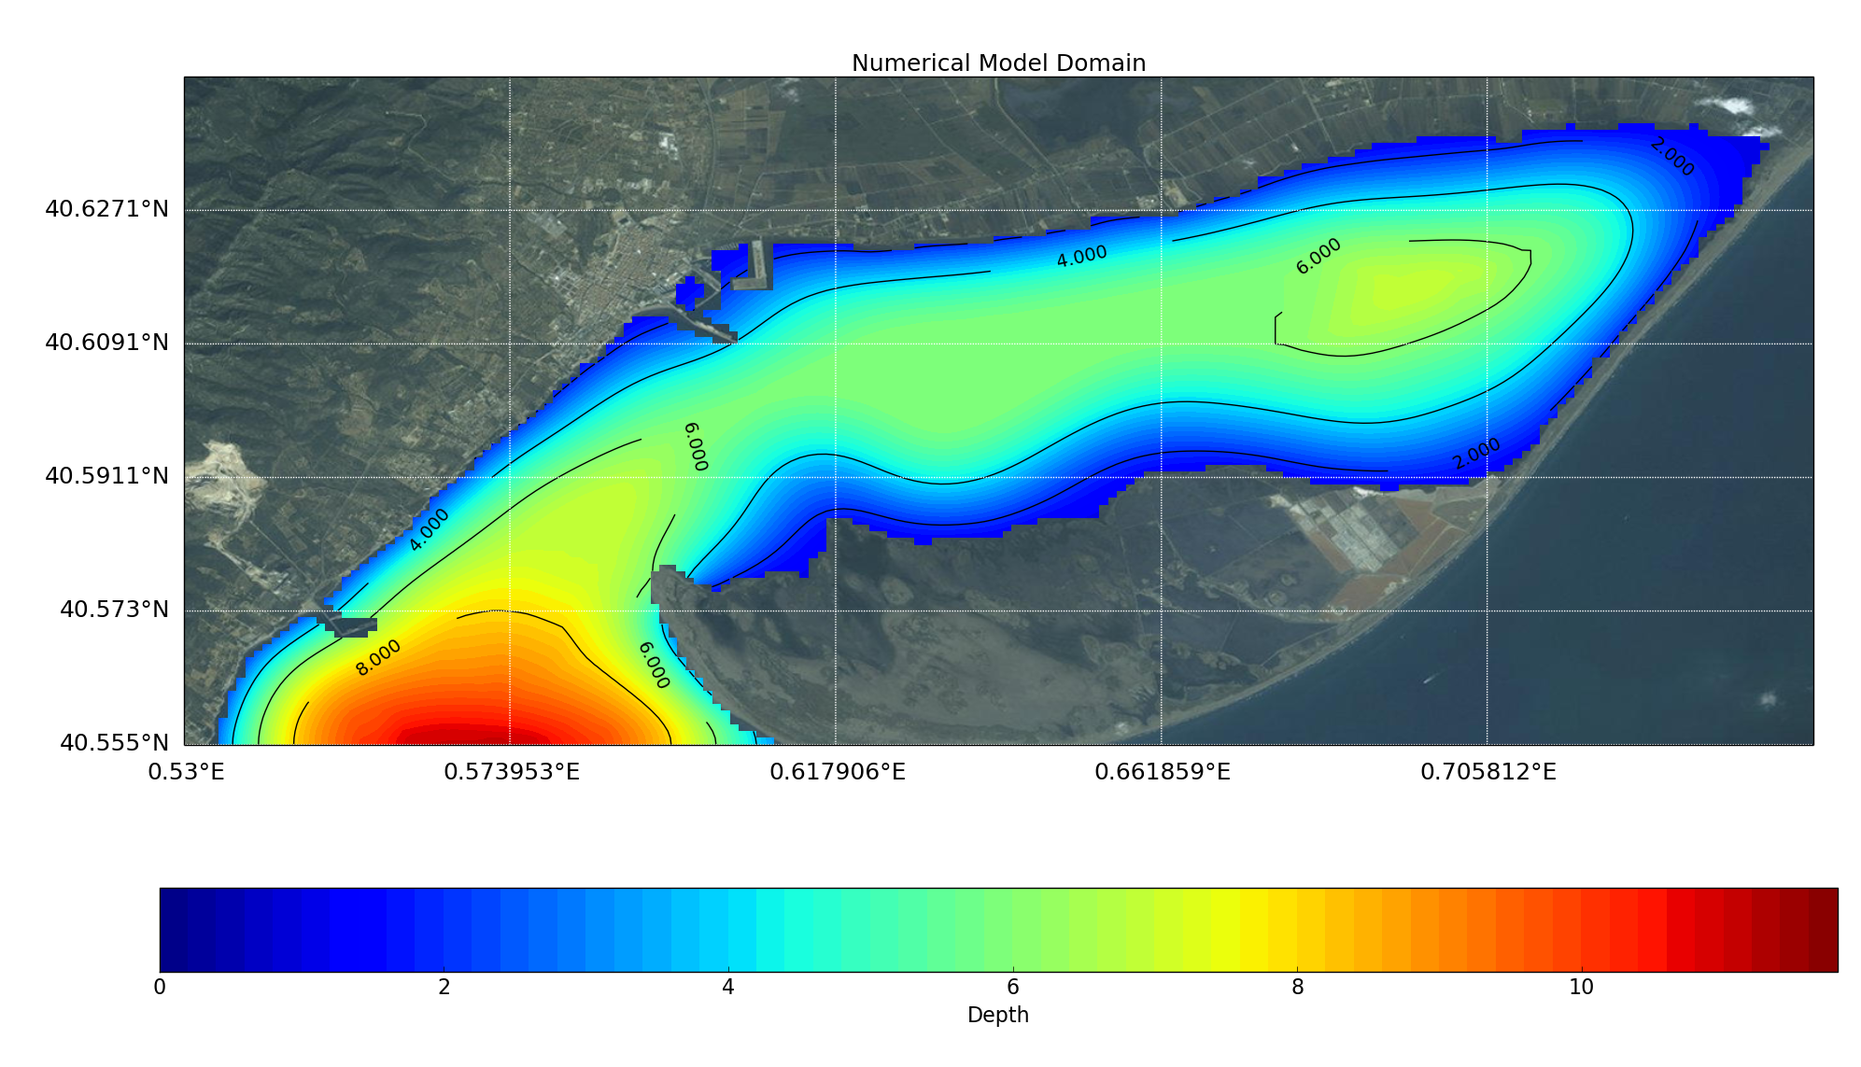
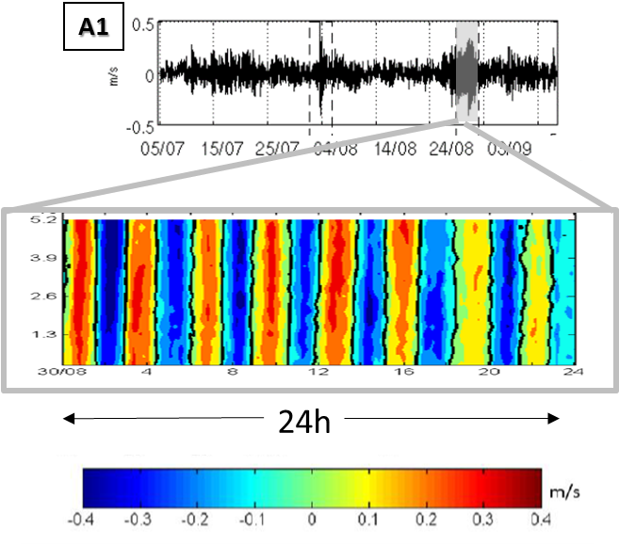
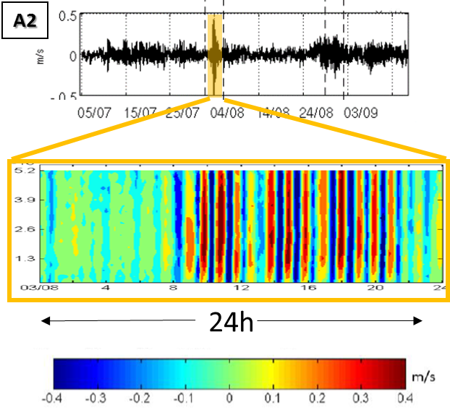
Hydrodynamic response in a microtidal and shallow bay under wind and seiche episodes (Alfacs Bay)
Pablo Cerralbo, Manel Grifoll, Manuel Espino
Maritime Engineering Laboratory (LIM), Technical University of Catalonia (UPC-BarcelonaTech), Barcelona, Spain
Contact e-mail: pablo.cerralbo@upc.edu
Abstract
Seiche (S1-1)
winds
winds
a)
winds
b)
In this contribution we investigate the hydrodynamic response in Alfacs Bay (semi-enclosed bay in The Ebro Delta, NW Mediterranean Sea) (Fig.1). The bay is micro-tidal, with a mixed tidal regime, with a persistent T/S structure during most of the year (Fig.2) showing a salty layer in the bottom and freshwater layer on top due to freshwater input from rice fields ^{[1]}. Short-term response to energetic wind events was found in the hydrography and water velocity observations, sometimes inverting the estuarine circulation or developing one-layered flow. In comparison to previous investigations in Alfacs Bay, we observed that water current variability, and also maximum velocities, were directly related to the development of surface standing waves (i.e. seiches in Fig.3)^{[2]}. Mixing mechanisms versus buoyancy sources are studied through adimensional numbers (Fig.5), potential energy anomaly equation and numerical modeling (ROMS ^{[3]}, Fig.6), proving the leading freshwater contribution to stratification, enhanced by heat fluxes in summer. On the other hand, mixing is directly related to winds, mainly in winter and early spring when both buoyancy forces are lower. Seiche induced mixing is suggested as an eventual mechanism that may break the stratification within the Bay under special circumstances ^{[4]} (Fig.6).
2. Density structure (Temperature and Salinity)
4 . Mixing Events
Transects T_{a} T_{b}, T_{c} and T_{d} for both salinity (upper panel) and temperature (lower panel) during May 2014. Dotted vertical lines indicates the location of each CTD profile. Contour interval is 0.2 for all the images. Temperature is in ºC and salinity in PSU. Location of each transects is shown in Fig.1 (Location and Numerical Domain).
This Figure shows the typical estuarine structure in Alfacs Bay, with water on the surface layers (freshwater inputs from rice-fields drainage system during April-December) and saltier water entering into the bay at the deeper layers.
Panels a and b shows temperature evolution of CTs sensors in A2 for both summer (a) and spring (b). Energetic events are marked by colored boxes: orange for seiche and blue for wind episodes.
5 . Adimensional Numbers
Richardson Layered Number indicates the threshold between mixing and well stratified conditions:
Ri_{L}<2 → Well mixed (bottom friction dominates)
Ri_{L}>20 → Stable stratification.
Seiche 1h (S1-1)
3. Seiches (Sea Level and currents)
6 . Model Test Cases (ROMS)
1. Location and Numerical Domain
Sea Level
a)
b)
45ºN
43ºN
c1)
c2)
Latitude
Numerical domain of Alfacs Bay and corresponding bathymetry. Contour lines at 2, 4, 6 and 8m depth. A1 and A2 indicates the location of the ADCP moorings. Dashed line indicates the CTD transects (T_{A}, T_{B}, T_{C}, T_{d}) shown in panel 2.
41ºN
Power Spectra of sea level records at A1 and A2 . Grey thin line for standard deviation. D and SD show diurnal and semidiurnal frequencies. Light grey boxes show most noticeable frequencies detected on 3h, and light orange for 1h frequencies. These frequencies corresponds to fundamental (~3h) and first mode (~1h) of seiches in Alfacs Bay.
m/s
39ºN
Image a shows modelled depth-averaged currents corresponding to S1-1 event (seiche ~1h) in ms⁻¹.
Images b-c shows the numerical experiment reproducing S1-1 event. Image b for current velocity at A2 location. Image c1 shows the evolution of salinity profiles at A2, and c2 closer to the coast (shallow water)
0º
2ºE
4ºE
6ºE
8ºE
Time-series analysis allowed to identify the most energetic seiche events:
Seiche 1h (S1-1)
Longitude
40.63ºN
A2
TA
40.61ºN
Tc
ACKNOWLEDGMENTS
40.59ºN
Td
Alongshore currents
The campaigns were carried out thanks to the MESTRAL (CTM2011-30489-C02-01). The authors also acknowledge the economical funding and support received from the MINECO and FEDER who founded the Plan-Wave (CTM2013-45141-R) and Rises-AM (contract GA603396, founded by European Community's Seventh Framework programme) projects. We also want to thank to Secretaria d'Universitats i Recerca del Dpt. d'Economia i Coneixement de la Generalitat de Catalunya (Ref 2014SGR1253) who support our research group.
A1
Mab( m)
40.57ºN
Tb
REFERENCES
40.55ºN
0.57ºE
0.62ºE
0.66ºE
0.70ºE
[1] Llebot, C., Rueda, F.J., Solé, J., Artigas, M.L., Estrada, M., 2013. Hydrodynamic states in a wind-driven microtidal estuary (Alfacs Bay). J. Sea Res. doi:10.1016/j.seares.2013.05.010
0.53ºE
[2] Cerralbo, P., Grifoll, M., Valle-Levinson, A., Espino, M., 2014. Tidal transformation and resonance in a short, microtidal Mediterranean estuary (Alfacs Bay in Ebre delta). Estuar. Coast. Shelf Sci. 145, 57–68. doi:10.1016/j.ecss.2014.04.020
Top Images for depth-averaged alongshore currents in A1 (left) and A2 (right) locations. Bottom images shows the vertical variability of the alongshore currents during 3h seiche in A1 (left) and during 1h seiche in A2 (right.)
[3] Shchepetkin, A. F., and McWilliams, J. C. 2005. The regional oceanic modeling system (ROMS): a split-explicit, free-surface, topography-following-coordinate oceanic model. Ocean Model, 9(4), 347–404.
0
2
4
6
8
12
Depth (m)
[4] Cerralbo, P., Grifoll, M., Espino, M., 2015. Hydrodynamic response in a microtidal and shallow bay under energetic wind and seiche episodes. J. Mar. Syst. 149, 1–13. doi:10.1016/j.jmarsys.2015.04.003

