Slide 1


Temperature dependence of hydraulic properties of Upper Rhine Graben rocks at conditions modelling deep geothermal reservoirs
M. Hernández¹, J. Renner¹ and T. Mueller^{1,2}
¹Ruhr-Universität Bochum (mariela.hernandezcastaneda@rub.de), ²now at University of Leeds
1.
Overview
2. Methodology
3. Experimental
conditions
4.
Results
PICO Navigation
5.
Conclusions
6.
Outlook
7.
References
‘Home’
button brings you to
the section menu
The left/right arrows
take you to the
next page

Slide 2
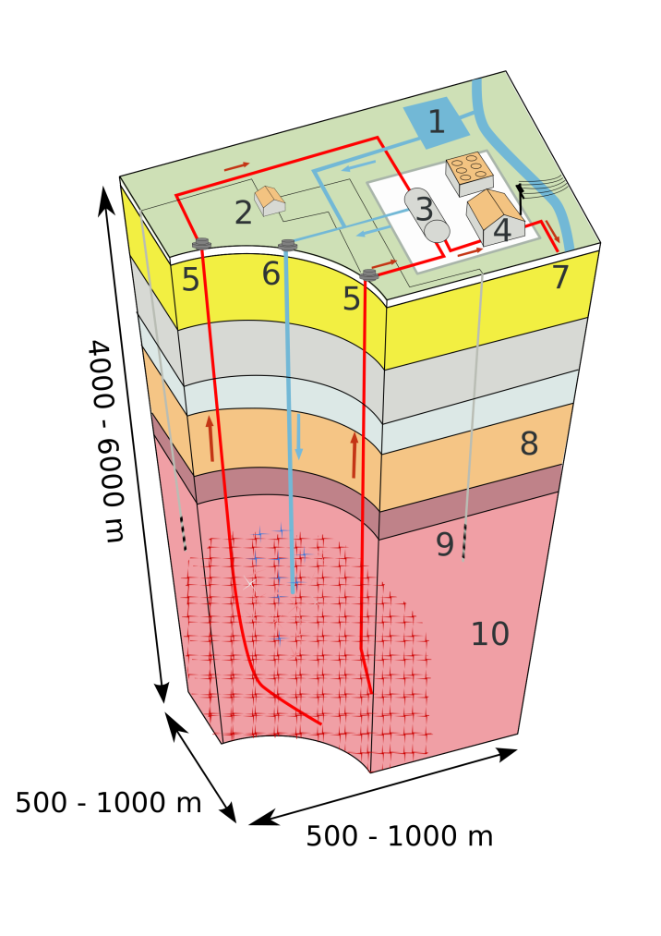
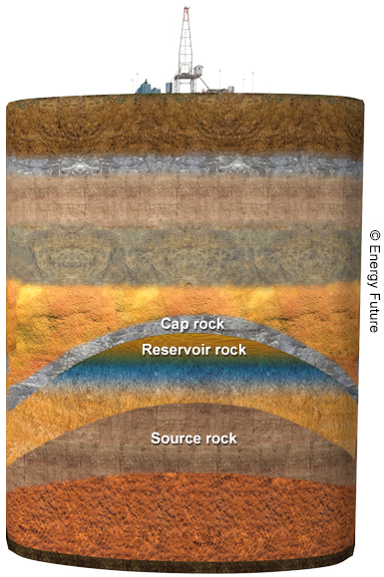
Hydraulic properties of Rocks
Rocks are characterized by two hydraulics properties: the capacity for storing a fluid and the ability of transmitting it.
Hydraulic properties of reservoir rocks critically affect the operation and long term sustainability of geothermal and petroleum reservoirs.
Geothermal
reservoir
1. Overview
https://en.wikipedia.org/wiki/Enhanced_geothermal_system
Aim
Study the evolution of permeability k and specific storage capacity s as a function of pressure P, temperature T and time t
Petroleum
reservoir

Slide 3
Hydraulic properties of Rocks
Rocks are characterized by two hydraulics properties: the capacity for storing a fluid and the ability of transmitting it.
Hydraulic properties of reservoir rocks critically affect the operation and long term sustainability of geothermal and petroleum reservoirs.
Geothermal
reservoir
1. Overview
https://en.wikipedia.org/wiki/Enhanced_geothermal_system
Aim
Study the evolution of permeability k and specific storage capacity s as a function of pressure P, temperature T and time t
Petroleum
reservoir

Slide 4
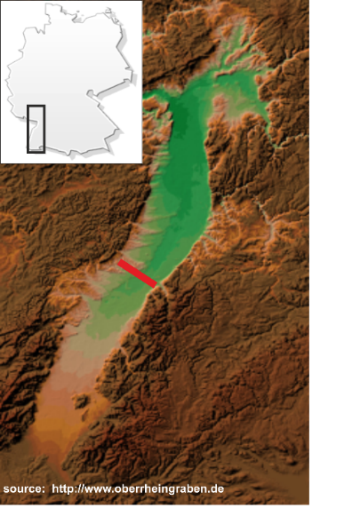
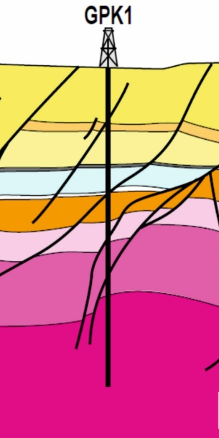
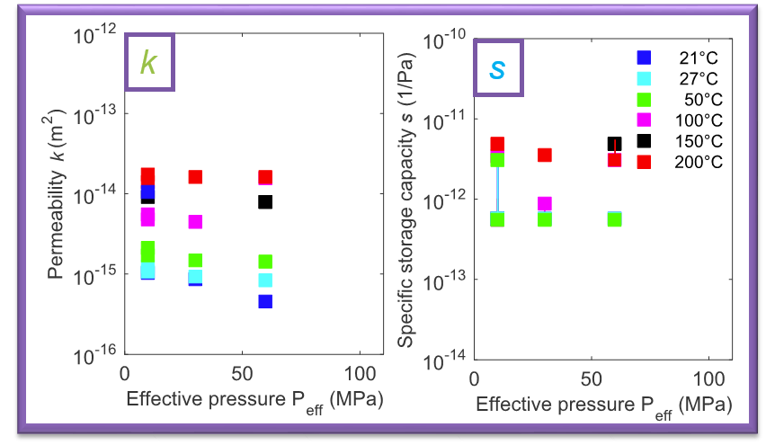
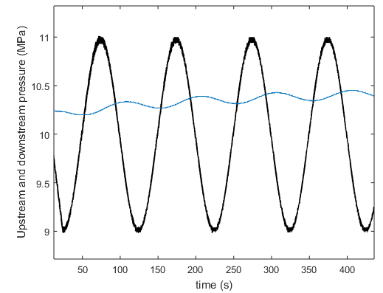
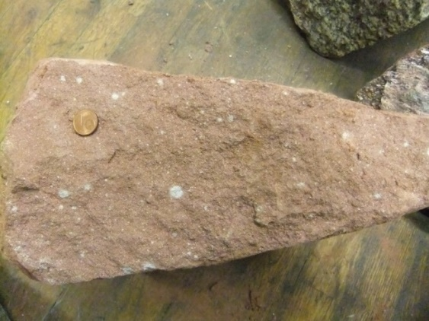
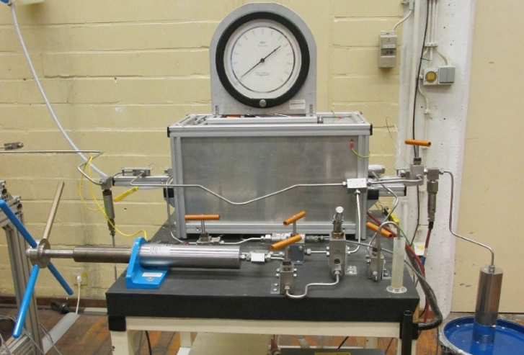
Location
1. Overview
Osc. P_{p}. test
Samples
k
s
s
k
Experiments
Ruhr-Universität Bochum

Slide 5
Location
1. Overview
Osc. P_{p}. test
Samples
Experiments
Ruhr-Universität Bochum

Slide 6

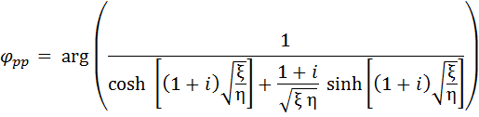
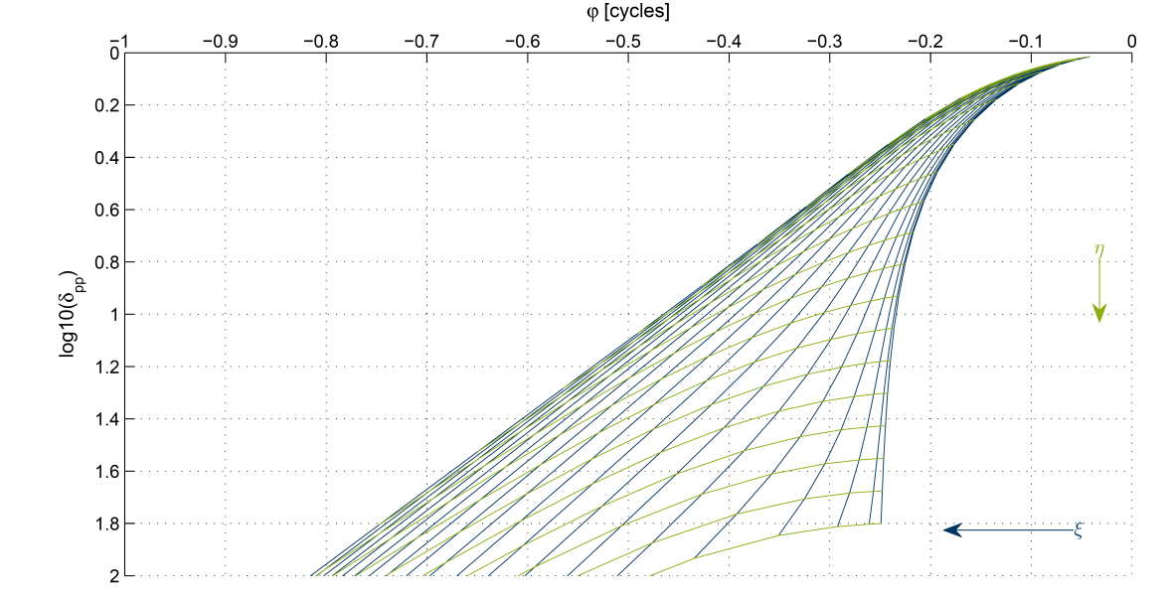
Oscillatory pore pressure method
2. Methodology
Bernabe, et al. (2006)
Permits determination of k and s
Continuous records vs. time
Minimization of fluid flowing through sample
Characterization of long term behavior of rocks with fractures regarding their (micro)structure (e.g., porosity, roughness)
Ruhr-Universität Bochum

Slide 7
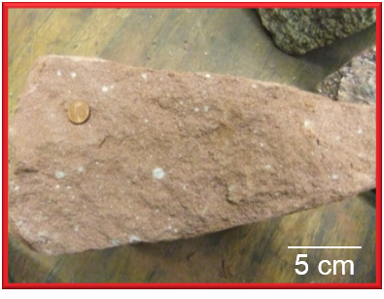
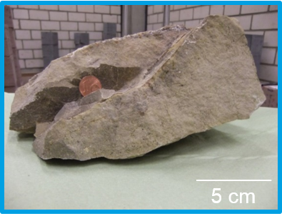
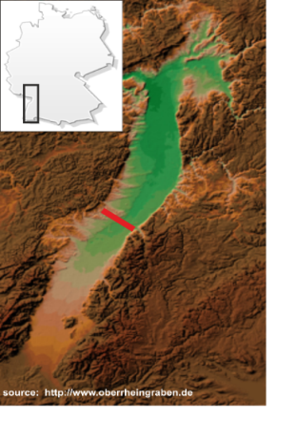
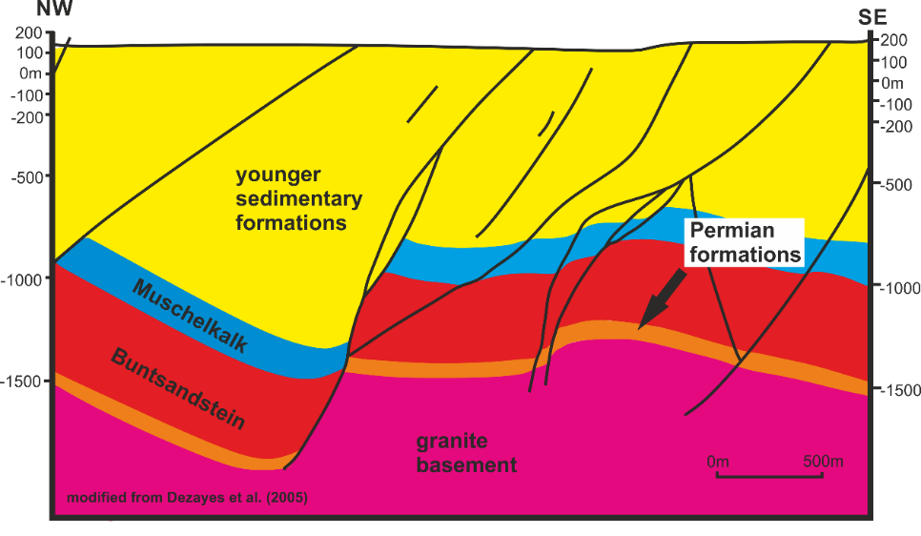

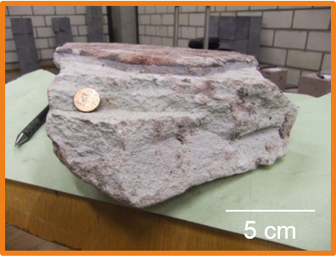
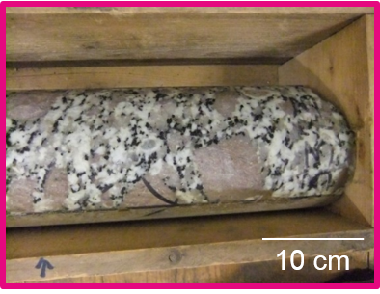
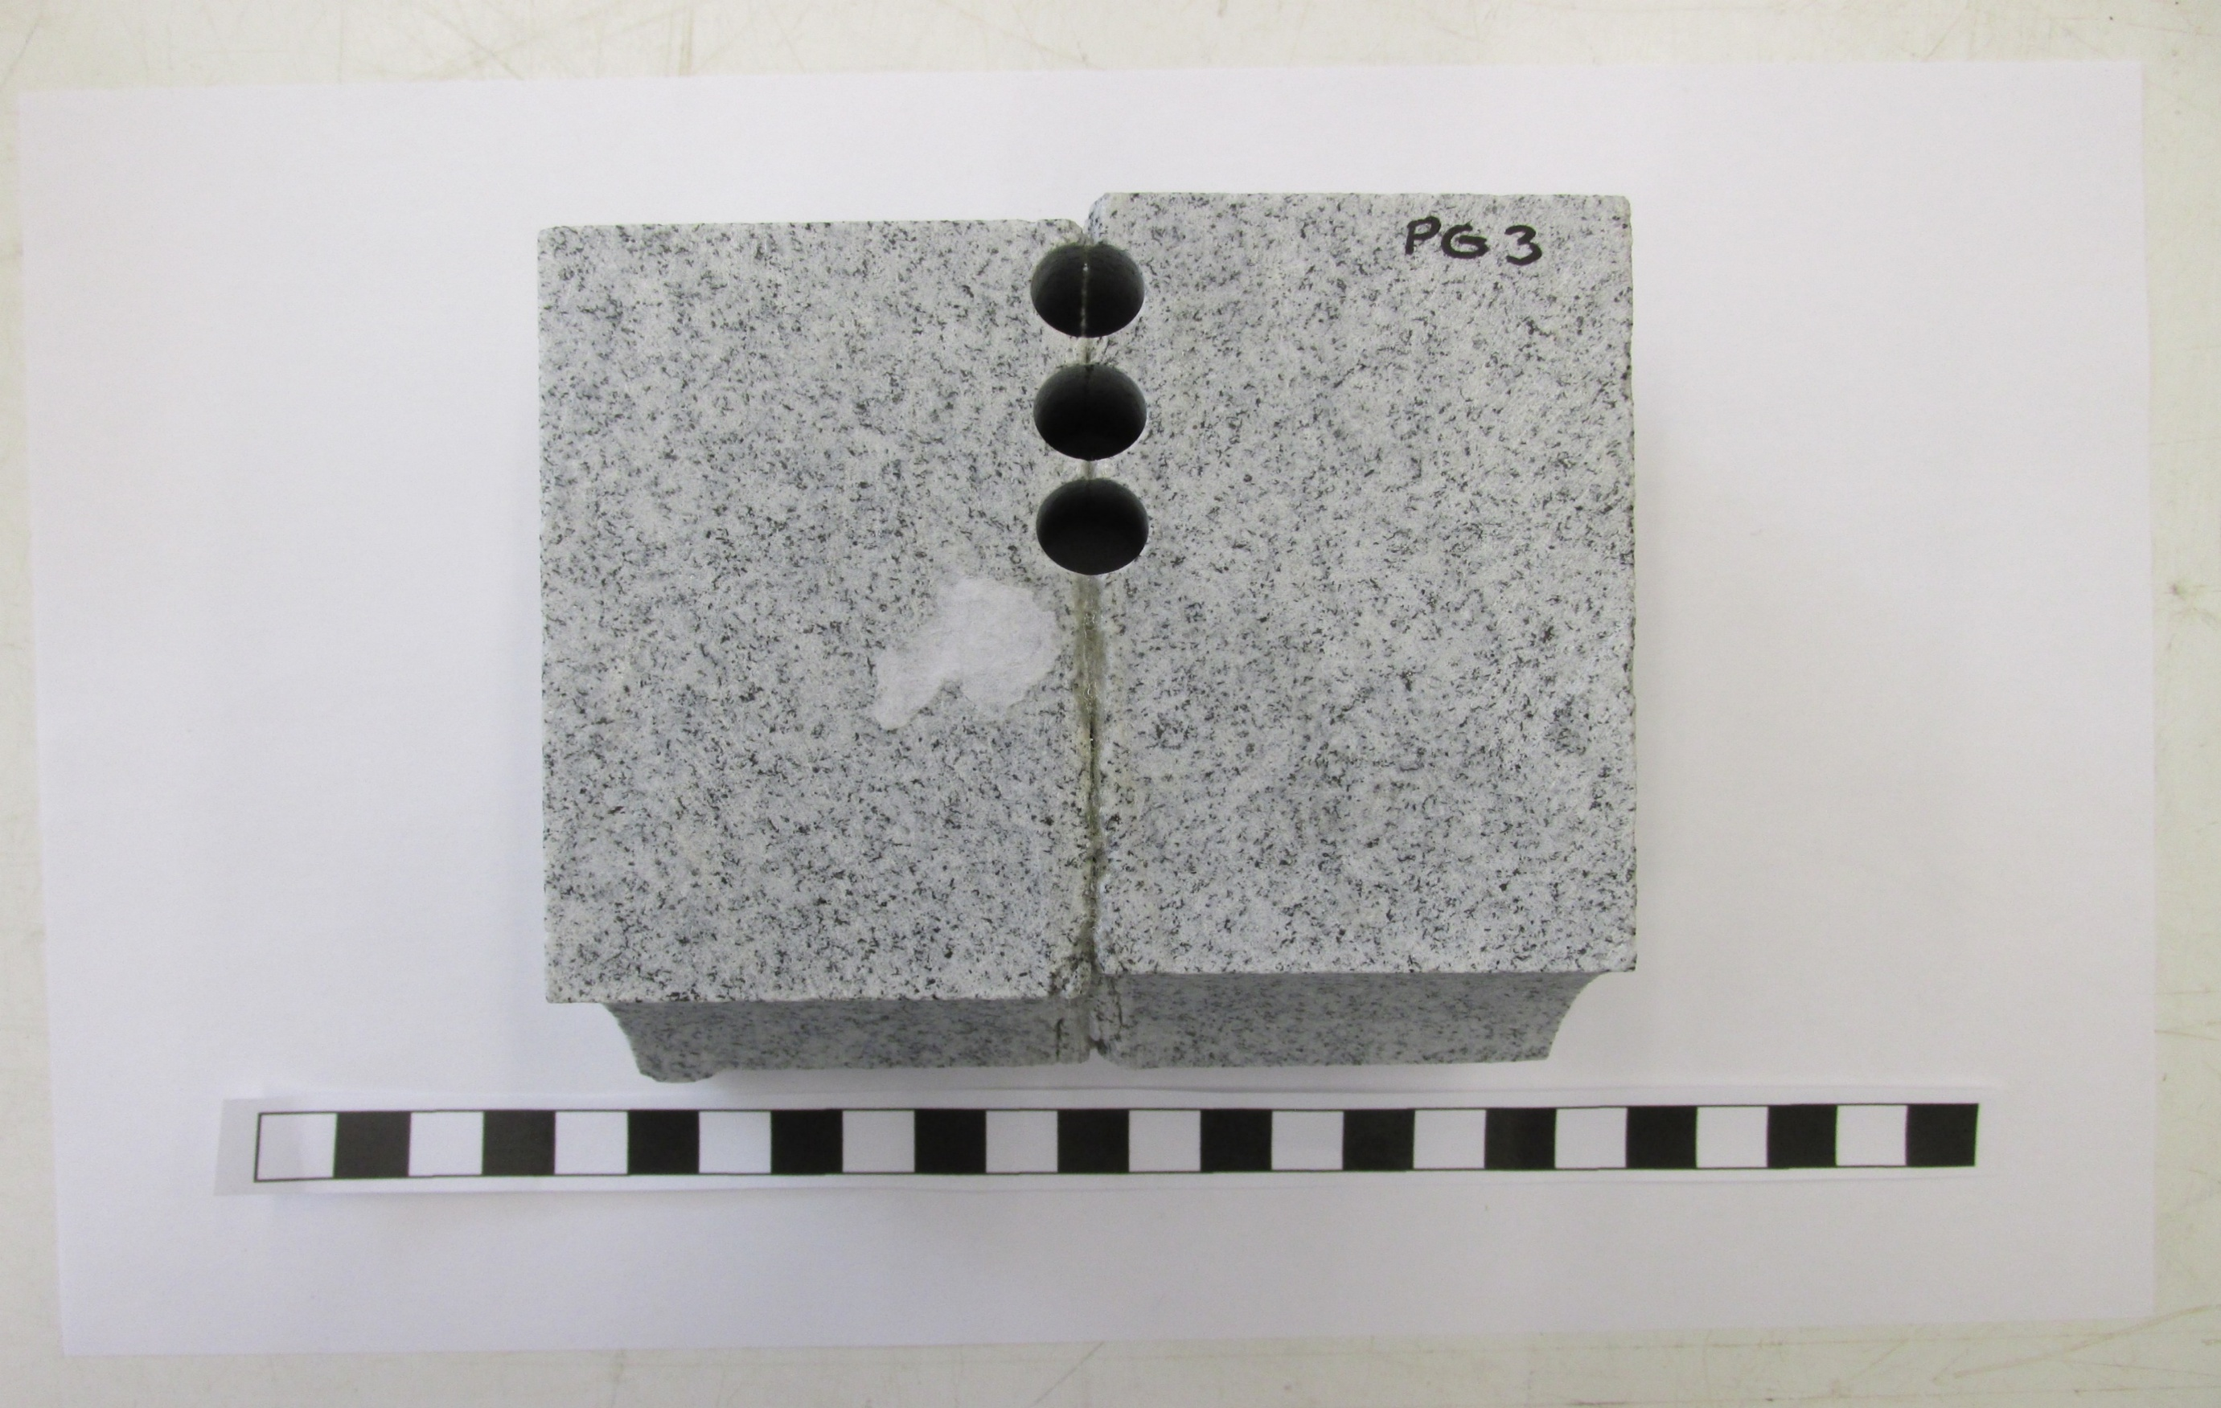
Outcrop samples, geological setting: Upper Rhine Graben
Sandstone
(Buntsandstein)
Limestone
(Muschelkalk)
Location
2. Methodology
Volcanic Ash
(Permian)
Granite
(HDR reservoir)
Padang Granite
(China)
Ruhr-Universität Bochum

Slide 8
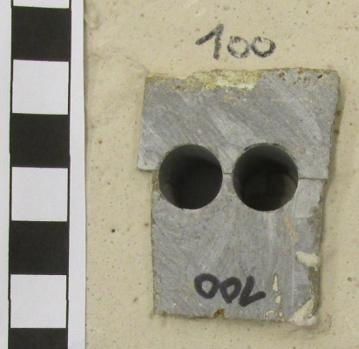
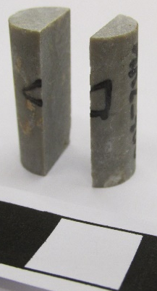
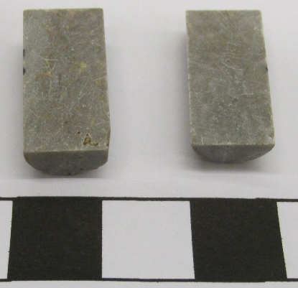
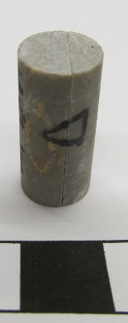

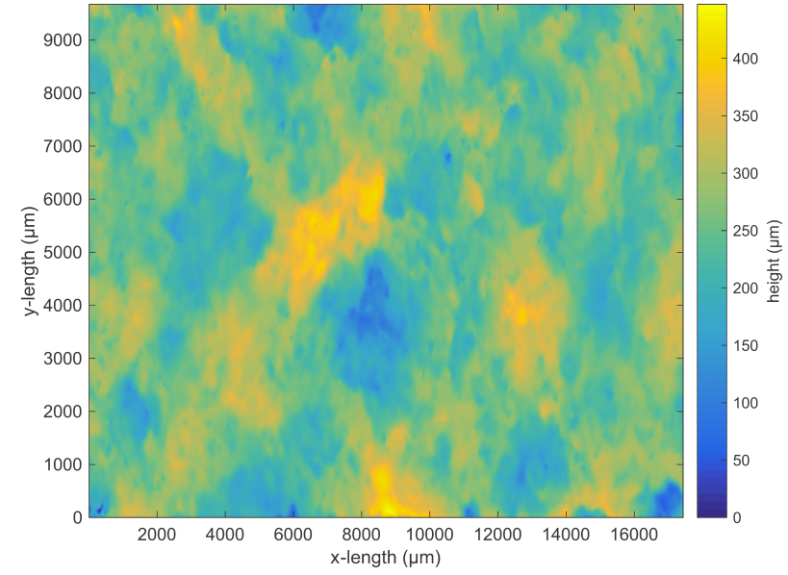
Roughness aproach: Artificially “fractured” samples
Blocks
Cores
Digital microscope (Keyence VHX 2000)
100, 600, 1200 grit
Scan before/after
experiments
2. Methodology
10 x 20 mm
(-)
(+)
Polishing level
Apply FFT
Surface
topography
data
Ruhr-Universität Bochum

Slide 9


Roughness aproach
2. Methodology
(close)

Slide 10
Roughness aproach
2. Methodology
(close)
Ruhr-Universität Bochum

Slide 11
Analysis of fracture properties
Hydraulic width (w_{hyd})
From the cubic law (Witherspoon, et al. 1980)
where k_{F} is the hydraulic permeability of a fracture and w_{hyd} its hydraulic width/aperture
Permeability modulus (K_{k})
Pressure-dependent parameter that express relative changes in permeability due to changes in fluid pressure (Renner & Steeb, 2015)
2. Methodology
where is permeability compliance
Normal Stiffness of a fracture (N_{F,hyd})
Fracture geometry is sensitive to pressure. An increase in efective pressure prominently changes average aperture. The resistance to normal displacement is typically expressed by e.g., normal stiffness (Renner & Steeb, 2015)
Ruhr-Universität Bochum

Slide 12
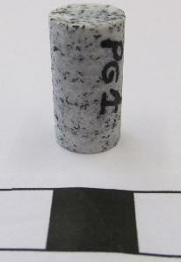

Long term experiments
Conditions
P_{confining} = 20 - 110 MPa
P_{pore} = 10 MPa
T = 20-200 °C
t = 24-120 h (plan: up to 700h)
Constant fluid composition
Intact/fractured rock cores
Sample preparation
Rock cores (Ø = 10 mm, l = 20 mm)
Intact samples (e.g. Padang granite)
3. Experimental Conditions
Fractured samples (e.g. limestone)
Ruhr-Universität Bochum

Slide 13
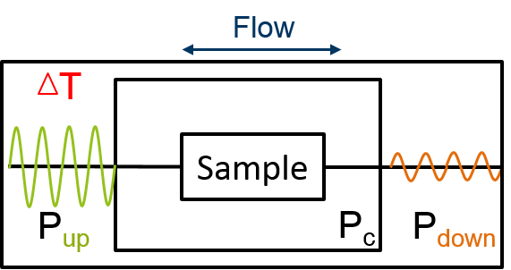
Long term experiments
Conditions
P_{confining} = 20 - 110 MPa
P_{pore} = 10 MPa
T = 20-200 °C
t = 24-120 h (plan: up to 700h)
Constant fluid composition
Intact/fractured rock cores
Sample preparation
Rock cores (Ø = 10 mm, l = 20 mm)
Intact samples (e.g. Padang granite)
3. Experimental Conditions
Fractured samples (e.g. limestone)

Slide 14
Hydraulic properties: Intact samples
Sandstone
k
s
s
k
4. Results
φ_{app}
D
D
Ruhr-Universität Bochum
Notes:
PG1_D,

Slide 15
Hydraulic properties: Intact samples
Limestone
s
D
k
4. Results
Granite
s
D
k
Ruhr-Universität Bochum
Notes:
PG1_D,

Slide 16
Fractured Granite: different grades of roughness
100 grit
600 grit
1200 grit
k
k
k
k
4. Results
100 grit
600 grit
1200 grit
s
s
s
s
Ruhr-Universität Bochum
Notes:
PG1_A_Fr 100, 600, Polisched. MK2_A_Fr 100, 600, 1200

Slide 17
Fractured Limestone: different grades of roughness
100 grit
600 grit
1200 grit
k
k
k
k
4. Results
100 grit
600 grit
1200 grit
s
s
s
s
Ruhr-Universität Bochum

Slide 18
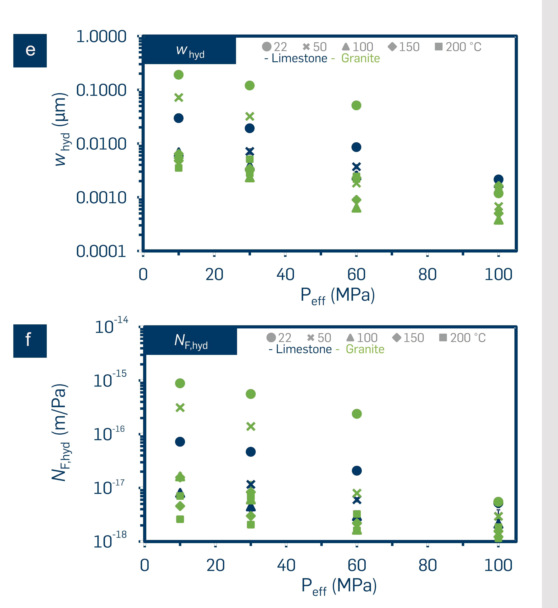
Calculated fracture properties
Hydraulic width (w_{hyd})
4. Results
Ruhr-Universität Bochum

Slide 19
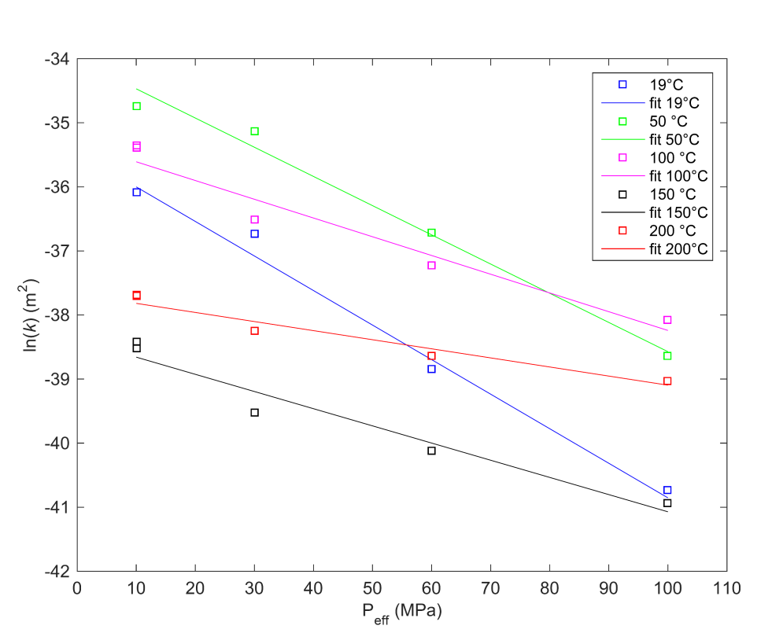
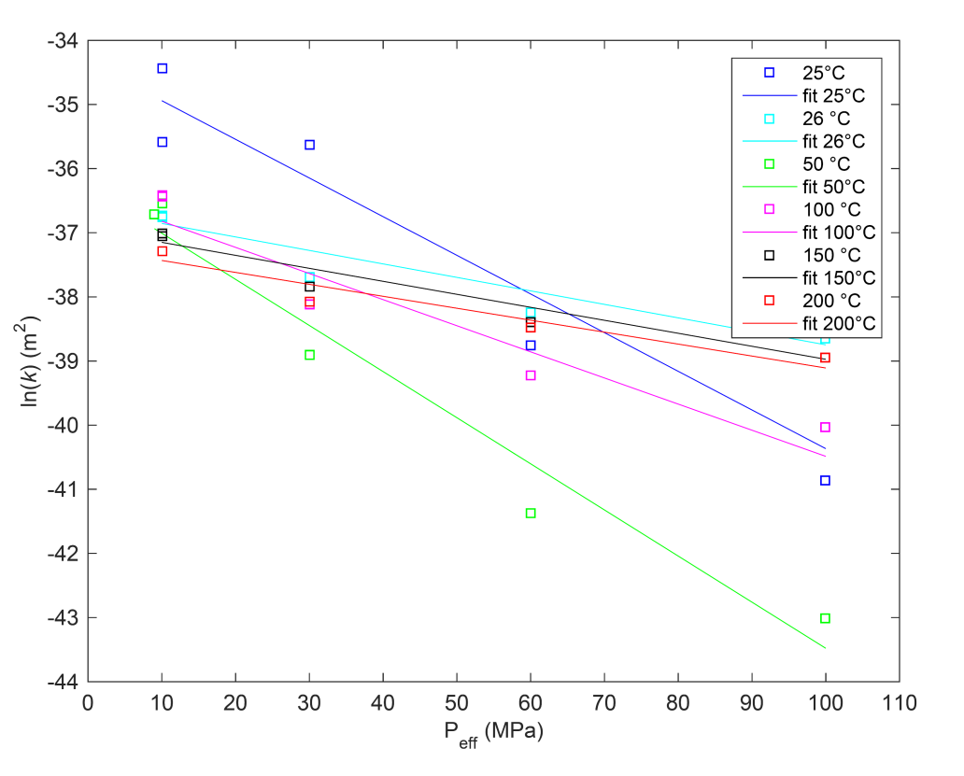
Calculated fracture properties
Permeability modulus (K_{K})
Fractured Granite (100 Grit)
Fractured Limestone (100 Grit)
T (°C) | K_{k}(GPa) | K_{k_err}(GPa)
19 | 0.0185 | 0.0007
50 | 0.0219 | 0.0008
100 | 0.0342 | 0.0011
150 | 0.0373 | 0.0016
200 | 0.0705 | 0.0040
T (°C) | K_{k}(GPa) | K_{k_err}(GPa)
25 | 0.0166 | 0.0008
26 | 0.0476 | 0.0023
50 | 0.0139 | 0.0003
100 | 0.0246 | 0.0004
150 | 0.0494 | 0.0018
200 | 0.0537 | 0.0015
4. Results
Notes:
MK2_A_Fr_100

Slide 20
Calculated fracture properties
4. Results
(close)
Notes:
MK2_A_Fr_100

Slide 21
Calculated fracture properties
4. Results
(close)
Notes:
MK2_A_Fr_100

Slide 22
Calculated fracture properties
Normal Stiffness of a fracture (N_{F,hyd})
4. Results
Ruhr-Universität Bochum

Slide 23
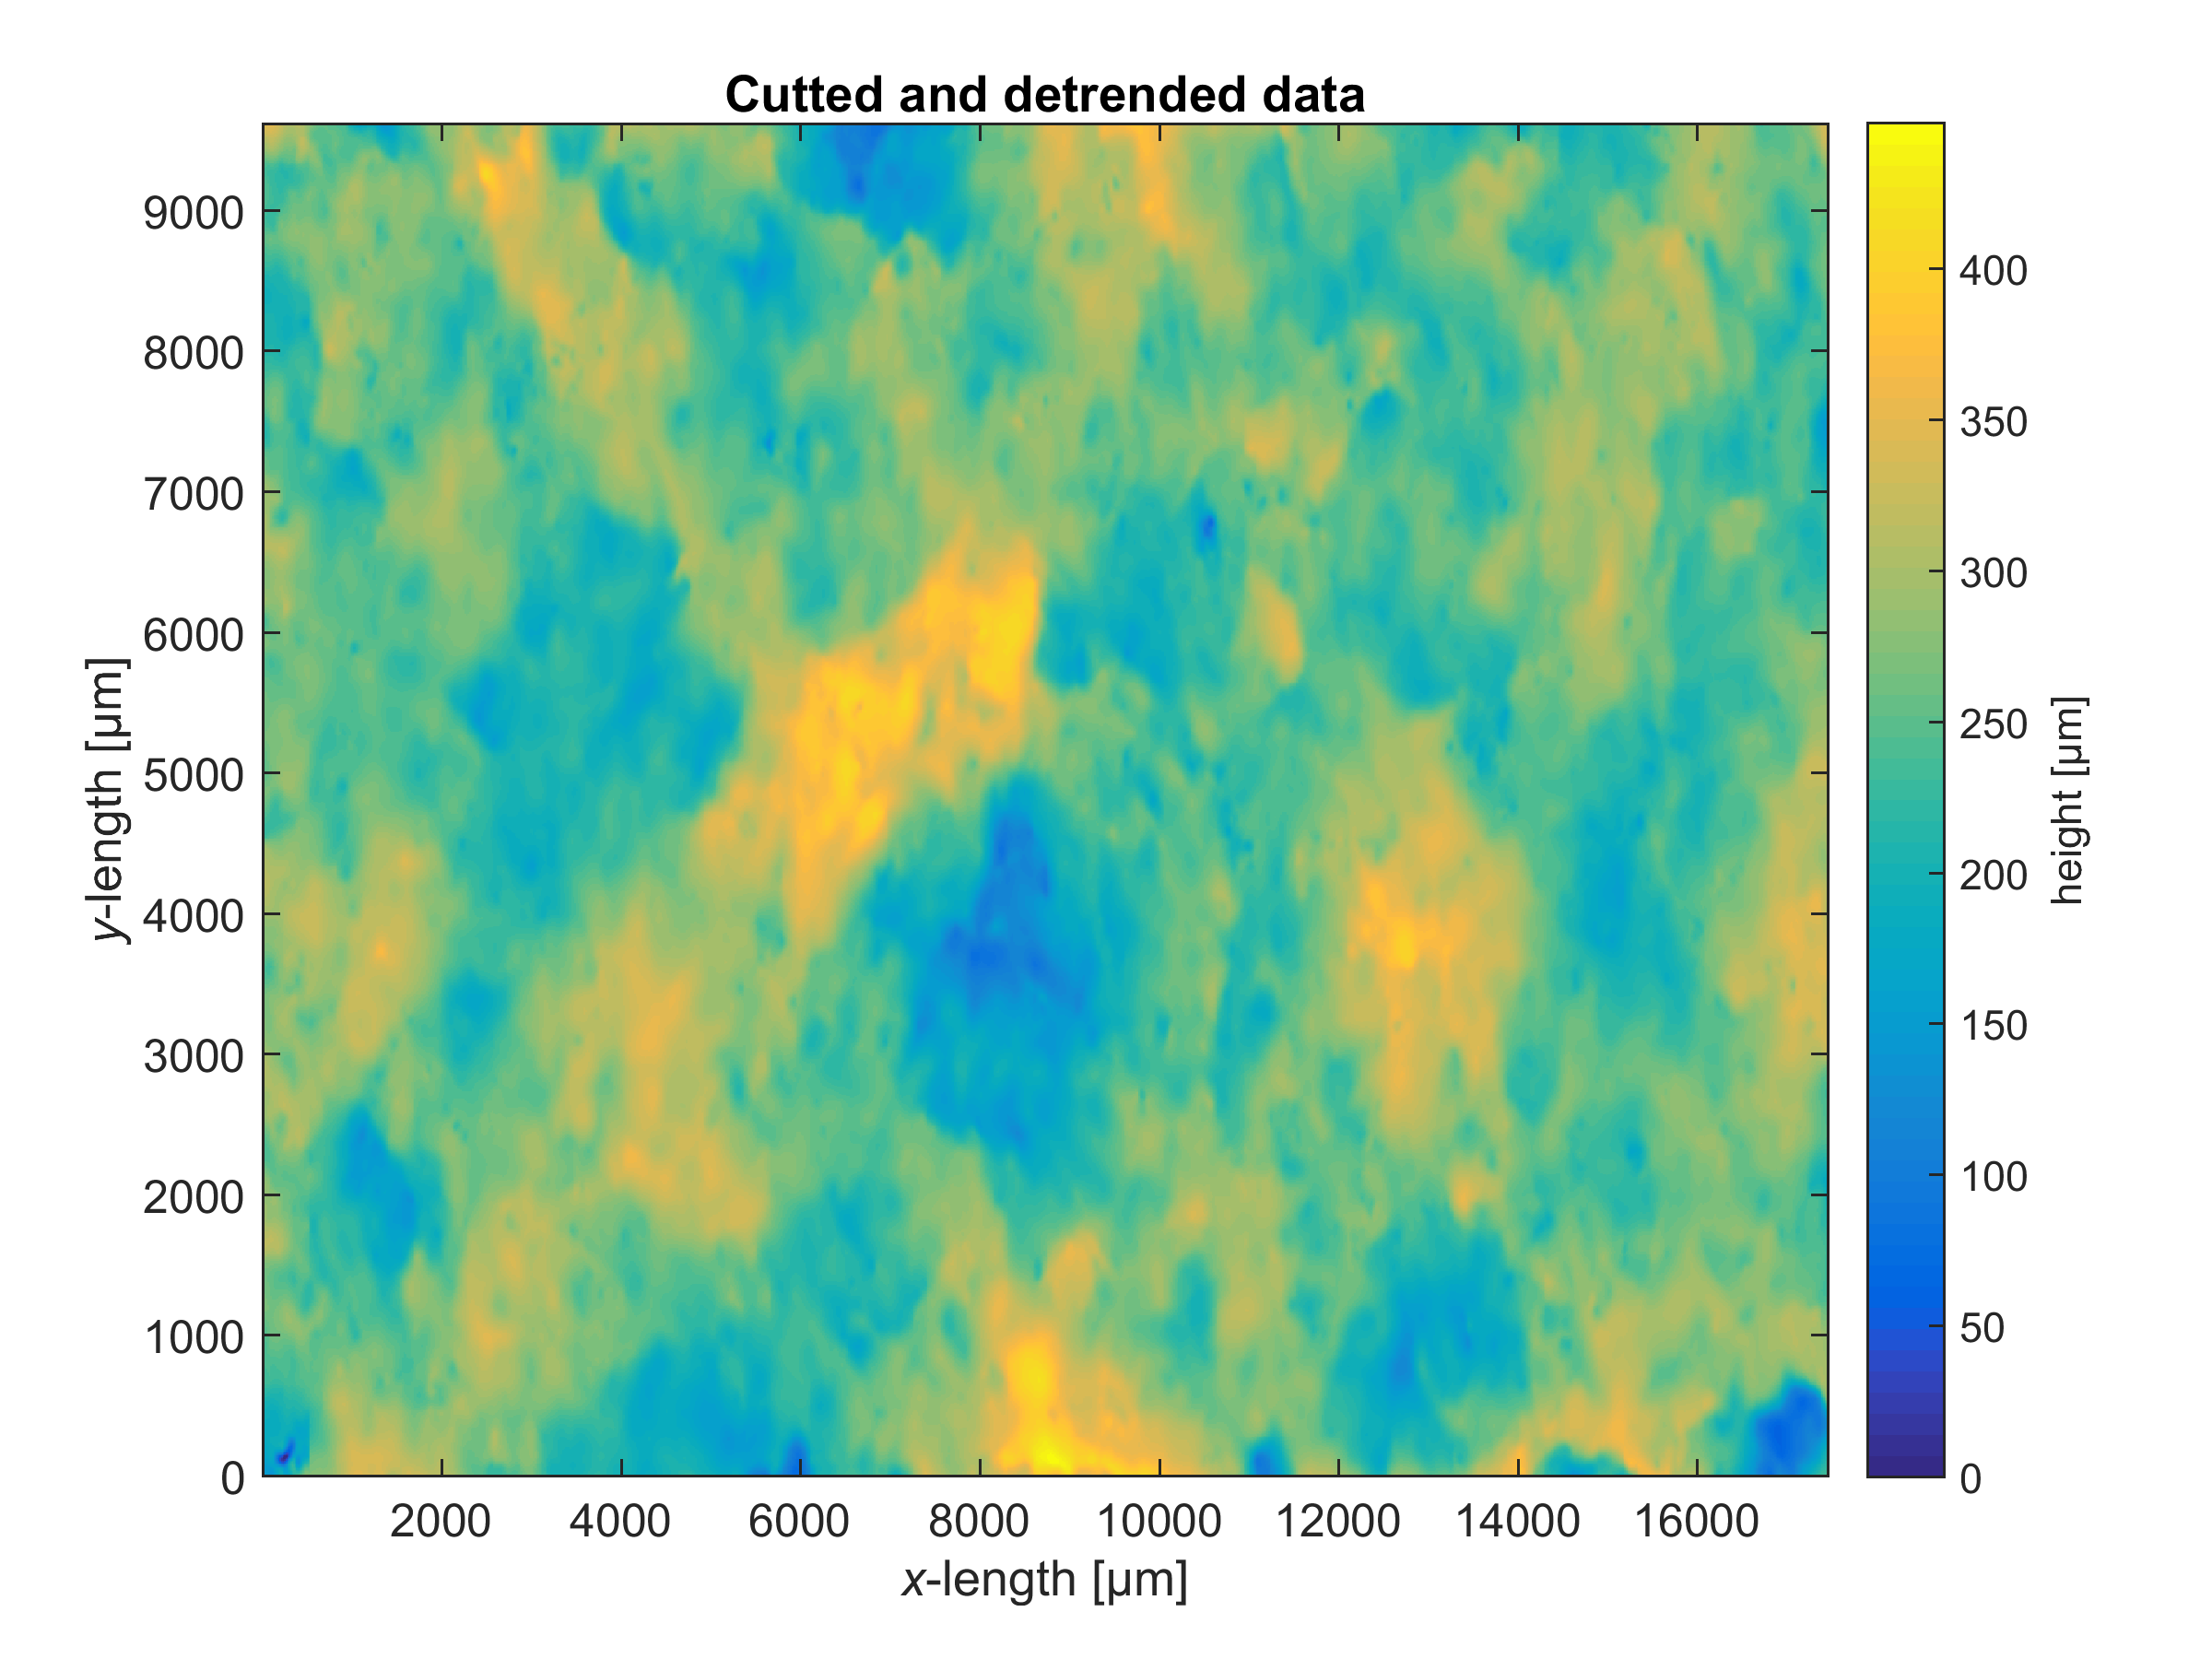
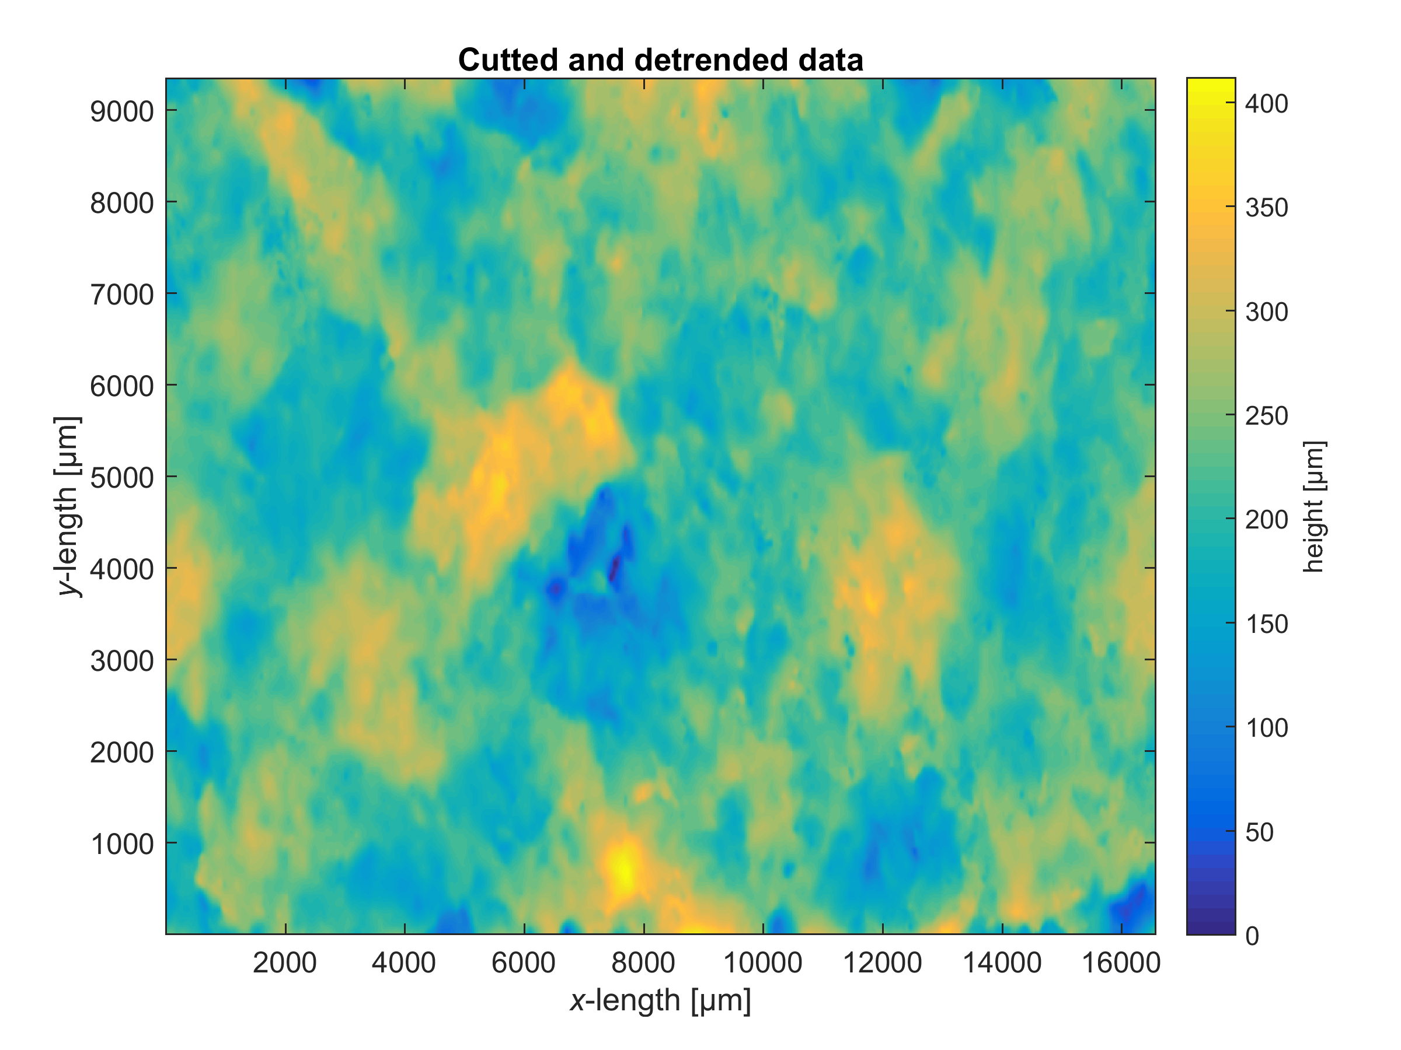
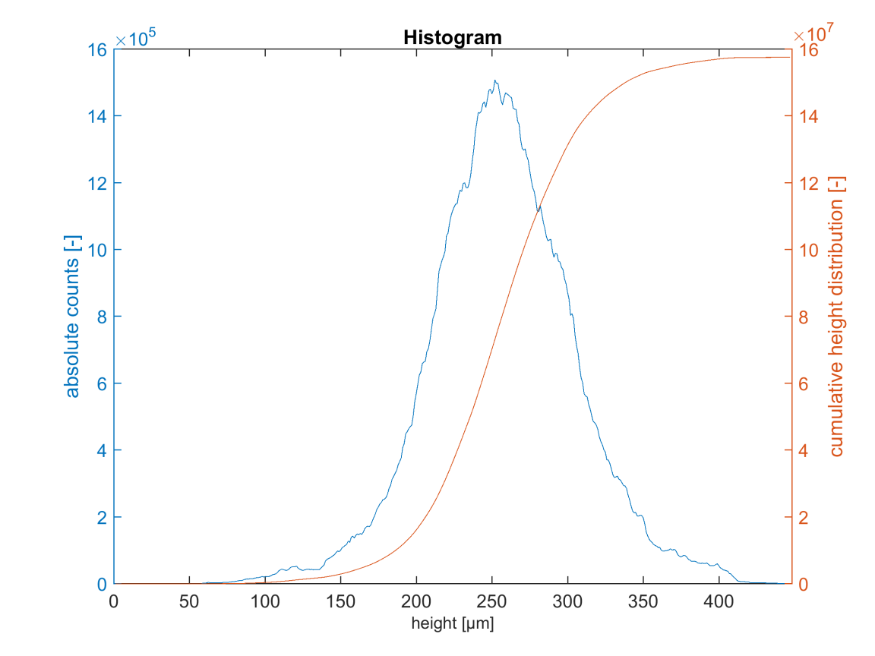
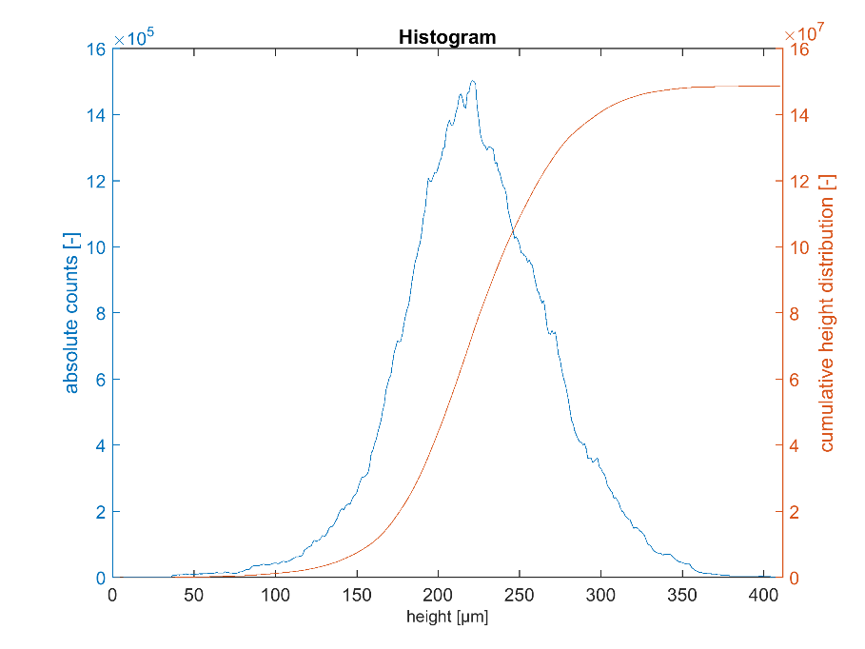
Roughness: Granite
Before
After
4. Results

Slide 24
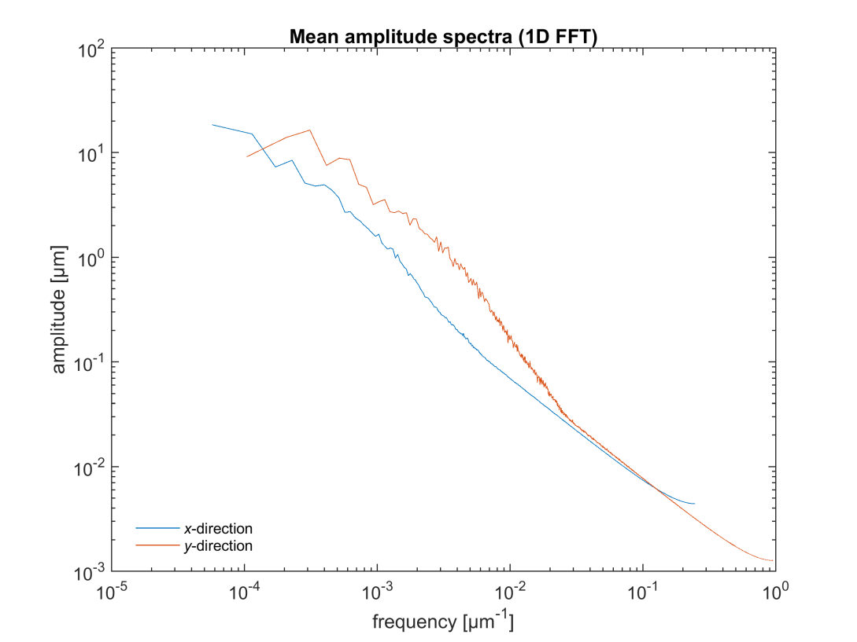
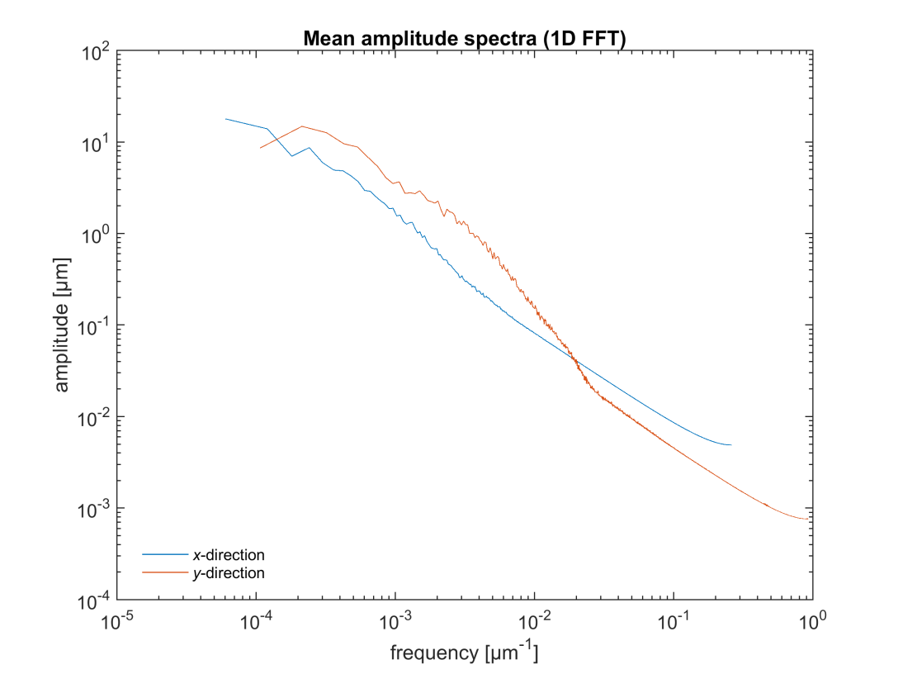
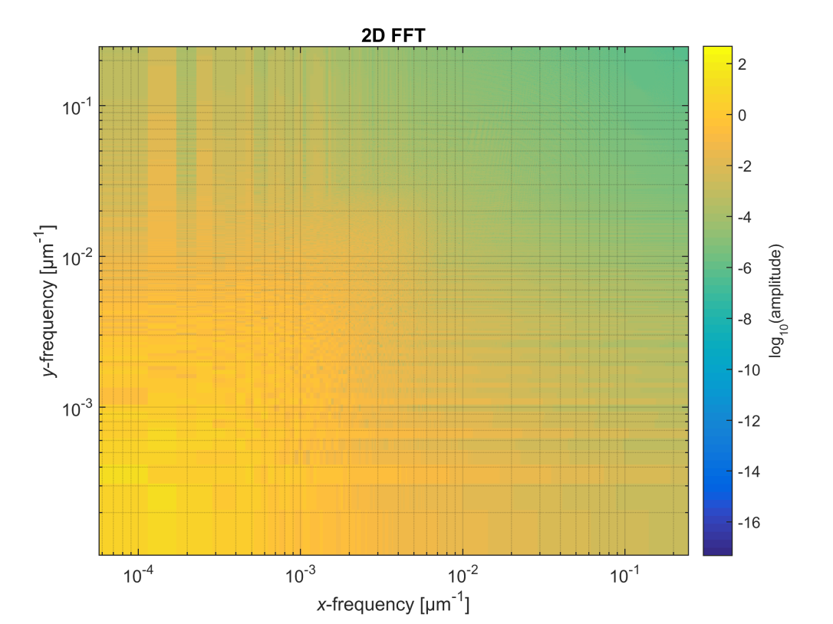
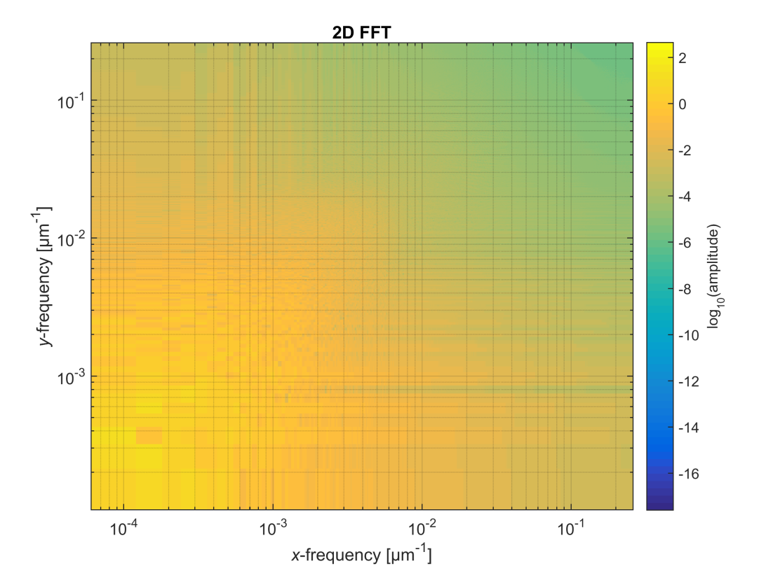


Roughness: Granite
Before
After
4. Results

Slide 25
Permeability and specific storage capacity are about 10⁻¹⁹, 10⁻¹⁸, and 10⁻¹⁴ m², and 10⁻¹³, 10⁻¹¹ and 10⁻¹¹ Pa⁻¹, and exhibit modest dependence on temperature and pressure; for intact samples of granite, limestone and Buntsandstone, respectively.
Fractures cause an increase in permeability up to 3 and 2 orders of magnitudes for samples of granite and limestone, respectively.
Repeat experiments at room temperature after the thermal treatment revealed that a slight permeability reduction is permanent.
Digital scan of granite sample before/after the oscillatory pore pressure test presented a relative variation of approximately 50 µm.
Prominent decreases in a fracture aperture and normal stiffness are observed for the fractured limestone and granite samples as the P_{eff} was increased during the oscillatory test -as expected.
5. Conclusions
Ruhr-Universität Bochum

Slide 26
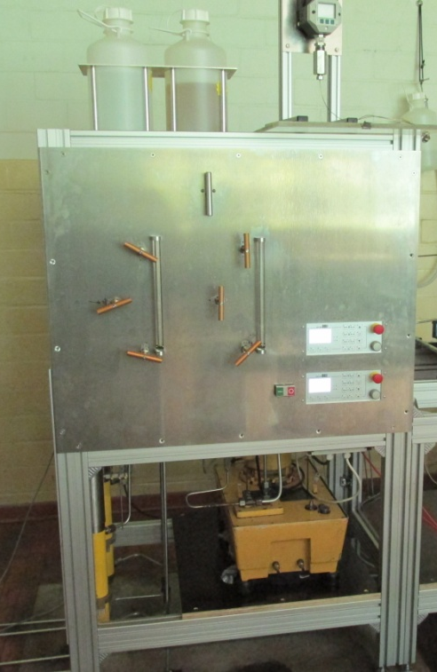
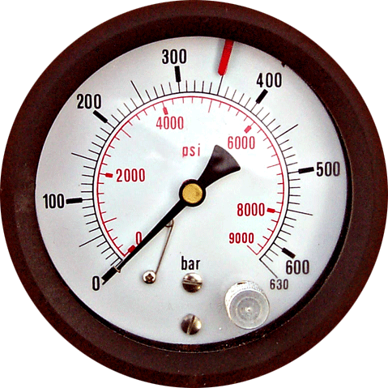
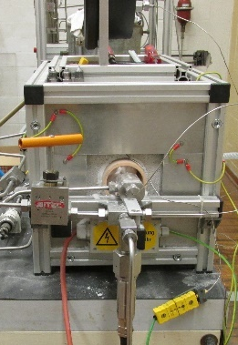
Carry out experiments with different type of rock cores/fractured rock cores
Determination of k and s as f(P,T,t) in 4 different samples simultaneously
Analysis of the fracture properties, e.g. aperture, normal stiffness, roughness
Improve the FFT fracture analysis method
Design and build 4 “P,T permeameters” for the long term experiments (up to 700 hours)
6. Outlook
Pc
Pp
Ruhr-Universität Bochum

Slide 27
Bernabé, Y., Mok, U. & Evans, B. (2006) A note on the oscillating flow method for measuring rock permeability. Int. J. Rock Mech. Min. Sci and Geomech., 43, 311–316.
Renner and Steeb (2015) Modeling of Fluid Transport in Geothermal Research. In: Freeden W., Nashed, M. , Sonar T. (Eds.) Handbook of Geomathematics. Sprinter, Belin/Heidelberg, pp 1444-1496.
Song, I., and J. Renner (2007) Analysis of oscillatory fluid flow through rock samples. Geophysical Journal International, 170, 195–204.
Witherspoon, P. A., Wang J. S. Y. , K. Iwai, Gale J. E. (1980) Validity of Cubic Law for fluid flow in a deformable rock fracture.
7. References
Ruhr-Universität Bochum

