Slide 1
Inter-system biases estimation in multi-GNSS relative positioning with GPS and Galileo
Cecile Deprez and Rene Warnant
University of Liege, Belgium

Slide 2
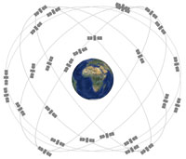
Multi-GNSS
Many systems : GPS, GLONASS, Galileo, BeiDou, QZSS, IRNSS
Improved reliability – availability - precision
Independent but compatible…
Possibility for Multi-GNSS RTK !

Slide 3
Multi-GNSS
Overlapping frequencies :
L1 (GPS) – E1 (Galileo) – B1 (BeiDou) – L1 (QZSS)
L5 (GPS) – E5a (Galileo) – L5 (QZSS) – L5 (IRNSS)
L2 (GPS) – L2 (QZSS)
E5b (Galileo) – B2 (BeiDou)
Upper L-Band
E1
Lower L-Band
E5a
L5
E5b
E6
L1
L1
L2
L5
B2
L2
B3
B1
Frequency (Mhz)
1207,14
1247,00
1268,52
1176,45
1227,60
1278,75
1575,42
1602,00
1191,795
GLONASS
GPS
BeiDou
Galileo

Slide 4
Inter-system Biases (ISBs)
One-way code observable model
GPS : $P_{1,k}^{G}=D_{1}^{G}+T_{1}^{G}+I_{1,k}^{G}+M_{1,k,m}^{G}+c.\left(δt_{1}^{(G)}−δt^{G}\right){+ d}_{1}− d^{G}+ε_{1,k,m}^{G}$
Galileo : $P_{1,k}^{E}=D_{1}^{E}+T_{1}^{E}+I_{1,k}^{E}+M_{1,k,m}^{E}+c.\left(δt_{1}^{(E)}−δt^{E}\right){+ d}_{1}− d^{E}+ε_{1,k,m}^{E}$
$+ c.({δt_{1}^{(E)}−δ}_{GGTO}− {δt}^{E})$
$P_{1,k}^{∗}$: Pseudo-range $δt_{1}$: Receiver clock errors
$D_{1}^{∗}$: Geometric distance $δt^{∗}$: Satellite clock errors
$T_{1}^{∗}$: Tropospheric delay $d_{1}$: Receiver hardware delay
$I_{1,k}^{∗}$: Ionospheric delay $d^{∗}$: Satellite hardware delay
$M_{1,k,m}^{∗}$ : Multipath $ε_{1,k,m}^{∗}$ : Code noise
Galileo to GPS
Time Offset
=
Different Time Systems

Slide 5
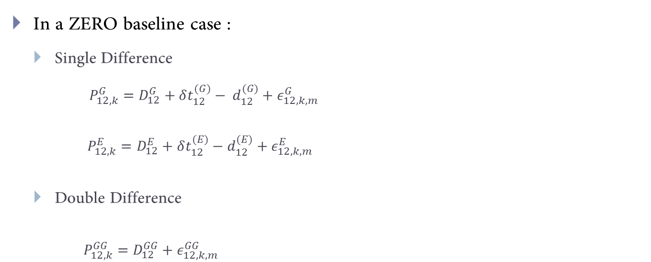
Inter-system Biases (ISBs)
In a ZERO baseline case :
Single Difference
$P_{12,k}^{G}=D_{12}^{G}+δt_{12}^{(G)}− d_{12}^{(G)}+ε_{12,k,m}^{G}$
$P_{12,k}^{E}=D_{12}^{E}+δt_{12}^{(E)}−d_{12}^{(E)}+ε_{12,k,m}^{E}$
Double Difference
$P_{12,k}^{GG}=D_{12}^{GG}+ε_{12,k,m}^{GG}$
The GGTO term disappears
4 unknowns :
X,
Y,
Z,
Differential hardware delay between GPS and Galileo (ISB)
$$P_{12,k}^{GE}=D_{12}^{GE}−d_{12}^{(GE)}+ε_{12,k,m}^{GE}$$
Single reference satellite for all observations

Slide 6
Equipment
Receivers :
2 x Septentrio PolaRx4 (Sept 1 & Sept 2)
2 x Trimble NetR9 (TRM 1 & TRM 2)
1 x Septentrio PolaRxS (Sept 3)
Antennae :
2 x TRIMBLE TRM 59800 SCIS (choke ring antenna) (ULG0 & ULG1)
Splitter :
1 x 2-way splitter
1 x 4-way splitter
Fixed precise coordinates

Slide 7
Configurations
End of 2014 – DOY 179 of 2015
ULG0
ULG1
TRM1
TRM2
Sept1
Sept3
DOYs180-292 of 2015
ULG0
ULG1
TRM1
Sept1
TRM2
Sept3
DOYs 293-365 of 2015 – DOYs 1-12 of 2016
ULG0
ULG1
TRM1
TRM2
Sept1
Sept2
DOYs 13 –now of 2016
ULG0
ULG1
TRM1
Sept2
Sept1
Sept3
TRM2

Slide 8
Results
Zero baselines results – Identical Receivers with identical firmware
 |  | GPS L1/Galileo E1 |  |  |  | GPS L5/Galileo E5a
 |  | Mean ISB (m) |  | Std ISB (m) |  | Mean ISB (m) |  | Std ISB (m)
 |  | Epochs | 10-min | Epochs | 10-min | Epochs | 10-min | Epochs | 10-min
Sept2 – Sept1 | 14’ | NO DATA
 | 15’ | 0,004 | 0,003 | 0,003 | 0,003 | 0,005 | 0,008 | 0,004 | 0,008
 | 16’ | 0,002 | 0,002 | 0,000 | 0,001 | 0,002 | 0,008 | 0,003 | 0,008
Sept2 – Sept3 | 14’ | NO DATA
 | 15’ | 0,001 | 0,001 | 0,004 | 0,005 | 0,050 | 0,047 | 0,006 | 0,005
 | 16’ | 0,000 | 0,002 | 0,009 | 0,007 | 0,040 | 0,021 | 0,010 | 0,049
Not considered in the computation : Galileo satellites E18 - E14 - E20

Slide 9
Results
Zero baselines results – Identical Receivers with identical firmware
 |  | GPS L1/Galileo E1 |  |  |  | GPS L5/Galileo E5a
 |  | Mean ISB (m) |  | Std ISB (m) |  | Mean ISB (m) |  | Std ISB (m)
 |  | Epochs | 10-min | Epochs | 10-min | Epochs | 10-min | Epochs | 10-min
Sept1 – Sept3 | 14’ | 0,023 | 0,027 | 0,018 | 0,017 | 0,078 | 0,058 | 0,036 | 0,029
 | 15’ | 0,004 | 0,002 | 0,003 | 0,005 | 0,044 | 0,042 | 0,007 | 0,012
 | 16’ | 0,003 | 0,003 | 0,016 | 0,017 | 0,034 | 0,037 | 0,008 | 0,016
TRM1 – TRM2 | 14’ | 0,120 | 0,120 | 0,011 | 0,012 | 0,003 | 0,004 | 0,019 | 0,076
 | 15’ | 0,150 | 0,150 | 0,004 | 0,004 | 0,0017 | 0,013 | 0,020 | 0,036
 | 16’ | 0,140 | 0,140 | 0,004 | 0,004 | 0,008 | 0,01 | 0,021 | 0,030
Same receivers show ISBs different from 0?
Not considered in the computation : Galileo satellites E18 - E14 - E20

Slide 10
Results
Zero baselines results – Identical Receivers with identical firmware
Analysis over the year 2015
Firmware updates ?

Slide 11
Results
Zero baselines results – Identical Receivers with identical firmware
Analysis over the year 2015
E24 – E30
E26 – E22
E08 – E09
New satellites influence?

Slide 12
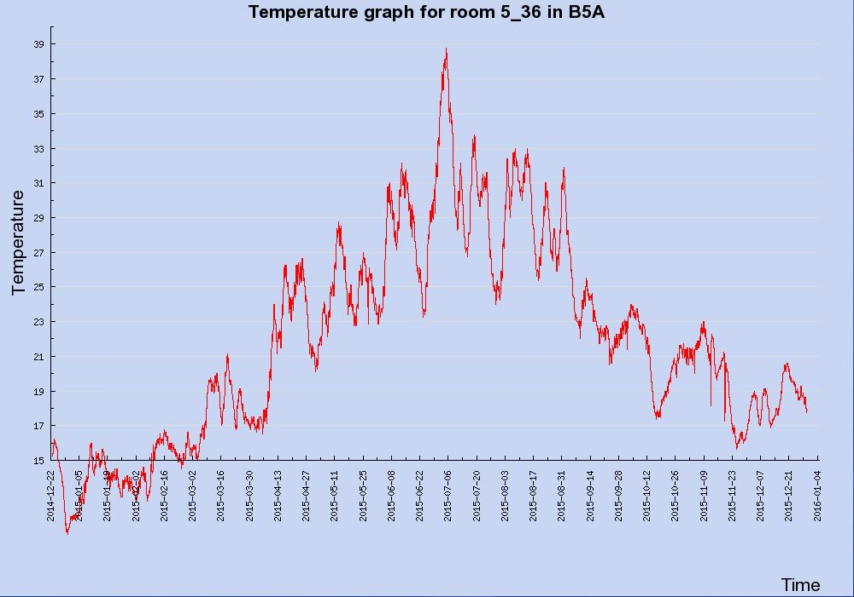
Results
Influence of the temperature?
Temperature registered inside the receiver’s room
TRM2 seems to be responsible for the observed variations of the ISBs!

Slide 13
Results
Zero baselines results – Different Receivers
ZB TRM1-TRM2 = 0,26
 |  | GPS L1/Galileo E1 |  |  |  | GPS L5/Galileo E5a
 |  | Mean ISB (m) |  | Std ISB (m) |  | Mean ISB (m) |  | Std ISB (m)
 |  | Epochs | 10-min | Epochs | 10-min | Epochs | 10-min | Epochs | 10-min
TRM1 – Sept2 | 16a’ | 0,478 | 0,479 | 0,015 | 0,017 | 4,359 | 4,404 | 0,125 | 0,080
 | 16b’ | 0,432 | 0,443 | 0,016 | 0,052 | 4,360 | 4,361 | 0,098 | 0,069
TRM2 – Sept1 | 16a’ | 0,288 | 0,287 | 0,022 | 0,021 | 4,427 | 4,407 | 0,176 | 0,082
 | 16b’ | 0,182 | 0,187 | 0,026 | 0,024 | 4,359 | 4,399 | 0,064 | 0,041
ZB TRM1-TRM2 = 0,19
Not considered in the computation : Galileo satellites E18 - E14 - E20

Slide 14
Results
Zero baselines results – Different Receivers
 |  | GPS L1/Galileo E1 |  |  |  | GPS L5/Galileo E5a
 |  | Mean ISB (m) |  | Std ISB (m) |  | Mean ISB (m) |  | Std ISB (m)
 |  | Epochs | 10-min | Epochs | 10-min | Epochs | 10-min | Epochs | 10-min
TRM1 – Sept2 | 16a’ | 0,478 | 0,479 | 0,015 | 0,017 | 4,359 | 4,404 | 0,125 | 0,080
 | 16b’ | 0,432 | 0,443 | 0,016 | 0,052 | 4,360 | 4,361 | 0,098 | 0,069
TRM2 – Sept1 | 16a’ | 0,288 | 0,287 | 0,022 | 0,021 | 4,427 | 4,407 | 0,176 | 0,082
 | 16b’ | 0,182 | 0,187 | 0,026 | 0,024 | 4,359 | 4,399 | 0,064 | 0,041
Difference of 10 cm in 70 days in 2015
Difference of 10 cm in 70 days
Not considered in the computation : Galileo satellites E18 - E14 - E20

Slide 15
Results
Zero baselines results – Different Receivers
 |  | GPS L1/Galileo E1 |  |  |  | GPS L5/Galileo E5a
 |  | Mean ISB (m) |  | Std ISB (m) |  | Mean ISB (m) |  | Std ISB (m)
 |  | Epochs | 10-min | Epochs | 10-min | Epochs | 10-min | Epochs | 10-min
TRM1 – Sept1 | 14’ | 0,488 | 0,491 | 0,009 | 0,013 | 4,372 | 4,393 | 0,009 | 0,110
 | 15’ | 0,385 | 0,387 | 0,031 | 0,037 | 4,238 | 4,359 | 0,099 | 0,145
TRM2 – Sept3 | 14’ | 0,248 | 0,261 | 0,052 | 0,062 | 4,586 | 4,563 | 0,382 | 0,421
 | 15’ | 0,145 | 0,120 | 0,022 | 0,102 | 4,104 | 4,451 | 0,295 | 0,161
 | 16a’ | 0,278 | 0,292 | 0,062 | 0,038 | 4,321 | 4,238 | 0,276 | 0,250
 | 16b’ | 0,163 | 0,168 | 0,011 | 0,024 | 4,431 | 4,361 | 0,050 | 0,125
Not considered in the computation : Galileo satellites E18 - E14 - E20

Slide 16
Positioning with ISBs
Precision of the computed positions with Galileo E5a/ GPS L5 in zero baseline

Slide 17
Conclusions
ISBs results in zero baseline
Identical receivers :
Septentrio receivers : zero value
Trimble receivers : non zero value + variation in time
Investigation of the variation : Influence of firmware updates, new Galileo’s satellites and temperature
Different receivers :
Variation in time
Triangle loop
Positioning
Removing mean ISBs form previous days improve positioning results

Slide 18
Prospects
Compute phase ISBs
Further investigate GPSL5/GalileoE5a ISB behaviour
Extend this research to other frequencies/GNSS
Tests of the new Septentrio PolaRx5
Study the longer baseline’s ionospheric issues

Slide 19
Thank you for your attention
Cecile Deprez and Rene Warnant
University of Liege, Belgium

