Slide 1





Flood forecasting using non-stationarity on a river with tidal influence
A feasibility study
Rebecca Killick, Ann Kretzschmar, Wlodek Tych, Suzi Ilic

Slide 2
Flooding is a worldwide problem
Storm Desmond 5th/6th December 2015
  Widespread damage to infrastructure
Notes:
Flooding is a worldwide problem but its severity was brought home to those of us living in the north-west UK on 5th/6th December 2015 when storm Desmond hit. It caused 400-500 million gbp worth of damage
Flooding worldwide problem
Bought home to NW England
Desmond – 5th/6th December 2015
400-500 million damage

Slide 3
Flooding is a worldwide problem
Storm Desmond 5th/6th December 2015
  Widespread damage to infrastructure
  Severe flooding across the north of England
Notes:
Flooding is a worldwide problem but its severity was brought home to those of us living in the north-west UK on 5th/6th December 2015 when storm Desmond hit. It caused 400-500 million gbp worth of damage across the north of England and southern Scotland.
Severe flooding
Northern England
Southern Scotland

Slide 4
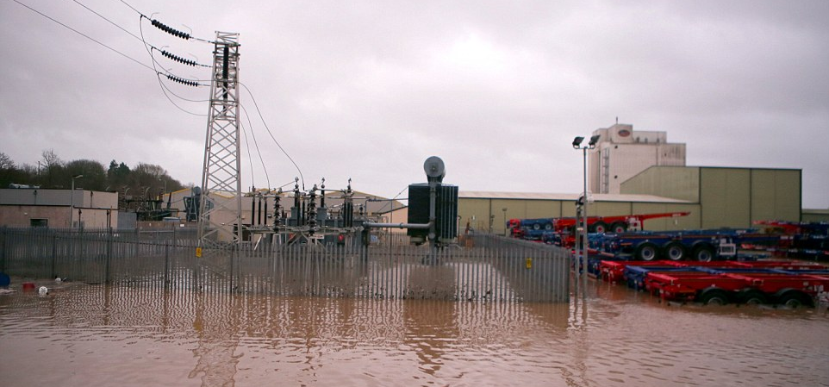
Flooding is a worldwide problem
Storm Desmond 5th/6th December 2015
  Widespread damage to infrastructure
  Severe flooding across the north of England
  61K homes without power
Notes:
Flooding is a worldwide problem but its severity was brought home to those of us living in the north-west UK on 5th/6th December 2015 when storm Desmond hit. It caused 400-500 million gbp worth of damage across the north of England and southern Scotland. There was severe flooding and in Lancaster the electricty sub-station was flooded leaving 61K homes without power and shutting the University one week early.
Electricity sub-station flooded
61k homes without power
University forced to close

Slide 5
Flooding is a worldwide problem
Storm Desmond 5th/6th December 2015
  Widespread damage to infrastructure
  Severe flooding across the north of England
  61K homes without power
  Rainfall and river flow records broken
Notes:
Flooding is a worldwide problem but its severity was brought home to those of us living in the north-west UK on 5th/6th December 2015 when storm Desmond hit. It caused 400-500 million gbp worth of damage across the north of England and southern Scotland. There was severe flooding and in Lancaster the electricity sub-station was flooded leaving 61K homes without power and shutting the University one week early. There was severe damage to infra-structure across the area including, roads, bridges and railway lines. Many rainfall and river flow records were broken. 16 months on, the damage is still visible.
Rainfall and river flow records broken

Slide 6
Flooding is a worldwide problem
Storm Desmond 5th/6th December 2015
  Widespread damage to infrastructure
  Severe flooding across the north of England
  61000 homes without power
  Rainfall and river flow records broken
Major wind and rain storms are likely to become more frequent and more severe due to the affects of climate change
Notes:
Flooding is a worldwide problem but its severity was brought home to those of us living in the north-west UK on 5th/6th December 2015 when storm Desmond hit. It caused 400-500 million gbp worth of damage across the north of England and southern Scotland. There was severe flooding and in Lancaster the electricty sub-station was flooded leaving 61K homes without power and shutting the University one week early. There was severe damage to infra-structure across the area including, roads, bridges and railway lines. Many rainfall and river flow records were broken. 16 months on, the damage is still visible.
It is likely that it will happen again but worse due to the effects of climate change. SO …
Major wind and rain storms
more frequent
More intense
Climate change

Slide 7
Forecasting extremes is essential …
Notes:
Forecasting these extremes is essential.
Modelling techniques have improved but there are often still discrepancies between predictions and observations most significantly during storm events when these are most important.
Generally, it is assumed that the errors are independent, stationary and normally distributed. This is usually not the case especially under storm conditions and even more so when tidal influences come into play as they did in Lancaster.
Accurate forecasts of extremes are essential

Slide 8
Forecasting extremes is essential …
Modelling has improved but
  Discrepancies exist between predictions and observations
  Most significant during all important storm events
Notes:
Forecasting these extremes is essential.
Modelling techniques have improved but there are often still discrepancies between predictions and observations most significantly during storm events when these are most important.
Generally, it is assumed that the errors are independent, stationary and normally distributed. This is usually not the case especially under storm conditions and even more so when tidal influences come into play as they did in Lancaster.
Improvements in modelling
Discrepancies
Predictions v observations
Most significant during storms

Slide 9
Forecasting extremes is essential …
Modelling has improved but
  Discrepancies exist between predictions and observations
  Most significant during all important storm events
Assumptions made about errors are generally not true (especially during storms)
  Independent
  Stationary
  Normally distributed
Notes:
Forecasting these extremes is essential.
Modelling techniques have improved but there are often still discrepancies between predictions and observations most significantly during storm events when these are most important.
Generally, it is assumed that the errors are independent, stationary and normally distributed. This is usually not the case especially under storm conditions and even more so when tidal influences come into play as they did in Lancaster.
Error assumptions
Independent
Stationary
Normally distributed
Generally not true

Slide 10
Forecasting extremes is essential …
Modelling has improved but
  Discrepancies exist between predictions and observations
  Most significant during all important storm events
Assumptions made about errors generally not true (especially during storms)
  Independent
  Stationary
  Normally distributed
The challenge is even greater in tidal river reaches
Notes:
Forecasting these extremes is essential.
Modelling techniques have improved but there are often still discrepancies between predictions and observations most significantly during storm events when these are most important.
Generally, it is assumed that the errors are independent, stationary and normally distributed. This is usually not the case especially under storm conditions and even more so when tidal influences come into play as they did in Lancaster.
Biggest challenge
Reaches with tidal influence
Lancaster substation

Slide 11
Feasibility study
Interdisciplinary collaboration
  Lancaster Environment Centre
  Lancaster University Data Science Institute
1 Romanowicz et al., 2006 2 Killick et al., 2017
Notes:
This project has been funded by the MathsForsees Network as a joint feasibility study between Lancaster Environment Centre and Lancaster University Data Science Institute. The aim was to compare two methods for real-time forecasting – traditional adaptive Kalman Filter approach and a powerful statistical technique based on data driven wavelet decomposition.
A trial model was set up for the River Lune catchment that flows through Lancaster and caused flooding during storm Desmond.
Funded as a feasibility study
LEC and DSI

Slide 12
Feasibility study
Interdisciplinary collaboration
  Lancaster Environment Centre
  Lancaster University Data Science Institute
Compare adaptive forecasting techniques
1 Romanowicz et al., 2006 2 Killick et al., 2017
Notes:
This project has been funded by the MathsForsees Network as a joint feasibility study between Lancaster Environment Centre and Lancaster University Data Science Institute. The aim was to compare two methods for real-time forecasting – traditional adaptive Kalman Filter approach and a powerful statistical technique based on data driven wavelet decomposition.
A trial model was set up for the River Lune catchment that flows through Lancaster and caused flooding during storm Desmond.
Comparison of adaptive forecasting techniques

Slide 13
Feasibility study
Interdisciplinary collaboration
  Lancaster Environment Centre
  Lancaster University Data Science Institute
Compare forecasting techniques
  Adaptive forecasting using Kalman filter approach¹
  Powerful statistical technique using data driven wavelet decomposition²
1 Romanowicz et al., 2006 2 Killick et al., 2017
Notes:
This project has been funded by the MathsForsees Network as a joint feasibility study between Lancaster Environment Centre and Lancaster University Data Science Institute. The aim was to compare two methods for real-time forecasting – traditional adaptive Kalman Filter approach and a powerful statistical technique based on data driven wavelet decomposition.
A trial model was set up for the River Lune catchment that flows through Lancaster and caused flooding during storm Desmond.
Basic cascading transfer function model
Detail later
Predictions adapted by two tehniques
Modification of traditional adaptive Kalman Filter
Statistical technique
Data-driven wavelet decomposition
Developed by lead author

Slide 14
Feasibility study
Interdisciplinary collaboration
  Lancaster Environment Centre
  Lancaster University Data Science Institute
Compare forecasting techniques
  Data based mechanistic modelling using Matlab Captain Toolbox
    Adaptive forecasting using Kalman filter approach¹
    Powerful statistical technique using data driven wavelet decomposition²
Trial model River Lune, NW England
  Rainfall
  Water levels
  Tidal data
1 Romanowicz et al., 2006 2 Killick et al., 2017
Notes:
This project has been funded by the MathsForsees Network as a joint feasibility study between Lancaster Environment Centre and Lancaster University Data Science Institute. The aim was to compare two methods for real-time forecasting – traditional adaptive Kalman Filter approach and a powerful statistical technique based on data driven wavelet decomposition.
A trial model was set up for the River Lune catchment that flows through Lancaster and caused flooding during storm Desmond.
Trial model
River Lune, NW England
Record levels recorded during Desmond
Rainfall input
Forecast water levels at several locations
Tidal influence

Slide 15
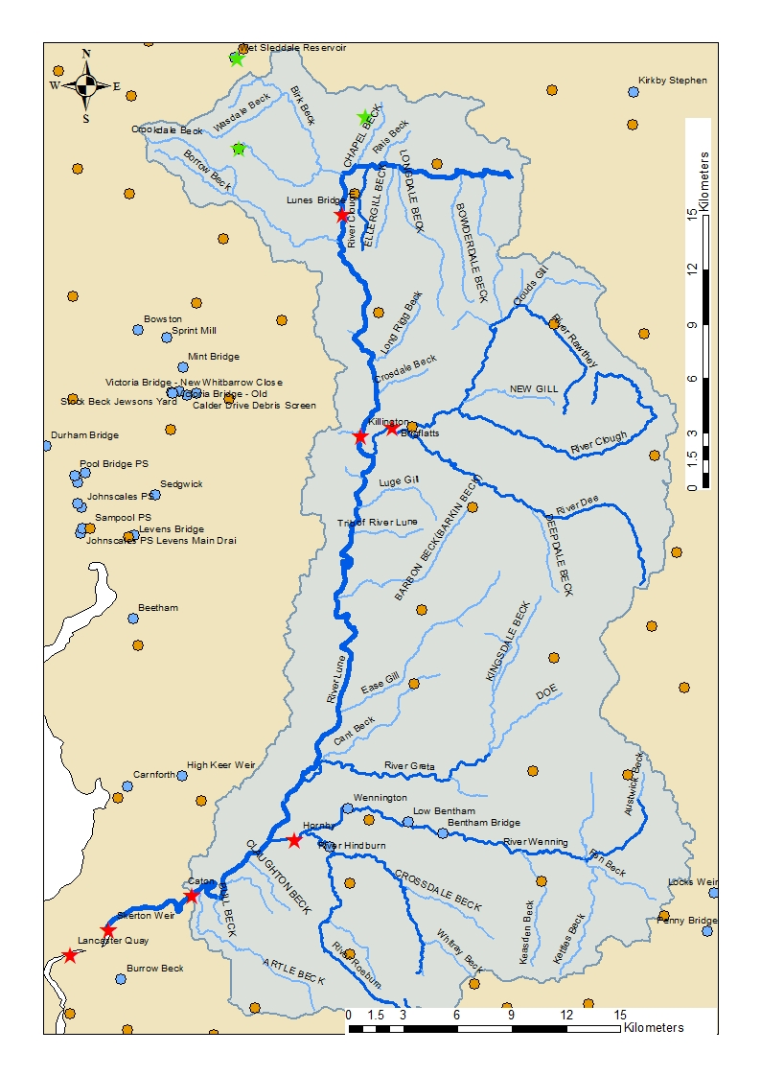
Study catchment system – River Lune
Notes:
The Lune rises in the North Pennines and reaches the sea at Lancaster. It has 2 major tributaries that gather water from the Bowland Fells to the East. There was a flash flood on the Hindburn in 1967 when ¼ of the village of Wray was washed away and it was affected again by storm Desmond. The Lune flows out to the sea through Lancaster with the tidal limit being Skerton Weir just upstream of the town.
Study catchment
River Lune

Slide 16
Study catchment system – River Lune
Catchment are approx. 1000km² above tidal limit
Rises in northern Pennines
Flows out to the sea at Lancaster
High ground to the east
Drained by two major tributaries
Historically subject to flash flooding
Notes:
The Lune rises in the North Pennines and reaches the sea at Lancaster. It has 2 major tributaries that gather water from the Bowland Fells to the East. There was a flash flood on the Hindburn in 1967 when ¼ of the village of Wray was washed away and it was affected again by storm Desmond. The Lune flows out to the sea through Lancaster with the tidal limit being Skerton Weir just upstream of the town.
Area 1033 km2 above tidal limit
Rises in North Pennines
High land – Howgills and Bowland Fells to East
Flows into sea at Lancaster

Slide 17
Study catchment system – River Lune
Catchment are approx. 1000km² above tidal limit
Rises in northern Pennines
Flows out to the sea at Lancaster
High ground to the east
Drained by two major tributaries
Historically subject to flash flooding
Notes:
The Lune rises in the North Pennines and reaches the sea at Lancaster. It has 2 major tributaries that gather water from the Bowland Fells to the East. There was a flash flood on the Hindburn in 1967 when ¼ of the village of Wray was washed away and it was affected again by storm Desmond. The Lune flows out to the sea through Lancaster with the tidal limit being Skerton Weir just upstream of the town.
3 rain gauges
Use singly or average

Slide 18
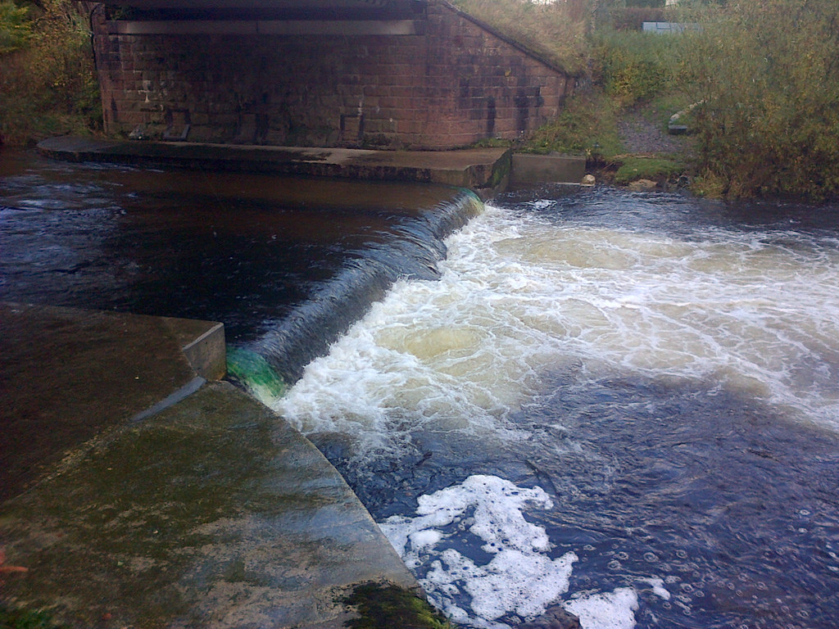
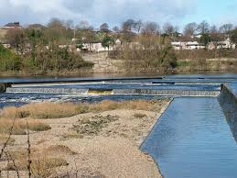
Study catchment system – River Lune
Lunes Bridge
https://www.flickr.com/photos/environment-agency/13712948634/
Skerton Weir
Notes:
The Lune rises in the North Pennines and reaches the sea at Lancaster. It has 2 major tributaries that gather water from the Bowland Fells to the East. There was a flash flood on the Hindburn in 1967 when ¼ of the village of Wray was washed away and it was affected again by storm Desmond. The Lune flows out to the sea through Lancaster with the tidal limit being Skerton Weir just upstream of the town.
4 water levels stations on main river
Skerton Weir tidal limit

Slide 19
Study catchment system – River Lune
Lunes Bridge
https://www.flickr.com/photos/environment-agency/13712948634/
Skerton Weir
Notes:
The Lune rises in the North Pennines and reaches the sea at Lancaster. It has 2 major tributaries that gather water from the Bowland Fells to the East. There was a flash flood on the Hindburn in 1967 when ¼ of the village of Wray was washed away and it was affected again by storm Desmond. The Lune flows out to the sea through Lancaster with the tidal limit being Skerton Weir just upstream of the town.
2 on tributaries
Drain fells
Subject to flash floods

Slide 20
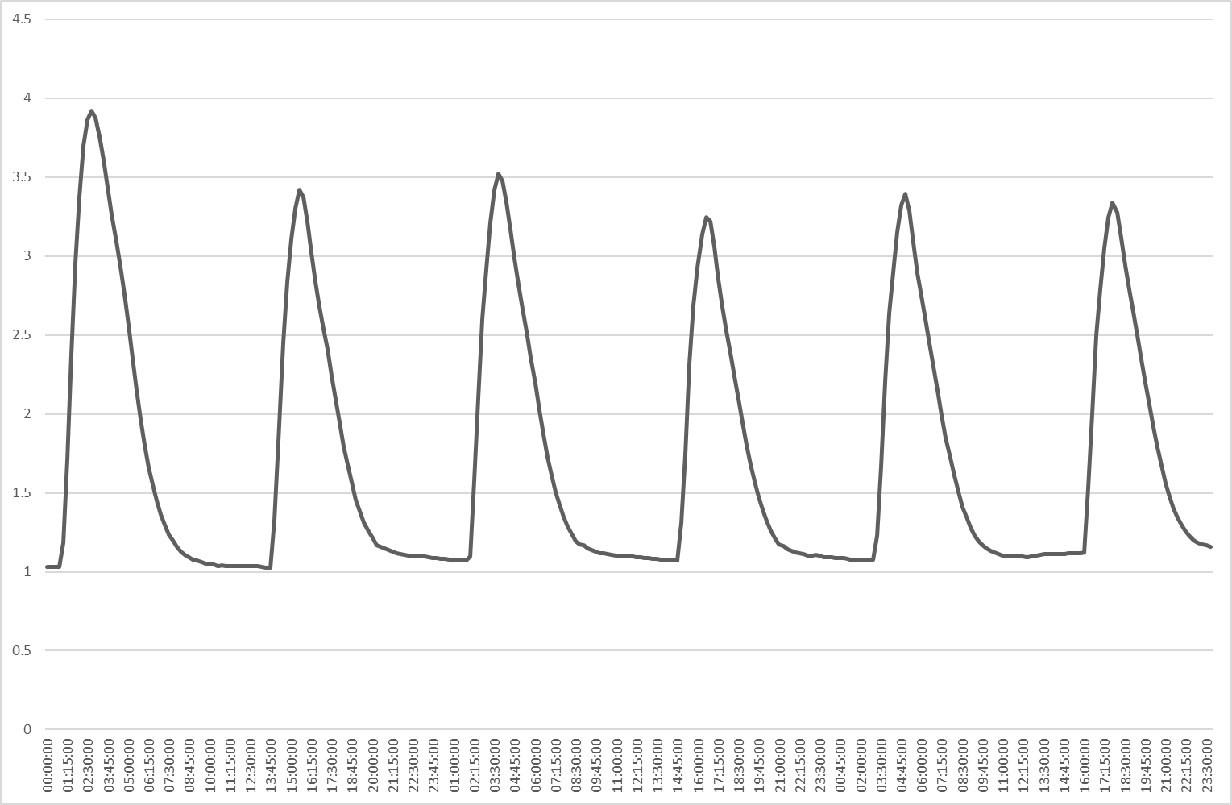
Schematic model
Rainfall
Demings Moss
Orton-Shallowford
Wet Sleddale
Water level
Lunes Bridge
Cascading Transfer function models⁴
River Lune
Water level
Killington
River Rawthey
Brigflatts
River Wenning
Hornby
Average Water levels
Caton
Water level plus tidal influence
Skerton
Tidal Limit
Tidal interaction
Dynamic Harmonic regression³
Tidal height
Lancaster Quay
3 Young et al., 1999; Smith et al 2013; 4 Romanowicz et al., 2006
Notes:
Rainfall, Water level and tidal data for the catchment was made available by the Environment Agency. The methodology employed is similar to that used by Romanowicz et al 2006 on the river Severn.
A series of cascading transfer function models were set up linking rainfall in the upper catchment to water level forecasts at Skerton Weir – the tidal limit. It was proposed that the tidal influence at Skerton – which maybe over-topped at very high tides - be modelled using Dynamic Harmonic Regression as suggested by Smith et al 2013.
The full model set-up is shown here however for the purposes of this feasibility study, the tidal influence and tributaries were was not included.
Tidal forecasts
Forecast using Dynamic harmonic regression

Slide 21
Simplified cascading transfer function model used in feasibility study
Average rainfall
3 rainfall gauges
Measured rainfall
Lunes Bridge
Cascading models
Cascading uncertainty
River Lune
Killington
Caton
Skerton
Tidal Limit
Notes:
The simplified Lune Model is shown here together with the absolute time delays at each measurement point. The modelled output at each level is used as the input to the next level so the uncertainty increases down the cascade.
In order to issue a timely flood warning, the Environment Agency require a lead time of 2hrs and inland locations and 6 for tidal and coastal locations.
The use of cascading transfer function models has a lead time built-in according to the absolute time delay in the model (time for rain/ flood wave to travel from one point to the next). An adaptive forecast looking 2hrs ahead is applied at the forecast point.
The adaptive forecasting approach which alters the forecast as more data is added should largely counter this. So lets consider our two approaches ….
Simplified model used for feasibilty study

Slide 22
Simplified cascading transfer function model used in feasibility study
Average rainfall
3 rainfall gauges
Measured rainfall
Upstream | Downstream | Time delay
Rain | Lunes Bridge | 2 hr
Lunes Bridge | Killington | 4 hr
Killington | Caton | 5 hr
Caton | Skerton | 1 hr
Absolute time delay in the system |  | 12 hrs
Cascading models
Cascading uncertainty
Lunes Bridge
River Lune
Killington
Caton
Skerton
Tidal Limit
Notes:
The simplified Lune Model is shown here together with the absolute time delays at each measurement point. The modelled output at each level is used as the input to the next level so the uncertainty increases down the cascade.
In order to issue a timely flood warning, the Environment Agency require a lead time of 2hrs and inland locations and 6 for tidal and coastal locations.
The use of cascading transfer function models has a lead time built-in according to the absolute time delay in the model (time for rain/ flood wave to travel from one point to the next). An adaptive forecast looking 2hrs ahead is applied at the forecast point.
The adaptive forecasting approach which alters the forecast as more data is added should largely counter this. So lets consider our two approaches ….
Models fitted to 2015 and early 2016
Covering storm desmond
12 hr absolute time-delay
2hrs required for forecasting
However cascadijng models mean cascading uncertainty
Output from one input to next
So adaptive correction required

Slide 23
Simplified cascading transfer function model used in feasibility study
Average rainfall
3 rainfall gauges
Measured rainfall
Upstream | Downstream | Time delay
Rain | Lunes Bridge | 2 hr
Lunes Bridge | Killington | 4 hr
Killington | Caton | 5 hr
Caton | Skerton | 1 hr
Absolute time delay in the system |  | 12 hrs
Cascading models
Cascading uncertainty
Lunes Bridge
River Lune
Killington
Output from each model becomes input to the next
Cascading uncertainty
Adaptive forecasting should help to compensate for this
Caton
Skerton
Tidal Limit
Notes:
The simplified Lune Model is shown here together with the absolute time delays at each measurement point. The modelled output at each level is used as the input to the next level so the uncertainty increases down the cascade.
In order to issue a timely flood warning, the Environment Agency require a lead time of 2hrs and inland locations and 6 for tidal and coastal locations.
The use of cascading transfer function models has a lead time built-in according to the absolute time delay in the model (time for rain/ flood wave to travel from one point to the next). An adaptive forecast looking 2hrs ahead is applied at the forecast point.
The adaptive forecasting approach which alters the forecast as more data is added should largely counter this. So lets consider our two approaches ….
Adaptive forecasting should counter uncertain forecasts
Two methods used
Adaptive Kalman filter
Locally stationary wavelet model

Slide 24
Output from cascading TF models – Skerton Weir
Storm Desmond
Notes:
A model has been fitted to the data for 2015 and the early part of 2016. As can be seen, the extreme conditions in Winter 2015 have biased the model fit so that one size does not fit all. Whilst the model fit in the winter is better than spring it is still not good because it is attempting to fit a single averaged model under all conditions. It would be possible to fit one model to Spring, one to summer and one to winter but in reality the conditions are changing continuously and the model parameters are constantly.
Both the locally stationary wavelet model, LPACF and adaptive KF take this into account but use different approaches.
Output from cascading TF models
Uncertain

Slide 25
Output from cascading TF models – Skerton Weir
Observed and modelled water-levels for Skerton Weir 2015-early 2016
Storm Desmond
Notes:
A model has been fitted to the data for 2015 and the early part of 2016. As can be seen, the extreme conditions in Winter 2015 have biased the model fit so that one size does not fit all. Whilst the model fit in the winter is better than spring it is still not good because it is attempting to fit a single averaged model under all conditions. It would be possible to fit one model to Spring, one to summer and one to winter but in reality the conditions are changing continuously and the model parameters are constantly.
Both the locally stationary wavelet model, LPACF and adaptive KF take this into account but use different approaches.
Model biased by Desmond

Slide 26
Output from cascading TF models
Observed and modelled water-levels for Skerton Weir 2015-early 2016
Model fits very poorly in Spring
Storm Desmond
Notes:
A model has been fitted to the data for 2015 and the early part of 2016. As can be seen, the extreme conditions in Winter 2015 have biased the model fit so that one size does not fit all. Whilst the model fit in the winter is better than spring it is still not good because it is attempting to fit a single averaged model under all conditions. It would be possible to fit one model to Spring, one to summer and one to winter but in reality the conditions are changing continuously and the model parameters are constantly.
Both the locally stationary wavelet model, LPACF and adaptive KF take this into account but use different approaches.
Poor fit in spring and early autumn

Slide 27
Output from cascading TF models
Observed and modelled water-levels for Skerton Weir 2015-early 2016
One size does not fit all, extreme conditions in Autumn/Winter bias the model
Model fits very poorly in Spring
Storm Desmond
Notes:
A model has been fitted to the data for 2015 and the early part of 2016. As can be seen, the extreme conditions in Winter 2015 have biased the model fit so that one size does not fit all. Whilst the model fit in the winter is better than spring it is still not good because it is attempting to fit a single averaged model under all conditions. It would be possible to fit one model to Spring, one to summer and one to winter but in reality the conditions are changing continuously and the model parameters are constantly.
Both the locally stationary wavelet model, LPACF and adaptive KF take this into account but use different approaches.
One size does not fit all
Model parameters change by season
Time varying adaptive model should deal with this

Slide 28
The Adaptive Kalman Filter⁶
Powerful recursive tool for predicting the state of a system from the previous state
6 Lees et al., 1994
Notes:
Our adaptive forecast correction is in addition to KF, compensating for the time varying parameters of the actual system and for the unmodelled nonlinearities in it. This is not a standard KF. Please call it adaptive correction, not adaptive gain (it is additive, not multiplicative). Like LPACF it picks up adaptively the patterns in the KF prediction errors, and in its additive form used here it picks up a first order AR (related to first order PACF) pattern,
The aim of the project was to compare the outcome of two forecasting techniques and apply them to storm Desmond. The first method is the traditional Kalman filter.
The Kalman filter is a powerful tool for predicting the state of a system based on the previous state. It is an iterative process that quickly homes in on the correct value of a process that contains random error or uncertainty as new values are added. It is efficient and can be used in real-time because the estimate of the current state is only dependent on the previous step not the whole history.
The basic Kalman filter updates the the prediction only not the state of the system. The wavelet method (termed LPACF) builds on the errors in that prediction.
The plot shows the kalman filter estimate for December 2015 covering the period including storm Desmond. The basic KF does quite a good job but tends to under-estimate the peaks. The 95% forecast uncertainty band is quite narrow.
Now lets look at the Kalman Filter with adaptive gain. This is the output to be compared with LPACF.
Traditional method – adaptive Kalman Filter
Powerful recursive tool
New additive version

Slide 29
The Adaptive Kalman Filter⁶
Powerful recursive tool for predicting the state of a system from the previous state
  Every time a measurement is added, the model is refined
  Efficient – no history needs storing
  Uncertainty generated – longer lead-time predictions are less certain
6 Lees et al., 1994
Notes:
Our adaptive forecast correction is in addition to KF, compensating for the time varying parameters of the actual system and for the unmodelled nonlinearities in it. This is not a standard KF. Please call it adaptive correction, not adaptive gain (it is additive, not multiplicative). Like LPACF it picks up adaptively the patterns in the KF prediction errors, and in its additive form used here it picks up a first order AR (related to first order PACF) pattern,
The aim of the project was to compare the outcome of two forecasting techniques and apply them to storm Desmond. The first method is the traditional Kalman filter.
The Kalman filter is a powerful tool for predicting the state of a system based on the previous state. It is an iterative process that quickly homes in on the correct value of a process that contains random error or uncertainty as new values are added. It is efficient and can be used in real-time because the estimate of the current state is only dependent on the previous step not the whole history.
The basic Kalman filter updates the the prediction only not the state of the system. The wavelet method (termed LPACF) builds on the errors in that prediction.
The plot shows the kalman filter estimate for December 2015 covering the period including storm Desmond. The basic KF does quite a good job but tends to under-estimate the peaks. The 95% forecast uncertainty band is quite narrow.
Now lets look at the Kalman Filter with adaptive gain. This is the output to be compared with LPACF.
Everytime data is added, model is refined
New value only dependent on previous value
No history to store
Efficient and quick – suitable for real time
Uncertainty also generated
Forecasting further in the future, more unceratin

Slide 30
The Adaptive Kalman Filter⁶
Powerful recursive tool for predicting the state of a system from the previous state
  Every time a measurement is added, the model is refined
  Efficient – no history needs storing
  Uncertainty generated – longer lead-time predictions are less certain
Adaptive form updates the system states
  Compensates for time-varying parameters and unmodelled non-linearities
  Focuses quickly on estimate of true value as more data comes in
6 Lees et al., 1994
Notes:
Our adaptive forecast correction is in addition to KF, compensating for the time varying parameters of the actual system and for the unmodelled nonlinearities in it. This is not a standard KF. Please call it adaptive correction, not adaptive gain (it is additive, not multiplicative). Like LPACF it picks up adaptively the patterns in the KF prediction errors, and in its additive form used here it picks up a first order AR (related to first order PACF) pattern,
The aim of the project was to compare the outcome of two forecasting techniques and apply them to storm Desmond. The first method is the traditional Kalman filter.
The Kalman filter is a powerful tool for predicting the state of a system based on the previous state. It is an iterative process that quickly homes in on the correct value of a process that contains random error or uncertainty as new values are added. It is efficient and can be used in real-time because the estimate of the current state is only dependent on the previous step not the whole history.
The basic Kalman filter updates the the prediction only not the state of the system. The wavelet method (termed LPACF) builds on the errors in that prediction.
The plot shows the kalman filter estimate for December 2015 covering the period including storm Desmond. The basic KF does quite a good job but tends to under-estimate the peaks. The 95% forecast uncertainty band is quite narrow.
Now lets look at the Kalman Filter with adaptive gain. This is the output to be compared with LPACF.
System states updated
Compensates for Time-varying parameters
And unmodelled non-linearities
Focusses in quickly on true value as data added

Slide 31
The Adaptive Kalman Filter⁶
Powerful recursive tool for predicting the state of a system from the previous state
  Every time a measurement is added, the model is refined
  Dependent on how much trust can be placed in the estimate and the new measurement
  Efficient – no history needs storing
  Uncertainty generated – longer lead-time predictions are less certain
Adaptive form updates the system states
  Compensates for time-varying parameters and unmodelled non-linearities
  Focuses quickly on estimate of true value as more data comes in
6 Lees et al., 1994
Notes:
Our adaptive forecast correction is in addition to KF, compensating for the time varying parameters of the actual system and for the unmodelled nonlinearities in it. This is not a standard KF. Please call it adaptive correction, not adaptive gain (it is additive, not multiplicative). Like LPACF it picks up adaptively the patterns in the KF prediction errors, and in its additive form used here it picks up a first order AR (related to first order PACF) pattern,
The aim of the project was to compare the outcome of two forecasting techniques and apply them to storm Desmond. The first method is the traditional Kalman filter.
The Kalman filter is a powerful tool for predicting the state of a system based on the previous state. It is an iterative process that quickly homes in on the correct value of a process that contains random error or uncertainty as new values are added. It is efficient and can be used in real-time because the estimate of the current state is only dependent on the previous step not the whole history.
The basic Kalman filter updates the the prediction only not the state of the system. The wavelet method (termed LPACF) builds on the errors in that prediction.
The plot shows the kalman filter estimate for December 2015 covering the period including storm Desmond. The basic KF does quite a good job but tends to under-estimate the peaks. The 95% forecast uncertainty band is quite narrow.
Now lets look at the Kalman Filter with adaptive gain. This is the output to be compared with LPACF.
Forecast for Desmond peak improves as lead time decreases

Slide 32
Basic Kalman filter estimate for December 2015.
Adaptive Kalman filter estimate for December 2015.
Notes:
As can be seen, it does a better job than the basic KF.
Basic Kalman filter gives good estimates
Additive adaptive version does much better
Narrow confidence limits
Most estimates within limits (desmond peak just ouside 95% limits but it was very extreme!)
Desmond over-predicted

Slide 33
Locally stationary wavelet model – LPACF⁵
Why is it needed?
  Parameters of model change with time
  Model cannot be improved by adding more data
5 Killick et al., 2017
Notes:
We have seen that the model parameters change with time and that adding more data (Longer period) doesn’t help. The traditional forcasting methods are based on AR models where the AR order is selected using the PACF.
A simulated example shows how auto-correlation might change through a data set. At the start the auto-correlation is positive, in the middle it becomes uncorrelated white noise and at the end it is negatively correlated.
Output from the basic model biased by Desmond
Parameters change with time
Cannot be improved by adding more data

Slide 34
Locally stationary wavelet model – LPACF⁵
Why is it needed?
  Parameters of model change with time
  Model cannot be improved by adding more data
  Traditional forecasting uses AR models (Yule-Walker equations)
  AR order selected using partial auto-correlation function (PACF)
  LPACF picks up the local non-stationarity
5 Killick et al., 2017
Notes:
We have seen that the model parameters change with time and that adding more data (Longer period) doesn’t help. The traditional forcasting methods are based on AR models where the AR order is selected using the PACF.
A simulated example shows how auto-correlation might change through a data set. At the start the auto-correlation is positive, in the middle it becomes uncorrelated white noise and at the end it is negatively correlated.
Traditional forecasting based on autoregressive models
Order selected by partial autocorrelation function
Use a simulated example to show how LPACF works

Slide 35
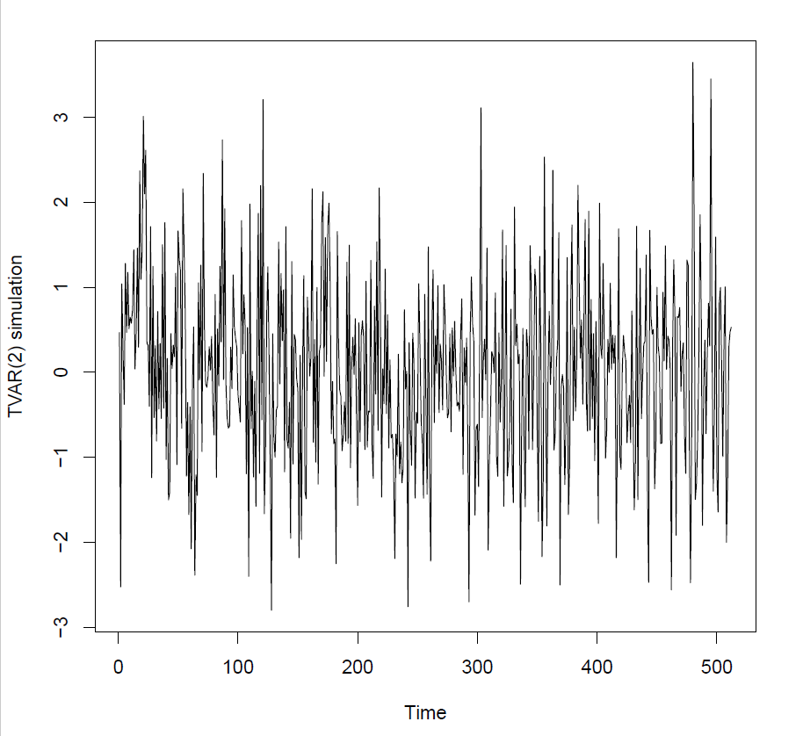

Locally stationary wavelet model – LPACF⁵
+ve auto-correlation
Why is it needed?
  Parameters of model change with time
  Model cannot be improved by adding more data
  Traditional forecasting uses AR models (Yule-Walker equations)
  AR order selected using partial auto-correlation function (PACF)
  LPACF picks up the local non-stationarity
Simulated example
White noise
-ve auto-correlation
$$X_{t}=alpha_{t} X\left\{t−2\right\}+N(0,1)$$
$$−0.6<alpha_{t}<0.6$$
5 Killick et al., 2017
Notes:
We have seen that the model parameters change with time and that adding more data (Longer period) doesn’t help. The traditional forcasting methods are based on AR models where the AR order is selected using the PACF.
A simulated example shows how auto-correlation might change through a data set. At the start the auto-correlation is positive, in the middle it becomes uncorrelated white noise and at the end it is negatively correlated.
Simulation so we know what we should get out
Autocorrelation changes
+ve – white noise - -ve
Range 0.6 to -0.6

Slide 36
Simulated example – 2-step ahead forecast
Current data point depends on what happened 2-steps ago so lag-1 ACF is centred on 0
Notes:
These plots show a 2-step ahead forecast of the data points – signal extracted from the noise. The wiggles at the beginning are the model war-up period.
The 2-step forecast looks at what happens 2-steps back so the current data-points depends only ONLY on what happened 2 steps back. So the lag-1 auto-correlation is centred on zero and and the lag-2 auto-correlation in this simuated example goes from 0.6 to -0.6 as expected.
The method quickly picks up changes in parameters and should result in more realistic confidence intervals. For further information on the method please contact the PI (reference given) for a pre-print of the paper.
Two-step ahead forecast
Current data-point only depends on what happens 2-steps back
1-step autocorrelation centred on 0
@-step

Slide 37
Simulated example – 2-step ahead forecast
Current data point depends on what happened 2-steps ago so lag-2 ACF ranges from 0.6 to -0.6 as expected
Current data point depends on what happened 2-steps ago so lag-1 ACF is centred on 0
Notes:
These plots show a 2-step ahead forecast of the data points – signal extracted from the noise. The wiggles at the beginning are the model war-up period.
The 2-step forecast looks at what happens 2-steps back so the current data-points depends only ONLY on what happened 2 steps back. So the lag-1 auto-correlation is centred on zero and and the lag-2 auto-correlation in this simuated example goes from 0.6 to -0.6 as expected.
The method quickly picks up changes in parameters and should result in more realistic confidence intervals. For further information on the method please contact the PI (reference given) for a pre-print of the paper.
2-step ahead ranges from 0.6 to -0.6 as expected
Picks up changes in parameters
Gives realistic confidence intervals

Slide 38
Simulated example – 2-step ahead forecast
Current data point depends on what happened 2-steps ago so lag-2 ACF ranges from 0.6 to -0.6 as expected
Current data point depends on what happened 2-steps ago so lag-1 ACF is centred on 0
Model stabilising (allow for this)
Notes:
These plots show a 2-step ahead forecast of the data points – signal extracted from the noise. The wiggles at the beginning are the model war-up period.
The 2-step forecast looks at what happens 2-steps back so the current data-points depends only ONLY on what happened 2 steps back. So the lag-1 auto-correlation is centred on zero and and the lag-2 auto-correlation in this simuated example goes from 0.6 to -0.6 as expected.
The method quickly picks up changes in parameters and should result in more realistic confidence intervals. For further information on the method please contact the PI (reference given) for a pre-print of the paper.
Process takes time to stabilise
Need to allow extra data for this
Preprint from first author (referenced)

Slide 39
LPACF forecast Skerton 2015
LPACF forecast adds variability
Most estimates are within the 95% confidence band
LPACF under-predicts the peak for storm Desmond
  But still predicts flooding
  Out-side 95% confidence
Timing issues
Storm Desmond
Notes:
The LPACF forecasts are shown for the period including storm Desmond in comparison with the observed levels and the KF adaptive forecast. LPACF reduces some of the peaks including Desmond (though still predicts flooding). Most of the variation between the methods is within the confidence limits.
LPACF forecast for storm Desmond
More variability than additive KF
Most estimates with 95% CI
Under-predicts Desmond peak – outside limits

Slide 40
Comparison between adaptive KF and LPACF
LPACF – more variability
Adaptive Kalman filter – CI comparable
Notes:
LPACF more variable than KF
Confidence intervals comparable
Some timing issues with LPACF

Slide 41
Comparison between adaptive KF and LPACF
LPACF – more variability
Adaptive Kalman filter – CI comparable
Notes:
LPACF underestimates Desmond
Adaptive KF overestimates
Bothe just outside 95% limits

Slide 42
Comparison between adaptive KF and LPACF
LPACF – more variability
Adaptive Kalman filter – CI comparable
Notes:
LPACF timing sometimes slightly out
LPACF adds some inapproriate variability
Both sets of estimates with 95% limits
Merit further investigation

Slide 43
Conclusions and further work
Both adaptive KF and LPACF methods provide estimates of the observed water-levels at Skerton Weir for storm Desmond generally with 95% confidence
Notes:
Both methods generally estimate the true values to within 95% confidence however there are variations. LPACF tends to reduce the estimated value – but not always. Future work includes investigating where the methods differ and when they over or under estimate. It would be useful to provide guidance on when it would be better to use one method rather than the other.
The interaction of river water and tides is important to forecasts at Lancaster Quay. The influence of the river on the tidal cycle is evident in the fast rise and slow tidal recession and will be included if the model is extended.
Both methods estimate WL at Skerton generally with 95% CI
Initial model estimates biased by extreme conditions

Slide 44
Conclusions and further work
Both adaptive KF and LPACF methods provide estimates of the observed water-levels at Skerton Weir for storm Desmond generally with 95% confidence
Where there are differences
  LPACF adds variability
  LPACF sometimes under-estimates - but not always
  Adaptive KF over-estimates Desmond, LPACF under-estimates
  The differences are not consistent
Notes:
Both methods generally estimate the true values to within 95% confidence however there are variations. LPACF tends to reduce the estimated value – but not always. Future work includes investigating where the methods differ and when they over or under estimate. It would be useful to provide guidance on when it would be better to use one method rather than the other.
The interaction of river water and tides is important to forecasts at Lancaster Quay. The influence of the river on the tidal cycle is evident in the fast rise and slow tidal recession and will be included if the model is extended.
Differences
LPACF adds variability
LPACF often underestimates but not always
KF over-estimates Desmond, LPACF under-estimates

Slide 45
Conclusions and further work
Both adaptive KF and LPACF methods provide estimates of the observed water-levels at Skerton Weir for storm Desmond generally with 95% confidence
Where there are differences
  LPACF adds variability
  LPACF sometimes under-estimates - but not always
  Adaptive KF over-estimates Desmond, LPACF under-estimates
  The differences are not consistent
Next steps
  Investigate the differences
  Draw up guidelines on when it is better to use each method
  Extend basic model to include tributaries and to cover tidal influence
  Look at effect of temporal resolution
Notes:
Both methods generally estimate the true values to within 95% confidence however there are variations. LPACF tends to reduce the estimated value – but not always. Future work includes investigating where the methods differ and when they over or under estimate. It would be useful to provide guidance on when it would be better to use one method rather than the other.
The interaction of river water and tides is important to forecasts at Lancaster Quay. The influence of the river on the tidal cycle is evident in the fast rise and slow tidal recession and will be included if the model is extended.
Adaptive KF works well for this data set
LPACF may not be approprate
LPACF may be appropriate for other data-sets/ sampling interevals
Investigate and provide guidelines
Extend model to include tidal interaction

Slide 46
Acknowledgements
Funding
  EPSRC through the Maths Forsees network
Support
  PI Rebecca Killick
  For unstinting advice and patience Wlodek Tych
Data
  Suzi Ilic
  Environment Agency

Slide 47
Selected references
Killick, R., Knight, M., Nason, G.P., Eckley, I.A. (2017) The Local Partial Autocorrelation Function and its Application to the Forecasting of Locally Stationary Time Series. Submitted – contact r.killick@lancaster.ac.uk for pre-print
Lees, M. J., Young, P. C., Ferguson, S., Beven, K. J. & Burns, J. 1994 An adaptive flood warning scheme for the River Nith at Dumfries. In 2nd International Conference on River Flood Hydraulics (ed. W. R. White & J. Watts), pp. 65–75. John Wiley & Sons, Chichester
Romanowicz, R, Young, PC & Beven, KJ 2006, 'Data assimilation and adaptive forecasting of water levels in the river Severn catchment, United Kingdom.' Water Resources Research, vol 42, no. 6, pp.
Smith PJ, Beven KJ, Horsburgh K. 2013. Data-based mechanistic modelling of tidally affected river reaches for flood warning purposes: an example on the River Dee, UK. Q. J. R. Meteorol. Soc. 139: 340–349.
Young, P. C., Pedregal, D. J. and Tych, W. (1999), Dynamic harmonic regression. J. Forecast., 18: 369–394.

Slide 48
Thank you for listening
Any questions?

Slide 49
Data available*
Rainfall | Station number |  | Grid Reference | Record start | Record end
Demings Moss | 580353 |  | NY55450655 | 01/01/2005 | 01/02/2016
Orton-Shallowford | 580058 |  | NY62460832 | 01/01/2005 | 01/02/2016
Wet Sleddale | 600986 |  | NY55301153 | 01/01/2005 | 01/02/2016
Flow | Datum m AOD | River | Grid Reference | Catchment area km² | Period
Lunes Bridge | 165.54 | Lune | NY61210289 | 141.5 | 10/07/2003 | 22/01/2017
Killington | 82.83 | Lune | SD62189063 | 219 | 10/07/2003 | 22/01/2017
Brigflatts | 83.13 | Rawthey | SD63949110 | 200 | 10/07/2003 | 22/01/2017
Hornby | 23.05 | Wenning | SD58556836 | 232 | 06/09/1990 | 22/01/2017
Caton | 10.66 | Lune | SD52866529 | 983 | 10/07/2003 | 21/11/2016
Skerton | 4.76 | Lune | SD48236334 | 1033 | 10/07/2003 | 05/05/2016
Tidal |  | River | Grid Reference |  | Period
Lancaster Quay |  | Lune | SD46136200 |  | 10/07/2003 | 14/11/2016
*Courtesy of the Environment Agency

