Slide 1
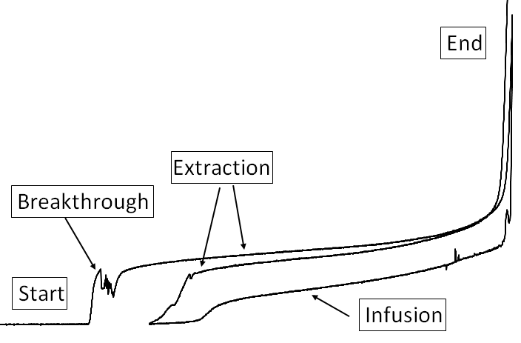
Continuous measurement of Soil-water characteristic curves at low suction levels
Z. Szilvagyi, Richard P. Ray, Katalin J. Bene
Széchenyi István University
Győr, Hungary
ray@sze.hu benekati@sze.hu

Slide 2
Our presentation today
Testing Equipment and Methods
Test Results
Complementary Tests
Conclusions and Caveats

Slide 3
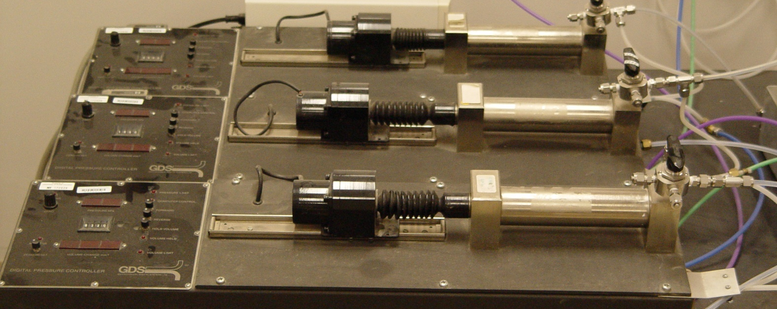
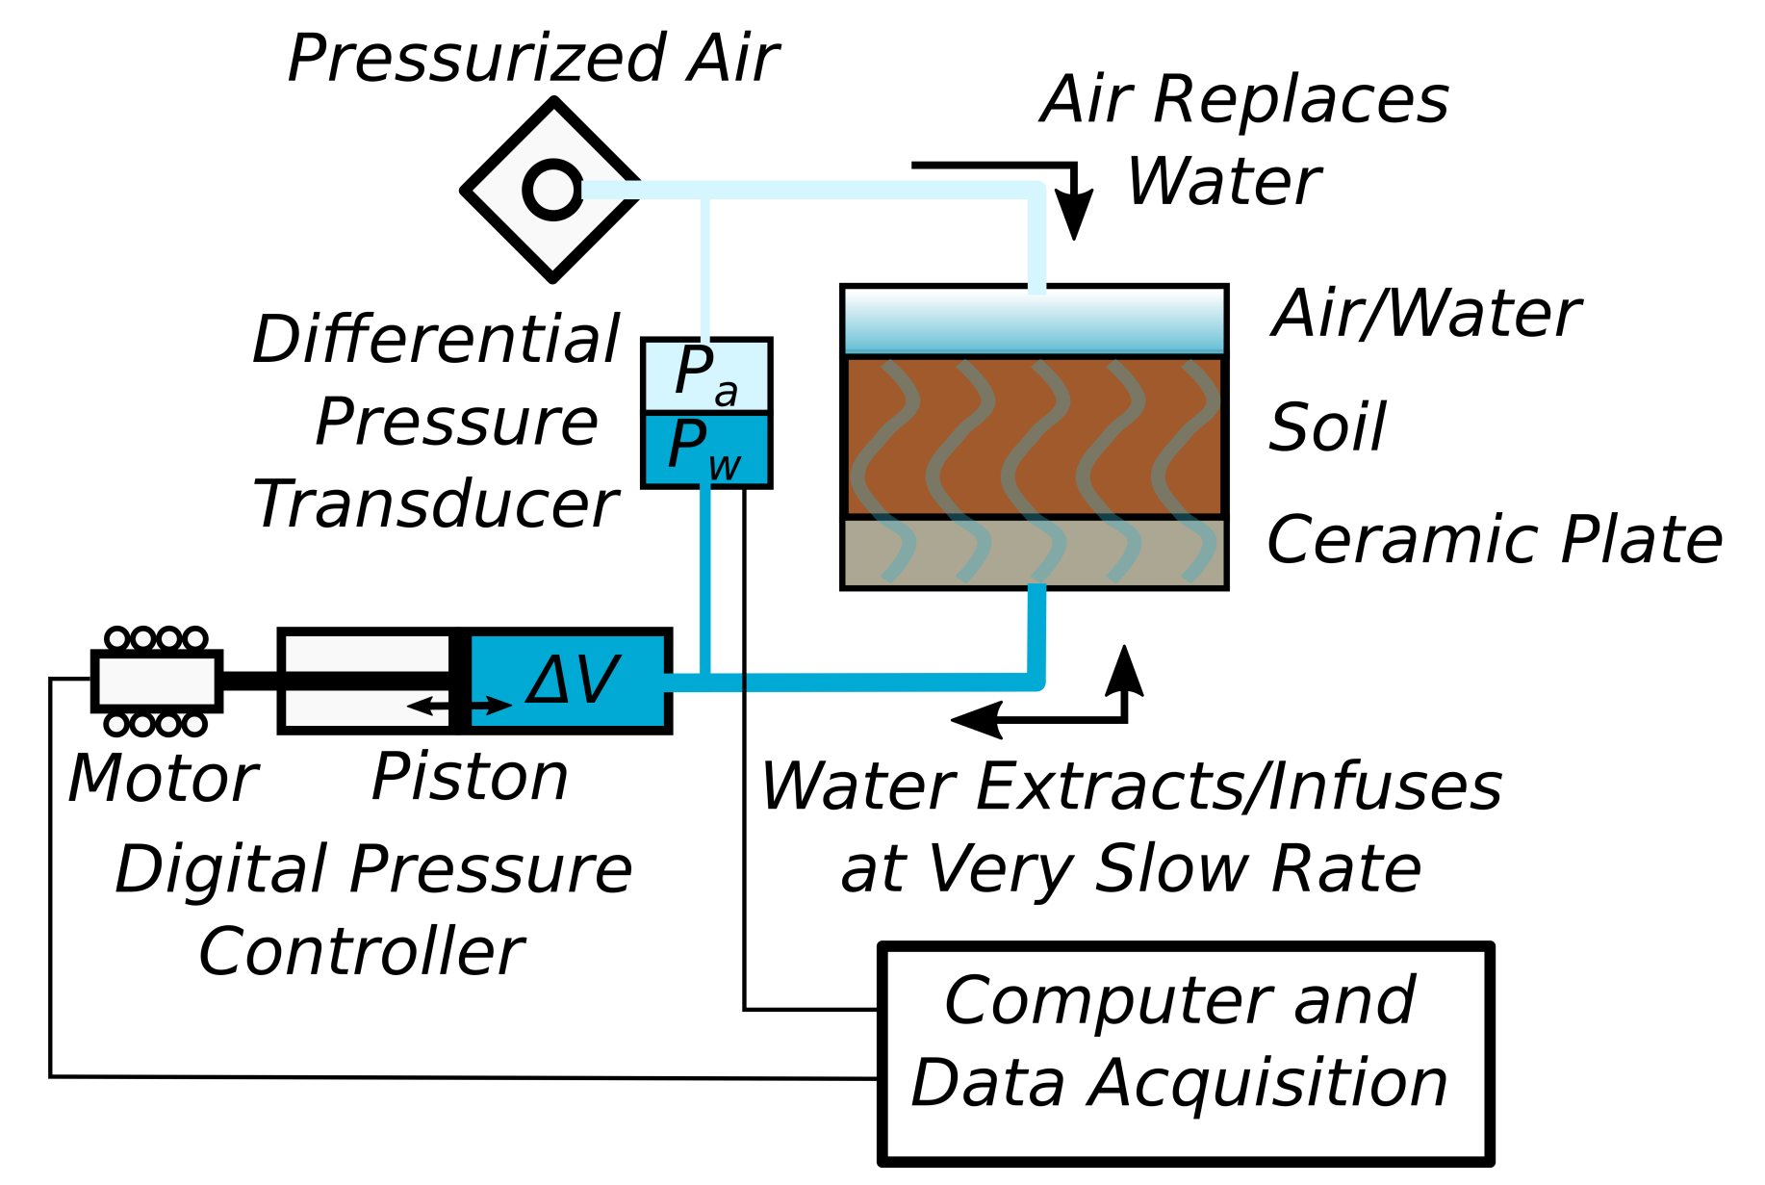
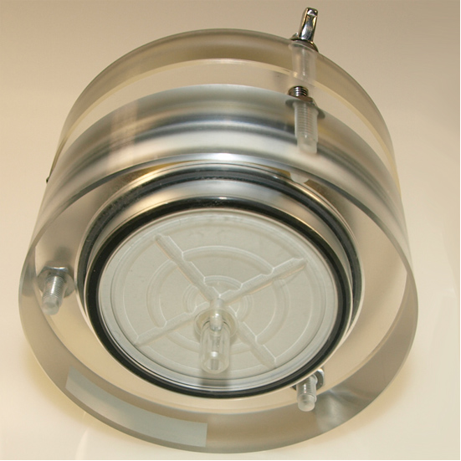
Testing Equipment-Concept

Slide 4
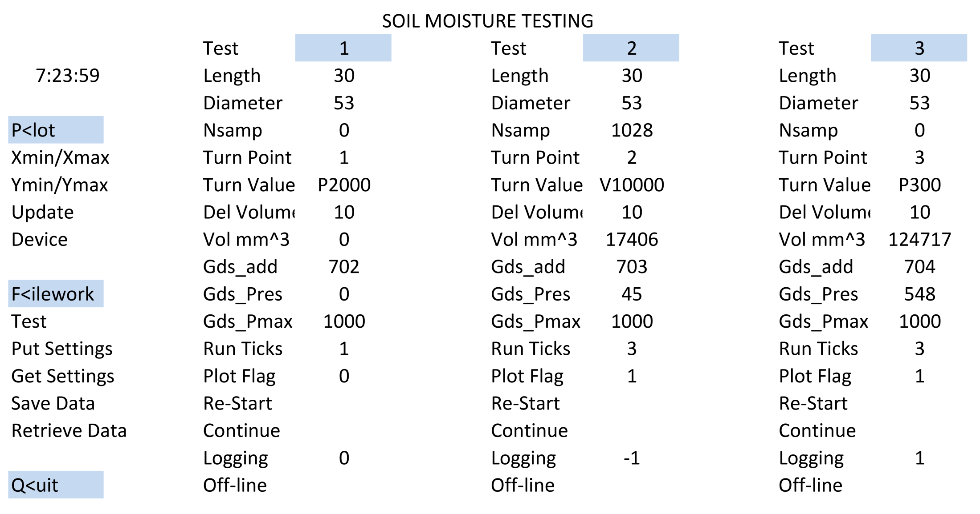
Testing Control

Slide 5
Testing Method
Soak Ceramics
Prepare Tempe Cell Underwater
Dry Pluviate or Place Specimen
Saturate Gently
De-air all tubing
Lock controller, pressurize
Slowly extract water from base
Monitor test, reverse, complete
Dump data

Slide 6
Testing Capabilities
Extract 0.5 mm³ per command
Arbitrary delay between extractions (1-10 sec)(15 hr +)
Maximum volume = 200 000 mm³
Pressure resolution = 1 cm H₂O for 1 Bar FS (1000 cm)
3 tests running simultaneously
Reversals specified as (-)pressure or volume, max10 pair
Sample built-up or from field
Maximum 20 000 data pairs (-pres, vol)
Results text file storage

Slide 7
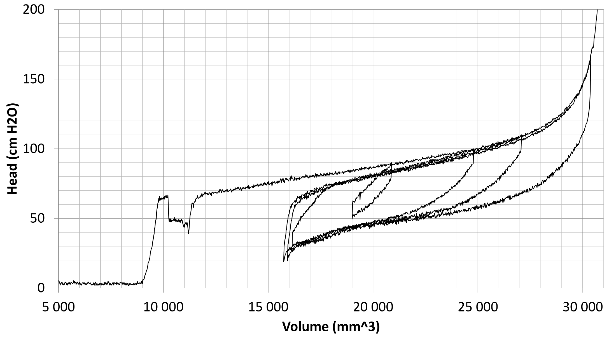
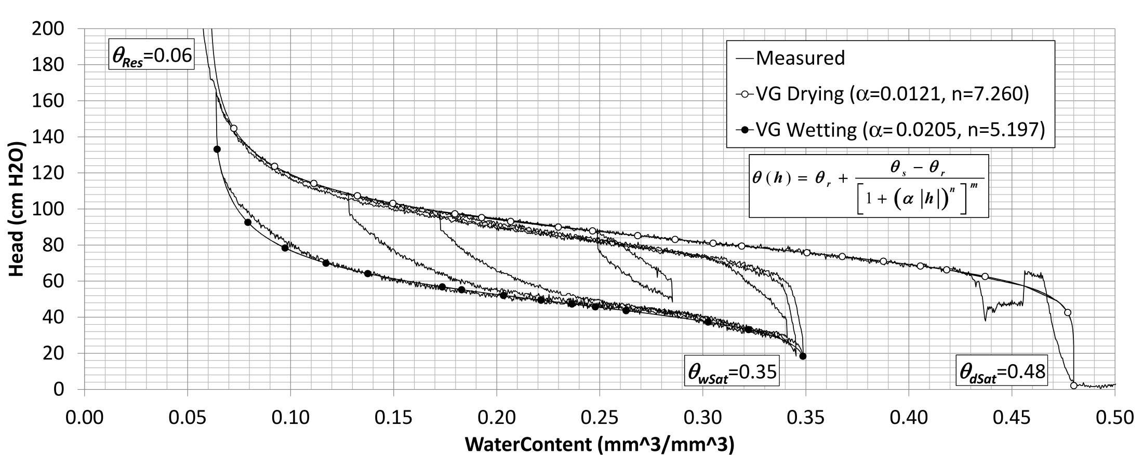
Testing Results – Fine Sand

Slide 8
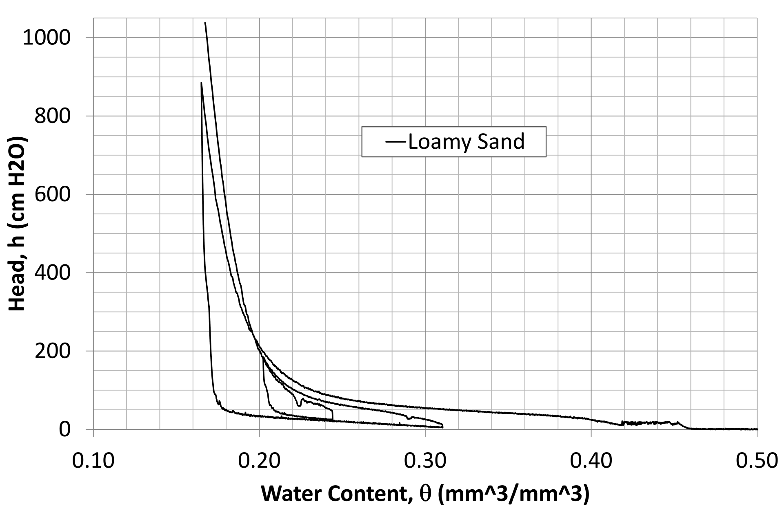
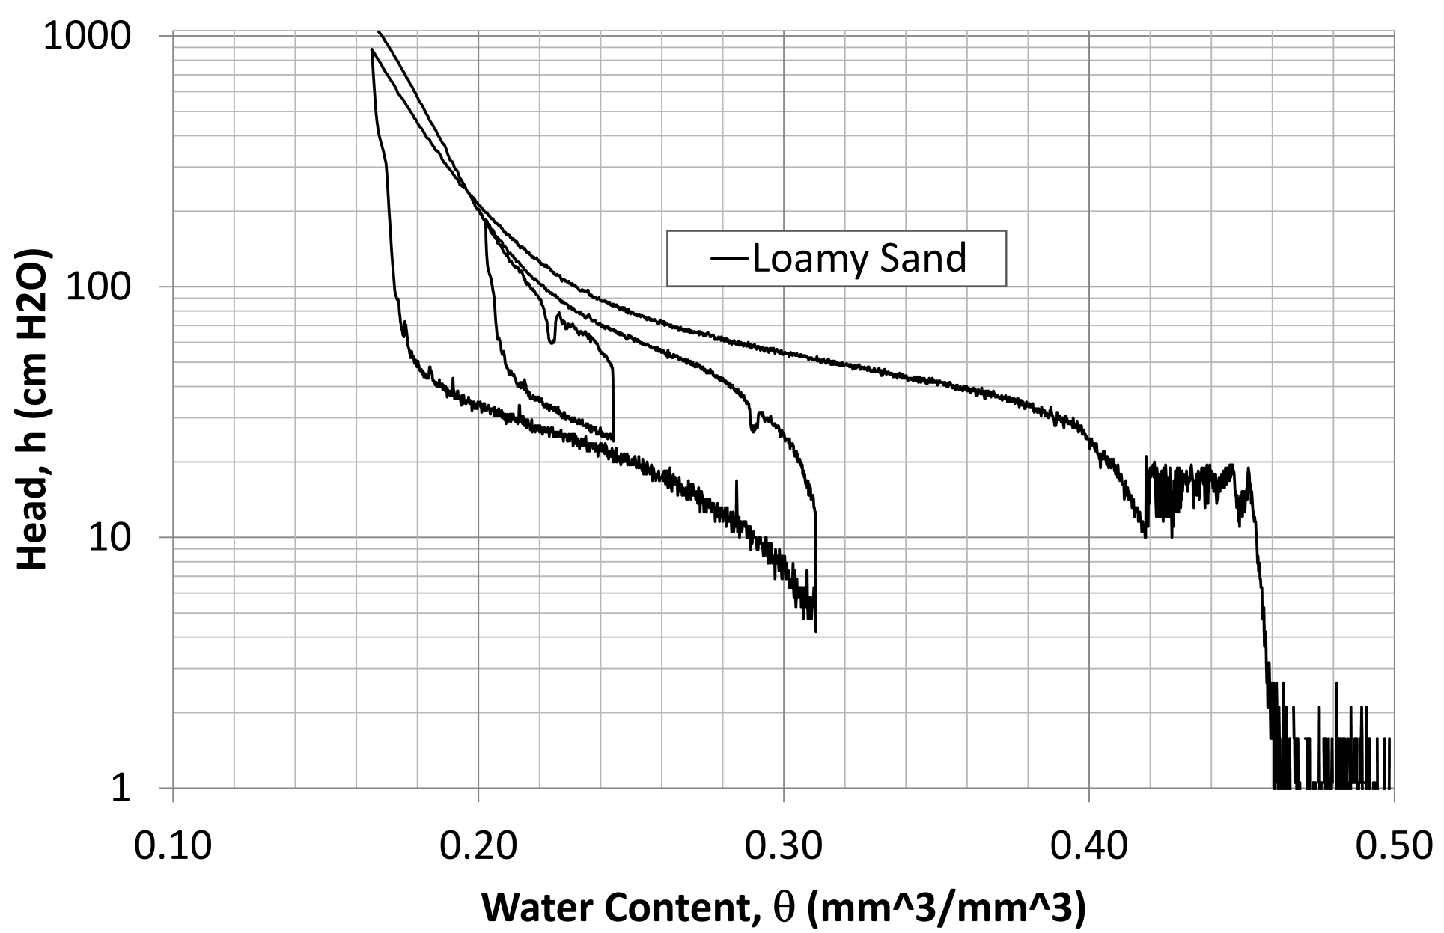
Loamy Sand

Slide 9
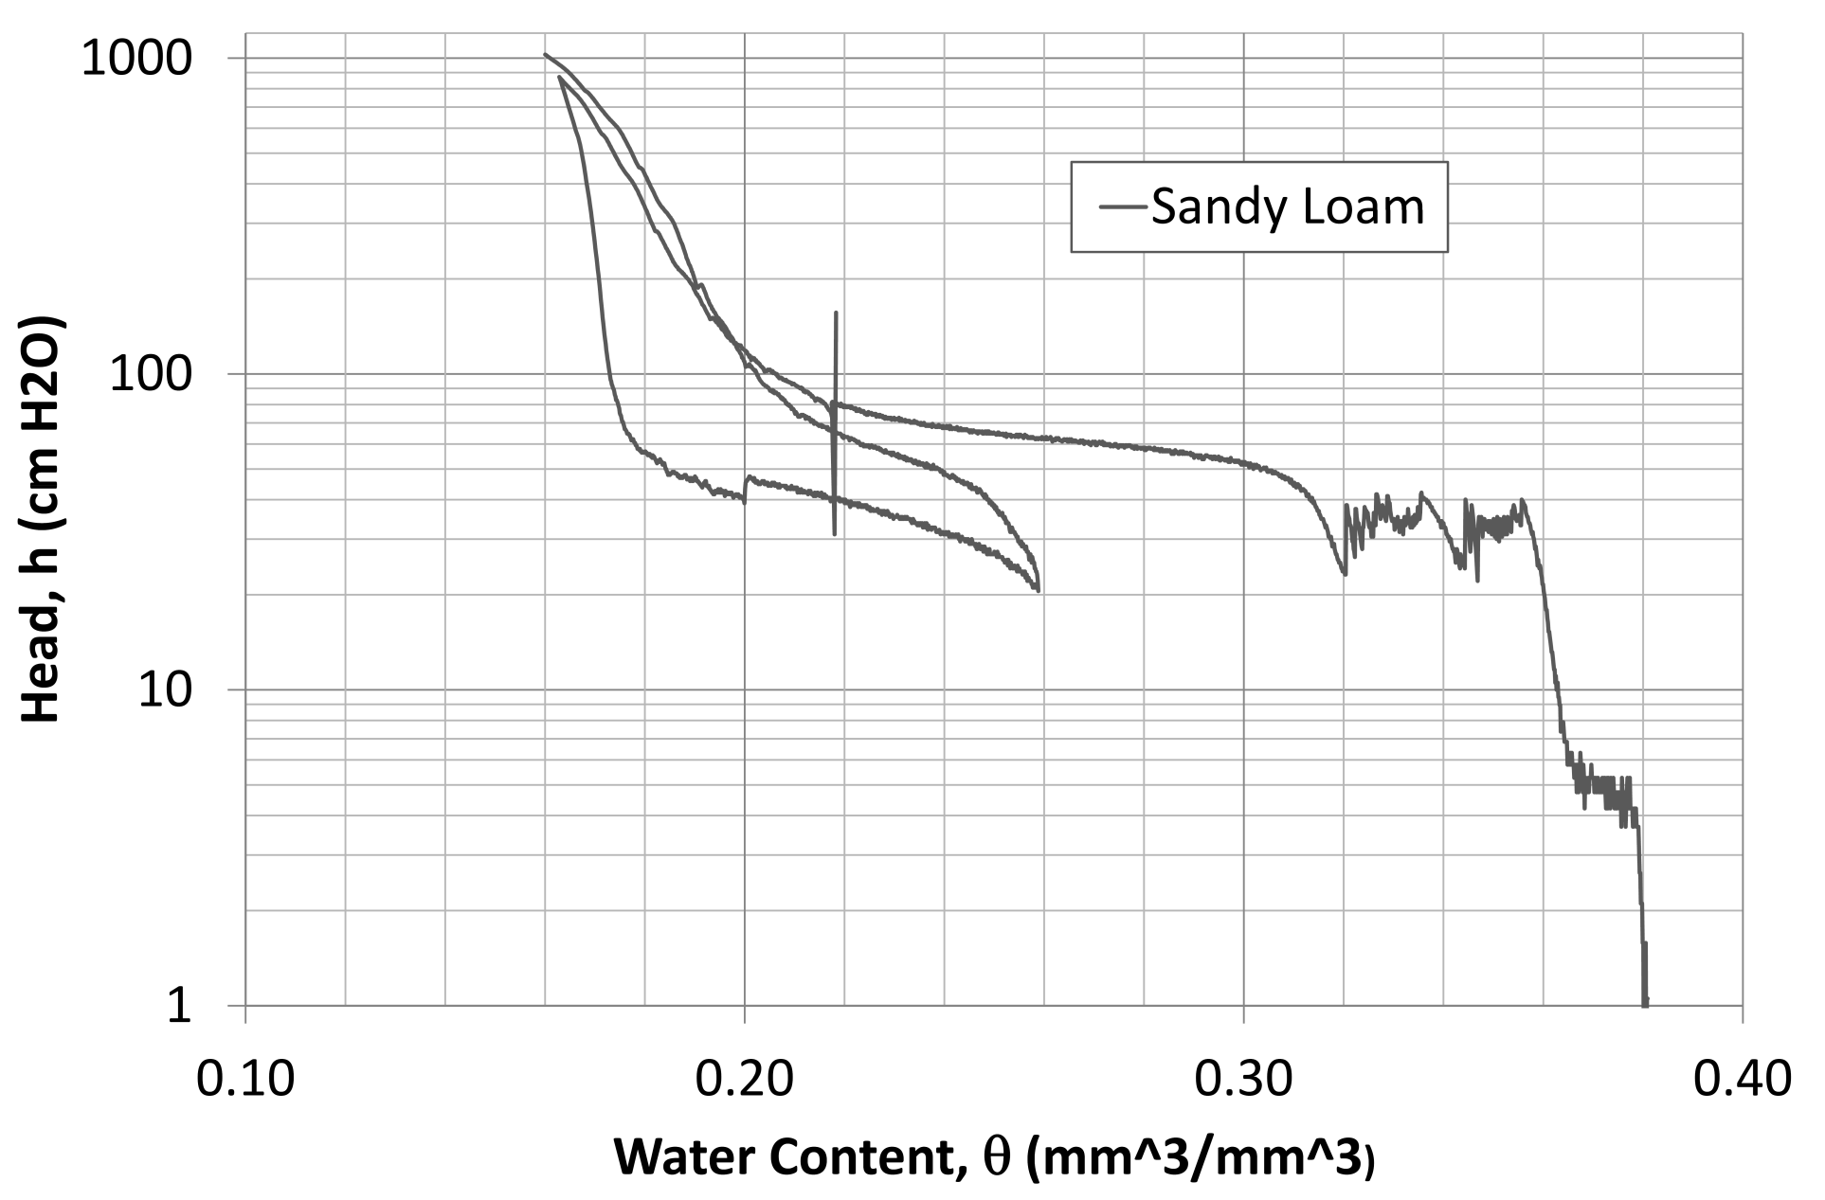
Sandy Loam-Sensor Power Lost

Slide 10
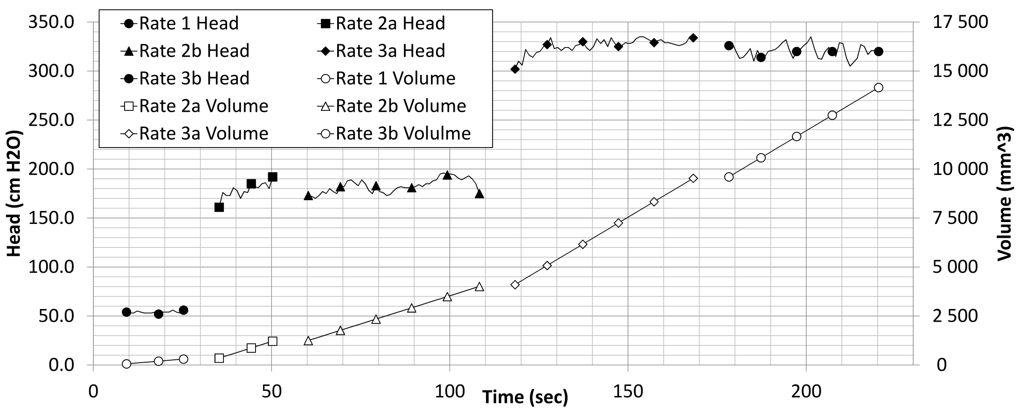
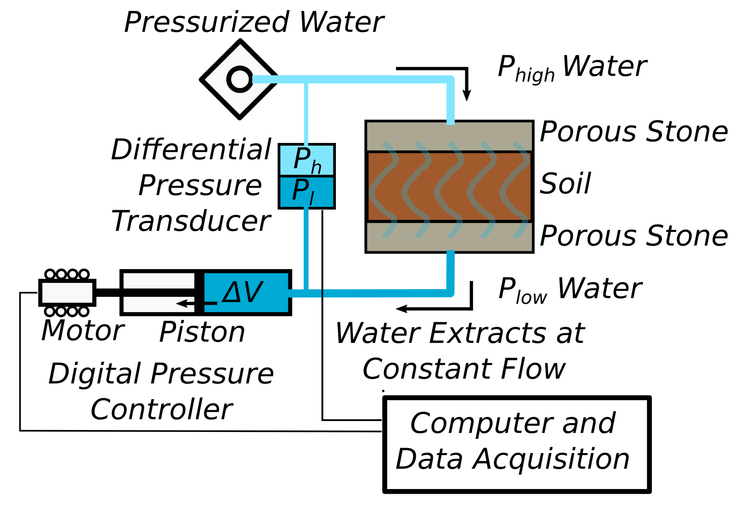
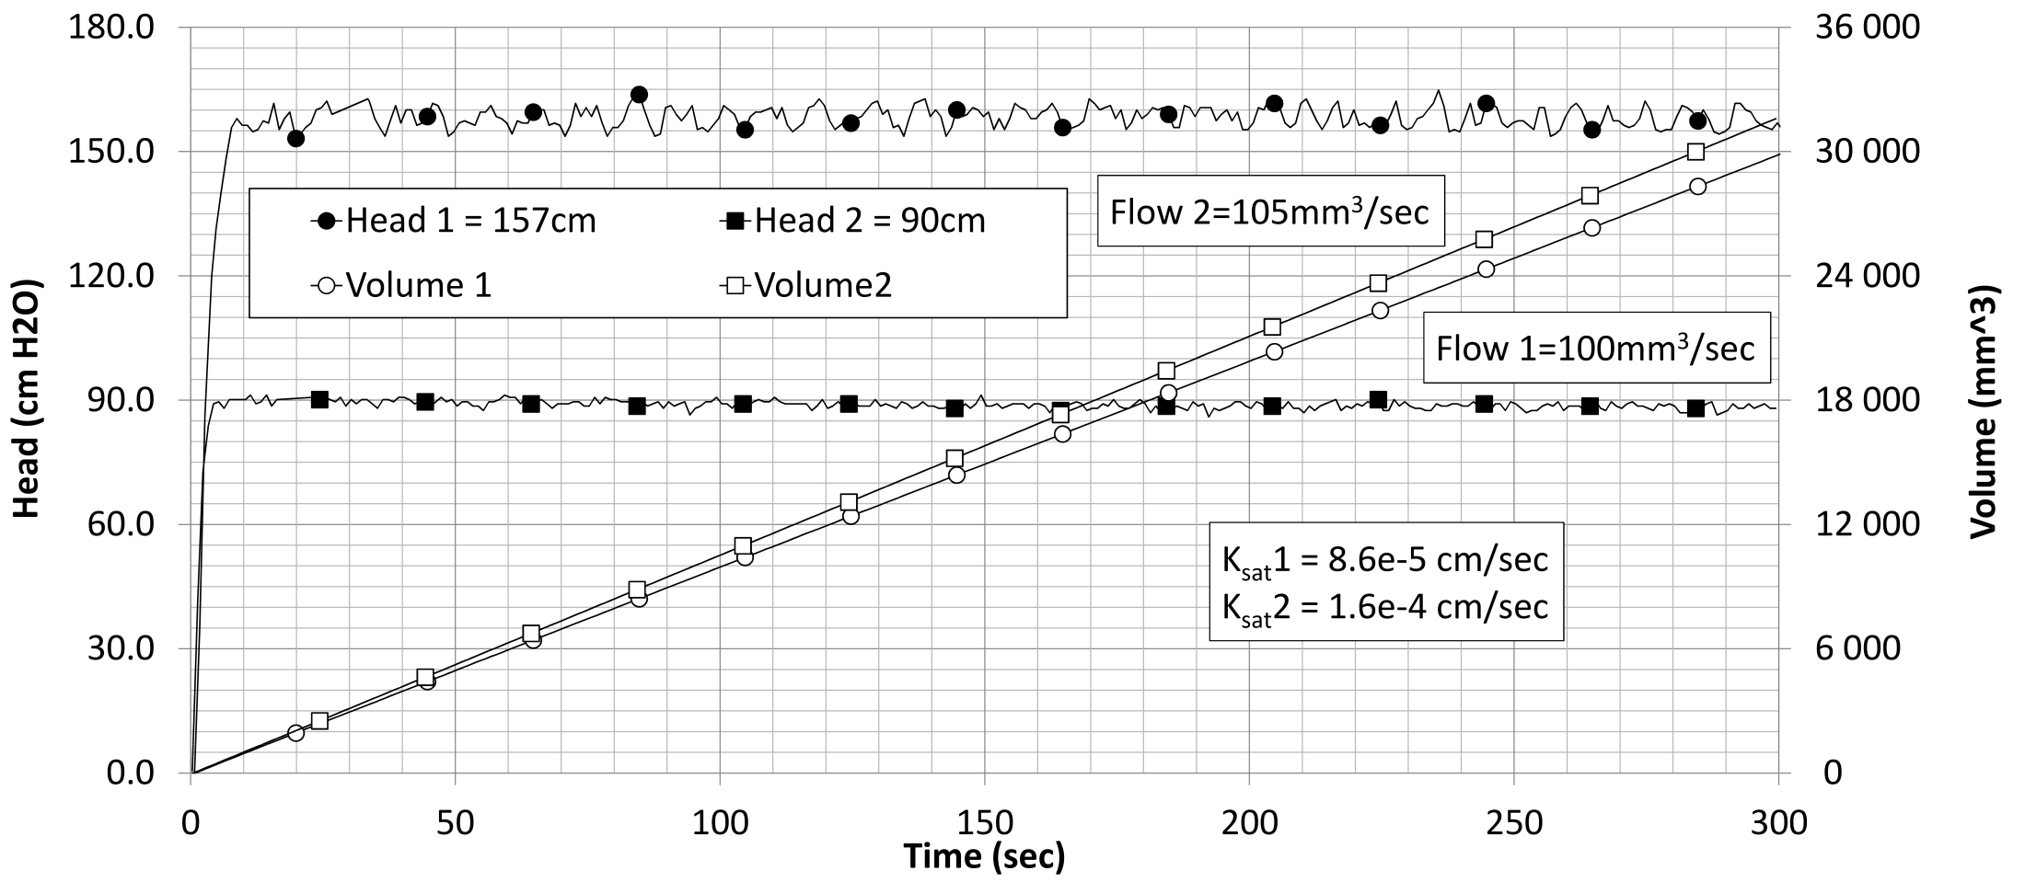
Ksat Tests
 | ΔHead | Δ Volume | Δ Time | Q | K_{sat}
Stage | (mm H₂O) | (mm³) | (sec) | (mm³/sec) | (m/sec)
1 | 538.2 | 245 | 16 | 15.31 | 3.87E-07
2a | 1785.0 | 862 | 15 | 57.47 | 4.38E-07
2b | 1828.4 | 2759 | 48 | 57.48 | 4.27E-07
3a | 3259.8 | 5428 | 50 | 108.56 | 4.53E-07
3b | 3202.6 | 4560 | 42 | 108.57 | 4.61E-07

Slide 11
Conclusions and Caveats
Controlled flow extraction produces reliable, repeatable results
Testing duration is relatively short for the amount of data generated
Extraction/Infusion rate is important to control (estimate from anticipated k(h) )
Volume change is often negligible, if not there are other ways to measure it.
Database of test results is being constructed, about 100 SWWC tests and 150 ksat on different soils

Slide 12
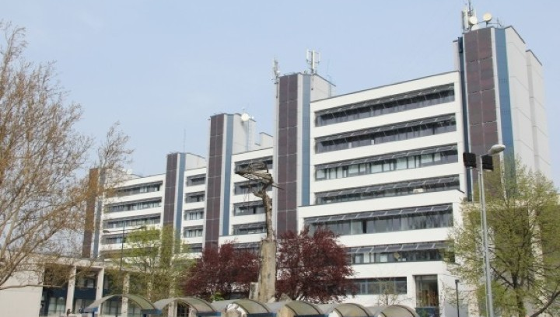
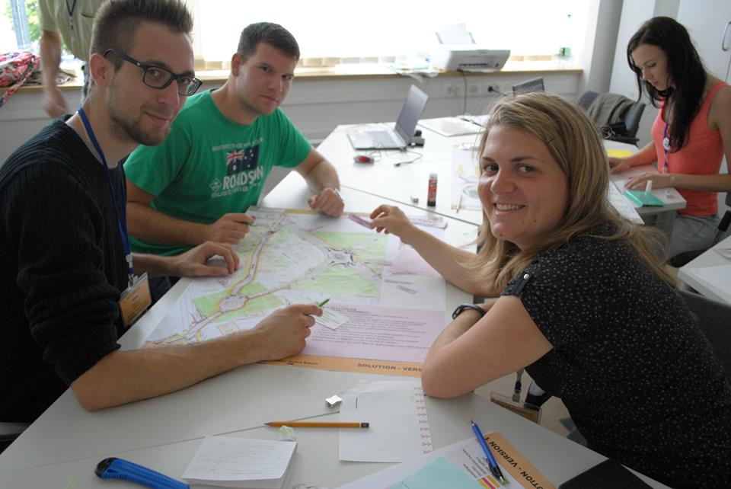
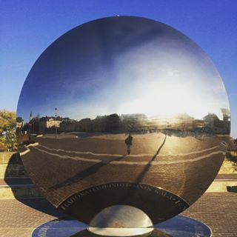
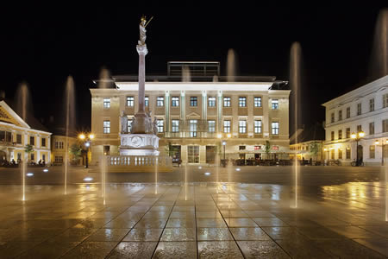
Thanks, come visit us in Győr !
ray@sze.hu benekati@sze.hu

