Slide 1
Present-day irrigation mitigates heat extremes
The challenge
The idea
Model skill
Impact on extremes

Slide 2
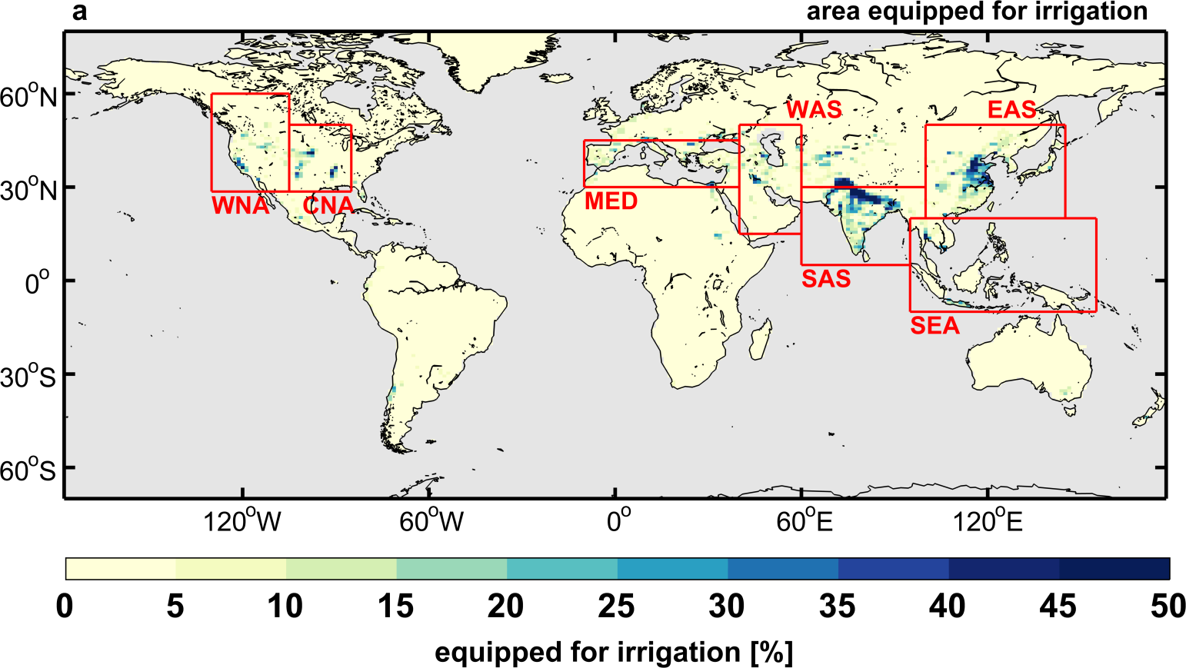
Present-day irrigation mitigates heat extremes
The challenge
The idea
Model skill
(Adapted from Siebert et al., 2005)
Impact on extremes

Slide 3
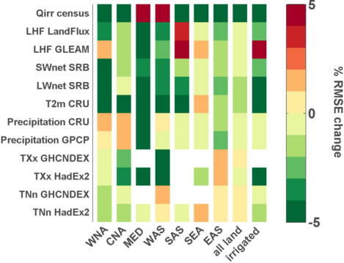
Present-day irrigation mitigates heat extremes
The challenge
The idea
Model skill
(Thiery et al., JGR 2017)
More on
Impact on extremes
nnnnnnnnnIrrigation amounts

Slide 4
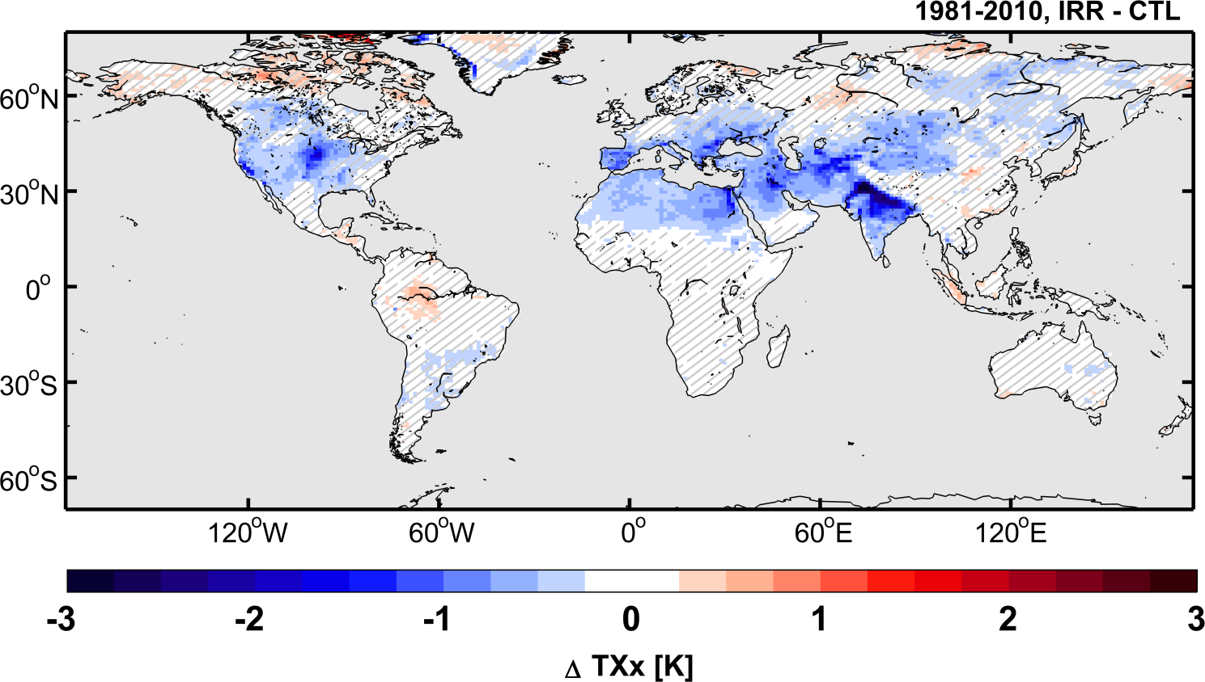
Present-day irrigation mitigates heat extremes
The challenge
More on
The idea
NnnnnnnnnImpact asymmetry
(Thiery et al., JGR 2017)
NnnnnnnnnImpact on means
Model skill
nnnnnnnnnSEB
Impact on extremes
nnnnnnnnnSubgrid scale

Slide 5
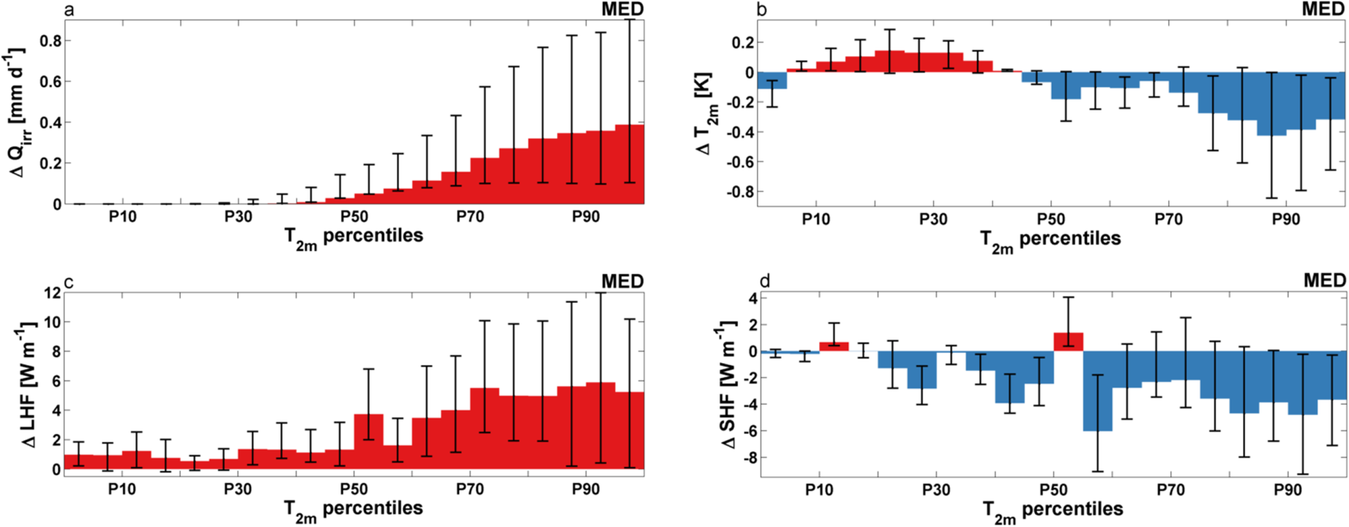
Present-day irrigation mitigates heat extremes
The challenge
More on
The idea
(Thiery et al., JGR 2017)
NnnnnnnnnImpact asymmetry
Model skill
NnnnnnnnnImpact on means
nnnnnnnnnSEB
Impact on extremes
nnnnnnnnnSubgrid scale

Slide 6
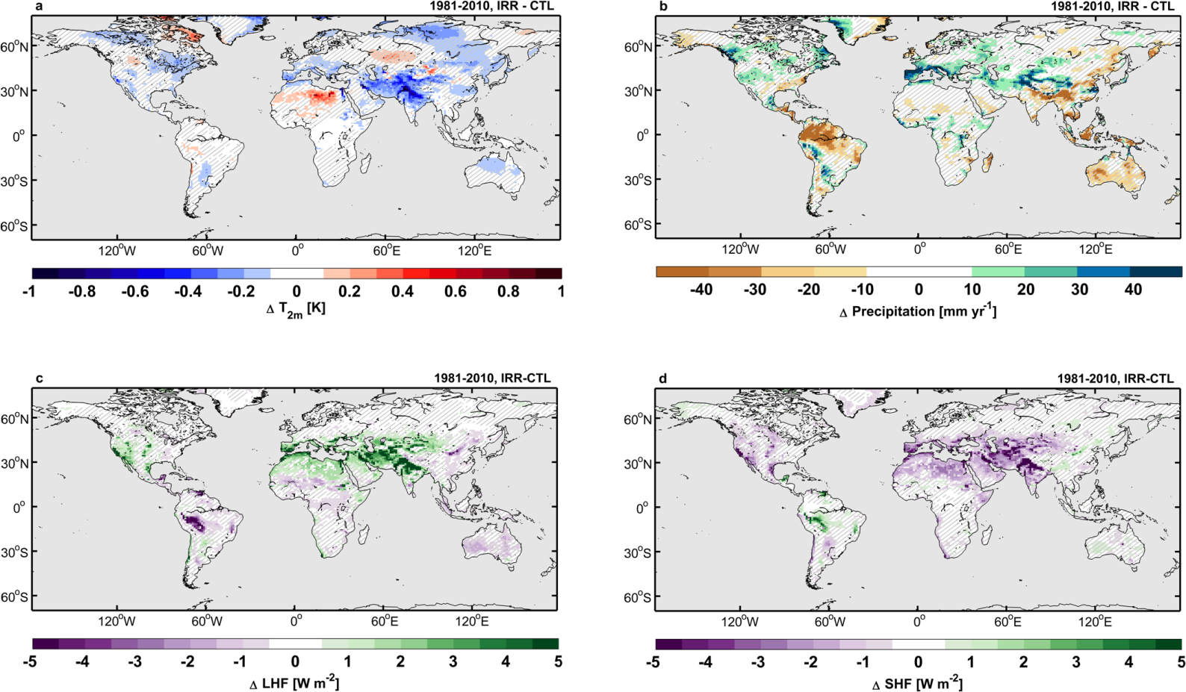
Present-day irrigation mitigates heat extremes
The challenge
More on
The idea
NnnnnnnnnImpact asymmetry
Model skill
NnnnnnnnnImpact on means
(Thiery et al., JGR 2017)
nnnnnnnnnSEB
Impact on extremes
nnnnnnnnnSubgrid scale

Slide 7
Present-day irrigation mitigates heat extremes
The challenge
More on
The idea
NnnnnnnnnImpact asymmetry
(Thiery et al., JGR 2017)
Model skill
NnnnnnnnnImpact on means
nnnnnnnnnSEB
Impact on extremes
nnnnnnnnnSubgrid scale

Slide 8
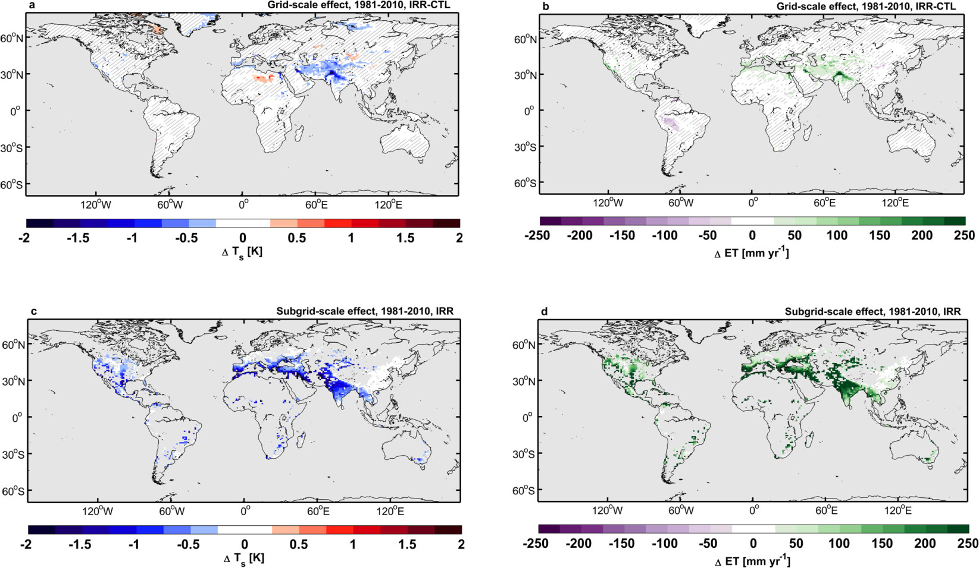
Present-day irrigation mitigates heat extremes
The challenge
More on
The idea
NnnnnnnnnImpact asymmetry
Model skill
NnnnnnnnnImpact on means
(Thiery et al., JGR 2017)
nnnnnnnnnSEB
Impact on extremes
nnnnnnnnnSubgrid scale

Slide 9
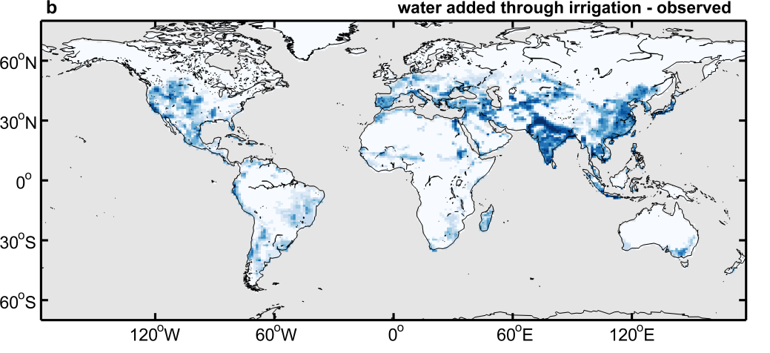
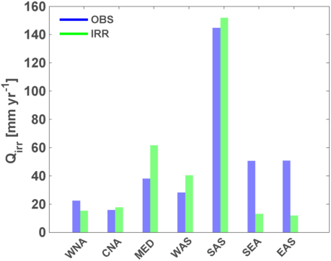
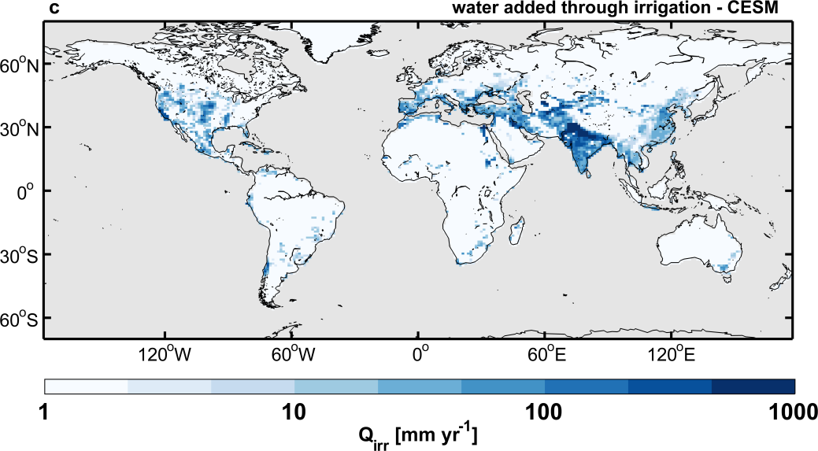
Present-day irrigation mitigates heat extremes
The challenge
The idea
(Thiery et al., JGR 2017)
Model skill
More on
Impact on extremes
nnnnnnnnnIrrigation amounts

Slide 10
Present-day irrigation mitigates heat extremes
The challenge
More on
The idea
NnnnnnnnnImpact asymmetry
Model skill
NnnnnnnnnImpact on means
nnnnnnnnnSEB
Impact on extremes
nnnnnnnnnSubgrid scale

