Slide 1
Session: HS2.4.4
EGU2017-18319
Modification of land-atmosphere interactions by CO2 effects
Léo Lemordant¹ , Pierre Gentine¹, Marc Stéfanon², Philippe Drobinski³, Simone Fatichi⁴
leo.lemordant@columbia.edu
¹ Earth & Env. Eng. Dept, Columbia University, USA
² CEA / LSCE, France
³ LMD, CNRS/IPSL, Ecole Polytechnique, France
⁴ Institute of Environmental Engineering, ETH Zurich, Switzerland
April, 25th 2017

Slide 2
Motivation (1/2)
Motivation
Leo Lemordant

Slide 3
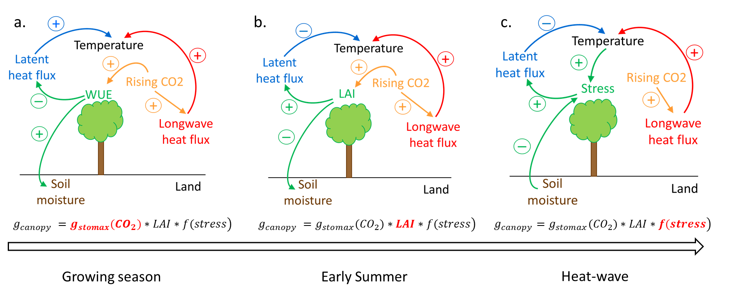
Motivation (2/2)
Motivation
CO₂-enriched atmosphere feedbacks on Temperature and Water Cycle:
contradictory
temporally intertwined
CO₂ ↗ WUE ↗ LH ↘ T ↗
CO₂ ↗ LAI ↗ LH ↗ T ↘
WUE ↗ SM ↗ stress ↘ LH ↗ T ↘
Leo Lemordant

Slide 4
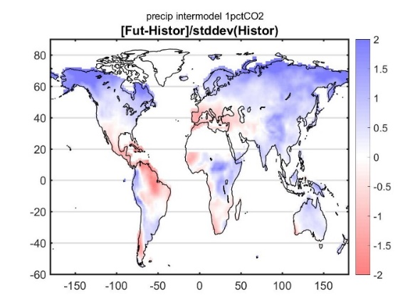
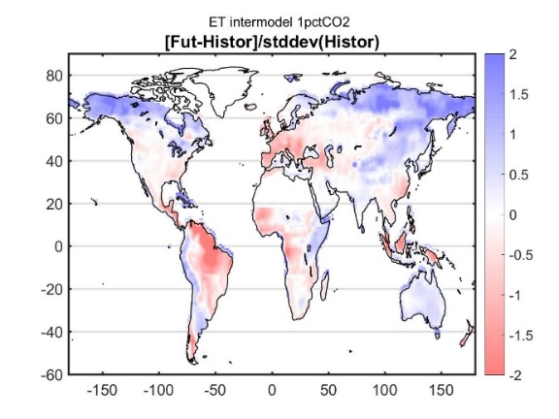
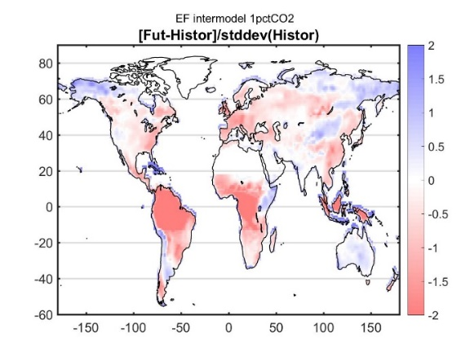
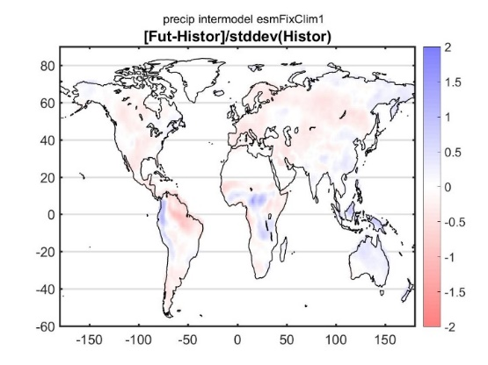
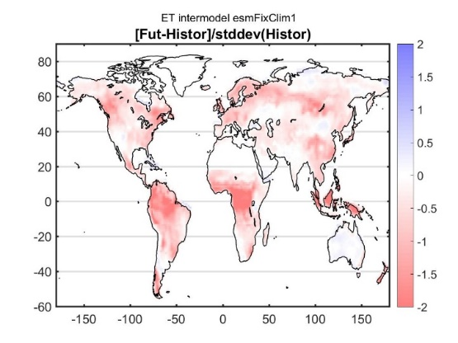
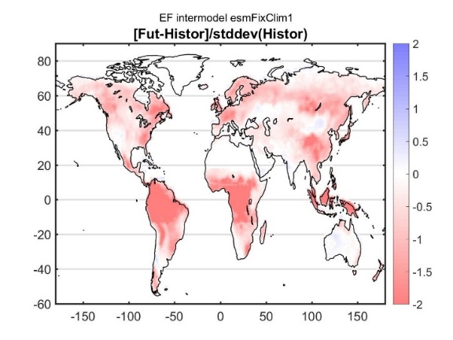
1st approach(1/1)
1st approach: Statistical analysis with GCMs
Precip
ET
EF
CTL
FER
Lemordant et al., submitted
=> Strong physiological feedback onto the water cycle
Leo Lemordant

Slide 5
2nd Approach (1/5)
2nd Approach: Process level how one particular event would be different under 2100 CO2?
France heatwaves in 2003
Consequences
France:
15,000 deaths
Mortality increased by 55% over the 1st three weeks of Aug
Similar stories all over Western Europe
Stéfanon 2012
And… such extreme events are believed to occur more often with climate change !
Leo Lemordant

Slide 6
2nd Approach (2/5)
Design of the RCM experiment
Regional scale: 10x15deg domain centered on France
Coupling of an atmospheric model (WRF) with a surface model (ORCHIDEE)
Boundaries: 2003 ERA-I temperature
CO2 (in ppm) | WRF | ORCHIDEE | Effect investigated
CTL | 373 | 373 | Control
FER | 373 | 935 | Vegetation response
FER_{dry} | 373 | 935 | Replica of FER with soil moisture of CTL
FER - FER_{dry} isolates the water cycle feedback
Leo Lemordant

Slide 7
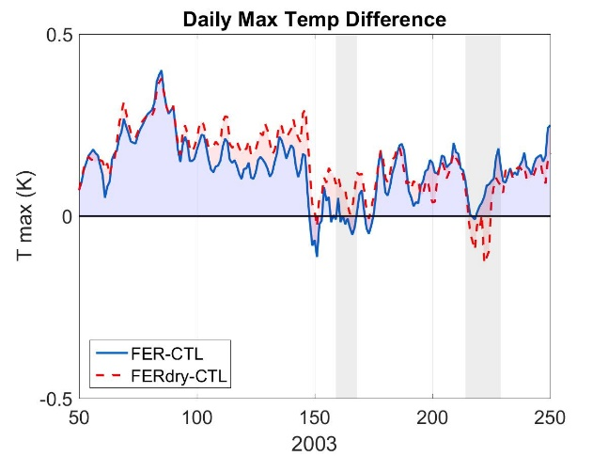
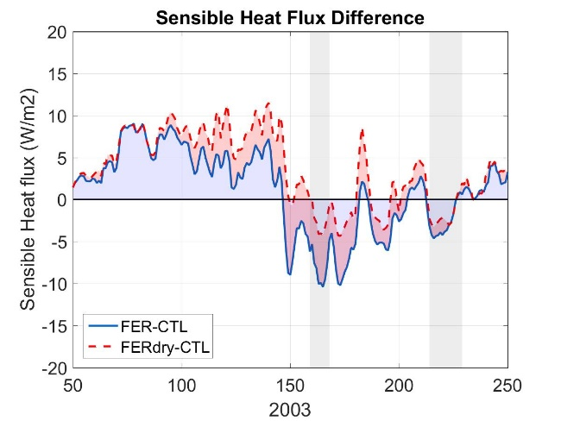
2nd Approach (3/5)
Temperature
Heat wave periods
LAI & Stress
WUE
LAI & Stress
WUE
WUE feedback
LAI feedback
Water cycle feedback
Leo Lemordant

Slide 8
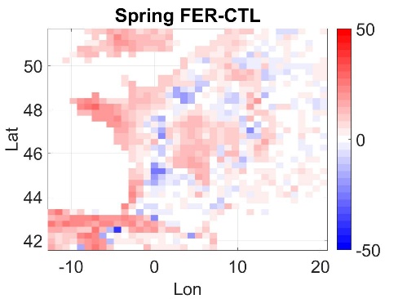
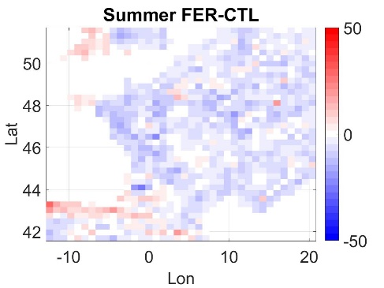
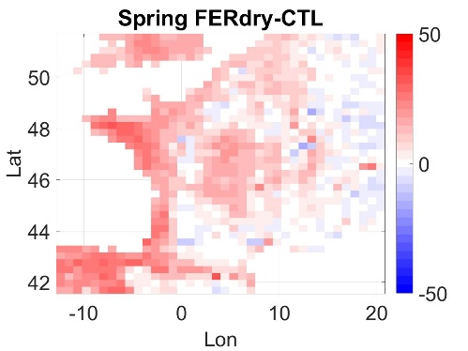
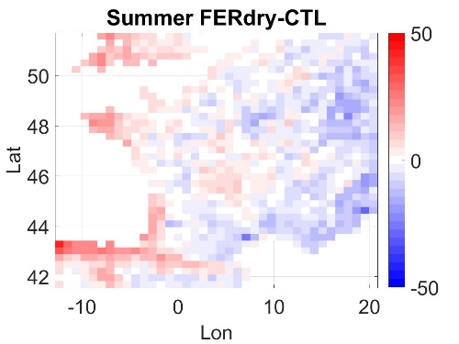
2nd Approach (4/5)
Sensible Heat Flux
FER
FER_{dry}
Leo Lemordant

Slide 9
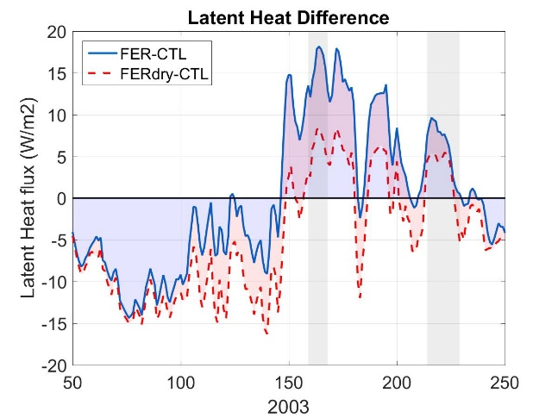
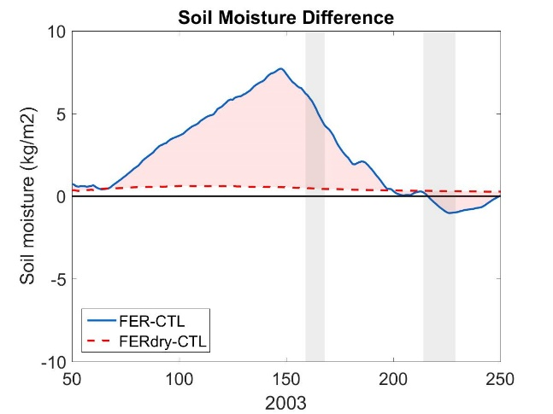
2nd Approach (5/5)
Water cycle & energy distribution altered: role of the soil moisture
Water cycle feedback
WUE
WUE
LAI & Stress
LAI & Stress
Leo Lemordant

Slide 10
Wrap-up (1/1)
Main conclusions
Carbon-water cycle feedback leads to 2 regimes
1- Growing season: WUE enhancement
=> soil moisture build-up during the growing season
=> Temperature increases ~ Radiative Forcing
2- Summer & heat-wave: LAI enhancement + extra-soil moisture
=> soil moisture mobilization to sustain higher LH
=> Temperature and sensible heat flux reduction
CO2 physiological mitigation of heat waves
=> Vegetation carbon cycle is essential to accurately estimate future heat waves, dryness through land-atmosphere interactions
Leo Lemordant

Slide 11
Danke schön!
Léo Lemordant
leo.lemordant@columbia.edu
Earth and Environmental Engineering Dept

Slide 12
Works cited
Keenan, T. F., Hollinger, D. Y., Bohrer, G., Dragoni, D., Munger, J. W., Schmid, H. P., & Richardson, A. D. (2013). Increase in forest water-use efficiency as atmospheric carbon dioxide concentrations rise. Nature, 499(7458), 324–7.
Morgan, J. a et al. C4 grasses prosper as carbon dioxide eliminates desiccation in warmed semi-arid grassland. Nature 476, 202–205 (2011)
Hussain, M. Z. et al. Future carbon dioxide concentration decreases canopy evapotranspiration and soil water depletion by field-grown maize. Glob. Chang. Biol. 19, 1572–1584 (2013).
Leuzinger, S. & Körner, C. Water savings in mature deciduous forest trees under elevated CO2. Glob. Chang. Biol. 13, 2498–2508 (2007).
Ainsworth, E. a. & Long, S. P. What have we learned from 15 years of free-air CO2 enrichment (FACE)? A meta-analytic review of the responses of photosynthesis, canopy properties and plant production to rising CO2. New Phytol. 165, 351–372 (2005).
Effects of interactive vegetation phenology on the 2003 summer heat waves, Marc Stéfanon, Philippe Drobinski, Fabio D’Andrea, and Nathalie de Noblet-Ducoudré, Journal of Geophysical Research: Atmospheres, 2012
Leo Lemordant

