Slide 1
The World Radiation Monitoring Center
of the Baseline Surface Radiation Network
Status April 2017
Amelie Driemel, Gert König-Langlo, Rainer Sieger, and Charles N Long

Slide 2
Definitions
Baseline Surface Radiation Network (BSRN)
Global observatory network providing observations of the best possible quality for short- & long-wave surface radiation fluxes in 1 min resolution
World Radiation Monitoring Center (WRMC)
The WRMC is the central archive for all data from the BSRN, since 2008 operated at the Alfred-Wegener Institut in Bremerhaven
In 2017 the director changed from G. König-Langlo to A. Driemel

Slide 3
Definitions
Baseline Surface Radiation Network (BSRN)
Global observatory network providing observations of the best possible quality for short- & long-wave surface radiation fluxes in 1 min resolution
World Radiation Monitoring Center (WRMC)
The WRMC is the central archive for all data from the BSRN, since 2008 operated at the Alfred-Wegener Institut in Bremerhaven
In 2017 the director changed from G. König-Langlo to A. Driemel

Slide 4
Data overview, status 04-2017
1 | LR 0100: Global, Diffuse, Direct, Long-wave down | 59 stations
2 | LR 0300: Reflex, Long-wave up | 15 stations
3 | LR 0500: UV | 12 stations
4 | LR 1000: Synops | 13 stations
5 | LR 1100: Upper air soundings | 30 stations
6 | LR 1200: Total ozone | 9 stations
7 | LR 1300: Ceilometer data | 3 stations
8 | LR 30x0: Radiation measurements from tower | 13 stations
Status April 2017, LR0100 >9500 monthly datasets (>790 years)

Slide 5
Stations temporal range
1992 2017

Slide 6
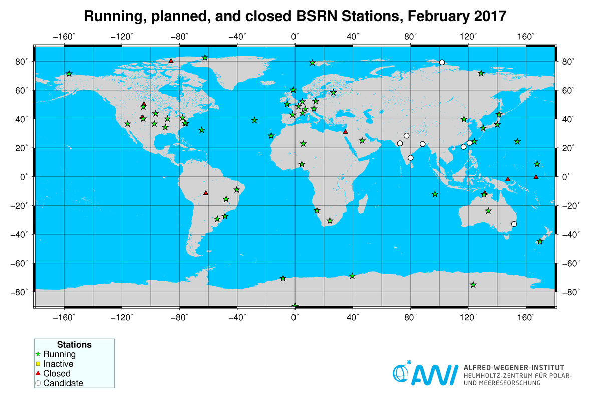
Stations geographical range

Slide 7
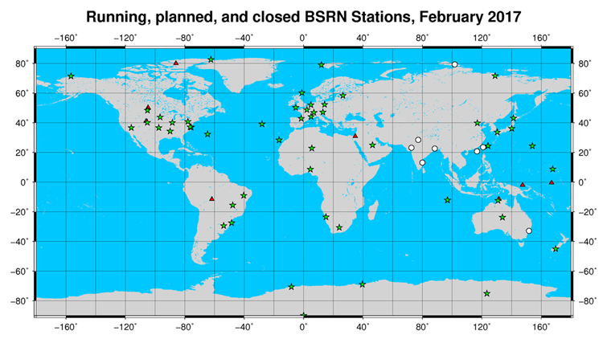
Stations with complete budget

Slide 8
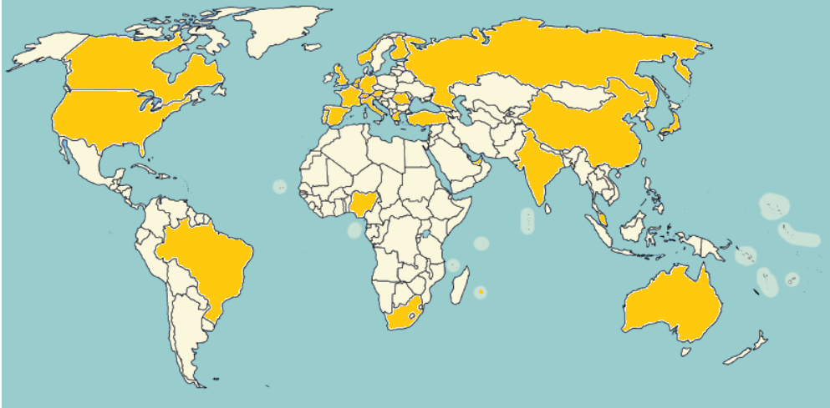
Data usage
April 2016 - April 2017 in total 140 access requests from 33 countries

Slide 9
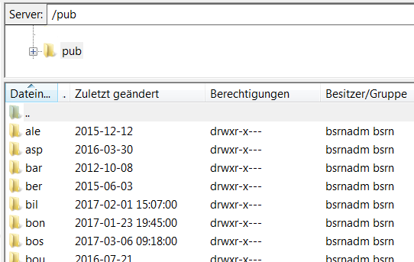
Data extraction
ftp server: ftp.bsrn.awi.de station-to-archive files
PANGAEA: https://dataportals.pangaea.de/bsrn/

Slide 10
Ongoing issues
Some stations closed/no longer maintained/with financial problems
Data submission in arrears => inactive status will be introduced
Some quality issues e.g. in remote areas difficult to manage
Discussion on WSG/WISG standard, see e.g. Nyeki et al. 2017 doi:10.5194/amt-2017-41

Slide 11
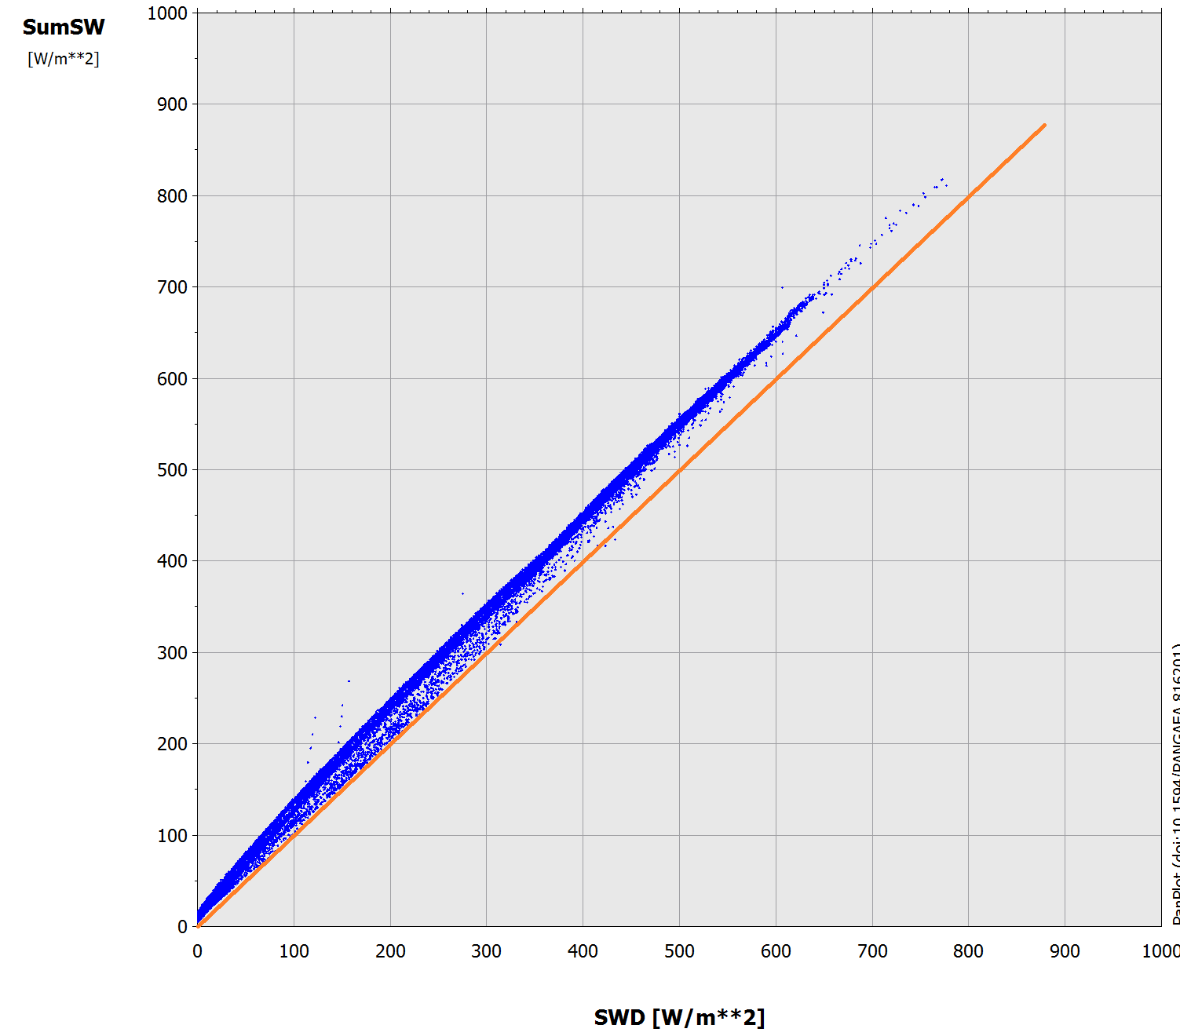
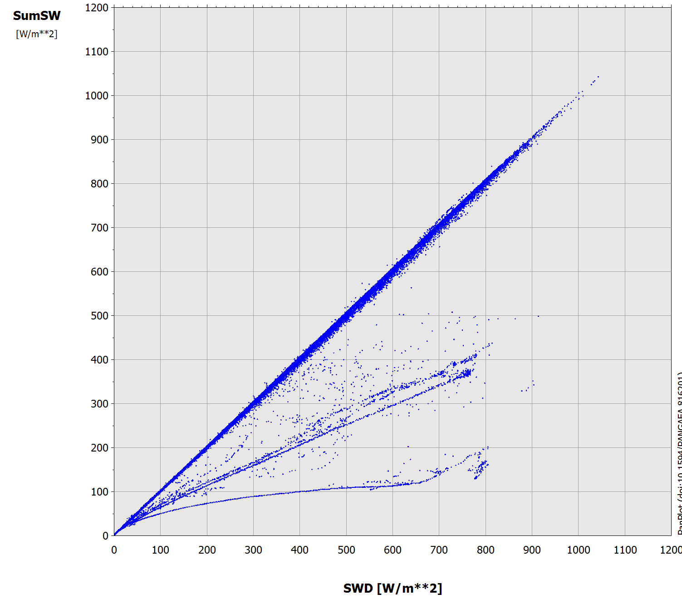
Ongoing issues

Slide 12
Thanks!
….To all station scientists and technicians working to keep BSRN alive

Slide 13
Thanks!
….To Gert König-Langlo who was WRMC director for the last 10 years and who retires at the end of this month
Gert

Slide 14
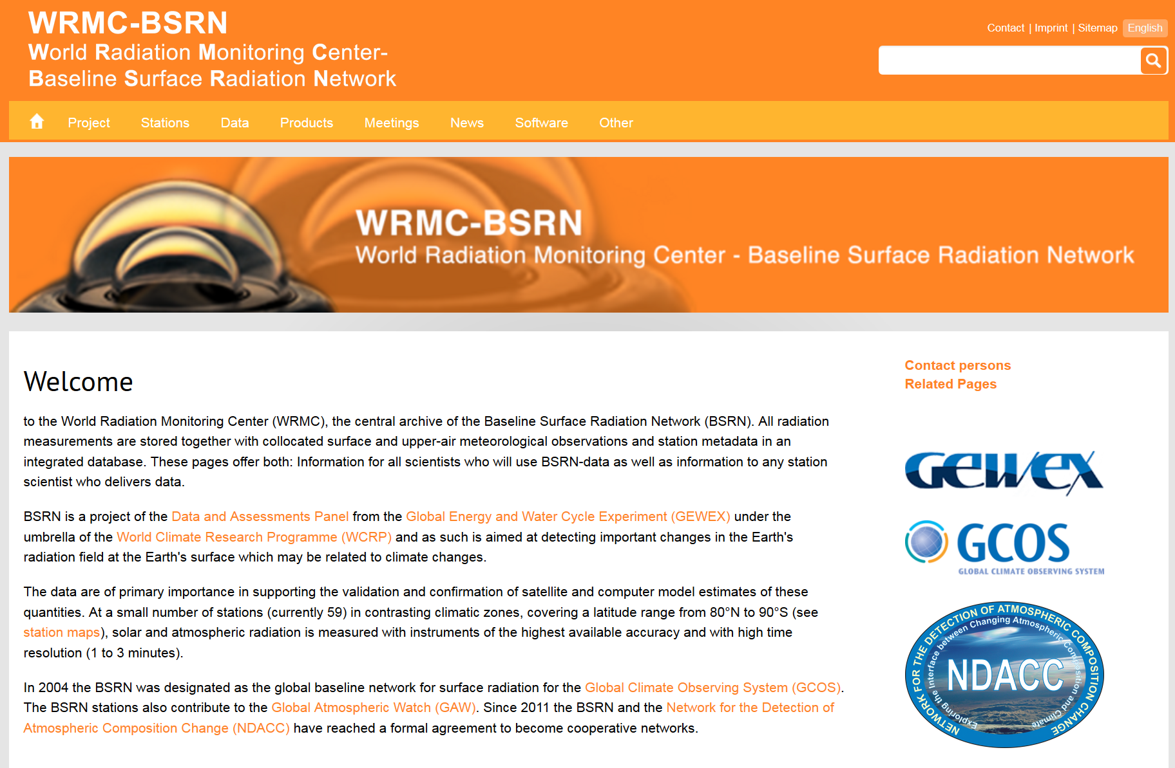
Thanks!
….For listening!
More information at: http://bsrn.awi.de/

