Slide 1
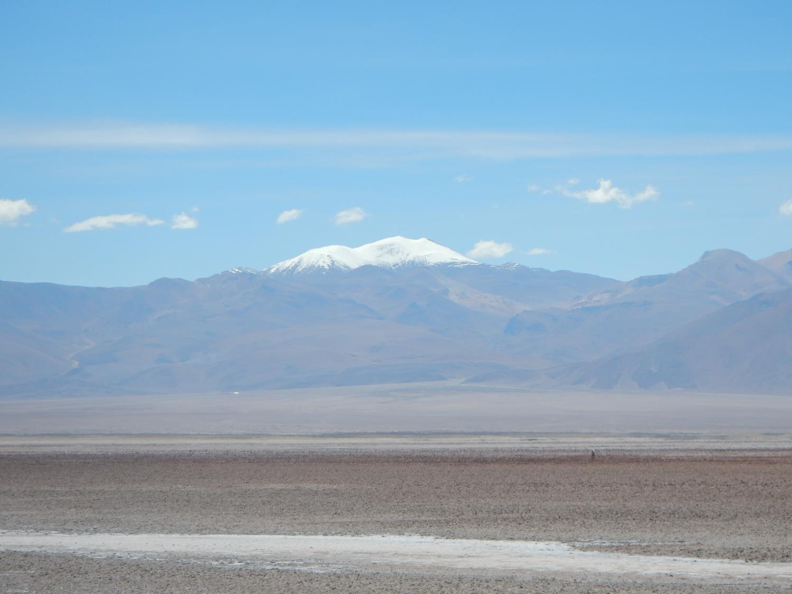
PICO Session - GM3.1/GI3.17/NH4.11
Navigation
Title Slide
Elevation validation and geomorphic metric comparison with focus on ASTER GDEM2, SRTM-C, ALOS World 3D, and TanDEM-X
2 Minute Teaser
Area & Data
Study Area
Data (dGPS/DEM)
Analyses
Elevation Validation:
30 m
< 30 m
Geomorphometry:
Chi Plot (m/n)
Slope, Curvature, Drainage Area
Ben Purinton and Bodo Bookhagen
Institute of Earth and Environmental Science, Universität Potsdam
2D Fourier Analysis
Takeaways
Conclusions
Links / References
28 April 2017
EGU2017-4510
Click to move forward or use the Navigation panel on the left

Slide 2
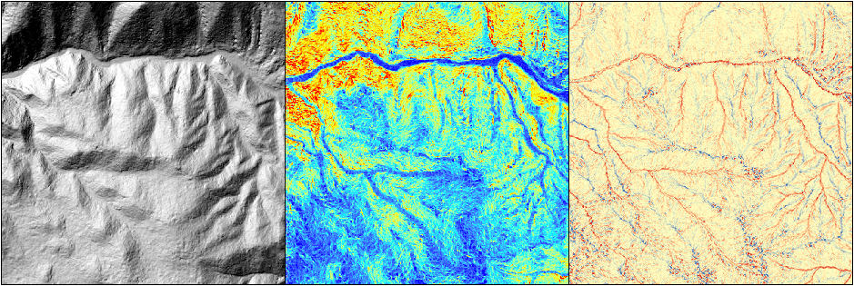
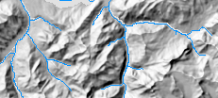
DEMs and Geomorphology
2 Minute Teaser (1/4)
Digital Elevation Models (DEMs) allow the quantitative analysis of the land-surface through Geomorphometry:
Test hypotheses of landscape evolution, geomorphic processes, transient responses, etc.
Navigation
Title Slide
2 Minute Teaser
Area & Data
Study Area
Hillshade
Slope
Curvature
Data (dGPS/DEM)
Analyses
Elevation Validation:
30 m
< 30 m
Geomorphometry:
Chi Plot (m/n)
Slope, Curvature, Drainage Area
2D Fourier Analysis
Stream Network
Takeaways
Conclusions
Links / References
28 April 2017
EGU2017-4510

Slide 3
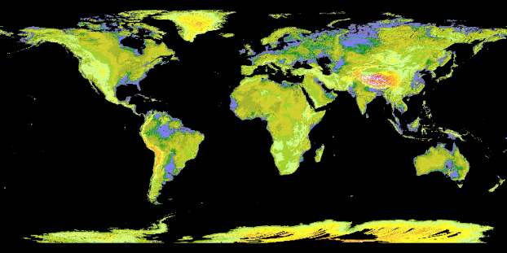
Increase in DEM Availability
2 Minute Teaser (2/4)
Navigation
Title Slide
The past 20 years have seen dramatic increases in the resolution, accuracy, and availability of DEMs from a number of satellite sensors:
Radar (interferometry) – SRTM
Optical (stereogrammetry) – Terra ASTER
2 Minute Teaser
Area & Data
Study Area
Data (dGPS/DEM)
Analyses
Elevation Validation:
30 m
< 30 m
Geomorphometry:
Chi Plot (m/n)
Slope, Curvature, Drainage Area
2D Fourier Analysis
Takeaways
Conclusions
Links / References
28 April 2017
EGU2017-4510

Slide 4
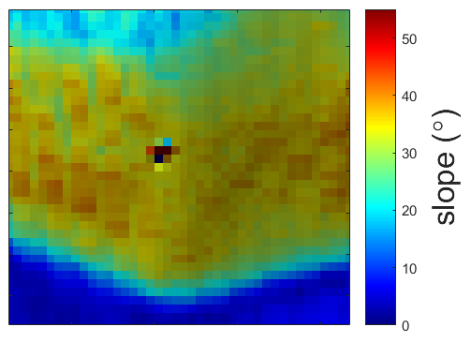
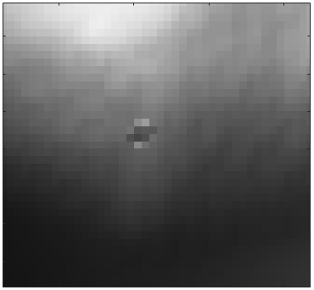
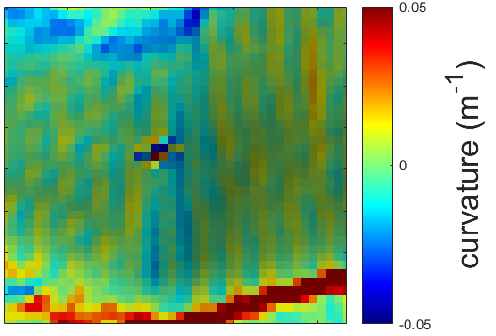
Issue and Study Motivation
2 Minute Teaser (3/4)
Navigation
Unlike elevation change studies (glaciology), geomorphometry relies on the accuracy of a single pixel and the relation to neighboring pixels for channel and hillslope analysis
Title Slide
2 Minute Teaser
Area & Data
Study Area
Data (dGPS/DEM)
Analyses
Elevation Validation:
30 m
< 30 m
Geomorphometry:
Given the widespread availability and resolutions of modern satellite-derived gridded DEMs, which are the most effective for geomorphometric studies?
Chi Plot (m/n)
Slope, Curvature, Drainage Area
2D Fourier Analysis
Takeaways
A.K.A., What to choose in lieu of “high” resolution (VHR) products from GeoEye, Pleiades, IKONOS,…. lidar, etc.?
Conclusions
Links / References
28 April 2017
EGU2017-4510

Slide 5
Methods
2 Minute Teaser (4/4)
Navigation
Title Slide
2 Minute Teaser
We assess the state-of-the-art in space DEMs (SRTM, ASTER, ALOS, TerraSAR-X/TanDEM-X) at resolutions of 5-30 m via:
elevation validation (> 300,000 dGPS measurements)
comparison of geomorphic potential (fluvial m/n, slopes, curvatures, Fourier frequency noise detection)
Area & Data
Study Area
Data (dGPS/DEM)
Analyses
Elevation Validation:
30 m
< 30 m
Geomorphometry:
Chi Plot (m/n)
Slope, Curvature, Drainage Area
Want to see the dirty details? Come by and check it out!
2D Fourier Analysis
Takeaways
Conclusions
Links / References
28 April 2017
EGU2017-4510

Slide 6
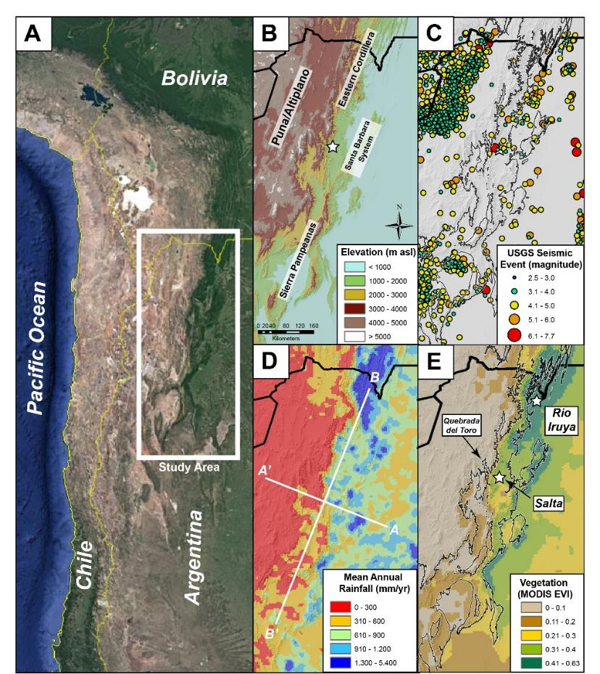
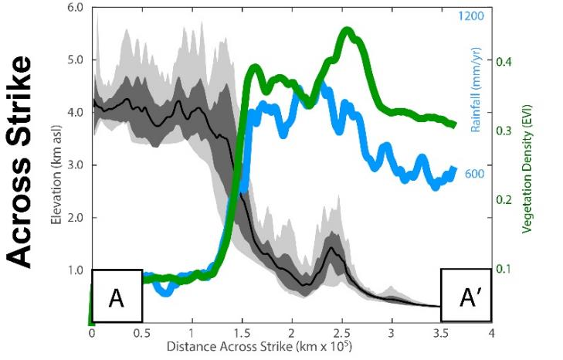
Study Area
NW Argentina
Study Area (1/2)
Navigation
Title Slide
2 Minute Teaser
Area & Data
Plateau
Study Area
Data (dGPS/DEM)
Analyses
Plateau
Elevation Validation:
30 m
< 30 m
Geomorphometry:
Atmospheric and vegetation interference on remote sensing are minimal on arid and internally drained Altiplano-Puna Plateau
Chi Plot (m/n)
Slope, Curvature, Drainage Area
A
2D Fourier Analysis
A’
Takeaways
Conclusions
Links / References
28 April 2017
EGU2017-4510
Courtesy, B. Bookhagen

Slide 7
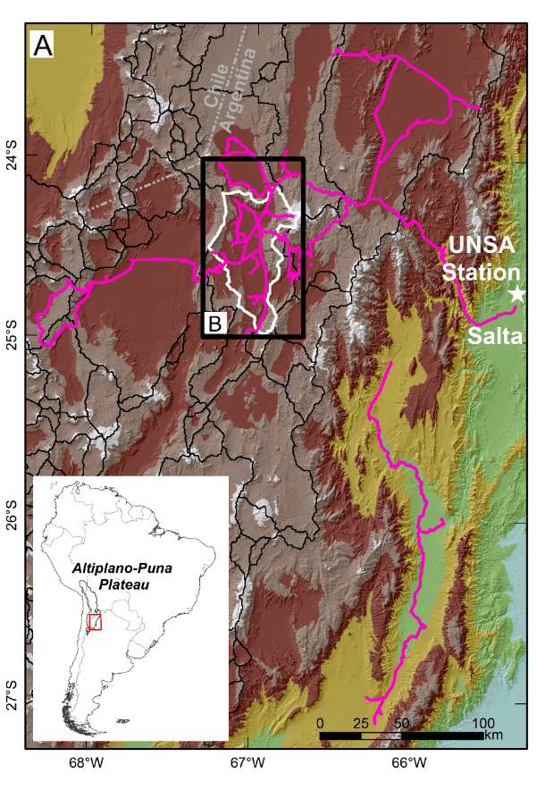
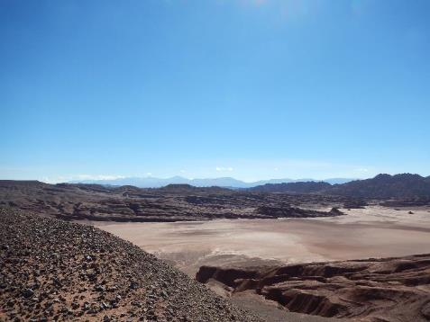
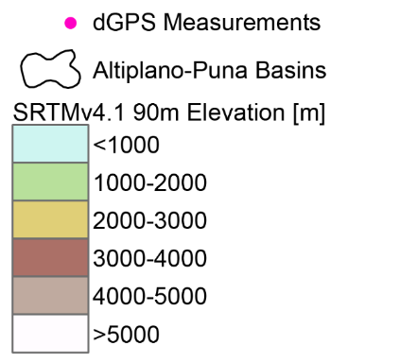
Study Area
Puna Plateau
Study Area (2/2)
Navigation
(A) Study area of dGPS coverage, with focus on (B) Salar de Pocitos within the internally drained Puna Plateau:
Title Slide
2 Minute Teaser
Area & Data
Study Area
Pocitos
Data (dGPS/DEM)
Analyses
Elevation Validation:
30 m
< 30 m
Geomorphometry:
Chi Plot (m/n)
Slope, Curvature, Drainage Area
2D Fourier Analysis
Takeaways
Conclusions
Links / References
28 April 2017
EGU2017-4510

Slide 8
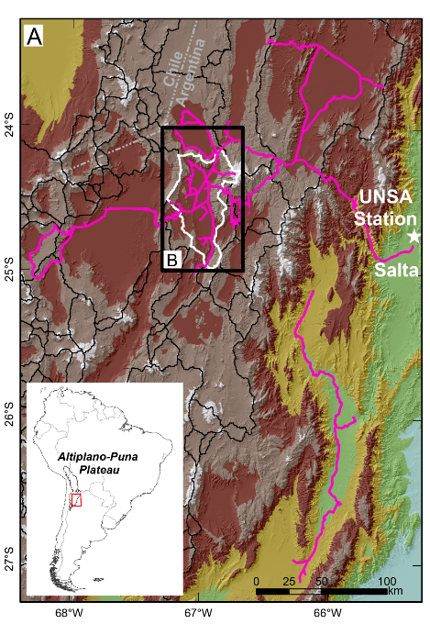
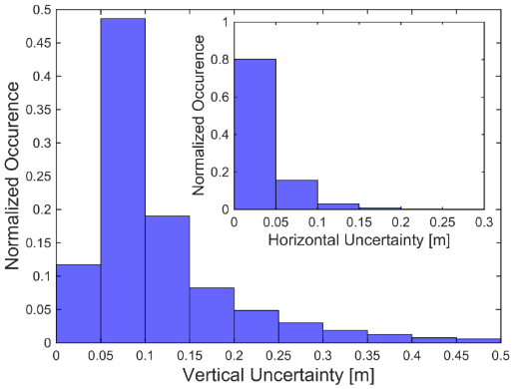
dGPS Data
Data (dGPS/DEM) (1/3)
Navigation
Title Slide
307,509 dGPS points with vertical and horizontal accuracy < 0.5 m
2 Minute Teaser
Area & Data
Study Area
Data (dGPS/DEM)
Analyses
Elevation Validation:
30 m
< 30 m
Geomorphometry:
Chi Plot (m/n)
Slope, Curvature, Drainage Area
2D Fourier Analysis
Collection using Trimble ProXRS receivers (car/backpack)
Kinematic correction in RTKLIB (http://www.rtklib.com), using UNSA permanent station in Salta
Gridding of dGPS data to DEM of interest, taking average of dGPS heights in each pixel
Takeaways
Conclusions
Links / References
28 April 2017
EGU2017-4510

Slide 9
DEMs – Used
Data (dGPS/DEM) (2/3)
Navigation
Focus on radar and optical satellite-derived DEMs from SRTM-C, ASTER, ALOS, TerraSAR-X/TanDEM-X, with resolutions of 5-30 m, all released in past five years!
Title Slide
2 Minute Teaser
Area & Data
Dataset (short name) | Data Type | Resolution (m) | Source
SRTM C-band (SRTM-C) | Radar / Edited global product | 30 | Public
ASTER GDEM Version 2 (ASTER GDEM2) | Optical / Edited global product | 30 | Public
ASTER L1A Stereopair Stack (ASTER Stack) | Optical / Raw stereopairs | 30 | Public
ALOS World 3D (AW3D5/30) | Optical / Edited global product | 5/30 | Public (30 m) / Commercial (5 m)
CoSSC TerraSAR-X / TanDEM-X (CoSSC TDX) | Radar / Raw interferograms | 10 | Research agreement
TanDEM-X DEM (TanDEM-X 12/30) | Radar / Edited global product | 12/30 | Research agreement
Study Area
Data (dGPS/DEM)
Analyses
Elevation Validation:
30 m
< 30 m
Geomorphometry:
Chi Plot (m/n)
Slope, Curvature, Drainage Area
2D Fourier Analysis
Takeaways
Conclusions
Links / References
28 April 2017
EGU2017-4510

Slide 10
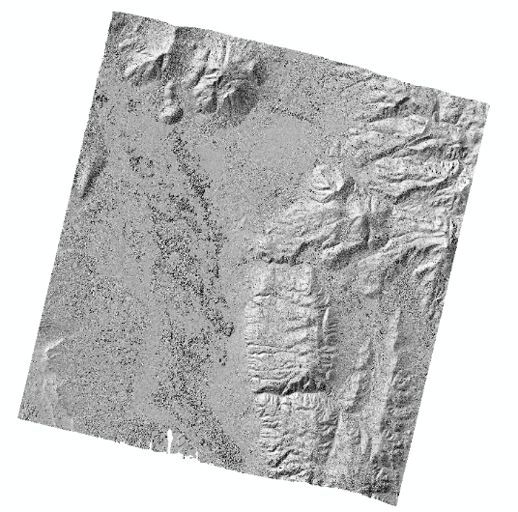
DEMs – Not used
Data (dGPS/DEM) (3/3)
Navigation
A number of DEMs were also downloaded and/or experimentally generated, but not used in further analysis because of low resolution (SRTMv4.1), or high frequency noise and artifacts, particularly prevalent in single-pass DEMs from optical sensors:
SRTMv4.1 90 m (radar)
SRTM-X 30 m (radar)
RapidEye 12 m (optical)
SPOT6 5 m (optical)
ALOS PRISM tri-stereopair 10 m (optical)
TerraSAR-X/TerraSAR-X pairs 10 m (radar)
Single-CoSSC TerraSAR-X / TanDEM-X processed to 5 m (radar)
Title Slide
2 Minute Teaser
Area & Data
Study Area
Data (dGPS/DEM)
Analyses
Elevation Validation:
30 m
< 30 m
Geomorphometry:
Chi Plot (m/n)
Slope, Curvature, Drainage Area
2D Fourier Analysis
Takeaways
Conclusions
Links / References
28 April 2017
EGU2017-4510

Slide 11
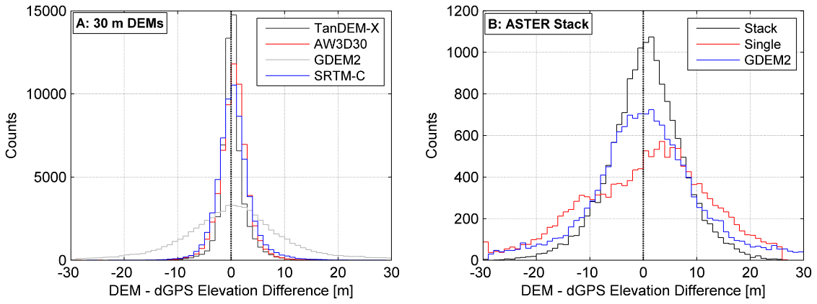
Elevation Validation
30 m DEMs
Elevation Validation (1/6)
Navigation
Title Slide
2 Minute Teaser
1-σ < 3.5 m
1-σ > 7 m
Area & Data
Study Area
Data (dGPS/DEM)
Analyses
Elevation Validation:
30 m
< 30 m
Geomorphometry:
Chi Plot (m/n)
Slope, Curvature, Drainage Area
2D Fourier Analysis
Even after meticulous manual generation and stacking of eight raw ASTER L1A stereopair DEMs, vertical error remained high for ASTER products.
SRTM-C, TanDEM-X, and ALOS World 3D all performed comparably at 30 m resolution
Takeaways
Conclusions
Links / References
28 April 2017
EGU2017-4510

Slide 12
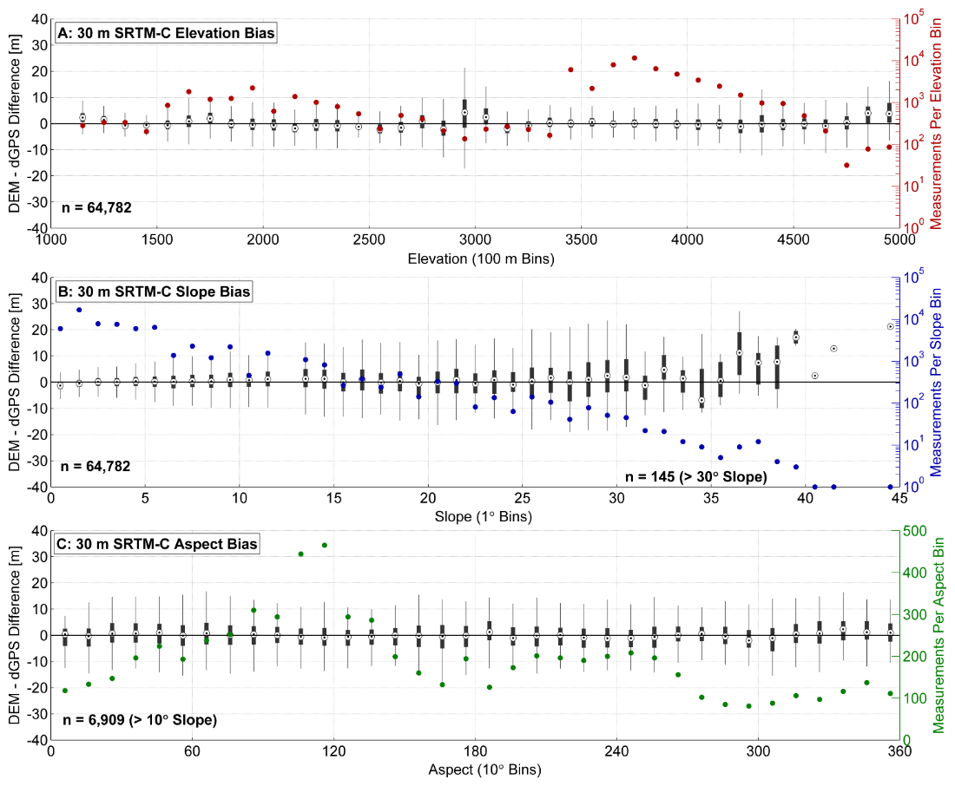
Elevation Validation
30 m DEMs
Elevation Validation (2/6)
Navigation
SRTM-C vertical uncertainty w.r.t. terrain elevation, slope, and aspect
Title Slide
2 Minute Teaser
Area & Data
Study Area
Data (dGPS/DEM)
Analyses
Elevation Validation:
30 m
< 30 m
Geomorphometry:
Chi Plot (m/n)
Slope, Curvature, Drainage Area
2D Fourier Analysis
Takeaways
Conclusions
Links / References
28 April 2017
EGU2017-4510

Slide 13
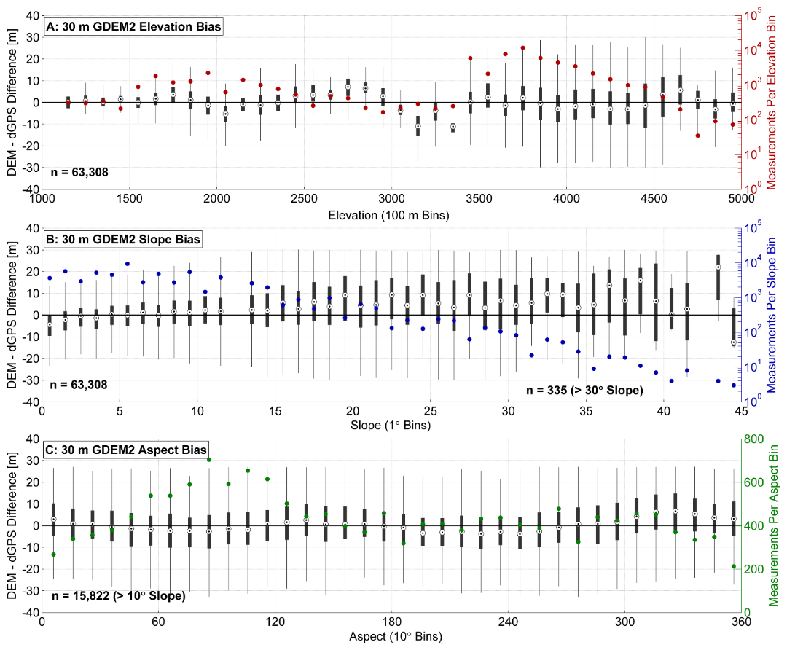
Elevation Validation
30 m DEMs
Elevation Validation (3/6)
Navigation
ASTER GDEM2 vertical uncertainty w.r.t. terrain elevation, slope, and aspect
Title Slide
2 Minute Teaser
Area & Data
Study Area
Data (dGPS/DEM)
Analyses
Elevation Validation:
30 m
< 30 m
Geomorphometry:
Chi Plot (m/n)
Slope, Curvature, Drainage Area
2D Fourier Analysis
Takeaways
Conclusions
Links / References
28 April 2017
EGU2017-4510

Slide 14
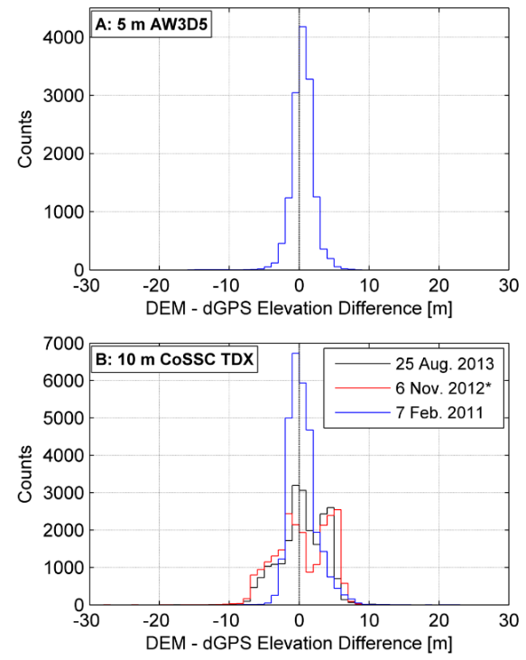
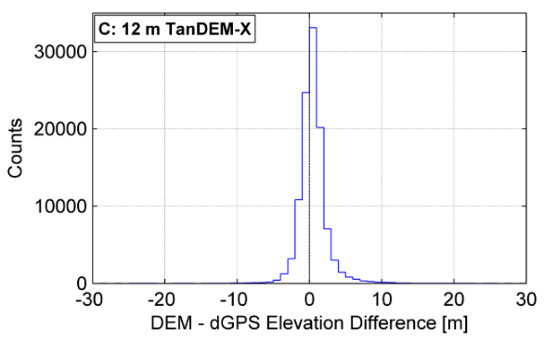
Elevation Validation
< 30 m DEMs
Elevation Validation (4/6)
Navigation
Title Slide
1-σ = 1.6 m
1-σ = 2 m
2 Minute Teaser
Area & Data
Study Area
Data (dGPS/DEM)
Analyses
Elevation Validation:
30 m
< 30 m
5 m ALOS World 3D and TanDEM-X show best vertical accuracy.
Even single-pass CoSSC TerraSAR-X/TanDEM-X DEMs have excellent vertical accuracy.
Geomorphometry:
1-σ = 2-4 m
Chi Plot (m/n)
Slope, Curvature, Drainage Area
2D Fourier Analysis
Takeaways
Conclusions
Links / References
Note difference in count magnitude: ALOS World 3D and CoSSC TDX only cover Pocitos Basin, but TanDEM-X covers almost all dGPS measurements
28 April 2017
EGU2017-4510

Slide 15
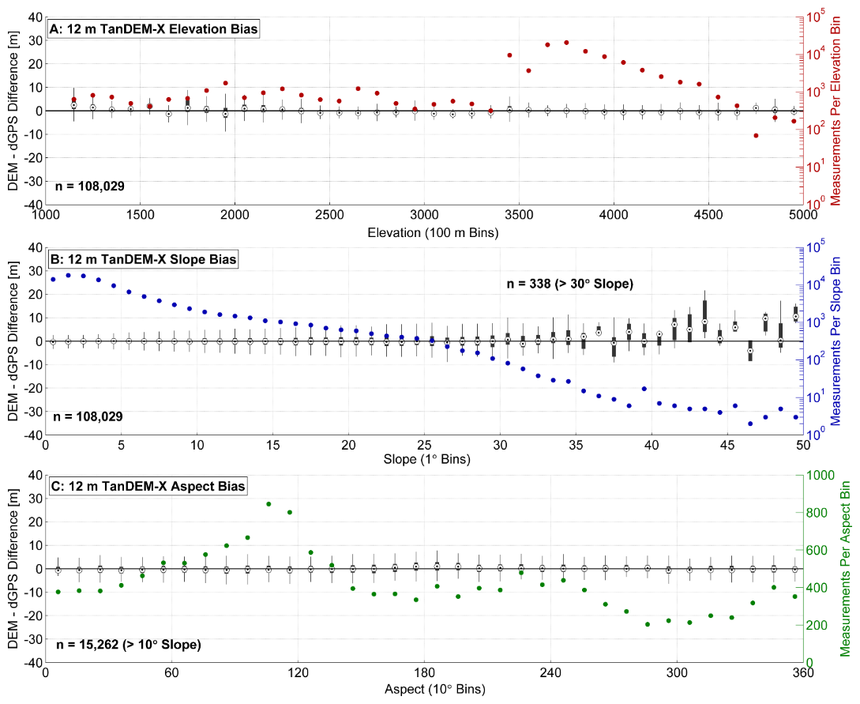
Elevation Validation
< 30 m DEMs
Elevation Validation (5/6)
Navigation
12 m TanDEM-X vertical uncertainty w.r.t. terrain elevation, slope, and aspect
Title Slide
2 Minute Teaser
Area & Data
Study Area
Data (dGPS/DEM)
Analyses
Elevation Validation:
30 m
< 30 m
Geomorphometry:
Chi Plot (m/n)
Slope, Curvature, Drainage Area
2D Fourier Analysis
Takeaways
Conclusions
Links / References
28 April 2017
EGU2017-4510

Slide 16
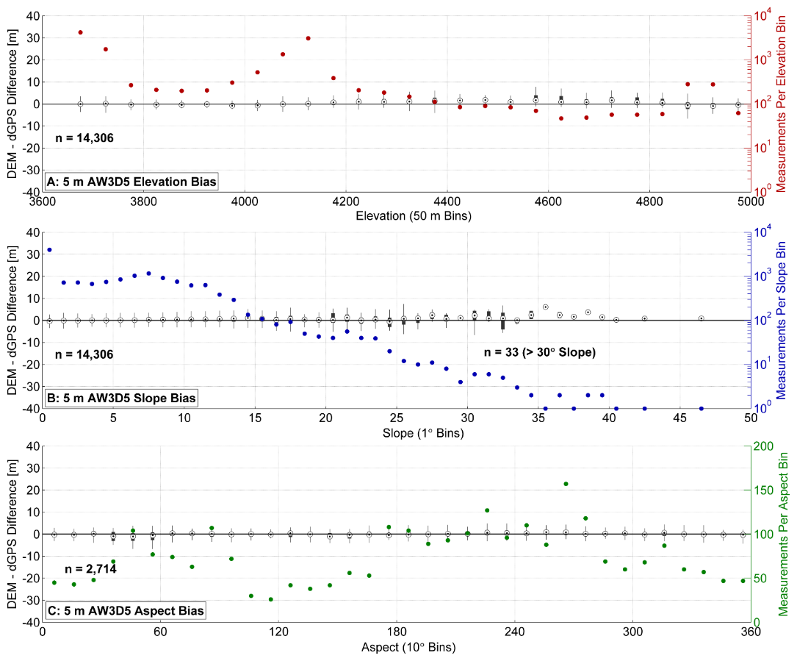
Elevation Validation
< 30 m DEMs
Elevation Validation (6/6)
Navigation
5 m ALOS World 3D vertical uncertainty w.r.t. terrain elevation, slope, and aspect
Title Slide
2 Minute Teaser
Area & Data
Study Area
Data (dGPS/DEM)
Analyses
Elevation Validation:
30 m
< 30 m
Geomorphometry:
Chi Plot (m/n)
Slope, Curvature, Drainage Area
2D Fourier Analysis
Takeaways
Conclusions
Links / References
28 April 2017
EGU2017-4510

Slide 17
Geomorphometric Comparison
Geomorphometry (1/9)
Navigation
We now have a number of high quality (low vertical uncertainty) DEMs with resolutions of 5-30 m
Q: How can we test the quality of geomorphic metrics without field measurements of slope, curvature, channel heads, etc.?
1-3 m control DEM (VHR, lidar, etc.)
A: With a transiently adjusting test catchment and field knowledge of geomorphic processes
Title Slide
2 Minute Teaser
Area & Data
Study Area
Data (dGPS/DEM)
Analyses
Elevation Validation:
30 m
< 30 m
Geomorphometry:
Chi Plot (m/n)
Slope, Curvature, Drainage Area
Patrick
2D Fourier Analysis
Takeaways
Conclusions
Links / References
28 April 2017
EGU2017-4510

Slide 18
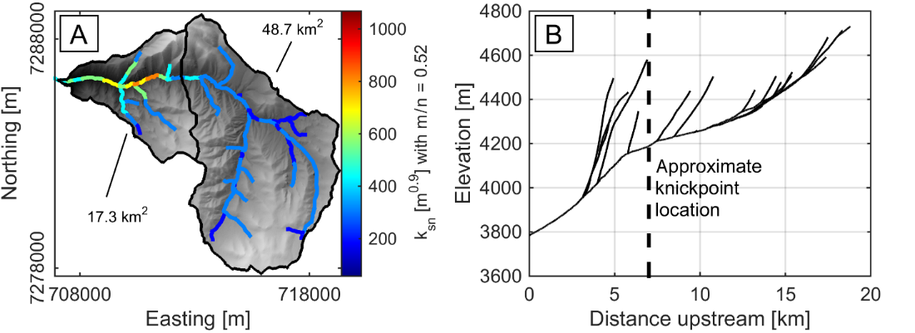
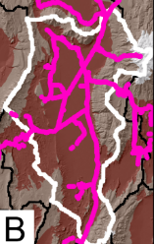
Geomorphometric Comparison
Quebrada Honda Catchment
Geomorphometry (2/9)
Navigation
Title Slide
2 Minute Teaser
Area & Data
Study Area
Data (dGPS/DEM)
Analyses
Elevation Validation:
30 m
< 30 m
Geomorphometry:
Catchment within the Pocitos Basin, used for testing geomorphic hypotheses of transient response to migrating knickpoint.
Using highest-quality DEMs only, across a range of resolution:
30 m SRTM-C
30 m TanDEM-X
12 m TanDEM-X
10 m CoSSC TDX
5 m ALOS World 3D
Chi Plot (m/n)
Slope, Curvature, Drainage Area
2D Fourier Analysis
Takeaways
Conclusions
Links / References
28 April 2017
EGU2017-4510

Slide 19
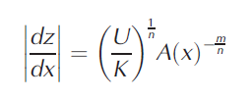
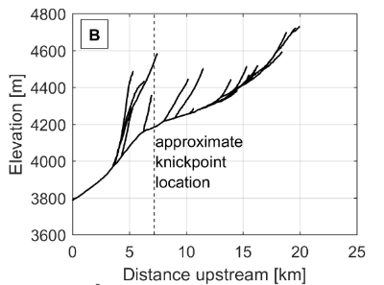
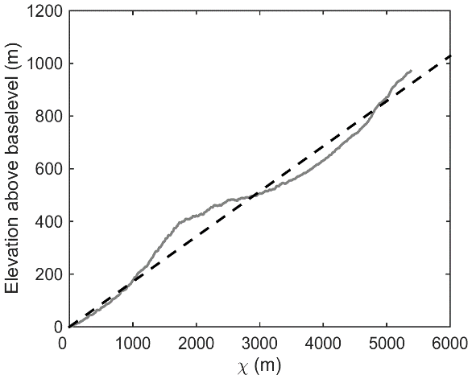
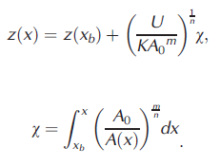
Geomorphometric Comparison
Chi Plot Channel Analysis
Geomorphometry (3/9)
Navigation
Stream Power Incision Model (SPIM):
Title Slide
2 Minute Teaser
Area & Data
Study Area
Data (dGPS/DEM)
Issue: must calculate slope from noisy DEM data!
Analyses
Elevation Validation:
30 m
< 30 m
Integrate to generate chi plot and find best fitting m/n without the need to calculate slope and do power-law fitting
Geomorphometry:
Chi Plot (m/n)
Slope, Curvature, Drainage Area
2D Fourier Analysis
Takeaways
Conclusions
Links / References
28 April 2017
EGU2017-4510

Slide 20
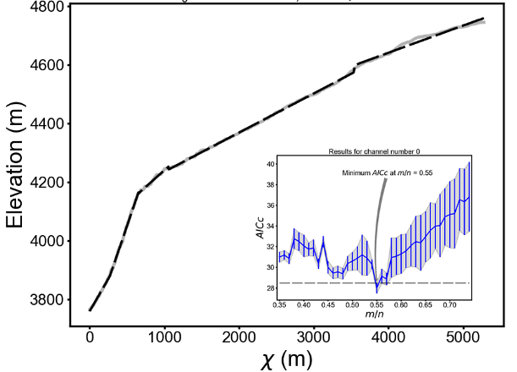
Geomorphometric Comparison
Chi Plot Channel Analysis
2 Methods Tested:
Geomorphometry (4/9)
Navigation
Title Slide
2 Minute Teaser
Area & Data
Least-squares fit (Perron and Royden, 2013)
Piece-wise fit (Mudd et al., 2014)
Study Area
m/n = 0.51-0.56
m/n = 0.53-0.57
Data (dGPS/DEM)
Analyses
Elevation Validation:
30 m
< 30 m
Geomorphometry:
Chi Plot (m/n)
Slope, Curvature, Drainage Area
2D Fourier Analysis
Takeaways
Similar m/n value found regardless of DEM resolution or chi plot method
Slightly lower uncertainties from piece-wise fitting for 5 m DEM
Conclusions
Links / References
28 April 2017
EGU2017-4510

Slide 21
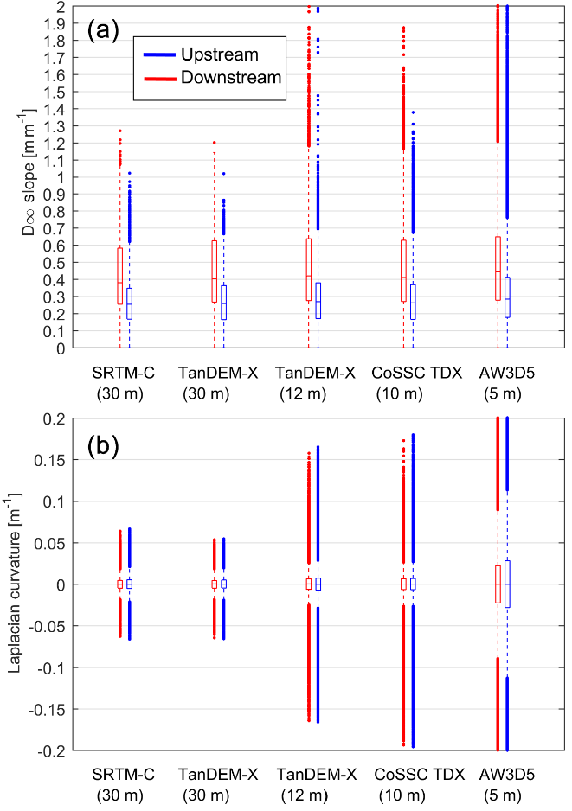
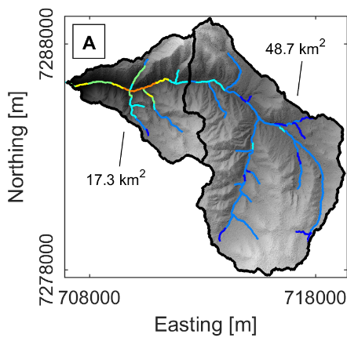
Geomorphometric Comparison
Slope and Curvature Distributions
Geomorphometry (5/9)
Navigation
Title Slide
2 Minute Teaser
Area & Data
Study Area
Data (dGPS/DEM)
Analyses
Elevation Validation:
30 m
< 30 m
Geomorphometry:
Chi Plot (m/n)
Higher slopes downstream of knickpoint in all DEMs.
More outliers with fining resolution, particularly pronounced in curvature measurements.
Slope, Curvature, Drainage Area
2D Fourier Analysis
Takeaways
Conclusions
Links / References
28 April 2017
EGU2017-4510

Slide 22
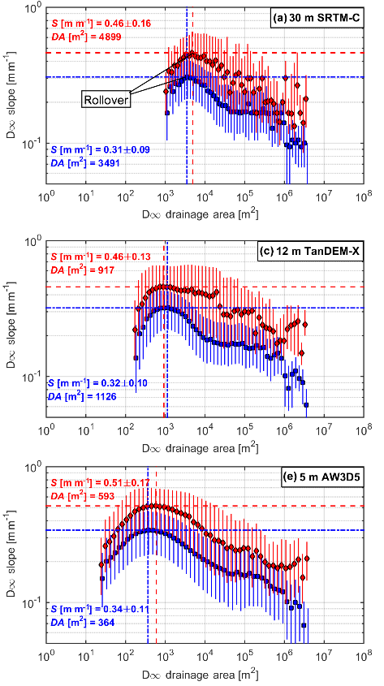
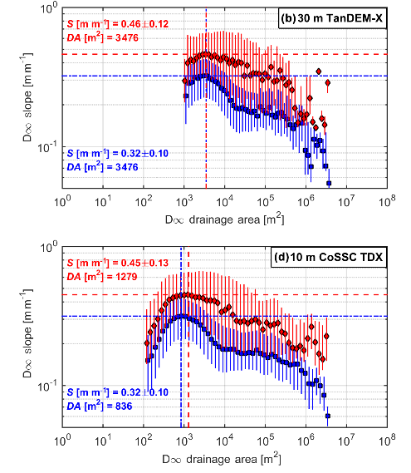
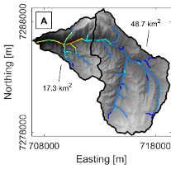
Geomorphometric Comparison
Drainage Area-Slope
Geomorphometry (6/9)
Navigation
Title Slide
2 Minute Teaser
Area & Data
Study Area
Data (dGPS/DEM)
Analyses
Elevation Validation:
30 m
< 30 m
Geomorphometry:
Chi Plot (m/n)
Slope, Curvature, Drainage Area
Slopes 0.1-0.2 m/m greater downstream
Drainage area at rollover decreases with fining resolution, but converting to hillslope length reveals consistent L_{H} = 109 ± 26 m.
Issue: Known deficiencies with L_{H} estimation from area-slope plots
2D Fourier Analysis
Takeaways
Conclusions
Links / References
28 April 2017
EGU2017-4510

Slide 23
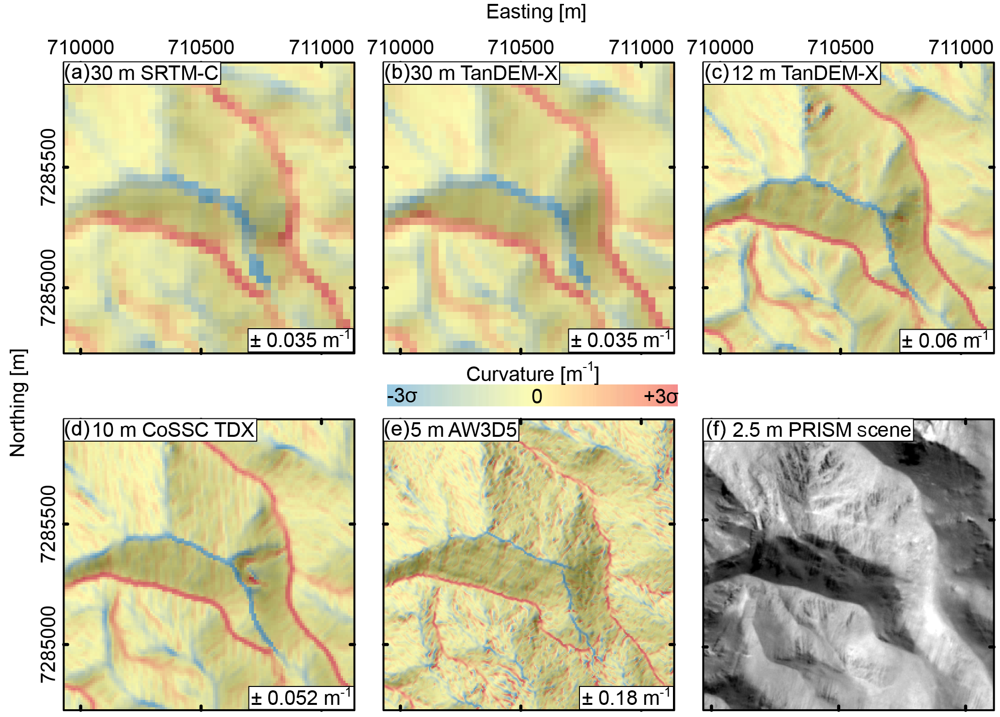
Geomorphometric Comparison
Curvature
Geomorphometry (7/9)
Navigation
Title Slide
2 Minute Teaser
Area & Data
Study Area
Data (dGPS/DEM)
Analyses
Elevation Validation:
30 m
< 30 m
Geomorphometry:
Chi Plot (m/n)
Slope, Curvature, Drainage Area
2D Fourier Analysis
Takeaways
Conclusions
Curvature shows large variability with fining resolution, and with sensor type
Is variability in the ALOS World 3D 5 m just noise from this optical sensor?
Links / References
28 April 2017
EGU2017-4510

Slide 24
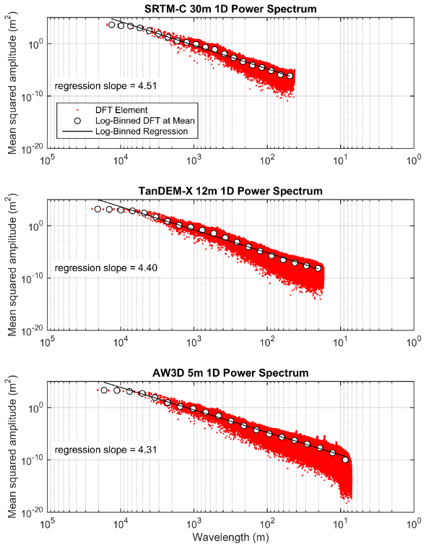
Geomorphometric Comparison
2D Fourier Analysis – DEM Noise
Geomorphometry (8/9)
Navigation
Title Slide
2 Minute Teaser
Area & Data
2D Discrete Fourier Transform (2D DFT) of gridded DEM array allows exploration of the frequencies present (Perron et al., 2008).
Here we take 8 km by 14 km rectangular clips from each DEM over the Quebrada Honda and apply the 2D DFT to generate a 1D plot of spectral power versus wavelength.
Study Area
Data (dGPS/DEM)
Analyses
Elevation Validation:
30 m
< 30 m
Geomorphometry:
Chi Plot (m/n)
Slope, Curvature, Drainage Area
2D Fourier Analysis
2D DFT:
Takeaways
$$Z\left(k_{x},k_{y}\right)= \sum_{m=0}^{N_{x}−1}{\sum_{n=0}^{N_{y}−1}{z(m∆x,n∆y)e^{−2πi\left(\frac{k_{x}m}{N_{x}} + \frac{k_{y}n}{N_{y}}\right)}}}$$
Conclusions
Links / References
28 April 2017
EGU2017-4510
Normalize this by the log-binned regression….. (see next slide)

Slide 25
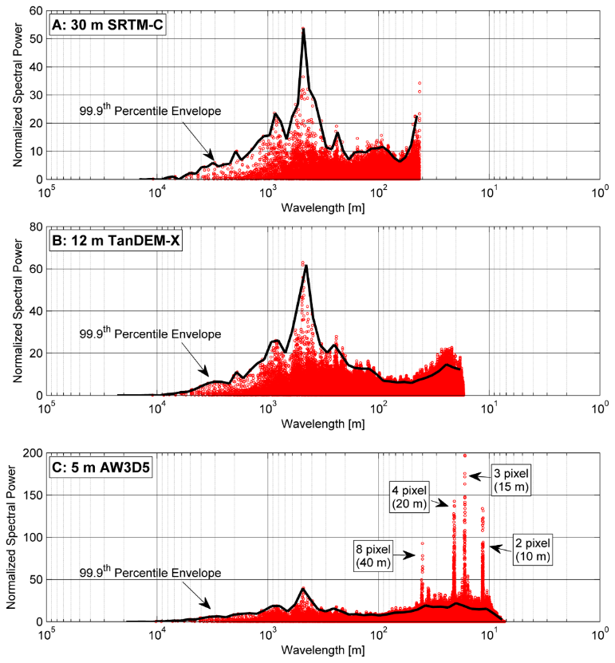
Geomorphometric Comparison
2D Fourier Analysis – DEM Noise
Geomorphometry (9/9)
Navigation
Title Slide
2 Minute Teaser
Area & Data
Study Area
Data (dGPS/DEM)
Analyses
Elevation Validation:
30 m
< 30 m
Geomorphometry:
Chi Plot (m/n)
Slope, Curvature, Drainage Area
2D Fourier Analysis
Takeaways
Conclusions
Links / References
Note the noise prevalent in 2-8 pixel steps in the optically generated ALOS World 3D 5 m DEM! This is likely causing slope and curvature outliers.
28 April 2017
EGU2017-4510

Slide 26
Conclusions
Navigation
Elevation validation does not provide a complete picture of DEM accuracy for geomorphology
All DEMs performed equally well for m/n channel analysis at large (catchment) scales
Slope and curvature measurements are partially dependent on resolution, but curvature in particular is dramatically effected by noise
Optical sensors (e.g., ALOS and ASTER) provide less realistic DEMs compared to radar sensors (e.g., TanDEM-X and SRTM-C) in this study area, where lack of clouds and vegetation should make optical remote sensing easy
While stacking can improve DEM quality (e.g., ASTER Stack and TanDEM-X), for fine-scale analysis of hillslope processes “high” resolution is likely still necessary (Pleiades, lidar, etc.)
Title Slide
2 Minute Teaser
Area & Data
Study Area
Data (dGPS/DEM)
Analyses
Elevation Validation:
30 m
< 30 m
Geomorphometry:
Chi Plot (m/n)
Slope, Curvature, Drainage Area
2D Fourier Analysis
Takeaways
Conclusions
Links / References
28 April 2017
EGU2017-4510

Slide 27
Links / References
Navigation
Purinton, B., and Bookhagen, B: Validation of digital elevation models (DEMs) and comparison of geomorphic metrics on the southern Central Andean Plateau, Earth Surface Dynamics, 5, 211-237, 2017 (http://www.earth-surf-dynam.net/5/211/2017/)
Perron, J. T. and Royden, L.: An integral approach to bedrock river profile analysis, Earth Surf. Proc. Land., 38, 570-576, 2013.
Perron, J. T., Kirchner, J. W., and Dietrich, W. E.: Spectral signatures of characteristic spatial scales and nonfractal structure in landscapes, J. Geophys. Res., 113, F04003, 2008.
Mudd, S. M., Attal, M., Milodowski, D. T., Grieve, S. W. D., and Valters, D. A.: A statistical framework to quantify spatial variation in channel gradients using the integral method of channel profile analysis, J. Geophys. Res.-Earth, 119, 138-152, 2014.
Title Slide
2 Minute Teaser
Area & Data
Study Area
Data (dGPS/DEM)
Analyses
Elevation Validation:
30 m
< 30 m
Geomorphometry:
Chi Plot (m/n)
RTKLIB (dGPS Post-Processing): http://www.rtklib.com
TopoToolbox (Matlab DEM tools): https://github.com/csdms-contrib/topotoolbox
LSDTopoTools (Chi-analysis and other tools): https://github.com/LSDtopotools
DEM Fourier Noise (From this study): https://github.com/bpurinton/DEM_fourier_noise
Slope, Curvature, Drainage Area
2D Fourier Analysis
Takeaways
Conclusions
Links / References
28 April 2017
EGU2017-4510

