Slide 1
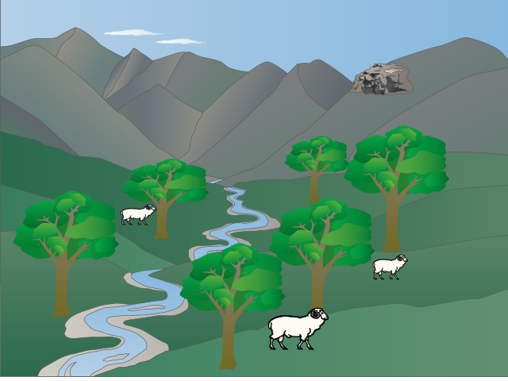



Investigating the impact of shelterbelts on soil hydrology
Bid Webb¹, Andy Smith¹, Miles Marshall², Tim Pagella¹, John Healey¹.
¹Bangor University, Bangor, UK.
²Centre of Ecology and Hydrology, Bangor, UK

Slide 2

Increased frequency and intensity of flooding have highlighted concerns regarding flood resilience
Are trees the answer?
Plant trees to sustainably intensify agricultural practices & improve ecosystem resilience?
Limited research into hydrological impact of shelterbelts
Knowledge gaps: species, age, seasonality, spatial variability, management technique
Photo: Martin Katerberg

Slide 3
Objective
To characterise the impact of tree species-specific root morphology on soil hydraulic properties.
Hypotheses:
Root characteristics (such as length, biomass, density, tip numbers) of individual trees and associated soil hydraulic conditions are species-dependent
Species with a larger proportion of fine roots compared with coarse roots exhibit the highest hydraulic conductivity due to greater root surface area
Hydraulic conductivity is greatest in species with the greatest root biomass at all three sampled depths

Slide 4
Root morphologies
Typical root morphology differs across tree species. However, soil texture, soil depth and underlying geology can change and limit the root extent and orientation. Tree roots create pathways for water to move easily through the soil matrix and channels remain intact for some time following root death.
(Polomski & Kuhn, 1998)

Slide 5
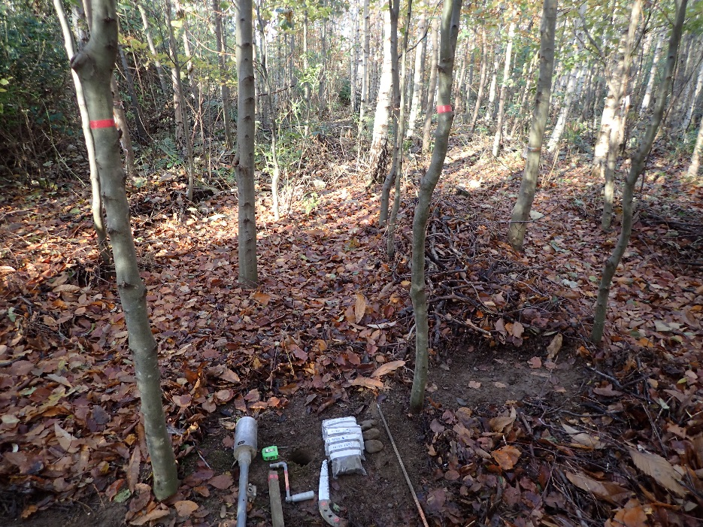
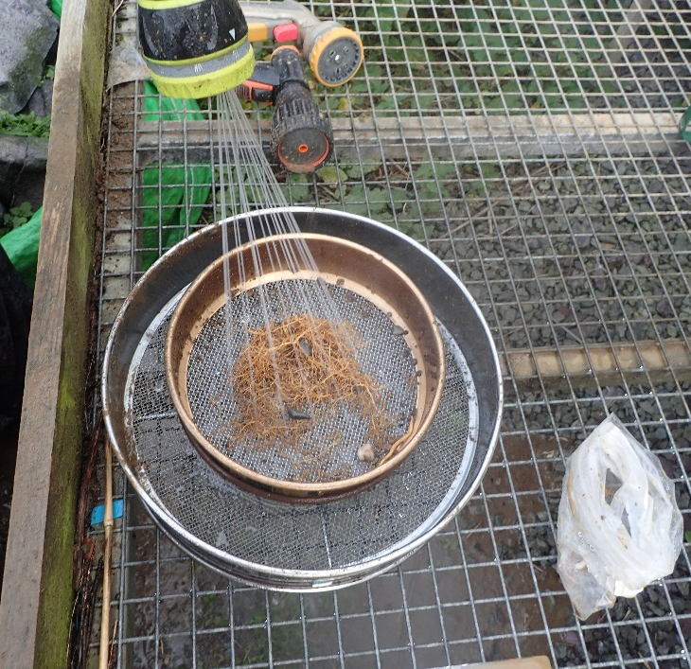
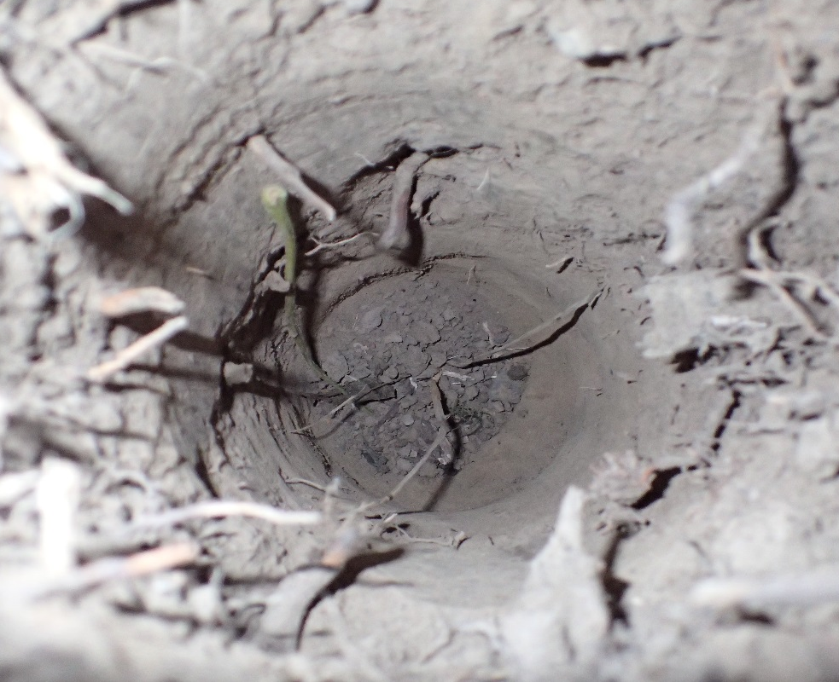
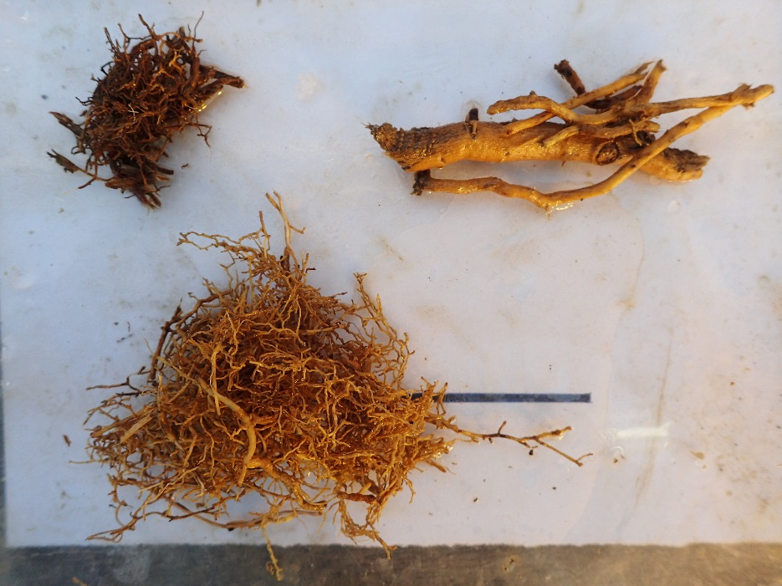
METHODOLOGY
Root analysis
Two 8cm diameter soil cores taken from 3 depths (0-10, 10-20, 20-30cm) equidistant to sample trees, near the centre of each plot
Samples washed and roots separated into fine (<2mm ø), coarse (≥2mm ø) and dead categories
Coarse and dead roots dried for 48 hours at 80°C and then weighed
Fine roots scanned using WinRHIZO (v2005c) software to analyse for biomass, length, surface area, volume, tip numbers, fine root tip density, specific fine root area, specific fine root length, and fine root tissue density
Fine roots dried for 48 hours at 80°C and then weighed

Slide 6
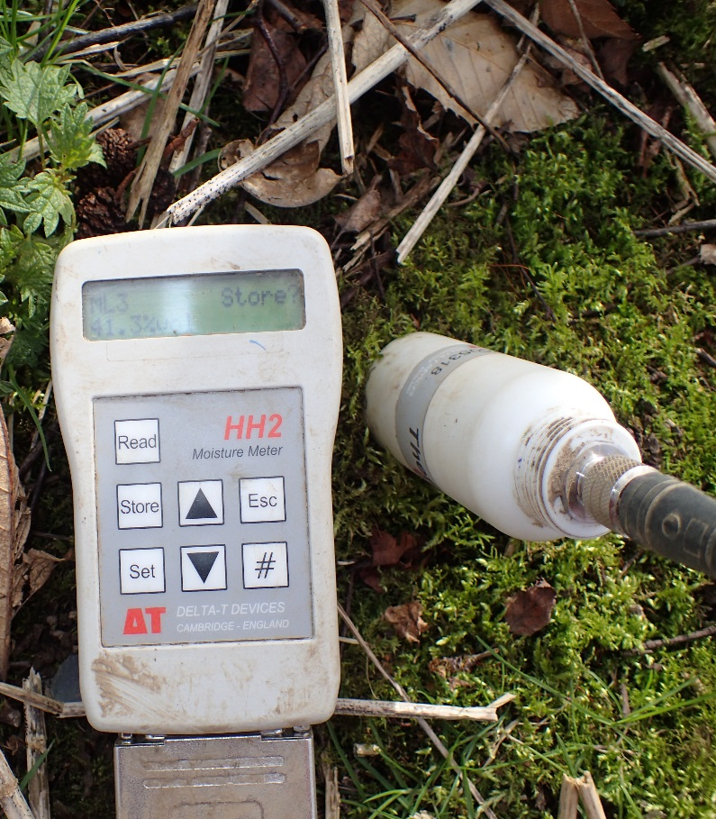
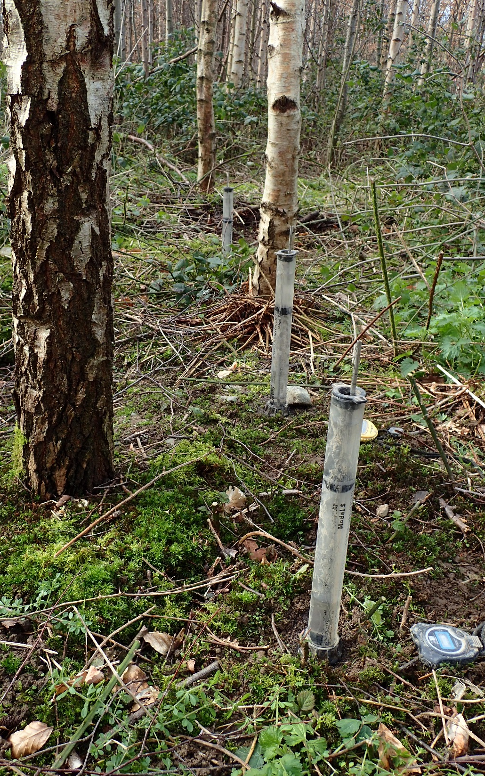
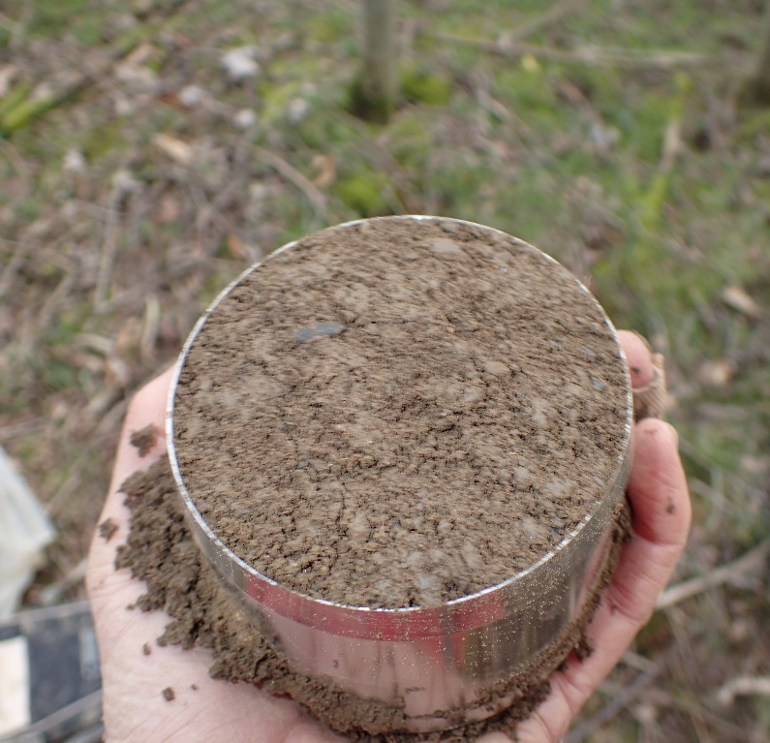
METHODOLOGY
Soil hydraulic condition
3 x Decagon Portable Minidisk Tension Infiltrometer devices measured infiltration at each plot and hydraulic conductivity calculated.
UMS soil sampling cores (250 ml) obtained soil samples at 0-5cm and 10-15cm depths
Soil moisture taken at 9 sites within each plot
Laboratory analysis is ongoing for saturated hydraulic conductivity using the UMS KSAT and to derive water retention curves using HYPROP
Control measurements (minidisk, sampling cores and moisture readings) were taken in four plots within an adjacent grazed field and will also be taken in an adjacent ungrazed field.

Slide 7
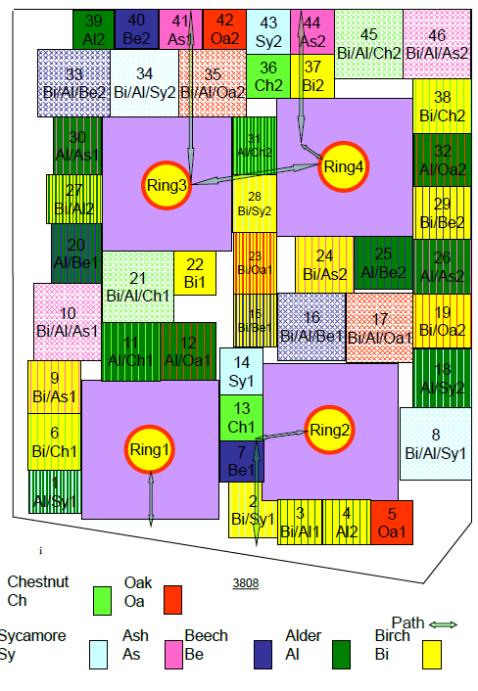
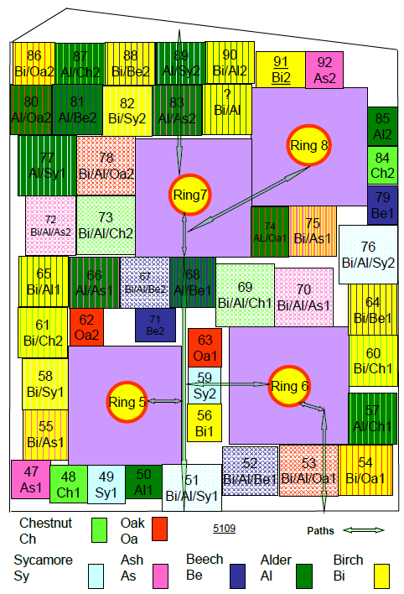
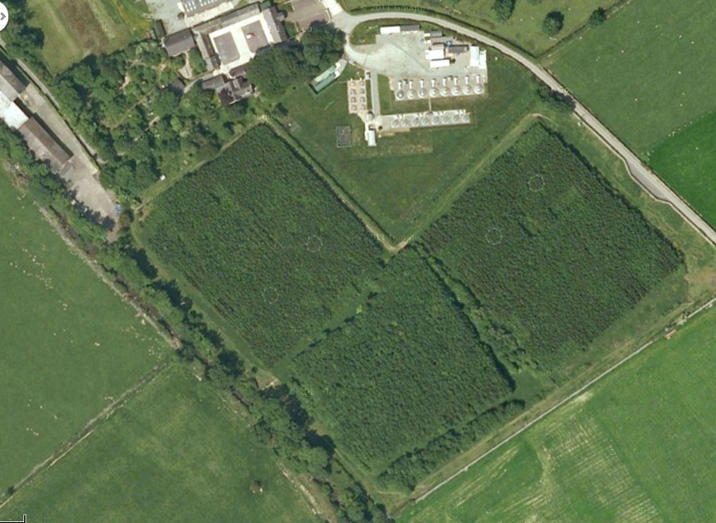
SITE SELECTION:
BangorDIVERSE experimental plots
Abergwyngregyn, North Wales, UK
92 plots fully replicated (n=4)
2.36 ha across two fields
Planted in March 2004, 60 cm saplings
Thinned 2012/13
10,000 stems ha⁻¹(1 m spacing)
2,500 stems ha⁻¹ (after thinning)
Plot sizes 0.01 – 0.16 ha
7 tree species
  Monoculture
  Two species mixtures
  Three species mixtures

Slide 8
Species and provenance
SITE SELECTION
Each of the species are represented in four single species plots across the site. Root analysis and soil hydraulic condition assessment was carried out on each of the single species plots, providing four replicates per species.
Species | Common Name | Provenance
Alnus glutinosa | Common alder | Shropshire
Betula pendula | Silver birch | Northumberland
Fagus sylvatica | European beach | Shropshire
Fraxinus excelsior | Ash | Cumbria
Acer pseduoplatanus | Sycamore | Scottish borders
Castanea sativa | Chestnut | Wales
Quercus robur | Pedunculate oak | Wiltshire

Slide 9
Figure 1: Mean root length (aggregated) at 0-10cm depth across single species plots

Slide 10
Figure 2: Total root biomass across 6 species (Ash, Beech, Birch, Chestnut, Oak, Sycamore) compared with mean hydraulic conductivity
*Alder has been excluded from these data as the plots were drought-stressed and had substantial infestation of ash roots (not included in root biomass total) from adjacent plots.

Slide 11
Initial conclusions
Ash has far greater root length than other species in every diameter class
Total root biomass is related to hydraulic conductivity
The greater the root biomass the greater the potential for subsurface flow
Removal of Ash from the countryside due to Ash Dieback (Hymenoscyphus fraxineus) may have far greater hydrological consequences than the removal of other species
Species composition of shelterbelts is likely to be an influential parameter of soil hydraulic properties

Slide 12
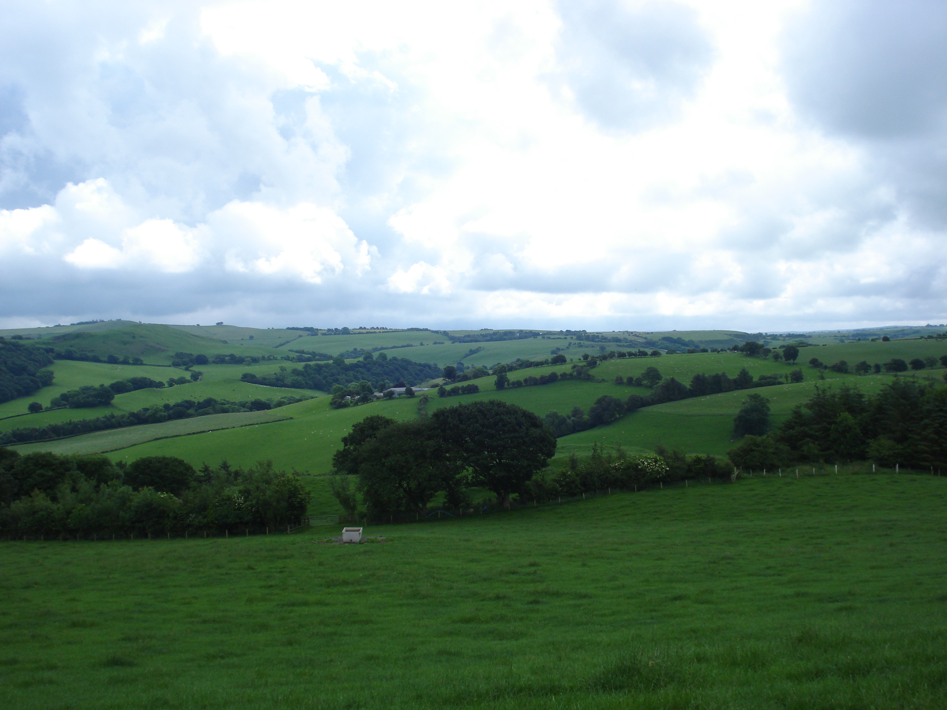
Investigating the impact of shelterbelts on soil hydrology
Further research
Further detailed analysis of the relationship between hydraulic conductivity and tree roots (single species)
Mixed species grouping root and soil condition analysis
Investigating the hydrological influence of shelterbelts across a chronosequence (1 - 50+ years)
- Root and soil condition analysis
- Seasonal water movement
- Develop 2D water movement model (HYDRUS)
Upscale results to catchment/landscape scale

