Slide 1
Mobility support and Networking
for women in STEM
No one can make you feel inferior without your consent
Eleanor Roosvelt, reformist, journalist, diplomat (1884-1962)
Gianna Avellis,
Chair of GEMS WG of MCAA
EGU, Vienna, 28 April 2017
www.mariecuriealumni.eu

Slide 2
Background
Impact of mobility on women scientists career: the role models for mobility of MCAA
Connection between Mobility and Scientific Excellence
Rewarding Mobility
Mobility as gender sensitive

Slide 3
Background
Unconscious gender bias in selection processes
Definition of scientific excellence
Work-life balance, Dual Career, …
The issue of mobility of women in science

Slide 4
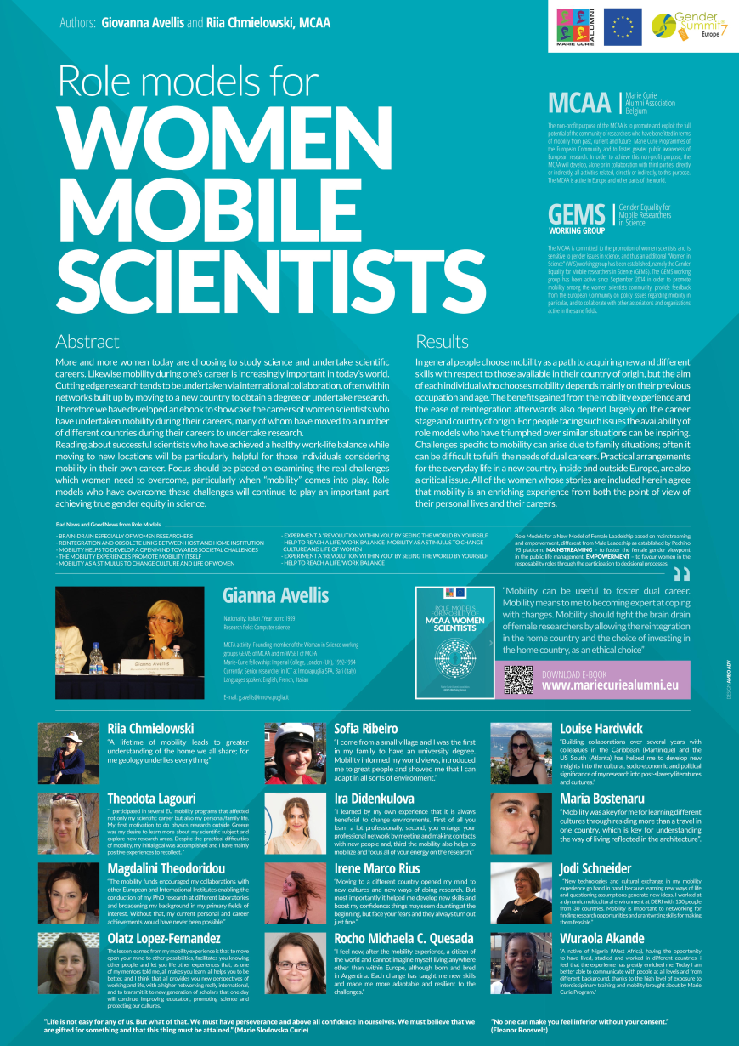
Findings
Mobility to improve personal skills of project management and communication of science
Dual Career – women follows usually male in mobility
Care of children, elders, family
Women mobile at the early stage of their career

Slide 5
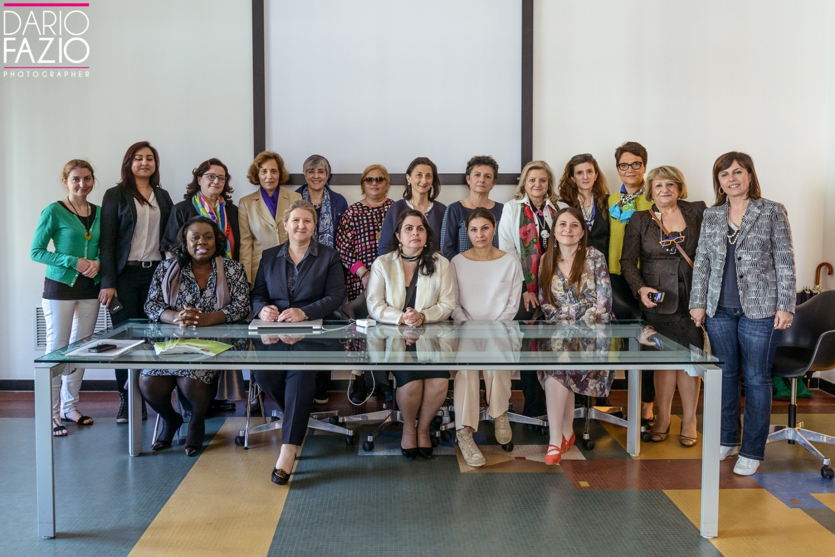
Results: Workshop at University of Bari

Slide 6
Networking
Board member of Marie Curie Fellows Association – chair m-WiSET WG
Ex-officio Board Member of Marie Curie Alumni Association – chair of GEMS WG
Board member ITWIIN (Italian Women Innovators and Inventors Network)
Member Italian Chapter of MCAA
Founding Member of Career Development WG of MCAA
HUMBOLDT Alumni
Marie Curie Alumni – member of GEMS WG
L’Oreal UNESCO “For Women in Science” fellow
President of the Natural Hazard division at European Geoscience Union
Member of the Outstanding Scientist Award Committee
Member of Estonian Chapter of MCAA

Slide 7
Background
Women as a source of untapped potential
Understanding of barriers and different obstacles faced by women in the Science field
the Science in Society panel in HORIZON 2020 deal with the horizontal and vertical segregation experienced by women in their careers and best practices to manage these issues.
Foster women participation in STEM
Effective representation of women in decision-making positions

Slide 8
Ebook on Role Models
Ana Sofia Ribeiro
Giovanna Avellis
Ira Didenkulova
Irene Marco-Rius
Jodi Schneider
Louise Hardwick
Magdalini Theodoridou
Maria Bostenaru Dan
Olatz Lopez-Fernandez
Riia Chmieloswki
Rocio Micaela Crespo Quesada
Theodota Lagouri
Wuraola Akande
https://www.mariecuriealumni.eu/library/role-models-mobility-mcaa-women-scientists

Slide 9
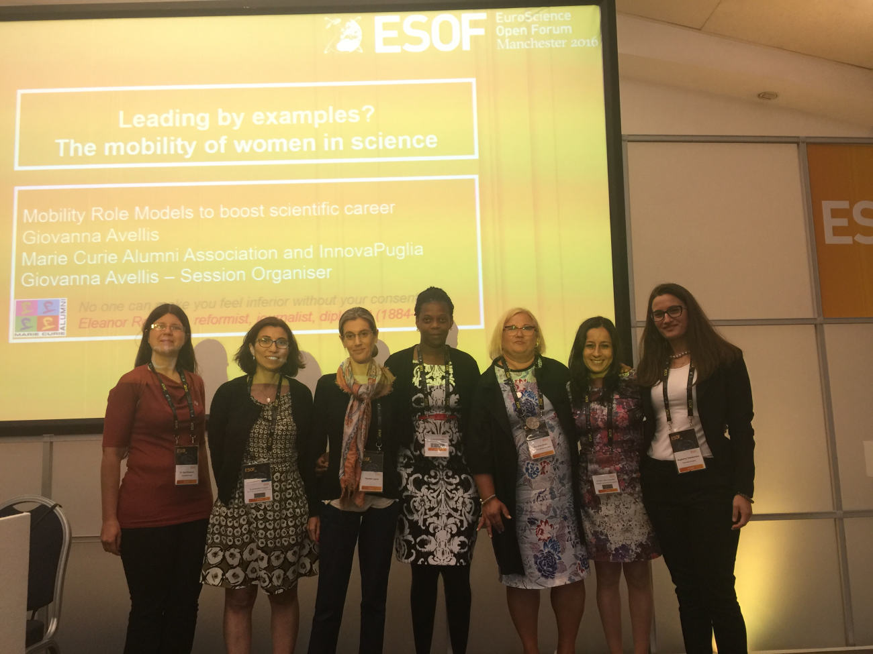
ESOF 2016
European Science Open Forum Mancester 23-27 July 2016
Leading by examples? The mobility of women in science
Session winner – Gianna Avellis
7 speakers from GEMS WG of MCAA (Olga Efremova, Antonella Di Trapani, Theodota Lagouri, Wuraola Akande, Gianna Avellis, Olatz Lopez Fernandez, Magdalini Theodoridou)
Exploit the work done in the ebook on Role Models
Attract more MCAA women to GEMS WG
Supported by European Commission

Slide 10
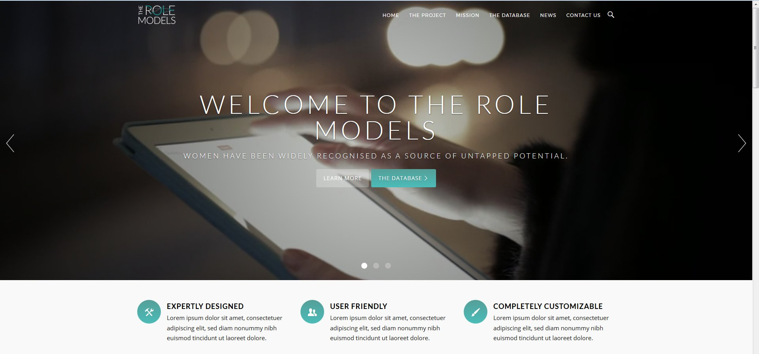
AvH project
Project focus: Networking of women in STEM
Paying attention to their mobility
Provide mentoring support
Annual Workshops
Ebooks on Role Models of mobile women scientists
Portal www.therolemodels.net
Database of Role Models similar to AcademiaNet

Slide 11
Results

Slide 12
Networking
Marie Curie Alumni Association – MCAA (GEMS Working Group)
Marie Curie Fellows Association – MCFA (m-WiSET Working Group)
European Platform of Women in Science – EPWS
ITWIIN, EUWIIN, GWIIN
Tallinn University of Technology and Tartu University, Estonia;
University of Bremen, Leibniz Universität Hannover, University of Kiel, Germany
University of Bari, Italy
University of Salento, Lecce, Italy.
…

Slide 13
Future Activities
Continue to participate to WiS conferences (ESOF2018, ITWIIN 2017/2018, EUWIIN, …)
Organisation of Workshops (Bremen, Bari, …)
Contribution to two ebooks on Role Models
Contribution to the portal www.therolemodels.net
Organisation of EUWIIN2017 (European Women Inventors and Innovators Network) Conference Exhibition and Award at University of Bari, Italy

Slide 14
Promotion of ebook on Role Models
http://www.mariecuriealumni.eu/library/role-models-mobility-mcaa-women-scientists
Resource in GenPORT – the Gender Portal http://www.genderportal.eu/resources/role-models-mcaa-women-mobile-scientists
Portal of Role Models http://therolemodels.net
Frauke Kersten – Dissemination activities in Germany and Andalusia
Future actions: to exploit and disseminate the ebook in the schools and/or universities through workshops

Slide 15
EUWIIN 2017
28th June Exhibition and Conference
29th June Conference and Gala Dinner with Awards
Organisers and sponsors GWIIN, EUWIIN, ITWIIN, MCAA, AvH, …
Lone inventor
Lone innovators
Exceptionally creative Women
Capacity Building
Higher Education
…

Slide 16
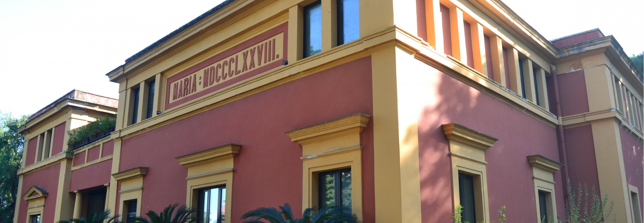
Workshop in Bari, Italy
Apulia Academy of Science, Bari, Italy
23 June 2018– 9.00-13.00
Organisers AvH Alumni, MCAA: GEMS WG - Career Development WG and Italian Chapter
Title „Boosting career development and leadership through mobility
Role Models for career development and leadership session
How to improve gender Equality in Research Organisation session

Slide 17
GEMS WG
Gender Equality for Mobile Researchers in Science
Promote mobility among women scientists
Empower women scientists and discourage discrimination and marginalisation
Foster gender equality and scientific excellence in SET
Encourage the promotion of equality policies at national and European level

Slide 18
Thank you!
Gianna Avellis
avellisgianna@gmail.com

