Slide 1


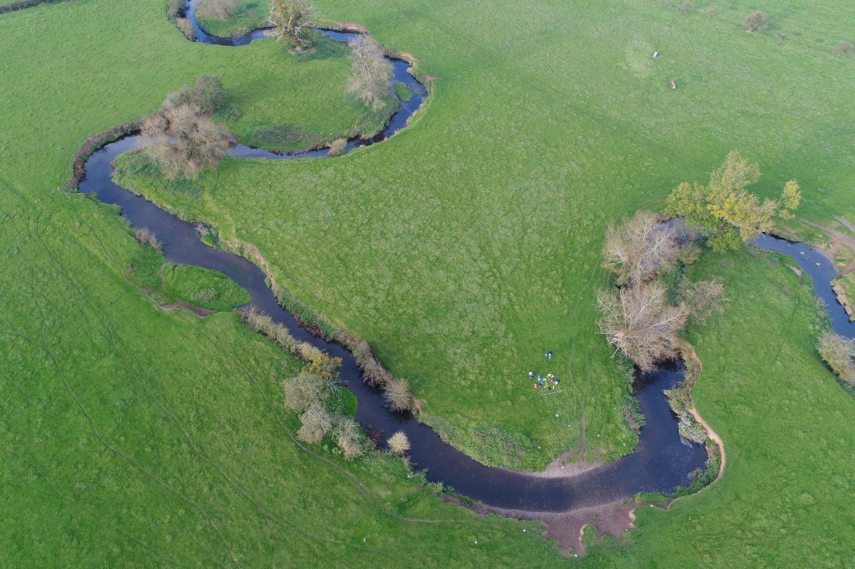
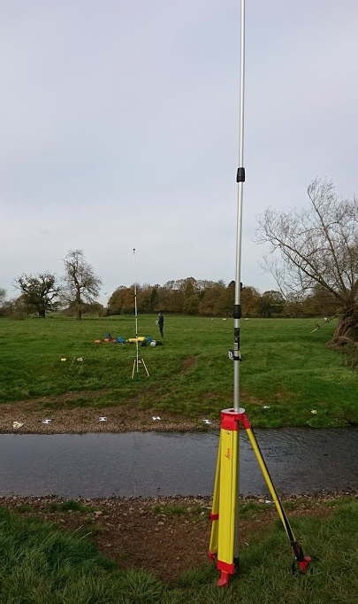

A comparison of using Unmanned Aerial Vehicles (UAV) and mobile video for establishing surface flow velocity measurements using the LSPIV method on the River Arrow, Warwickshire.
Correspondence: g.pearce@worc.ac.uk
$${Sophie Pearce}^{1}, {Prof Ian Maddock}^{1},{Dr Mark Corbett}^{1}, {Nick Everard}^{2.}$$
Navigation
1. University of Worcester, England, UK. 2. Environment Agency, UK.
Introduction
Please use the navigation bar located to the right of each page to view content.
Aims & Objectives
Study Site & Survey methods
LSPIV Processing Parameters
Seeding material
Discharge
Summary
References

Slide 2
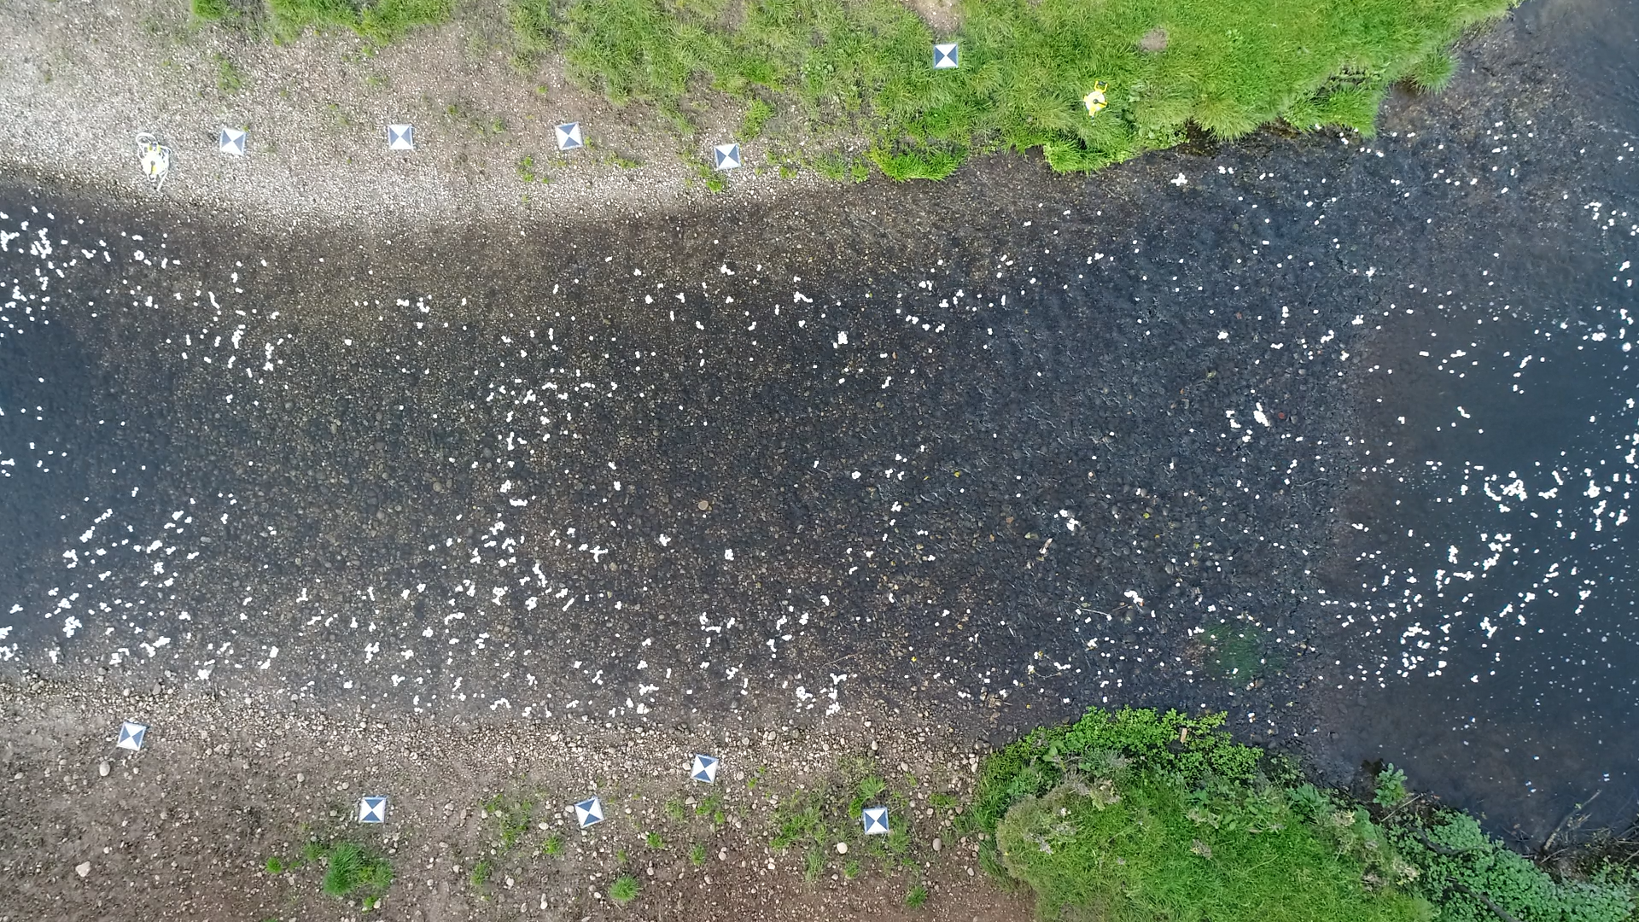
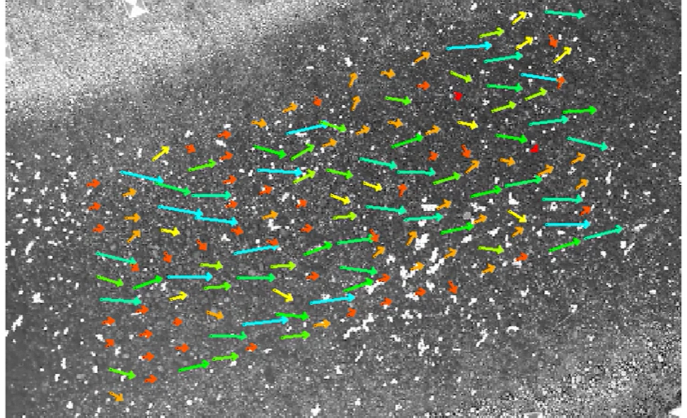
A comparison of using Unmanned Aerial Vehicles (UAV) and mobile video for establishing surface flow velocity measurements using the LSPIV method on the River Arrow, Warwickshire.
Correspondence: g.pearce@worc.ac.uk
$${Sophie Pearce}^{1}, {Prof Ian Maddock}^{1},{Dr Mark Corbett}^{1}, {Nick Everard}^{2.}$$
Navigation
1. University of Worcester, England, UK. 2. Environment Agency, UK.
Introduction
Large Scale Particle Image Velocimetry (LSPIV) has proven an effective technique for monitoring river flows at numerous scales¹ and through using various video platforms (e.g. fixed upon structural support², mounted on a telescopic pole at the bankside³, or through Unmanned Aerial Vehicles (UAVs⁾⁴. However, comparisons of the results obtained from each platform are rarely analysed during the same hydrological and morphological conditions. Furthermore, the processing of LSPIV requires certain parameters to be defined by the user⁵; the Interrogation Areas (IA) and Search Areas (SA) are defined by the users experience, yet a failure to apply the most accurate parameters can cause large uncertainty and erroneous velocity results⁶. Additionally, the presence or absence of seeding material can result in varied outputs of LSPIV calculations⁷. For reliable and robust results to be acquired using the LSPIV method, it is essential that the platform, processing parameters and data collection technique are as accurate and reliable as practicably possible⁸.
Introduction
Aims & Objectives
Study Site & Survey methods
LSPIV Processing Parameters
Seeding material
Discharge
Summary
References

Slide 3
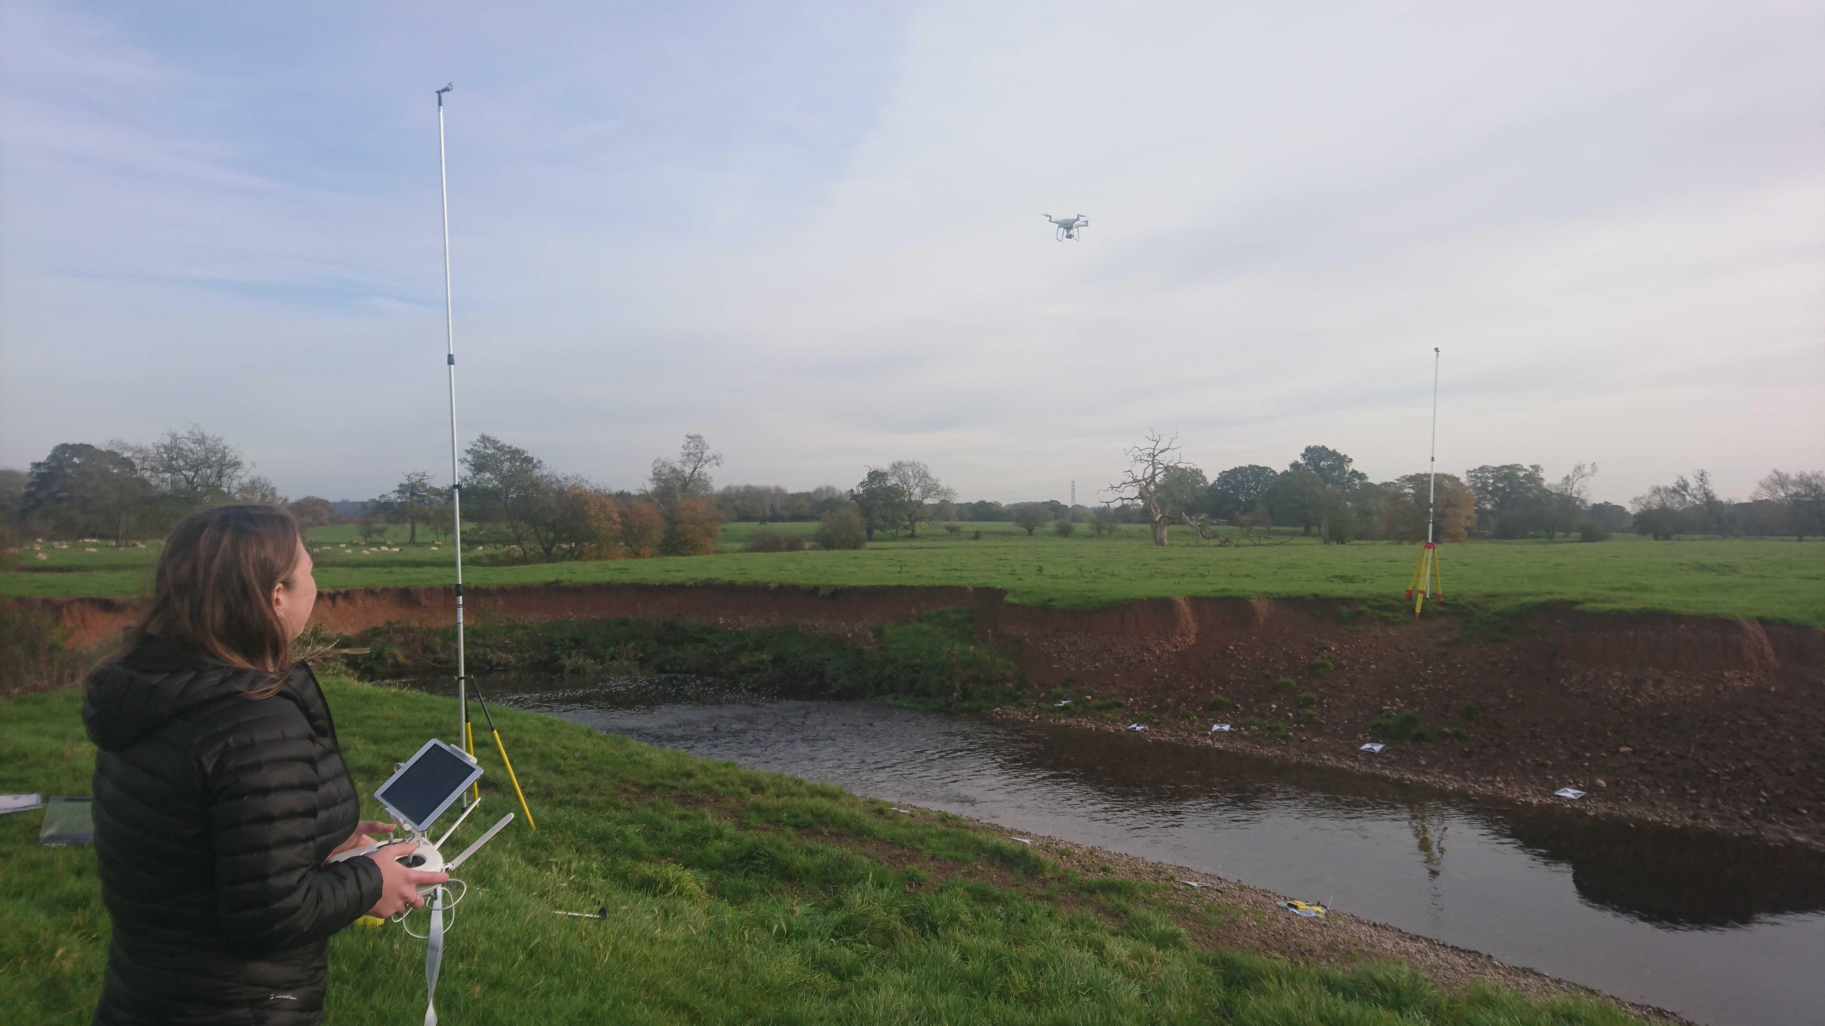
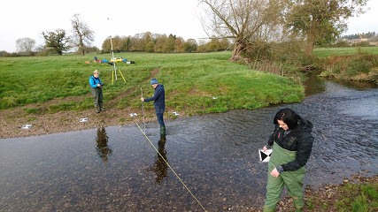
A comparison of using Unmanned Aerial Vehicles (UAV) and mobile video for establishing surface flow velocity measurements using the LSPIV method on the River Arrow, Warwickshire.
Correspondence: g.pearce@worc.ac.uk
$${Sophie Pearce}^{1}, {Prof Ian Maddock}^{1},{Dr Mark Corbett}^{1}, {Nick Everard}^{2.}$$
Navigation
1. University of Worcester, England, UK. 2. Environment Agency, UK.
Aim:
This study aims to compare the results calculated via the LSPIV method for calculating stream discharge using two different platforms; a mounted camera (GoPro Hero 4) on a telescopic pole and an Unmanned Aerial Vehicle (DJI Phantom 4 Pro). All video within this study was recorded at 1080p , therefore results will be representative of such resolution.
Objectives:
Explore the influence of LSPIV processing parameters (Interrogation Area (IA) and Search Area (SA)) on the accuracy of surface flow velocity measurements collected from two video platforms.
Using the most accurate LSPIV processing parameters from Objective i. explore the influence of the presence or absence of seeding material upon the accuracy of measurements collected from both platforms.
Calculate channel discharge from both platforms using the best results found from Objectives i. and ii.
Introduction
Aims & Objectives
Study Site & Survey methods
LSPIV Processing Parameters
Seeding material
Discharge
Summary
References

Slide 4
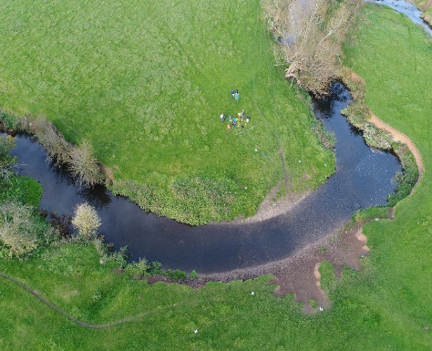
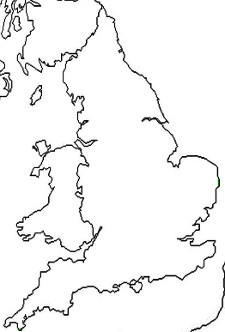
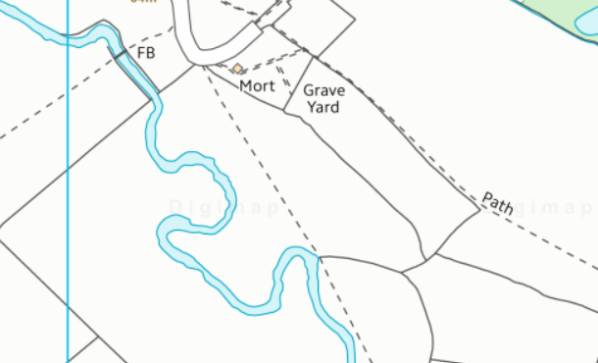

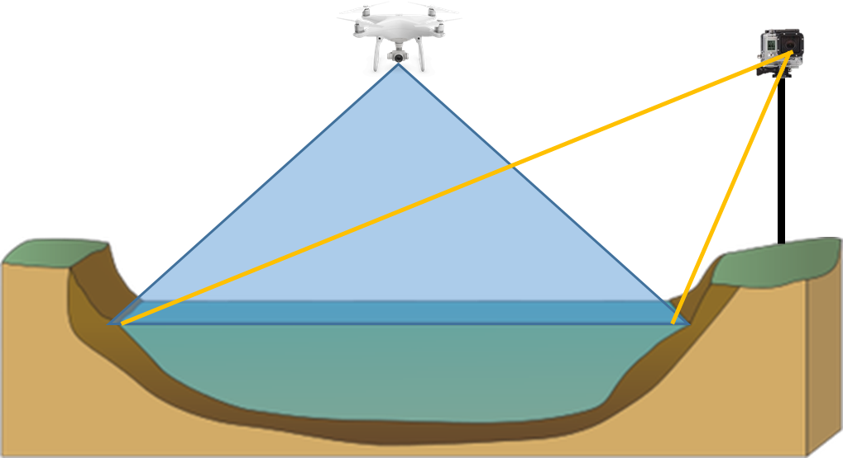
A comparison of using Unmanned Aerial Vehicles (UAV) and mobile video for establishing surface flow velocity measurements using the LSPIV method on the River Arrow, Warwickshire.
Correspondence: g.pearce@worc.ac.uk
$${Sophie Pearce}^{1}, {Prof Ian Maddock}^{1},{Dr Mark Corbett}^{1}, {Nick Everard}^{2.}$$
Navigation
Study Site and Survey Methods
1. University of Worcester, England, UK. 2. Environment Agency, UK.
The present study was conducted on a small channel of approximately 5m wide and 20m long reach on the River Arrow, Warwickshire, a small tributary of the River Avon (figure ). The site was chosen due to its accessibility to fly an UAV, as well as it encountering relatively stable flows over a given period for data collection.
(a)
(b)
Introduction
Aims & Objectives
Study Site & Survey methods
Surveys were collected using the DJI Phantom 4 at an altitude of 60m at a ‘constant position’* and a GoPro situated atop a telescopic pole at the side of the channel; videos were recorded for 60 seconds both with and without seeding material (artificial eco-foam were distributed evenly across the flow). Videos were all recorded at a rate of 30 frames per second and an image resolution of 1080p. 10 Ground control points were distributed on either side of the channel close to the waters edge for orthorectification purposes⁵; GCPs XYZ coordinates were surveyed using the dGPS.
*Reference to a constant position is relative to how stable the GPS hold of the UAV is; corrections were made pre-data processing to remove large movements of the UAV during flight.
LSPIV Processing Parameters
Seeding material
Discharge
Summary
References

Slide 5
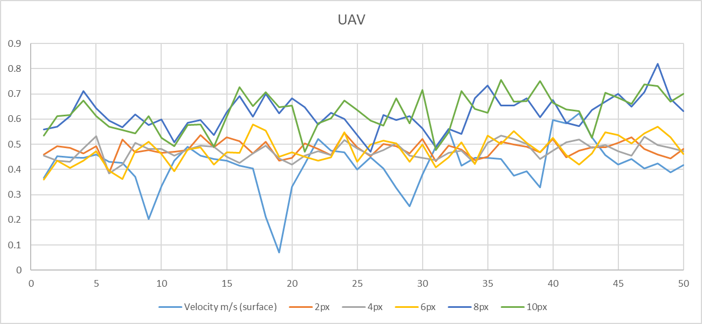
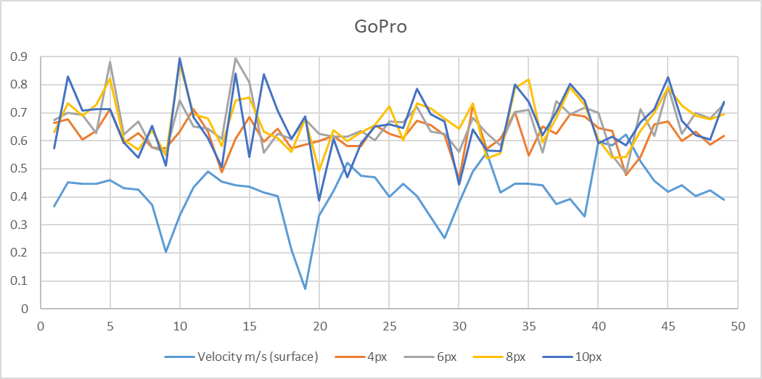
A comparison of using Unmanned Aerial Vehicles (UAV) and mobile video for establishing surface flow velocity measurements using the LSPIV method on the River Arrow, Warwickshire.
Correspondence: g.pearce@worc.ac.uk
$${Sophie Pearce}^{1}, {Prof Ian Maddock}^{1},{Dr Mark Corbett}^{1}, {Nick Everard}^{2.}$$
Navigation
LSPIV Processing Parameters
1. University of Worcester, England, UK. 2. Environment Agency, UK.
Results
Introduction
Outline and Method
To compute surface flow velocities using LSPIV, a cross correlation algorithm is applied to an Interrogation Area (IA) centred on point a_{ij} in the first image at time t and the IA centred on a point b_{ij} in the second image at time t + dt⁹. The size of the IA is determined by the user; different chosen sizes will result in various output results¹⁰.
A Search Area (SA) is also applied to each image, to determine the maximum particle displacement between images.
To estimate the most appropriate IA value five different parameters were chosen (pixel sizes) 2,4,6,8 & 10 to evaluate the impact of the size difference upon calculated velocities. These parameters were applied to two sets of video (UAV and GoPro mounted upon a telescopic pole) each of which were 20 seconds, at 5fps (100 images).
Using a paired t-test all results prove statistically significant; there are large differences between individual point measurements of reference values and LSPIV calculations. All GoPro measurements resulted in p= 0.00001. The lower UAV IA values (2,4, 6 pixels) resulted in p values of 0.025, 0.027 and 0.001 respectively.
Using an IA value of 6pixels for both UAV and GP measurements, the most appropriate SA sjp value would be 10 pixels (Table 1).
Click to expand
Aims & Objectives
Study Site & Survey methods
LSPIV Processing Parameters
Click for detailed LSPIV processing outline
Discussion
The lower IA values provide results that are in better agreement with the reference values, with an IA of 6 pixels providing the most accurate results. However, the LSPIV values calculated are on average, much higher than the reference values; the reference values were collected as near to surface flow as possible, using an electromagnetic current meter. Through using an IA of 6pixels and an SA (sjp) of 10 pixels, LSPIV results prove to be in better agreement with the reference values. However, UAV measurements provide slightly more accurate values than the GoPro calculation, this could perhaps a result of distortions generated during orthorectification.
Seeding material
Click for method for SA estimation
Discharge
Summary
References

Slide 6
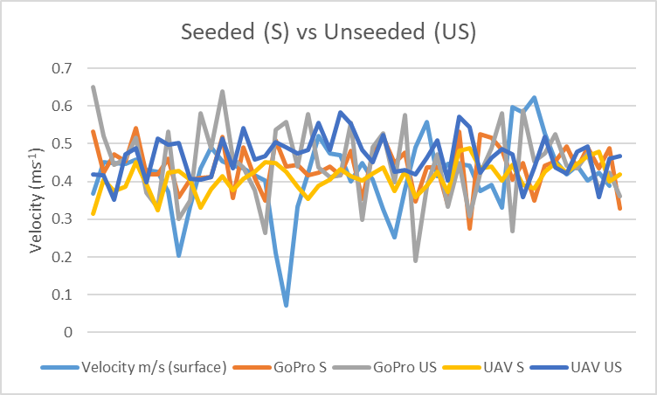
A comparison of using Unmanned Aerial Vehicles (UAV) and mobile video for establishing surface flow velocity measurements using the LSPIV method on the River Arrow, Warwickshire.
Correspondence: g.pearce@worc.ac.uk
$${Sophie Pearce}^{1}, {Prof Ian Maddock}^{1},{Dr Mark Corbett}^{1}, {Nick Everard}^{2.}$$
Navigation
Presence/Absence of Seeding Material
1. University of Worcester, England, UK. 2. Environment Agency, UK.
Results
The most accurate results are those collected using the UAV, with seeding material present; the results collected using the UAV provide the least variation overall. The LSPIV results collected using the GoPro fluctuate more, with the seeded results providing a better accuracy.
The paired t-test results suggest that only the UAV unseeded results are statistically significant, with a p-value of 0.005.
Introduction
Outline and Method
LSPIV requires a good visualisation of the stream surface movement for the accurate calculation of surface flow velocities. There is a need to identify at what flow rate the need to add seeding material is deemed necessary, therefore this study evaluated the accuracy of seeded and unseeded measurements during low flow conditions; future research will evaluate the influence of seeding at multiple flow rates. Two sets of video were recorded for 1 minute, both with and without seeding material. Video was recorded using both a UAV and GoPro; processing parameters remained consistent and in accordance with the most accurate estimations established in objective i) with an IA of 6pixels and SA Sjp of 10pixels.
Outline and Method
To compute surface flow velocities using LSPIV, a cross correlation algorithm is applied to an Interrogation Areas (IA) centred on point a_{ij} in the first image at time t and the IA centred on a point b_{ij} in the second image at time t + dt⁹. The size of the IA is determined by the user; different chosen sizes will result in various output results¹⁰.
Five different parameters were chosen (pixel sizes) 2,4,6,8 & 10 to evaluate the impact of the size difference upon calculated velocities. These parameters were applied to two sets of video (UAV and GoPro mounted upon a telescopic pole) each of which were 60 seconds, at 5fps (100 images).
Aims & Objectives
Study Site & Survey methods
Video of Seeding
Click to expand
LSPIV Processing Parameters
Discussion
The most accurate LSPIV results are those that have seeding material present upon the surface. However, the unseeded measurements from the GoPro prove more accurate than those from the UAV; the differing camera angles creating different surface lighting may be a result of such. It is suggested that future research will compare the presence and absence of seeding in higher flow, where natural surface features are also present. Various parameters may have also influenced the accuracy of results, including the reflection of light on the water surface, and the movement of the camera.
Seeding material
Discharge
Summary
References

Slide 7
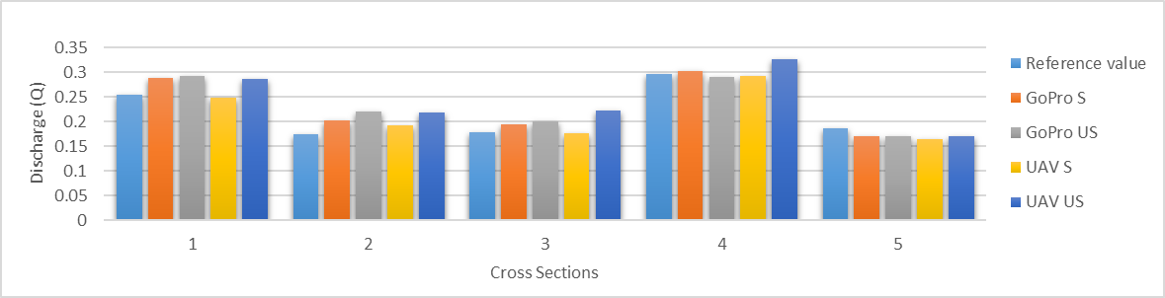
A comparison of using Unmanned Aerial Vehicles (UAV) and mobile video for establishing surface flow velocity measurements using the LSPIV method on the River Arrow, Warwickshire.
Correspondence: g.pearce@worc.ac.uk
$${Sophie Pearce}^{1}, {Prof Ian Maddock}^{1},{Dr Mark Corbett}^{1}, {Nick Everard}^{2.}$$
Navigation
Discharge Calculation
1. University of Worcester, England, UK. 2. Environment Agency, UK.
Results
The total discharge values for each LSPIV calculation prove to be in good agreement with the reference (in-situ) values. Through performing a paired t-test, all results proved insignificant. Although not large differences, seeded LSPIV measurements prove more accurate than unseeded measurements.
Individual cross-section discharges highlight some variation, both between different cross sections (cross sections were located approx. 1.5-2m apart), and between the different platforms/density of seeding materials.
Introduction
Outline and Method
For an accurate comparison between different platforms, the discharge were calculated for both. Using the results from Objective i. and ii. The following processing parameters for surface flow velocity were chosen:
To calculate depth average velocities (required for accurate discharge estimation) a commonly accepted surface alpha of k=0.85 was used. Channel bathymetry was collected via in-situ measurements prior to the collection of the video at 5 cross sections along the 10 metre reach.
Discharge was also calculated for each cross-section using Q = V x A (Q = discharge. V = depth averaged velocity. A = cross sectional area). For each test (e.g. GoPro seeded, GoPro Unseeded, UAV seeded and UAV unseeded) a total discharge were calculated using the five cross sectional discharge measurements for each.
Aims & Objectives
Study Site & Survey methods
Click to expand
LSPIV Processing Parameters
Discussion
Results suggest that LSPIV measurements are near accurate when compared to in-situ reference measurements. The type of platform used and the density of seeding does have an influence upon the accuracy of the measurement. UAV results prove more accurate than those collected using a GoPro; it is likely that image distortions generated during orthorectification may be the cause in differences. The seeded UAV measurement provides the most accurate discharge measurement.
Seeding material
Discharge
Summary
References

Slide 8
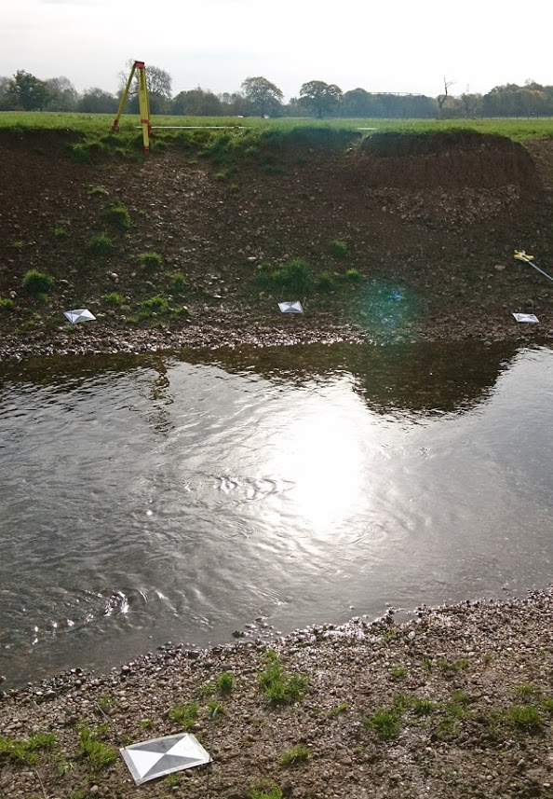
A comparison of using Unmanned Aerial Vehicles (UAV) and mobile video for establishing surface flow velocity measurements using the LSPIV method on the River Arrow, Warwickshire.
Correspondence: g.pearce@worc.ac.uk
$${Sophie Pearce}^{1}, {Prof Ian Maddock}^{1},{Dr Mark Corbett}^{1}, {Nick Everard}^{2.}$$
Navigation
Summary and further research
1. University of Worcester, England, UK. 2. Environment Agency, UK.
Introduction
This study has proven that it is essential for the user to define the most appropriate interrogation and search areas when processing LSPIV calculations. If the wrong parameter is chosen, then surface flow velocity measurements calculated could be very inaccurate.
Although, the interrogation area and search areas used within this study are only representative to the resolution of imagery used. To enhance the applicability and usability of finding the most appropriate parameters used, it is suggested that further analysis will be conducted to explore the possibility of finding an appropriate ratio of IA and SA parameters chosen in relation to the camera resolution applied.
Within low flow conditions it is also essential that seeding material is present for the most accurate results. Future research will explore the thresholds of the necessity of adding artificial material into a channel, and assess the accuracy of using natural features upon the water surface during higher flow conditions.
Within this study it is implied that LSPIV results collected via the UAV provide more accurate results than those collected using a bankside camera (GoPro). It is suggested that the main reason for this may be a result of the angle of the bankside camera encountering more sunlight reflections off the water surface compared to the aerial capture of the UAV. Sunlight reflections upon the water surface act as a blind spot for collecting surface flow velocities, therefore future research should investigate possibilities of reducing sunlight glare on the water surface.
Aims & Objectives
Study Site & Survey methods
LSPIV Processing Parameters
Seeding material
Discharge
Summary
References

Slide 9
A comparison of using Unmanned Aerial Vehicles (UAV) and mobile video for establishing surface flow velocity measurements using the LSPIV method on the River Arrow, Warwickshire.
Correspondence: g.pearce@worc.ac.uk
$${Sophie Pearce}^{1}, {Prof Ian Maddock}^{1},{Dr Mark Corbett}^{1}, {Nick Everard}^{2.}$$
Navigation
References
1. University of Worcester, England, UK. 2. Environment Agency, UK.
Introduction
Muste, M., Fujita, I. & Hauet, A. (2008) Large Scale Particle Image Velocimetry: A proof of concept. Water Resources Research. 44 (4), 1-14.
Fujita, I., Muste, M. & Kruger, A. (1998) Large Scale Particle Image Velocimetry for flow analysis in hydraulic engineering applications. Journal of Hydraulic Research. 36 (3), 397-414.
Kim, Y., Muste, M., Hauet, A., Krajewski, W., Kruger, A. & Bradley, A. (2008) Stream discharge using mobile large-scale particle image velocimetry: A proof of concept. Water Resources Research. 44 (9), 1-6.
Tauro, F., Petroselli, A. & Arcangeletti, E. (2016) Assessment of drone-based surface flow observations. Hydrological Processes. 30 (7), 1114-1130.
Le Coz, J., Renard, B., Bonnifait, L., Branger, F. and Le Boursicaud, R. (2014). Combining hydraulic knowledge and uncertain gaugings in the estimation of hydrometric rating curves: A Bayesian Approach. Journal of Hydrology. 509, 573-587.
Termini and Leonardo 2016
Detert, M. & Weitbrecht, V. (2015) A low cost airborne velocimetry system: Proof of concept. Journal of Hydraulic Research. 53 (4), 532-539.
Jodeau, M., Hauet, A., Le Coz, J., Bercovitz, Y. & Lebert, F. (2017) Laboratory and field LSPIV measurements of flow velocities using FUDAA-LSPIV, a free user-friendly software. Proceedings of the 1st International Symposium and Exhibition Sensors and Software – HydroSenSoft 2017. pp82-86.
LeCoz, J., Jodeau, M., Hauet, A., Marchand, B. & Le Boursicaud, R. (2014) Image based velocity and discharge measurements in field and laboratory river engineering studies using the free FUDAA-LSPIV software. River Flow 2014.
Sutarto, T. (2015) Application of large scale particle image velocimetry (LSPIV) to identify flow pattern in a channel. Procedia Engineering. 125, 213-219.
Aims & Objectives
Study Site & Survey methods
LSPIV Processing Parameters
Seeding material
Discharge
Summary
References

Slide 10
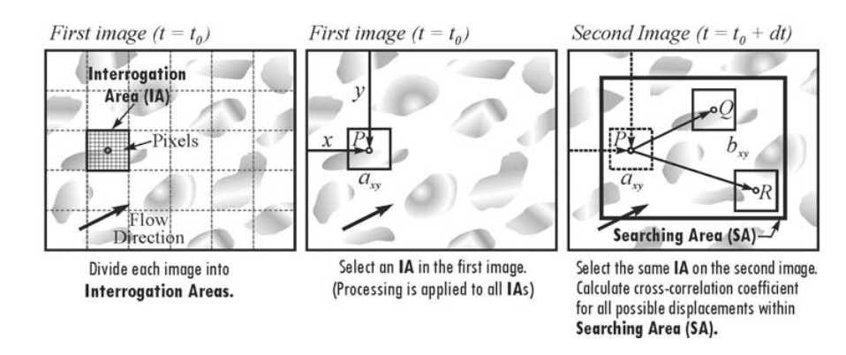
A comparison of using Unmanned Aerial Vehicles (UAV) and mobile video for establishing surface flow velocity measurements using the LSPIV method on the River Arrow, Warwickshire.
X
LSPIV Outline
LSPIV is an image based technique for measuring surface flow velocities; the system collects video and analyses the movement of particles on the water surface through successive image pairs (figure). LSPIV calculation requires particles (or seeding material) to be present upon the water surface to provide a good visualisation of stream flow. Surface flow velocities are estimated by calculating the displacement of particles between image pairs at a specified time interval. Particles are tracked between images at a certain point within each image, this is known at theinterrogation area (IA). Defined points are chosen for the location of the IA, these are referred to as a_{ij} in the first image, and b_{ij} in the second image. Between each image, the displacement of particles are tracked within a specified search area (SA). Therefore, the maximum correlation of particle displacement will result in the most accurate distribution of velocity measurements.
Correspondence: g.pearce@worc.ac.uk
$${Sophie Pearce}^{1}, {Prof Ian Maddock}^{1},{Dr Mark Corbett}^{1}, {Nick Everard}^{2.}$$
Navigation
LSPIV Processing Parameters
1. University of Worcester, England, UK. 2. Environment Agency, UK.
Results
Introduction
Outline and Method
To compute surface flow velocities using LSPIV, a cross correlation algorithm is applied to an Interrogation Area (IA) centred on point a_{ij} in the first image at time t and the IA centred on a point b_{ij} in the second image at time t + dt⁹. The size of the IA is determined by the user; different chosen sizes will result in various output results¹⁰.
A Search Area (SA) is also applied to each image, to determine the maximum particle displacement between images.
To estimate the most appropriate IA value five different parameters were chosen (pixel sizes) 2,4,6,8 & 10 to evaluate the impact of the size difference upon calculated velocities. These parameters were applied to two sets of video (UAV and GoPro mounted upon a telescopic pole) each of which were 20 seconds, at 5fps (100 images).
Using a paired t-test all results prove statistically significant; there are large differences between individual point measurements of reference values and LSPIV calculations. All GoPro measurements resulted in p= 0.00001. The lower UAV IA values (2,4, 6 pixels) resulted in p values of 0.025, 0.027 and 0.001 respectively.
Using an IA value of 6pixels for both UAV and GP measurements, the most appropriate SA sjp value would be 10 pixels (Table 1).
Click to expand
Aims & Objectives
Study Site & Survey methods
LSPIV Processing Parameters
Click for detailed LSPIV processing outline
Discussion
The lower IA values provide results that are in better agreement with the reference values, with an IA of 6 pixels providing the most accurate results. However, the LSPIV values calculated, are on average much higher than the reference values; the reference values were collected as near to surface flow as possible, using an electromagnetic current meter.
The UAV measurements provide slightly more accurate values than the GoPro calculation, this could perhaps a result of distortions generated during orthorectification.
Seeding material
Click for method for SA estimation
Discharge
Summary
Conceptualisation of LSPIV image processing algorithm (Source: Muste et al. 2008).
References

Slide 11
A comparison of using Unmanned Aerial Vehicles (UAV) and mobile video for establishing surface flow velocity measurements using the LSPIV method on the River Arrow, Warwickshire.
X
Estimating the most accurate Search Area dimensions
To estimate the most appropriate Search Area for the given data, various Sjp (Stream wise) distances were tested. The Sjm were set to 0 to avoid any mistaken ‘backward velocities’, the Sip and Sim were set to 5 pixels, and the Sjp was tested at 5,10 and 15 pixels to see which size would provide the most accurate results.
The IA remained at 6pixels for all tests, as this result proved the most accurate during prior testing.
Correspondence: g.pearce@worc.ac.uk
$${Sophie Pearce}^{1}, {Prof Ian Maddock}^{1},{Dr Mark Corbett}^{1}, {Nick Everard}^{2.}$$
Navigation
LSPIV Processing Parameters
1. University of Worcester, England, UK. 2. Environment Agency, UK.
Results
Introduction
Outline and Method
To compute surface flow velocities using LSPIV, a cross correlation algorithm is applied to an Interrogation Area (IA) centred on point a_{ij} in the first image at time t and the IA centred on a point b_{ij} in the second image at time t + dt⁹. The size of the IA is determined by the user; different chosen sizes will result in various output results¹⁰.
A Search Area (SA) is also applied to each image, to determine the maximum particle displacement between images.
To estimate the most appropriate IA value five different parameters were chosen (pixel sizes) 2,4,6,8 & 10 to evaluate the impact of the size difference upon calculated velocities. These parameters were applied to two sets of video (UAV and GoPro mounted upon a telescopic pole) each of which were 20 seconds, at 5fps (100 images).
Using a paired t-test all results prove statistically significant; there are large differences between individual point measurements of reference values and LSPIV calculations. All GoPro measurements resulted in p= 0.00001. The lower UAV IA values (2,4, 6 pixels) resulted in p values of 0.025, 0.027 and 0.001 respectively.
Using an IA value of 6pixels for both UAV and GP measurements, the most appropriate SA sjp value would be 10 pixels (Table 1).
Click to expand
Aims & Objectives
Study Site & Survey methods
Sip
SA
LSPIV Processing Parameters
Click for detailed LSPIV processing outline
Sjm
IA
(6px)
Sjp
Seeding material
Click for method for SA estimation
Discussion
The lower IA values provide results that are in better agreement with the reference values, with an IA of 6 pixels providing the most accurate results. However, the LSPIV values calculated, are on average much higher than the reference values; the reference values were collected as near to surface flow as possible, using an electromagnetic current meter.
The UAV measurements provide slightly more accurate values than the GoPro calculation, this could perhaps a result of distortions generated during orthorectification.
Discharge
Sim
Summary
References

Slide 12
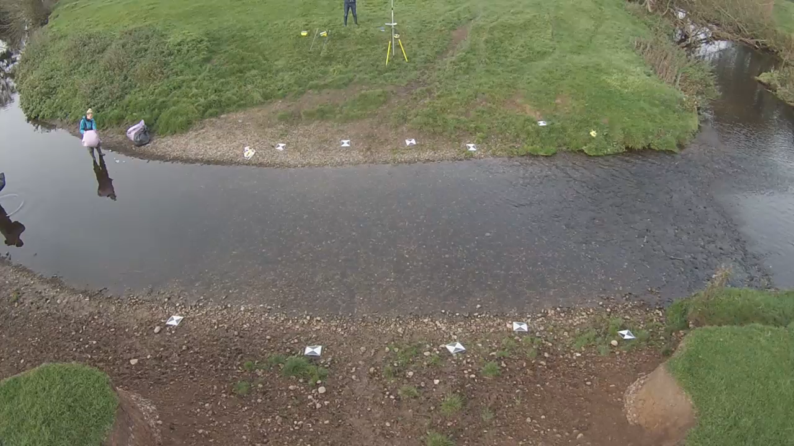
A comparison of using Unmanned Aerial Vehicles (UAV) and mobile video for establishing surface flow velocity measurements using the LSPIV method on the River Arrow, Warwickshire.
Correspondence: g.pearce@worc.ac.uk
$${Sophie Pearce}^{1}, {Prof Ian Maddock}^{1},{Dr Mark Corbett}^{1}, {Nick Everard}^{2.}$$
Navigation
X
Presence/Absence of Seeding Material
1. University of Worcester, England, UK. 2. Environment Agency, UK.
Video of Seeding process
Introduction
Results
Outline and Method
To compute surface flow velocities using LSPIV, a cross correlation algorithm is applied to an Interrogation Areas (IA) centred on point a_{ij} in the first image at time t and the IA centred on a point b_{ij} in the second image at time t + dt⁹. The size of the IA is determined by the user; different chosen sizes will result in various output results¹⁰.
Five different parameters were chosen (pixel sizes) 2,4,6,8 & 10 to evaluate the impact of the size difference upon calculated velocities. These parameters were applied to two sets of video (UAV and GoPro mounted upon a telescopic pole) each of which were 60 seconds, at 5fps (100 images).
Outline and Method
LSPIV requires a good visualisation of the stream surface movement for the accurate calculation of surface flow velocities. There is a need to identify at what flow rate the need to add seeding material is deemed necessary, therefore this study evaluated the accuracy of seeded and unseeded measurements during low flow conditions; future research will evaluate the influence of seeding at multiple flow rates.
Two sets of video were recorded for 1 minute, both with and without seeding material. Video was recorded using both a UAV and GoPro; processing parameters remained constant and in accordance with the most accurate estimations established in objective i.
Aims & Objectives
Study Site & Survey methods
LSPIV Processing Parameters
Discussion/conclusion
Seeding material
Discharge
Summary
References

Slide 13
A comparison of using Unmanned Aerial Vehicles (UAV) and mobile video for establishing surface flow velocity measurements using the LSPIV method on the River Arrow, Warwickshire.
X
Correspondence: g.pearce@worc.ac.uk
$${Sophie Pearce}^{1}, {Prof Ian Maddock}^{1},{Dr Mark Corbett}^{1}, {Nick Everard}^{2.}$$
Navigation
LSPIV Processing Parameters
1. University of Worcester, England, UK. 2. Environment Agency, UK.
Results
Introduction
Outline and Method
To compute surface flow velocities using LSPIV, a cross correlation algorithm is applied to an Interrogation Area (IA) centred on point a_{ij} in the first image at time t and the IA centred on a point b_{ij} in the second image at time t + dt⁹. The size of the IA is determined by the user; different chosen sizes will result in various output results¹⁰.
A Search Area (SA) is also applied to each image, to determine the maximum particle displacement between images.
To estimate the most appropriate IA value five different parameters were chosen (pixel sizes) 2,4,6,8 & 10 to evaluate the impact of the size difference upon calculated velocities. These parameters were applied to two sets of video (UAV and GoPro mounted upon a telescopic pole) each of which were 20 seconds, at 5fps (100 images).
Using a paired t-test all results prove statistically significant; there are large differences between individual point measurements of reference values and LSPIV calculations. All GoPro measurements resulted in p= 0.00001. The lower UAV IA values (2,4, 6 pixels) resulted in p values of 0.025, 0.027 and 0.001 respectively.
Using an IA value of 6pixels for both UAV and GP measurements, the most appropriate SA sjp value would be 10 pixels (Table 1).
Pixel resolution* on the GoPro results was too small to allow a 2pixel IA to be performed
*Pixel resolution was the same for both sets of data, however during orthorectification of the GoPro results, pixel sizes would have been distorted.
Click to expand
Aims & Objectives
Study Site & Survey methods
LSPIV Processing Parameters
Click for detailed LSPIV processing outline
Discussion
The lower IA values provide results that are in better agreement with the reference values, with an IA of 6 pixels providing the most accurate results. However, the LSPIV values calculated, are on average much higher than the reference values; the reference values were collected as near to surface flow as possible, using an electromagnetic current meter.
The UAV measurements provide slightly more accurate values than the GoPro calculation, this could perhaps a result of distortions generated during orthorectification.
Seeding material
Click for method for SA estimation
Discharge
Summary
References

Slide 14
A comparison of using Unmanned Aerial Vehicles (UAV) and mobile video for establishing surface flow velocity measurements using the LSPIV method on the River Arrow, Warwickshire.
Correspondence: g.pearce@worc.ac.uk
$${Sophie Pearce}^{1}, {Prof Ian Maddock}^{1},{Dr Mark Corbett}^{1}, {Nick Everard}^{2.}$$
Navigation
Discharge Calculation
1. University of Worcester, England, UK. 2. Environment Agency, UK.
Results
The total discharge values for each LSPIV calculation prove to be in good agreement with the reference (in-situ) values. Through performing a paired t-test, all results proved insignificant. Although not large differences, seeded LSPIV measurements prove more accurate than unseeded measurements.
Individual cross-section discharges highlight some variation, both between different cross sections (cross sections were located approx. 1.5-2m apart), and between the different platforms/density of seeding materials.
Introduction
Outline and Method
For an accurate comparison between different platforms, the discharge were calculated for both. Using the results from Objective i. and ii. The following processing parameters for surface flow velocity were chosen:
To calculate depth average velocities (required for accurate discharge estimation) a commonly accepted surface alpha of k=0.85 was used. Channel bathymetry was collected via in-situ measurements prior to the collection of the video at 5 cross sections along the 10 metre reach.
Discharge was also calculated for each cross-section using Q = V x A (Q = discharge. V = depth averaged velocity. A = cross sectional area). For each test (e.g. GoPro seeded, GoPro Unseeded, UAV seeded and UAV unseeded) a total discharge were calculated using the five cross sectional discharge measurements for each.
Aims & Objectives
X
Study Site & Survey methods
Click to expand
LSPIV Processing Parameters
Discussion
Results suggest that LSPIV measurements are near accurate when compared to in-situ reference measurements. The type of platform used and the density of seeding does have an influence upon the accuracy of the measurement. UAV results prove more accurate than those collected using a GoPro; it is likely that image distortions generated during orthorectification may be the cause in differences.
The seeded UAV measurement provides the most accurate discharge measurement.
Seeding material
Discharge
S = Seeded
US = Unseeded
Summary
References

Slide 15
A comparison of using Unmanned Aerial Vehicles (UAV) and mobile video for establishing surface flow velocity measurements using the LSPIV method on the River Arrow, Warwickshire.
Correspondence: g.pearce@worc.ac.uk
$${Sophie Pearce}^{1}, {Prof Ian Maddock}^{1},{Dr Mark Corbett}^{1}, {Nick Everard}^{2.}$$
Navigation
1. University of Worcester, England, UK. 2. Environment Agency, UK.
Presence/Absence of Seeding Material
X
Video of Seeding
Introduction
Results
Seeded results provide more accurate velocity measurements compared to unseeded results. Furthermore, the UAV seeded measurements prove the most accurate and least variable when compared to reference values. The paired t-test results suggest that only the UAV unseeded results are statistically significant.
Outline and Method
LSPIV requires a good visualisation of the stream surface movement for the accurate calculation of surface flow velocities. There is a need to identify at what flow rate the need to add seeding material is deemed necessary, therefore this study evaluated the accuracy of seeded and unseeded measurements during low flow conditions; future research will evaluate the influence of seeding at multiple flow rates. Two sets of video were recorded for 1 minute, both with and without seeding material. Video was recorded using both a UAV and GoPro; processing parameters remained consistent and in accordance with the most accurate estimations established in objective i) with an IA of 6pixels and SA Sjp of 10pixels.
Outline and Method
To compute surface flow velocities using LSPIV, a cross correlation algorithm is applied to an Interrogation Areas (IA) centred on point a_{ij} in the first image at time t and the IA centred on a point b_{ij} in the second image at time t + dt⁹. The size of the IA is determined by the user; different chosen sizes will result in various output results¹⁰.
Five different parameters were chosen (pixel sizes) 2,4,6,8 & 10 to evaluate the impact of the size difference upon calculated velocities. These parameters were applied to two sets of video (UAV and GoPro mounted upon a telescopic pole) each of which were 60 seconds, at 5fps (100 images).
Aims & Objectives
Study Site & Survey methods
Click to expand
LSPIV Processing Parameters
Discussion
The most accurate LSPIV results are those that have seeding material present upon the surface. Unseeded measurements from the GoPro prove more accurate than those from the UAV; the differing camera angles creating different surface lighting may be a result of such. It is suggested that future research will compare the presence and absence of seeding in higher flow, where natural surface features are also present. Various parameters may have also influenced the accuracy of results, including the reflection of light on the water surface, and the movement of the camera.
Seeding material
Discharge
Summary
References

