Slide 2
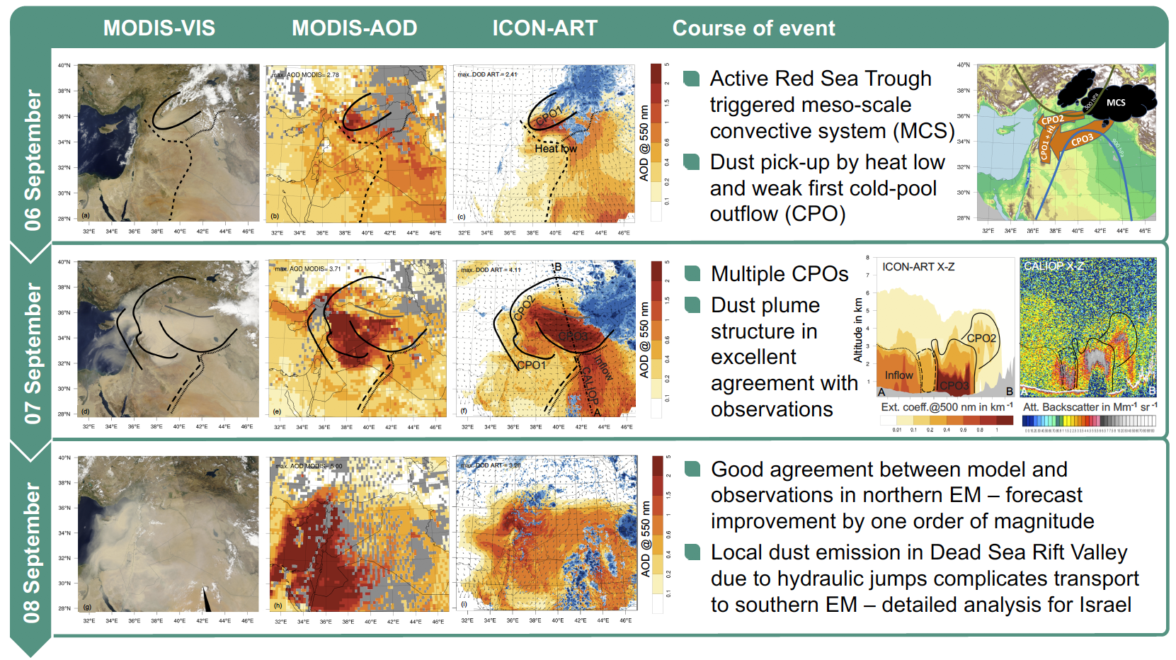
Overview
Click me to return
to this slide
Click me
Event overview
Course
Forecast failure
Our approach
Event analysis
Meteorological drivers
Model vs. satellite
Full event animation
Spatial dust distribution
Vertical dust structure
Conclusions
Highlight
6 Sep ‘15
7 Sep ‘15
8 Sep ‘15
I will always show you the current event time

Slide 3
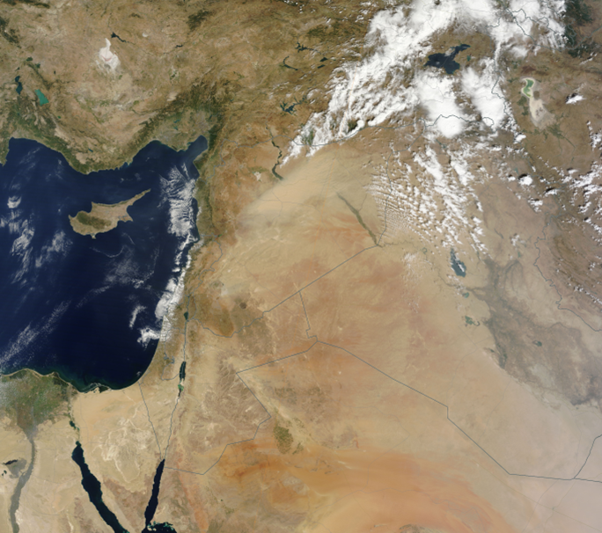
Spatial extent and temporal evolution
MODIS TERRA VIS
NASA Earth Observatory
08
6/9
7/9
8/9
UTC

Slide 4
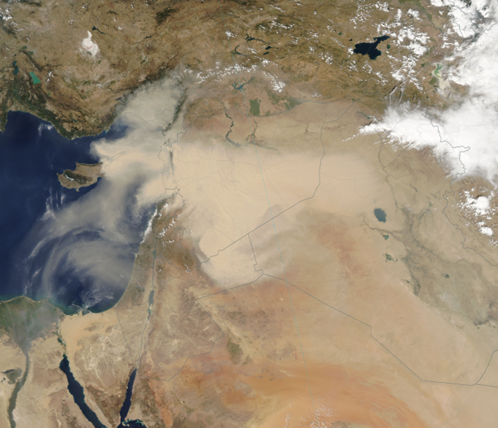
Spatial extent and temporal evolution
MODIS TERRA VIS
NASA Earth Observatory
6/9
10
7/9
8/9
UTC

Slide 5
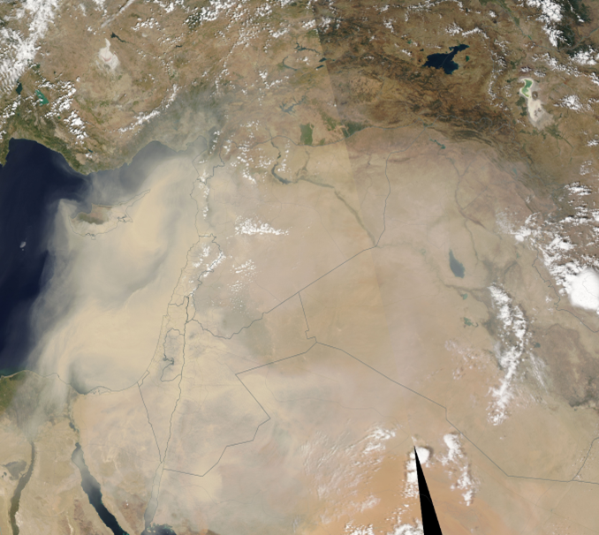
Spatial extent and temporal evolution
MODIS TERRA VIS
NASA Earth Observatory
6/9
7/9
11
8/9
UTC

Slide 6
Forecast failure of global models
► OBS
► FCST
Multi-model mean dust optical depth
Obtained from WMO Model intercomparison project at http://sds-was.aemet.es
6/9
10
7/9
8/9
UTC
8/9

Slide 7
Forecast failure of global models
► OBS
► FCST
Multi-model mean dust optical depth
Obtained from WMO Model intercomparison project at http://sds-was.aemet.es
6/9
7/9
11
8/9
UTC
8/9

Slide 8
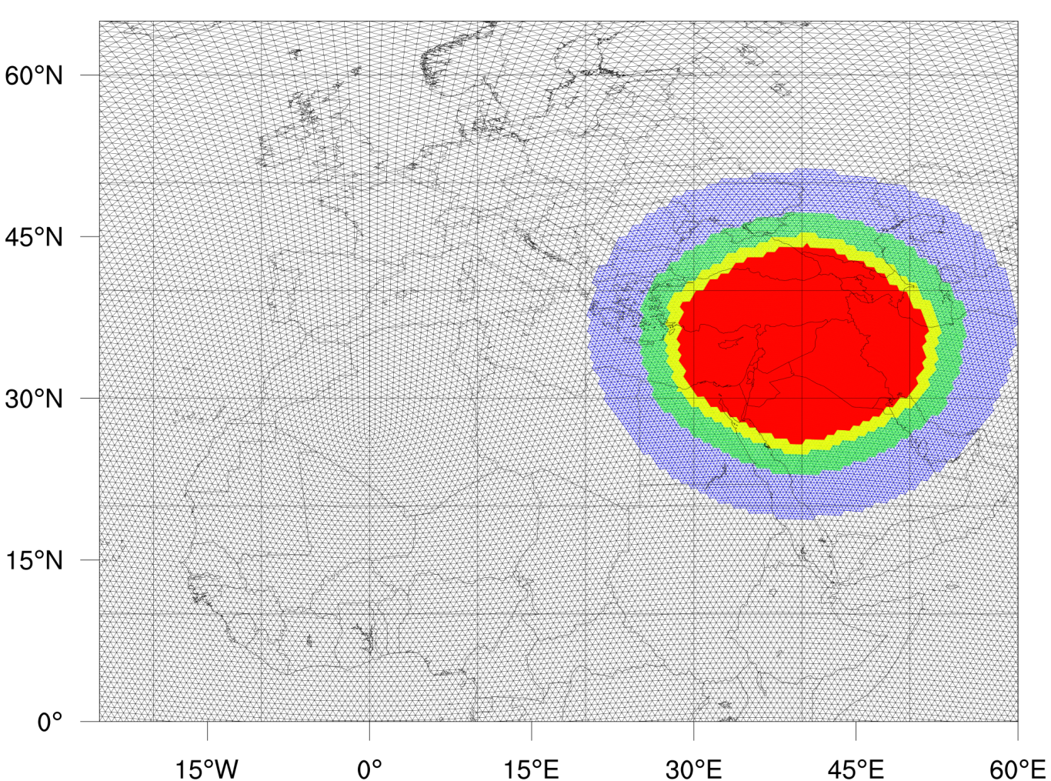
Forecast failure of global models
Our approach
ICON-ART global simulation,
40 km grid spacing
Nests down to 2.5 km grid spacing with 2000 km diameter
Switch-off convection parametrization
Global grid
Local nests
2.5 km nest,
convection-
permitting
6/9
7/9
8/9
UTC
8/9

Slide 9
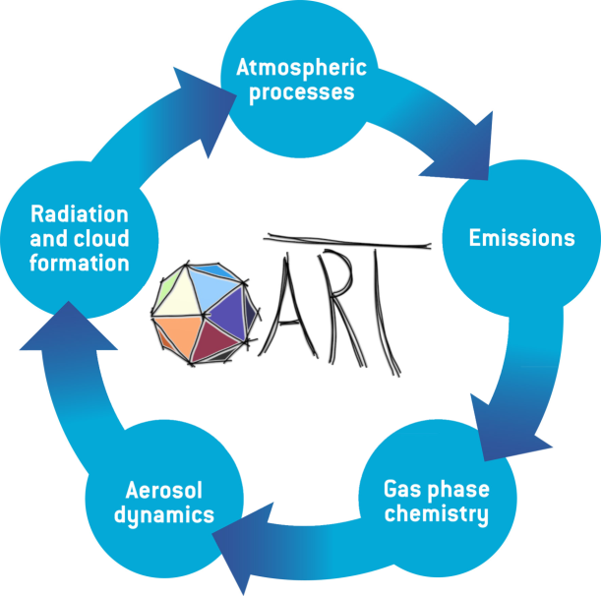
ICON-ART
ICON
Developed by DWD and Max-Planck
Non-hydrostatic global model
Mass consistent tracer transport
2-way nesting capabilities
global grid
local nest
© F. Prill, DWD
ART – Aerosols and Reactive Trace gases
Developed at KIT
Mineral dust module
Emission, transport, dry and wet deposition
Online radiation interaction
Rieger et al. (2015), Geosci. Mod. Dev.

Slide 10
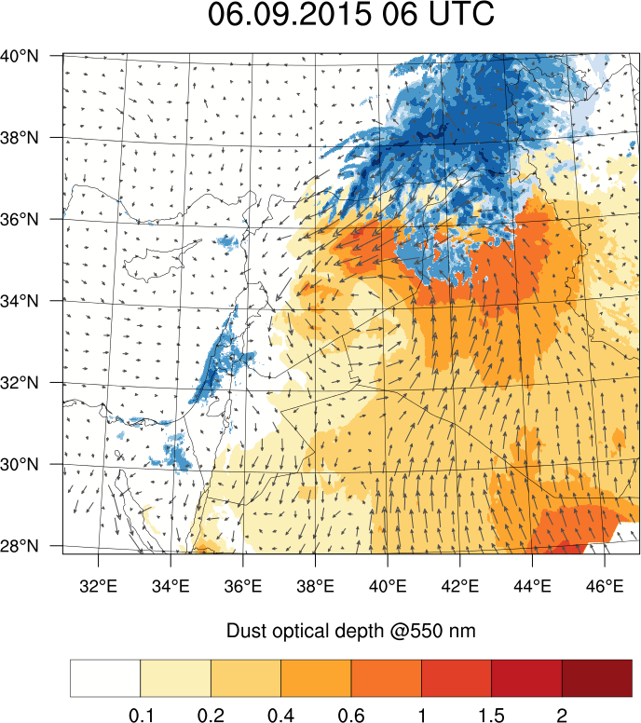
Course of event
ICON-ART simulation results
Three day forecast starting 6 September 2015
Dust is shown by brown color
Clouds are shown by blue color
06
6/9
7/9
8/9
Notes:
ICON-ART

Slide 11
Course of event
06
6/9
7/9
8/9
Notes:
ICON-ART

Slide 12
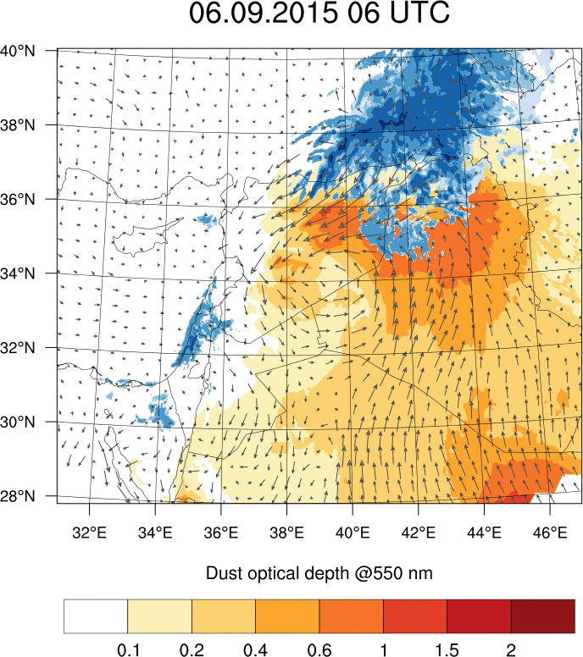
Course of event
6/9
7/9
8/9
Notes:
ICON-ART

Slide 13
Synoptic situation
MCS
500 hPa
CPO2
HL + CPO1
CPO3
900 hPa
6/9
7/9
8/9
Notes:
ICON-ART

Slide 14
Synoptic situation
Active Red Sea Trough synpotic situation triggered meso-scale convective systems (MCS)
Supported by orography
Dust pick-up by heat low and multiple cold-pool outflows (CPO)
MCS
500 hPa
CPO2
HL + CPO1
CPO3
900 hPa
6/9
7/9
8/9
Notes:
ICON-ART

Slide 15
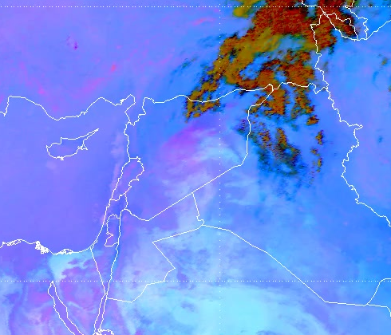
Validation of ICON-ART
ICON-ART model
EUMETSAT satellite
Cloud
Cloud
Dust
Dust
SEVIRI Dust RGB Product
provided by and thanks to
J. Kerkman, S. Lancaster, H. Roesli
06
6/9
7/9
8/9
Notes:
ICON-ART

Slide 16
Validation of ICON-ART
ICON-ART model
EUMETSAT satellite
6/9
7/9
8/9
Notes:
ICON-ART

Slide 17
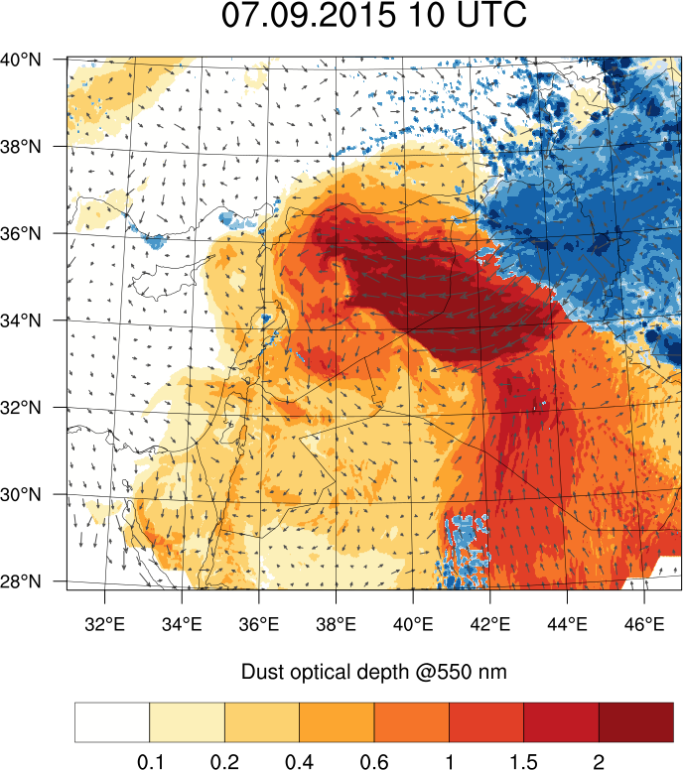
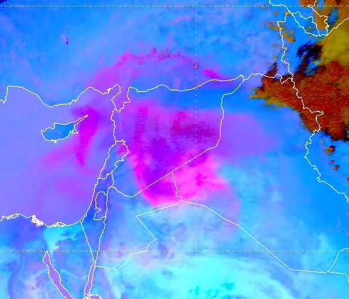
Validation of ICON-ART
ICON-ART
ICON-ART model
EUMETSAT satellite
6/9
10
7/9
8/9
Notes:
ICON-ART

Slide 18
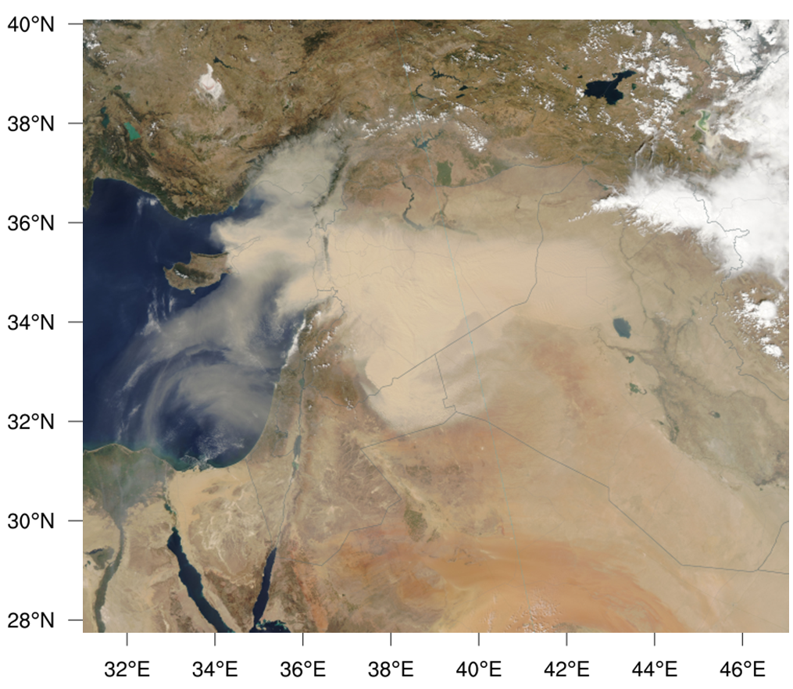
Validation of ICON-ART
ICON-ART
MODIS TERRA VIS satellite
ICON-ART model
6/9
10
7/9
8/9
Notes:
ICON-ART

Slide 19
Validation of ICON-ART
07 Sep ’15 – 10 UTC
Detailed agreement between model and satellite
All features present in model with small spatial offsets
→ Vertical profile obtained by CALIPSO overpass follows
ICON-ART
MODIS TERRA VIS satellite
ICON-ART model
6/9
10
7/9
8/9
Notes:
ICON-ART

Slide 20
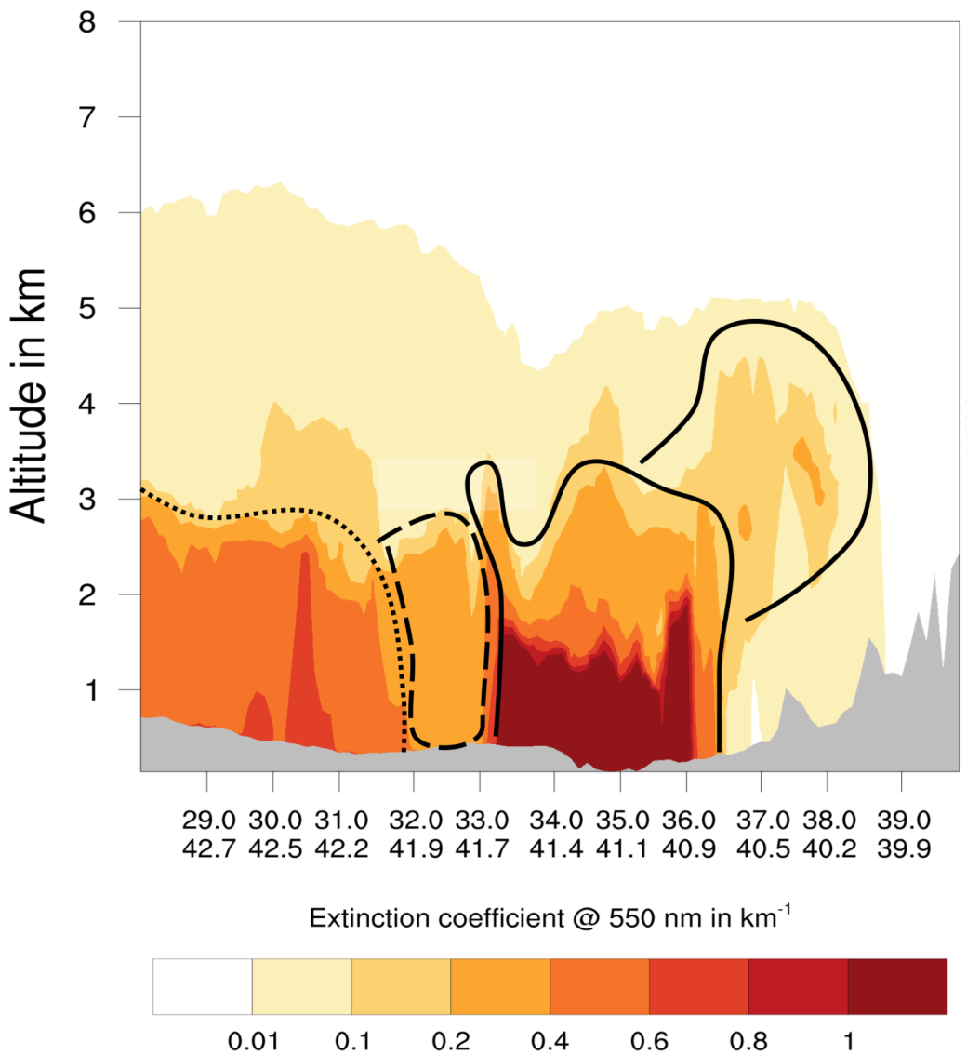
Validation of ICON-ART
ICON-ART
ICON-ART X-Z model
ICON-ART model
6/9
10
7/9
8/9
Notes:
ICON-ART

Slide 21
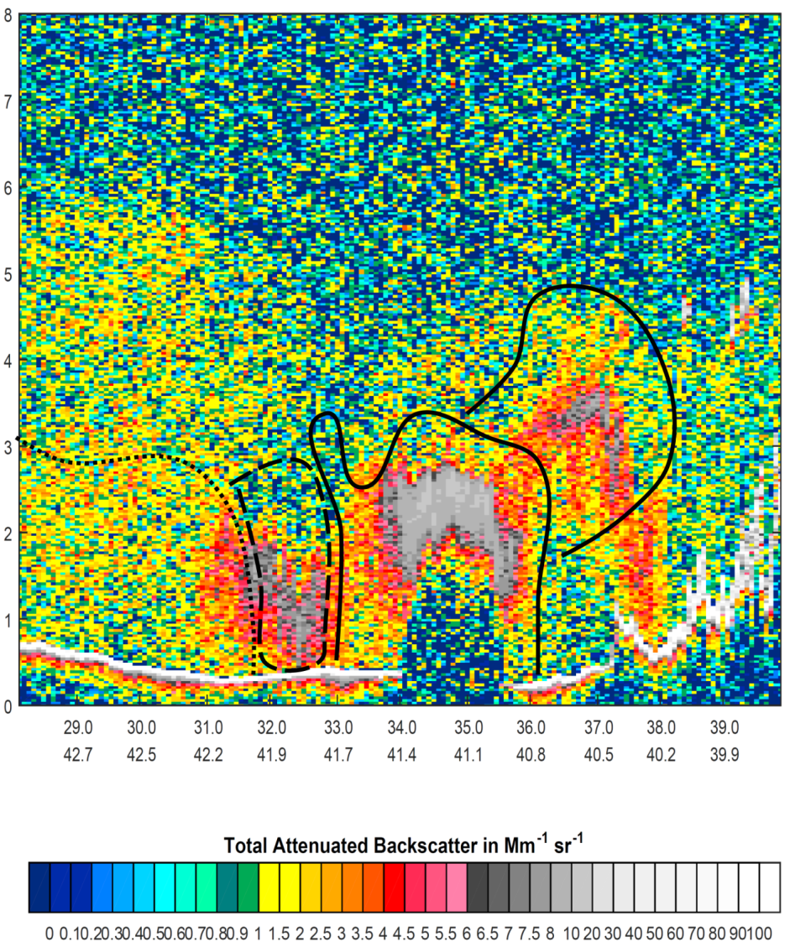
Validation of ICON-ART
CALIPSO X-Z satellite
ICON-ART X-Z model
6/9
10
7/9
8/9
Notes:
ICON-ART

Slide 22
Validation of ICON-ART
07 Sep ’15 – 10 UTC
Good agreement in vertical dust plume features between ICON-ART and CALIPSO
→Rest of simulation time follows
CALIPSO X-Z satellite
ICON-ART X-Z model
6/9
10
7/9
8/9
Notes:
ICON-ART

Slide 23
Forecast improvement
ICON-ART
EUMETSAT satellite
ICON-ART model
6/9
10
7/9
8/9
Notes:
ICON-ART

Slide 24
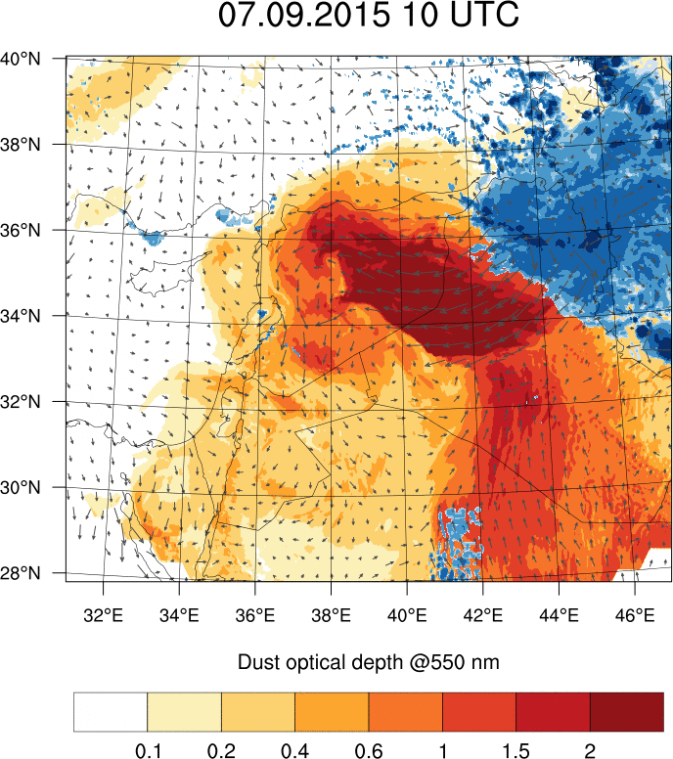
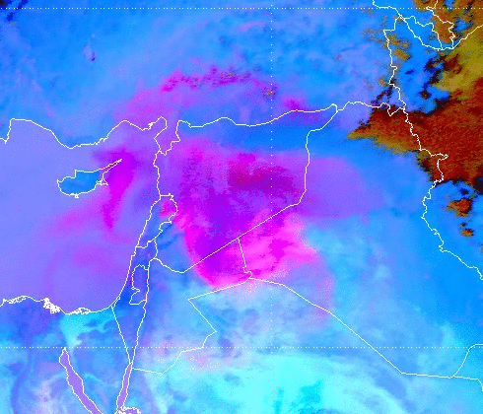
Forecast improvement
ICON-ART model
EUMETSAT satellite
6/9
7/9
8/9
Notes:
ICON-ART

Slide 25
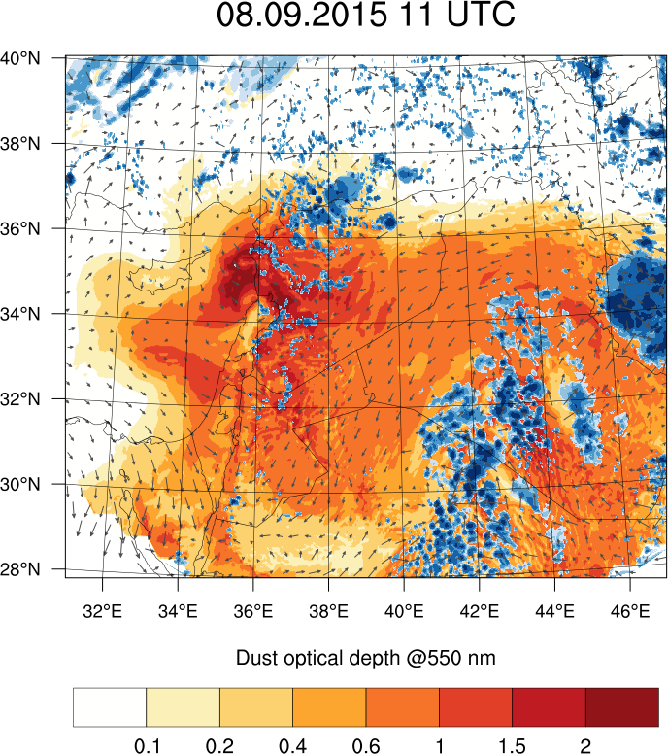
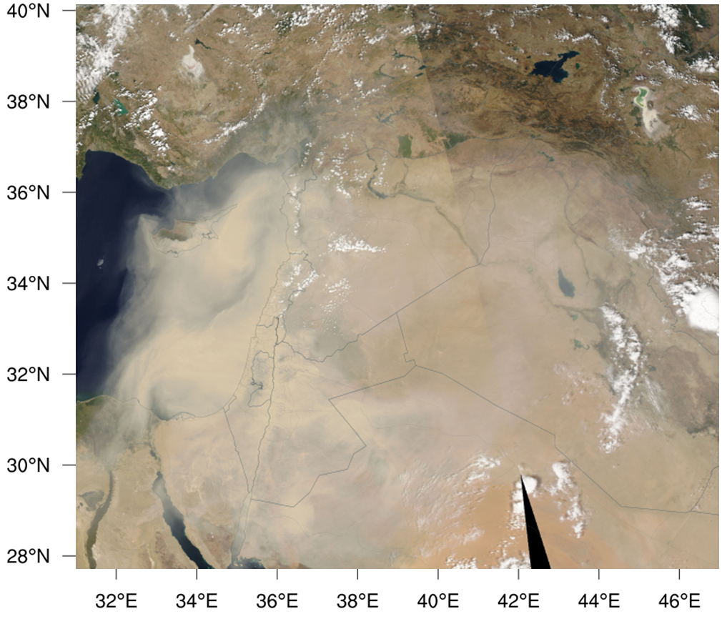
Forecast improvement
ICON-ART model
MODIS AQUA VIS satellite
11
6/9
7/9
8/9
8/9
UTC

Slide 26
Forecast improvement
08 Sep ’15 – 11 UTC
Good dust forecast in northern part of Eastern Mediterranean
Transport towards south underestimated due to complex interaction with orography
ICON-ART model
MODIS AQUA VIS satellite
11
6/9
7/9
8/9
8/9
UTC

Slide 27
Conclusions
Decisive forecast improvement of historic dust event with convection permitting simulation

