Slide 1


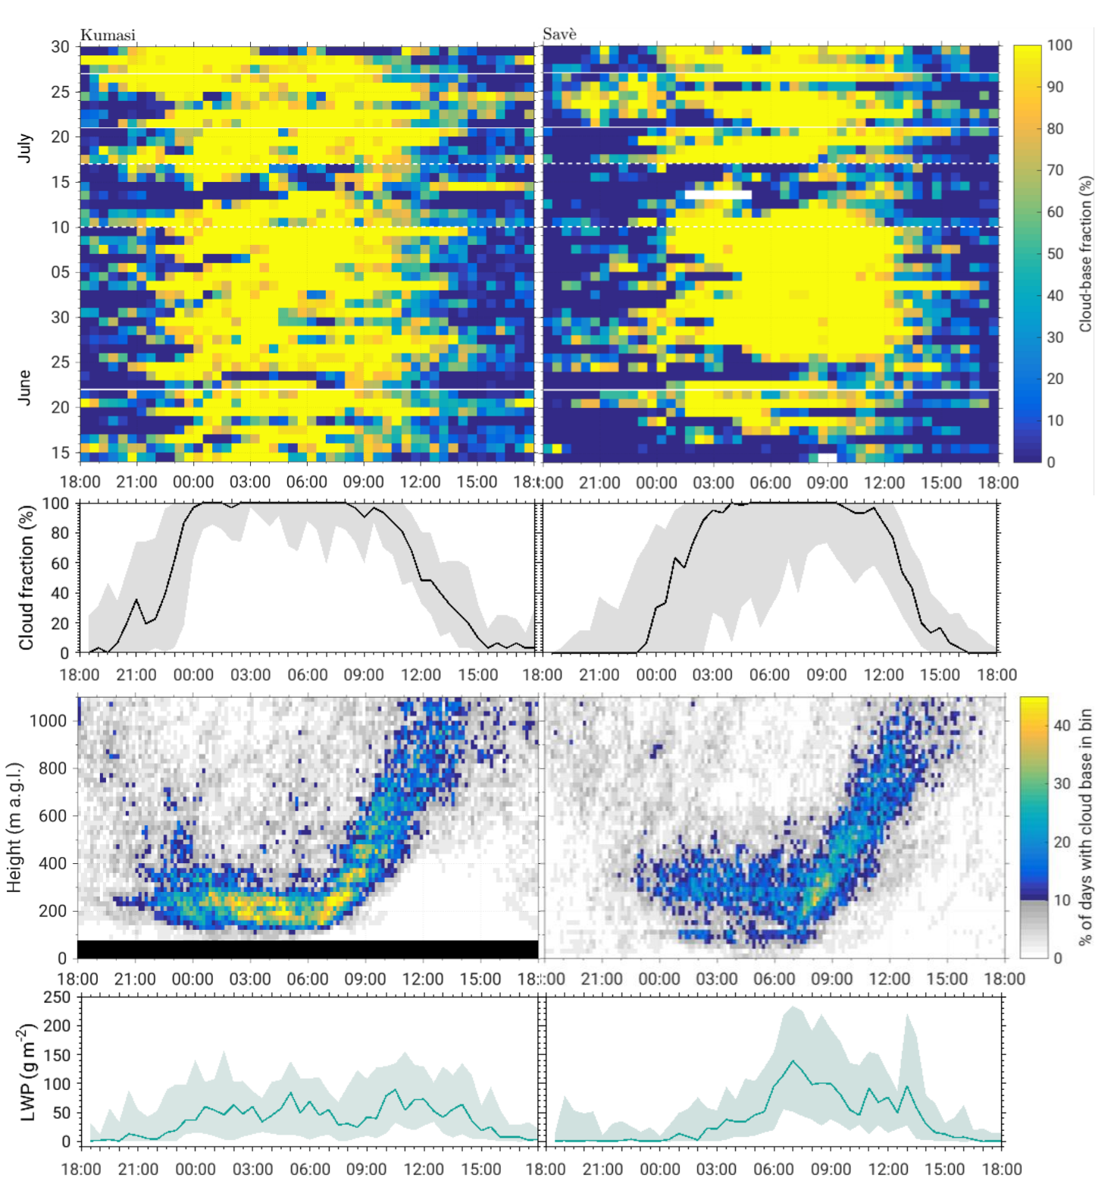

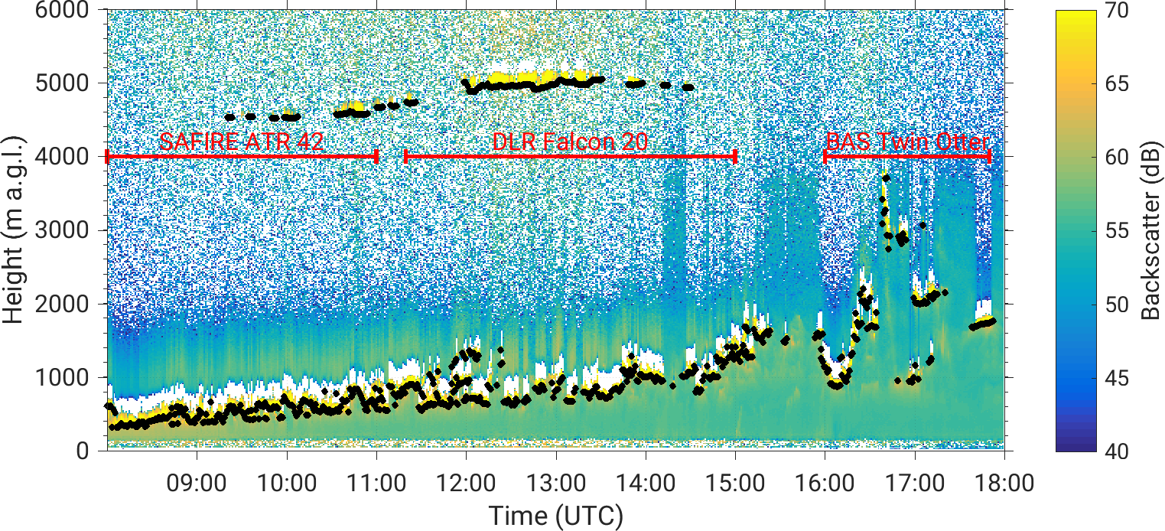

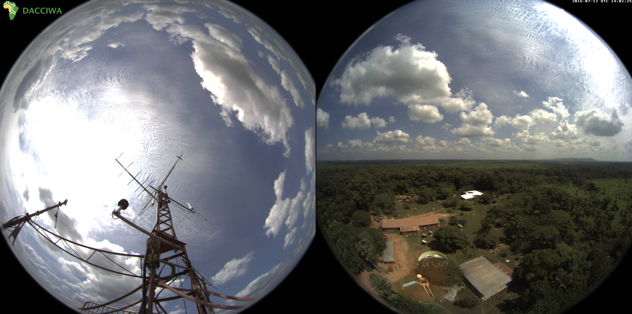
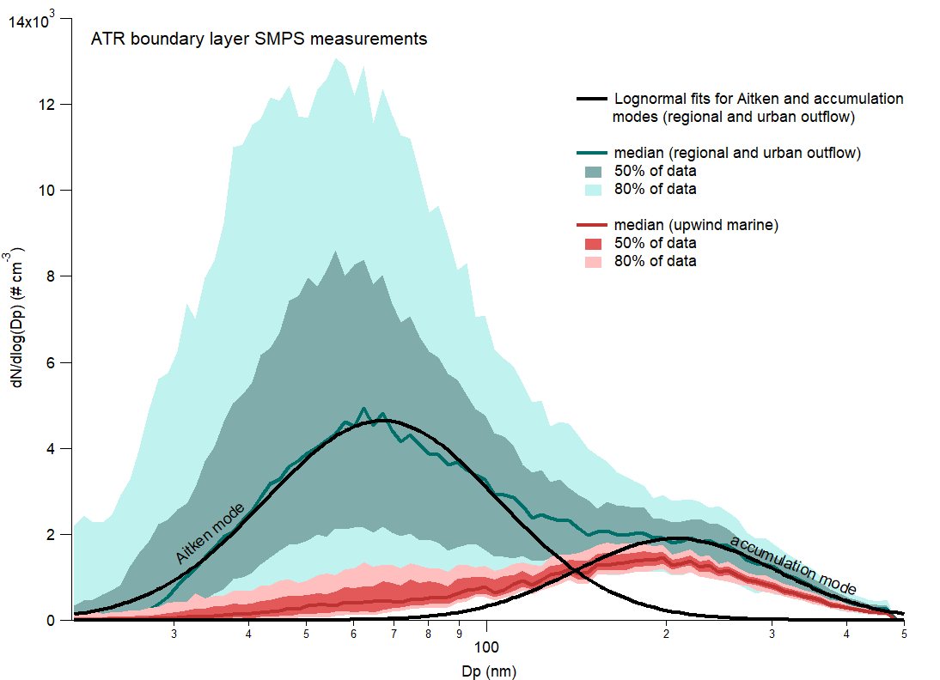


















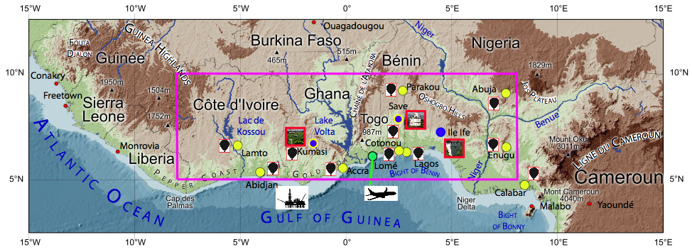
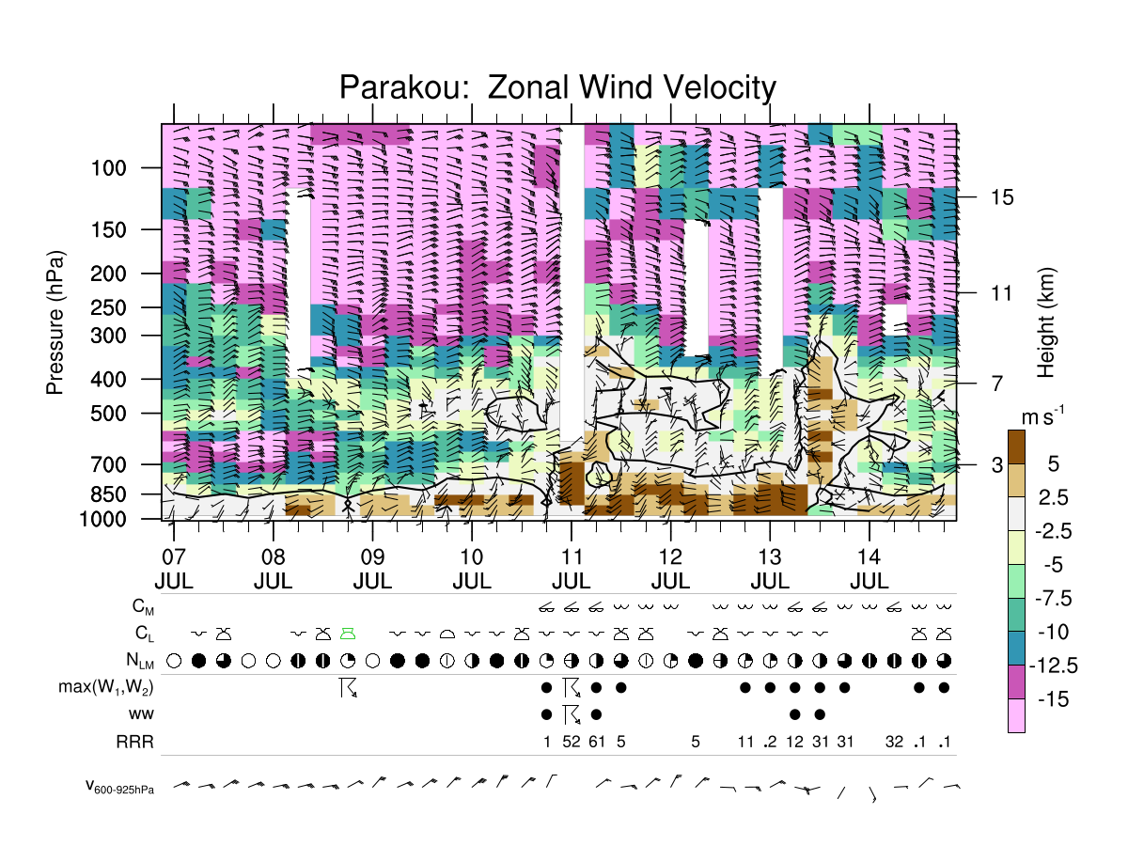
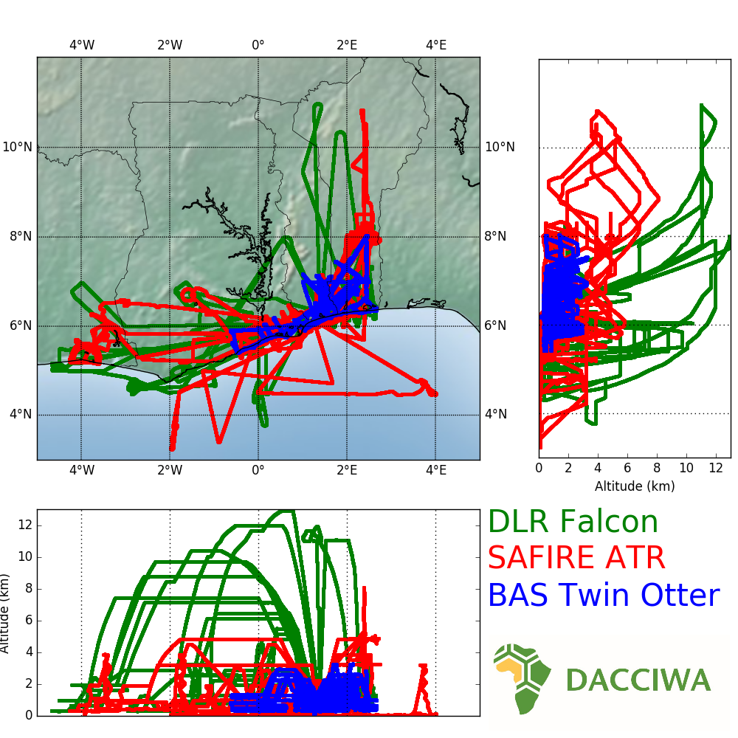
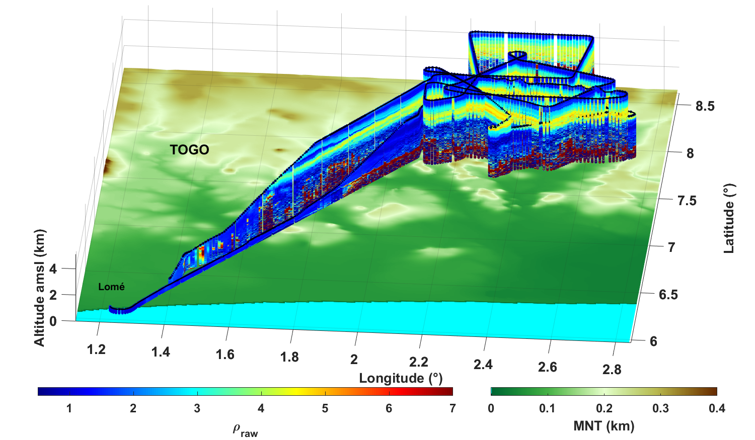
The DACCIWA Project: Dynamics-Aerosol-Chemistry-Cloud Interactions in West Africa
Peter Knippertz & the DACCIWA Team (peter.knippertz@kit.edu)
DACCIWA in Brief
Low-Level clouds
Left: (a) Cloud-base fraction, (b) median of clouds between 0 and 1000 m a.g.l., (c) cloud-base height occurrence during the whole 48 days period (from ceilometer) , and (d) median diurnal cycles of liquid water path (from microwave radiometer) for Kumasi (left) and Savè (right) (from Kalthoff et al. 2018). Below: Cloud camera in Lamto (Ivory Coast).
Collaborative project co-funded through EU FP7 with €8.75M
16 European and African research organisations plus many
associated partners (operational centres, international
programs, policy-makers, users)
Duration: Dec. 2013 – Nov. 2018
Project Coordinator: Karlsruhe Institute of Technology (DE)
Geographic/seasonal focus: Southern West Africa during summer monsoon
Scientific approach: Targeted field campaign in June–July 2016, long-term monitoring, evaluation of satellite retrievals and models, modelling experiments spanning the range from high-resolution process to global climate models
Main research questions: Impacts of rapidly increasing anthropogenic emissions from the explosively growing cities along the Guinea Coast:
– on human health on the urban scale & on regional air quality (e.g. ozone, acids)
– on aerosol generation & associated modifications of weather and climate
Dissemination: Key findings from DACCIWA will be communicated through policy briefs, recommendations to operational centres and stakeholder workshops
Project website at: http://www.dacciwa.eu
Data: Observations are shared with other scientists through our database at http://baobab.sedoo.fr/DACCIWA (freely available after November 2018)
DACCIWA special issue in ACP: www.atmos-chem-phys.net/special_issue914.html
Above: Time–height evolution of backscatter and cloud-base height from ceilometer (black dots) in Savè on 5 July 2016. Cloud bases are observed as the thin layer of high backscatter. Times of overflying aircraft are marked. (from Flamant et al. 2018)
Right: Contribution of different cloud types to the diurnal mean radiation budget of the atmosphere of southern West Africa for June–September 2006–2010. (from Hill et al. 2018)
Aerosols
Air pollution
Above: Schematic illustrating aerosol-related feedbacks (SCT= stratus to cumulus transition, AI = Atlantic inflow) (from Deetz et al. 2018)
Left: Boundary layer number concentration measurements from the ATR42, including lognormal fits for the inland Aitken and accumulation modes. Note high numbers of accumulation mode particles already occurring upstream. (Figure by S. Haslett)
Above: Aerosol composition (BC=black carbon, OC= organic carbon, POM=particulate organic matter) at 4 sites in Abidjan and Cotonou for particles of <0.2 µm (inner), 0.2–1 µm (middle) and >1 µm (outer) with total mass (µg m⁻³) in brackets. (from Flamant et al. 2018)
Above: WHO guideline and measured aerosol burden in African cities. (from Djossou et al. 2018)
DACCIWA Field Campaign
Below: Time–height diagram showing the evolution of the vertical wind regime at Parakou (Benin) from 9 to 16 July 2016. 772 extra radiosondes were launched. (from Flamant et al. 2018)
Conclusions / Highlight Results
DACCIWA is the first project to comprehensively and systematically analyse the impacts of the explosive increase in anthropogenic emissions in southern West Africa (SWA) on air quality, health, weather and climate.
DACCIWA combines measurements from a major international field campaign in SWA in June-July 2016 with extensive modelling and analysis of satellite data.
International air quality standards are frequently violated for particles, which are locally produced and advected in from extensive fires in equatorial Africa.
Current emission inventories underestimate some aerosol precursors.
High background concentrations cause low susceptibility for cloud-aerosol interactions, while aerosol radiative effects likely have some relevance.
Frequent occurrence of low-level stratus decks impacts on regional energy balance and precipitation as well as West African monsoon circulation.
DACCIWA satellite data
Above: Geographical overview of DACCIWA campaign with radiosonde stations (yellow), ground supersites (blue), aircraft operation base (green) and main area of interest (purple box). (from Flamant et al. 2018)
Above: Supersite in Savè (Benin). Below: Field sites to measure emissions from traffic (bottom), domestic fires (top left) and waste burning (top right) in Abidjan & Cotonou.
Key References and Acknowledgement
Kalthoff et al 2018: An overview of the diurnal cycle of the atmospheric boundary layer during the West African monsoon season: results from the 2016 observational campaign. Atmos. Chem. Phys., 18, 2913–2928, doi:10.5194/acp-18-2913-2018.
Flamant et al 2018: The Dynamics-Aerosol-Chemistry-Cloud Interactions in West Africa field campaign: Overview and research highlights. Bull. Amer. Meteorol. Soc., 99(1), 83–104, doi:10.1175/BAMS-D-16-0256.1.
Knippertz et al 2017: A meteorological and chemical overview of the DACCIWA field campaign in West Africa in June–July 2016. Atmos. Chem. Phys., 17, 10893–10918, doi:10.5194/acp-17-10893-2017.
Knippertz et al 2015a: The possible role of air pollution in climate change in West Africa. Nature Clim. Change, 5, 815–822. doi:10.1038/NCLIMATE2727
Knippertz et al 2015b: The DACCIWA project: Dynamics-aerosol-chemistry-cloud interactions in West Africa. Bull. Amer. Meteor. Soc., 96, 1451–1460. doi:10.1175/BAMS-D-14-00108.1
DACCIWA has received funding from the European Union 7th Framework Programme (FP7/2007-2013)
under the Grant Agreement no. 603502 .
Above: Overview of timeline of DACCIWA campaign. (from Flamant et al. 2018)
Left: Flight tracks of all 50 science flights, 29 June – 16 July 2016.
(from Flamant et al. 2018)
Above: Raw depolarization ratio measured from ULICE lidar on-board SAFIRE ATR42 on 2 Jul 2016 overlain on terrain elevation. (from Flamant et al. 2018)

