Slide 1

MEDITERRANEAN THERMOHALINE RESPONSE TO LARGE-SCALE WINTER ATMOSPHERIC FORCING IN A HIGH-RESOLUTION OCEAN MODEL SIMULATION
Eleonora Cusinato¹, Davide Zanchettin¹, Gianmaria Sannino², Angelo Rubino¹
¹University Ca’Foscari of Venice, Dept. of Environm. Sc., Informatics and Statistics, Via Torino 155, 30172 Mestre, Italy
² ENEA - Climate Modelling and Impacts Laboratory, Rome, Italy
Notes:
The main focus of this talk is to see how the large-scale atm forcing penetrate in the Mediterranean ocean interior.

Slide 2
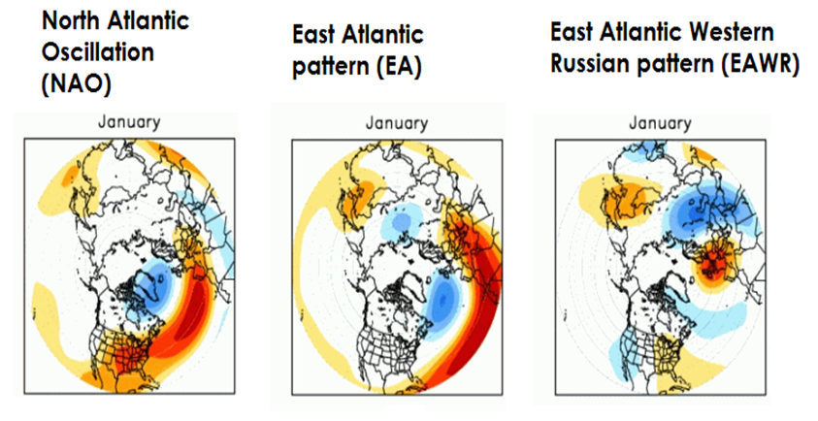

1. INTRODUCTION
LARGE-SCALE MODES OF
ATMOSPHERIC VARIABILITY
Red colours:
High Pressure
Blue colours:
Low Pressure
+ MOI over the Mediterranean region

Slide 3
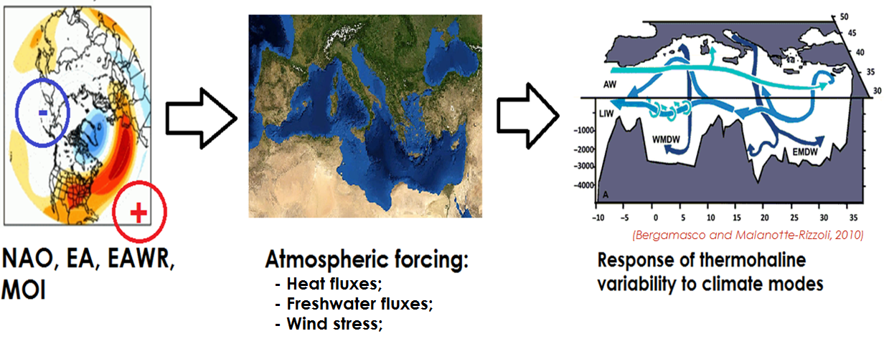
2. DATA AND METHODS
1. AIM

Slide 4

2. DATA AND METHODS
2. DATA AND MODEL USED
Model used: MedMIT12:
Involved in the Euro-Cordex project;
High resolution of 1/12° (up to 10 km) with 75 vertical levels;
Whole Mediterranean Sea plus a small portion near Atlantic Ocean;
Atmospheric fields for the simulation come from the ERA_interim reanalysis over the period 1979 – 2013.
(Adcroft et al., 1997,
Hermann et al., 2011,
Reale et al., 2017)
Period of time used in this analysis: 1980 - 2012

Slide 5
2. DATA AND METHODS
3. METHODOLOGY
Three monthly average: December to February;
Four key regions selected to study the signal propagation: South Adriatic Pit, Aegean Sea, Levantine Sea and Gulf of Lions;
Years with anomalous states of the climate modes are identified;
Comparison of the Med. thermohaline properties during these anomalous years in a composite analysis;

Slide 6
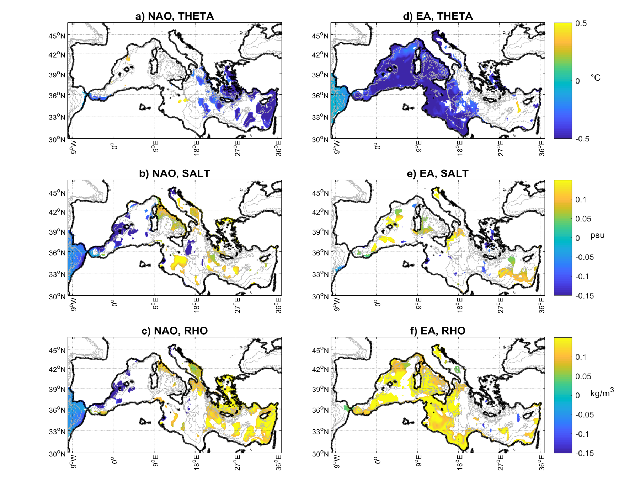
3. RESULTS
NAO⁺ - (NAO⁻)
EA⁻ - (EA⁺)
Temperature
(surface)
Salinity
(surface)
Density
(surface)

Slide 7
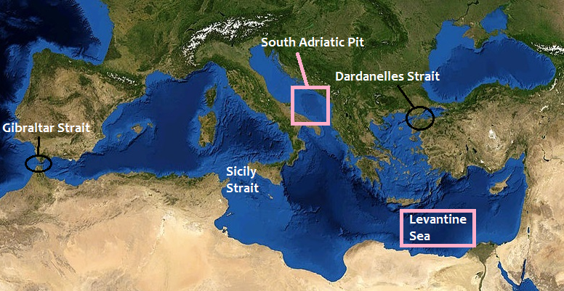
3. RESULTS

Slide 8
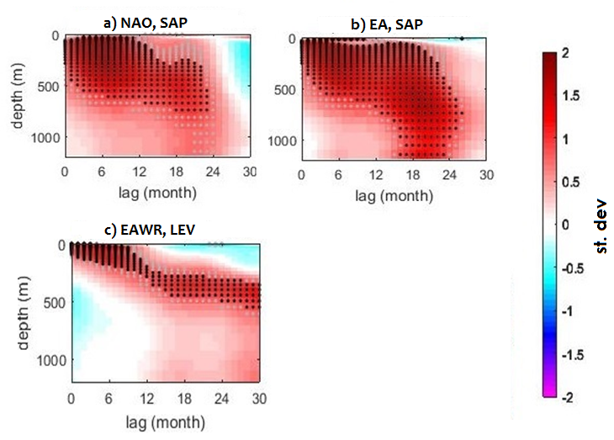
3. RESULTS
NAO⁺ - (NAO⁻)
EAWR⁺ – (EAWR⁻)
EA⁻ - (EA⁺)
Propagation of density
anomalies in key regions
in response to
NAO, EA and EAWR
Note: Standardized data

Slide 9
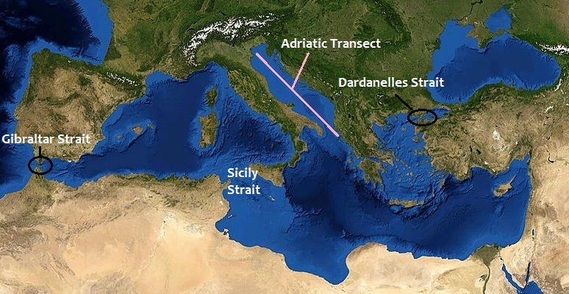

Slide 10
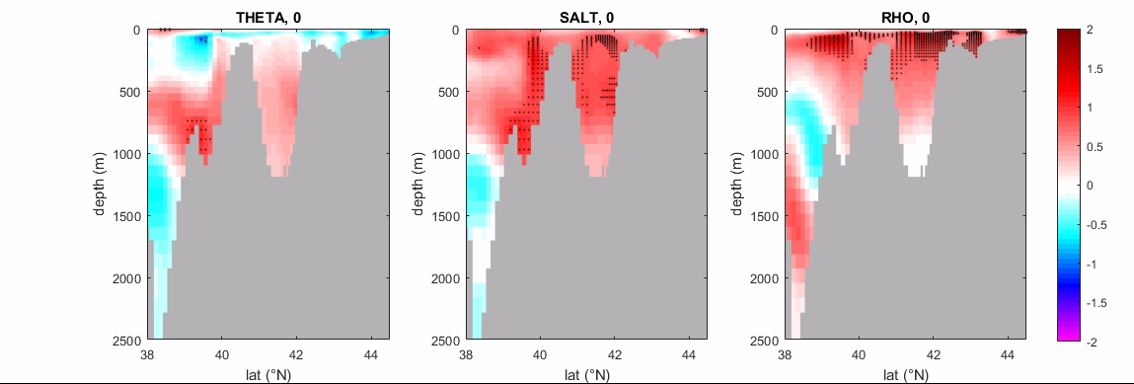
EVOLUTION OF T, S AND D FOR 3 YEARS IN RESPONSE TO EA, FROM JANUARY

Slide 11
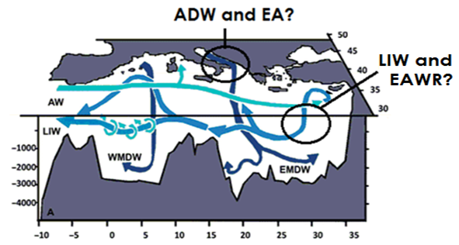
CONCLUSIONS
The considered climate modes significantly and differently imprint on the Med. thermohaline properties affecting near-surface and ocean interior circulation;
Paper in press in Pure and Applied Geophysics

Slide 12
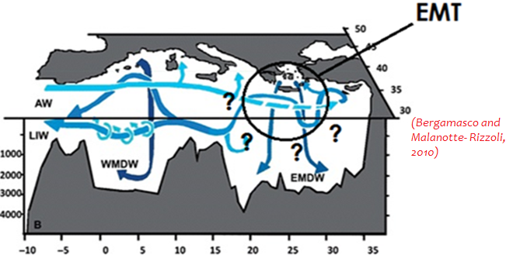

OUTLOOK
Perform additional analysis to explore what happens in the ocean interior in terms of deep-water formation or EMT-like events in response to the considered climate modes;
Multi-model approach to validate the results obtained.

Slide 13
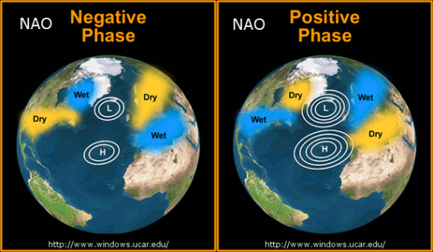
APPENDIX 1

Slide 14
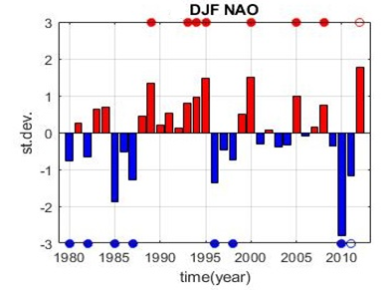
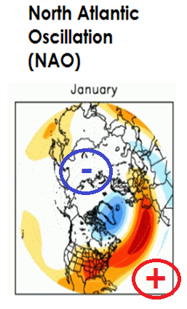
APPENDIX 2
Detrended and standardized winter time series of EA. Red (blue) bars represent positive (negative) state of the climate modes. Red (blue) dots mark the positive (negative) anomalous years
Positive anomalous years:
above the 75thpercentile;
Negative anomalous years: below the 25th
percentile;

Slide 15
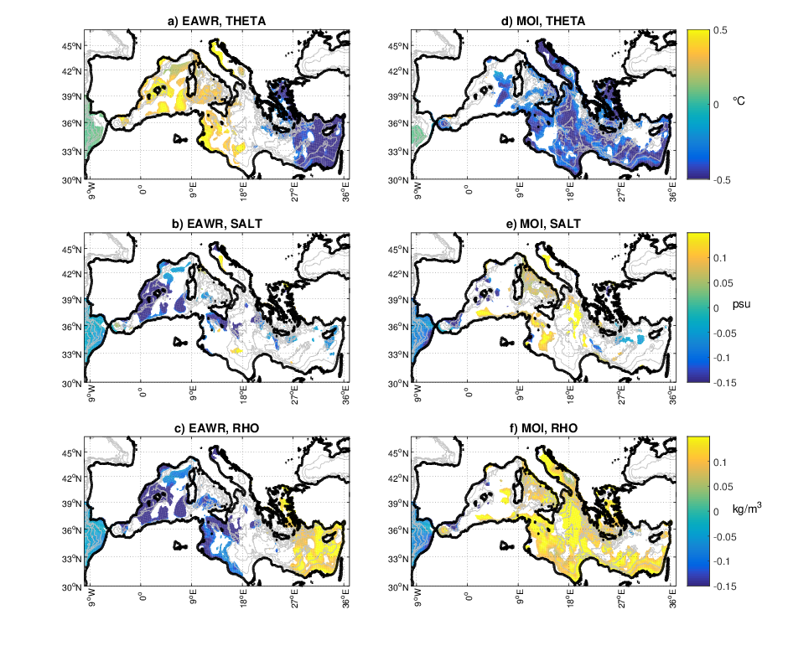
APPENDIX 3
EAWR⁺ - (EAWR⁻)
MOI⁺ - (MOI⁻)
Temperature
(surface)
Salinity
(surface)
Density
(surface)

Slide 16
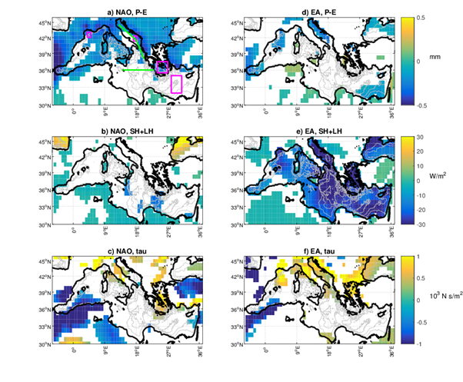
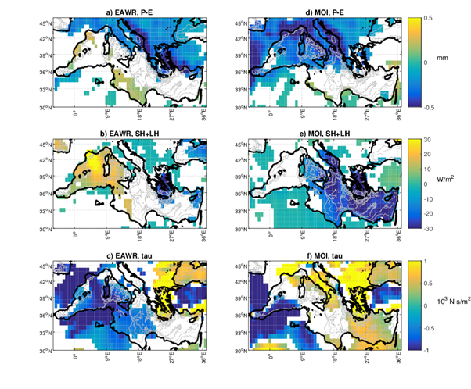
APPENDIX 4
NAO
EA
EAWR
MOI

Slide 17
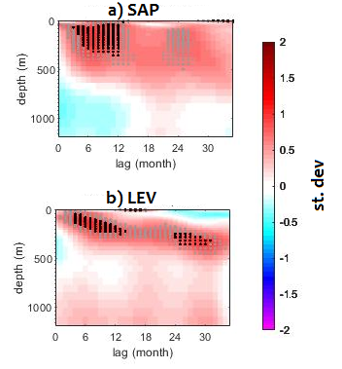
APPENDIX 5
MOI⁺ - (MOI⁻)
Propagation of density anomalies
In South Adriatic Pit and in Levantine
Sea in response to MOI
Note: Standardized Data
Notes:
DA FARE CON MATLAB METTI STESSA UNITà MISURA DI ALTRE FIGURE X COERENZA …

Slide 18
REFERENCES
Adcroft, A., Hill, C., Marshall, J., 1997. Representation by topography by shaved cells in a height coordinate ocean model. Monthly Weather Review, 125, (9), 2293-2315. https://doi.org/10.1175/1520-0493(1997)125<2293:ROTBSC>2.0.CO;2
Bergamasco, A. and Malanotte-Rizzoli, P., 2010. The circulation of the Mediterranean Sea: A historical review of experimental investigations. Advances in Oceanography and Limnology. Doi: 10.1080/19475721.2010.491656
Herrmann, M., Somot, S., Calmanti, S., Dubois, C., Sevault, F., 2011. Representation of spatial and temporal variability of daily wind speed and of intense wind events over the Mediterranean Sea using dynamical downscaling: Impact of the regional climate model configuration. Natural Hazards and Earth System Sciences, 11, 1983-2001. Doi: 10.5194/nhess-11-1983-2011.
Med-CORDEX. Retrieved December 2017, from https://www.medcordex.eu/
NOAA. National Weather Service. Climate Prediction Center. Teleconnection Introduction. Retrieved December 2017, from http://www.cpc.ncep.noaa.gov/data/teledoc/teleintro.shtml
Reale, M., Salon, S., Crise, A., Farneti, R., Mosetti, R., Sannino, G., 2017 Unexpected covariant behaviour of the Aegean and Ionian Seas in the period 1987-2008 by means of a non-dimensional sea-surface height index. Journal of Geophysical Research, 122, (10), 8020-8033. Doi: 10.1002/2017JC012983
Wikipedia, Retrieved November 2017, from https://it.wikipedia.org/wiki/Mar_Mediterraneo

