Slide 1
New approaches to analysis and forecast of processes in bio-, techno -, and geospheres:
the most important aspect of space weather
Alexander Perov (1) and Stanislav Perov (2)
1 Peoples’ Friendship University, Russia
2 Earth and Universe Journal of presidium of RAS

Slide 2
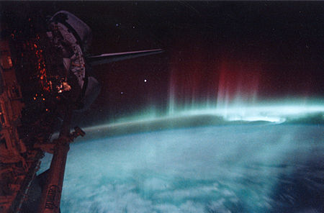
Aurora australis observed by Discovery, May 1991
Space weather is a branch of space physics and aeronomy concerned with the time varying conditions within the Solar System, including the solar wind, emphasizing the space surrounding the Earth, including conditions in the magnetosphere, ionosphere, thermosphere, and exosphere.[Space weather is distinct from the terrestrial weather of the Earth's atmosphere (troposphere and stratosphere). The term space weather was first used in the 1950s and came into common usage in the 1990s.[see Vikipedia]
In first time this report advanced new type of classical space weather – “tide space weather” acting on on all spheres (including bio- and socio spheres) of the Earth and on the Sun
Unlike the first, it is predictable (easy to calculate) and regularly manifested (4 5 times a month) and is the cause of a large number of emergencies
It is important to note that normal weather is synchronized with gravitational-tidal weather

Slide 3
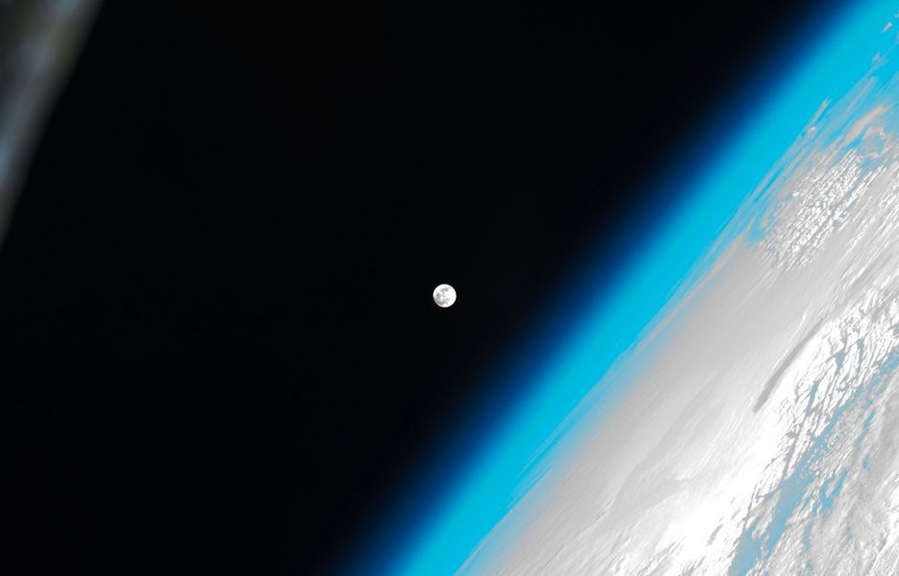
Consider for example the Earth’s atmosphere
“…Physics of the atmosphere ... is one of the most complex systems studied by physicists. Describe the evolution of this system is very difficult. Complex systems behave in a fundamentally unpredictable manner, because even the most insignificant change in the initial parameters can lead to "exponentially fast divergence of trajectories," or as physicists say to dynamic chaos. Therefore, predictions for more than 2 - 3 days are often incorrect…”
Academician Alexander SERGEYEV
President of the Russian Academy of Sciences
It is especially difficult to do this taking into account space weather factors. including when taking into account the microgravity caused by the solar lunar tides
in our view, the predictability limit should be higher than the existing value of up to 5-10 days that is, the forecast will increase to at least a month

Slide 4
MULTANOVSKY VANGENGEYM, DZERDEEVSKY, PAGAVA 1920-1970
In the early 2000s, NS Sidorenkov made a disclosure(Sidorenkov, 2002) that has not been evaluated by experts in the atmosphere so far. As is known, due to the effects of terrestrial tidal tides during the lunar month (27.3 days), 4 the regime of rotation of the Earth of unequal duration (an average of 6.8 days). But because of the slow movement of the perigee and the nodes of the lunar orbit, this period can vary from 4 to 9 days. Thus, the quantum of the average variability of meteorological parameters (T, P, X, W. ) is about 7 days SYNOPTIC PROCESSES IN EUROPE & ASIA TO ENISEY RIVER FOR MIDDLE LATITUDE MANAGED BY THE ZONAL TIDES, CHANGE WITH THE SAME PERIODS (VANGENGEYM, DZERDEEVSKY, 1920-1950 [1,2] )

Slide 5
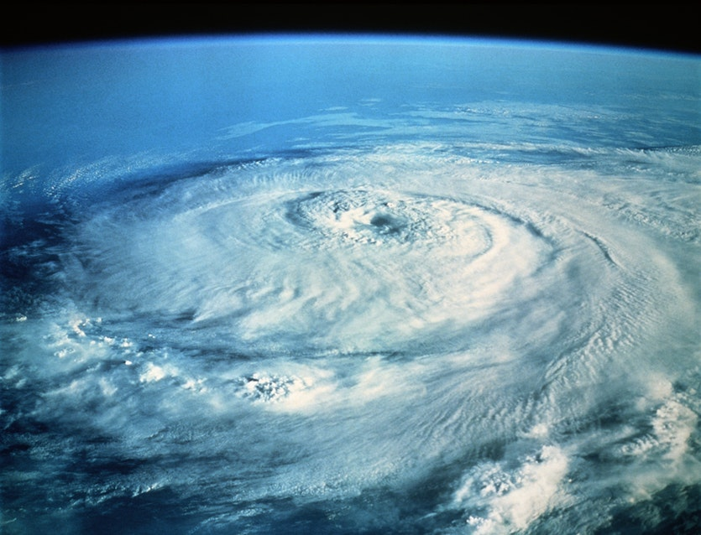
Quanta weather
Quanta weather
"Quanta weather" determine the evolution of the atmosphere, determining the structure of pressure and temperature fields in the hemisphere. "The regions in which cyclones and anticyclones most often appear, suggesting the corresponding structures in a solid Earth whose activity can be controlled by tides .

Slide 6
XVII century; Golden Age of Holland (the Netherlands, Gouden Eeuw) - a period in the history of the Netherlands, during which the Republic of the United Provinces reached its peak in trade, art AND SCIENCE Christiaan Huygens FRS was a Dutch physicist, mathematician, astronomer and inventor, who is widely regarded as one of the greatest scientists of all time and a major figure in the scientific revolution
Golden Age of Holland

Slide 7
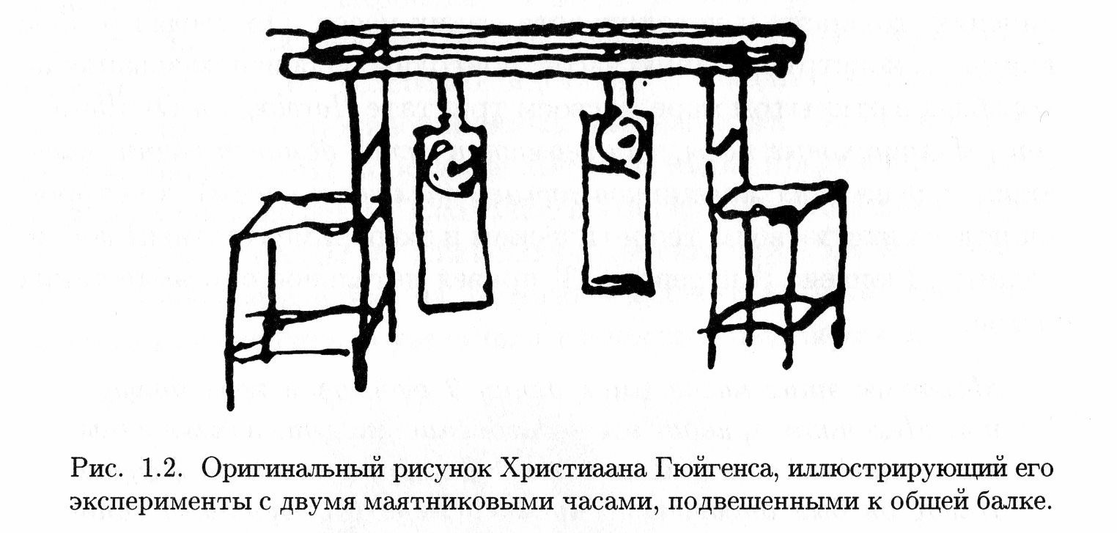
Huygens' own picture, illustrating his experiments with two pendulum clocks hanging on a common beam Two loosely coupled self-oscillating systems (each of which exerts an external influence on the other). The result is the occurrence of synchronous mode in both systems. This is the type of mutual Synchronization of related systems. Beatings: Synchronization with a small difference in the periods leads to periodic beats

Slide 8
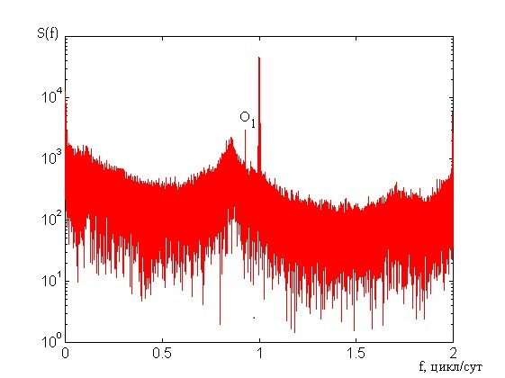
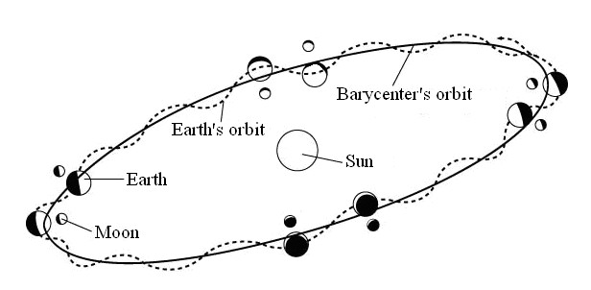
The decisive contribution to the NCEP / NCAR (1995 [1,2]) database for reanalysis was made by the USSR (~.200 ground-based, ship-based (research vessels) ,aerological stations with 4 single-shot and regular rocket probes.) . The most important result of reanalysis the equatorial components h1 and h2 of angular momentum of the atmosphere.The axis of ordinates is the values ​​of the spectral density in conventional units: the abscissa-frequency axis in cycles for the mean solar day.to the left of the daily wave, the line at 0.99295 (day (-1)), corresponding to decomposition of the tidal potential The main feature of the spectrum is a wide maximum of 0.85 (day) (-1) and a weak wide maximum near the doubled frequency of 1.7 (day) (-1) .These are the main "quanta" of weather, determined by gravitational interactions of the Earth, the Moon and the Sun according to the laws of the heavenly mechanka.(1,2)

Slide 9
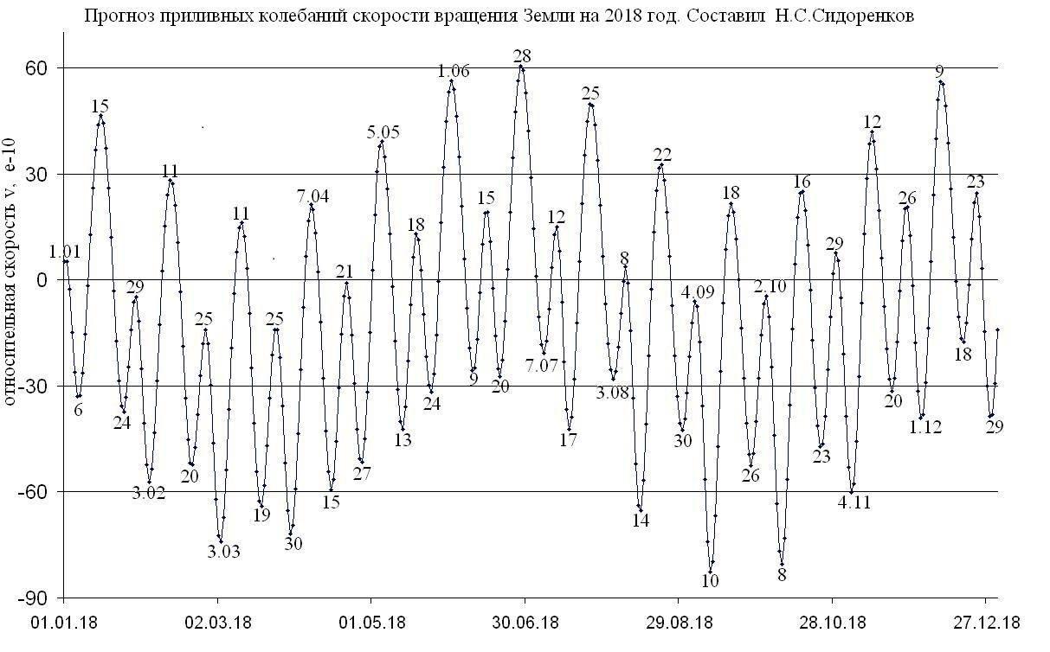
FORECAST FOR 2018! Synchronous change of weather parameters (modes) (t, p, h, w) on the Earth and other important characteristics of the environment (including in fact new sort of space weather) (see below) takes place on the days of extremes (max and min) of Earth's rotation rate(ERR). These are the days of the maximum and minimum of the ERR (EERR-1, the first derivative of an ERR is equal to 0) and the additional maximum modulus of the change in the ERR (EERR-2. The second derivative of ERR is equal to 0)) The last an be calculated as mean value from two neibour (max and min) values of ERR/forecast variability of natural synoptic periods in 2018. Journal Earth and Universe .[3]

Slide 10
EXAMPLE of SYNCHRONIZATION OF VARIABILITY OF AIR PRESSURE IN MOSCOW AND VLADIVOSTOK
along the y axis, the difference in days between the predictable and real dates in days for all histograms below Pressure Moscow
/\ Т <- Desyncrinisation, days
-1 \\\\\\\\\\\\\\\\\\\\\\5
-0,5 \\\\\\\\\\\\\\\\\\\\\\\\\\\\\\\\\\\\\\\\\\\9
0 \\\\\\\\\\\\\\\\\\\\\\\\\\\\\\\\\\\\\\\\\\\\\\\\\\\\\\\\\\\\\\\\\\\\\\\\\\\\\\\\\\\\\\\\\\\\\\\20
0,5 \\\\\\\\\\\\\\\\\\\\\\\\\\\\\\\\\\\\\\\\\\\\\\\\\\\\\\\\\\\\\\\\\\\\\\\\\\\\\\\\\\\\\\\\\\\\\\19
1,0 \\\\\\\\\\\\\\\\\\\\\\\\\\\\\\\\\\\\\\\\\\\\\\\\\\12
1,5 \\\\\\\\\\\\\\\\\\\\\\\\\\\\\\\\\\\7
2,0 \\\\1
Pressure Vladivostok
-2 \\\\\\2
-1,5 \\\\1-1 \\\\\\\\\\\\\\\\\\\\\\\\\\\\7
-0,5 \\\\\\\\\\\\\\\\\\\\\\\\\\\\\\\\\\\\\\\\\\\\\\\\\\\13
0 \\\\\\\\\\\\\\\\\\\\\\\\\\\\\\\\\\\\\\\\\\\\\\\\\\\\\\\\\\\\\\\\\\\15
0,5 \\\\\\\\\\\\\\\\\\\\\\\\\\\\\\\\\\\\\\\\\\\\\\\\\\\\\\\\\\\\\\\\\\\15
1,0 \\\\\\\\\\\\\\\\\\\\\\\\\\\\7
1,5 \\\\\\\\\\\\\\\3
2,0 \\\\1
GLOBAl CHARACTER OF SYNCHRONIZATION OF VARIABILITY OF WEATHER CONFIRMED BY ANALYSIS OF OBSERVATIONS AT STATIONS Equator Singapore, Quito, Manado, Sao Tome, Dakar, Trivandrum Northern Hemisphere Moscow, Vladivostok, Kislovodsk, Irkutsk, Norilsk, Reykjavik, Dushanbe, Ufa, Anadyr, Astana. Mexico City, Anchorage, Mumbai. Delhi. Kanpur, Ahmedabad, Lhasa, Honolulu Southern Hemisphere Darwin, Brisbane, Wellington, Perth, Hobart, Mar del Plata, Ushuaia, Suva

Slide 11
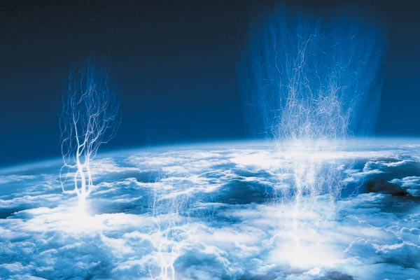
“Tatyana” Lomonosov MSU sattelite 2005-2007 The histograms of sinchronisation of UV flares in the atmosphere with respect to the extremes of the Earth's rotation rate (EERR) EERR-1 A; EERR-2 B in days /tatyana/txtftp//ftp.sinp.msu.ru/tatyana/txt/
N cp = 88 : 14 = 6,3 I А N cp
-2 // I
-1,5 // I -1 //// //// //// //// //// // 11
-0,5 //// I 0 //// //// //// //// //// //// //// //// // 17 1 //// //// //// //// //// //// //// //// 16 2 //1 I
N = 50 I B I -1,5 //// //// 4 I I - 1 //// 2 I -0,5 //// //// //// //// //9 0 //// //// //// //// //// //// // 13 0,5 //// //// ////6 1 //// 2 1,5 //// ////4 2 // 1 4 N = 38 Ncp = 6,3

Slide 12
The "Tatiana" satellite, created by scientists of the Moscow State University and launched in 2005, discovered unusual light phenomena in the atmosphere of the Earth, in the equatorial zone - outbursts in the upper atmosphere, RIA
https://ria.ru/science/20081010 https://ria.ru/science/20081010/152938826.html
",
“Tatiana” discovered the so-called transient light phenomena. It turned out that in the vicinity of the equator, as well as at the poles, transient light events are concentrated, with a high power of up to 10 megajoules, "

Slide 13
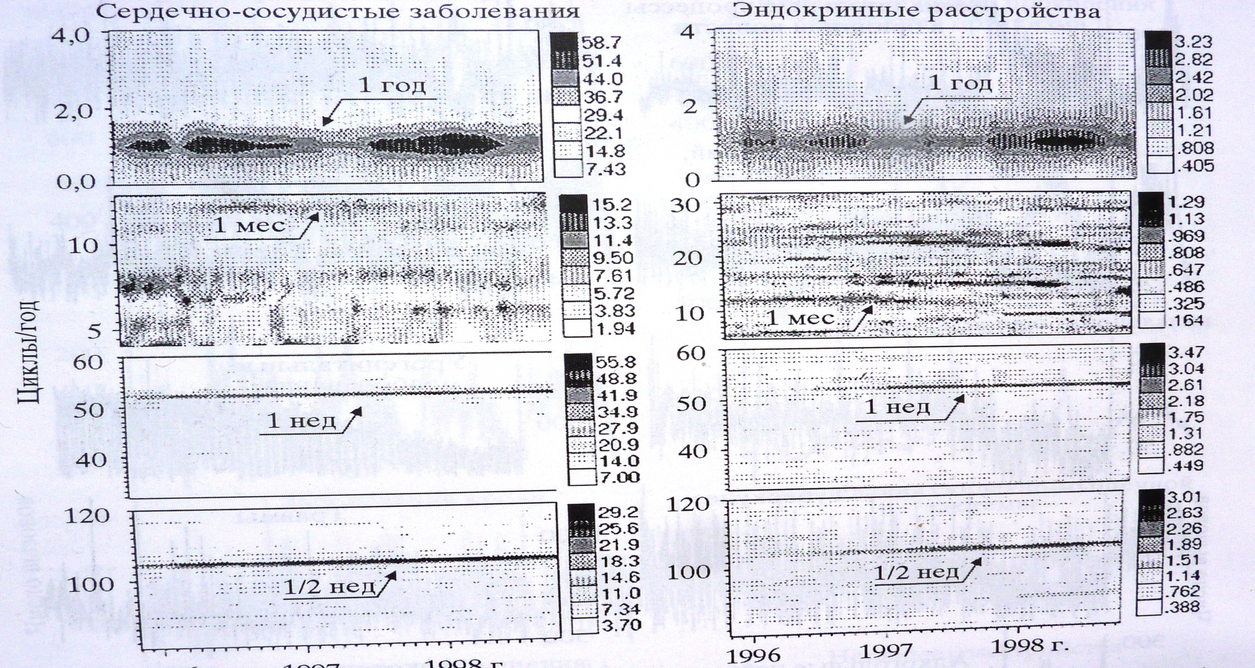
“Weather quanta” (~7 and ~3.5 days and their sub-harmonics of GW) affect a person Note the time resolution of spectral lines on 2 bottom graphes (right): ½, 1, 2………2,4.6,8 hrs are typical for GW in the atmosphere (and in the solid Earth!) Cardio-Vascular System illness (left) endocrine disorders (right)

Slide 14
A histogram of accidents at nuclear power plants (1952-2004) https://nuclearpeace.jimdo.com/ The disaster at the nuclear facility MAYAK occurred on Sept. 29, 1957, ESVZ-1 September 30, 1957 Disaster in Chernobyl occurred on the night of 25/26 April 1986 Both catastrophes were synchronized with the lunar-solar gravitational tides along the y axis, the difference in days between the predictable and real dates in days N cp = 27 : 7 = 4 I I А I ЭСВЗ-1 -2 0 I -1 //// //// //// //// 4 0 //// //// //// //// //// //// //// //// 8 1 //// //// //// //// 4 2 //// 1 N = 17 Б ЭСВЗ-2 -1 0 //// //// //// //// //// 5 1 //// //// //// 3 2 //// //// 2 i N = 10 N cp = 95 : 7 = 13,5

Slide 15
The histogram of the distributions of the daily Wolf numbers (2007-2009) relative to the extremes of the Earth's rotation rate (EERR) in days scale is reduced by 2 times relative to the previous histogram N cp = 95 : 7 = 13,5 I I А I ЭСВЗ-1 -2 0 I -1 //// 2 I 0 //// //// //// //// //// //// //// //// //// //// //// //// //// //// 28 1 //// //// //// //// //// //// //// //// //// //// //21 2 //// //// //// //// //// //// //// 14 N = 65 Б ЭСВЗ-2 - 2 0 -1 //// //// //// 3 0 //// //// //// //// //// //// //// //// 16 1 //// //// //// //// 8 2 //// //3 i N = 30 N cp = 95 : 7 = 13,5

Slide 16
SECCHI-A 2009-2010 The histograms of sinchronisation of CME (coronal mass ejections) with respect to the extremes of the Earth's rotation rate (EERR) EERR-1 A; EERR-2 B in days
N cp = 54 : 7 = 7,7 I А I -1 //// //// //// //// //// ////6 I 0 //// //// //// //// //// //// //// //// //// //// //// //// 12 1 //// //// //// //// //// //// //// //// //// ////10 2 //// //// //// //// //// ////6 I N = 34 I Б I - 1 //// //// 2 -0,5 //// //// 2 0 //// //// //// ////4 0,5 //// 1 1 //// 1 1,5 //// //// //// //// //// //// //// //// //// 9 2 //// 1 4 N = 20 Ncp = 8

Slide 17
The histogram of distributions of geomagnetic indices Kp (more than 5 (magnetic storm) (2006-2012) with respect to the extremes of the Earth's rotation rate (EERR) in days N cp = 63 : 7 = 9 I А I -2 //// 1 I -1 //// //// //// //// //// //// 6 0 //// //// //// //// //// //// //// //// //// //// //// //// //// //// //// 15 1 //// //// //// //// //// //// //// //// //// //// //// ////12 2 //// //// //// //// 4 N = 38 Б - 2 0 -1 //// //// //// //// //// //// //// 7 0 //// //// //// //// //// //// //// //// //// //// //// //// //// 13 1 //// //// 2 2 //// //// //// 3 i N = 25 N cp = 63 : 7 = 9

Slide 18
Sinchronisation of EERR with : - Weather changes (hmn.ru:t, p, h, w, rains); tropical depressions and cyclons – beginning and ending, maximal wind in TC and typhoons; monsoon precipitations; noctilucent clouds (NLC); thundertstorms etc) - Earthquacke (EQ) statistic (May-Nov. 2015) data of max. N of EQ +/-1 day EERR-1 85%; EERR-2 88% data of max. depth (>400 km) of EQ +/-1 day EERR-1 85%; -2 82% - NLC occurences in Moscow region 2007-2015 (Meteoweb.ru) - data of NLC +/-1 day EERR-1 87%; EERR-2 81% - Aviation accidents htpps://ru.wikipedia.org/wiki/General_Dynamics_F-116Fighting_Falcon F-116 ( 2002-2016) +/-1 day EERR-1(n=27) 74%; EERR-2 (n=20) 90% TU-154 (1973-2011) +/-1 day EERR-1(n=43) 81%; EERR-2 (n=26) 73% Big accidents in the world (all types lyners) (2008-2013) +/-1 day EERR-1(n=20) 65%; EERR-2 (13) 85% - Railway accidents (Russia, 1965-2009) +/-1 day EERR-1 83%; EERR-2 100% - Biosphere and humane characteristics [4,6] - Geomagnetic and ssolar events [5]

Slide 19
Conclusion
Thus synchronization of processes in geo (atmosphere, ocean, crust and mantle), bio (medical cases, populations of fauna and
flora), socio - and techno- spheres, with the astronomical (including the heliosphere) and geodynamic (Chandler
Wobble and other oscillations) is one of essential and fundamental phenomena in nature.(4,5) The results of our analysis of
synchronization of heliogeophysical proseses make the issue of gravitational tide space weather the most important.
An important question about the feedback of the gravitational influence of the earth-moon system on the activity of the sun requires additional research.

Slide 20
REFERENCES 1 Sidorenkov N.S. The interaction between Earth’s rotation and geophysical processes. Weinheim. WILEY-VCH Verlag GmbH & Co. KGaA, 2009. 317 p. . 2 Sidorenkov N. S.. Celestial Mechanical Causes of Weather and Climate Change ISSN 0001-4338, Izvestiya, Atmospheric and Oceanic Physics, 2016, Vol. 52, No. 7, pp. 667–682. © Pleiades Publishing, Ltd., 2016. DOI: 10.1134/S0001433816070094 3 Perov S.P., Sidorencov N,S “Forecast variability of natural synoptic periods in 2018. Journal Earth and Universe .” Earth and Universe N 1 2018, p 99. 4 Perov SP The interaction of astronomical and geodynamic oscillators determines the processes in the atmosphere and the ocean. Optics of the atmosphere and the ocean. Physics of the atmosphere. Collection of reports of the 18th international symposium (Electronic resource) Tomsk publishing house IO SB RAS 2012 5 Perov SP, Sidorenkov NS, Khlystov AI. Processes of synchronization in helio- and geospheres and solar lunar tides. Theses 15 All-Russian conference "Modern problems of remote sensing of the Earth from space" IKI RAS, November 13-17, 2017 6 Perov S.P. Dynamics and photochemistry of the ozonosphere and the middle atmosphere of the equatorial and tropical regions of the Earth M .: the dissertation on the scientific degree of the doctrine of physics and mathematics 2013.- 315 pages

