Slide 1
Università
degli Studi
di Perugia
Simplified method to derive a pedotransfer function for average field saturated hydraulic conductivity
Tommaso Picciafuoco
Supervisors:
Prof. Renato Morbidelli
Prof. Alessia Flammini
Prof. Corrado Corradini
Prof. Günter Blöschl
EGU 2018
Vienna, 10 April 2018

Slide 2
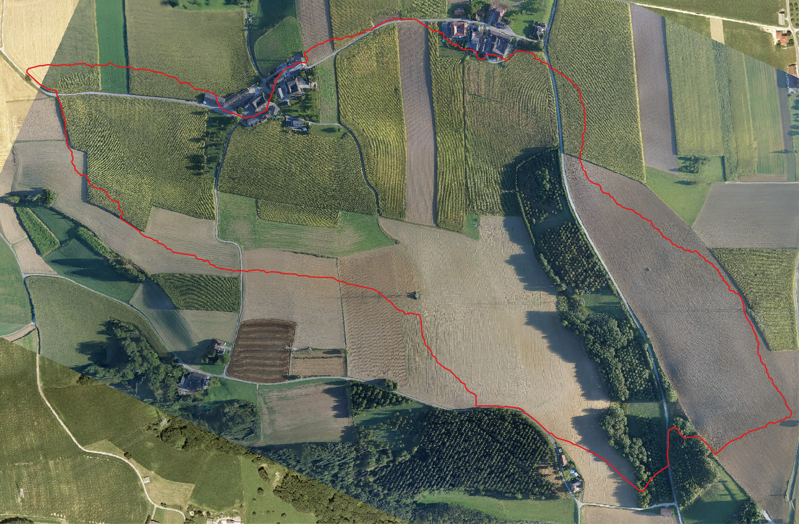
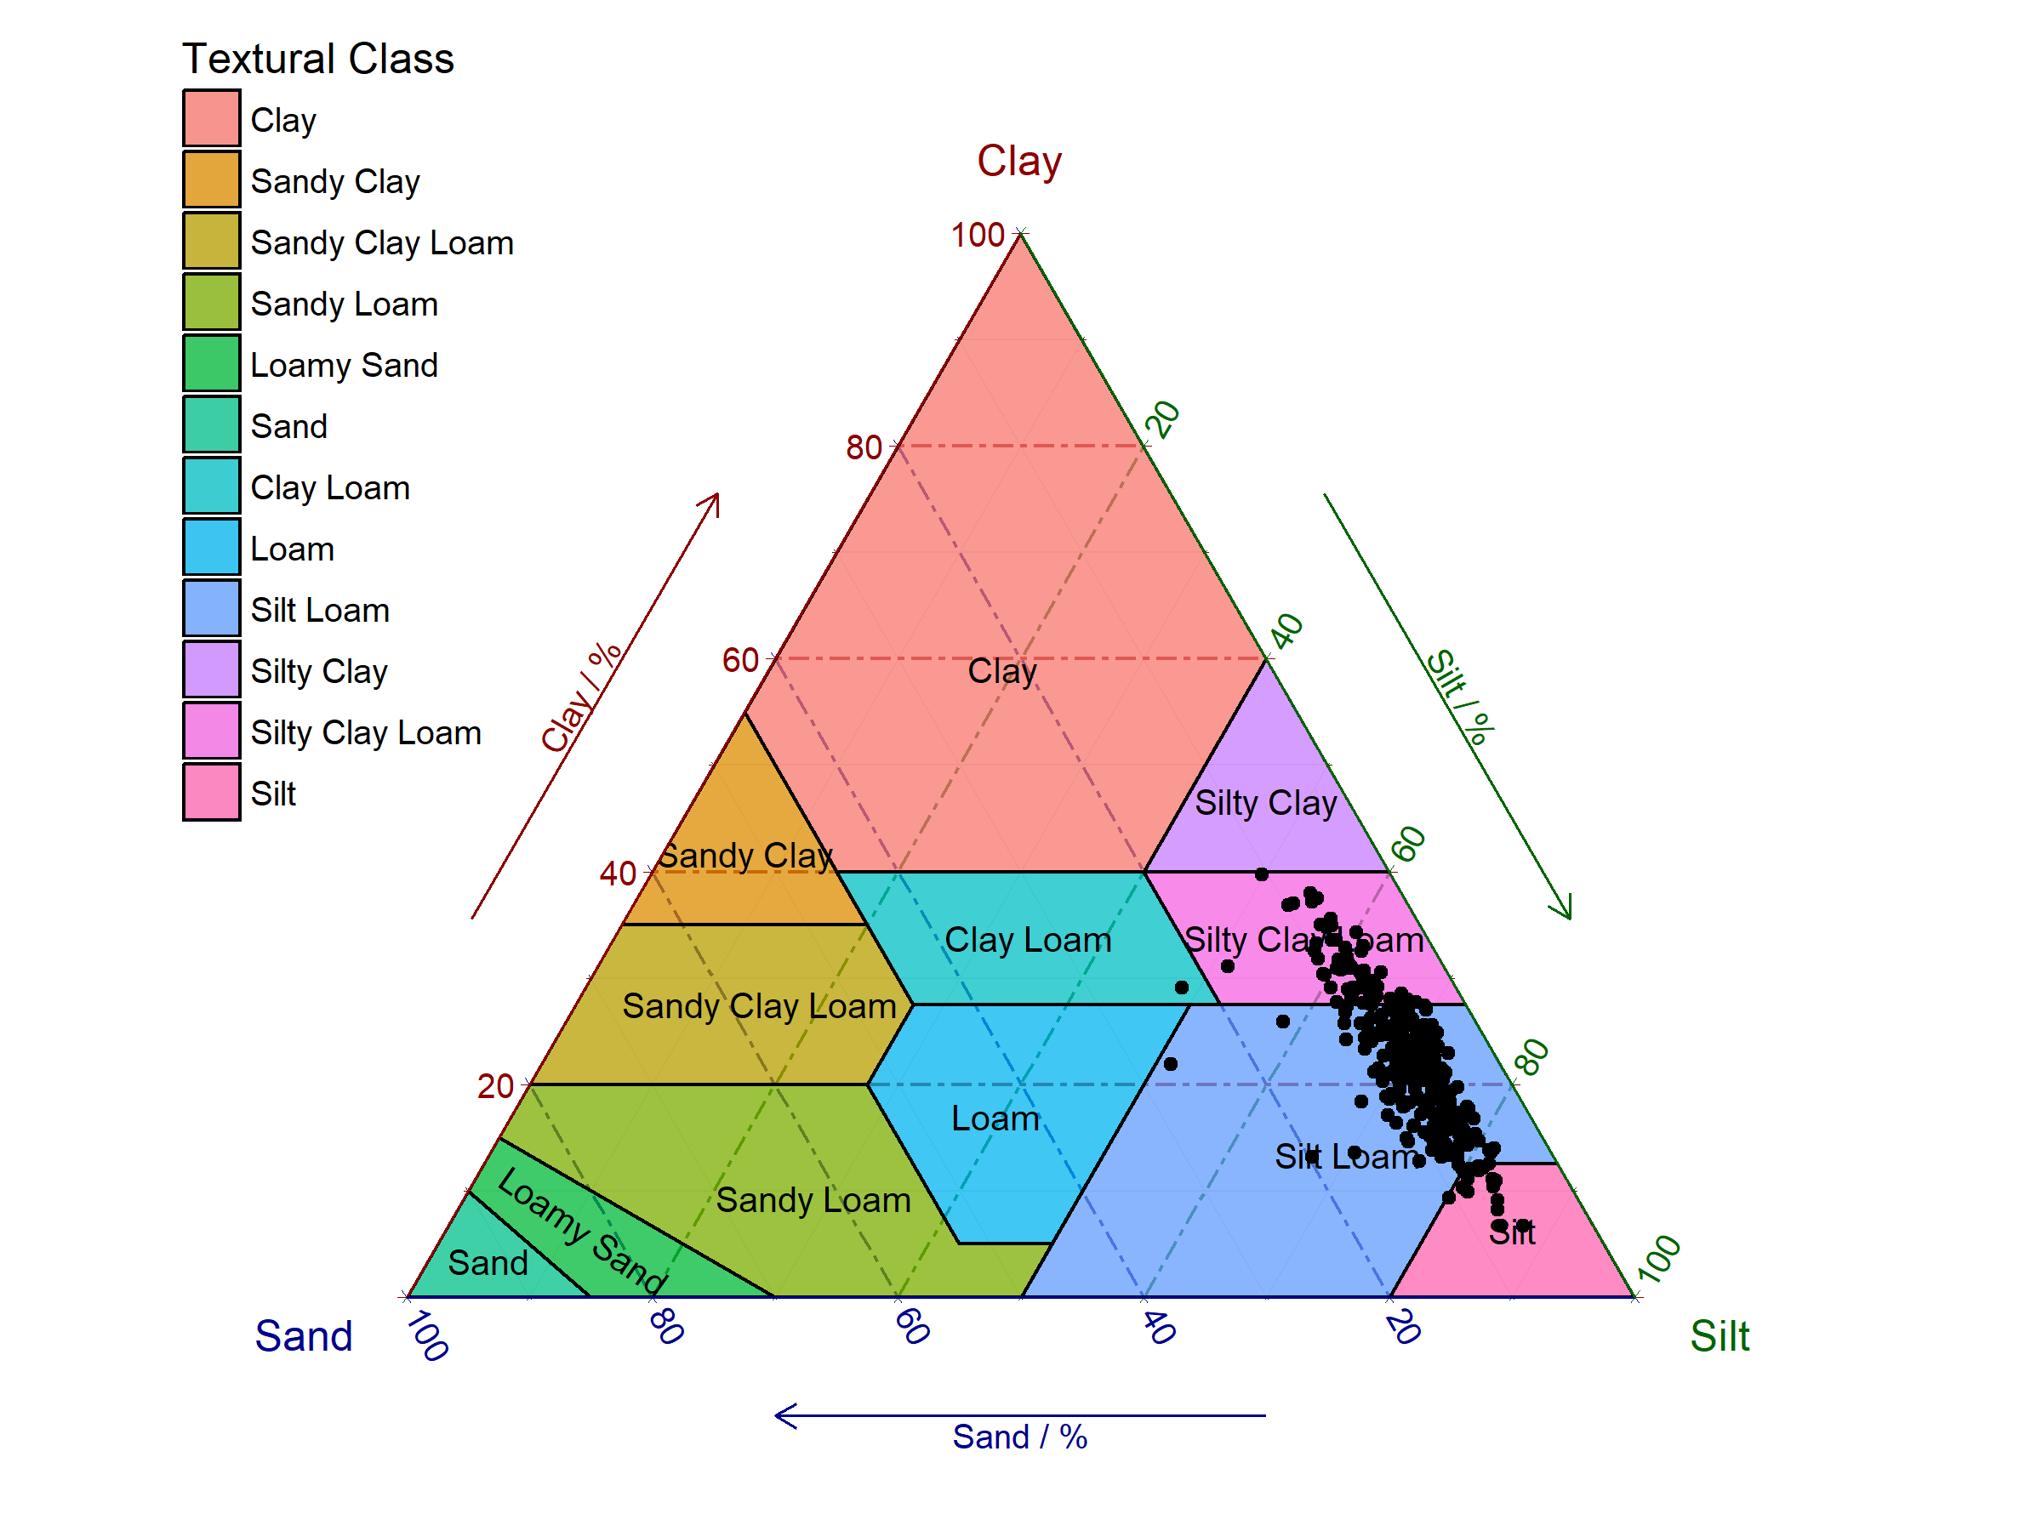
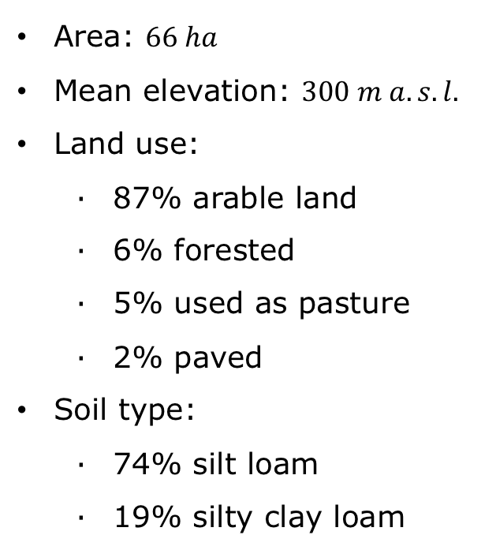
Università
degli Studi
di Perugia
Simplified method for a PTF of ${\overline{K}}_{s}$
Tommaso
Picciafuoco
Study Area
Measur. campaign
Minimum number of measur.
Pedotransfer function
Results
Conclusions
Hydrological Open Air Laboratory (HOAL)
Petzenkirchen, Austria
Area: $66 ha$
Mean elevation: $300 m a.s.l.$
Land use:
87% arable land
6% forested
5% used as pasture
2% paved
Soil type:
74% silt loam
19% silty clay loam

Slide 3
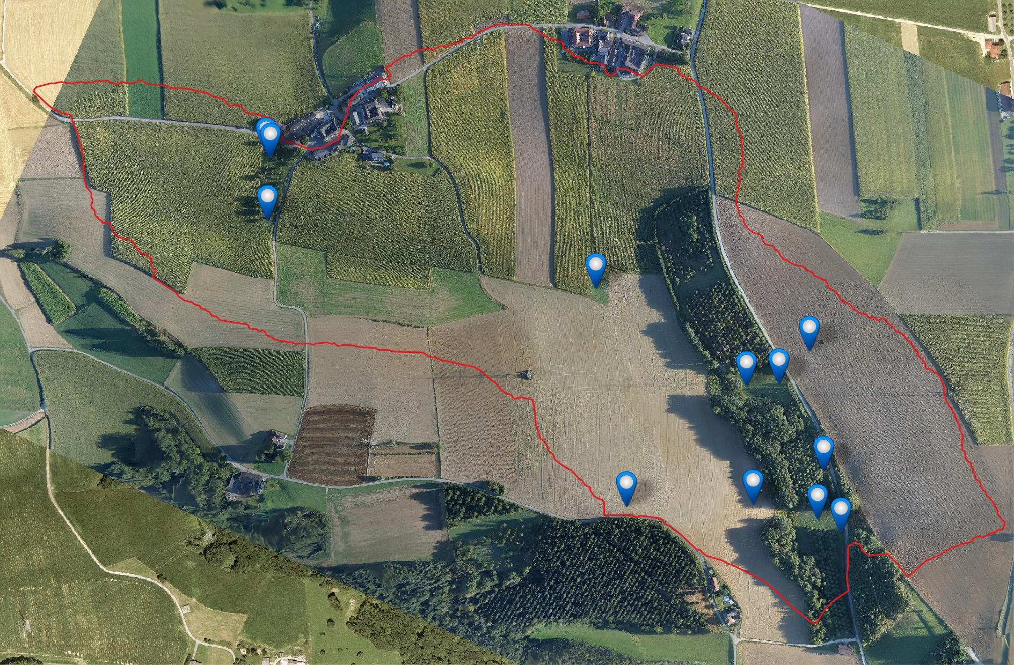
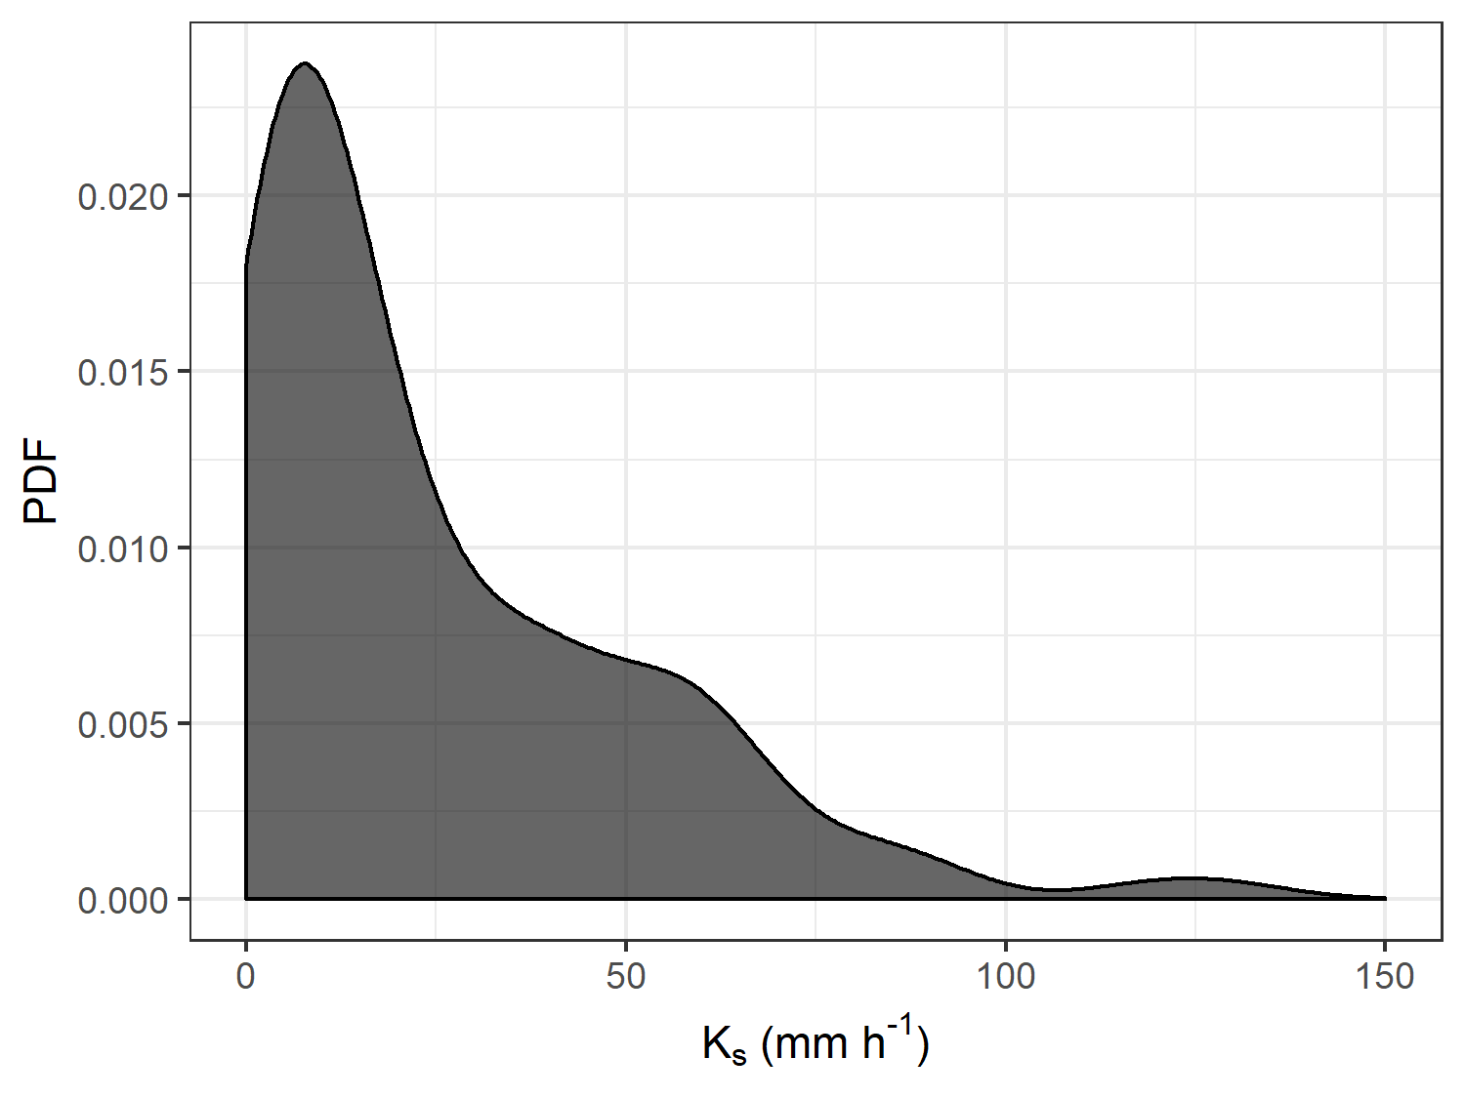
Università
degli Studi
di Perugia
Simplified method for a PTF of ${\overline{K}}_{s}$
Tommaso
Picciafuoco
Study Area
Measur. campaign
Minimum number of measur.
Pedotransfer function
Results
Conclusions
Measurement campaign
March – September 2017
136 measurements in 12 stations
Spatial resolution: $3m$
Double-Ring infiltrometer
Duration: 3-4h
$$K_{s}$$
range: $1−125 mm h^{−1}$
lognormal probability density function

Slide 4
Università
degli Studi
di Perugia
Simplified method for a PTF of ${\overline{K}}_{s}$
Tommaso
Picciafuoco
Study Area
Measur. campaign
Minimum number of measur.
Pedotransfer function
Results
Conclusions
Objective 1
Identifying the minimum number of measurements necessary for estimating a reliable average ${\overline{K}}_{s}$
Method
Non-parametric bootstrap method
95% confidence interval of geometric mean
Different number of measurements, $n$, considered
Amplitude of the interval, $A_{95}(n)$, compared to reference value
Notes:
The non-parametric bootstrap method was used to derive the 95% confidence interval of the geometric mean, considering different number of measurements
Non-parametric = no assumptions concerning the distribution of the data

Slide 5
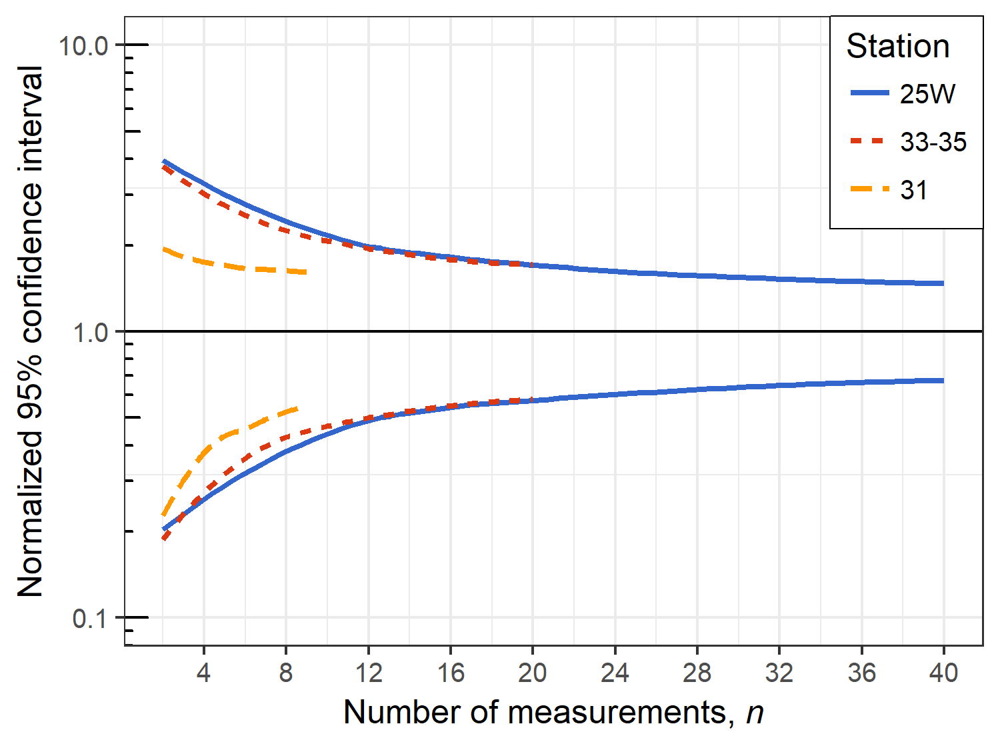
Università
degli Studi
di Perugia
Simplified method for a PTF of ${\overline{K}}_{s}$
Tommaso
Picciafuoco
Study Area
Measur. campaign
Minimum number of measur.
Pedotransfer function
Results
Conclusions
1: constant measurement density
3 stations considered
3 different plot sizes
SAME measurement density
SAME land use: naturally-vegetated
$$∼\frac{1}{10 m^{2}}$$
Amplitude decreases rapidly up to a certain $n$ and then more slowly
The benefit of 1 extra measurement is high at the beginning and then becomes negligible

Slide 6
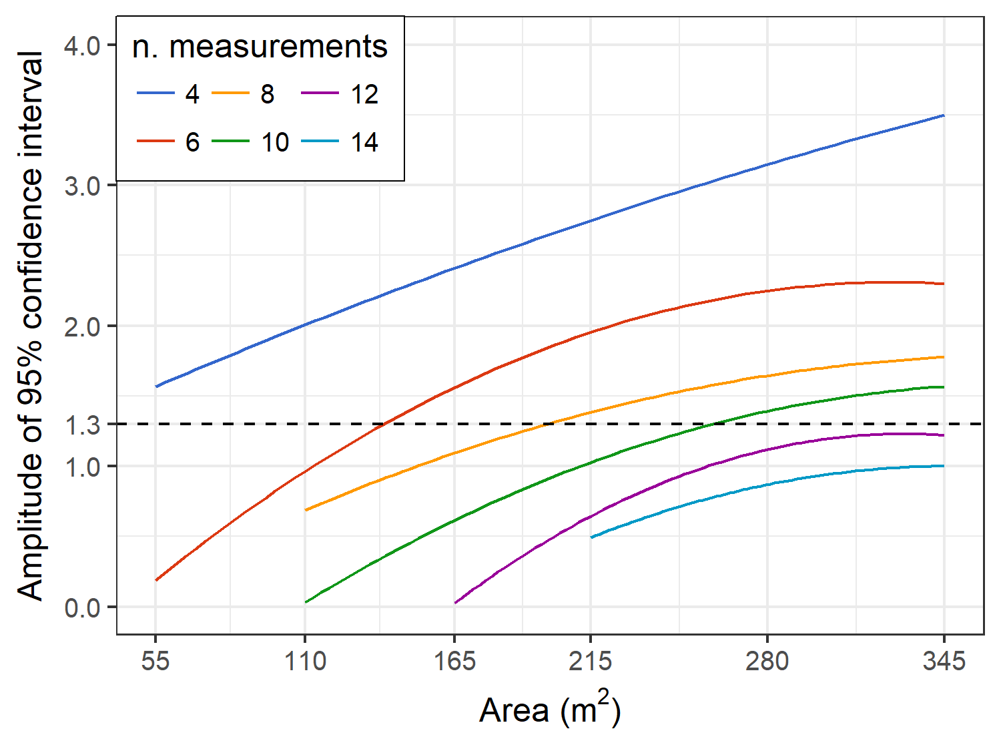
Università
degli Studi
di Perugia
Simplified method for a PTF of ${\overline{K}}_{s}$
Tommaso
Picciafuoco
Study Area
Measur. campaign
Minimum number of measur.
Pedotransfer function
Results
Conclusions
2: variable measurement density
1 naturally-vegetated station
fixed number of measurements (4 … 14)
increasing area
$A_{95}=1.3→$ reference value
Ahmed et al., 2015 – Journal of Hydrology, 530, 604-611
Example:
for an Area of 80 $m^{2}$ 4 measurements (blue line) are not sufficient for estimating a reliable ${\overline{K}}_{s}$, while 6 measurements (red line) are enough.
minimum number of measurements increases if plot area increases

Slide 7
Università
degli Studi
di Perugia
Simplified method for a PTF of ${\overline{K}}_{s}$
Tommaso
Picciafuoco
Study Area
Measur. campaign
Minimum number of measur.
Pedotransfer function
Results
Conclusions
Objective 2
Developing an average field saturated hydraulic conductivity, ${\overline{K}}_{s}$, map for the study area
Pedotransfer function (PTF) of ${\overline{K}}_{s}$
PTFs:
“Equations that transfer available soil properties (e.g., textural composition) into missing soil properties (e.g., hydraulic conductivity).”
Regression technique

Slide 8
Università
degli Studi
di Perugia
Simplified method for a PTF of ${\overline{K}}_{s}$
Tommaso
Picciafuoco
Study Area
Measur. campaign
Minimum number of measur.
Pedotransfer function
Results
Conclusions
Ridge Regression
Multicollinearity was detected in the matrix of regressors
Multicollinearity occurs when one or more regressors are highly correlated
Ordinary Least Squares (OLS) regression cannot be applied for predictions $→$ large regression coefficients and large associated variances
Ridge regression allows to obtain a reliable estimator, ${\hat{β}}_{ridge}$, in presence of multicollinearity
$$y=$$
dependent variables (${\overline{K}}_{s}$)
$${\hat{β}}_{ridge}={\left(X^{′}X+λI\right)}^{−1}X^{′}y$$
$$X=$$
matrix of regressors (textural composition,…)
$$λ=$$
shrinkage parameter

Slide 9
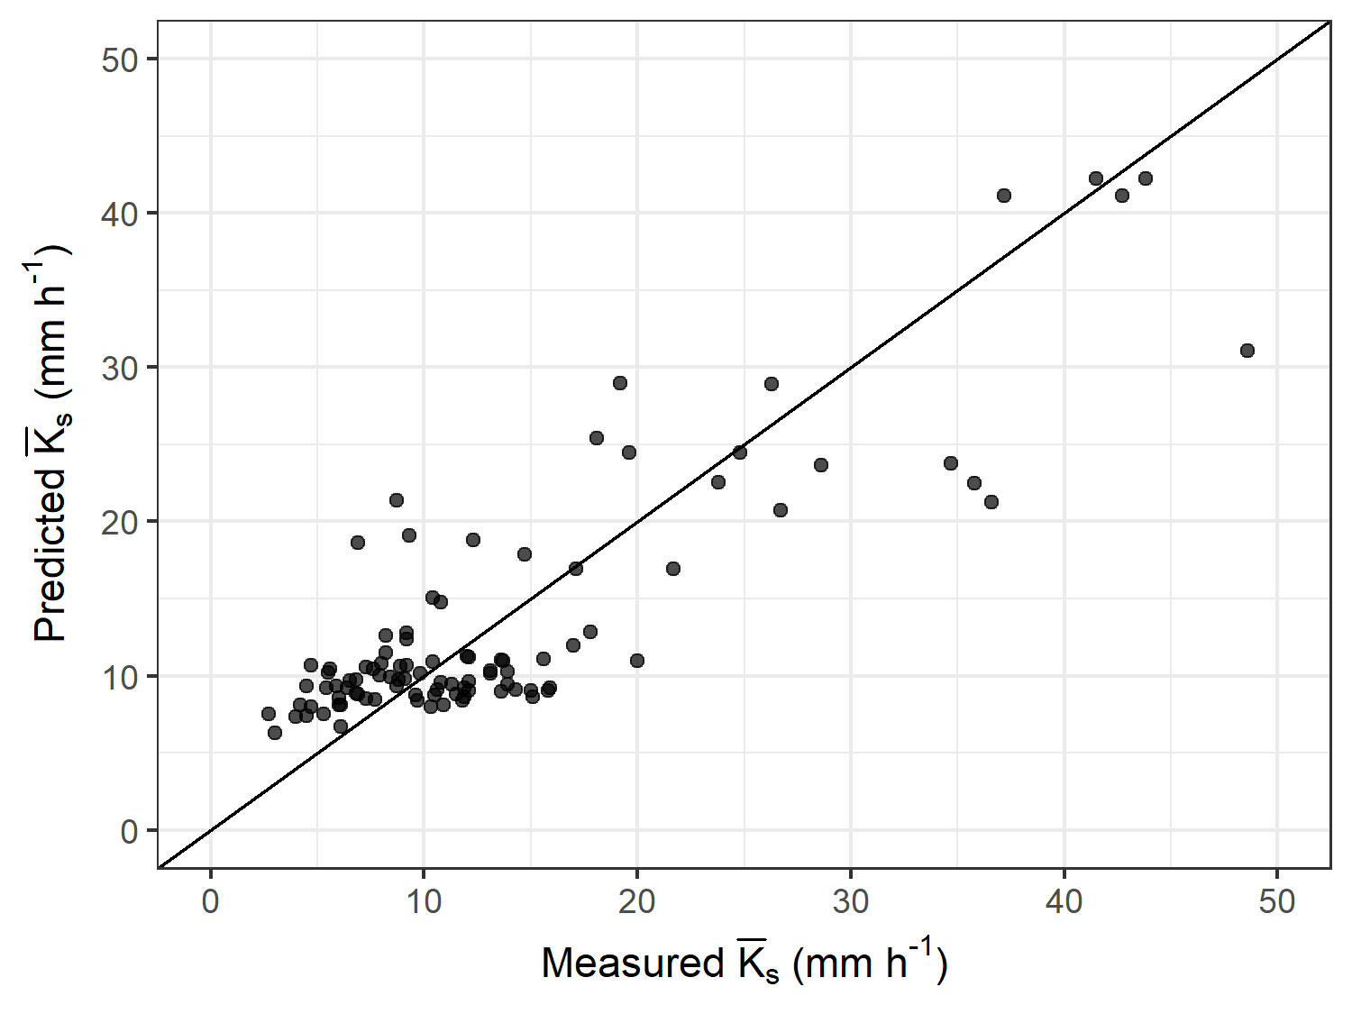
Università
degli Studi
di Perugia
Simplified method for a PTF of ${\overline{K}}_{s}$
Tommaso
Picciafuoco
Study Area
Measur. campaign
Minimum number of measur.
Pedotransfer function
Results
Conclusions
Training data-set
areas of $80 m^{2}$ were considered
$y→{\overline{K}}_{s}$ for each area is obtained averaging 6 measurements
$X→$ average textural composition, slope and elevation of each area
Calibration results
$$RMSE=5 mm h^{−1}$$
$$NRMSE=16 \%$$
$$GMER=1.08$$

Slide 10
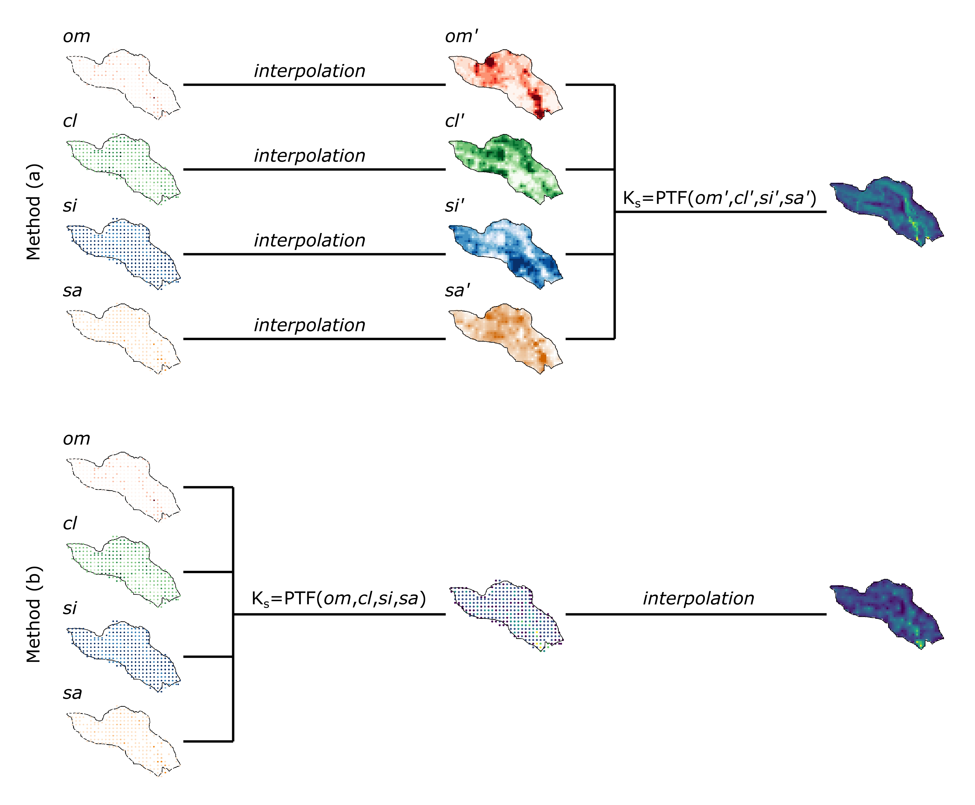
Università
degli Studi
di Perugia
Simplified method for a PTF of ${\overline{K}}_{s}$
Tommaso
Picciafuoco
Study Area
Measur. campaign
Minimum number of measur.
Pedotransfer function
Results
Conclusions
Spatial analysis

Slide 11
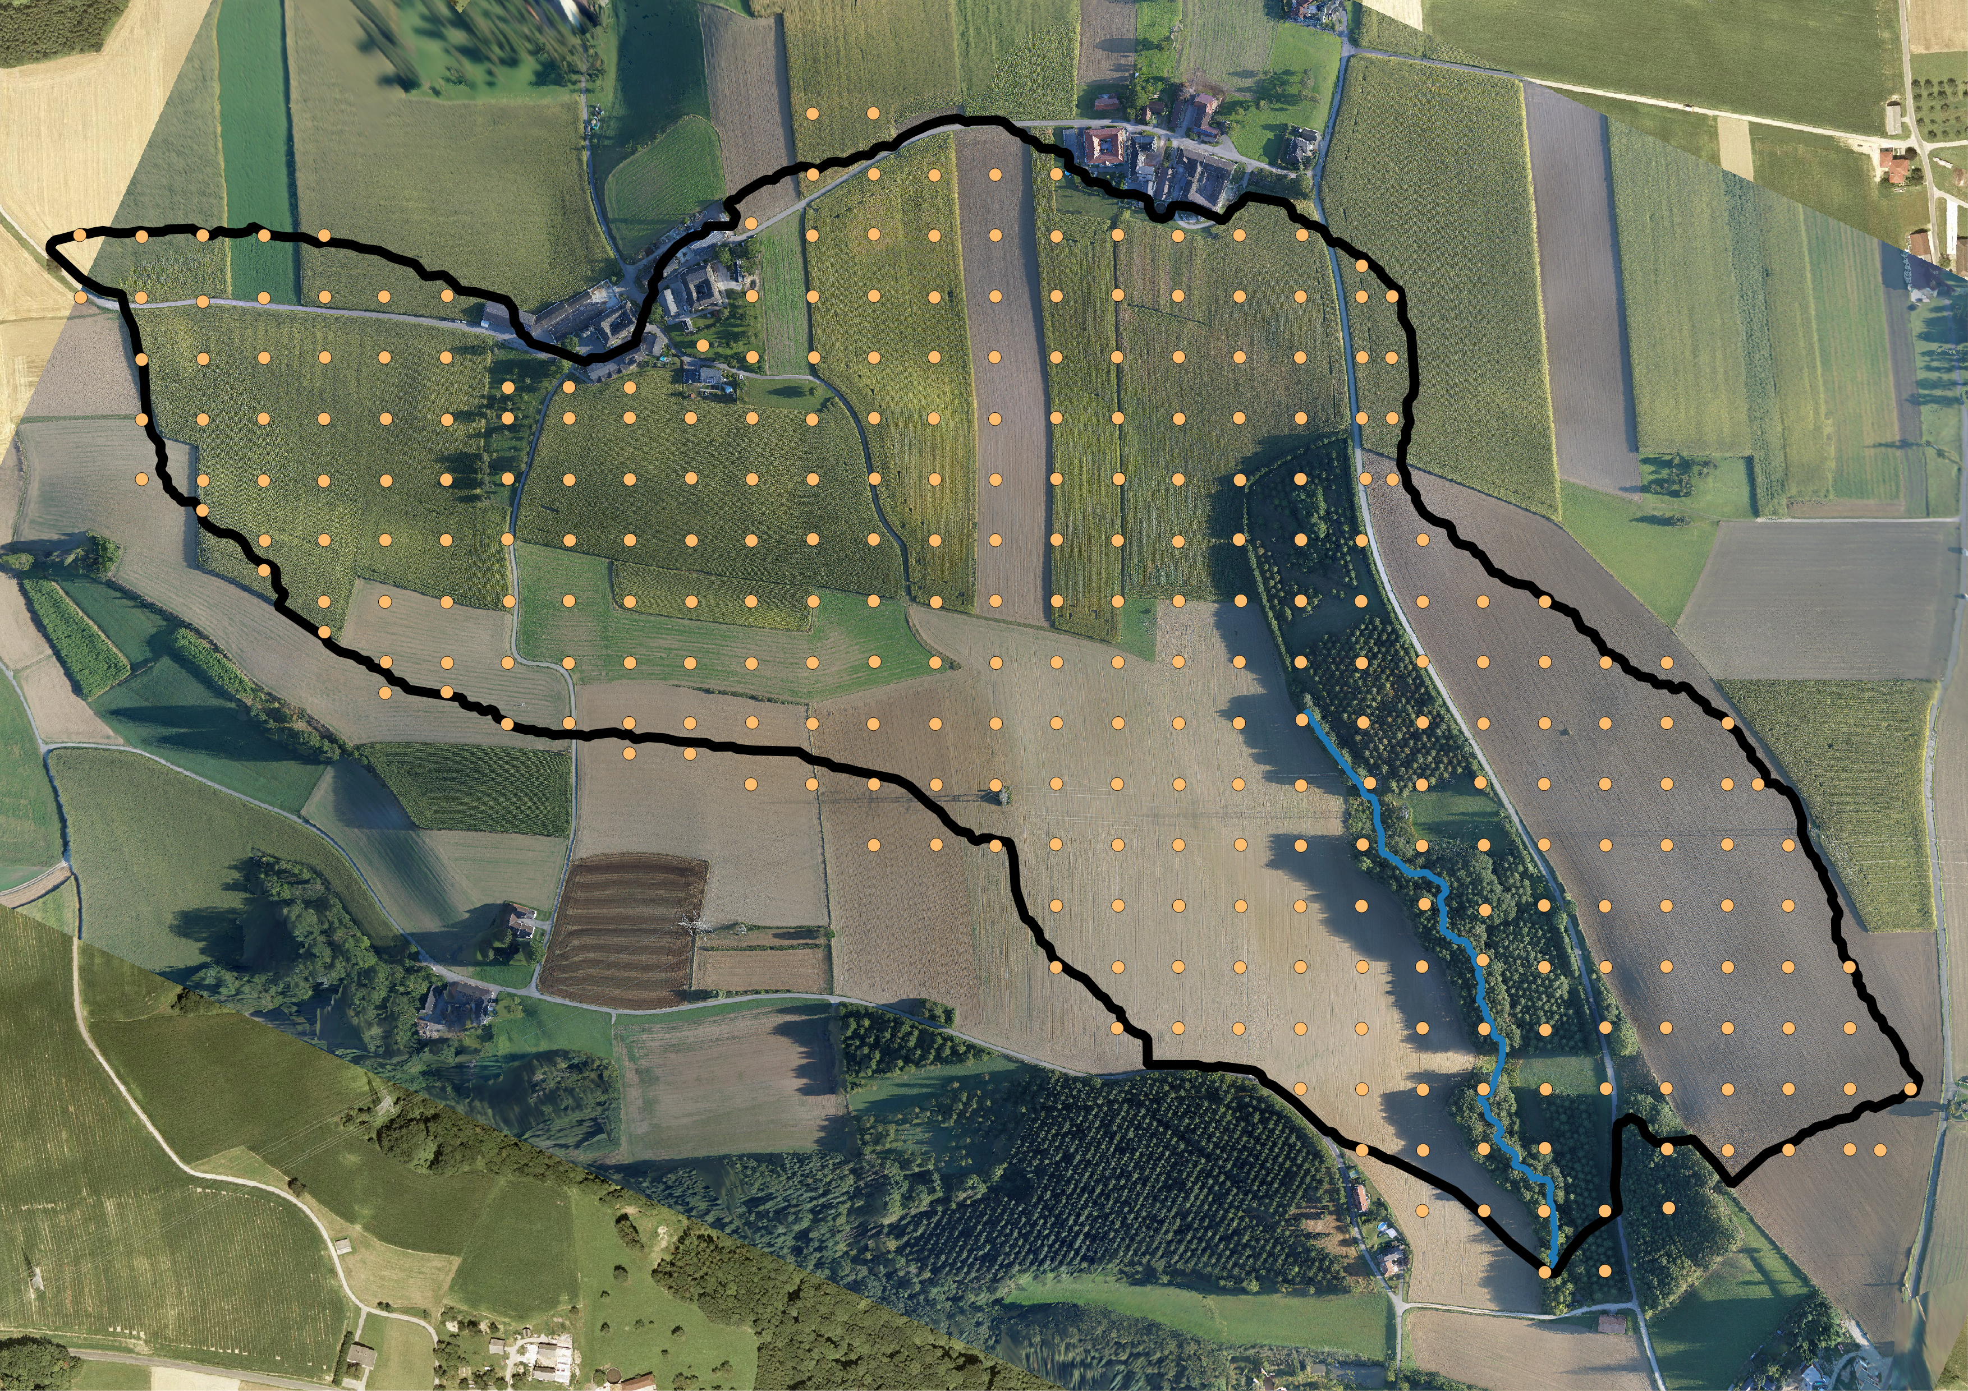
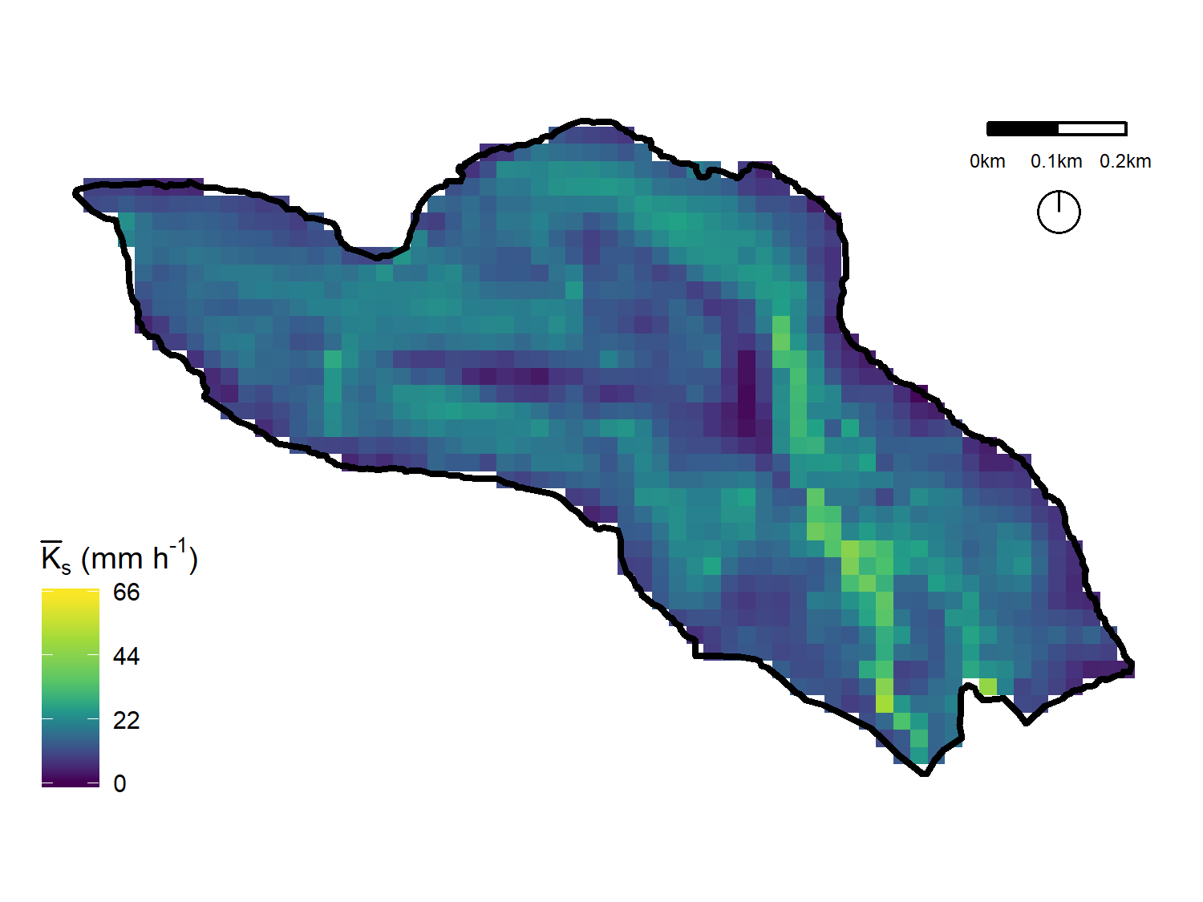
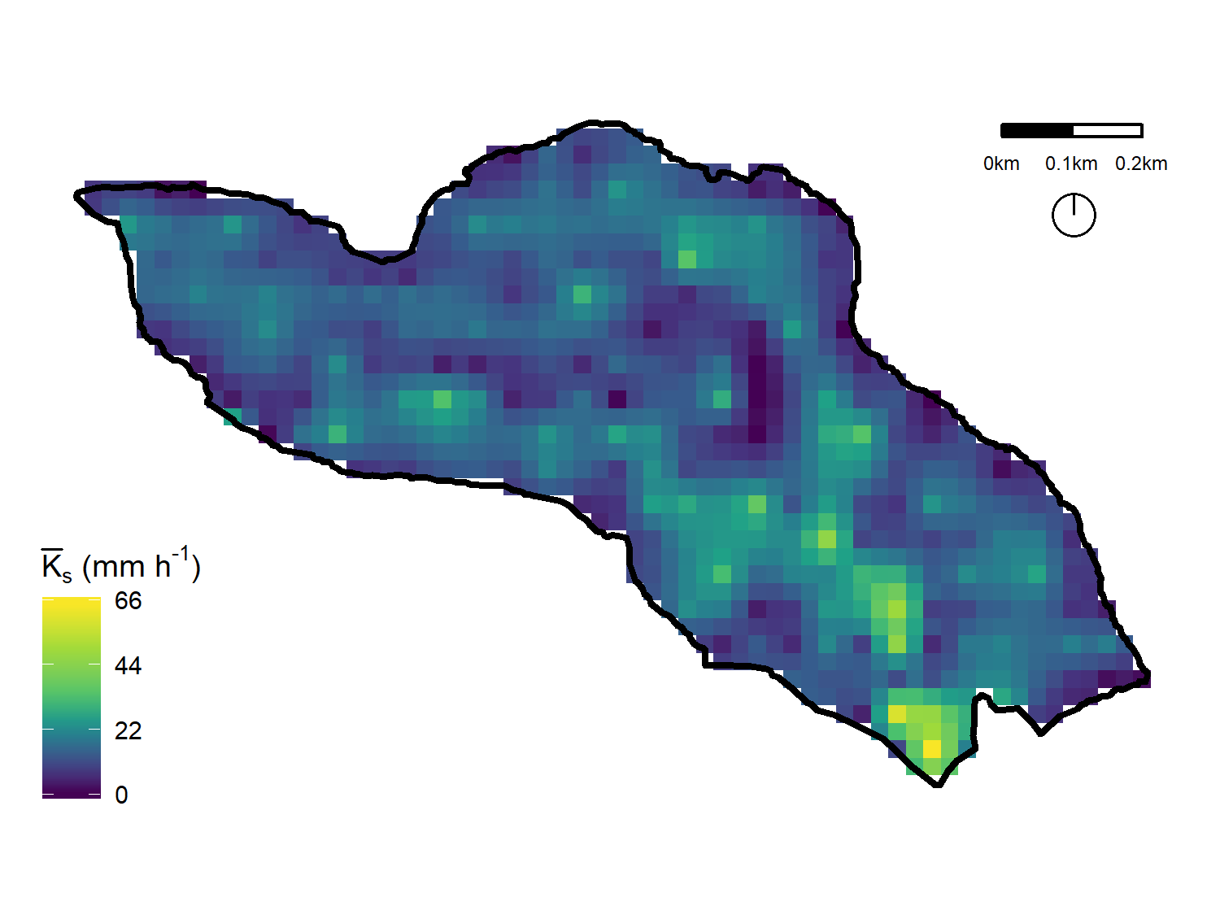
Università
degli Studi
di Perugia
Simplified method for a PTF of ${\overline{K}}_{s}$
Tommaso
Picciafuoco
Study Area
Measur. campaign
Minimum number of measur.
Pedotransfer function
Results
Conclusions
Testing data-set, $X_{test}$
300 measurements of:
textural composition
slope
elevation
Predicted maps
$$y_{pred}=X_{test} {\hat{β}}_{ridge}$$
Method (a)
Method (b)

Slide 12
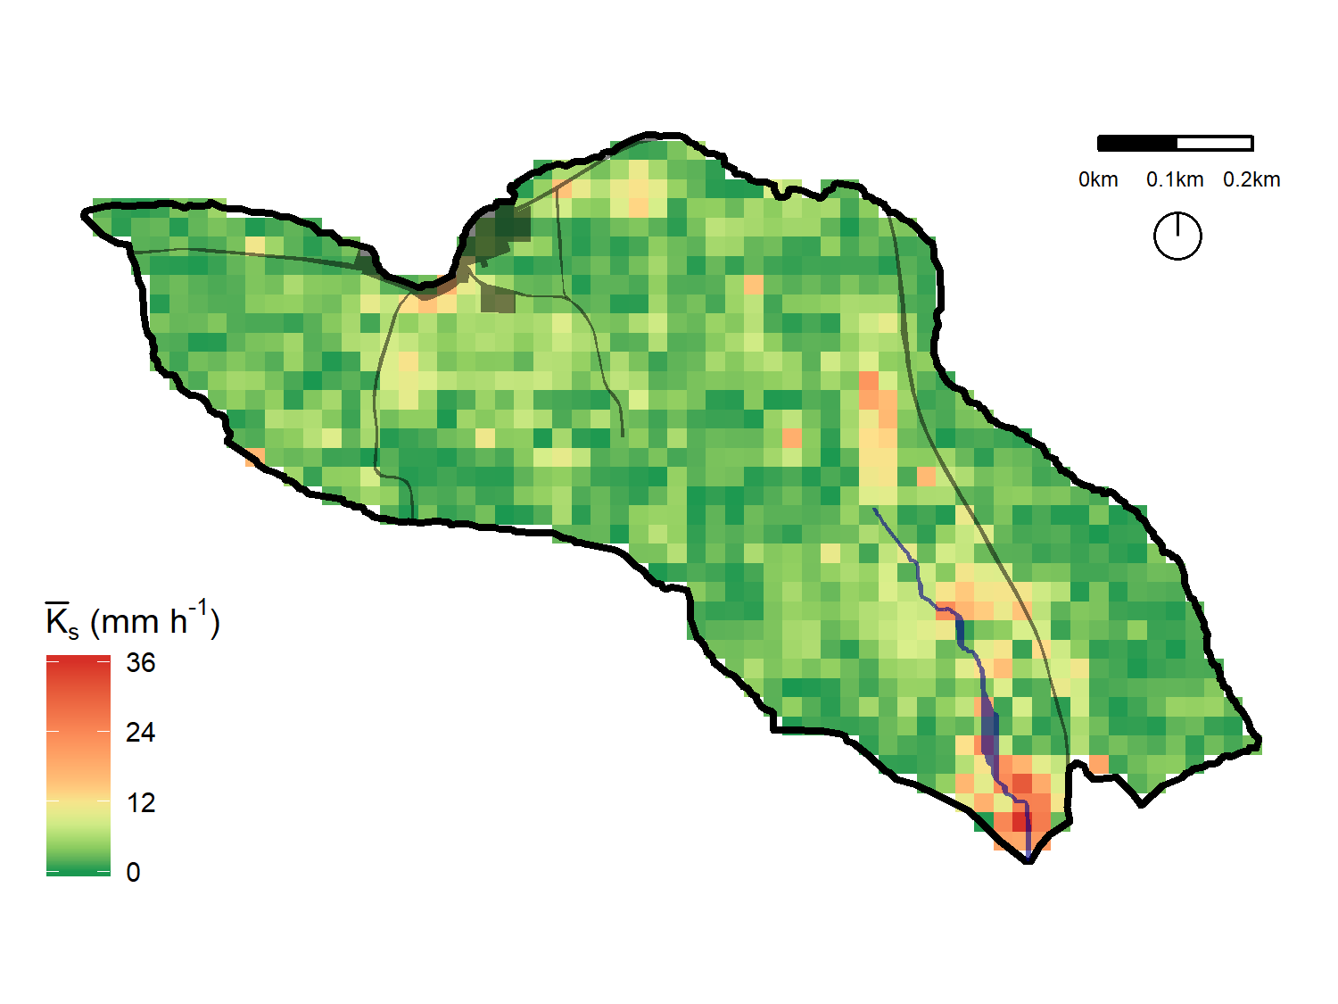
Università
degli Studi
di Perugia
Simplified method for a PTF of ${\overline{K}}_{s}$
Tommaso
Picciafuoco
Study Area
Measur. campaign
Minimum number of measur.
Pedotransfer function
Results
Conclusions
Comparison
Map of the absolute differences between methods (a) and (b)
 | Method (a) | Method (b)
RMSE | 13 $mm h^{−1}$ | 14 $mm h^{−1}$
NRMSE | 20 % | 21 %
GMER | 0.95 | 0.78

Slide 13
Università
degli Studi
di Perugia
Simplified method for a PTF of ${\overline{K}}_{s}$
Tommaso
Picciafuoco
Study Area
Measur. campaign
Minimum number of measur.
Pedotransfer function
Results
Conclusions
Conclusions
a statistical analysis was presented aimed at reducing the number of double-ring infiltrometer measurements necessary for a reliable estimate of ${\overline{K}}_{s}$ at the plot scale
ridge regression technique can be applied to improve the model prediction capabilities when multicollinearity affects the design matrix
for estimating a continuous map of ${\overline{K}}_{s}$ is preferable to apply the PTF on the interpolated independent variables

Slide 14
Università
degli Studi
di Perugia
Thank you
Contacts:
tommaso.picciafuoco@unifi.it
EGU 2018
Vienna, 10 April 2018

