Slide 1
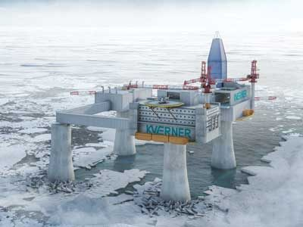







Sea hazards on offshore structures: waves, currents, tides and sea ice combined
S. Rynders (1), Y. Aksenov (1), R. Marsh (2), N. Skrilis (2), L. Hosekova (3), D. Feltham (3), L. Bertino (4), M. Srokosz (1), and T. Williams (4)
(1) National Oceanography Centre (S.Rynders@noc.ac.uk), (2) University of Southampton (3) University of Reading (4) Nansen Environmental and Remote Sensing Center
Acknowledgement: SOS-SOS project (NE/N017099/1), SWARP project (EU FP7 grant number 607476), sea ice physics program at the Isaac newton institute (Cambridge), ACSIS (NE/N018044/1)
EGU 8-13 April 2018, Vienna
Notes:
http://www.offshore-mag.com/articles/print/volume-74/issue-11/a
rctic/concrete-drilling-platform-could-extend-exploration-season-offshore-northern-russia-p1.html

Slide 2
Load calculation on offshore structures: the SOS-SOS project
Safer Operations at Sea - Supported by Operational Simulations
  aim: Improving safety of offshore structures and ships by maximum use of environmental information
Offshore structures developments:
  load calculation for sea ice similar to standard open ocean equation
  systematic assessment of loads using model data
Notes:
similar equations makes systematic model assessment easier
can do timeseries, statistics for any location, generate maps of loads
http://www.dierk-raabe.com/dramatic-material-failure/oil-drilling-platforms/

Slide 3
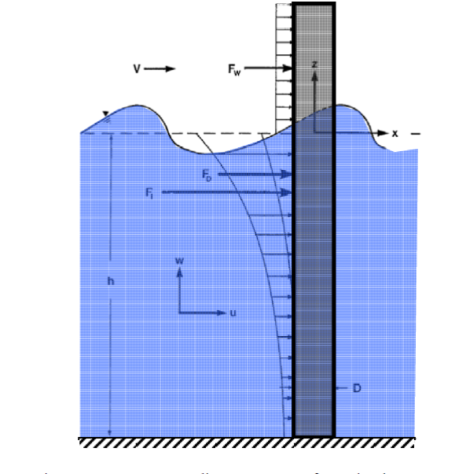
Morison equation
The Morison equation is a standard way to calculate loads due to currents and waves
Inertial force (F_{I})
Drag force (F_{D})
ρ = water density
C_{M} = 1+added mass coefficient
C_{D} = drag coefficient
A = cross sectional area of the cylinder
u = current due to waves
U = mean ocean current (including tidal current)
Force per vertical meter,
to be integrated over height
Notes:
The Froude–Krylov force is the force introduced by the unsteady pressure field generated by undisturbed waves. actual pressure in the wave as if the structure is not there
hydrodynamic mass force: movement of object through a fluid -> added mass here other way round
‘dynamic forces’
drag force: force of drag experienced by an object due to movement through a fully enclosing fluid standard one
https://en.wikipedia.org/wiki/Morison_equation

Slide 4
Extension for sea ice
We have developed a similar calculation for sea ice
2 components
  dynamic sea ice load (similar to inertial force)
  static sea ice load (similar to drag force)
ρ_{I} = sea ice density
C_{MI} = 1+added mass coefficient for sea ice
C_{DI} = sea ice friction coefficient
D = diameter of the structure
a_{I} = sea ice concentration
h = sea ice thickness
L_{f} = floe size
√G_{T} = fluctuation velocity of sea ice
U_{I} = mean sea ice velocity
Force vertically integrated
over ice cover

Slide 5
Environmental information
North Sea: model data from ocean and wave models
ocean: AMM7 (UK MetOffice)
waves: Wavewatch III
resolution is 7 km
Arctic: model data from a coupled sea ice and ocean model
sea ice: CICE (Los Alamos sea ice model)
ocean: NEMO (European consortium model)
waves-in-ice module: development from SWARP project
resolution is 35-111 km
Notes:
waves in ice module is important because necessary information is not available in standard models
wave attenuation
wave break up of ice floes -> floe size

Slide 6
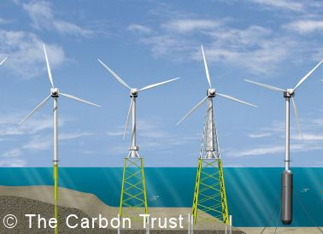
Structures
Equation is developed for cylindrical structures
examples:
  monopiles (for shallow water)
  spar structures (floating, for deep water)
Diameter can be varied
  structures in sea ice often bigger
Notes:
Morison equation not so good for inclined structures like jackets

Slide 7
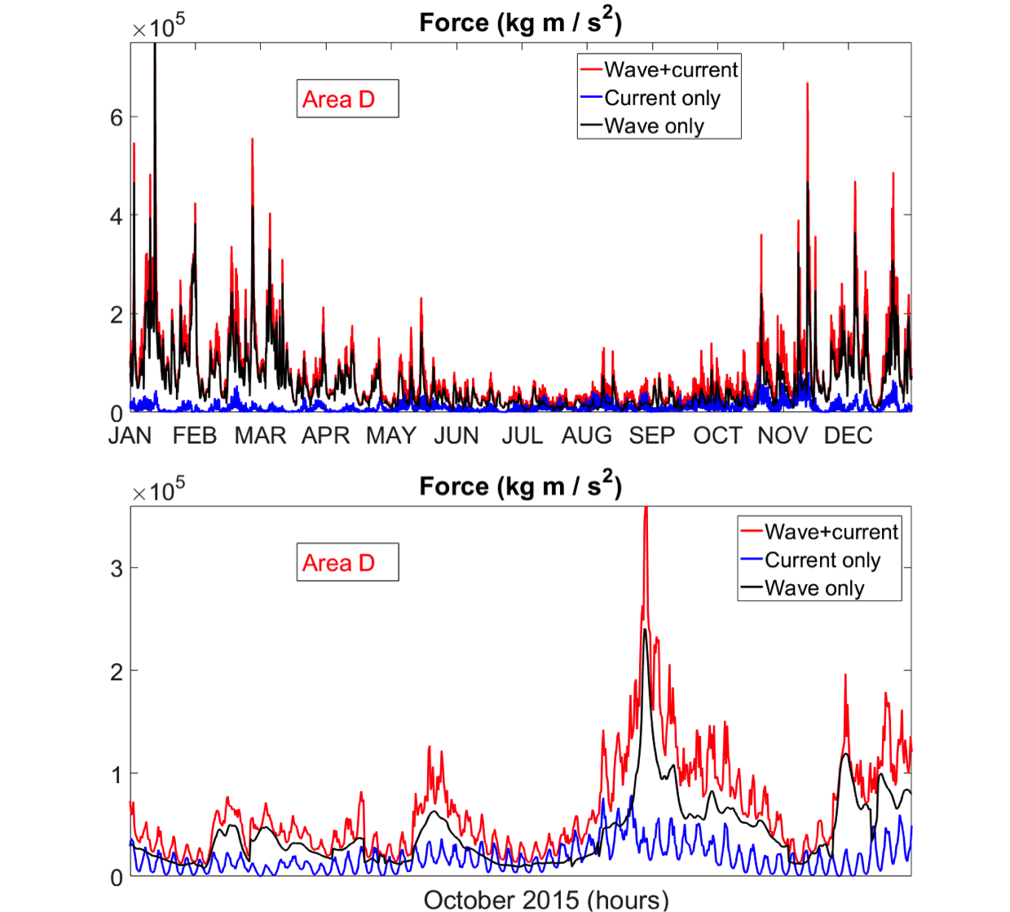
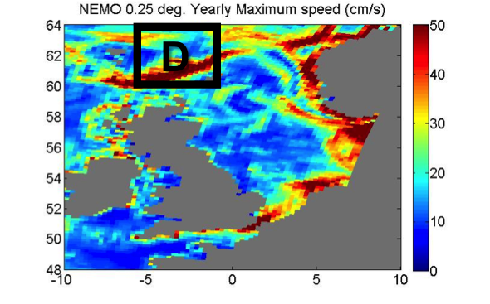
Results: North Sea
Waves dominate the loads in most cases.
Ocean currents are important where there are strong tides, at the shelf slope and in seasons with low storm activity
Notes:
wave especially high in winter because of storms

Slide 8
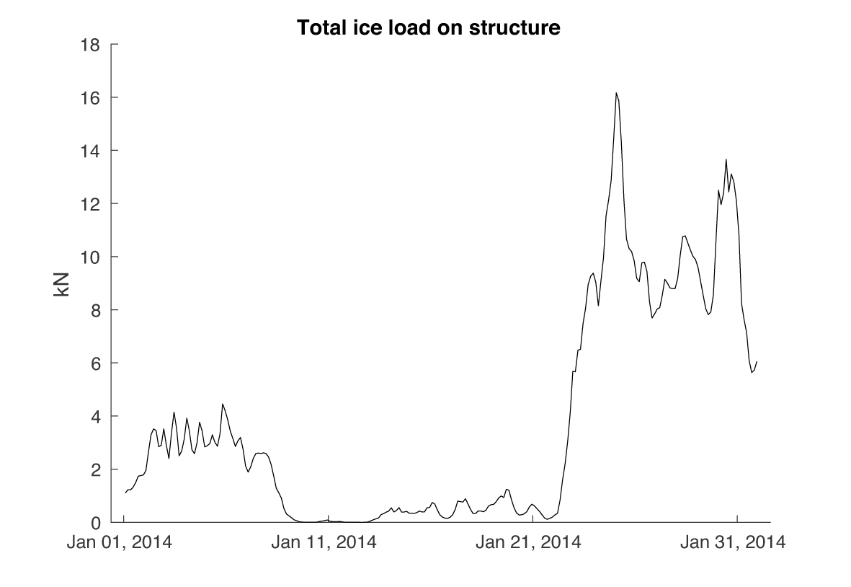
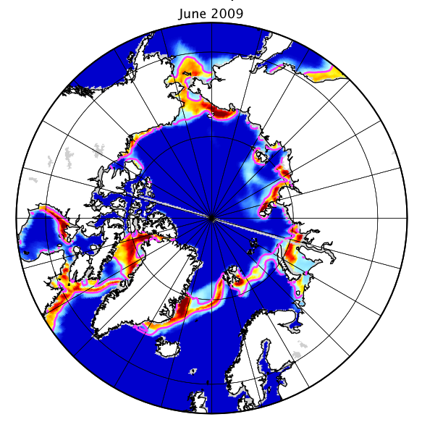
Results: Arctic
dynamic loading event
Large temporal variability of ice load
on short timescale
static load baseline

Slide 9
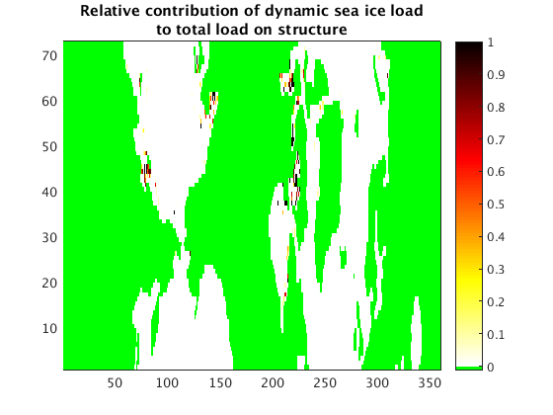
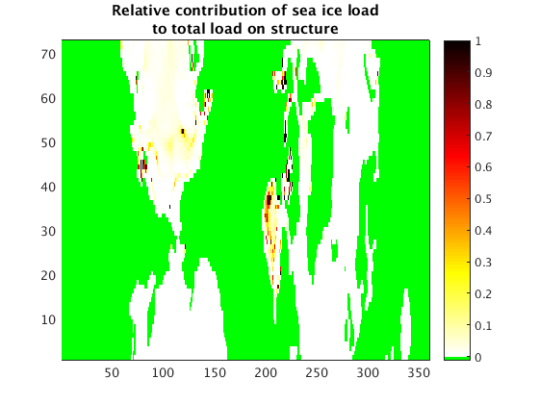
Results: Arctic
Ice loads can dominate ocean loads in ice-covered areas
Large dynamical ice loads in the marginal ice zones
Static ice load important in Hudson Bay and pack ice
Notes:
large sea ice drift in Hudson bay

Slide 10
Conclusion
The Morison equation has been extended with a sea ice load calculation
Sea ice loads can dominate total load on the offshore structure in the ice covered regions
Dynamic ice load dominates in the MIZ
In ice-free areas surface wave dominate loads on offshore structures
Our results show that to estimate loads on offshore structures the temporal and regional variability of environmental parameters needs to be taken into account.

Slide 11
Thank you for your attention
acknowledgements
SOS-sos project (NERC grant number NE/N017099/1)
Swarp project (EU FP7 grant number 607476)
sea ice physics program at the Isaac newton institute (Cambridge)
For the study we acknowledge support from the NERC Grant NE/R000654/1 ’Towards a Marginal Sea Ice Cover’ and the EU FP7 Project ‘Ships and waves reaching Polar Regions (SWARP), grant agreement 607476. We also acknowledge funding from the NERC Programme “The North Atlantic Climate System Integrated Study (ACSIS)” NE/N018044/1.
background image: http://www.offshore-mag.com/articles/print/volume-74/issue-11/a
rctic/concrete-drilling-platform-could-extend-exploration-season-offshore-northern-russia-p1.html

