Slide 1



The multi actor approach enabling engagement of actors in sustainable use of chemicals in agriculture
E. Belmans, P. Campling, E. Dupon, I. Joris, E. Kerselaers, S. Lammens, L. Messely, E. Pauwelyn, P. Seuntjens, E. Wauters
This project has received funding from the European Union’s Horizon 2020 Research and Innovation Programme under grant agreement No. 727450

Slide 2

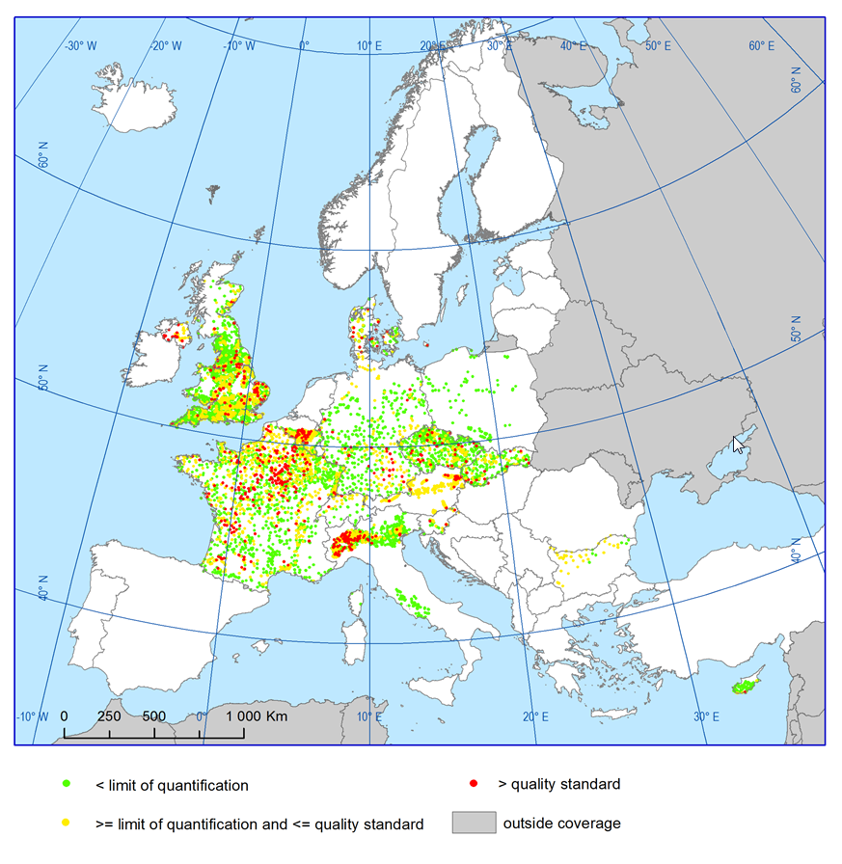
A CONTINUING CONCERN …
Occurrence and exceedance of selected pesticides in groundwater monitoring stations, 2010-2011 (Source: Eurostat)
Hot-spots of exceedance across Europe (>0.1 μg/l)
Hot-spots = intensive agriculture
Pollution sources are diffuse
Long residence times
Monitoring and treatment costly
Poor information across Europe
Mitigation measures are not in place, or not effective and need (farmer) engagement

Slide 3
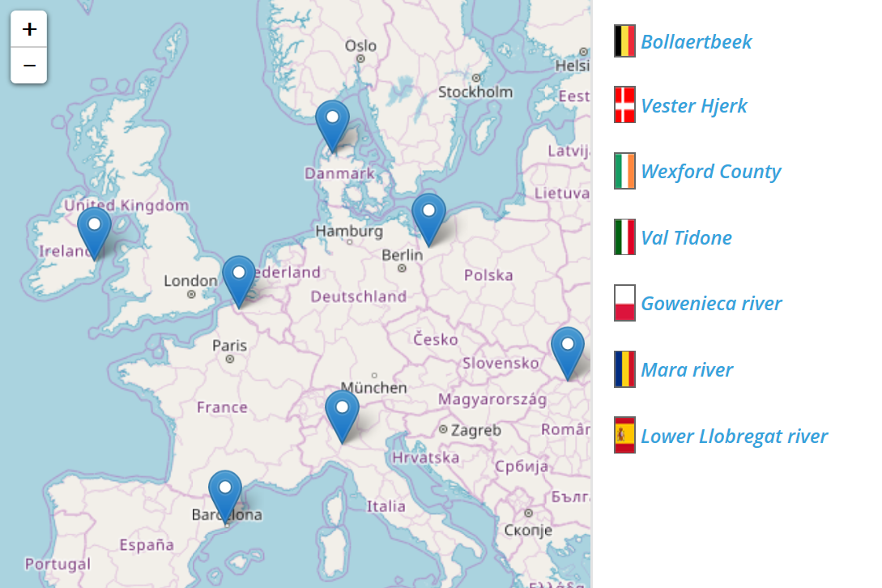
We present a MULTI-ACTOR APPROACH
Contribute to effective uptake and realisation of management practices and mitigation measures to protect drinking water resources
We need action in the field !
Actions are centered in local “Action Labs” (catchment scale)

Slide 4
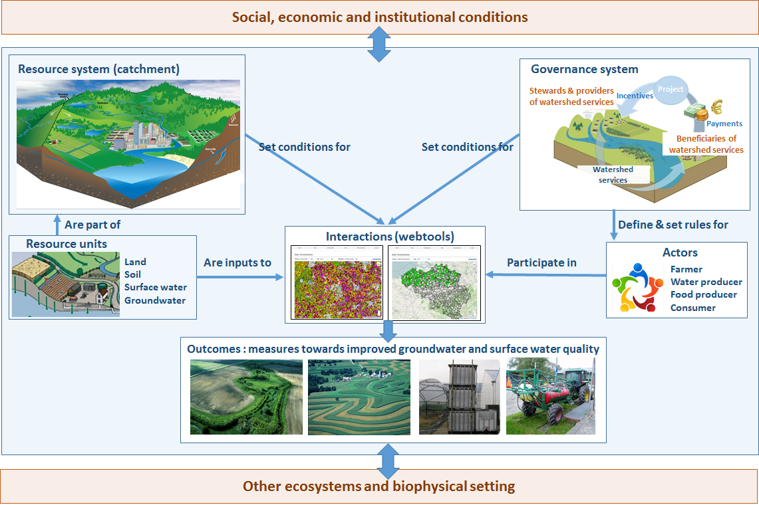
ACTION LAB concept
A blend of disciplines: social science, economics, engineering, agronomy, hydrology

Slide 5
STEPS in planning a multi-actor approach
Step 1 – Identifying the actors
collect data about the actors that have an influence on or that are influenced by the water system
map the stakeholders in a structured way
Step 2 – Designing the process
one manager to keep an overview over the whole process (action lab leader)
Organise in-depth interviews, focus groups, questionnaires, information moments, flyers
Notes:
information on the different actors in the region and get to know their stances related to the water quality
For every actor, we want to get more insight in their position, their interest in the project and their resources. Based on interviews with the key actors in the area, the position of the actor to the water system or water body, to the project (i.c. improvement of water quality), and the resources related to water quality issues can be derived. Aspects related to the position of the actor to the water system are: regulatory issues, water use, advisory roles, responsabilities. Questions such as: ‘Why would stakeholders be willing to cooperate? What’s in it for them? Will they support or resist the project?’, allow to derive the position of the actor to the project. Resources to implement the project depend on the financial benefits and position of the actor, his knowledge, the production environment, the legitimacy of the project, and the power to influence the project.
the action lab leader makes an overview of all stakeholder involvement moments, their associated actors, the goal and the required input and output (Table 2). To avoid taking too much time and engagement from the stakeholders, this overview can help to combine different stakeholder moments into the same interactive session.

Slide 6
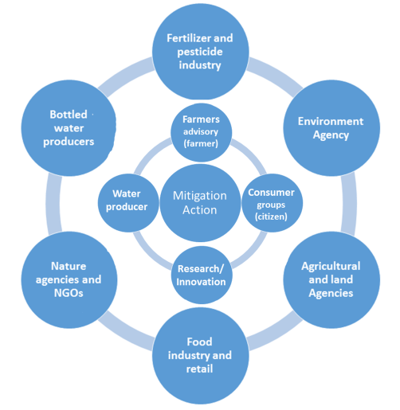
What is a TYPICAL MULTI-ACTOR partnership?
Led by action lab leader
Multi-level & multi-scale
Different composition depending on location, objective, and culture

Slide 7
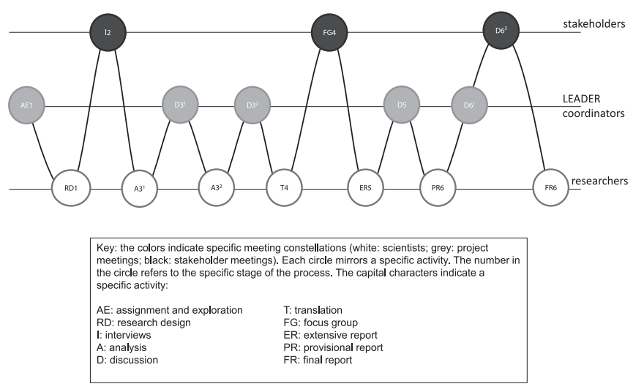
MULTI ACTOR MGT PRINCIPLES
A transparent and fair process
Visualization of the process for better understanding
An equal involvement of all actors
A neutral start for the process by sharing common objectives and a common language
Social and emotional dynamics to encourage overall group functioning
Action lab leader
Adapted from Messely, L. et al. 2013.
J. Rural Studies 32, 400–410.

Slide 8
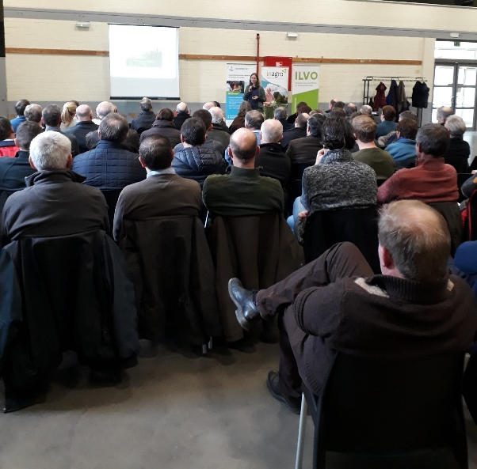
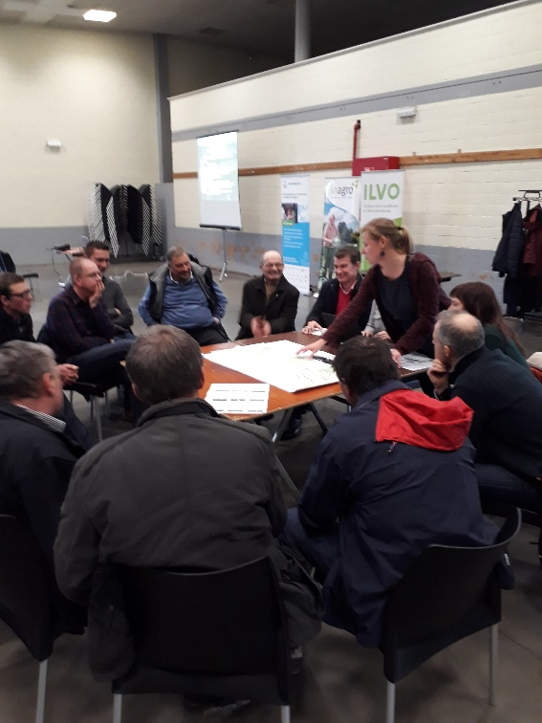
MULTI-ACTOR IN the BOLLAERTBEEK (BE)
MAG 1
MAG 2

Slide 9
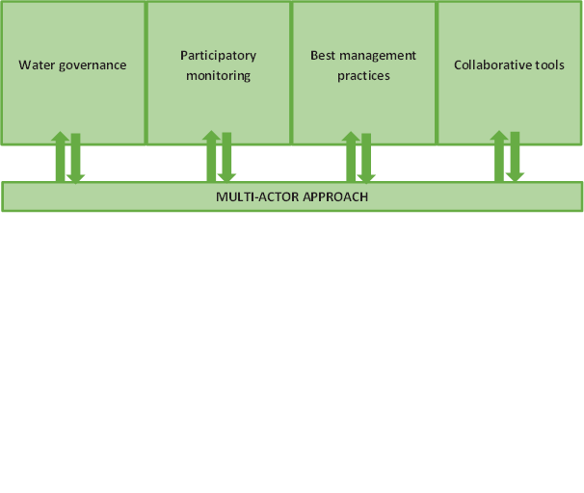
  MULTI ACTOR IS PART OF EACH ASPECT RELATED TO WATER QUALITY
  1. New governance: alternative financing
  2. Share data: participatory monitoring
  3. Best management into practice
  4. Bring all information close to actor using ICT

Slide 10
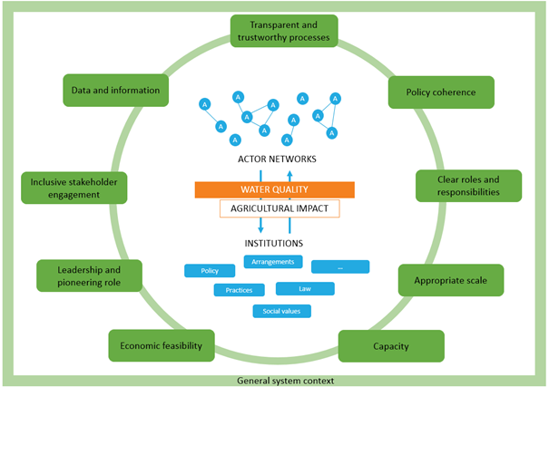
GOVERNANCE FRAMEWORK
The water system (orange): interaction between human and water system
The governance systems (blue): interactions between actor networks and the institutions
Building blocks to obtain a ‘constructive environment for development of a well-functioning governance system’ (green)
Finding the incentives to engage actors

Slide 11
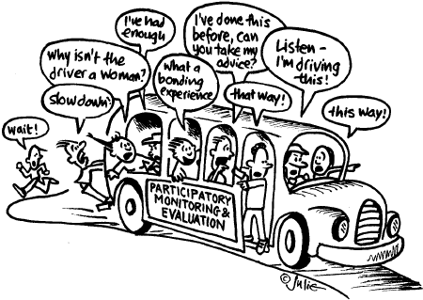
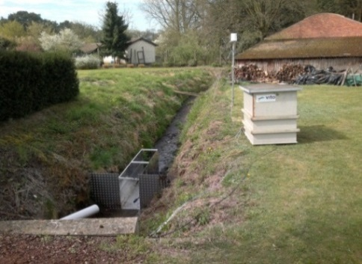
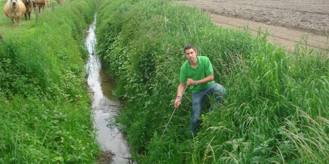
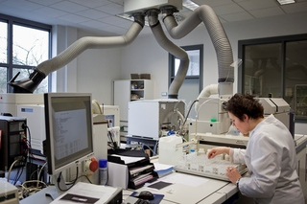
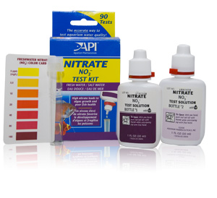
Participatory monitoring
Designing, aligning and bringing together monitoring data from:
Scientists
Environment agencies
Drinking water companies
Local farmers
Local citizens
complexity
Local engagement
Local actors become more engaged in the monitoring and they trust more the results.

Slide 12
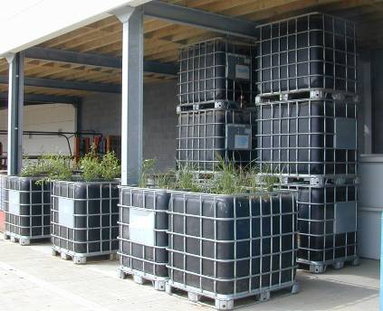
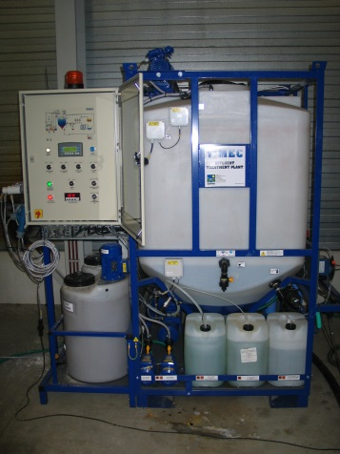
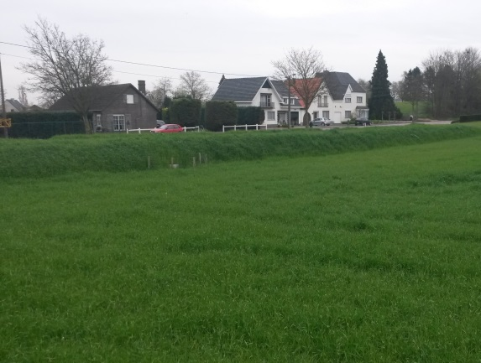
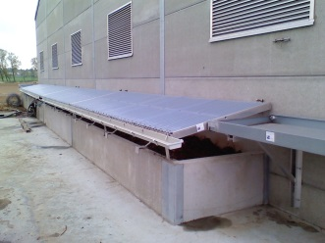
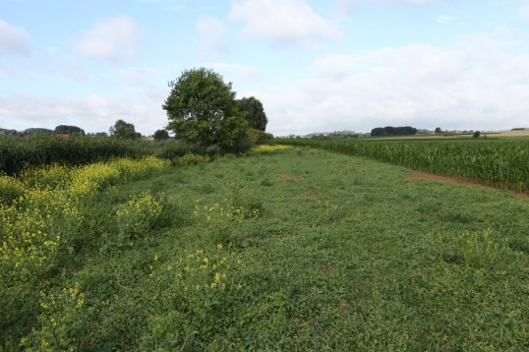
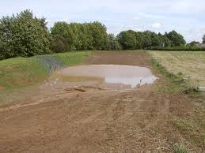
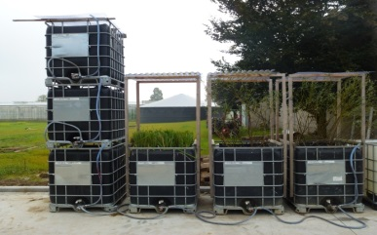

Best management practices
Engage actors to implement measures !
Diffuse sources: Bufferstrips
Mgt practices
Dams, pools
Treatment point
sources
The right / accepted measures at the right places

Slide 13
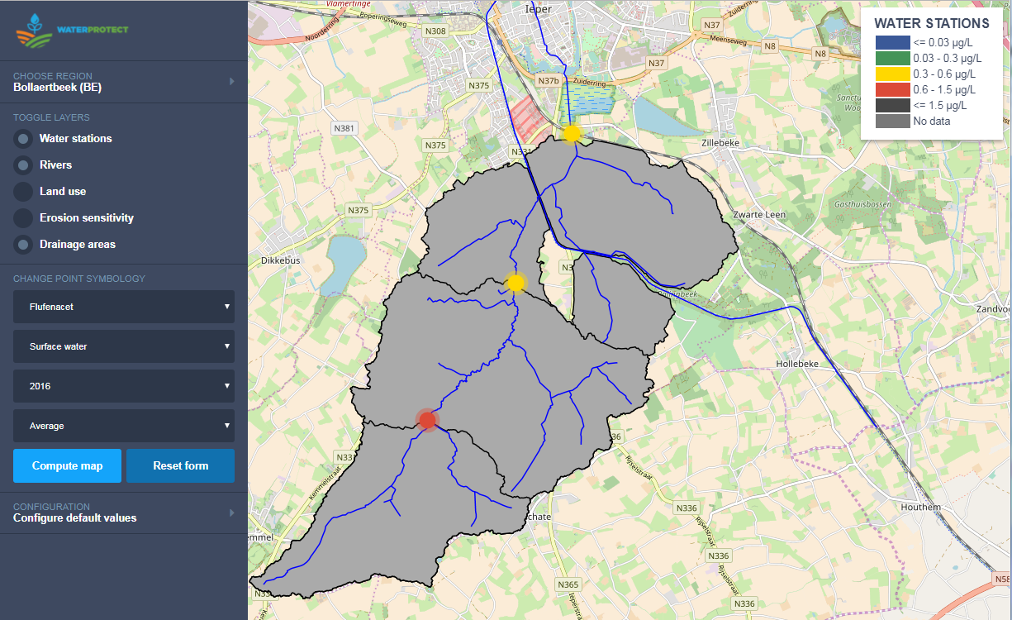
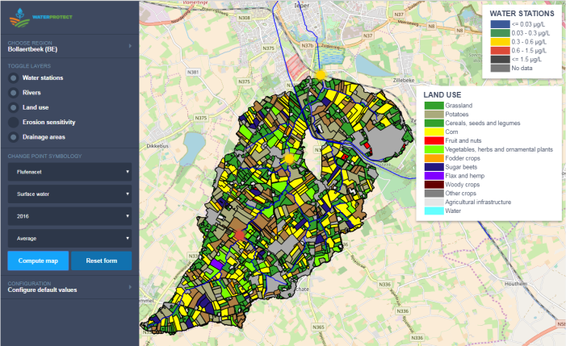
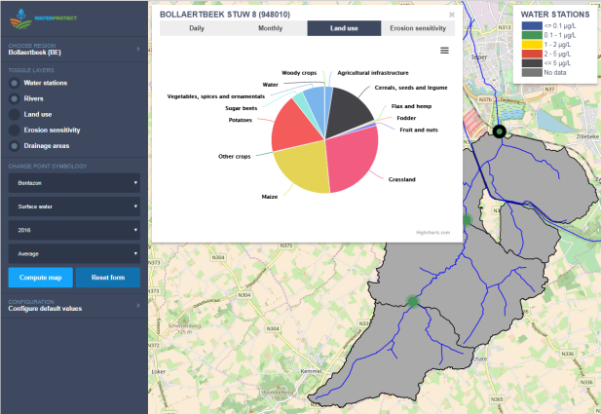
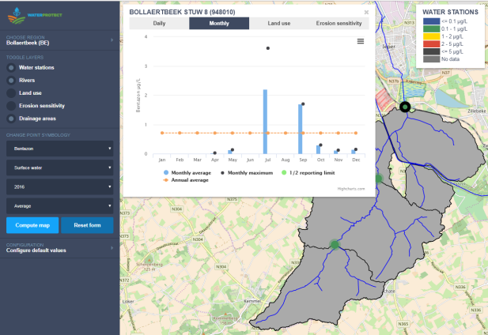
COLLABORATIVE TOOLS (APPS)
Harmonised data
Easy access
Link action to water quality
Visualise landscape
Show impact of behaviour
Transparency on the water system

Slide 14
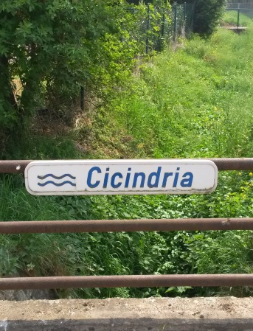
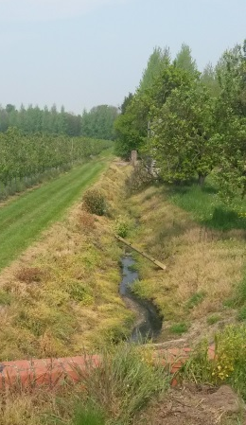
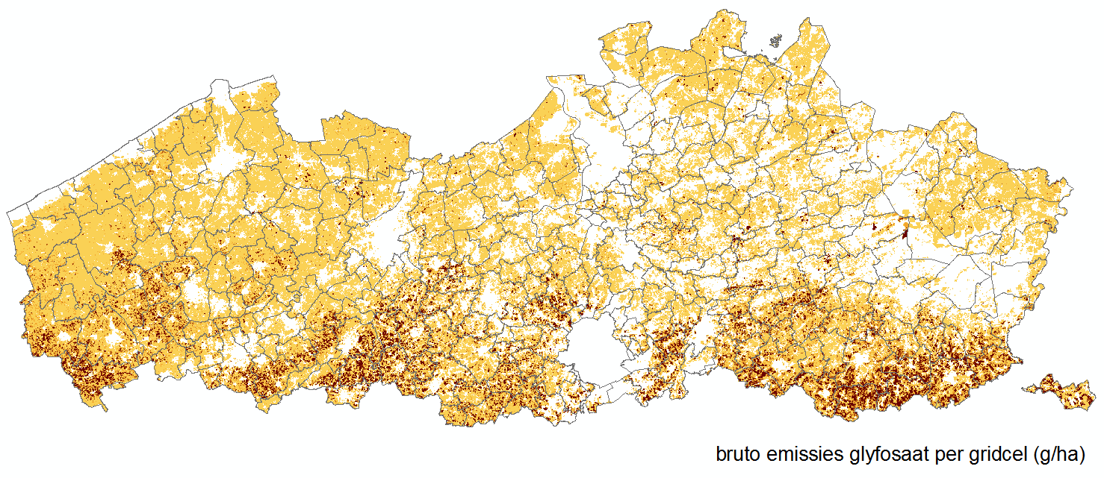
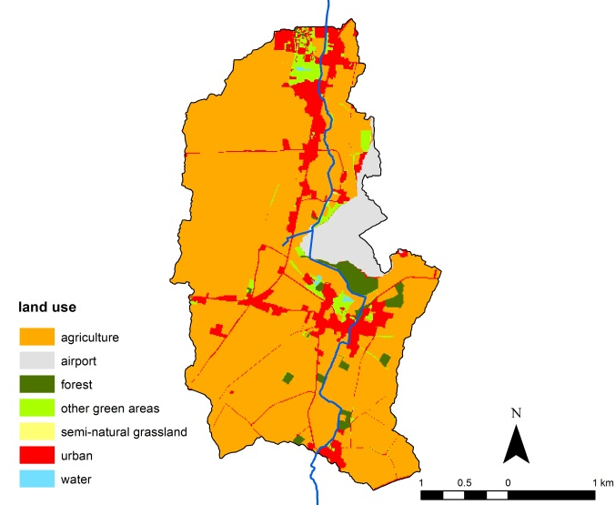

RUNNING PILOT STUDY CATCHMENT
Monitoring study (2014-2018) with implementation of measures (2016-2018)
the Haspengouw region in southern Limburg, intensive agriculture, mixed with residential landuse
multiple pesticides detected in headwaters
Cicindria catchment
area: 1075 ha
72% agriculture

Slide 15
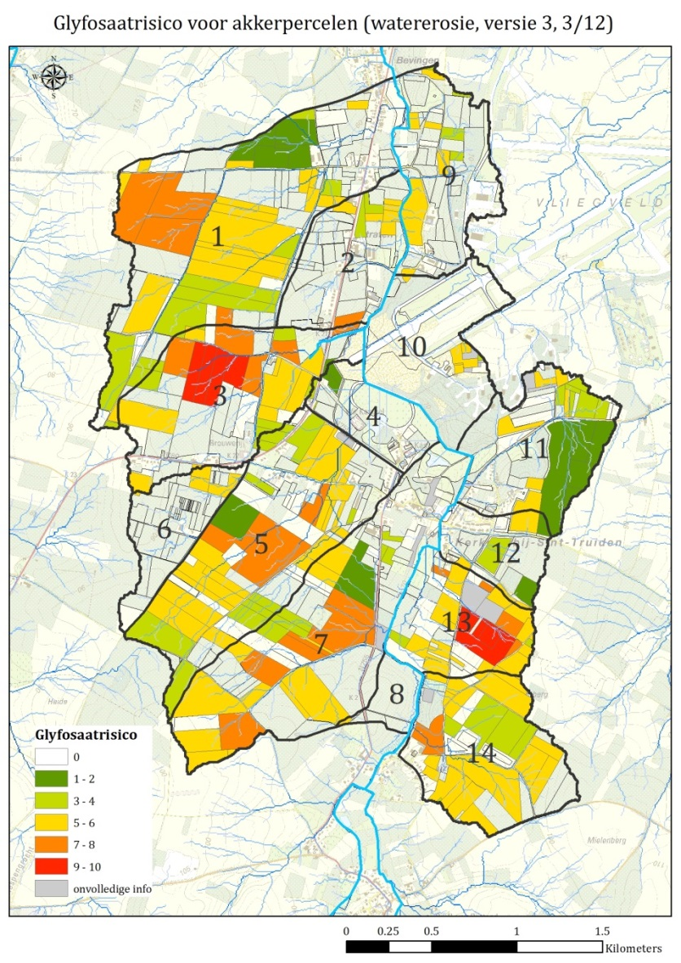
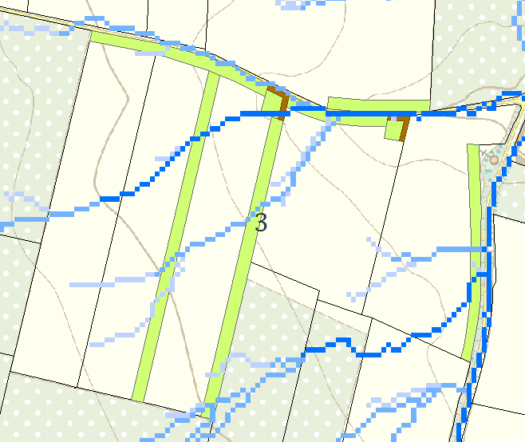
TARGET MEASURES IN PRIORITY ZONES
priority zones for measures of erosion control
target farmers with a significant impact on the pesticide load to surface water
encourage farmers to enter a voluntary erosion control program supported by the local government
A
B
C
D
Risk index
EGU2018-7697 Spatial and temporal analysis of priority zones to mitigate pesticide pollution in a small catchment by Gisela Quaglia

Slide 16
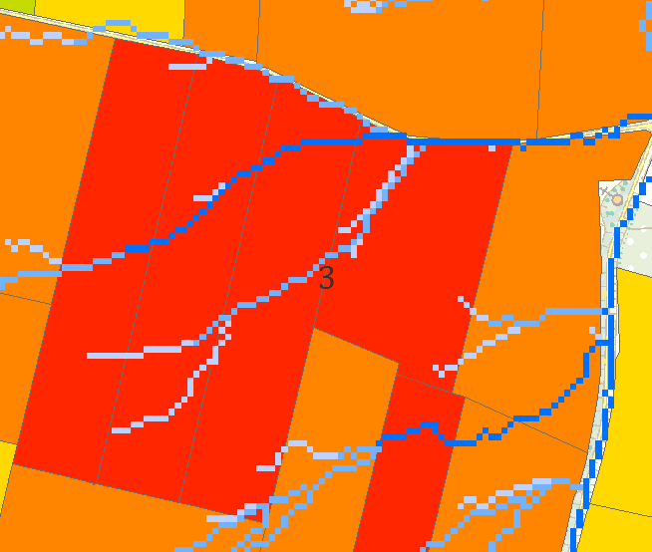
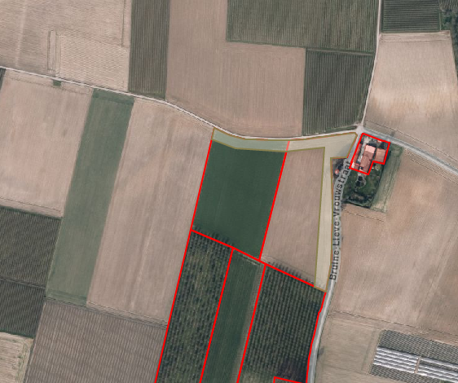
Example case: farmer engagement
Done (2018): Installation of 15 grass bufferstrips in the priority zones. Most of the bufferstrips are 9 m, 3 of them are 21 m wide. Continued sensitization of farmers about point sources. Promoting the installation of biofilters as part of farmers’ advisory daily activities. 8 biofilters built. Fyteauscan app promoted.
Example: zone B

Slide 17
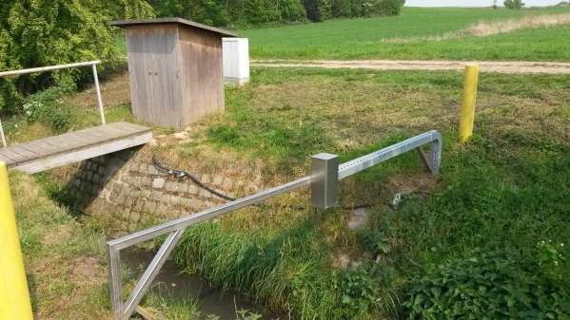
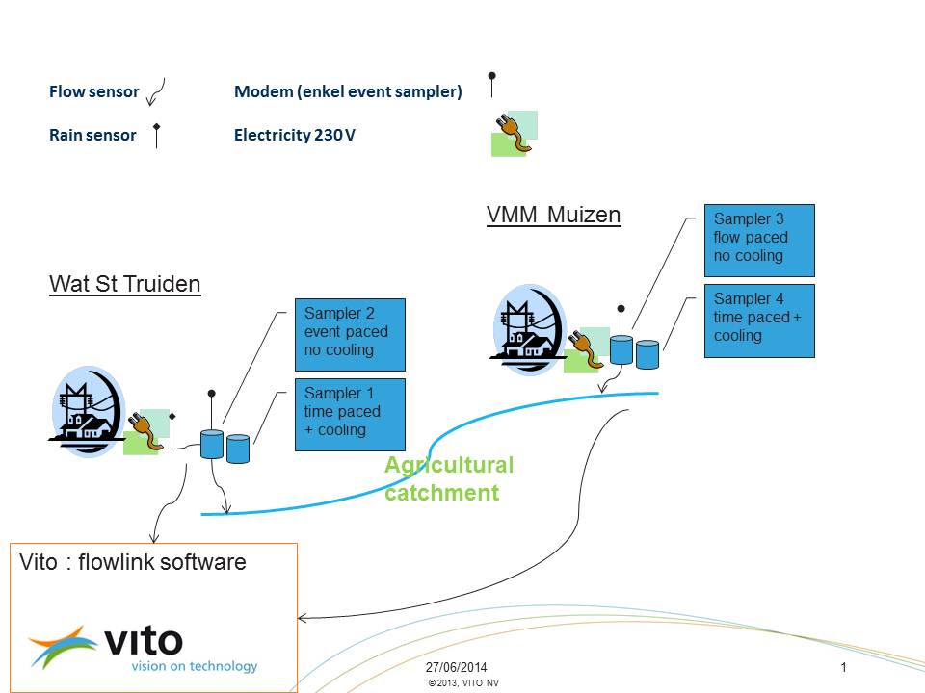
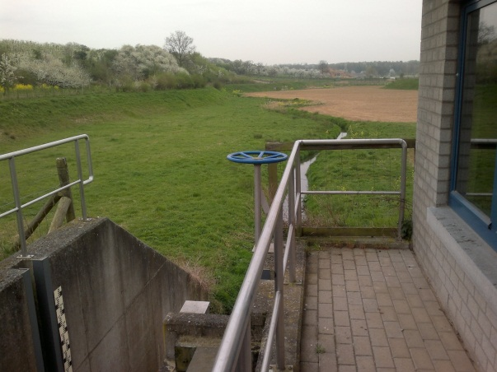
Monitoring 2014-2018: RESULTS EGU2019!
upstream location
2014-2015: baseline
2016-2018: during and after mitigation
downstream location

Slide 18
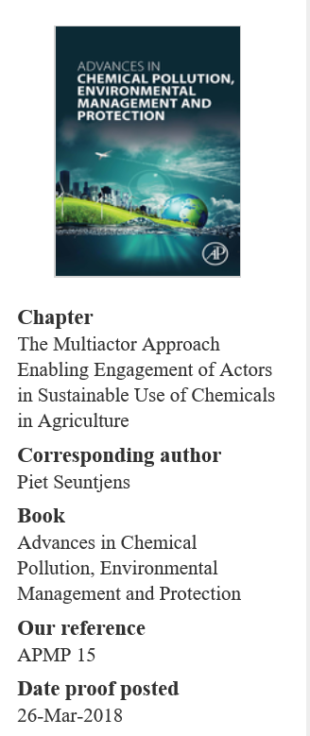
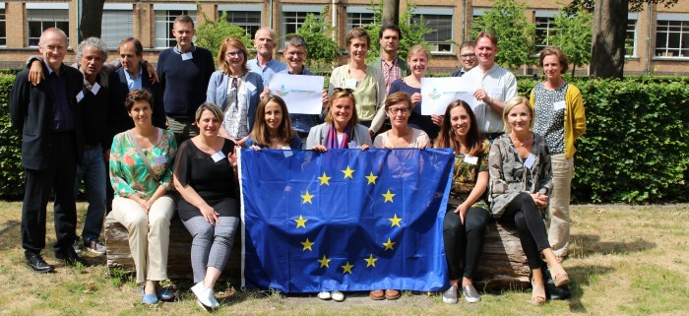
Stay in touch
  water-protect.eu
  Follow us on Twitter:
  @waterprotectEU

